Slide 1
Exchange Rate Regimes
Two polar cases
Fixed (pegged) exchange rates
CB buys or sells reserves to maintain a set price of foreign exchange
Flexible exchange rates
CB does not intervene in market for foreign exchange
and many in the middle
Much evolution over time
Fear of floating

Slide 2
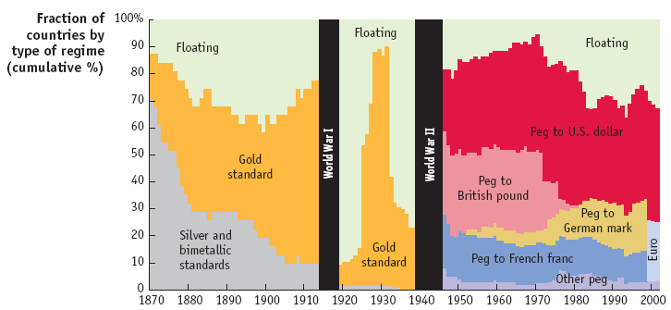
Historical View on Exchange Rate Regimes

Slide 3
Fixed versus Flexible
Shouldn’t e be determined by market forces?
Mundell versus Friedman
Foreign exchange is not like a normal market
Exchange rate is like a dictionary
Exchange of national currencies, fiat monies
A high price of foreign exchange does not lead to more supply
No fundamentals driving the market
Government policy must control supply of money
Then why should they be flexible?

Slide 4
Friedman on Flexible Rates
If internal prices were as flexible as exchange rates, it would make little economic difference whether adjustments were brought about by changes in exchange rates or by equivalent changes in internal prices.
The argument for flexible exchange rates is, strange to say, very nearly identical with the argument for daylight savings time. Isn’t it absurd to change the clock in summer when exactly the same result could be achieved by having each individual change his habits? All that is required is that everyone decide to come to his office an hour earlier, have lunch an hour earlier, etc. But obviously it is much simpler to change the clock that guides all than to have each individual separately change his pattern of reaction to the clock, even though all want to do so. The situation is exactly the same in the exchange market. It is far simpler to allow one price to change, namely, the price of foreign exchange, than to rely upon changes in the multitude of prices that together constitute the internal price structure.

Slide 5
Market for Foreign Exchange
Demand and supply for foreign exchange
Demand: where is all other factors that increase demand
Supply: where represents all other factors that increase supply
If there is no intervention then market clearing occurs at

Slide 6
Foreign Exchange
If CB does not intervene, then market price of foreign exchange is
Suppose demand for foreign exchange increases
Then if CB does nothing, e must rise
To keep e fixed CB must sell foreign exchange
So international reserves fall
Thus,
where is the fixed exchange rate
Notice that exchange rate can also be affected by policy
By affecting demand or supply

Slide 7
Fixed Rates and Reserve Accumulation
If the exchange rate is fixed, then reserves adjust as demand and supply shifts
The peg is sustainable if these shocks offset
Peg is unsustainable if shocks are biased
But there is asymmetry
Easier to accumulate foreign exchange
You cannot print it if you are running out!
When does a fixed rate collapse?
When reserves run out? No.

Slide 8
Time to Collapse
Suppose that the peg is unsustainable
When reserves run out the rate must collapse to
Implies that e will jump at that date, t
Implies capital gain at date t – 1
So people will sell at t -1, implies capital gain, so e collapses at t – 1
Implies e collapses at t – 2, …
So e must collapse at earliest date at which there is no capital gain
So e collapses before all reserves are depleted
Why not sell before t_{c} ?
Because then they incur capital loss

Slide 9
Unsustainable Peg
Suppose CB monetizes deficit, no shift in policy
=> domestic prices grow faster than foreign prices
=>eventually and , and thus,
reserves are declining as long as CB keeps
Agents know that the policy is unsustainable (not a secret), and they have rational expectations
Crisis is inevitable

Slide 10
Collapse
Exchange rate collapses before reserves run out
Nobody wants to be the last person to exit
If agents are forward looking they anticipate capital losses
So currency cannot collapse and then jump to shadow ratet
Currency must collapse at first point when it is feasible and profitable
=> date of collapse is determined in the model
Problem is that while agents are rational, government is mechanistic robot

Slide 11
Empirical Problem
In practice we see that currency collapses before reserves run out
In the UK, for example, foreign reserves were 116% of the monetary base, and in Mexico they were 120%.
Why not use all reserves to purchase the outstanding MB and maintain the peg?
CB could always repurchase the MB
Problem is the cost of doing so
No longer lender of last resort, interest rates may skyrocket
External versus internal balance

Slide 12
Monetary Base and Reserves (pct of GDP)

Slide 13

Fixing the Exchange Rate
Under fixed rates IR changes to offset any excess demand for foreign exchange
When there is ED > 0 the CB sells reserves, so
If ED < 0, the opposite takes place
What is the effect of this operation?
Suppose no sterilization
That is no attempt to offset the operation of pegging the exchange rate on the domestic money supply

Slide 14
No Sterilization
Start with the CB’s balance sheet
The assets of the CB, IR + DS = MB
The money supply just depends on the MB, so
Thus when reserves fall the money supply contracts, and vice versa
Fixing the exchange rate means giving up control over the supply of money
When the CB makes a foreign exchange transaction the MB changes

Slide 15
Central Bank Actions
Suppose the Fed purchases foreign exchange
4 cases
purchase from home-country banks:
in this case alongside the increase in IR is an increase in bank reserves.
purchase from home-country non-bank residents:
in this case, residents would receive payment in the form of currency in circulation.
purchase from foreign-country non-bank residents:
in this case, residents would receive payment in the form of currency in circulation.
purchase from foreign banks or central banks via changes in the foreign bank’s deposit at the Fed.
In this case, once the bank uses this deposit to purchase some interest-bearing security from a domestic bank, bank reserves will rise.
In all cases, the reserve transaction results in a simultaneous change in MB

Slide 16
Monetary Policy Autonomy Sacrificed
Suppose capital is mobile and
From UIPC,
But under fixed rates so
Money Market equilibrium requires
or
Thus, monetary authority does not control any of the variables on the RHS => money supply is endogenous under fixed exchange rates

Slide 17
Lack of Monetary Independence
Pegging e means that CB loses control of the money supply
Suppose the foreign interest rate increases.
The expression above shows that the home country’s central bank must decrease its money supply. Why?
If the i* > i, then investors will seek out foreign deposits, causing an excess demand for foreign exchange
CB has to sell foreign exchange to prevent e from rising
=> the money supply must decrease and interest rates will increase
=> import deflation from abroad
So, if there was monetary expansion abroad this would cause import of inflation
Can we sterilize the impact?

Slide 18
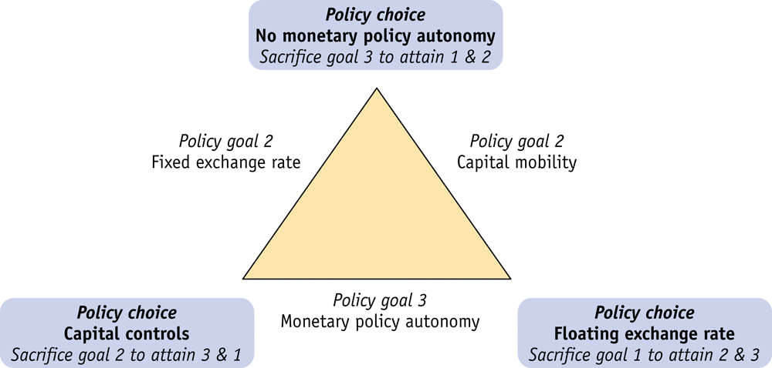
The Trilemma
There is an impossible trinity
Three goals: fixed exchange rate, capital mobility, and monetary policy autonomy
Can only achieve two of three

Slide 19
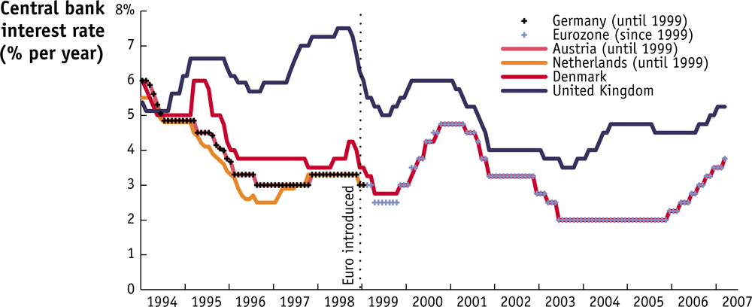
Trilemma in Europe
UK interest rates do not move in synch with Eurozone rates, but Danish rates do:

Slide 20
Sterilization
Sterilization occurs when the CB moves to insulate the domestic economy from foreign reserve transactions
Typically an open market operation: if inflows of foreign exchange are swelling the money supply then the CB sells bonds to soak it up, e.g.,
Notice that to persist in sterilization requires large stocks of both foreign reserves (if sterilizing an outflow) and domestic securities (in any case)
obviously difficult for debtor, what about for surplus case (like China)?
Need to keep selling DS, but how much will the public buy?
Depends on how financially developed the economy
Interest cost of sterilization can be large
Difference between return paid on DS and return earned on IR
Valuation changes

Slide 21
Effect on Monetary Policy
ES of foreign exchange causes IR to rise under fixed rates => M/P increases and i falls

Slide 22
Lack of Monetary Autonomy Perfect Capital Mobility, small open economy, δ = 0

Slide 23
Suppose δ > 0 (Exchange Rate Crisis)

Slide 24
Impossible Trinity
We see that a country cannot simultaneously have:
Independent monetary policy
Fixed exchange rate
Capital mobility
With fixed e you interest rates cannot diverge from i*
Conflict between internal and external balance
China’s “advantage”
China does not have open capital account
So it can sterilize current account surpluses
Lack of capital mobility depresses local interest rates, reduces costs of sterilization
Effect of large sterilization in some countries could be future inflation

Slide 25
Carrying Costs (pct of GDP)

Slide 26
Foreign Reserves net of currency

Slide 27
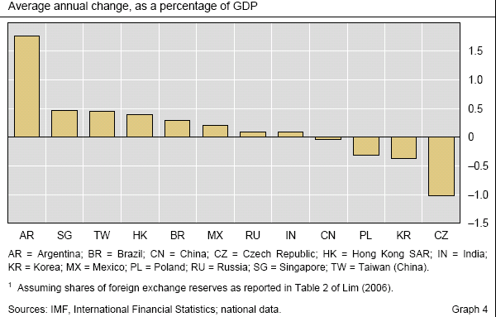
Valuation Changes on Foreign Reserves

Slide 28
China Balance of Payments Transactions

Slide 29
Capital Account Components

Slide 30
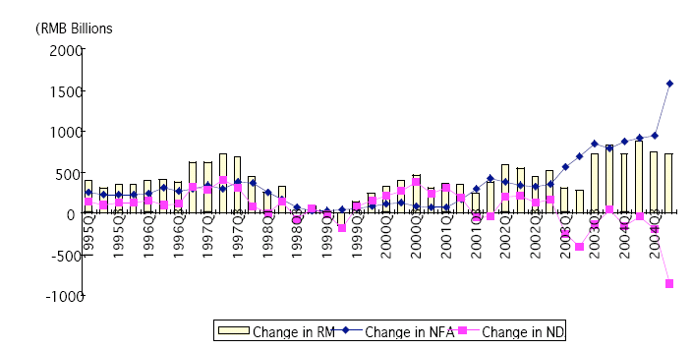
Annual Changes in NFA, NDA, and Reserves

Slide 31
Time of Collapse

Slide 32
Reserve Flow

Slide 33
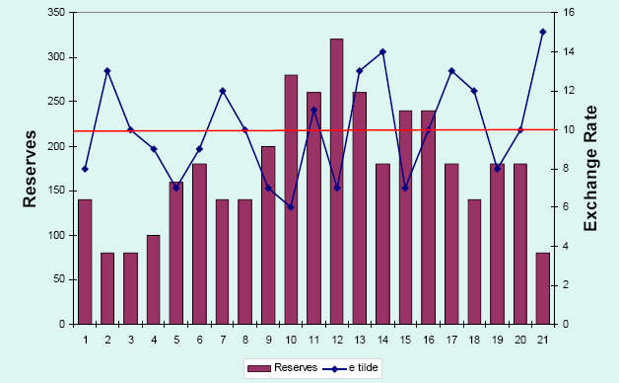
Sustainable exchange rate

Slide 34
Unsustainable Exchange Rate

Slide 35
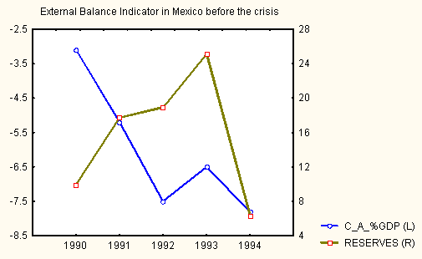
Mexico’s External Balances

Slide 36
Ruble Exchange Rate

Slide 37
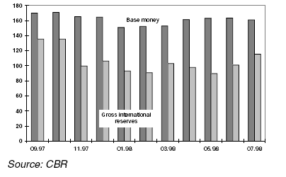
Monetary Base and Gross Reserves

Slide 38
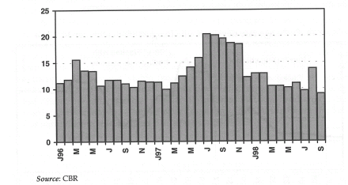
Russian Foreign Exchange Reserves (billions of $) MB = $6.7 billion in Sept 1998

Slide 39
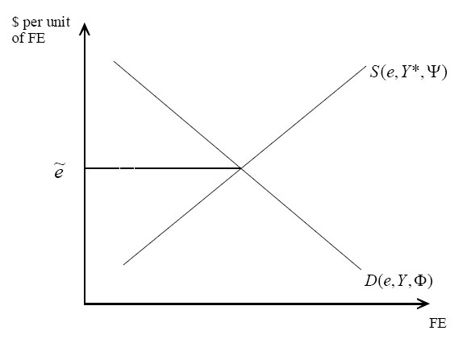
Market for Foreign Exchange

Slide 40
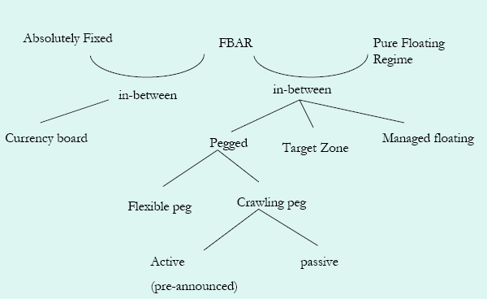
Varieties of Exchange Rate Regimes

