Slide 1
Gold Standard
Why study the gold standard?
Gold Standard is example of super-fixed exchange rate
Produced price stability and capital mobility
Solved Trilemma by sacrificing monetary autonomy
Yet gold standard no longer exists, and will not be restored
Why is a system that worked well in 19th century no longer feasible?
Understanding this gives insight to tradeoffs with monetary systems

Slide 2
Gold Standard
At the source of Hume’s specie-flow mechanism
Gold standard is historic, but informative
Established inadvertently by Newton who set the silver price of gold too high
Newton though supply and demand would lower the silver price of gold
Instead, Gresham’s law drove silver out of Britain
Rule based system, but not organized
Rules, 1-3 key
Rules 4-6 crucial for smooth operation of system

Slide 3
Hume’s Specie-flow mechanism
”Suppose four-fifths of all the money in Great Britain to be annihilated in one night...what would be the consequence? Must not the price of all labour and commodities sink in proportion, and everything be sold as cheap as they were in those ages? What nation could then dispute with us in any foreign market, or pretend to navigate or to sell manufactures at the same price, which to us would afford sufficient profit? In how little time, therefore, must this bring back the money which we had lost, and raise us to the level of all the neighbouring nations? Where, after we have arrived, we immediately lose the advantage of the cheapness of labour and commodities; and the farther flowing in of money is stopped by our fullness and repletion.”

Slide 4
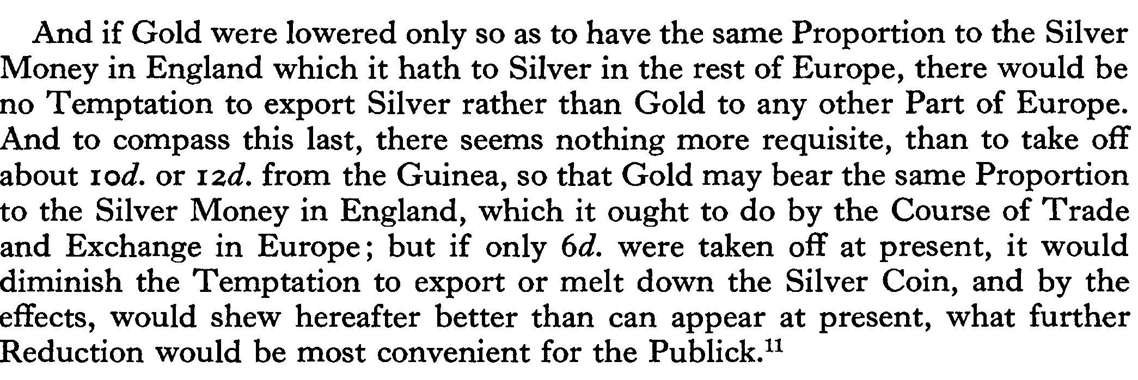
Newton on the Gold Price

Slide 5
Rules of the Game
Fix a gold price (parity) and convert gold freely between domestic money and gold at that price.
No restrictions on the export of gold by private citizens or of capital across countries.
Back national banknotes and coinage with gold reserves and condition long-run money growth on gold reserves
In short-run liquidity crises resulting from a gold outflow, have the central bank extend liquidity at higher interest rates (Bagehot’s Rule).
If rule 1 is temporarily suspended restore convertibility at the soonest feasible point in time at the old parity.
Allow the common worldwide price level to be determined endogenously by world demand and supply of gold.

Slide 6
Gold Points
If rules 1-2 hold exchange rates determined by fixed parities
Let x be the official (mint) dollar price of an oz. of gold and y the official (mint) sterling price of gold
Then x/y is the official exchange rate
Arbitrage keeps the spot rate (almost) equal to this amount
Let be the cost of shipping gold to Britain, and let S_{t} be the spot exchange rate.
Then it is profitable to ship gold if

Slide 7
Arbitrage
Suppose that that is spot rate above the gold point
Sterling’s spot price is very high, you want to sell
So you ship gold to Britain and exchange for sterling at par, and then convert sterling to dollars at the spot rate
This makes money since
The RHS is the dollar price of gold
The LHS is the dollar return on selling gold in Britain, net of the cost of shipping
So if the spot exceeds the gold point there are arbitrage profits to be made

Slide 8
Example
Let x = 6 and y = 3, so official e = 2
Suppose S = 3
If , then we ship gold to UK
Pay $6 for 1 oz. of gold
Ship to UK exchange for £3 pounds
Sell sterling at spot rate, receive $9 >>$6!!
But if , and ship gold to UK
Still pay $6 for 1 oz. Gold, but only get £2
Sell sterling at spot rate, receive $6 = $6, no gain

Slide 9
Gold Points
And it is profitable to import gold if
So the spot rate is bound by these limits or gold points
Notice that arbitrage depends on the cost of shipping gold
As costs fell, the bounds tighten and arbitrage is more effective

Slide 10
Restoration Rule
Rule 5 is the restoration rule
Means that rule 3 can be followed and gold devices used
Temporary suspension does not lead to speculation
Rise in interest rates is not a destabilizing signal
In modern financial crises i rises when δ >>0
Interest rate stabilized under the gold standard
But is this true?

Slide 11

Gold Points and Credibility
If gold points were credible this bounds the interest rate
Let be the current short-term sterling rate
Let be the max value under gold points
i.e.,
Then is maximum appreciation of sterling consistent with the gold standard, and we can define the maximum and minimum interest rate, given the gold points (think interest parity conditions)

Slide 12
Interest Bounds
Thus, if the gold points are credible, the interest rate should fluctuate within the bounds,
Amazingly, interest rates did stay within these bounds
Exceptions when fear of repudiation,
e.g., US in 1893-4, 1896
As rates rose (within the bounds) it led to stabilizing flows, attracting capital, why?
Because no exchange risk if rule 5 is followed
=> interest rate is negative feedback mechanism
Notice the stability of prices
This is a superb feature for a monetary system

Slide 13
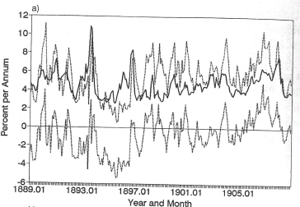
Dollar Interest Rate and Credibility Bounds

Slide 14
Reichsmark Interest Rate and Credibility Bounds

Slide 15
Franc Interest Rates and Credibility Bounds

Slide 16
A Model
Start with closed economy
Why use gold?
Time inconsistency problem
Ex post optimal policy not consistent with ex ante policy
Two-period tax problem: announce zero capital taxes, but in period two capital is sunk, so optimal to tax capital
But then nobody saves in period one
Gold standard can provide commitment
Dollar price of gold given, stock fixed
Demand for gold negatively related to relative price of gold

Slide 17
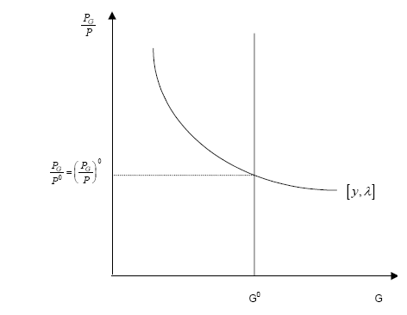
Stock Equilibrium

Slide 18
Gold Demand
Gold used for monetary and non-monetary use
Latter depends on relative price
Monetary demand depends on reserve ratio
Money demand depends on income
So,
We could easily add interest rates

Slide 19

Flow Supply
Changes in stock of gold depends on additions (discovery) and subtractions (wastage, usage)
Let be the non-monetary demand, and let be the depreciation rate, then gives wastage
So we have the flow supply diagram
Put the two together,
Suppose P falls, over time gold stock rises and relative price of gold falls back to initial equilibrium

Slide 20
Flow Supply
Remember that flow demand is negative, so when the curves intersect the net flow of gold is zero

Slide 21
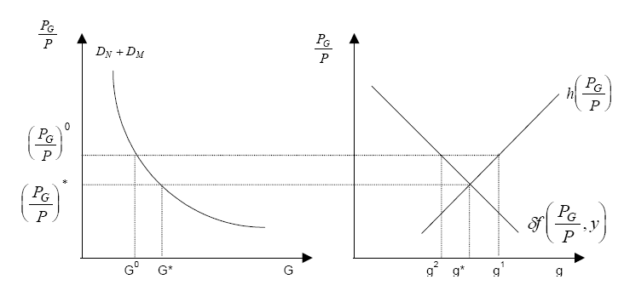
Stock-flow

Slide 22
Open Economy Version
How to modify model for open economy?
All we do is replace the flow supply function with export function and flow demand function with import demand function
Net gold supply now depends on international trade in goods and services.
i.e., on trade balance
Trade balance depends on relative prices and incomes,
Implies flow supply of gold changes faster
Don’t need to discover gold, we can import gold

Slide 23
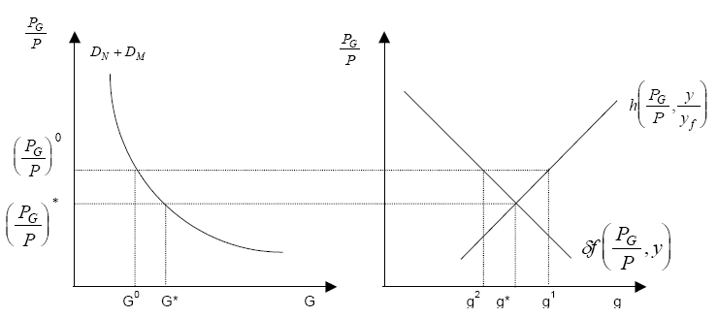
Open Economy Version

Slide 24
Increase in Money Demand

Slide 25
An Increase in Money Demand

Slide 26
Implication
Gold standard is a price level anchor
Suppose money demand increases
This causes relative price of gold to rise (price level falls)
Could cause recession in short run
But gold production increases and stock of gold rises
We return to old relative price of gold
What if we lost competitiveness?
Lose gold at initial relative prices => ΔG < 0
=> P falls, so TB restored

Slide 27
Decline in Competitiveness
Decline in competitiveness causes gold outflow and the price level to fall, restoring trade balance
Decline in competitiveness

Slide 28
Rules of the Game
Major difference between model and reality
Gold flows were not that large
Why?
Monetary policy utilized to prevent them
Anticipating gold flows and offsetting them
Keynes called this playing by the rules of the game:
The gold outflow will lead to a tightening of domestic credit and a deflation in the price level
Anticipating this outflow the central bank tightens before the outflow of gold occurs. Deflation and restoration of balance occurs before gold flows out
Why “play by these rules”?
To avoid the loss of gold that would otherwise occur.

Slide 29
Example
Suppose that at current there is trade deficit
Over time we lose gold and price level falls, relative price of gold rises, and we restore equilibrium
Alternatively, the Central Bank could raise
This increases the demand for gold and immediately raises its relative price, without any gold flow across countries
Of course this is not the popular thing to do
Notice how “19th Century” this is
A modern CB might try the opposite: sterilize the impact of the loss of gold on the domestic economy

Slide 30
Benefits of Gold Standard
Gold standard produces long-run price stability
Gold standard facilitates capital flows
Good Housekeeping Hypothesis
Gold standard as a contingent rule (rule 5)
sovereign borrowing costs differed substantially from country to country and these differences were correlated with a country’s long-term commitment to the gold standard.
Estimate that rates fell 40-50 basis points
Reverse causation?
Alternative hypothesis: British Empire
But data does not support that argument

Slide 31
Good Housekeeping Model
Gold standard as commitment device
Government has discretionary incentive to inflate, B
Current gain is higher employment, a one-time gain
Costs are reputational losses and higher future borrowing costs (C)
Losses are PV of future costs:
If cheating is punished sufficiently government refrains from inflating
PV of costs of cheating (L) > current benefits of inflating (B)
If the future is valuable ( ), refrain from cheating
Assumes collective punishments
sound money equilibrium is only attainable if the bond market punishes countries today that left gold in the past.

Slide 32
Implications
Thus if two nations issue bonds with identical expected cash flows, the bond market assigns a lower price to the nation that abandoned gold.
Implies arbitrage opportunity which market must forego to enforce trigger strategy equilibrium
19th century institutions such as CFB and large investment banks may have been sufficiently patient to enforce penalties
Corporation of Foreign Bondholders (CFB), an association of British investors holding bonds issued by foreign governments
It helped that so much savings flowed from Britain

Slide 33
Good Housekeeping Model: Tests
Theory predicts that expected yields on bonds are lower for countries that adhere
Problem, no data on expected yields
Use realized yields
Other factors affect borrowing costs
Estimate
Where if country i adheres to the gold standard in year t
And
The key hypothesis is that
Evidence supports this; predicted rates were lower where commitment to the rule was higher

Slide 34
Gold Standard: Costs
If the gold standard was so good, why was it abandoned?
It ties the world money supply to the production of a commodity.
There is no inherent reason why the growth in gold supplies will be related to the needs of international liquidity.
When gold discoveries are rare, the world supply of gold will not increase as fast as real income.
Between 1873 and 1896, the frequency of gold discoveries was rare while economic growth was rapid.
That is why US prices fell 53% in this period
System requires rule 5, subordinating internal balance for external balance
Democracy made it harder to go back to it after WW1

Slide 35
Bimetallism
Silver could augment gold as precious metal when gold supply was insufficient
If mint maintains fixed exchange rate of gold for silver (e.g., 15.5 to 1 in France)
If gold is in short supply the return to mining silver rises
Under bimetallism the money supply is given by
It is a bit weird, there are now two numeraires: dollar is x ounces of gold and y ounces of silver – fixed legal ratio as money,
If market price of silver price > official price there will be no monetary silver, and vice versa, Gresham’s Law
Bimetallism gives an extra leg to stand on, but requires same rate across countries
Debtors may want coinage of silver (at high rate) to augment M

Slide 36
Bimetallism
US was on bimetallic standard (16-1) till 1873
France (15.5-1) and Latin America were also
For a long time market ratio was stable
After 1873 market ratio collapses
Germany leaves Silver Standard
“Crime of 1873” in US
Eventually Austria, France, Russia, India all leave silver
What seemed to work collapsed to gold standard
Notice the big increase in gold production

Slide 37
Annual World Production as share of Stock

Slide 38
Ratio of Gold and Silver Stocks and Market Ratio

Slide 39
Share of World Output by Monetary Standard

Slide 40
Wizard of OZ
Wizard of Oz is a monetary allegory
Cleveland had repealed Sherman Act, big unemployment
Bryan: "you shall not press upon the bow of labor this crown of thorns, you shall not crucify mankind upon a cross of gold”
OZ = ounces of gold
Dorothy, honest Kansan, Midwesterner who does not understand the power of her silver shoes
Scarecrow = farmer, Tinman = worker idled (rusted) by unemployment, Cowardly Lion = Bryan
The Wicked Witch of the East is Wall Street — the advocates of tight money and most especially Grover Cleveland.
The Wicked Witch of the West is drought — at that time ruining farms in Kansas and Nebraska
hence, destroyed by water
Toto stands for ”teetotaler,” the prohibitionists, who agreed with the populists on silver.

Slide 41
Key Characters

Slide 42
Search for Silver?

Slide 43
More Oz
Emerald City is Washington,
where people must wear green shaded glasses; thus they are forced to see the world through the shade of money.
The Wizard is really just a man, whose solution – a balloon – vanishes like hot air
Winged Monkeys = plains Indians

Slide 44
Yellow Brick Road and Emerald City

Slide 45
Silver shoes
On the book’s next to last page, Glinda, Good witch of the South, tell Dorothy,
"Your Silver Shoes will carry you over the desert.....If you had known their power you could have gone back to your Aunt Em the very first day you came to this country." Glinda explains, "All you have to do is knock the heels together three times and command the shoes to carry you wherever you wish to go." (p.257).
William Jennings Bryan never outlined the advantages of the silver standard any more effectively. Not understanding the magic of the Silver Shoes, Dorothy walks the mundane — and dangerous — Yellow Brick Road.

Slide 46
Scarecrow, Tinman, Cowardly Lion
He complains of no brain — not understanding what the moneymen from the east tell him — but of course he finds that he has one by the end.
Once an independent and hard working human being, the Woodman found that each time he swung his axe it chopped off a different part of his body. Knowing no other trade he "worked harder than ever," for luckily in Oz tinsmiths can repair such things. Soon the Woodman was all tin (p. 59).
In this way Eastern witchcraft dehumanized a simple laborer so that the faster and better he worked the more quickly he became a kind of machine.
Here is a Populist view of evil Eastern influences on honest labor which could hardly be more pointed.[16] There is one thing seriously wrong with being made of tin; when it rains rust sets in. Tin Woodman had been standing in the same position for a year without moving before Dorothy came along and oiled his joints. The Tin Woodman’s situation has an obvious parallel in the condition of many Eastern workers after the depression of 1893.
This apparently is because by 1900, in his second race with McKinley, Bryan no longer fought the bimetallism issue. Baum is thus picturing him as a coward.

Slide 47
Plains Indians
"Once we were a free people, living happily in the great forest, flying from tree to tree, eating nuts and fruit, and doing just as we pleased without calling anybody master." "This," he explains, "was many years ago, long before Oz came out of the clouds to rule over this land“
Under Dorothy’s influence they become kind, but cannot take her to Kansas
"We belong to this country alone, and cannot leave it"

Slide 48
Was Bryan Right?
Bimetallism might have worked in 1873
Greater price stability would have ensued
US on silver, UK on gold
By 1896 horse left the barn
Too many countries were off silver
Market price was 30 to 1 not 16 to 1 by then
Coordination effect
Gold discoveries could not have been easily predicted

Slide 49
Gibson’s Paradox
The Fisher equation says nominal interest rates should be positively correlated with inflation
But during gold standard period interest rates were correlated with the price level

Slide 50
World Price Level and Consol Yield

Slide 51
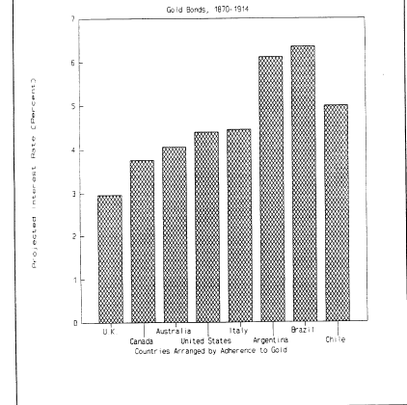
Value of Adhering to the Rule

Slide 52
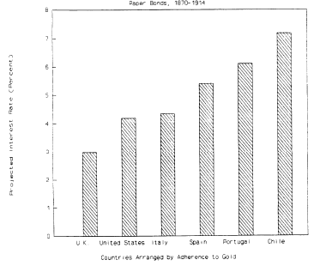
Value of Adhering to the Rule

Slide 53
Wholesale Prices in US and UK

Slide 54
Interest Rates and Prices under the Gold Standard

Slide 55
Wholesale Prices, 1790-1920

Slide 56
Wholesale Prices, 1790-1913

Slide 57
Value of Adhering to Gold, US

Slide 58
Value of Adhering to Gold, Argentina and Brazil

Slide 59
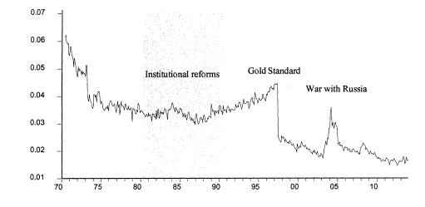
Japanese Risk Premium

Slide 60
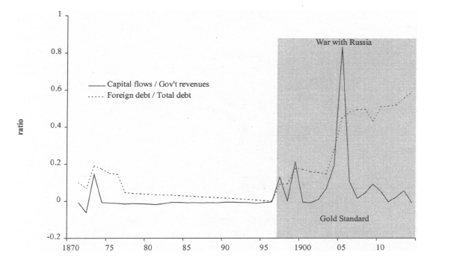
Japanese Capital Inflows and the Gold Standard

Slide 61
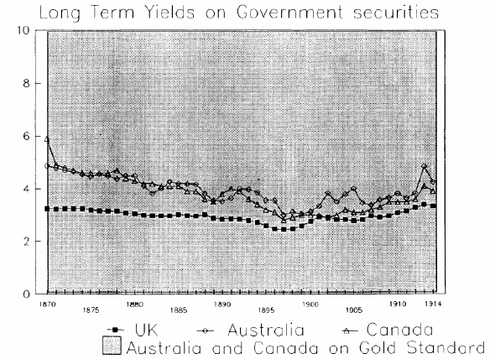
Value of Adhering to Gold, Australia and Canada

Slide 62
Free Coinage
Historically US had free coinage of both silver and gold (Hamilton’s Coinage Act, 1792)
Required the government to buy all silver or gold offered to it at prices of $1.2929... per troy ounce of pure silver and $19.3939... per troy ounce of fine gold, that is, 15 times as much for an ounce of gold as for an ounce of silver
15 to 1 was market price in 1792
But soon after, world price ratio rose above this
As a result, anyone who had gold and wanted to convert it to money would do better by exchanging the gold for silver at the market ratio and taking the silver to the mint than by taking the gold directly to the mint.

Slide 63
Problem
At a 15 to 1 ratio, an obvious get-rich scheme:
Take 15 oz. of silver to the mint, get 1 oz. of gold, sell the oz. of gold on the market for, say, 16 oz. of silver, and repeat…
with each cycle you have made 1 oz. of silver
Continue till you are millionaire
=>Mint runs out of gold
So we are effectively on a silver standard
Only silver coins circulated
That is why typically the mint commits to coinage of only one type of specie

Slide 64
Gold Makes a Return
In 1834 new legislation sets price at 16 to 1
This was a Jacksonian attack on Biddle’s Bank
Of course in 1896, Bryan would have loved 16 to 1
But in 1834 16-1 was greater than the market price
Gold coins could replace Bank paper notes
Silver stopped being coined
Civil War puts temporary end to this
When gold standard was resumed, free coinage into silver was not included
Omission = crime ?
Otherwise at 16 to 1 silver would have been coined

Slide 65
Consequences of the “Crime”
Omission crucial because of the expected decline in the price of silver
Had there been no decline in the silver-gold price ratio – or, as it is more usually expressed, rise in the gold-silver price ratio – it would have been irrelevant whether the fateful line was included in the act of 1873 or omitted.
In either event, the pre-Civil War situation of an effective gold standard would have continued when and if the United States resumed specie payments.
As it was, however, a rise in the gold-silver price ratio started well before the United States passed the act of 1873 and was in full swing when the United States resumed specie payments in 1879.
Gold was rising in value, but silver was no longer coined
You could not take cheap silver to the mint to buy gold
Resumption by the United States on the basis of gold was the final nail in the coffin of silver

Slide 66
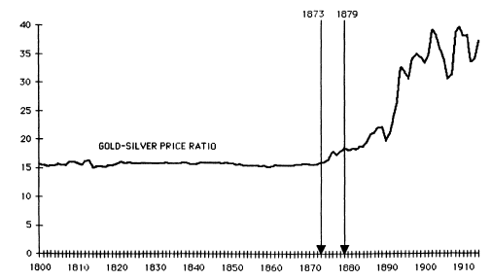
Ratio of Gold to Silver Price (annual)

Slide 67
Rise of Gold
Gold price rose as countries left silver
This speeded up rapidly after 1870, as one European country after another shifted from a silver or bimetallic standard to a single gold standard-a tribute to the leadership of Britain
Germany shifted in 1871-73, after it defeated France and imposed a large war indemnity payable in funds convertible into gold.
France, which had maintained a bimetallic standard since 1803 demonetized silver along with the other members of the Latin Monetary Union (Italy, Belgium, and Switzerland) in 1873-74.
The Scandinavian Union (Denmark, Norway, and Sweden), the Netherlands, and Russia followed suit in 1875-76 and Austria in 1879.
By the late 1870s, India and China were the only major countries on an effective silver standard.
And of course US increased demand for gold dramatically
The resulting increased demand for gold and increased supply of silver for nonmonetary purposes produced a dramatic rise in the gold-silver price ratio.
From 15.4 in 1870, it jumped to 16.4 by 1873, 18.4 by 1879, and 30 by 1896, when 16 to 1 was the Bryan battle cry.

Slide 68
Implications
The increased world demand for gold for monetary purposes coincided with a slowing in the rate of increase of the world's stock of gold and a rising output of goods and services.
These forces put downward pressure on the price level.
Issue of paper money could not offset this
The outcome was deflation from 1875 to 1896 at a rate of roughly 1.7 percent per year in the United States and 0.8 percent per year in the United Kingdom, which means in the gold standard world.
Led to agitation for silver purchases and coinage
Bland-Allison Act (1878) Sherman Silver Purchase Act (1890)
Agitation for free coinage of silver led to fear of leaving the gold standard
One paradoxical result of the agitation for inflation via silver was that it explains why deflation was more severe in the United States than in the rest of the gold standard world (1.7 percent vs. 0.8 percent).
Had there been no omission, US would have effectively been on silver, UK on gold
Augmentation of world money supply would have meant less deflation
=> less agitation for free coinage

