Slide 1
CS 398: Design Review
Team 206
Yiran Li, Mason Ma, Eve Lu, Diane Ding
Notes:
Good afternoon, everyone. We are [team X].

Slide 2
Agenda
Introduction
Project Plan
Resources, constraints, risks and milestones
Project Requirements
Personas & affinity diagram
Key features (functional requirements)
NFR (Non-functional requirements)
Project Design
Architecture Diagram
Low-Fi Prototype
Design Patterns
Notes:
We will go through some key features of our app in the intro session. Following up with more details, we will talk about our project planning and comparisons with other applications.

Slide 3
Introduction
Our product: a note taking application that mainly serves students
Problems that we solve:
Taking lecture notes
Taking casual daily notes e.g. a shopping list
Market
Many similar products in the market e.g. Apple Notes, Notion, etc.
But… our product provides an amazing set of features designed specifically for university students!
Niche, but growing market!

Slide 4
Project Plan: Resources, Constraints & Risks
Resources:
4 team members: Eve, Diane, Mason, Yiran each with a working computer
Guidelines and resources provided by the CS398 course staff
Constraints:
The mobile application must run properly on Android
Time constraint: team members will only be able to commit part-time to the project as we are all students taking 3-4 courses at the same time
Risks:
Team members might drop out from CS398
Mitigation: have the work committed to Git and information centralized in a space (e.g. a Notion workspace)
Members have no experience with Kotlin: steep learning curve
Mitigation: use all the resources provided on the course website
Members might not be able to attend in-person sessions due to COVID
Mitigation: online meetings

Slide 5
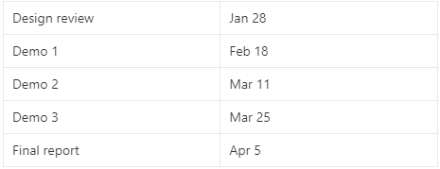
Project Plan: Milestones
Milestones/Deadlines:

Slide 6
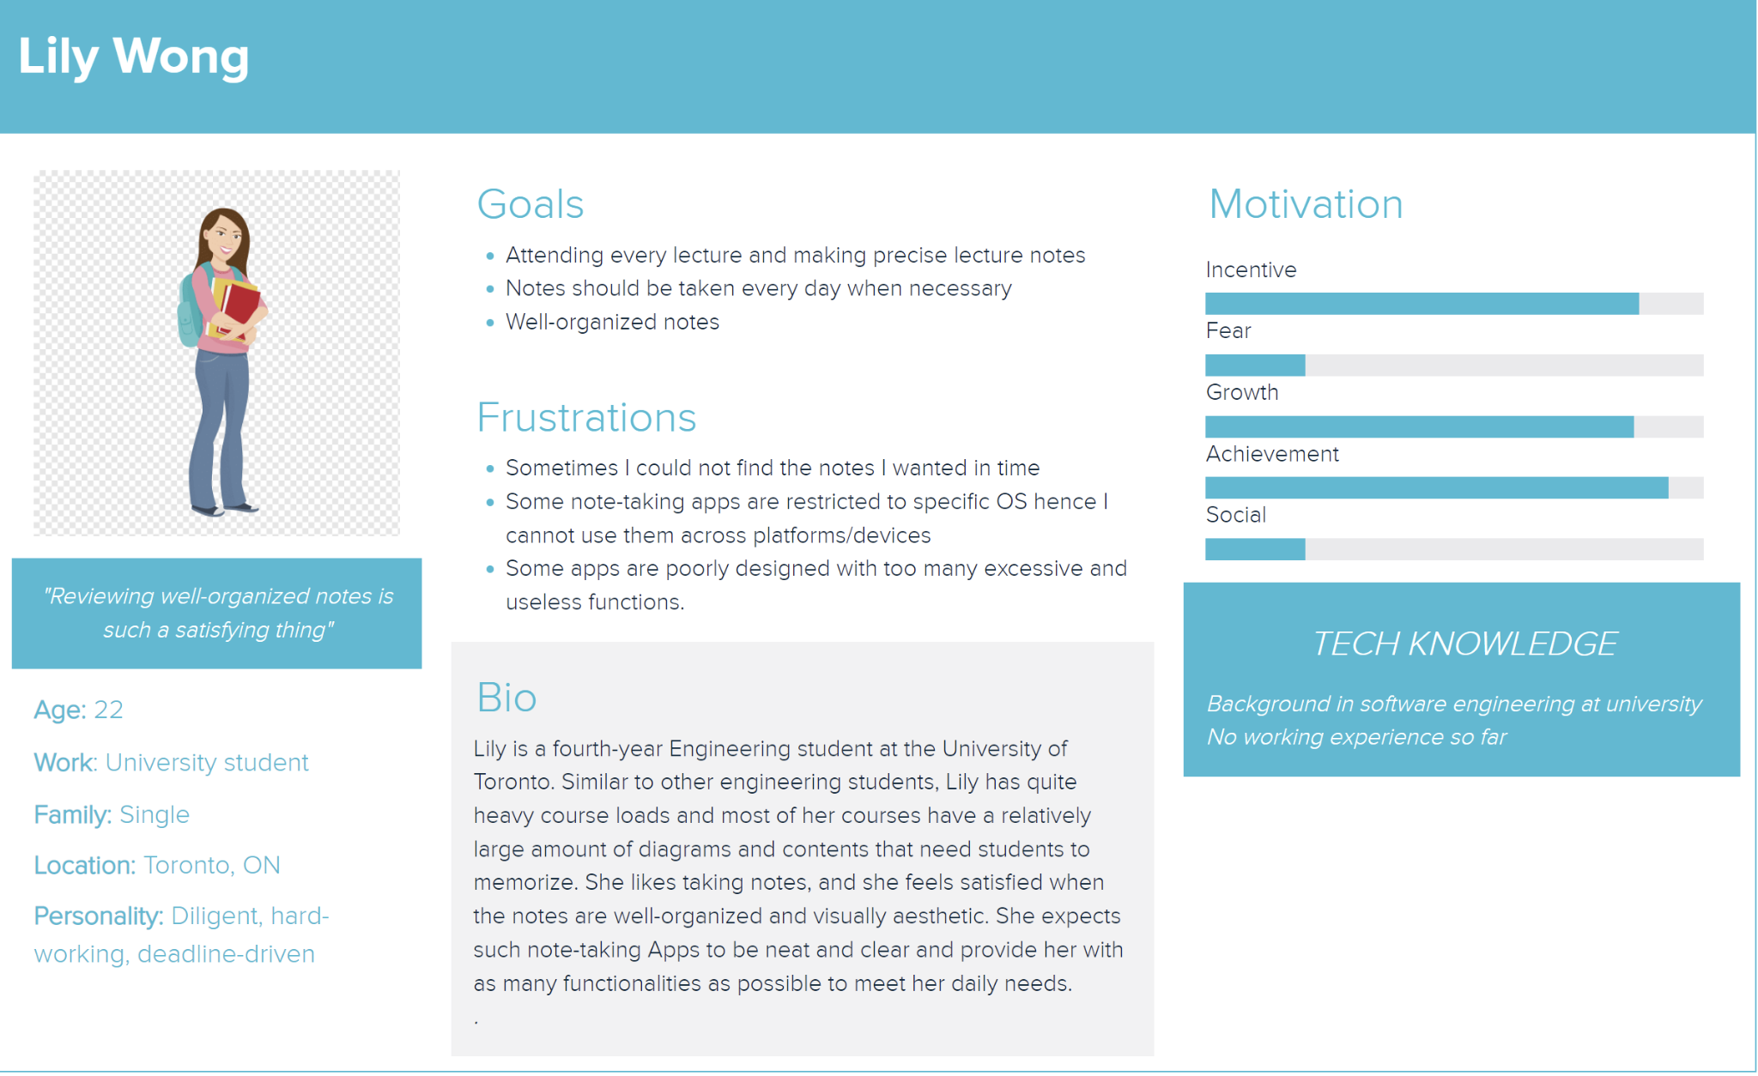
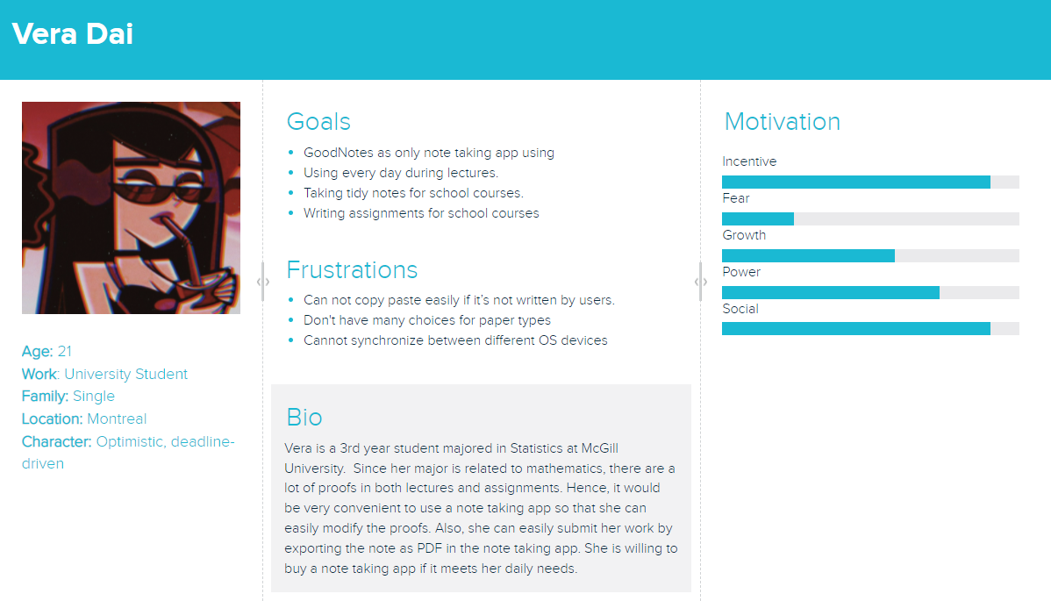
Personas (Part I)

Slide 7
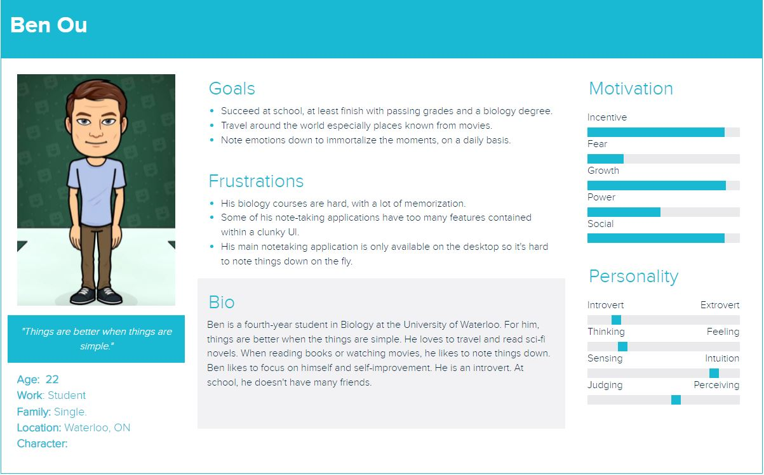
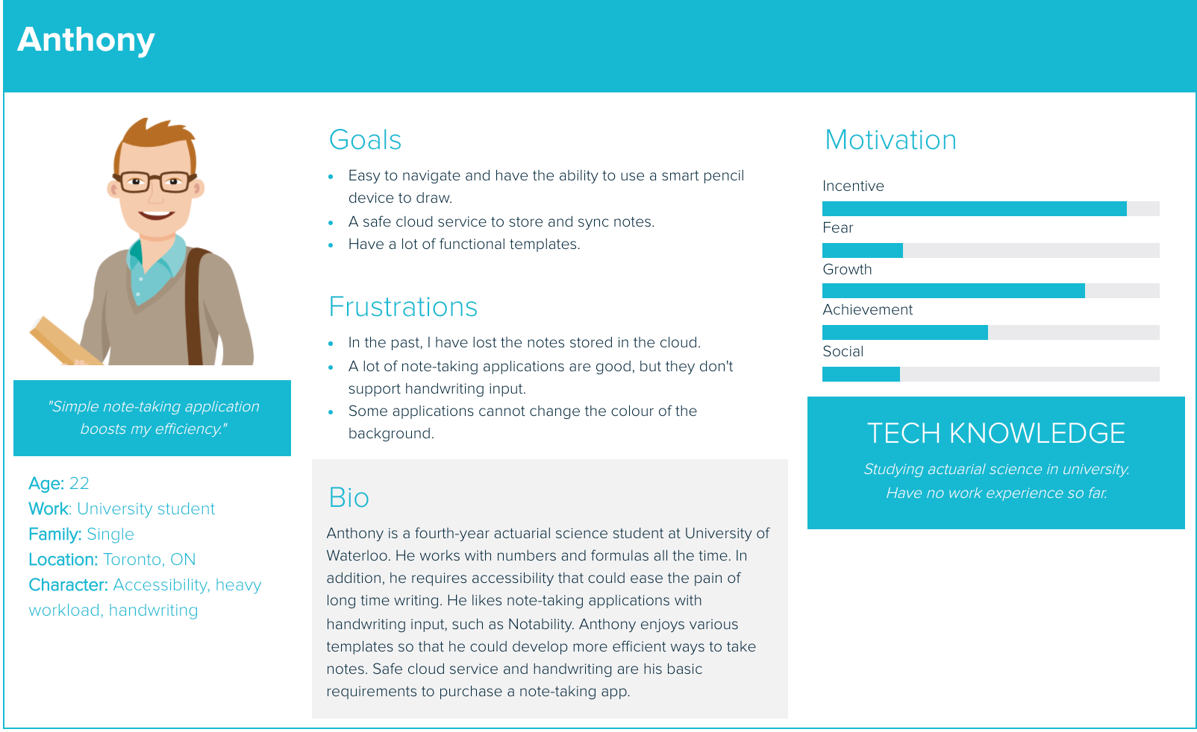
Personas (Part II)

Slide 8
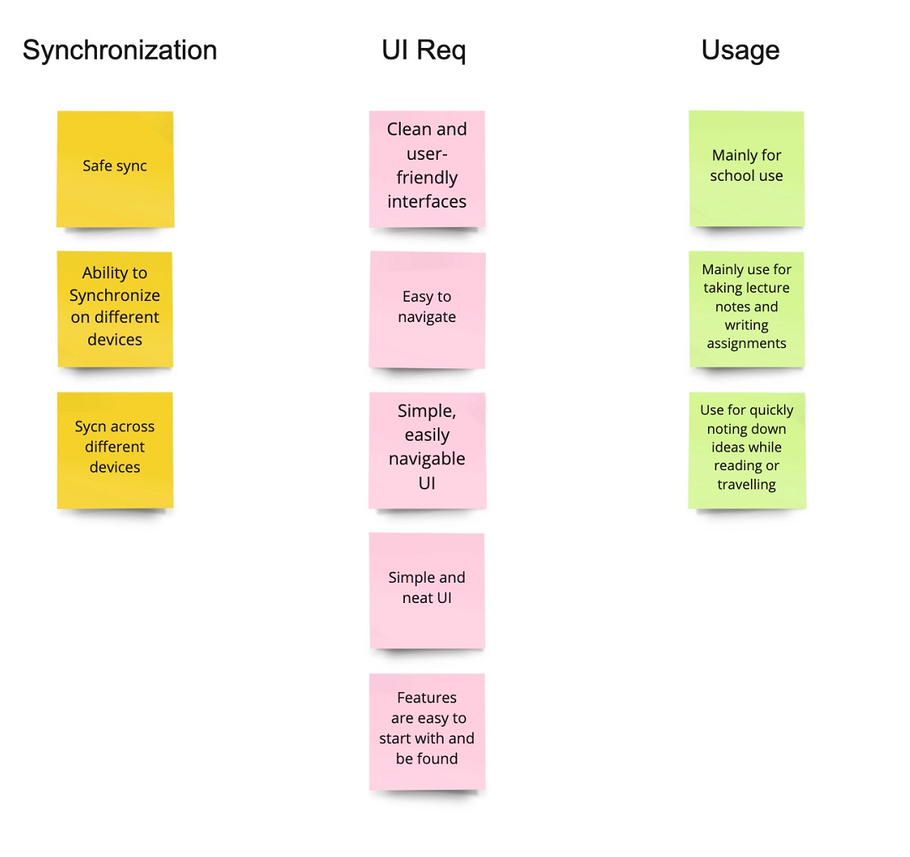
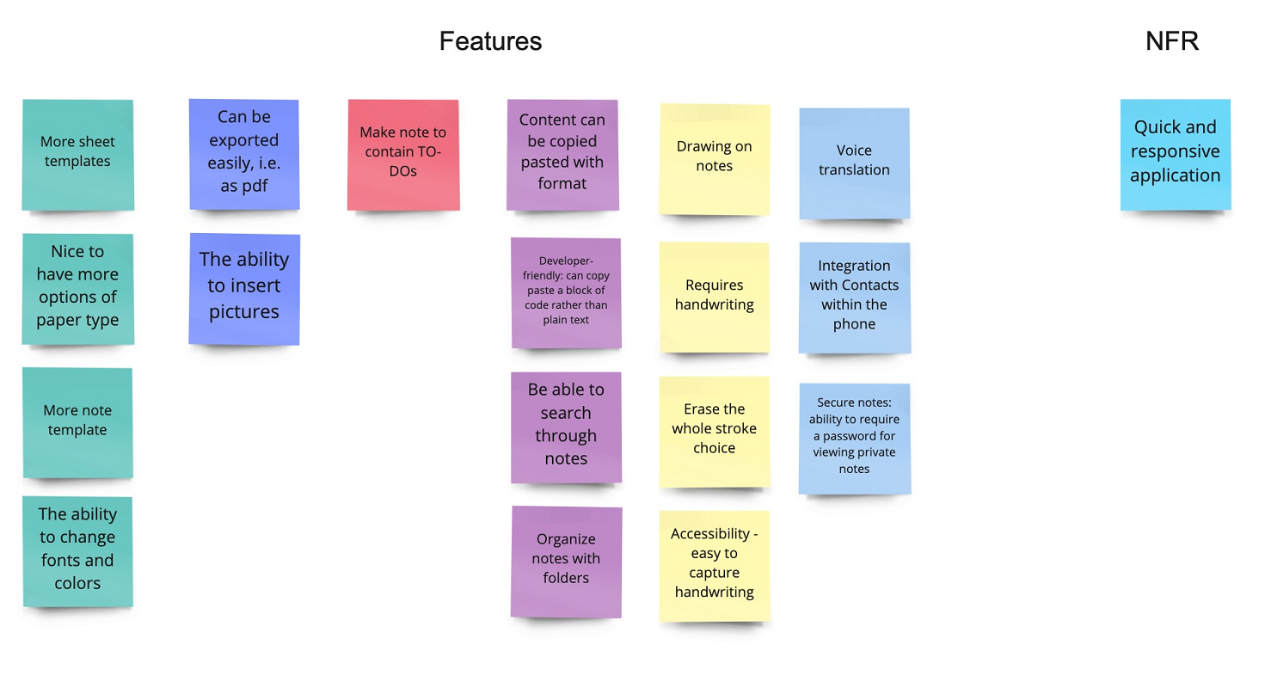
Affinity Diagram
Notes:
According to our interviews, we came up with a clear affinity diagram of what users are expecting from a note-taking app.

Slide 9
Key Features (Part I: Prioritized Features)
Flexible pages: easily-duplicated; previewing tools
Build-in note paper types
Free form: put text boxes/images anywhere
Nested hierarchical organization: drop down; multi-layered collection; graph overview showing connection between notes
Organizational system: using tags like #, enable searching with tags
Drag-and-drop between folders and tags
Hybrid editor: write; keyboard; Markdown support: preview + edit; rich text; code editor
TO-DOs
Focus mode
Synchronization: link with the cloud and sync notes across different devices

Slide 10
Key Features (Part II)
Multiple imported file formats: PDF; PowerPoint; Docs
Notes can also be exported, i.e. as pdf
The set up of app encourages daily journaling: default page when opening the app is a “Daily Note”
Search filter: search text through all existing notes
Archive feature: ability to archive notes
Security-focused: encrypt a private note with password
Themes: dark mode
Voice translation: voice-to-text

Slide 11
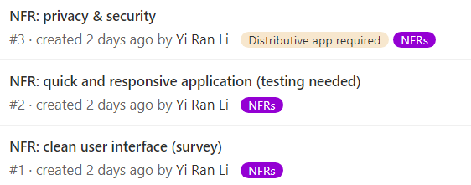
Non-functional Requirements
Usability: clean user interface
Users should find our interface usable.
Measured by surveying 5 users and asking them to rate our interface on a 1-5 scale. The mean score should be 3 or higher.
Performance: quick and responsive application
Application should launch and restore states in less than 5 seconds on Android.
Measured by manually timing execution during testing.
Privacy & security
Data is encrypted in the database.

Slide 12
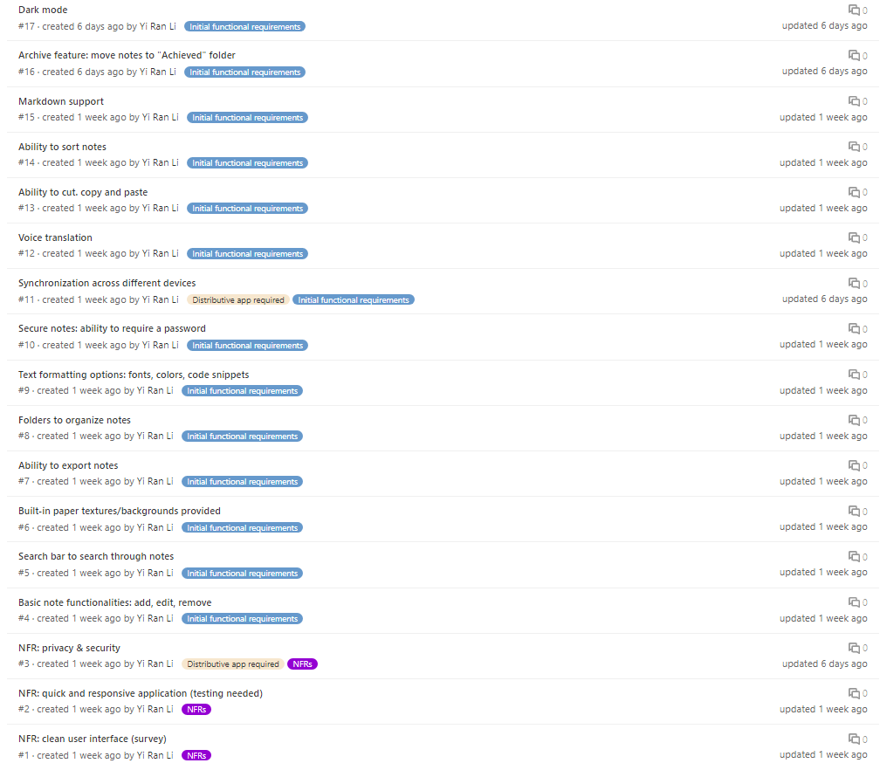
A Brief Overview of the Backlog

Slide 13
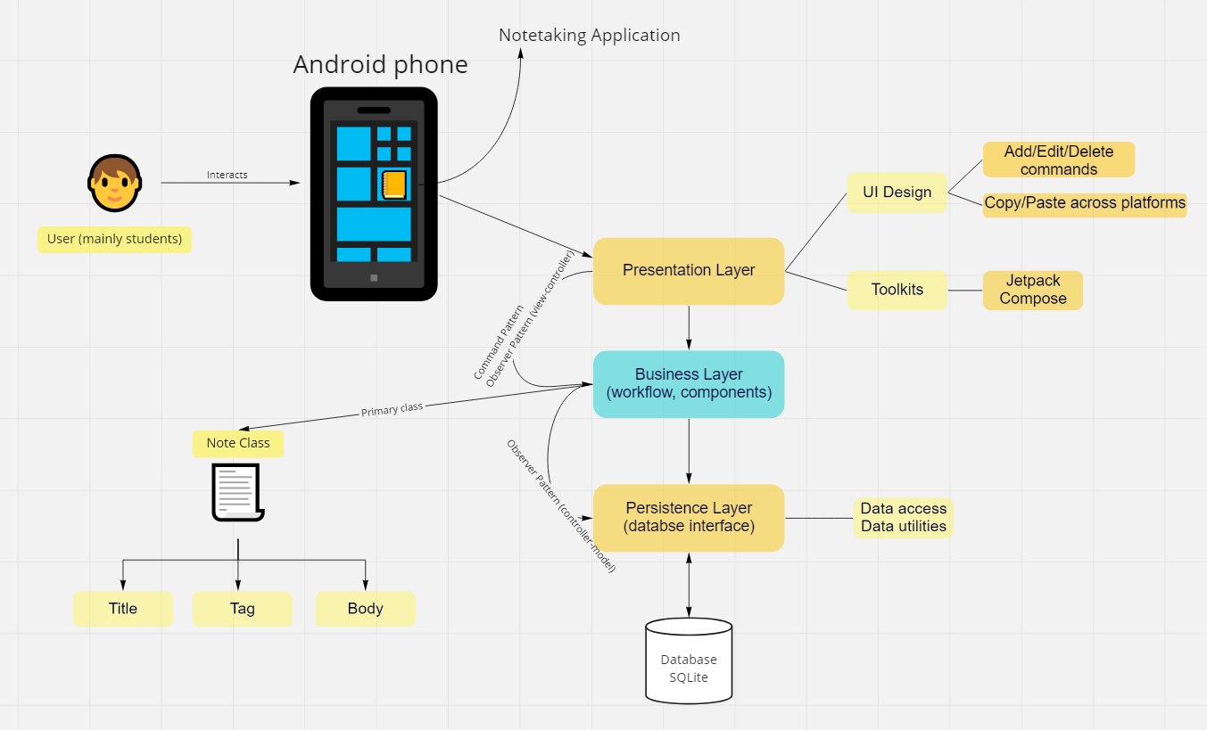
Architecture Diagram

Slide 14
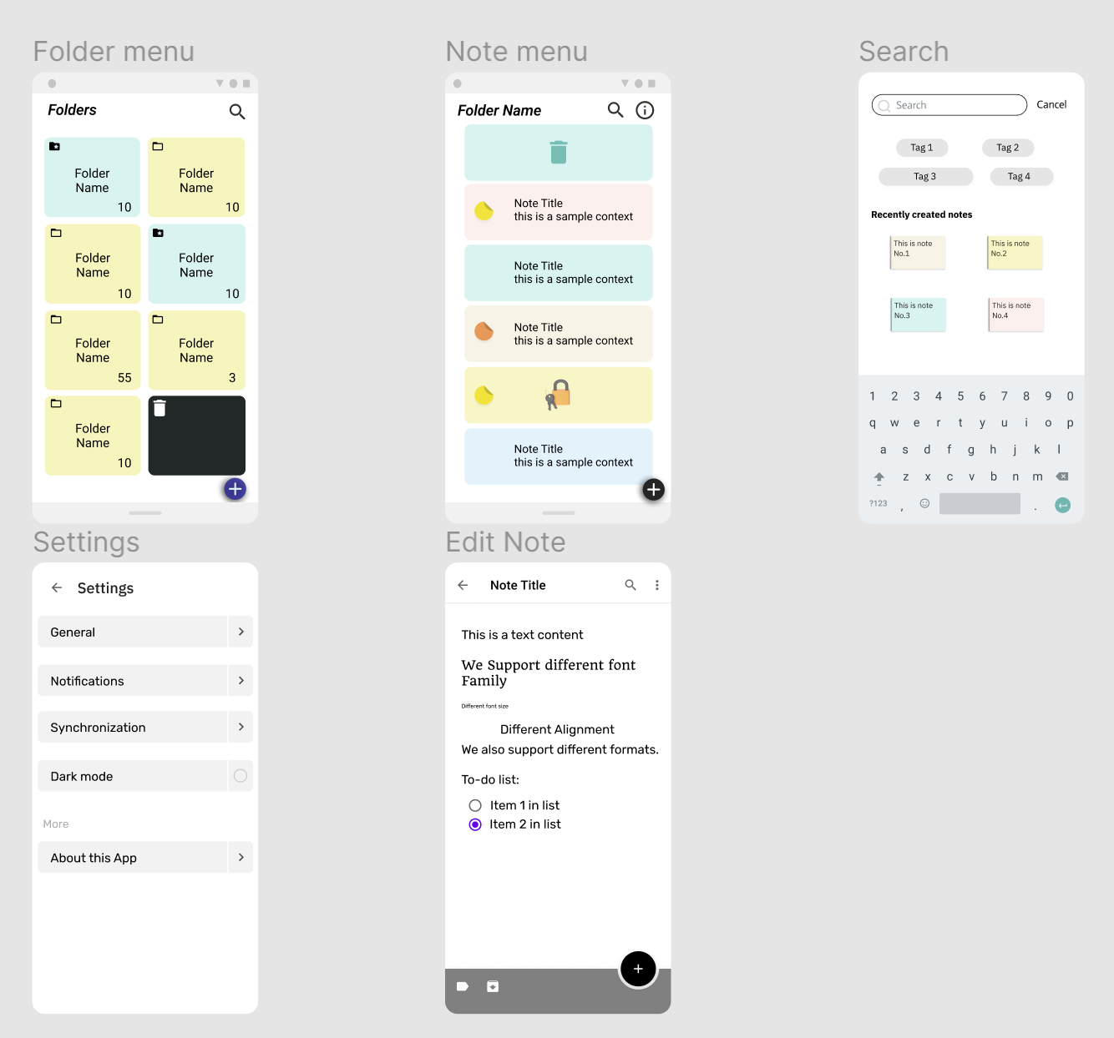
Low-Fi Prototype
Folder menu: select folder, add folder, rename a folder, recycle bin
Note menu: click on a folder and a board with all the notes in the folder will appear
Lock a note: just put a lock and preview will be block
Search: tap on the bar to search
Edit Note: different fonts, colours, formats, hybrid editor
Settings: accounts, modes, notifications, synchronization

Slide 15
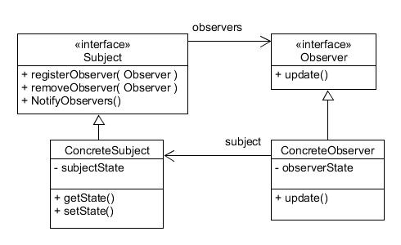
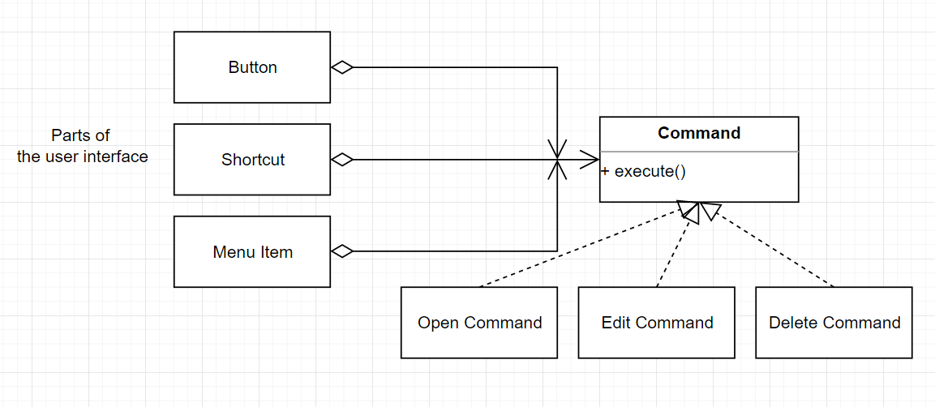
Design Patterns
Observer
MVC
Command

Slide 16
Q & A
Thank you for listening!

