Slide 1
Machine learning ideas in Seurat packages
Jan/16/2020
Sunho Park

Slide 2
Outline
Dimensionality reduction (visualization)
t-SNE
Uniform Manifold Approximation and Projection (UMAP)
Clustering approaches
Graph based methods: Louvain algorithm
Cell type identification
Multiple Dataset Integration
Canonical correlation analysis & L2-norm normalization
Anchoring

Slide 3
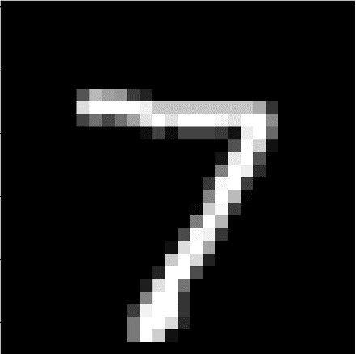
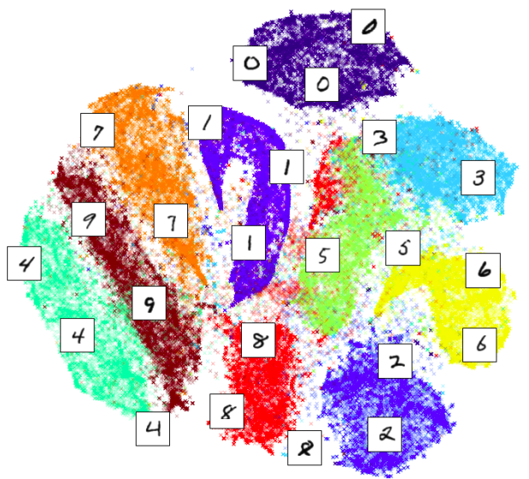
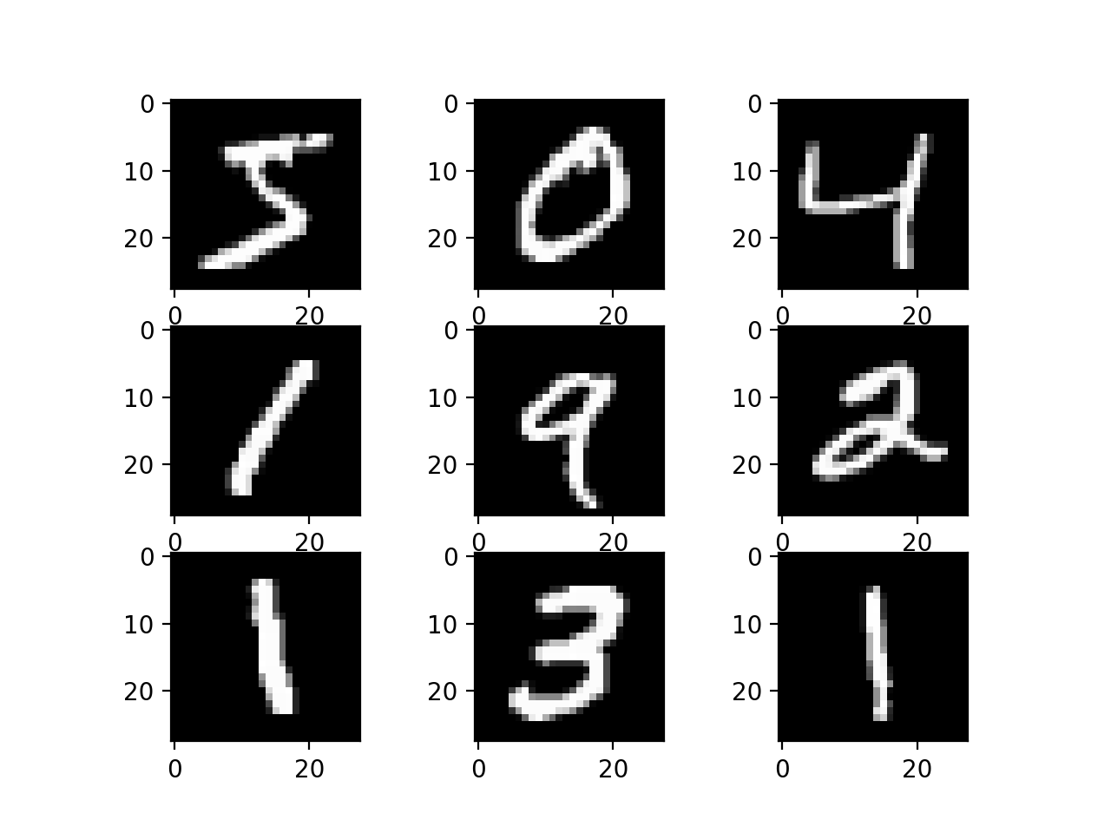


Dimensionality reduction
Figure credit: liam schoneveld
A process of reducing the number of the features
Original image (MNIST): $x_{i}∈ℝ^{784}$ ($28×28$)
Reduced space (by t-SNE): $x_{i}∈ℝ^{2}$

Slide 4
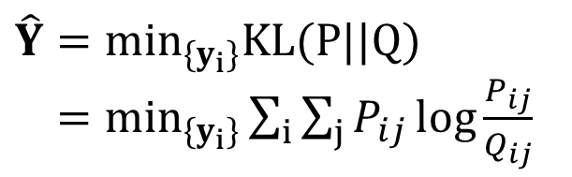

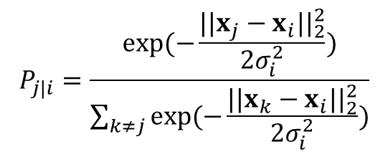

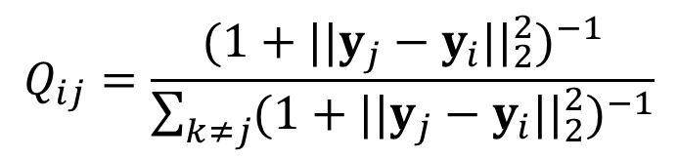



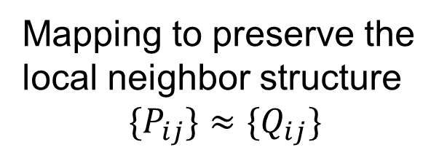

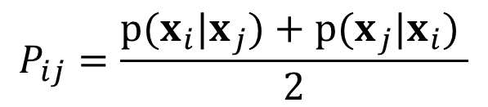
Dimensionality reduction: t-SNE
$$P_{ij}=\frac{{p(x_{i}|x}_{j})+{p(x}_{j}|x_{i}) }{2}$$
$$Q_{ij}=\frac{({1+||y_{j}−y_{i}{||}_{2}^{2})}^{−1}}{\sum_{k≠j}{({1+||y_{j}−y_{i}{||}_{2}^{2})}^{−1}}}$$
$$P_{j|i}=\frac{exp⁡(−\frac{||x_{j}−x_{i}{||}_{2}^{2}}{2σ_{i}^{2}})}{\sum_{k≠j}{exp⁡(−\frac{||x_{k}−x_{i}{||}_{2}^{2}}{2σ_{i}^{2}})}}$$
$$x_{i}$$
Mapping to preserve the
local neighbor structure
${\{P}_{ij}\}$ $≈{\{Q}_{ij}\}$
$$y_{i}$$
$$y_{k}$$
$$x_{j}$$
$$x_{k}$$
$$y_{j}$$
$$\hat{Y}=\min_{\{y_{i}\}}KL(P||Q)$$
$=\min_{\{y_{i}\}}\sum_{i}{\sum_{j}{P_{ij}\log{\frac{P_{ij}}{Q_{ij}}}}}$

Slide 5
Dimensionality reduction
t-SNE has been widely used for visualization of high dimensional data, but it has some limitations:
The global structure is not preserved
points in the same cluster are
close to each other (local structure)
Similarities between clusters might not
be accurate (global structure, e.g.,
consider clusters (0 and 3), (0 and 6))
It is not scalable to handle fast growing
sample sizes in single cell data.

Slide 6

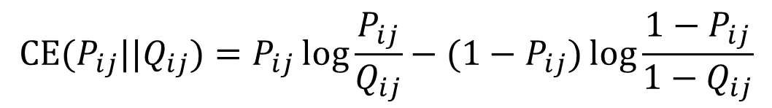




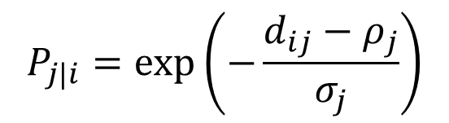


Uniform Manifold Approximation and Projection (UMAP)
$$P_{ij}=P_{i|j}+P_{j|i}−{P_{i|j}P}_{j|i}$$
$$Q_{ij}=({1+ad_{ij}^{2b})}^{−1}$$
$$P_{j|i}=exp⁡\left(−\frac{d_{ij}−ρ_{j}}{σ_{j}}\right)$$
$$x_{i}$$
${\{P}_{ij}\}$ $≈{\{Q}_{ij}\}$
$$y_{i}$$
$$y_{k}$$
$$x_{j}$$
$$x_{k}$$
$$y_{j}$$
$\hat{Y}=\min_{\{y_{i}\}}\sum_{i}{\sum_{j}{CE(P_{ij},Q_{ij})}}$
$$CE(P_{ij}||Q_{ij})=P_{ij}\log{\frac{P_{ij}}{Q_{ij}}}−{(1−P}_{ij})\log{\frac{{1−P}_{ij}}{{1−Q}_{ij}}}$$

Slide 7
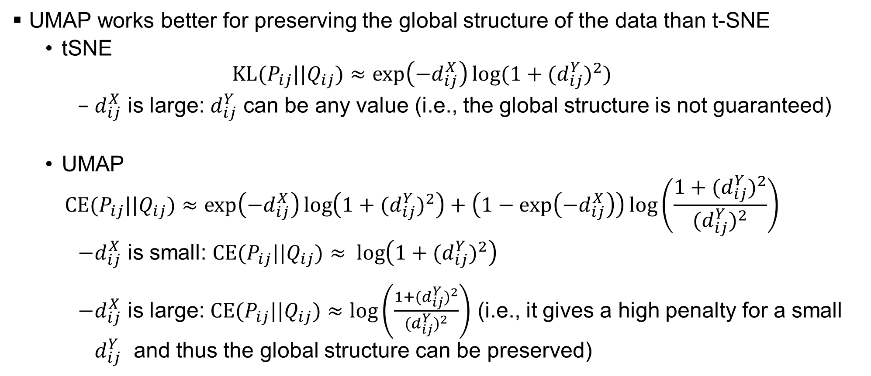
Dimensionality reduction
UMAP works better for preserving the global structure of the data than t-SNE
tSNE
$$KL(P_{ij}||Q_{ij})≈\exp\left(−d_{ij}^{X}\right)log⁡(1+{(d}_{ij}^{Y})^{2})$$
$d_{ij}^{X}$ is large: $d_{ij}^{Y}$ can be any value (i.e., the global structure is not guaranteed)
UMAP
$$CE(P_{ij}||Q_{ij})≈\exp\left(−d_{ij}^{X}\right)\log\left(1+{(d}_{ij}^{Y})^{2}\right)+\left(1−\exp\left(−d_{ij}^{X}\right)\right)\log\left(\frac{1+{(d}_{ij}^{Y})^{2}}{{(d}_{ij}^{Y})^{2}}\right)$$
$d_{ij}^{X}$ is small: $CE(P_{ij}||Q_{ij})≈ \log\left(1+{(d}_{ij}^{Y})^{2}\right)$
$d_{ij}^{X}$ is large: $CE(P_{ij}||Q_{ij})≈log\left(\frac{1+{(d}_{ij}^{Y})^{2}}{{(d}_{ij}^{Y})^{2}}\right)$ (i.e., it gives a high penalty for a small $d_{ij}^{Y}$ and thus the global structure can be preserved)

Slide 8



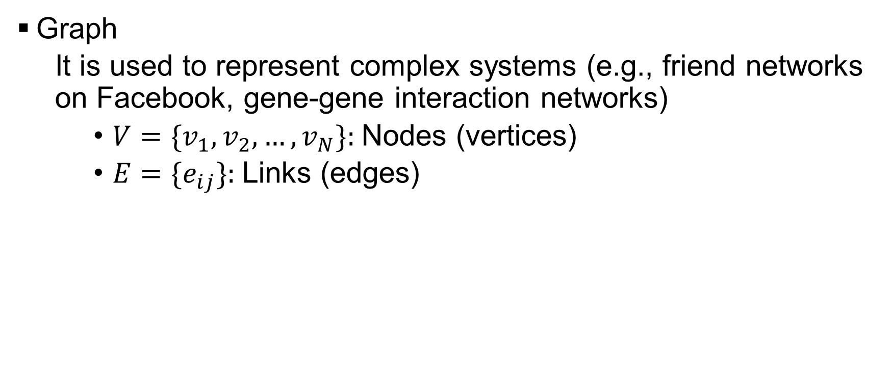



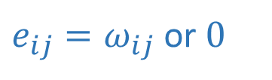
Community detection (clustering) in networks (graphs)
Graph
It is used to represent complex systems (e.g., friend networks on Facebook, gene-gene interaction networks)
$V=\{v_{1},v_{2},…,v_{N}\}:$Nodes (vertices)
$E=\{e_{ij}\}:$Links (edges)
$$v_{2}$$
$e_{ij}=ω_{ij}$ or $0$
$$v_{5}$$
$$G=\{V,E\}$$
$$v_{1}$$
$$v_{4}$$
$$v_{3}$$

Slide 9
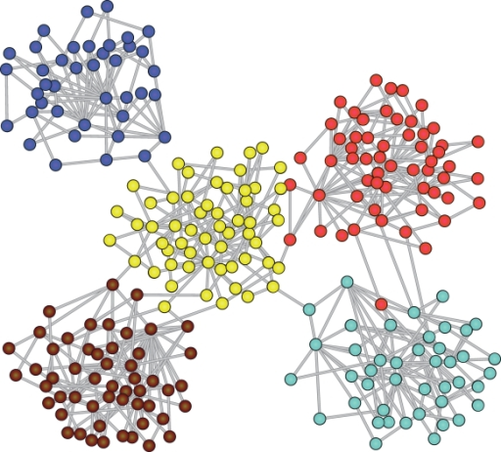
Clustering on graphs
Goal: divide a graph into multiple clusters where the nodes in the same cluster are more close to each other than to those in other clusters
Figure credit: https://github.com/benedekrozemberc
zki/awesome-community-detection

Slide 10
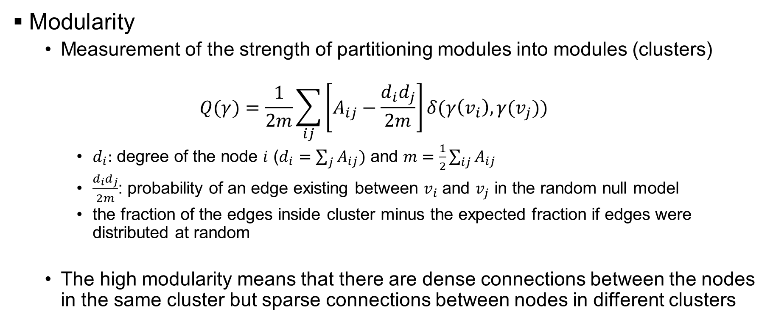
Graph clustering
Modularity
Measurement of the strength of partitioning modules into modules (clusters)
$$Q(γ)=\frac{1}{2m}\sum_{ij}{\left[A_{ij}−\frac{d_{i}d_{j}}{2m}\right]δ(γ\left(v_{i}\right), γ(v_{j}))}$$
$d_{i}:$ degree of the node $i$ ($d_{i}=\sum_{j}{A_{ij})}$ and $m=\frac{1}{2}\sum_{ij}{A_{ij}}$
$\frac{d_{i}d_{j}}{2m}$: probability of an edge existing between $v_{i}$ and $v_{j}$ in the random null model
the fraction of the edges inside cluster minus the expected fraction if edges were distributed at random
The high modularity means that there are dense connections between the nodes in the same cluster but sparse connections between nodes in different clusters

Slide 11

Graph clustering
Modularity
$$Q(γ)=\frac{1}{2m}\sum_{ij}{\left[A_{ij}−\frac{d_{i}d_{j}}{2m}\right]δ(γ\left(v_{i}\right), γ(v_{j}))}$$
The high modularity means that there are dense connections between the nodes in the same cluster but sparse connections between nodes in different clusters
# of clusters = # of nodes
single cluster
Sub-optimal partition
optimal partition

Slide 12
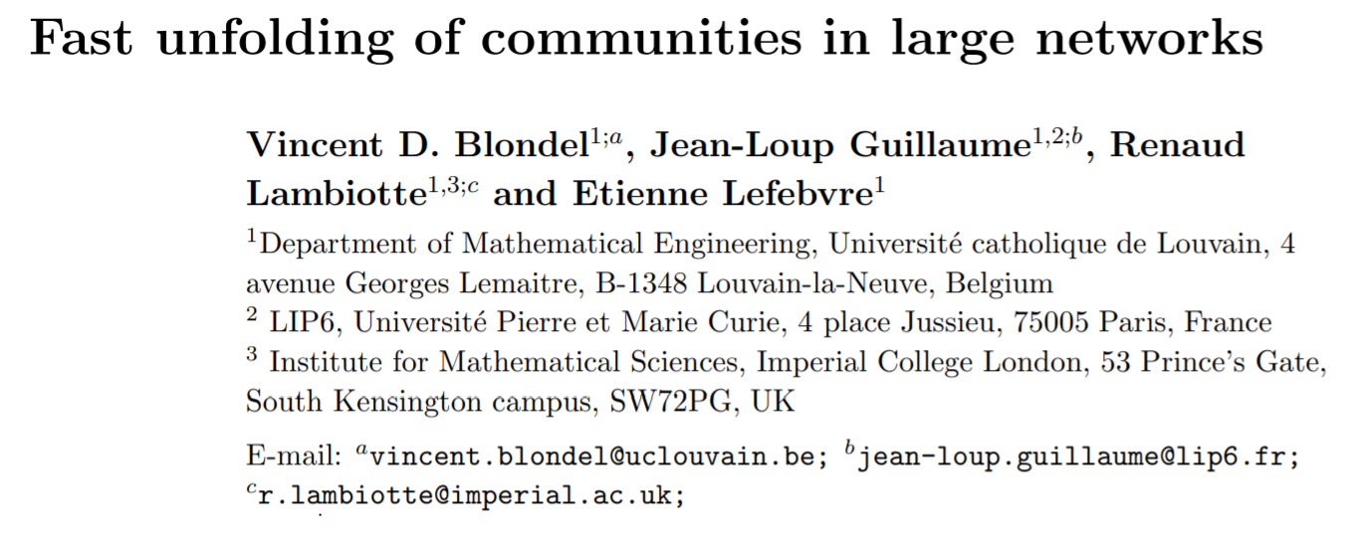
Clustering on graphs
Louvain algorithm
greedily maximizes the modularity score by using an agglomerative approach
one of the fastest modularity-based algorithms and scalable

Slide 13
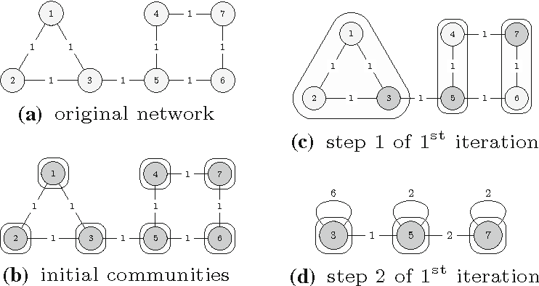
Clustering on graphs (Louvain algorithm)
Figure: Mário Cordeiro et al., “Dynamic community detection in evolving networks
using locality modularity optimization”, Social Network Analysis and Mining, 2016

Slide 14
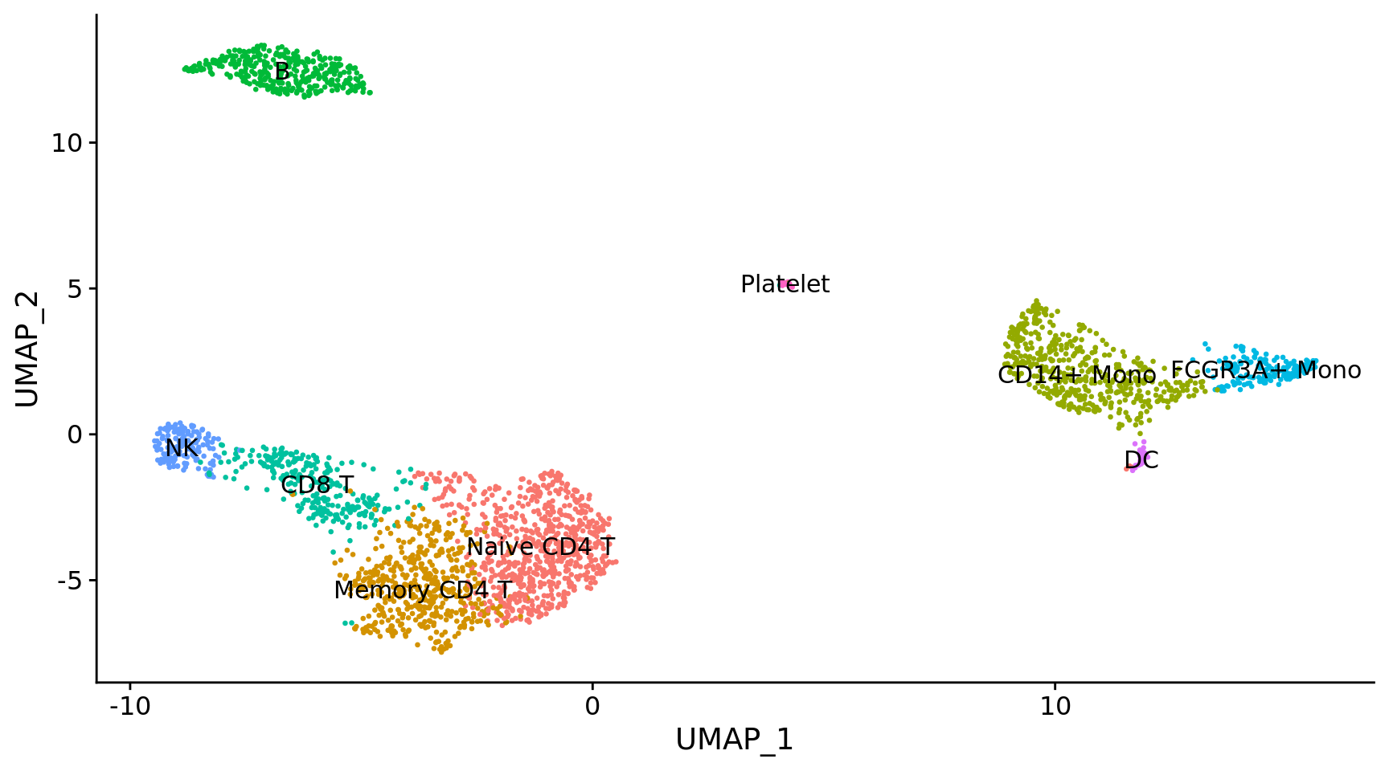
Cell type identification
Identify

Slide 15
Cell type identification
Clustering step
Find sub-groups in single-cell data using any clustering methods (e.g., Louvain algorithm)
Assignment step
Marker identification: finding differently expressed genes in a cluster compared to other cells (or to those in other clusters)
Assigning cell type identity to clusters by matching marker genes with known marker-gene signatures of cell types

Slide 16
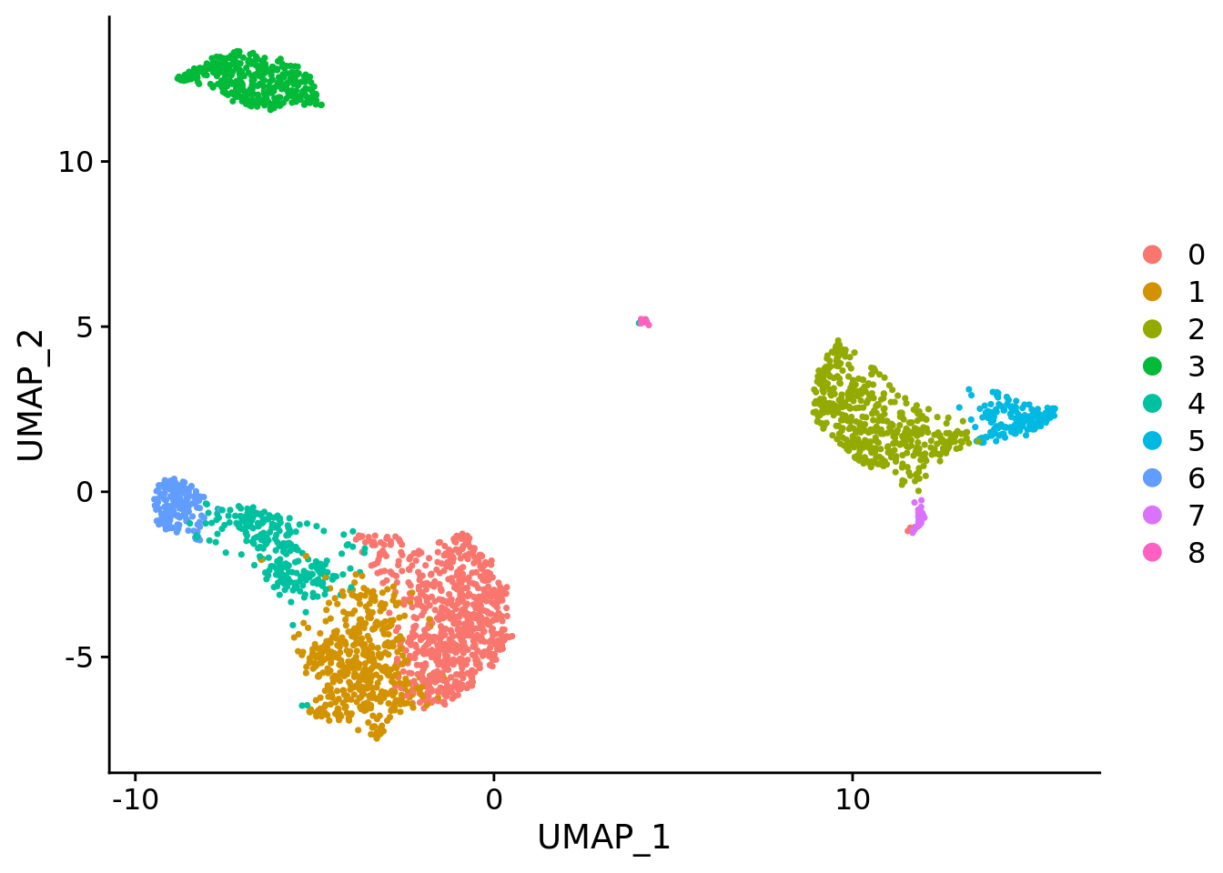
Cell type identification
Clustering
Figure credit: Seurat package

Slide 17
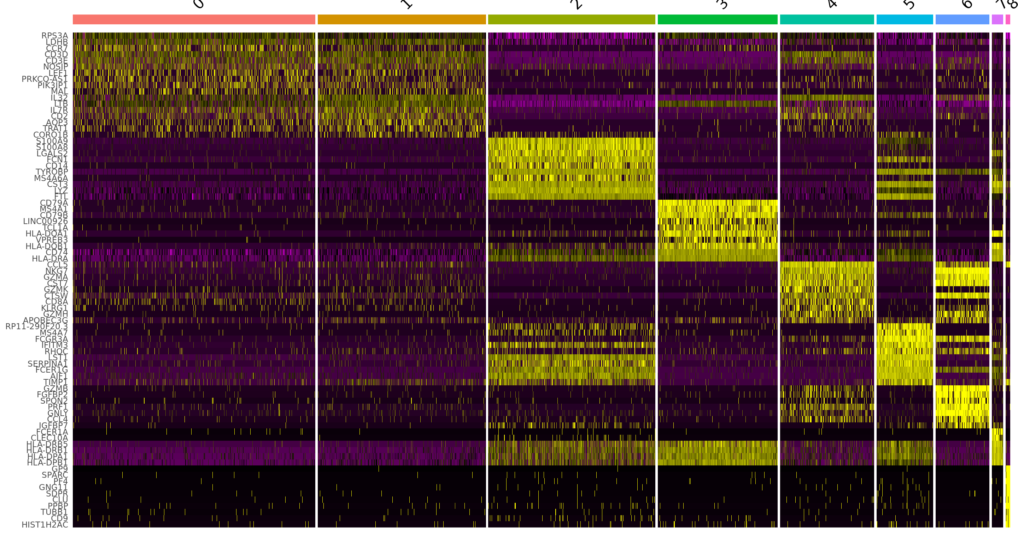
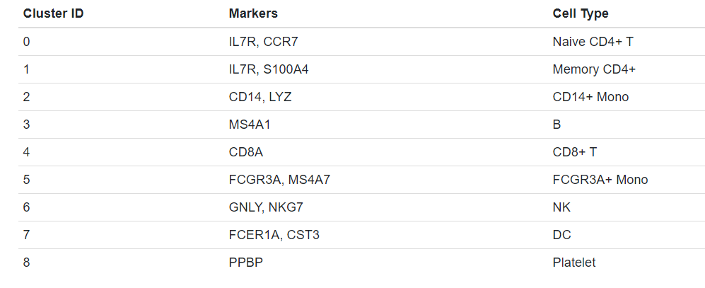
Cell type identification
Marker gene identification: finding differently expressed genes
Cell type assignment
Figure credit: Seurat package

Slide 18
Cell type identification
Final results

Slide 19
Multiple Dataset Integration

Slide 20



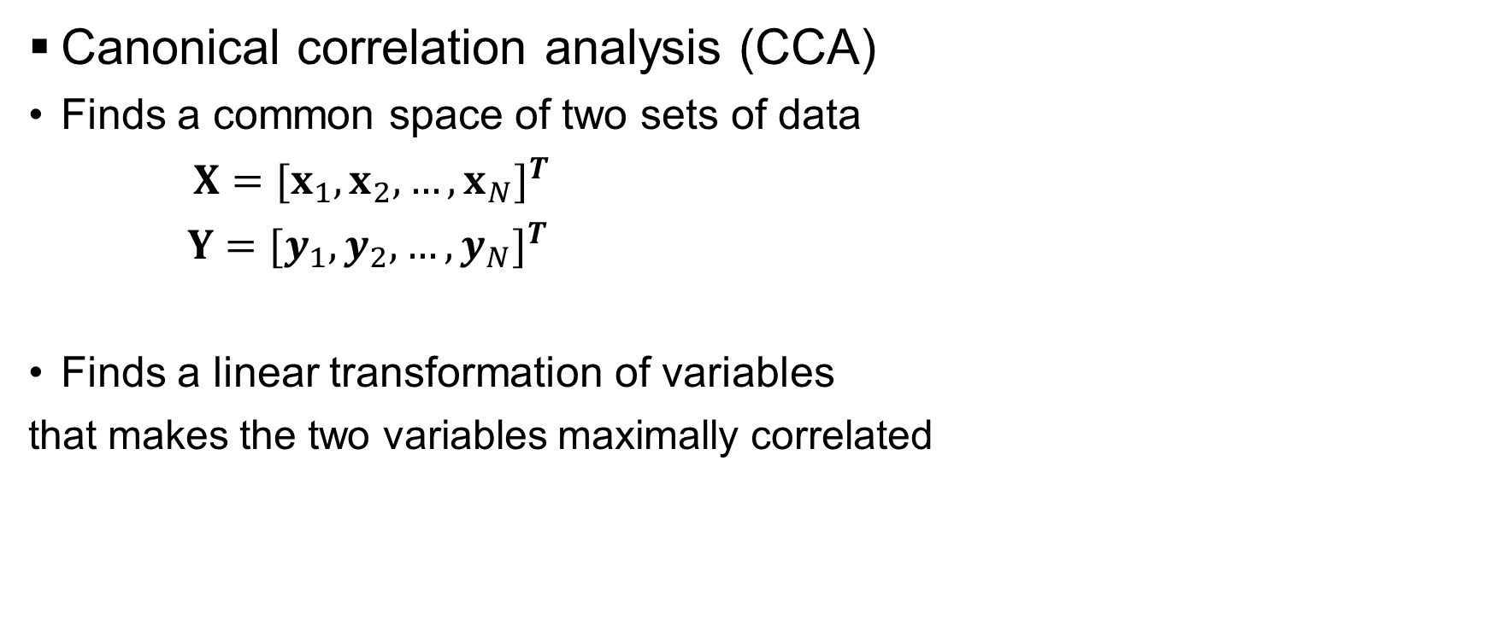

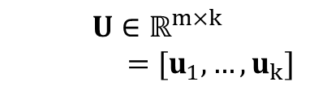
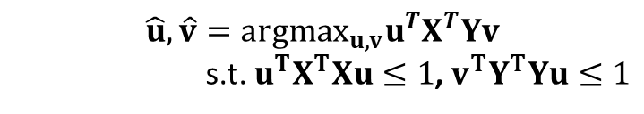

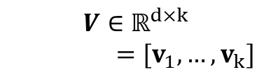
Multiple Dataset Integration
Canonical correlation analysis (CCA)
Finds a common space of two sets of data
$X=[x_{1},x_{2},…,x_{N}]^{T}$
$Y=[y_{1},y_{2},…,y_{N}]^{T}$
Finds a linear transformation of variables
that makes the two variables maximally correlated
$$x_{i}∈ℝ^{m}$$
$$y_{i}∈ℝ^{d}$$
$ℝ^{k}$ ($k≪m,d$)
$$U∈ℝ^{m×k}$$
$=[u_{1},…,u_{k}]$
$$V∈ℝ^{d×k}$$
$=[v_{1},…,v_{k}]$
$$\hat{u},\hat{v}={argmax}_{u,v}u^{T}X^{T}Yv$$
s.t. $u^{T}X^{T}Xu≤1$, $v^{T}Y^{T}Yu≤1$
$$U^{T}x_{i}$$
$$V^{T}y_{i}$$

Slide 21
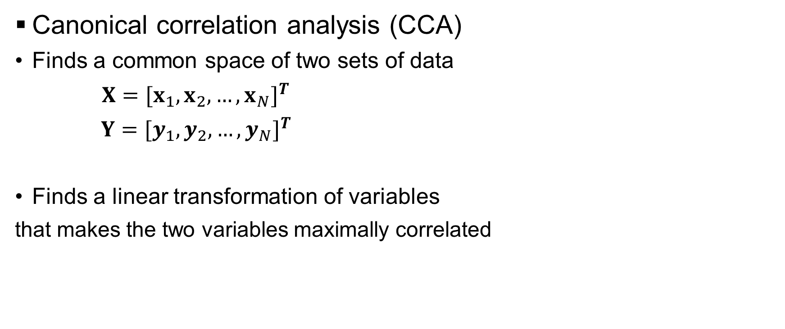
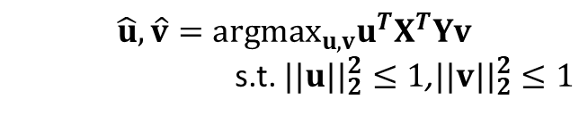
Multiple Dataset Integration
Canonical correlation analysis (CCA)
Finds a common space of two sets of data
$X=[x_{1},x_{2},…,x_{N}]^{T}$
$Y=[y_{1},y_{2},…,y_{N}]^{T}$
Finds a linear transformation of variables
that makes the two variables maximally correlated
$$x_{i}∈ℝ^{m}$$
$$y_{i}∈ℝ^{d}$$
$ℝ^{k}$ ($k≪m,d$)
$$U∈ℝ^{m×k}$$
$=[u_{1},…,u_{k}]$
$$V∈ℝ^{d×k}$$
$=[v_{1},…,v_{k}]$
In Seurat, the maximization problem is simplified as
$$\hat{u},\hat{v}={argmax}_{u,v}u^{T}X^{T}Yv$$
s.t. $||u{||}_{2}^{2}≤1$,$||v{||}_{2}^{2}≤1$
The problem can be solved using singular value decomposition (SVD)
$$U^{T}x_{i}$$
$$V^{T}y_{i}$$

Slide 22


Multiple Dataset Integration
$L_{2}$-norm normalization
CC2
CC2
$$\frac{x}{{ \left\|x\right\|}_{2}}$$
CC1
CC1

Slide 23


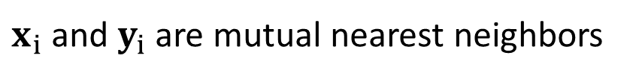

Multiple Dataset Integration
Anchors (Mutual nearest neighbors)
$$k=3$$
Batch I
$$x_{i}$$
Batch J
$$y_{i}$$
$x_{i}$ and $y_{i}$ are mutual nearest neighbors

Slide 24
References
Seurat package: https://satijalab.org/seurat/
Stuart, Tim et al. “Comprehensive Integration of Single-Cell Data” Cell, Volume 177, Issue 7, 1888 - 1902.e21
How Exactly UMAP Works: https://towardsdatascience.com/how-exactly-umap-works-13e3040e1668
V. Blondel et al., “Fast unfolding of communities in large networks”, Journal of Statistical Mechanics: Theory and Experiment 2008

