Slide 1
Chapter 4: Logical Database Design and the Relational Model
Modern Database Management
12th Edition
Jeff Hoffer, Ramesh Venkataraman,
Heikki Topi

Slide 2
Objectives
Define terms
List five properties of relations
State two properties of candidate keys
Define first, second, and third normal form
Describe problems from merging relations
Transform E-R and EER diagrams to relations
Create tables with entity and relational integrity constraints
Use normalization to decompose anomalous relations to well-structured relations

Slide 3
Components of relational model
Data structure
Tables (relations), rows, columns
Data manipulation
Powerful SQL operations for retrieving and modifying data
Data integrity
Mechanisms for implementing business rules that maintain integrity of manipulated data

Slide 4
Relation
A relation is a named, two-dimensional table of data.
A table consists of rows (records) and columns (attribute or field).
Requirements for a table to qualify as a relation:
It must have a unique name.
Every attribute value must be atomic (not multivalued, not composite).
Every row must be unique (can’t have two rows with exactly the same values for all their fields).
Attributes (columns) in tables must have unique names.
The order of the columns must be irrelevant.
The order of the rows must be irrelevant.
NOTE: All relations are in 1st Normal form.
Notes:
All relations are tables, but not all tables are relations. Think of a “table” as simply being a grid with rows and columns. In this sense, a spreadsheet could be a “table”. To qualify as a relation, each row would need to be unique, which implies that each row needs to have a primary key.

Slide 5
Correspondence with E-R Model
Relations (tables) correspond with entity types and with many-to-many relationship types.
Rows correspond with entity instances and with many-to-many relationship instances.
Columns correspond with attributes.
NOTE: The word relation (in relational database) is NOT the same as the word relationship (in E-R model).
Notes:
People often confuse the term “relation” with the term “relationship”. A relation is a table that follows certain rules, and refers to actual relational database architecture. A relationship is a conceptual term that refers to how entities relate to each other. The ER concept of relationship will be implemented by primary and foreign keys connecting the database’s relations.

Slide 6
Key Fields
Keys are special fields that serve two main purposes:
Primary keys are unique identifiers of the relation. Examples include employee numbers, social security numbers, etc. This guarantees that all rows are unique.
Foreign keys are identifiers that enable a dependent relation (on the many side of a relationship) to refer to its parent relation (on the one side of the relationship).
Keys can be simple (a single field) or composite (more than one field).
Keys usually are used as indexes to speed up the response to user queries (more on this in Chapter 5).
Notes:
Keys are to databases as identifiers are to E-R models.

Slide 7
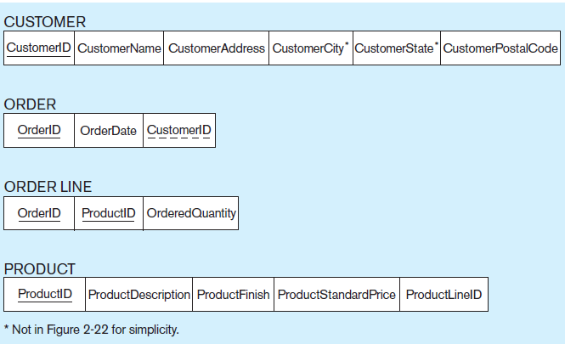
Figure 4-3 Schema for four relations (Pine Valley Furniture Company)
Primary Key
Foreign Key (implements 1:N relationship between customer and order)
Combined, these are a composite primary key (uniquely identifies the order line)…individually they are foreign keys (implement M:N relationship between order and product)
Notes:
The relation on the many side of a 1:N relationship will have a foreign key that corresponds with the primary key of the relation on the 1 side.
Any time you have a M:N relationship between entities, this must be implemented via a separate relation, often called an “intersection table” or a “junction table”. The Order Line table is an example of a relation that implements a many-to-many relationship between orders and products. Each order may involve several products, and likewise each product could be involved in many orders.

Slide 8
Integrity Constraints
Domain Constraints
Allowable values for an attribute (See Table 4-1)
Entity Integrity
No primary key attribute may be null. All primary key fields MUST contain data values.
Referential Integrity
Rules that maintain consistency between the rows of two related tables.

Slide 9
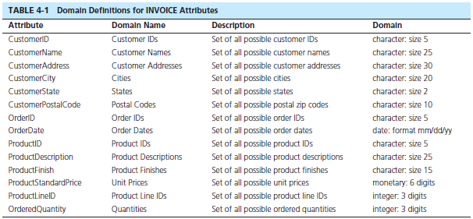
Domain definitions enforce domain integrity constraints.
Notes:
A domain definition usually consists of the following components: domain name, meaning, data type, size (or length), and allowable values or allowable range (if applicable).
There are many ways to enforce domain constraints. One way is in the SQL for creating tables, as we will see in later chapters. Another way is for applications to enforce this prior to inserting data into the database.
For example, in Table 4-1, you can verify that an entered date is legitimate (e.g. not Feb. 29, 2015). Or, you can verify that the unit price is a positive number.

Slide 10
Integrity Constraints
Referential Integrity–rule states that any foreign key value (on the relation of the many side) MUST match a primary key value in the relation of the one side. (Or the foreign key can be null)
For example: Delete Rules
Restrict–don’t allow delete of “parent” side if related rows exist in “dependent” side
Cascade–automatically delete “dependent” side rows that correspond with the “parent” side row to be deleted
Set-to-Null–set the foreign key in the dependent side to null if deleting from the parent side → not allowed for weak entities
Notes:
Because some tables are dependent on others, it is important to control how data is to be deleted. Referential integrity rules prevent data from being deleted when there is other data dependent on it. For example, a customer will not be deleted from the database if there are existing orders that were generated by that customer. The delete rules specify how such deletions can be controlled within the database.

Slide 11
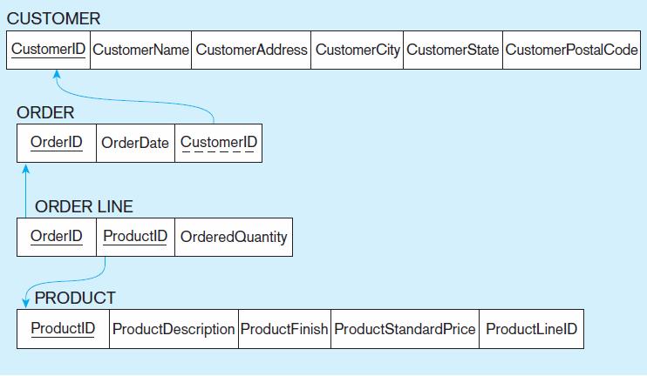
Figure 4-5
Referential integrity constraints (Pine Valley Furniture)
Referential integrity constraints are drawn via arrows from dependent to parent table
Notes:
In the relation diagrams of this chapter, arrows between foreign and primary keys depict referential integrity constraints.

Slide 12
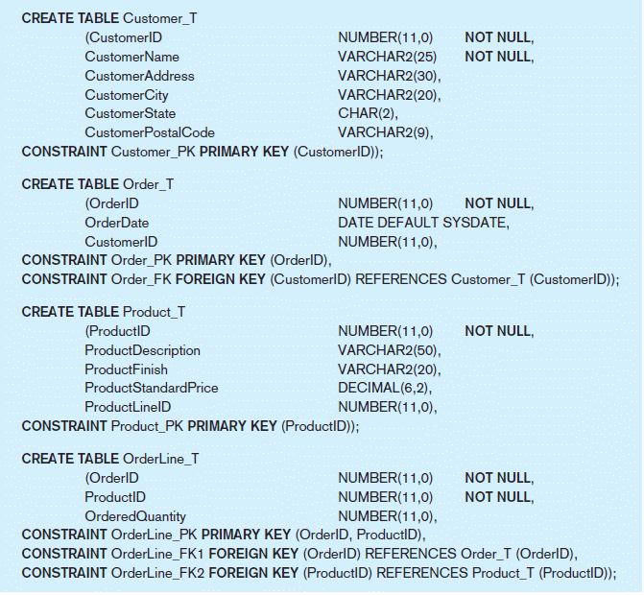
Figure 4-6 SQL table definitions
Referential integrity constraints are implemented with foreign key to primary key references.
Notes:
This is an example of CREATE TABLE statements in SQL. Here we can see how a dependent table references its dominant table through creation of a foreign key. We will learn more about CREATE TABLE in chapter 6.

Slide 13
Transforming EER Diagrams into Relations
Mapping Regular Entities to Relations
Simple attributes: E-R attributes map directly onto the relation
Composite attributes: Use only their simple, component attributes
Multivalued Attribute: Becomes a separate relation with a foreign key taken from the superior entity
Notes:
The next several slides show the mechanics of designing relational databases based on E-R and EER data models. As we saw in chapter 1, the database development life cycle often involves first constructing a conceptual model (E-R or EER) and then using this to create the logical model (relational database design). If you do a thorough job of developing the conceptual model, it should be a fairly simple matter to convert this to a well-structured relational database.
However, if you just start by creating tables, you could wind up with a database that is not well-structured, which required you to fix these mistakes. This is the process of normalization, which will be discussed later.

Slide 14

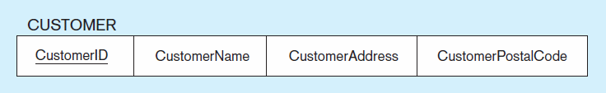
Figure 4-8 Mapping a regular entity
(a) CUSTOMER entity type with simple attributes
(b) CUSTOMER relation
Notes:
Very simple. Each attribute of the entity becomes a column (field) of the resulting relation. The identifier of the entity becomes a primary key in the relation.

Slide 15
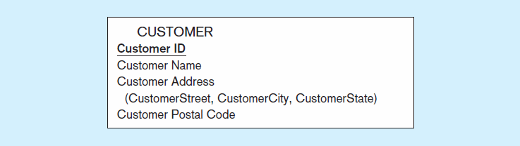

Figure 4-9 Mapping a composite attribute
(a) CUSTOMER entity type with composite attribute
(b) CUSTOMER relation with address detail
Notes:
A bit more complex. Although conceptually you can have a composite attribute, there is no such thing as a “composite column” or “composite field” in relational databases. So, the component attributes become individual columns. As you can see, there is no field called “Customer Address” in the relation, just its components.

Slide 16

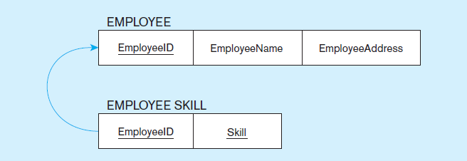
Figure 4-10 Mapping an entity with a multivalued attribute
(a)
Multivalued attribute becomes a separate relation with foreign key
(b)
One–to–many relationship between original entity and new relation
Notes:
Multivalued attributes in E-R models must be converted to separate relations in the logical database design. This is because there is no such thing as a multivalued attribute in relational databases. Remember the rules for 1st normal form.
In this case, there is a one-to-many relationship in the final database structure. The Employee Skill relation has a composite primary key (EmployeeID and Skill). The EmployeeID portion of this composite primary key is also a foreign key to the Employee table.

Slide 17
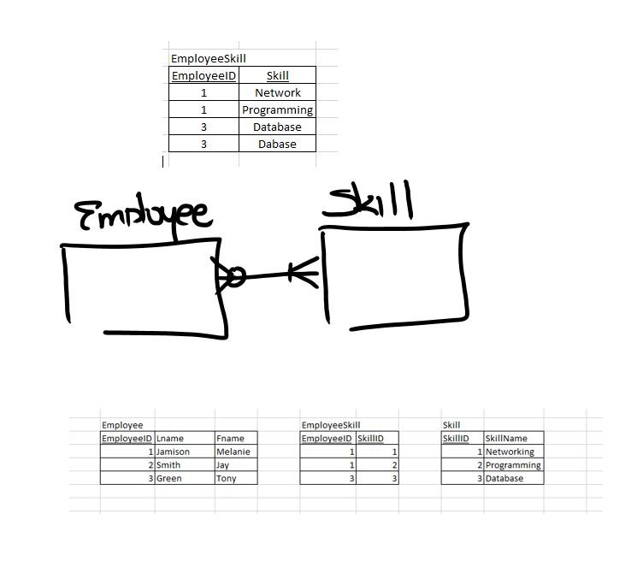

Slide 18
Transforming EER Diagrams into Relations (cont.)
Mapping Weak Entities
Becomes a separate relation with a foreign key taken from the superior entity
Primary key composed of:
Partial identifier of weak entity
Primary key of identifying relation (strong entity)

Slide 19
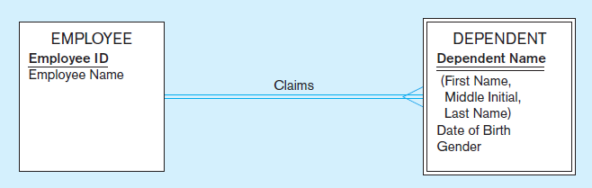
Figure 4-11 Example of mapping a weak entity
a) Weak entity DEPENDENT
Notes:
Recall that double lines depict weak entities and identifying relationships.

Slide 20
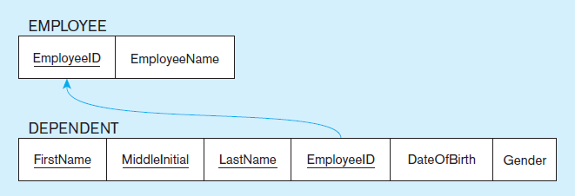
Figure 4-11 Example of mapping a weak entity (cont.)
b) Relations resulting from weak entity
NOTE: the domain constraint for the foreign key should NOT allow null value if DEPENDENT is a weak entity
Foreign key
Composite primary key
Notes:
If a foreign key is null, this implies an “optional one” in the 1:N relationship. But for weak entities this will never be the case. The weak entity cannot exist without its corresponding strong entity.
Note the assumption above. We assume that each dependent of an employee must have a unique name (first, middle, and last). Otherwise the fields comprising the composite primary key would not be unique, violating the rules of a relation.

Slide 21
Transforming EER Diagrams into Relations (cont.)
Mapping Binary Relationships
One-to-Many–Primary key on the one side becomes a foreign key on the many side
Many-to-Many–Create a new relation with the primary keys of the two entities as its primary key
One-to-One–Primary key on mandatory side becomes a foreign key on optional side

Slide 22
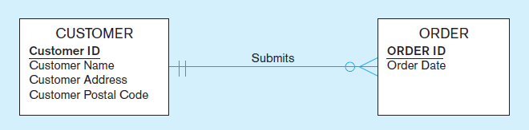
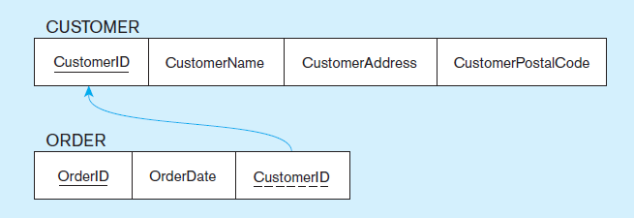
Figure 4-12 Example of mapping a 1:M relationship
a) Relationship between customers and orders
Note the mandatory one
b) Mapping the relationship
Again, no null value in the foreign key…this is because of the mandatory minimum cardinality.
Foreign key
Notes:
Because of the mandatory one in the relationship, we could have modelled ORDER as a weak entity and Submits as an identifying relationship.
In E-R diagrams, we generally don’t depict the idea of a “foreign key”. This is because the only purpose of a foreign key is to implement the relationship; it is not a meaningful piece of data in itself.

Slide 23
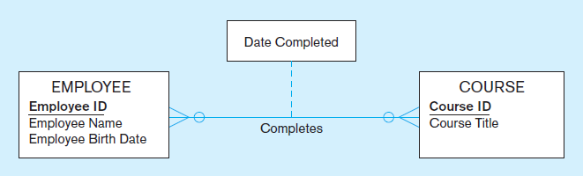
Figure 4-13 Example of mapping an M:N relationship
a) Completes relationship (M:N)
The Completes relationship will need to become a separate relation.

Slide 24
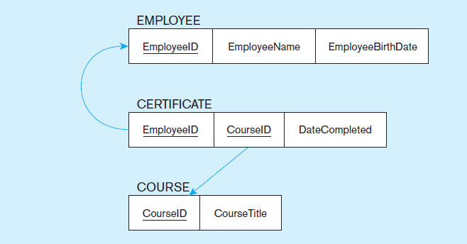
Figure 4-13 Example of mapping an M:N relationship (cont.)
b) Three resulting relations
Composite primary key
Foreign key
new intersection relation
Foreign key
Notes:
Note that any time you have a many-to-many relationship, whether or not it contains its own attributes, it must be implemented as a separate relation (table). Often this is called an intersection table or junction table.
In this example, the new table’s primary key is a composite, formed by two foreign keys, one to each of the entities comprising the M:N relationship (Employee and Course).

Slide 25
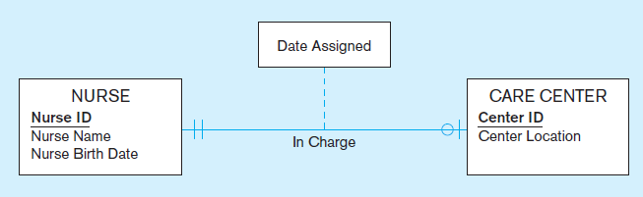
Figure 4-14 Example of mapping a binary 1:1 relationship
a) In charge relationship (binary 1:1)
Often in 1:1 relationships, one direction is optional
Notes:
Although 1 – to - 1 relationships are less common than 1:N or M:N, they still can occur. This E-R diagram shows that a nurse could be in charge of at most one care center, and that each care center must have exactly one nurse in charge.

Slide 26
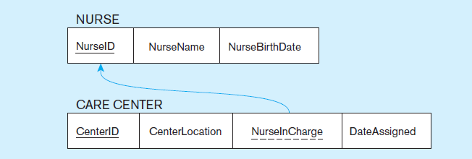
Figure 4-14 Example of mapping a binary 1:1 relationship (cont.)
b) Resulting relations
Foreign key goes in the relation on the optional side,
matching the primary key on the mandatory side
Notes:
So, since the care center must have a charge nurse, this means the foreign key in this relationship goes into the Care Center table. Also, because of the mandatory one in the relationship, this must mean that the NurseInCharge field can never have a null value.

Slide 27
Transforming EER Diagrams into Relations (cont.)
Mapping Associative Entities
Identifier Not Assigned
Default primary key for the association relation is composed of the primary keys of the two entities (as in M:N relationship)
Identifier Assigned
It is natural and familiar to end-users
Default identifier may not be unique
Notes:
As we saw in chapter 2, M:N relationships can also be modeled as associative entities. Sometimes this is preferable. Associative entities will map onto intersection tables in the resulting logical database design.

Slide 28
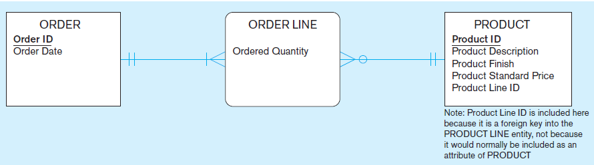
Figure 4-15 Example of mapping an associative entity
a) An associative entity
Notes:
Here, Order Line, which implements a M:N relationship between Order and Product, is explicitly modelled as an associative entity.

Slide 29
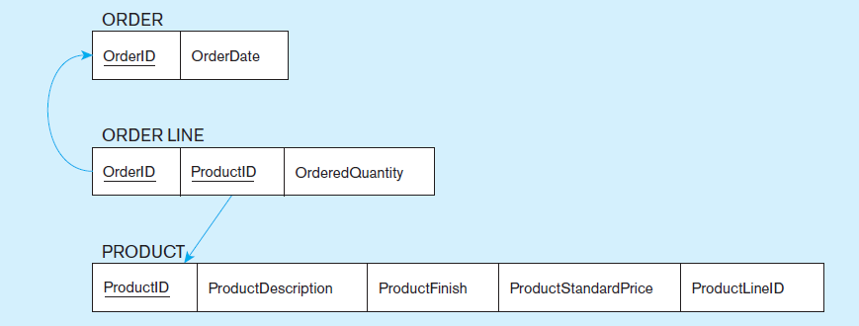
Figure 4-15 Example of mapping an associative entity (cont.)
b) Three resulting relations
Composite primary key formed from the two foreign keys
Notes:
The resulting intersection table connects orders to products. The same would have been true if there was just a M:N relationship (instead of an associative entity) in the E-R model.
So, mapping associative entities to relational databases is essentially identical to mapping M:N relationships to relational databases.

Slide 30
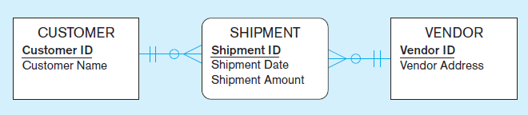
Figure 4-16 Example of mapping an associative entity with
an identifier
a) SHIPMENT associative entity
Notes:
In this case, the associative entity has its own identifier…..

Slide 31
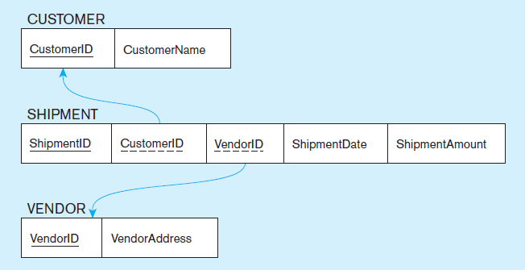
Figure 4-16 Example of mapping an associative entity with
an identifier (cont.)
b) Three resulting relations
Primary key differs from foreign keys
Notes:
…thus, the foreign keys of the resulting intersection relation are not part of the primary key.

Slide 32
Transforming EER Diagrams into Relations (cont.)
Mapping Unary Relationships
One-to-Many–Recursive foreign key in the same relation
Many-to-Many–Two relations:
One for the entity type
One for an associative relation in which the primary key has two attributes, both taken from the primary key of the entity

Slide 33
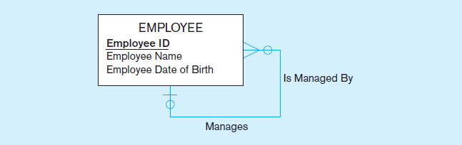
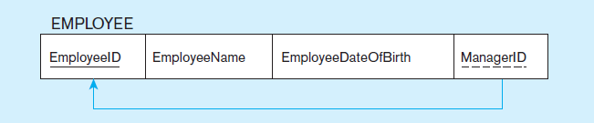
Figure 4-17 Mapping a unary 1:N relationship
(a) EMPLOYEE entity with unary relationship
(b) EMPLOYEE relation with recursive foreign key
Notes:
The E-R diagram involves a one-to-many relationship. Thus, the foreign ley is in the same table as the primary key. This is often called a “recursive” key because it points at records in the same table.
Because of the optional relationship, it is possible for an employee not to have any supervisor. Therefore, the ManagerID field could be null.
This structure is an example of storing hierarchies. It enables the representation of a supervisor who has subordinates, and these subordinates could in turn manage other subordinates, etc.

Slide 34
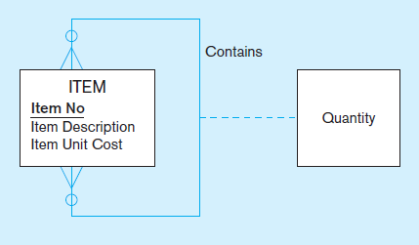
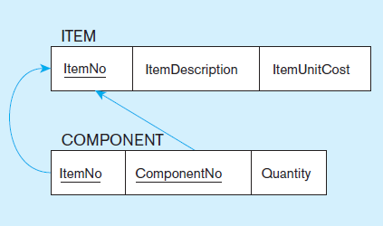
Figure 4-18 Mapping a unary M:N relationship
(a) Bill-of-materials relationships (unary M:N)
(b) ITEM and COMPONENT relations
Notes:
As always, any many-to-many relationship requires a separate table (relation).
Bill-of-materials is another classic example of representing hierarchies in a database. An item may have sub-items, which could in turn have other sub-items, etc. However, there is a difference between this and the employees example from earlier. A given employee can have only one direct manager (1:N). But a component could conceivable be part of many other items (M:N).

Slide 35
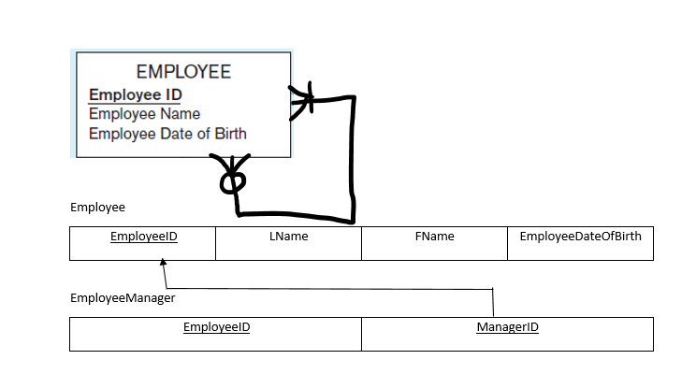

Slide 36
Transforming EER Diagrams into Relations (cont.)
Mapping Ternary (and n-ary) Relationships
One relation for each entity and one for the associative entity
Associative entity has foreign keys to each entity in the relationship

Slide 37
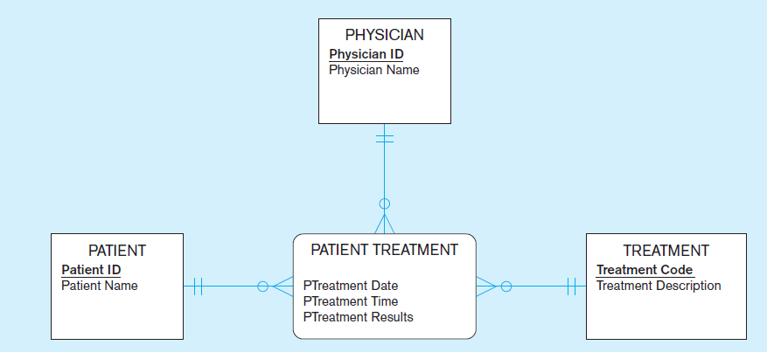
Figure 4-19 Mapping a ternary relationship
a) PATIENT TREATMENT Ternary relationship with associative entity
Notes:
Note that this ER diagram shows that a given physician can give a particular treatment to a particular patient, and that this could happen more than once.

Slide 38
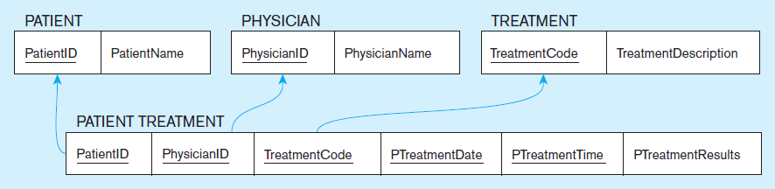
Figure 4-19 Mapping a ternary relationship (cont.)
b) Mapping the ternary relationship PATIENT TREATMENT
Remember that the primary key MUST be unique.
This is why treatment date and time are included in the composite primary key.
But this makes a very cumbersome key…
It would be better to create a surrogate key like Treatment#.
Notes:
This is why the primary key of the Patient Treatment table needs more than just the three foreign keys to Physician, Treatment, and Patient. This is why date and time are part of the primary key. But this creates a primary key consisting of five separate columns.
Suppose later we were to create a table that depends on patient treatment. If we did this, then that table would have a five-field foreign key! Very cumbersome.
So, the solution would be to have a surrogate primary key. If you have large composite primary keys, this is an indicator that a surrogate key is preferable.

Slide 39
Transforming EER Diagrams into Relations (cont.)
Mapping Supertype/Subtype Relationships
One relation for supertype and for each subtype
Supertype attributes (including identifier and subtype discriminator) go into supertype relation
Subtype attributes go into each subtype; primary key of supertype relation also becomes primary key of subtype relation
1:1 relationship established between supertype and each subtype, with supertype as primary table

Slide 40
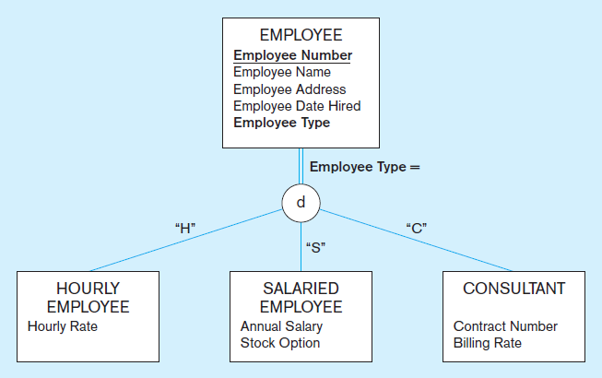
Figure 4-20 Supertype/subtype relationships
Notes:
Supertype-subtype relationships are essentially 1:1 relationships. So the rules that apply to these mappings will be similar to the rules we applied to other 1:1 relationship mappings, as we will see in the next slide.

Slide 41
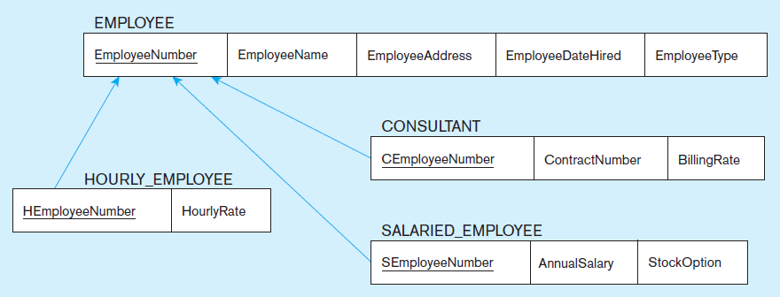
Figure 4-21
Mapping supertype/subtype relationships to relations
These are implemented as one-to-one relationships.
Notes:
The primary key of the subtype relation (table) is also a foreign key to the supertype relation. Note that we have not seen this before. We have seen composite primary keys where a part of the primary key is a foreign key, but we have not seen a case where the entire primary key is also a foreign key.
Therefore, if you ever see a database table where the entire primary key is also a foreign key, this should imply to you that there is a supertype-subtype relationship involved.

Slide 42
Data Normalization
Primarily a tool to validate and improve a logical design so that it satisfies certain constraints that avoid unnecessary duplication of data
The process of decomposing relations with anomalies to produce smaller, well-structured relations
Notes:
The previous slides showed how to map an E-R model to a relational database design. If you follow these mappings, then your result will be a well-structured database. But if you just start by creating tables without considering the ER rules, then you will likely get a database that is not well-structured. These databases could cause anomalies because of data duplication. In the next several slides we’ll see how to correct these anomalies through a process called “normalization”.

Slide 43
Well-Structured Relations
A relation that contains minimal data redundancy and allows users to insert, delete, and update rows without causing data inconsistencies
Goal is to avoid anomalies
Insertion Anomaly–adding new rows forces user to create duplicate data
Deletion Anomaly–deleting rows may cause a loss of data that would be needed for other future rows
Modification Anomaly–changing data in a row forces changes to other rows because of duplication
General rule of thumb: A table should not pertain to more than one entity type.

Slide 44

Example–Figure 4-2b
Question–Is this a relation?
Answer–Yes: Unique rows and no multivalued attributes
Question–What’s the primary key?
Answer–Composite: EmpID, CourseTitle
Notes:
This is a relation. But it is not a well-structured relation.

Slide 45
Anomalies in this Table
Insertion–can’t enter a new employee without having the employee take a class (or at least empty fields of class information)
Deletion–if we remove employee 140, we lose information about the existence of a Tax Acc class
Modification–giving a salary increase to employee 100 forces us to update multiple records
Why do these anomalies exist?
Because there are two themes (entity types) in this one relation. This results in data duplication and an unnecessary dependency between the entities.

Slide 46
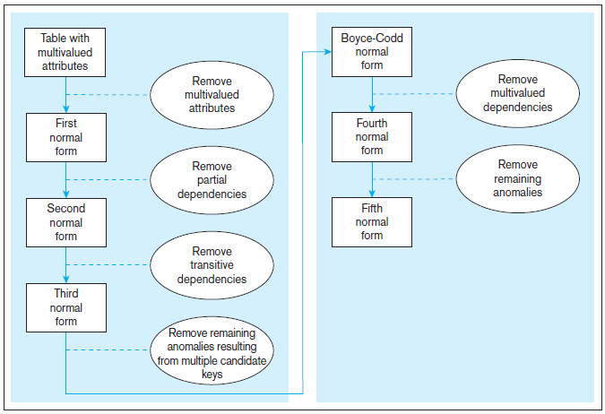
Figure 4.22 Steps in normalization
3rd normal form is generally considered sufficient
Notes:
It is important that a database reach third normal form. Boyce-Codd, fourth, and fifth are of theoretical interest, but not generally considered vital for qualifying as a set of well-structured relations.

Slide 47
Functional Dependencies and Keys
Functional Dependency: The value of one attribute (the determinant) determines the value of another attribute
Candidate Key:
A unique identifier. One of the candidate keys will become the primary key
E.g., perhaps there is both credit card number and SS# in a table…in this case both are candidate keys.
Each non-key field is functionally dependent on every candidate key.

Slide 48
First Normal Form
No multivalued attributes
Every attribute value is atomic
Fig. 4-25 is not in 1st Normal Form (multivalued attributes) ➔ it is not a relation.
Fig. 4-26 is in 1st Normal form.
All relations are in 1st Normal Form.

Slide 49
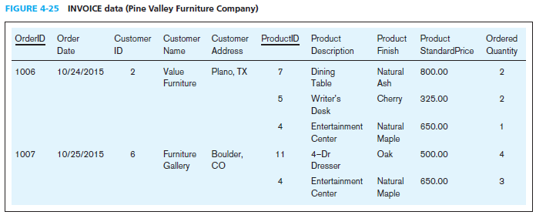
Table with multivalued attributes, not in 1st normal form
Note: This is NOT a relation.
Notes:
This table is not a relation. Note the blank OrderID field. Also, we don’t explicitly see the customer or order date for the second, third, and fifth rows. You can imagine seeing something like this in a spreadsheet and inferring that the second and third rows correspond with order 1006. But this is not sufficient for a database.
Basically, we here are violating the principle of “no multivalued attributes”. It’s as if OrderID 1006 has “ProductID” equaling 7, 5, and 4. You can’t have that in a true relation.

Slide 50
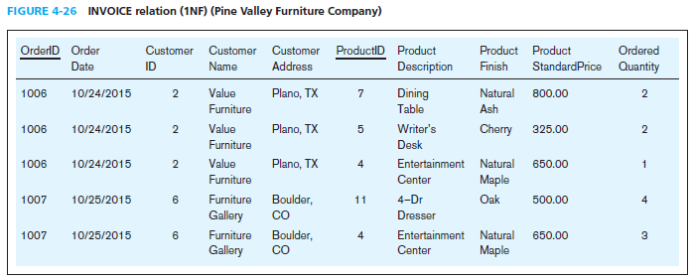
Table with no multivalued attributes and unique rows, in 1st normal form
Note: This is a relation, but not a well-structured one.
Notes:
Now we have a true relation. It is in first normal form. But note the data duplication. This will cause anomalies.

Slide 51
Anomalies in this Table
Insertion–if new product is ordered for order 1007 of existing customer, customer data must be re-entered, causing duplication
Deletion–if we delete the Dining Table from Order 1006, we lose information concerning this item’s finish and price
Update–changing the price of product ID 4 requires update in multiple records
Why do these anomalies exist?
Because there are multiple themes (entity types) in one relation. This results in duplication and an unnecessary dependency between the entities.

Slide 52
Second Normal Form
1NF PLUS every non-key attribute is fully functionally dependent on the ENTIRE primary key
Every non-key attribute must be defined by the entire key, not by only part of the key
No partial functional dependencies

Slide 53

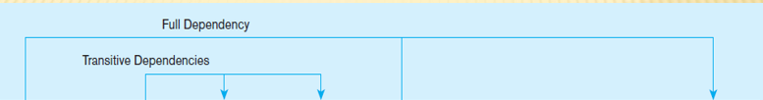
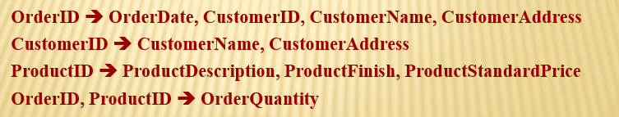
Figure 4-27 Functional dependency diagram for INVOICE
Therefore, NOT in 2nd Normal Form
Notes:
So, in this one relation, there are both partial and transitive dependencies. Because of partial dependencies, the relation is not in 2nd normal form. So, our first step is to remove the partial dependencies by splitting the table into three, one for orders, one for products, and one for order line.

Slide 54
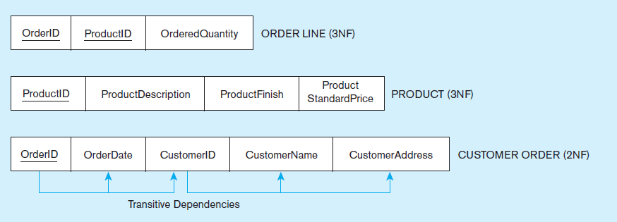
Figure 4-28 Removing partial dependencies
Getting it into Second Normal Form
Partial dependencies are removed, but there are still transitive dependencies
Notes:
So, now we have three separate relations. There is no partial dependency. But we still have a transitive dependency. We will fix this next by splitting customers from orders.

Slide 55
Third Normal Form
2NF PLUS no transitive dependencies (functional dependencies on non-primary-key attributes)
Note: This is called transitive, because the primary key is a determinant for another attribute, which in turn is a determinant for a third
Solution: Non-key determinant with transitive dependencies go into a new table; non-key determinant becomes primary key in the new table and stays as foreign key in the old table

Slide 56
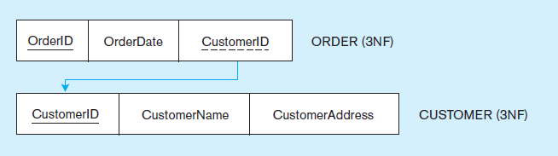
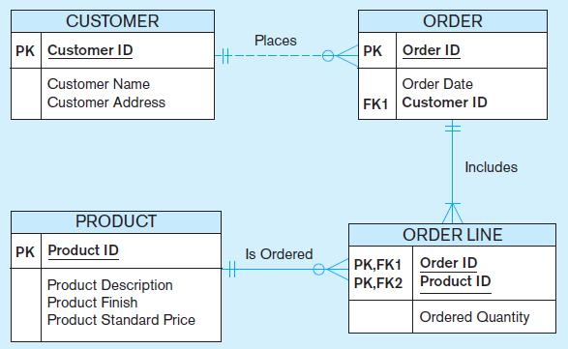
Figure 4-29 Removing partial dependencies
Getting it into Third Normal Form
Transitive dependencies are removed.
Figure 4-30 shows the result of normalization, yielding four separate relations where initially there was only one.
Notes:
Finally we are at third normal form. At this point we have a well-structured database.
Note that if we had started with a thorough ER model, we would not have wound up with one big table containing multiple themes. The original table basically had three separate entities all wrapped into a single relation (customer, product, and order). Furthermore, it hid the fact of a many-to-many relationship between orders and products.
This illustrates the danger of going straight to the logical database design without first performing the conceptual model analysis. But this sort of thing happens all to often.

Slide 57
Merging Relations
View Integration–Combining entities from multiple ER models into common relations
Issues to watch out for when merging entities from different ER models:
Synonyms–two or more attributes with different names but same meaning
Homonyms–attributes with same name but different meanings
Transitive dependencies–even if relations are in 3NF prior to merging, they may not be after merging
Supertype/subtype relationships–may be hidden prior to merging
Notes:
In large projects several subteams may work on logical design. May need to merge relations. Most medium-to-large organizations have many reasonably independent systems development activities that at some point may need to come together to create a shared database. The result is that some of the relations generated from these various processes may be redundant. This is where view integration comes in handy. But you need to be cautious about the problems that stem from these redundancies.

Slide 58
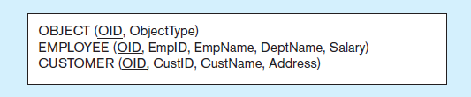
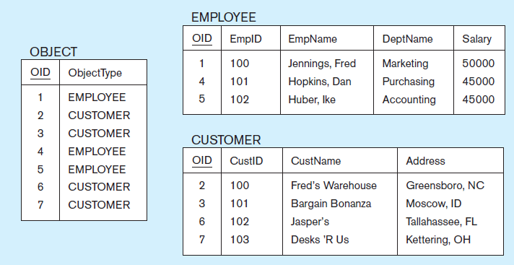
Figure 4-31 Enterprise keys
a) Relations with enterprise key
b) Sample data with enterprise key
Notes:
Experts suggest that keys be unique across the whole database Enterprise keys are primary keys that are unique in the whole database, not just within a single relation. This corresponds with the concept of an object ID in object-oriented systems
Mayber employees can also be customers

Slide 59


