Slide 1
Busybee
Project Design
Mason Krause, Mason Luna, Jacqueline Justice, Jason Moss

Slide 2
Project Design
User interface (UI):
Storyboard
Page layouts
Design Description
System Diagrams
User Interface, System Diagrams

Slide 3
User Interface
Our goal for the User Interface (UI) is to make the service bright, fun, and engaging.
Typically people associate job applications with boring resumes, cover letters, and hassle.
Our UI/UX aims to bring a positive association to the job application process.
User Experience (UX), Page Layouts, Design Elements

Slide 4
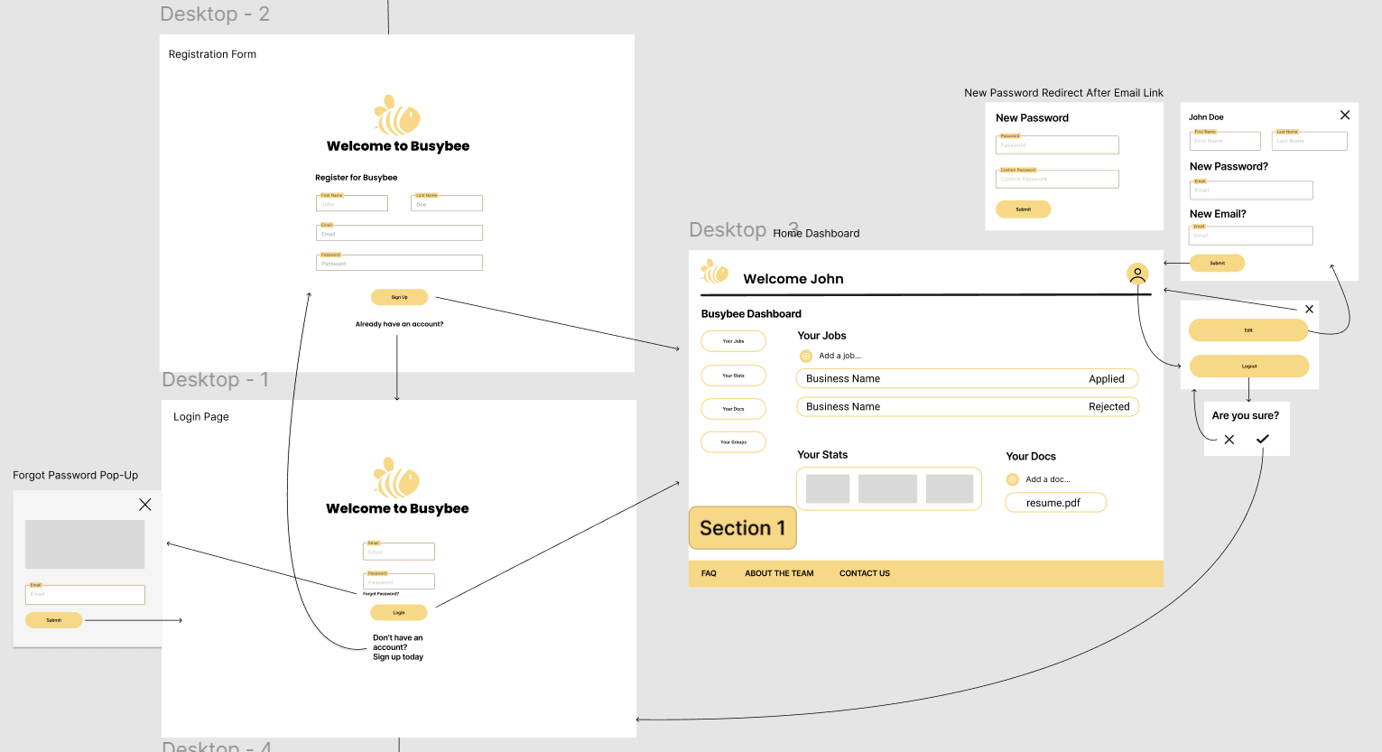

Slide 5
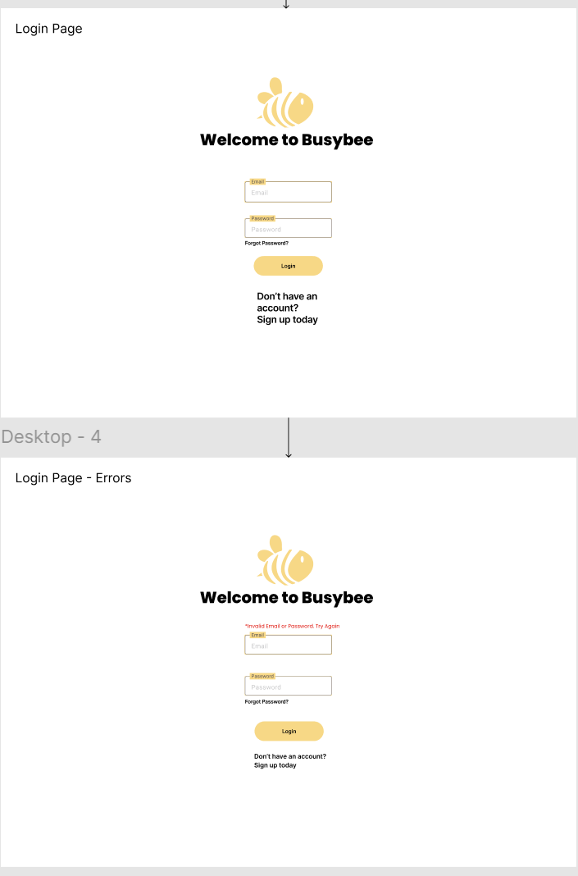
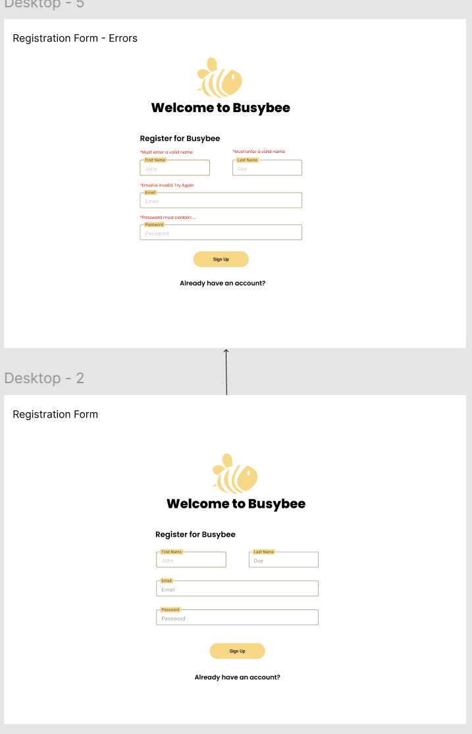

Slide 6
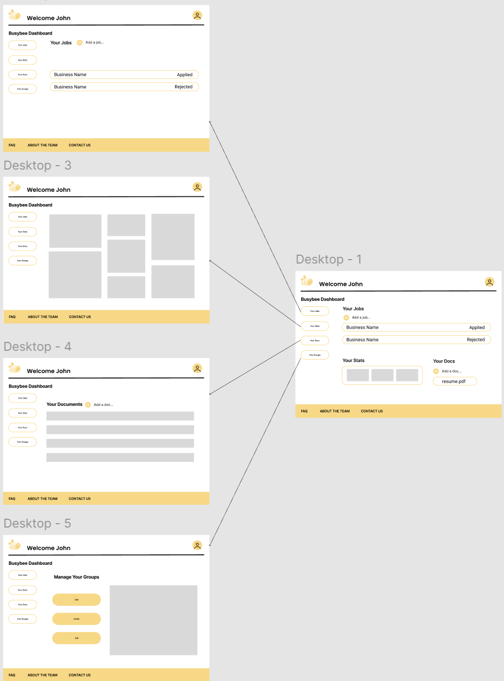

Slide 7
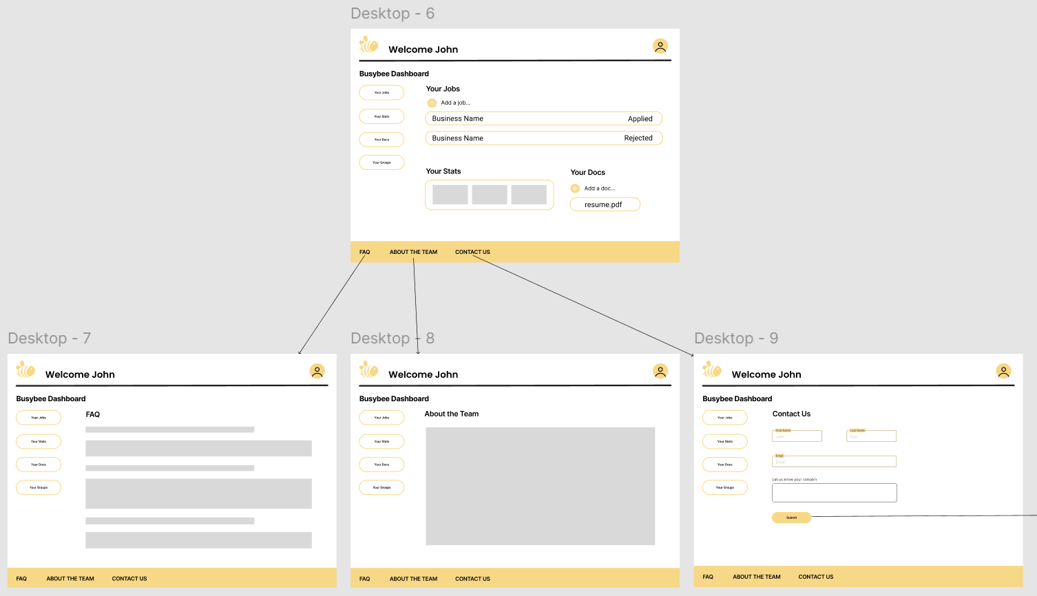

Slide 8
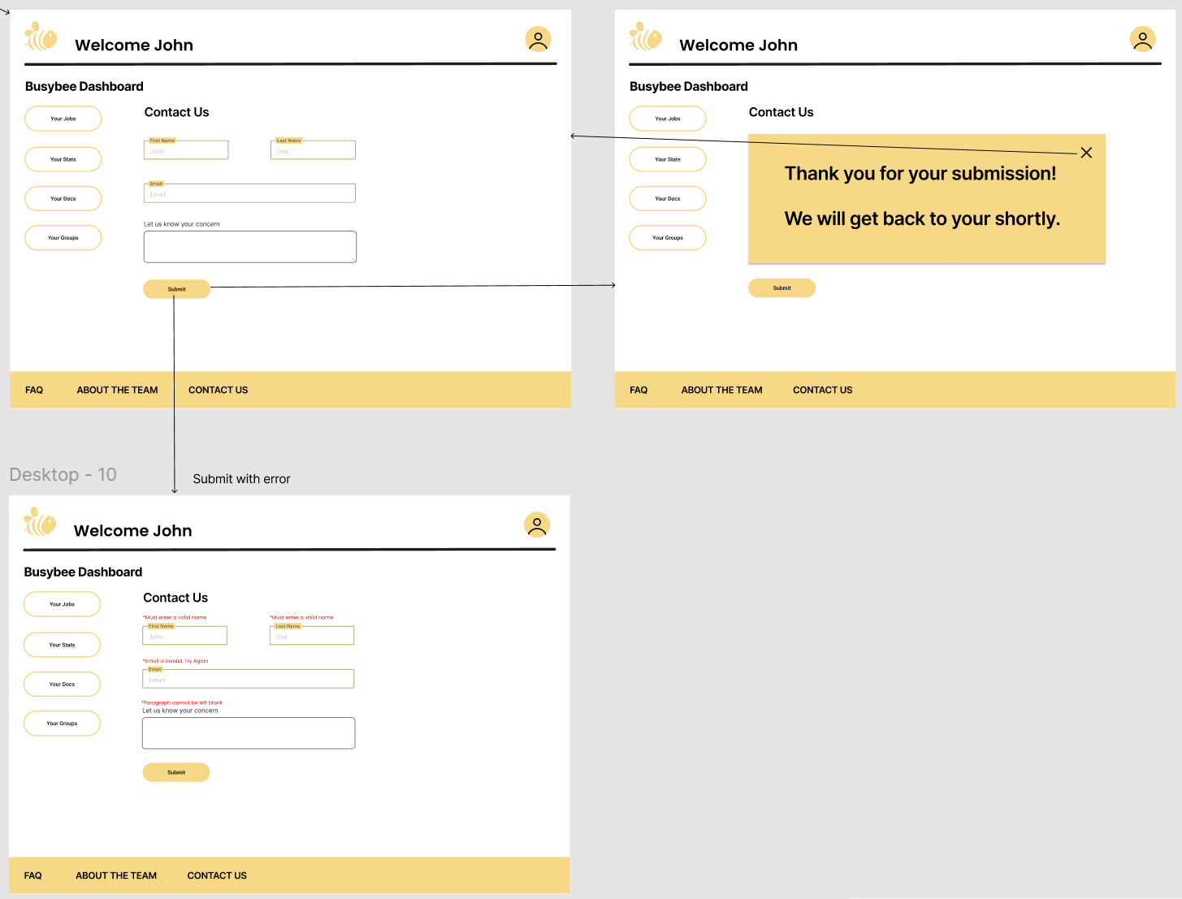

Slide 9
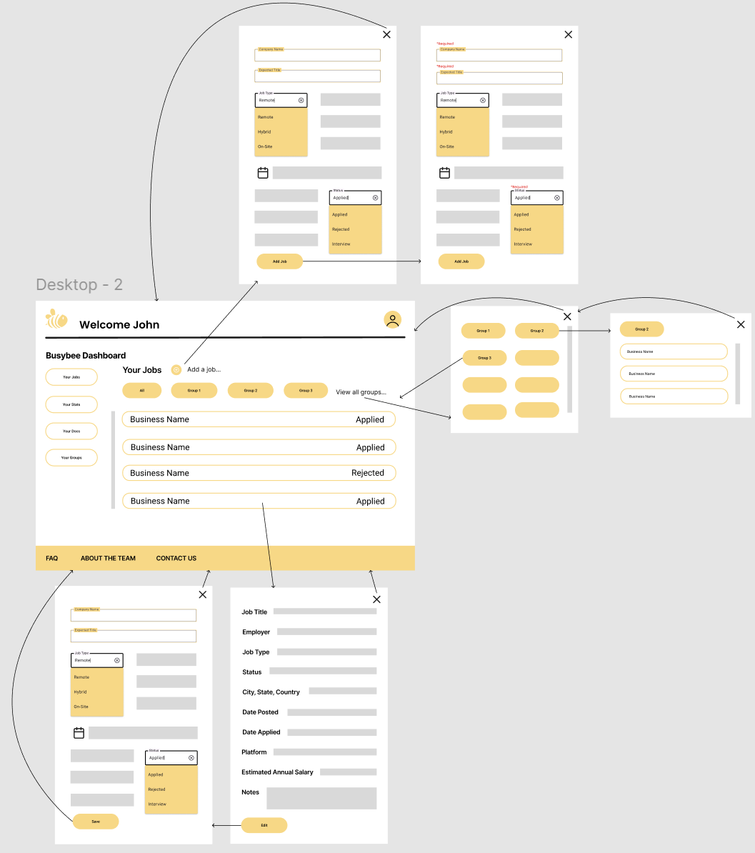

Slide 10
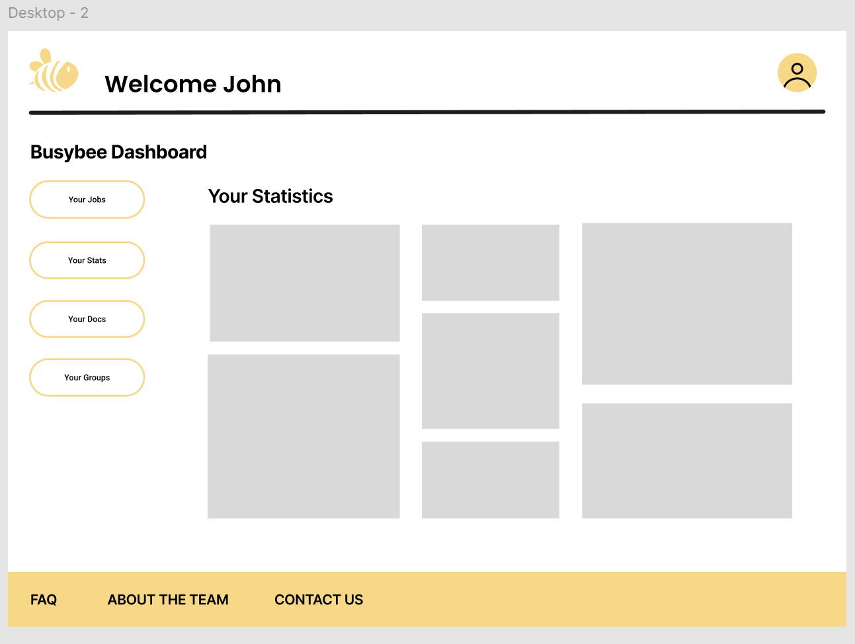

Slide 11
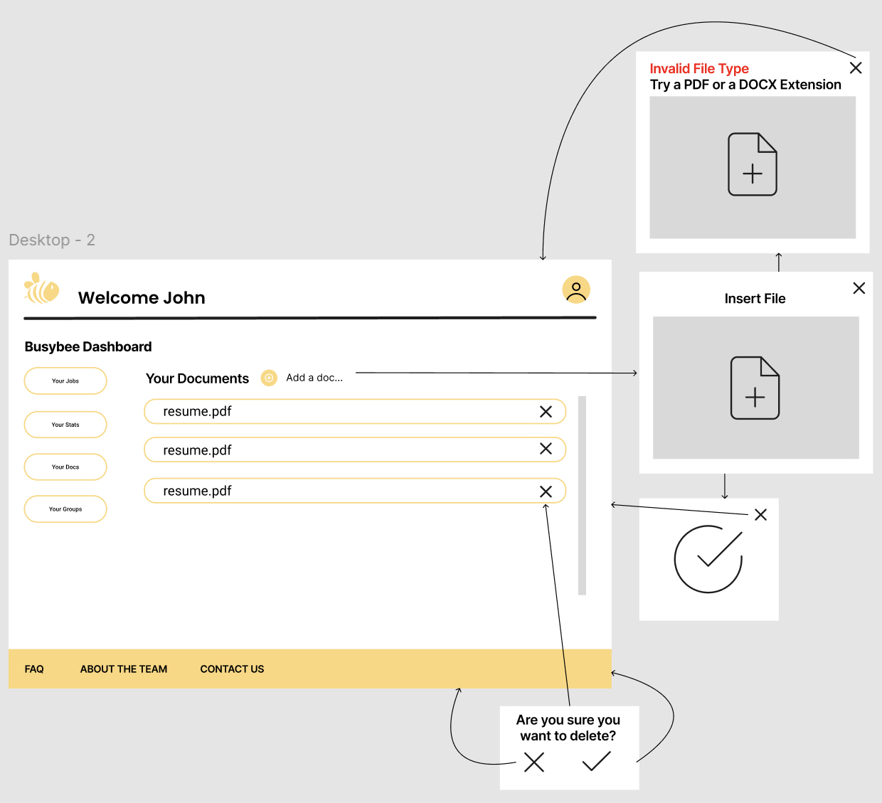

Slide 12
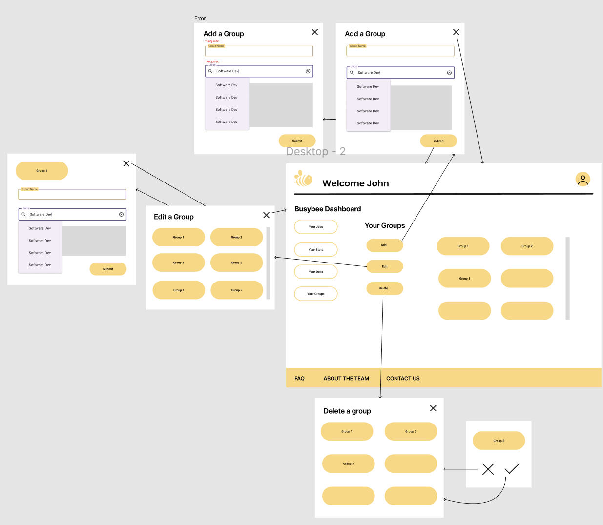

Slide 13
Diagrams
The block diagram provides an overview of the system architecture, including cloud hosting service providers and the elements of the system which they host, along with the main components of the application code.
The component diagram provides detail on the specific components of the application code and their implementation details.
The entity relationship diagram shows the entities involved, the data points we will store, and the relationships between entities.
The data flow diagram series shows how data flows from external entities through the various processes and data stores of the system, and back.
Block, Component, Entity Relationship, Data Flow

Slide 14
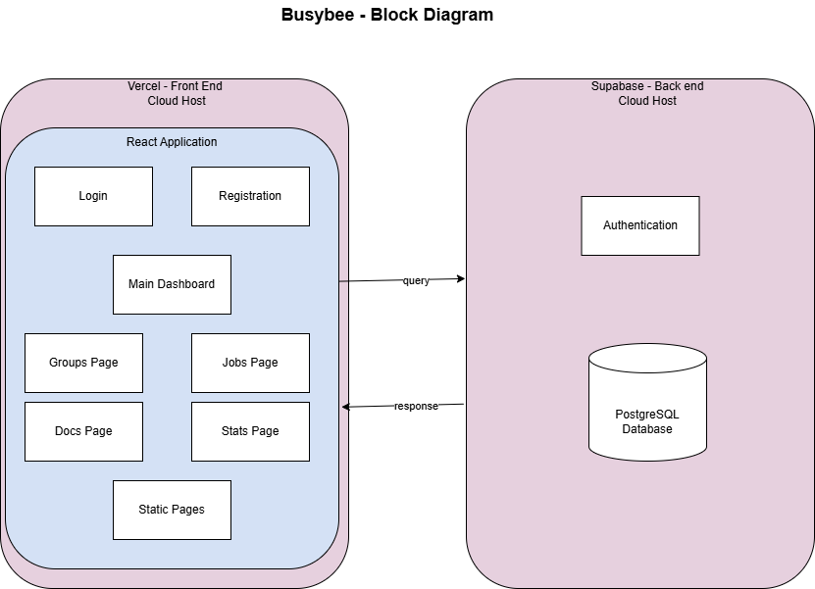
Block Diagram

Slide 15
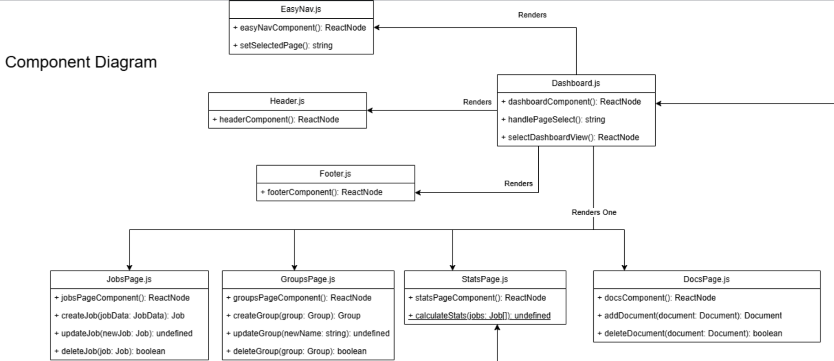
Component Diagram – Dashboard

Slide 16
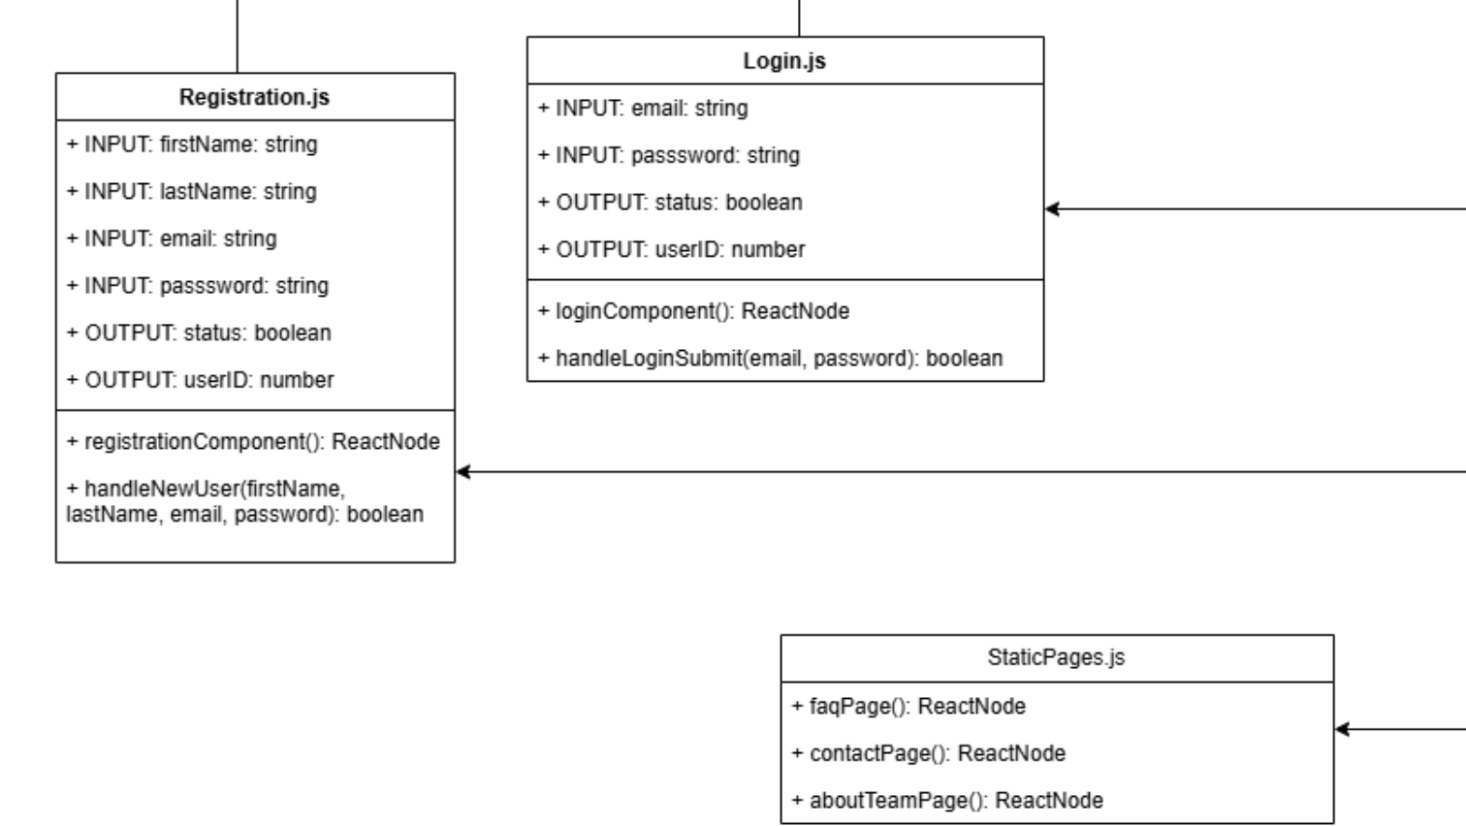
Component Diagram – Login/Registration

Slide 17
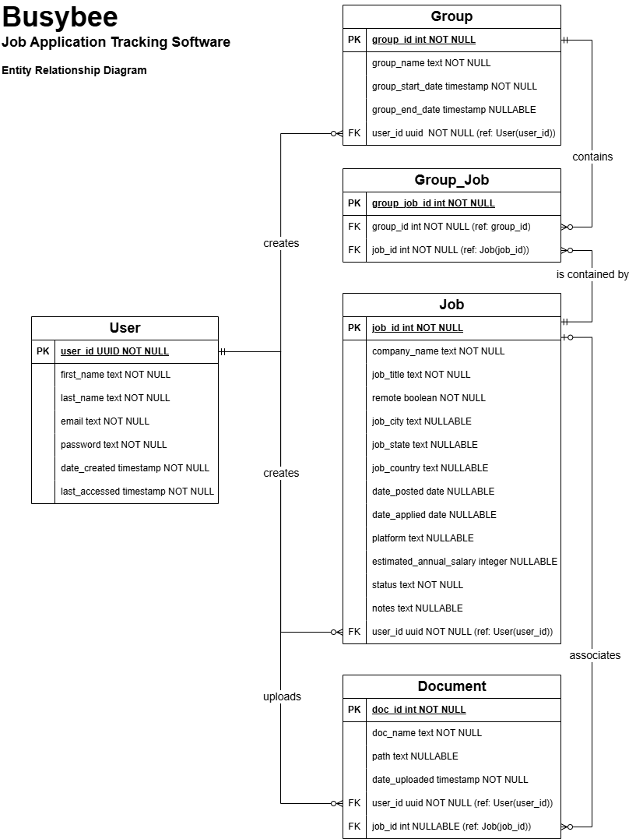
Entity Relationship Diagram
The Entity Relationship Diagram (ERD) shows the fields associated with each entity stored in the database.
A user can create 0 or more Jobs, Groups, and Documents.
Since many jobs can be associated with a group, and a job can be associated with many groups, Group_Job is a necessary associative entity.
A document may or may not be associated with a job.

Slide 18
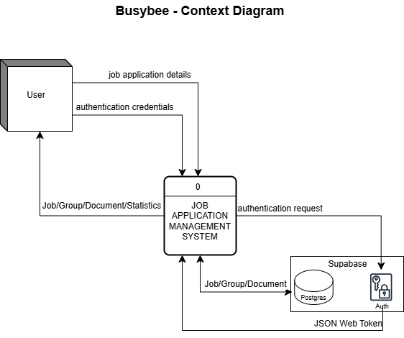

Slide 19
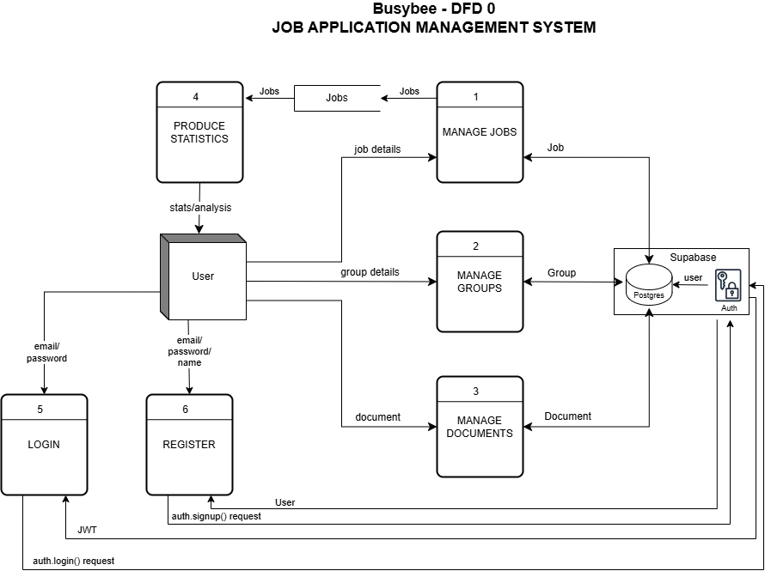

Slide 20
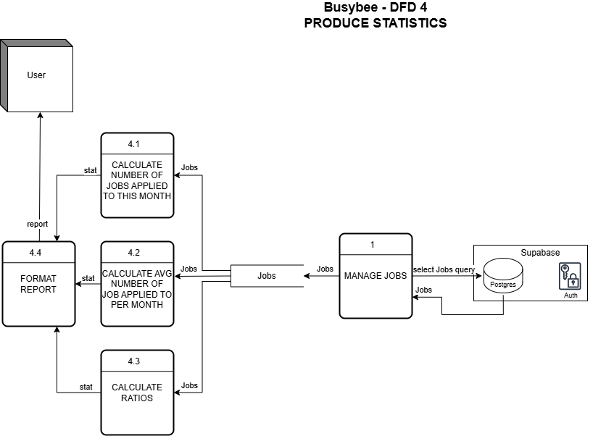

Slide 21
Thank you!

