Slide 1
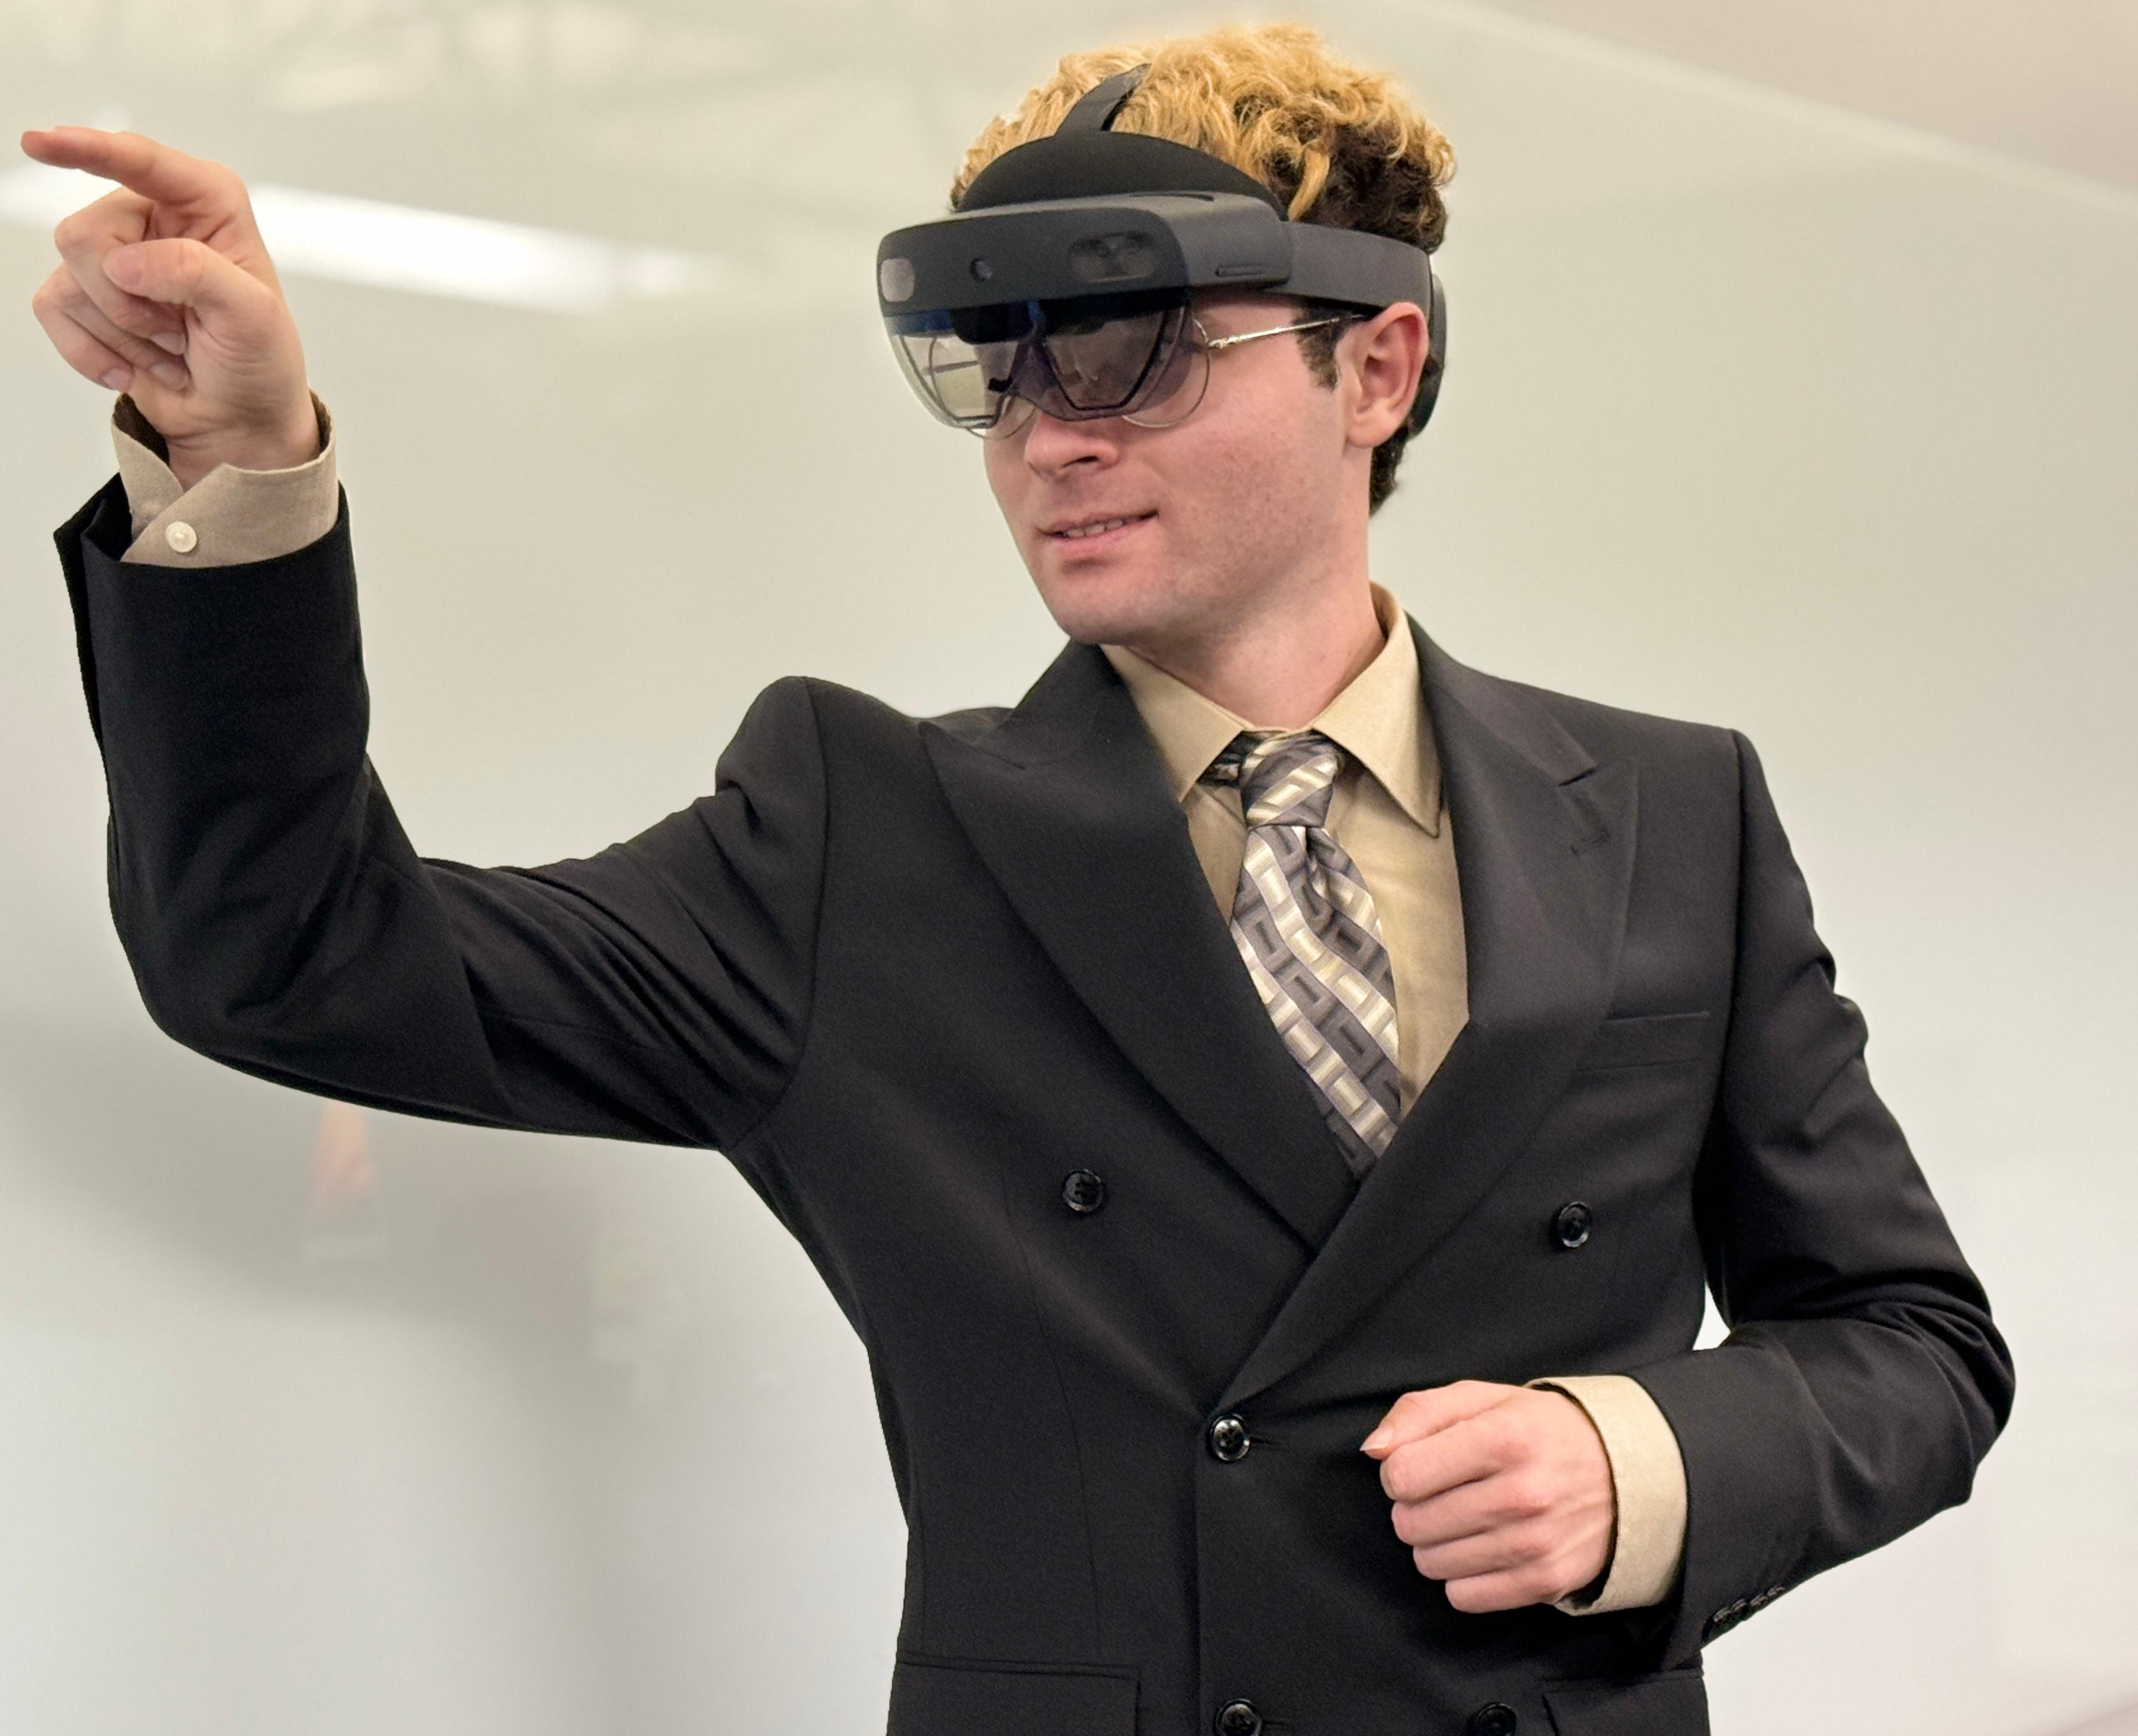
MIXED REALITY CONFIGURATOR USING HOLOLENS
Instructor
DR.SAID BETTAYEB
Mentor DR. ROSS NISWANGER

Slide 2




TEAM
Mason Lanham
Alekhya Kotha
Naga Vennela Kandru
Haricharan Mukthineni
Computer Science
Computer Information Systems
Computer Science
Computer Information Systems

Slide 3
AGENDA
Aim of the Project
Project Requirements
Introduction
Product Comparison
Motivation
3D Models
User Stories
System Design
Implementation
Timeline
Results
Future Scope
Conclusion
References
Demo

Slide 4


AIM OF THE PROJECT
Develop a Mixed Reality Configurator using existing 3D models from 2D and 3D configurators.
Enable users to experience mixed reality by allowing them to customize objects interactively.
Data Recorded
Configuration details or modifications during the session.
Session start and end times.
User customization choices.

Slide 5
Hardware Requirements
PROJECT REQUIREMENTS
Operating System: Windows, MAC
System Memory(RAM): 16GB
Microsoft Hololens 2
CPU Architecture: ARM 64
Software Requirements
Unity Hub: 3.5.1
Unity Editor Version: 2022.3.7f1
Visual Studio: Community 2022
Platform: Universal Windows Platform

Slide 6
INTRODUCTION
UNITY
Unity Technologies, June 2005
C#, C++
Interactive 2D & 3D
Virtual reality (VR), and augmented reality (AR) applications.
Cross-platform game engine and development environment.
Versatility and ease of use across various industries.

Slide 7
HOLOLENS
Cutting-edge Mixed Reality (MR) headset.
Digital content with the physical world.
Interact with holograms overlaid on their real environment.
Including eye-tracking (with gaze and dwell), hand-tracking, and voice input.

Slide 8

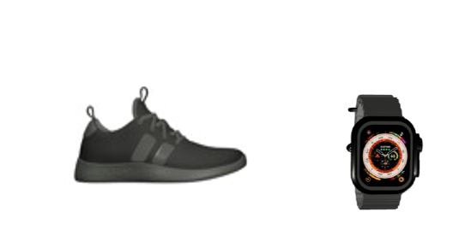
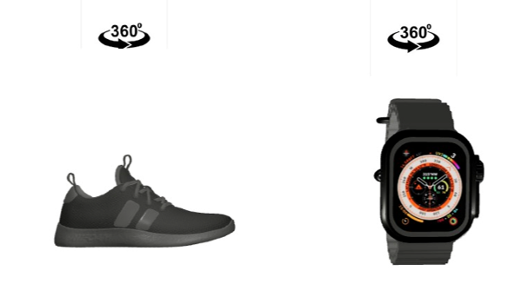
2D Interactive two-dimensional Interface: Options are displayed in a clear, grid-like or dropdown format. Quick Customization: make changes to the 2d model by selecting provided options.
PRODUCT COMPARISON
3D
Immersive 3D Visualization: Displays models in three dimensions, allowing users to experience a realistic and interactive view.
Full Control: Enables users to zoom in, zoom out and explore models from multiple angles.

Slide 9
MOTIVATION
Mixed Reality Configurator
Leveraging Advanced Technology
Mixed Reality utilizes cutting-edge technology to deliver an innovative solution for customization.
Enhancing User Experience
Existing configurators offer basic customization, inspiring us to create a more engaging and interactive experience.
Expanding Functionality
Mixed reality configurator enables real-world interaction, making customization more practical and intuitive than 2D and 3D versions.

Slide 10
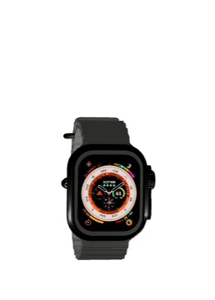
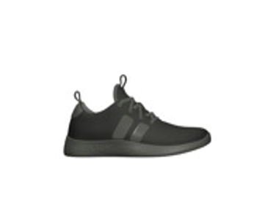
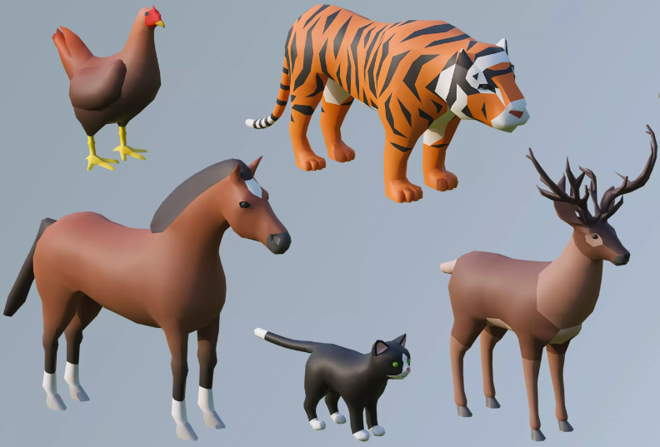
3D Models
Watch
Shoe
Animal Models

Slide 11
USER STORIES:
During the process of creating the user stories for the Mixed Reality Configurator software, we kept the INVEST criteria in mind. INVEST stands for independent, negotiable, valuable, estimable, small, and testable.
Key for features/epics:
SC: Select Configurator
BC: Begin Configuration
CC: Change Component
SA: Select Animal
T - Touch Interaction
ES: End Session
RD: Retrieve Data

Slide 12
USER STORIES
ID | STORY | ACCEPTANCE | PRIORITY
SC1 | As a surveyor, I want to select the desired configurator (shoe, watch, or animal) so that the respondent can configure the appropriate model. | The surveyor can select a configuration option. The software is in the start menu. The respondent begins configuration. | HIGH
BC1 | As a respondent, I want to start the configuration process to ensure my interactions are recorded accurately. | The start button is visible and functional. The configurator begins timing when selected. Models load and menus appear. | HIGH
CC1 | As a respondent, I want to change the color of individual components of the model to customize its appearance. | Respondents can select colors from a menu. Components update in real time. Changes are recorded as events. | HIGH

Slide 13
USER STORIES(CONT.…)
ID | STORY | ACCEPTANCE | PRIORITY
CC2 | As a respondent, I want to modify the texture of animal components to personalize the model further. | Respondents can select textures. Texture updates are highlighted and recorded as events. | MEDIUM
SA1 | As a respondent, I want to select a specific animal model to configure it according to my preferences. | Animal models are displayed. Selected models load and configurator menus update. | MEDIUM
ES1 | As a respondent, I want to end the configuration session when I am done. | The submit button displays a confirmation popup. The session ends when "yes" is selected. | HIGH

Slide 14
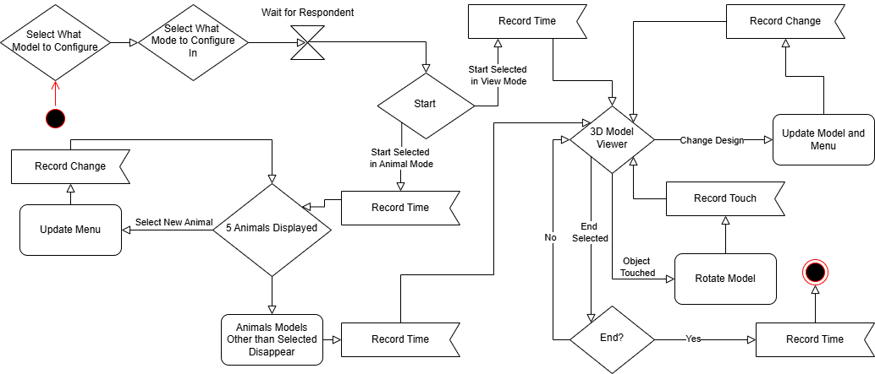
Fig: Activity Diagram
SYSTEM DESIGN
Submit Model Chosen

Slide 15

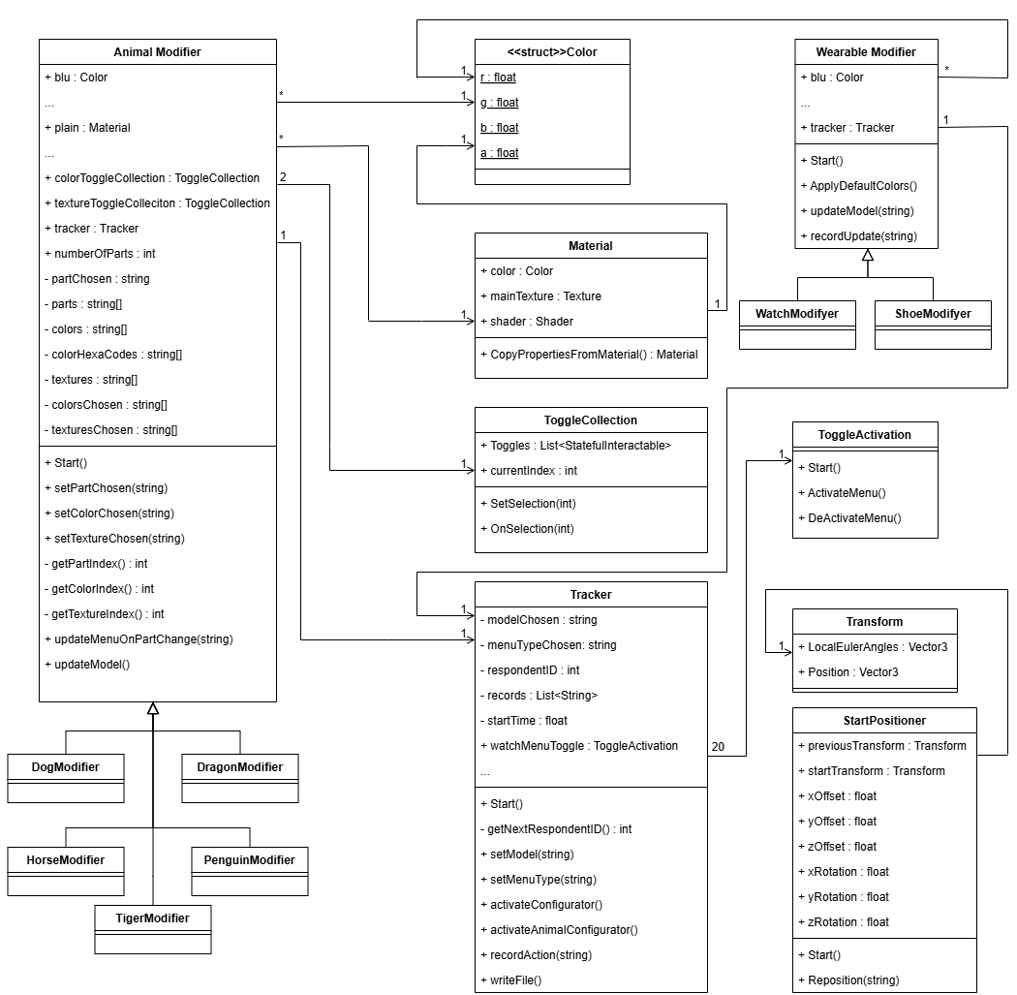

Fig: Class
Diagram

Slide 16
IMPLEMENTATION
Environment Setup
01
Real-Time Interaction
04
Event Tracking, Touch Interactions, Activation.
Tools: Unity, Hololens
3D Model Development
02
Data Tracking and Storage
05
Steps
Tools: Unity, Blender
Storage Method: CSV
Interface Design
Testing & Refinement
03
06
Interactive Customization Menus
Editor, Hololens Testing

Slide 17
Timeline 1st phase
1
Understanding the project
2
Project research and Requirement Analysis
3
SRS documentation
4
Initial setup and learning to use Hololens
5
Mixed reality 3d game development research
6
7
Mid presentation
Aug 23rd, 2024
Sept 06th, 2024
Sept 24th, 2024
Oct 07th, 2024
Aug 30th, 2024
Sept 13th, 2024
Oct 04th, 2024
UI Design of watch model

Slide 18
Timeline 2nd phase
Menu Integration (Shoe & Plush toy)
UI design of plush toy model
Testing the UI, models & survey
Final Presentation & submission
Oct 11th, 2024
Oct 25th, 2024
Nov 08th, 2024
Nov 25th, 2024
1
2
3
4
5
6
7
Oct 18th, 2024
Nov 01st, 2024
Nov 15th, 2024
UI design of shoe model
Track & store actions in .csv file
Final Testing

Slide 19
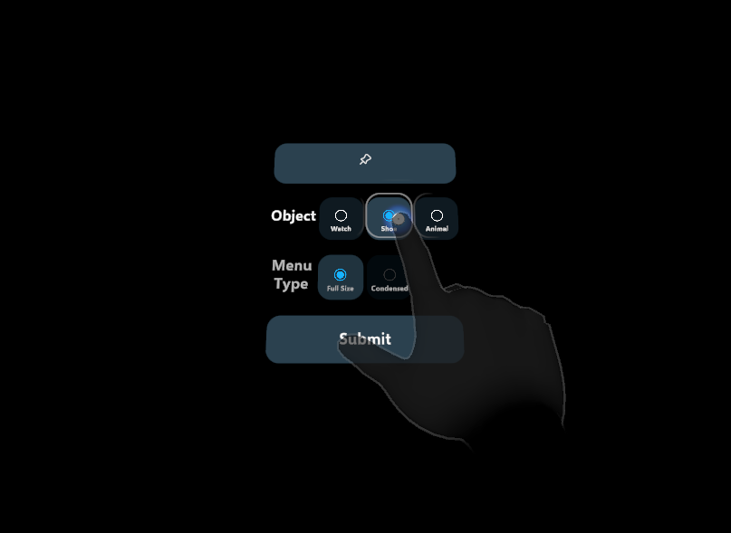
RESULTS
Fig: Main
Screen of Configurator

Slide 20
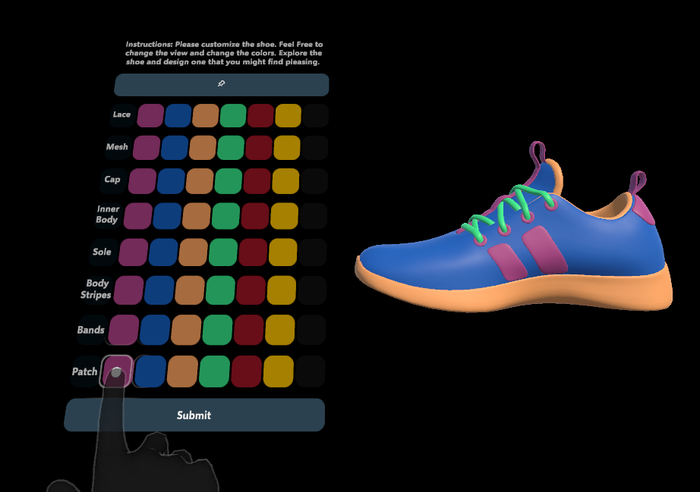
Fig: Shoe Configurator

Slide 21
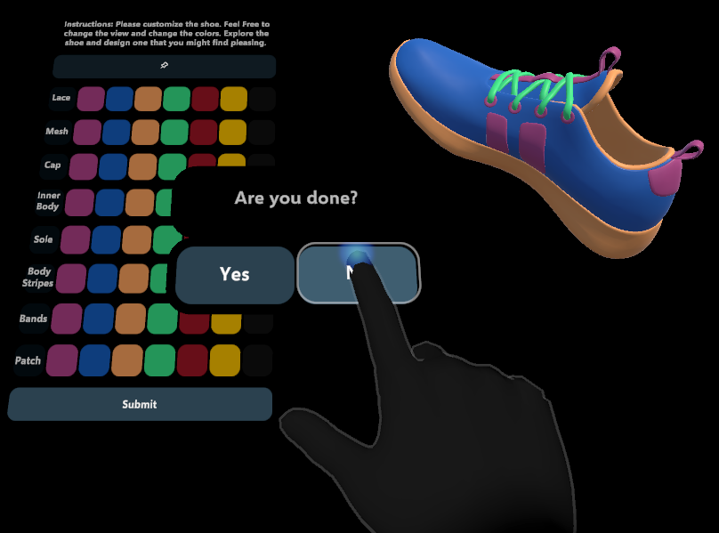
Fig: Shoe Configurator

Slide 22
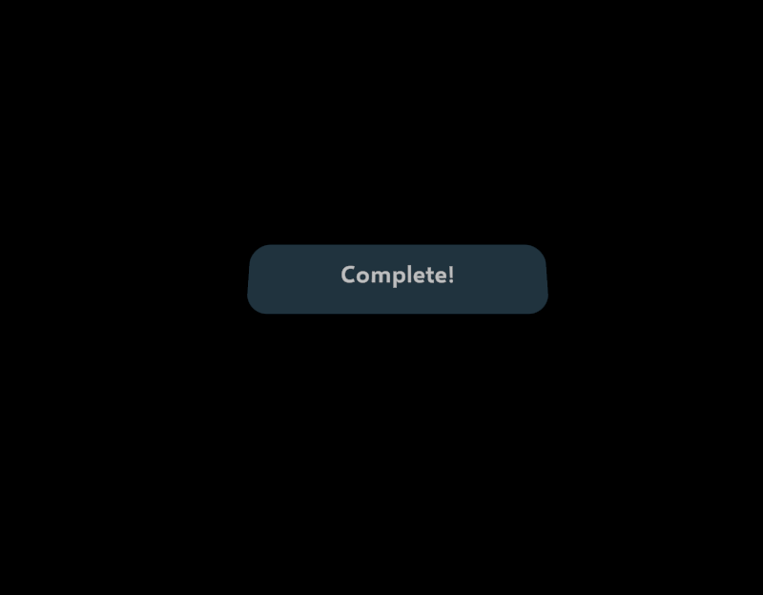
Fig: Final
Screen

Slide 23
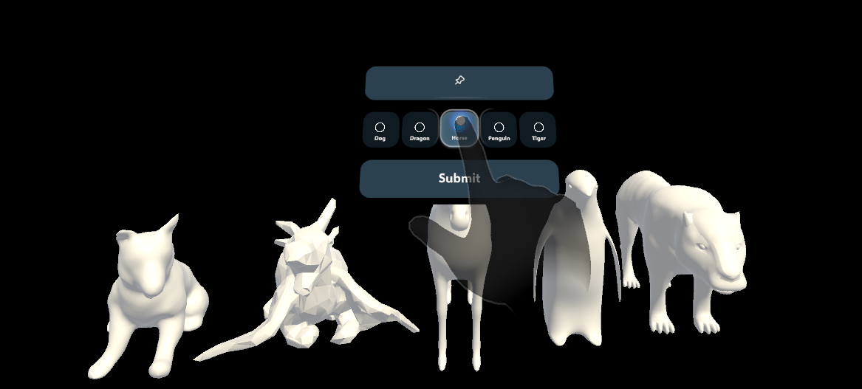
Fig: Animal
Select Menu

Slide 24
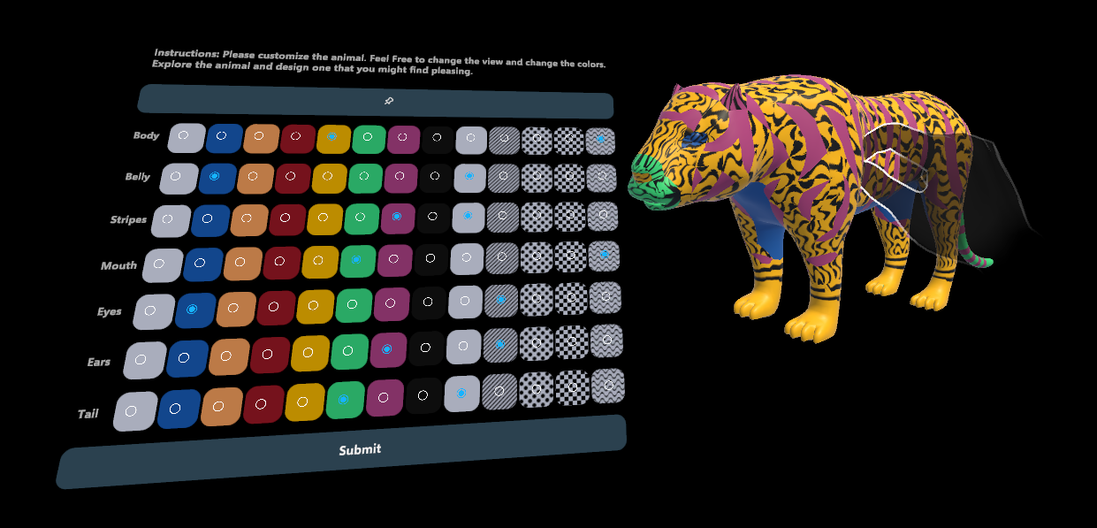
Fig: Tiger
Full Menu

Slide 25
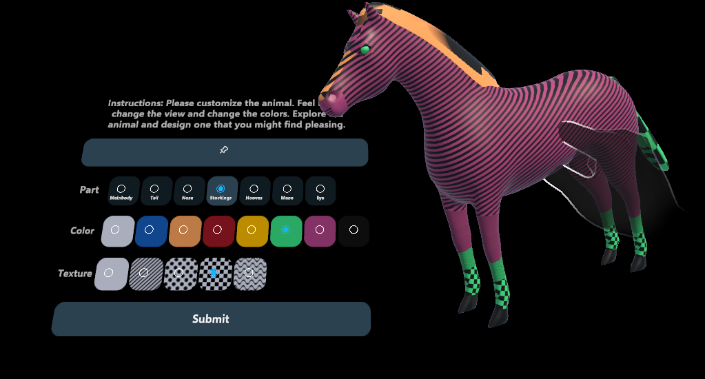
Fig: Horse Configurator

Slide 26
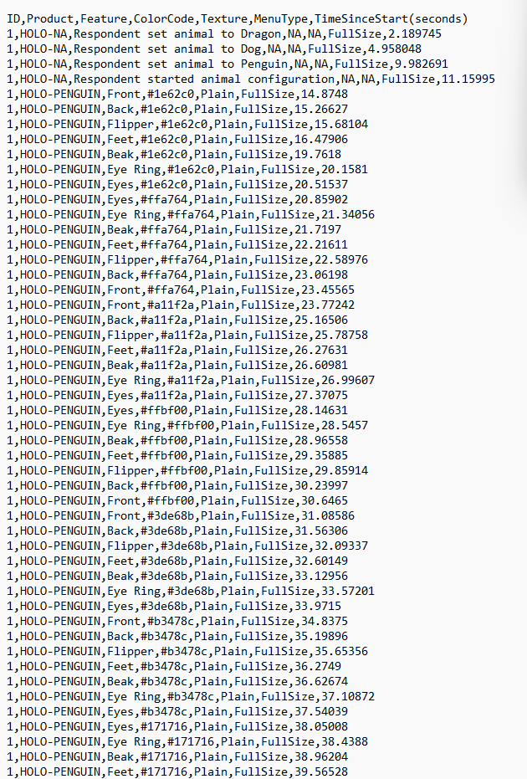
Fig: CSV File

Slide 27

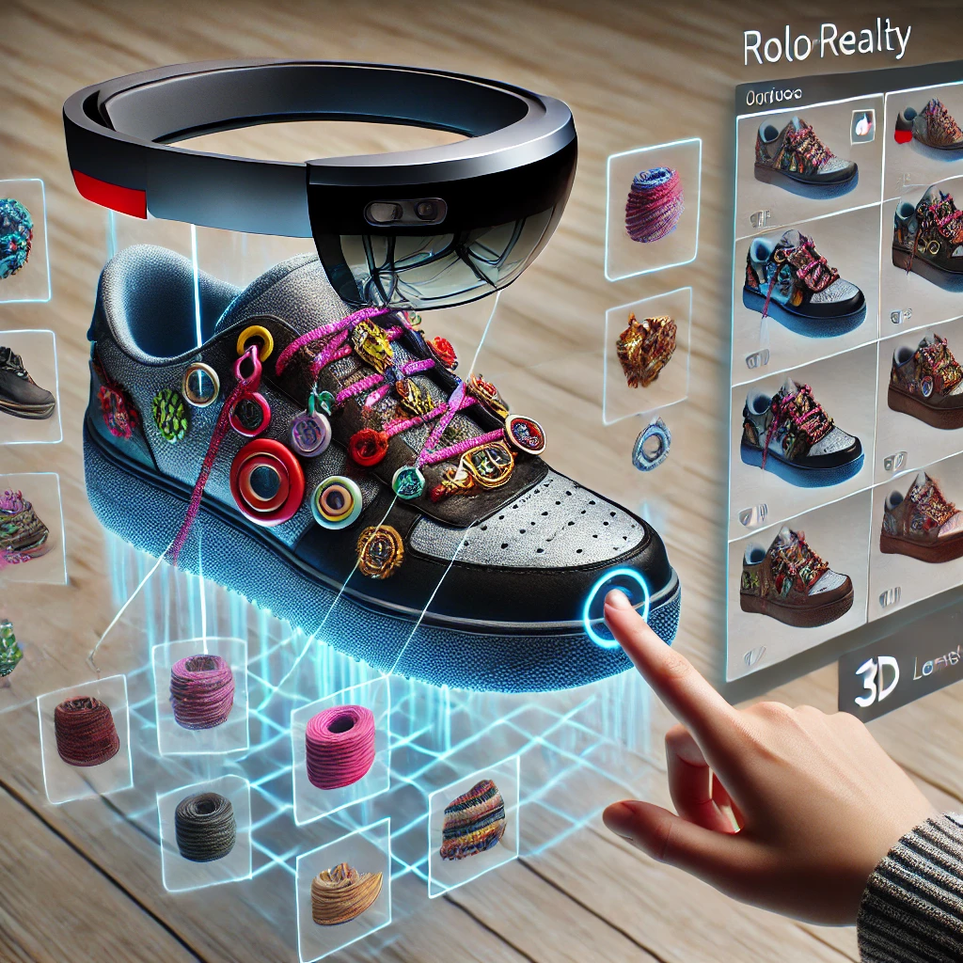
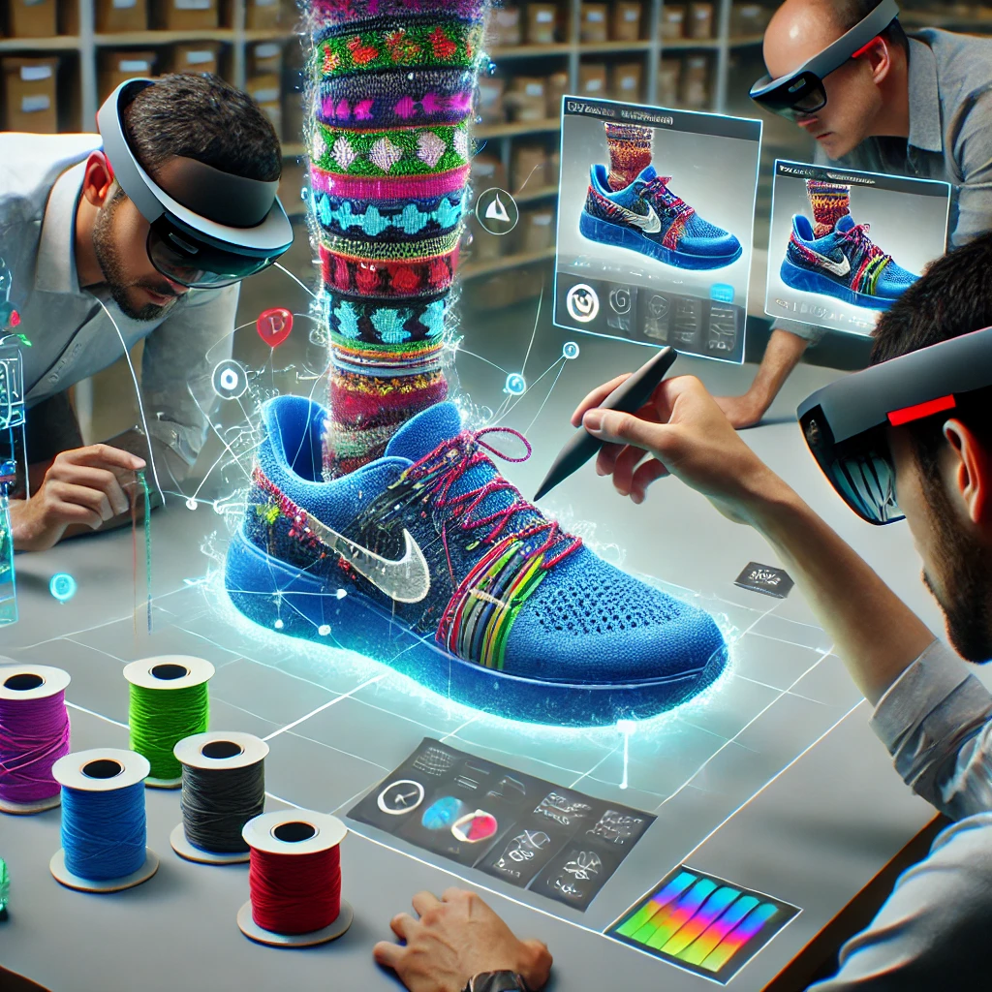
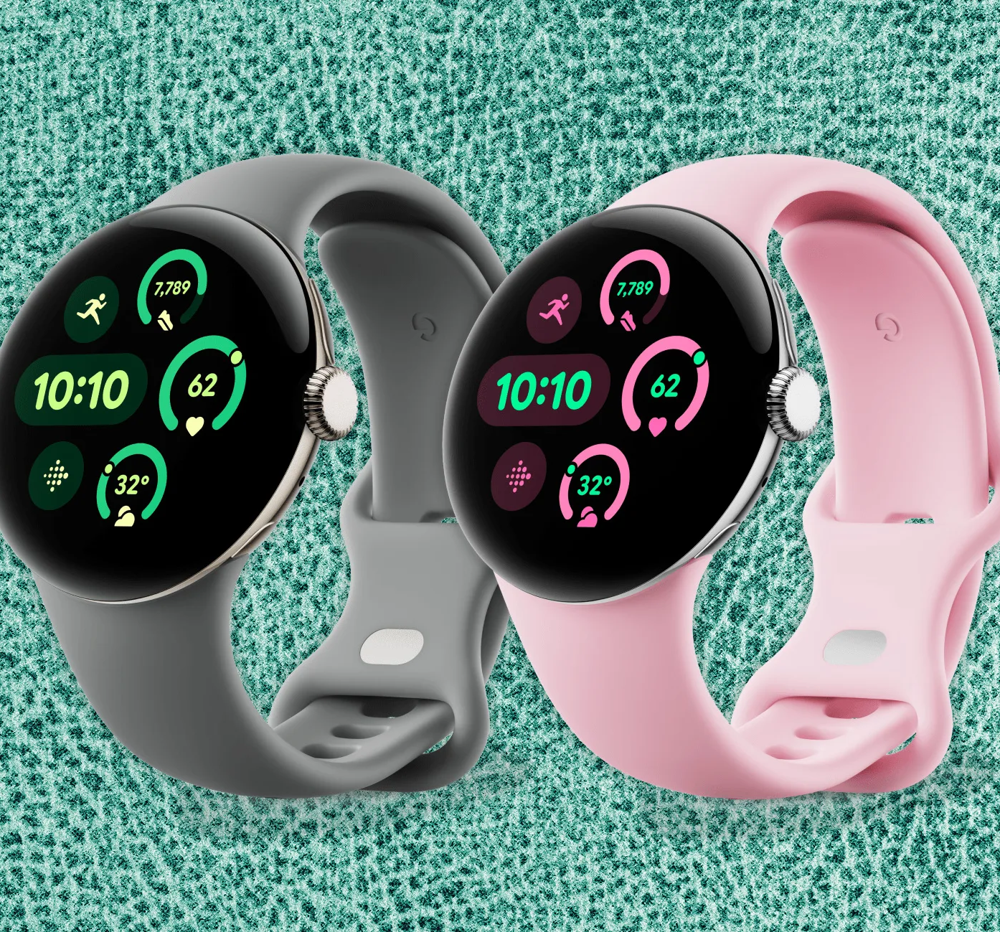
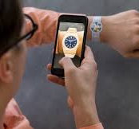
FUTURE SCOPE
Virtual Try-Ons
Advanced Customization Features
AI-Driven Recommendations
Improve Sensitivity and Performance of Menus

Slide 28
CONCLUSION
The configurator enables users to seamlessly interact with objects through features like manipulating and exploring customization options, enhancing usability and engagement.
By offering a dynamic and immersive way to customize products, the project redefines user interaction, making personalization intuitive and accessible.
The inclusion of data tracking capabilities ensures that every interaction is logged, enabling meaningful analysis and insights for surveyors.

Slide 29

DEMO

Slide 30
REFERENCES
[1] Hamalawi, Mohammed, et al. “Using the Windows Device Portal - Mixed Reality.” Mixed Reality | Microsoft Learn, Microsoft, 13 Apr. 2022, learn.microsoft.com/en-us/windows/mixed-reality/develop/advanced-concepts/using-the-windows-device-portal. Accessed 14 Nov. 2024
[2] “Hololens 2 Fundamentals: Develop Mixed Reality Applications - Training.” Training | Microsoft Learn, Microsoft, learn.microsoft.com/en-us/training/paths/beginner-hololens-2-tutorials/. Accessed 14 Nov. 2024.

Slide 31
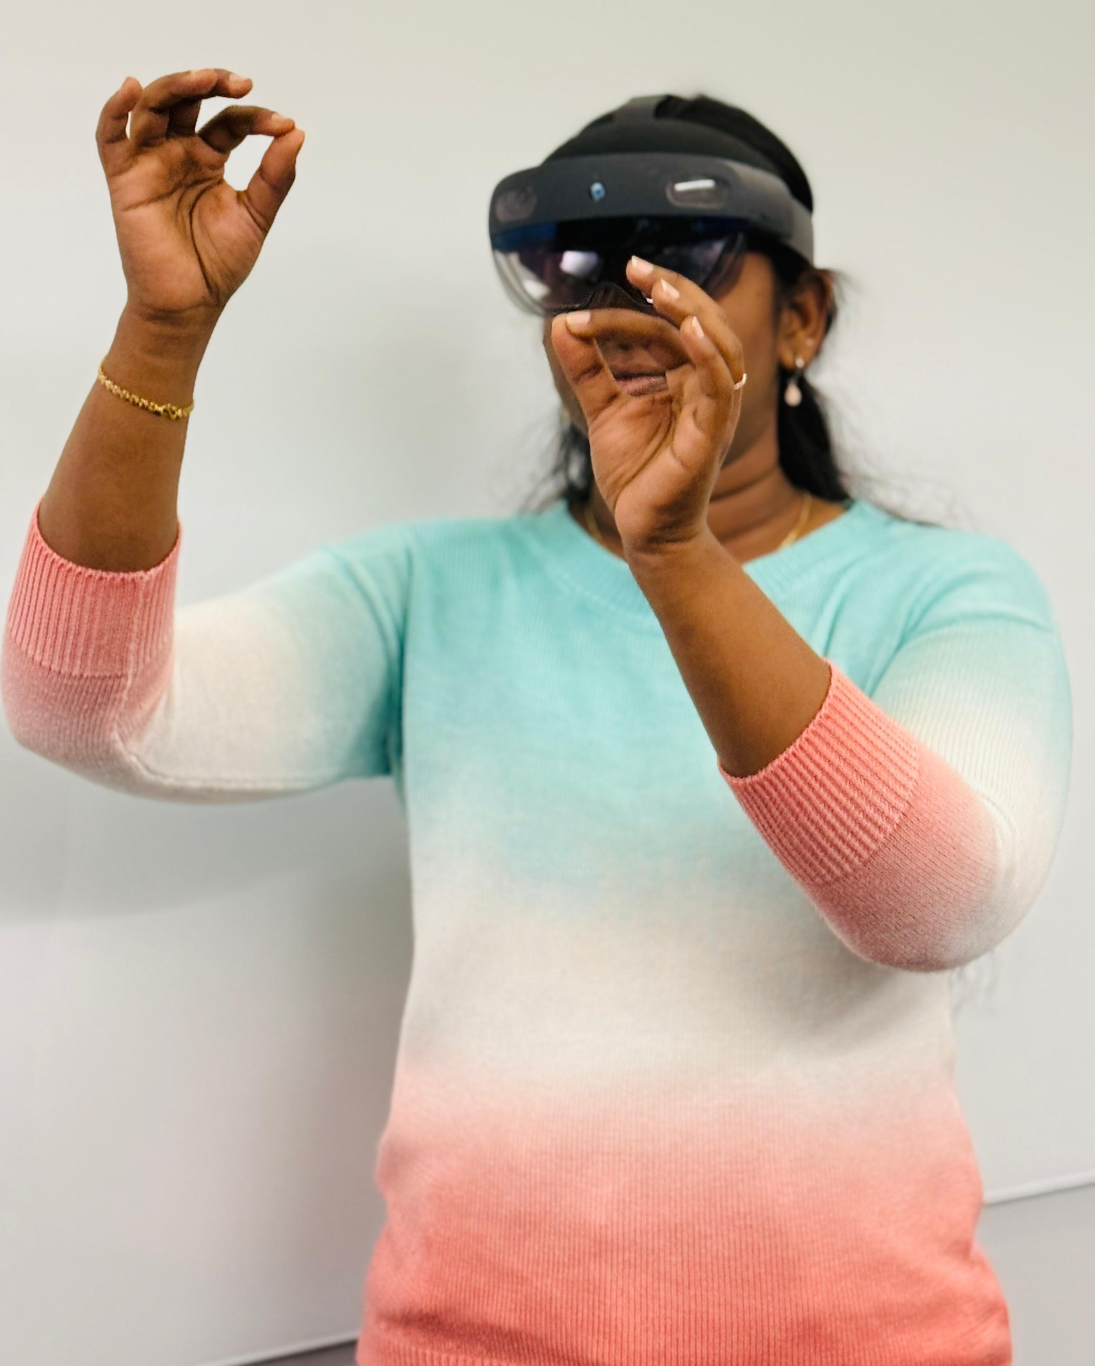
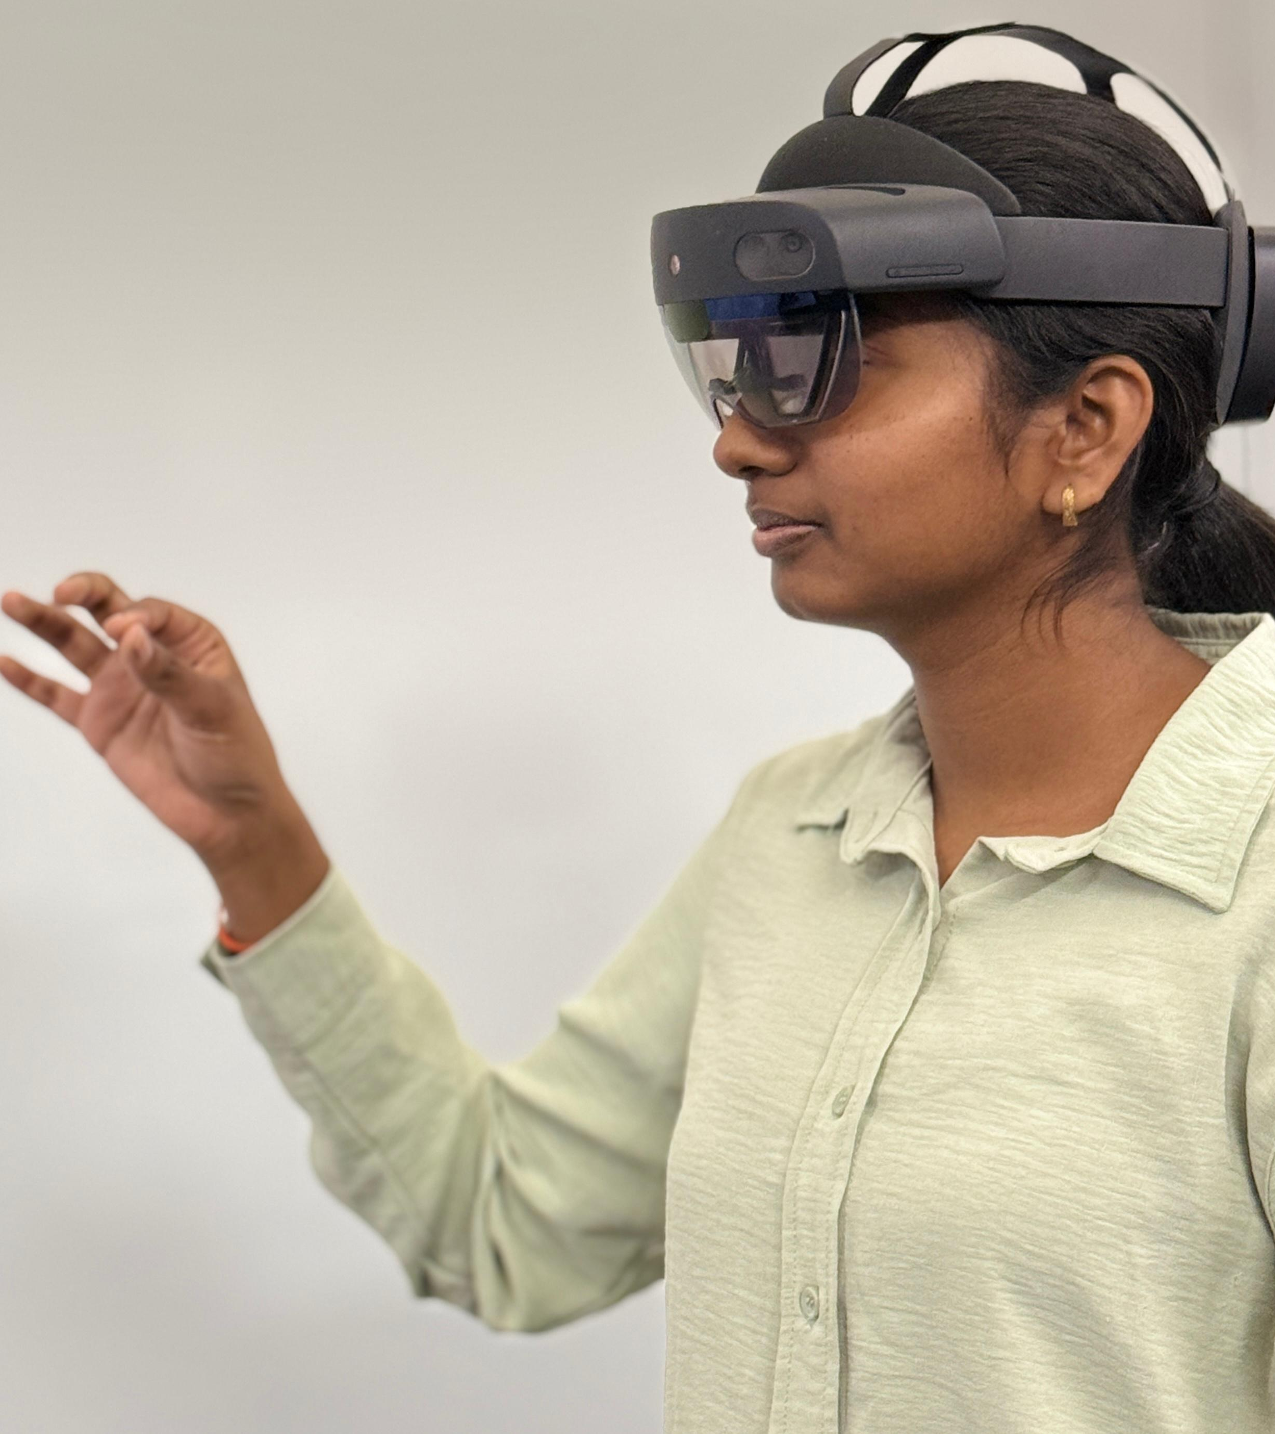
Thank you

