Slide 1

Project 1
Data Science & Visualization
Chicago Mag Mile Crime 2010:2020

Slide 2
Agenda and Team Members
Intro/Approach - Carl Coffman
Code/Charts - Tom Henry
Code/Charts - Gisela Gutierrez
Results/Analysis - Mason McCoy

Slide 3
What we learned
Sessions 1-6 (<project1, :Project1)
Project Team Challenges
Excel charting, PivotTables, and VBA (import)
Column and Bar category chart
Line chart over time
Record Total, Max, Min, Mean, % of Total
Sort Highest to Lowest, and %Change from previous
Work with variable types, float (rounding), integer, lists, string (concatenation, len, search, left/right)
Average/Mean, average change, change from previous
Print formatted report to terminal/file
Store/retrieve/iterate list, DataFrame, dict, tuple, csv
Random generator
Advanced charts: Boxplot, Scatter, annotate, set x/y limits/labels
Linear regression model (Y=a + bX)
Get: API, Key, json, csv – sources
Mapping Lat/Long, find nearest leveraging APIs
Pythonistas/Pythoneer? not yet! still learning....
For obvious reasons, 2020 was incomplete and too different from previous years – made decision to drop to meet deadline (switching to Qtr midstream too much).
Not enough time, had to stop pursing other ideas to meet deadline.
Understand source data dimensions (such as IUCR codes, 350 of them!)
Combining code
Aliases/non-aliases (pd/pandas)
Inconsistent “ or ‘ – but we know both work ☺
Difficult to look at other people’s code when trouble-shooting issues.
Working with smaller datasets during development, causing time-killer trouble-shooting.
Avoiding Excel - analyzing and charting is easy in Excel…what we’re familiar with ☺ (Carl’s comment)

Slide 4
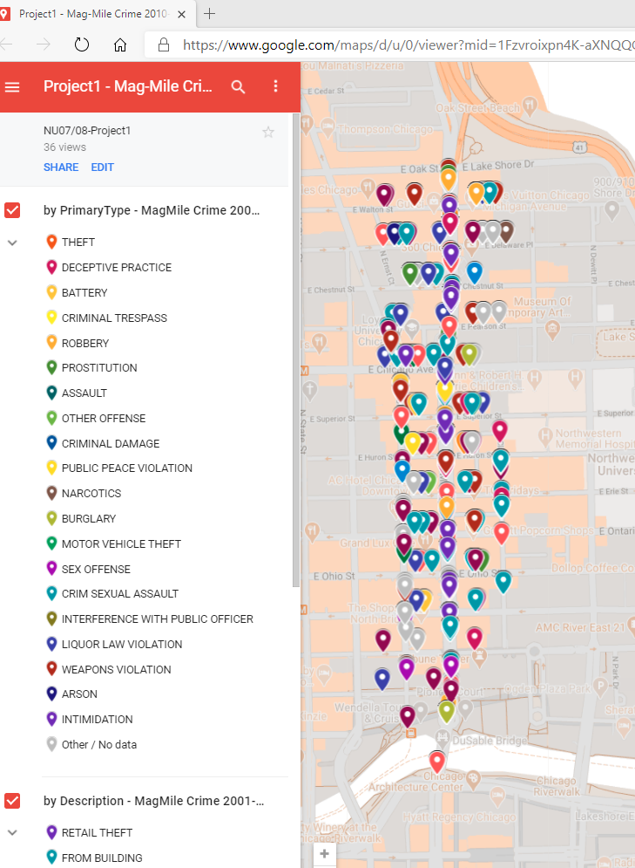
Topic & Approach
Chicago Mag Mile Crime
Crime within Chicago’s Magnificent Mile (Mag Mile)
Report on volume of overall crime and categories of crime
Are the number of crimes increasing or decreasing?
What type of crimes are increasing?
Defined Latitude and Longitude area for Mag Mile
Find API to source with 10 or more years of crime records and specific location data to identify geo location (latitude/longitude)
Use the tools and the knowledge gained to pull data via API, process it, store it, and analyze/report on it
GitHub: https://github.com/MasonMcCoy/Chicago_Crime
https://www.google.com/maps/d/u/0/edit?mid=1Fzvroixpn4K-aXNQQGaWB7dLD1c649Z3&ll=41.894382436893366%2C-87.61286242201719&z=16

Slide 5
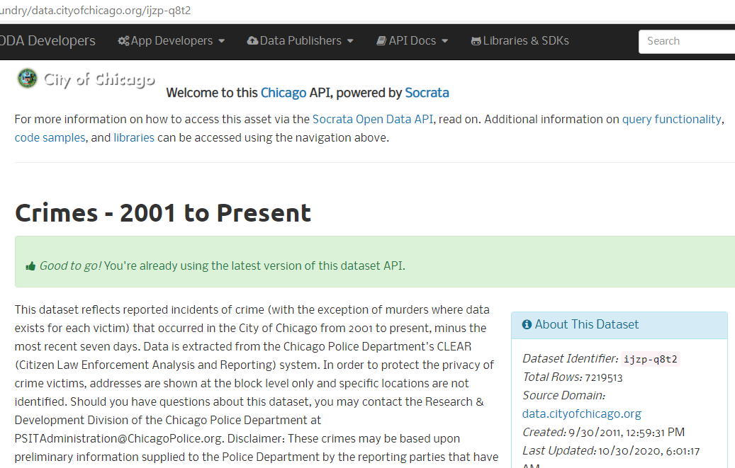
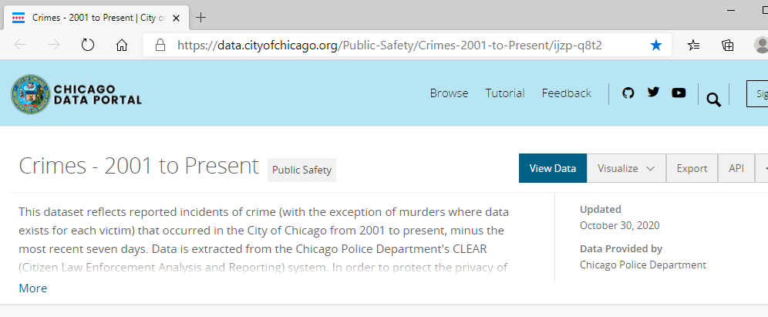
Key API Source
https://data.cityofchicago.org/Public-Safety/Crimes-2001-to-Present/ijzp-q8t2
Dataset Identifier

Slide 6
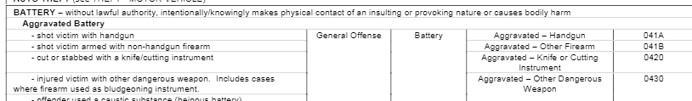
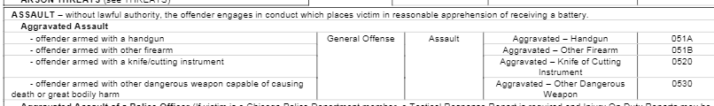

Data Definitions

Slide 7
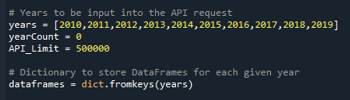

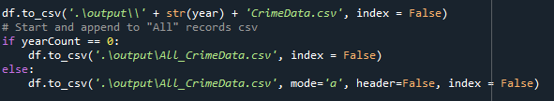
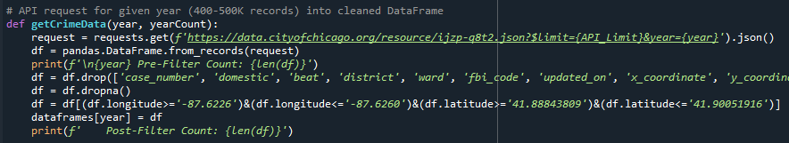
Key Code Items
Iteration List of previous-full 10yrs
Output csv and png files ‘./output/’
Writing each year’s csv data to its own file and appending to an all-data file
Year iterations, tracking number of years processed via ‘getCrimeData’ function
Function ‘getCrimeData’ to get, via API, a specific crime year’s data, dropping nulls and non-Mag Mile coordinates

Slide 8
Results & Analysis

Slide 9
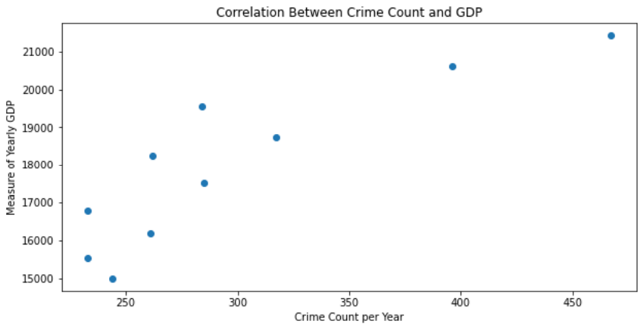
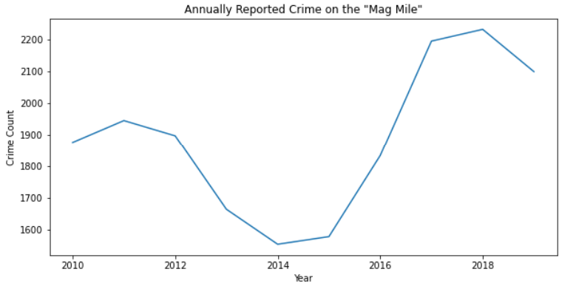
Correlation w/GDP and Yearly

Slide 10
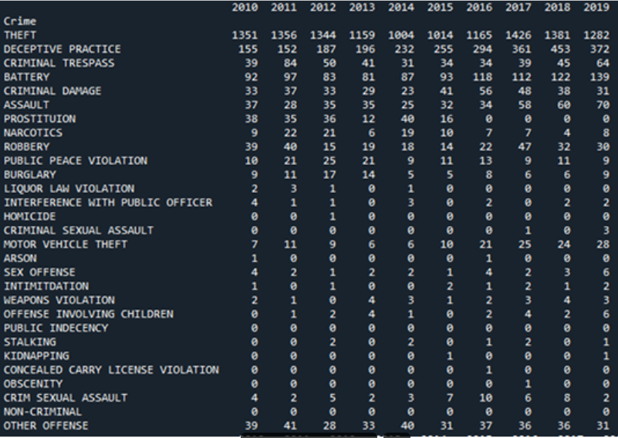
2010-2019 Crime Sorted by Volume
What stayed the same?
Theft continues to account for most crime in the Mag Mile.
What changed?
Violent crime has risen over the past decade

Slide 11
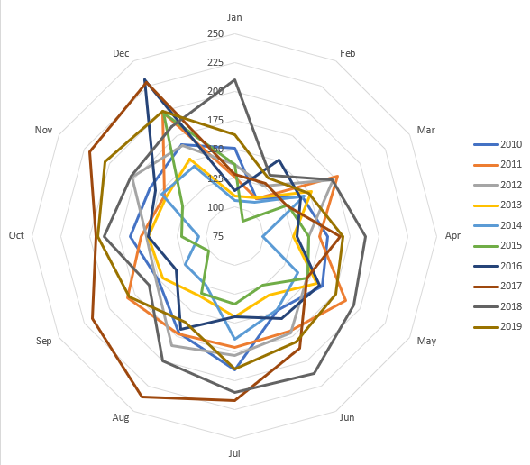
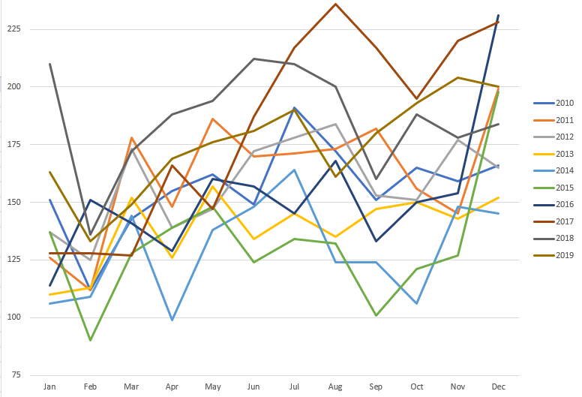
Crime volume by Month Mag Mile 2010-2019

Slide 12
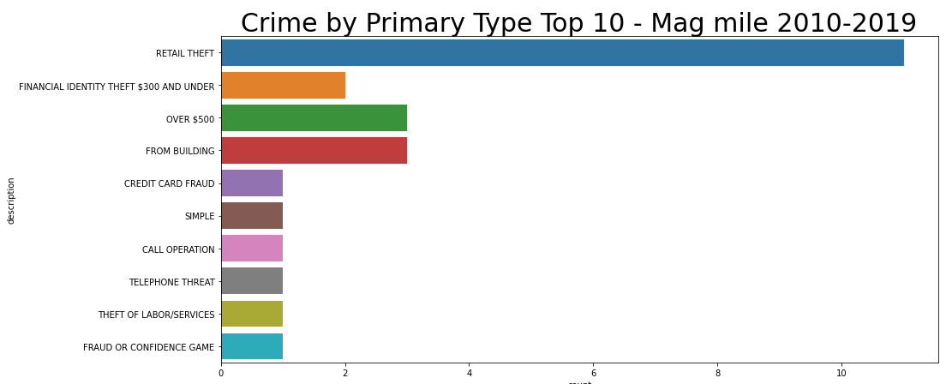
Crime by Primary Type – Top 10 Mag Mile 2010-2019

Slide 13
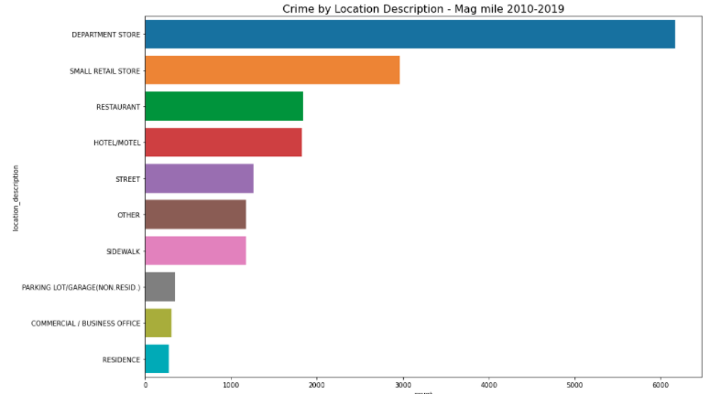
Crime by Loc-Description Mag Mile 2010-2019

Slide 14
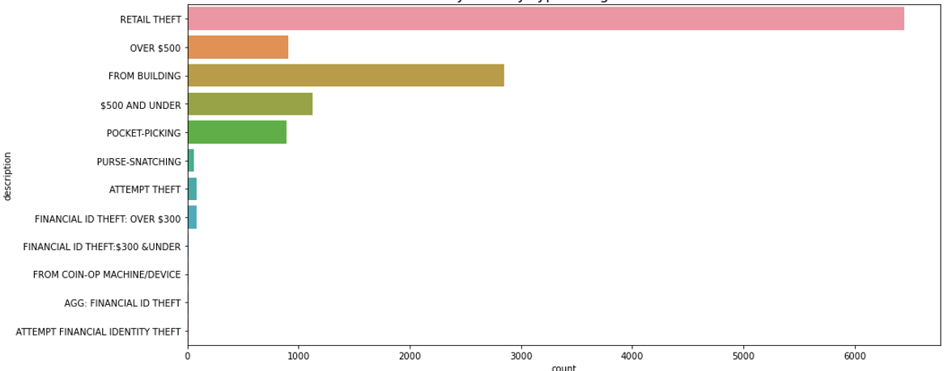
Crime Description by "Theft" Primary Type Mag Mile 2010-2019

Slide 15
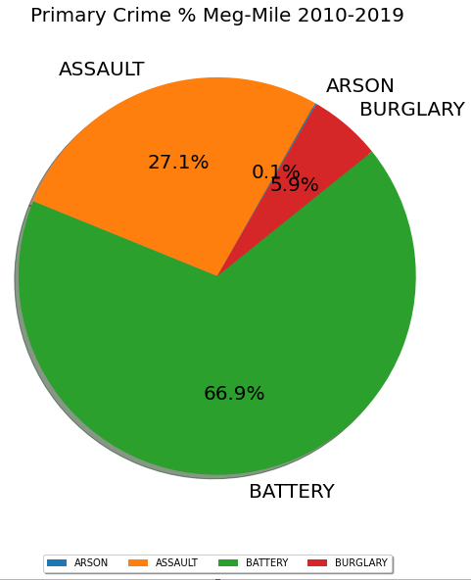
Top 4 Primary Crime Slice Mag Mile 2010-2019

Slide 16
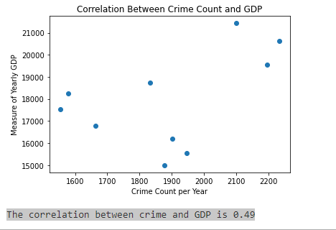
Correlation between Crime and GDP Mag Mile 2010-2019
Hypothesis
N0: The state of the economy as measured by yearly GDP has no impact on criminal activity.
N1: The state of the economy as measured by yearly GDP has an impact on criminal activity.

Slide 17
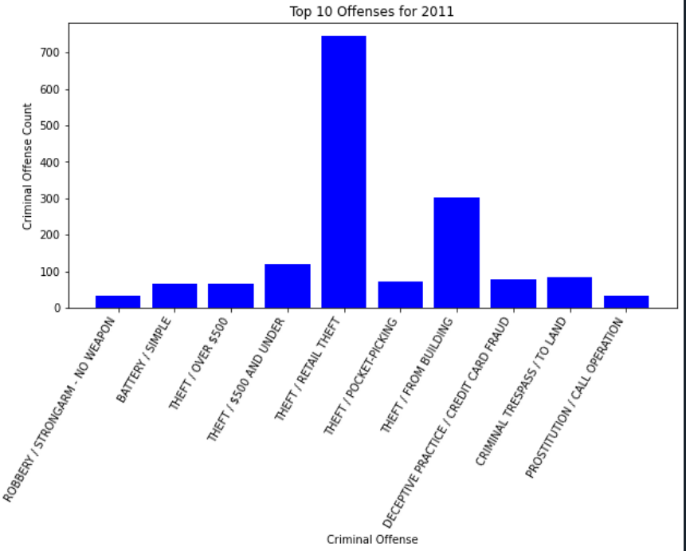
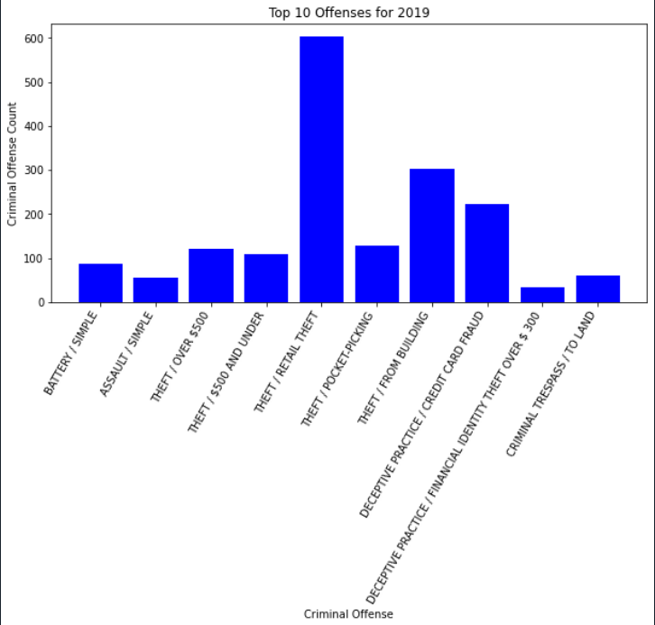
Top 10 Offences 2011 vs 2019

Slide 18
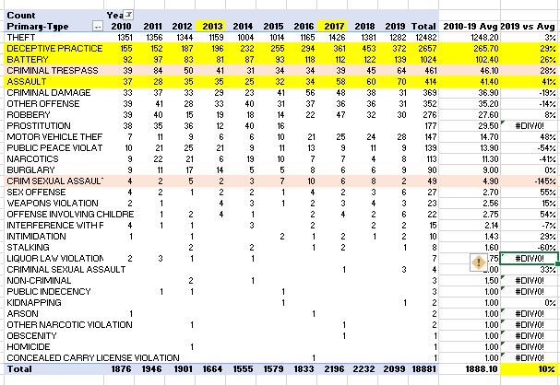
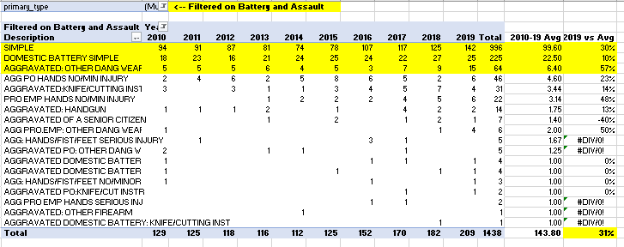

Excel Analysis
Overall 2019, up 10% from 10-year Mean
2019, up 31% for Battery & Assault
“Top-Talker” count and a significant % increase from previous year since 2014+

Slide 19
Opportunities

Slide 20
Potential Next Steps
Identify and source Mag Mile’s revenue and sales to report possible relationship between crime and revenue.
Research any additional granularity within Assault and Battery categories for additional insights within.
Compare Mag Mile to Chicago, city-wide data
Weather correlation – warmer weather, more crime?
Build additional comparison, map chart visuals
Start over with the knowledge gained during project ☺

Slide 21
Questions?

