Slide 1
ENGI 301 PCB Project
<Mason Melendez>
Due 12/12/2023 @ 11:59pm

Slide 2
Options
Can choose one of two options:
Create a PCB based on your Project #1
Create a PCB based on an example project
See Project #2 assignment for specific details
If choosing Option 1
Replace Background Information and System Block Diagram slides with your slides from the Project #1 proposal
Create a Mechanical Drawing
If choosing Option 2
Used provided Background Information and System Block Diagram slides
Create a Mechanical Drawing

Slide 3
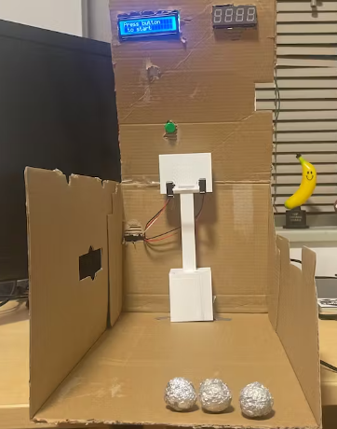
Background Information
Create a PCB for a “Pocket Bucket”
Hardware:
LCD display
LED display
Break beam sensors
Piezo element
Tactile button switch
PocketBeagle

Slide 4
scl
Game Clock
3.3k
sda
3.3k
Pocket Beagle
I2C2.SCL(P1_28)
I2C2.SDA(P1_26)
Potentiometer
Scoreboard
LCD VO (P3)
GPIO 59 (P2_33)
5V Power Connector
IR breakbeam
GPIO 23 (P2_03)
Piezo Element
GPIO 45 (P2_02)
Start button

Slide 5
Mechanical Drawing
4”
Hex Display
Piezo
1.25”
Pot
Pocket Beagle
LCD Display
USB
5”
Button
1.5”
IR break beam
2”
FRONT
BACK

