Slide 1
Popular Video Games and Developers

Slide 2
Intro to Group #9
Mason DeJesus
Mrunmai Gadbail
Nicholas Buse
Hassan Aftab

Slide 3
Thesis
Quantity vs Quality
Developers with fewer titles care more than larger developers and produce better products.

Slide 4
Data Cleaning
Changed Datatypes
Changed Columns to a list
Added two columns
Filtered for >200 Reviews to screen outliers

Slide 5
What are the most popular game titles?

Slide 6
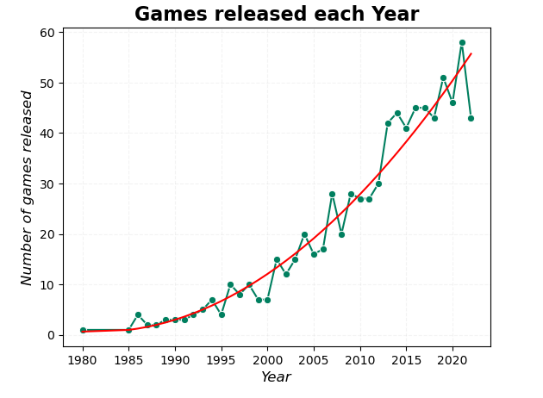
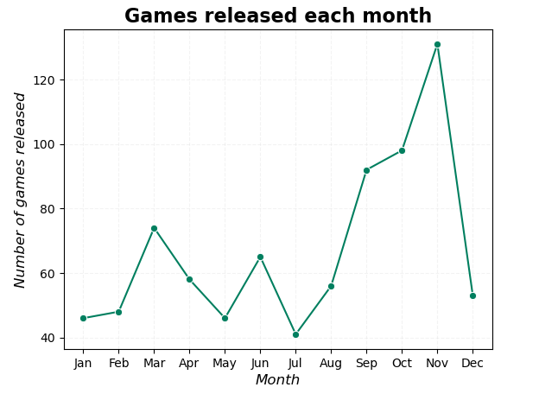

Slide 7
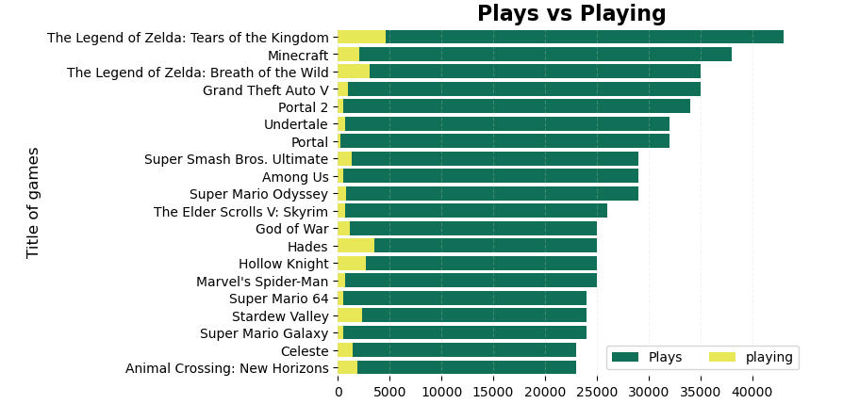

Slide 8
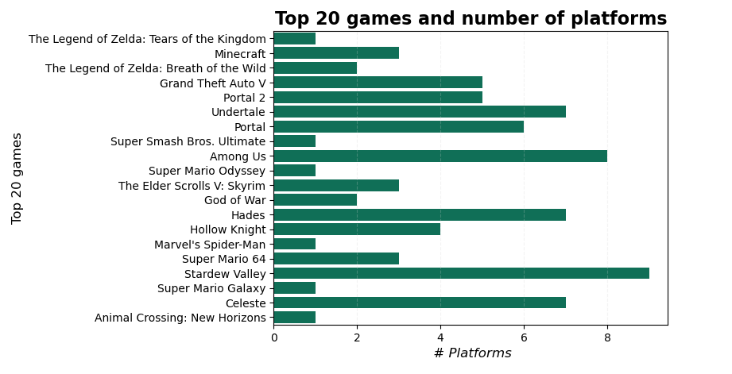

Slide 9
What are the Top 20 Developers

Slide 10
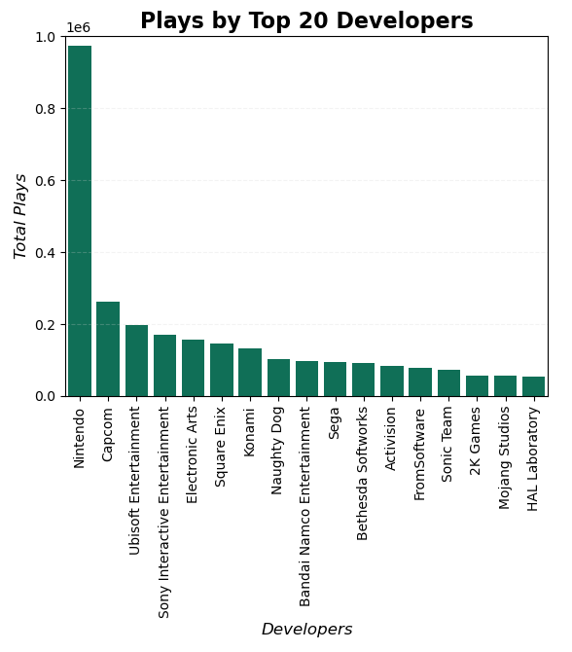
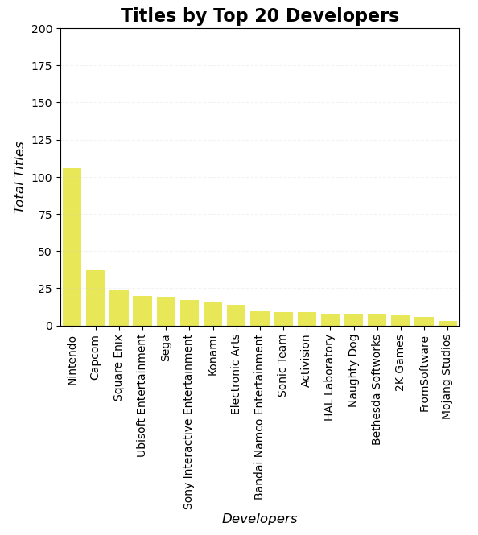
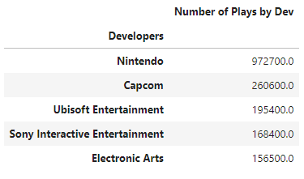
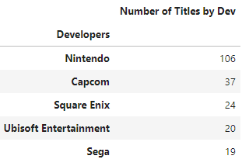

Slide 11
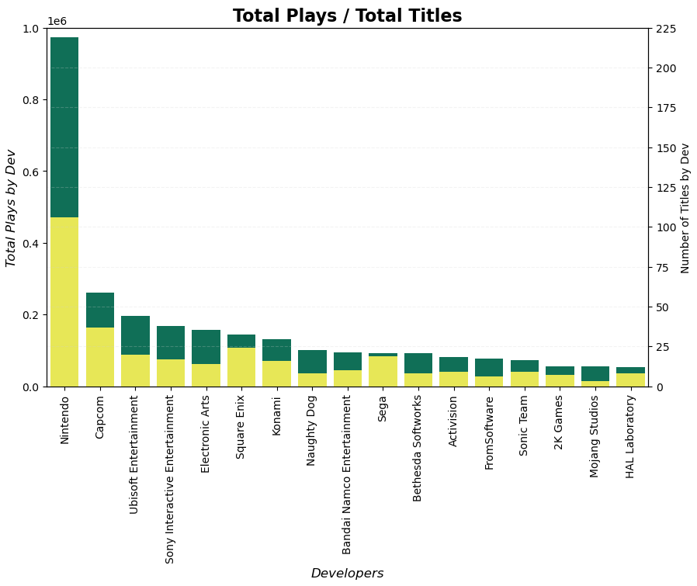

Slide 12
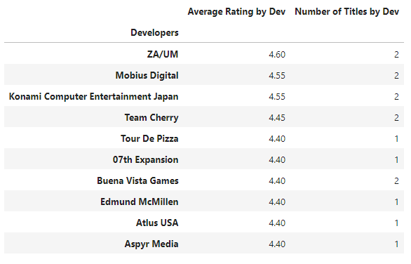
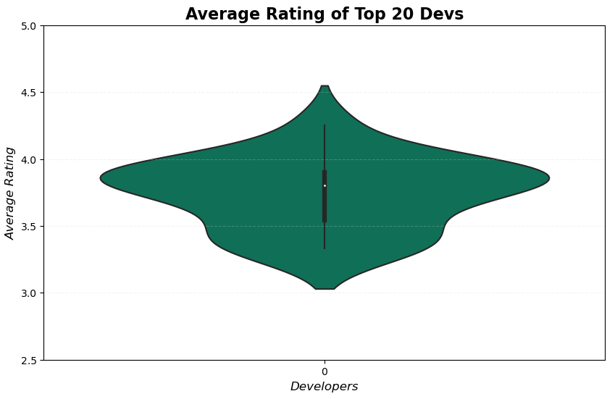

Slide 13
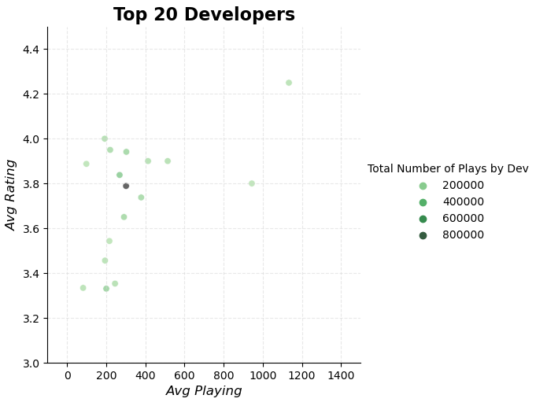
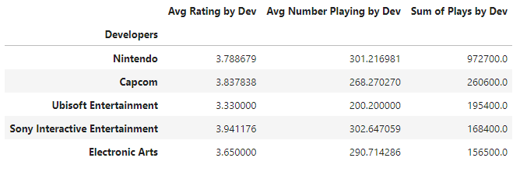

Slide 14
Regression - Does a higher amount of plays mean higher ratings?

Slide 15
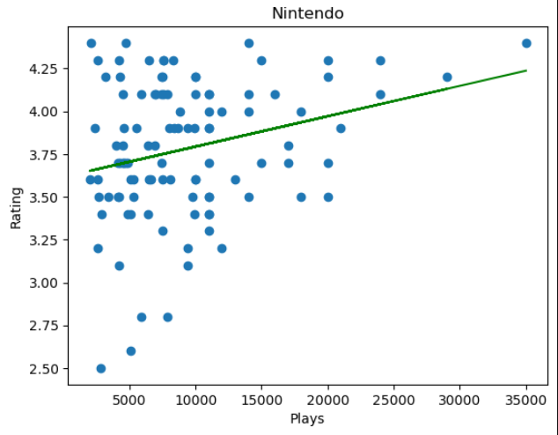

Slide 16
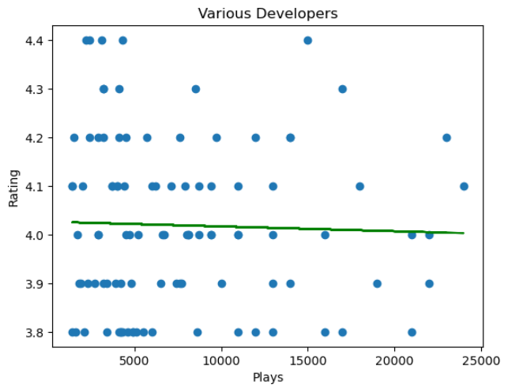

Slide 17
Call to Action
"Developers with fewer titles care more than larger developers and produce better products."
Quality vs Quantity turns into Customer vs Company Profit
From a customer's perspective, Indie and small developers make better games for niche markets.
From an investor's perspective, Nintendo has the system to produce profit. They produce profitable games.

Slide 18
Bias and Limitations
More Detail
User base/Concurrent players
Not sure if the game is linear/live service/limited
Dataset is static (not an API)
Dataset isn't constantly updated (last update was mid-2023)
Unclear of the origin of the data

Slide 19
Future Work
Dataset that had an api feed like Steam
Analyze bias in Rating vs Number of Reviews
Playthroughs/Completions of the games
Separate Game Developers from Game Producers
Estimate or exact size of the development team.

Slide 20
Works Cited
Chaves, Matheus Fonseca. Popular Video Games, 11 July 2023, www.kaggle.com/datasets/matheusfonsecachaves/popular-video-games/data.

Slide 21
Questions?

