Slide 1


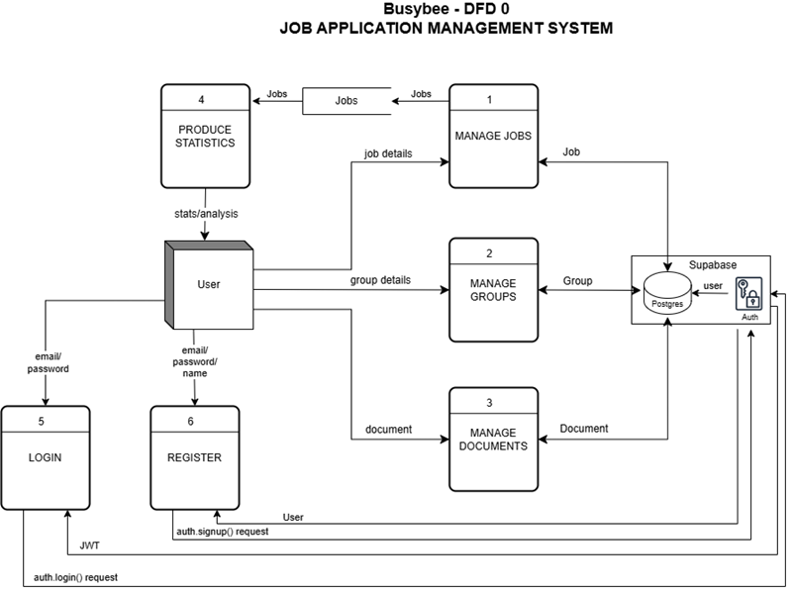

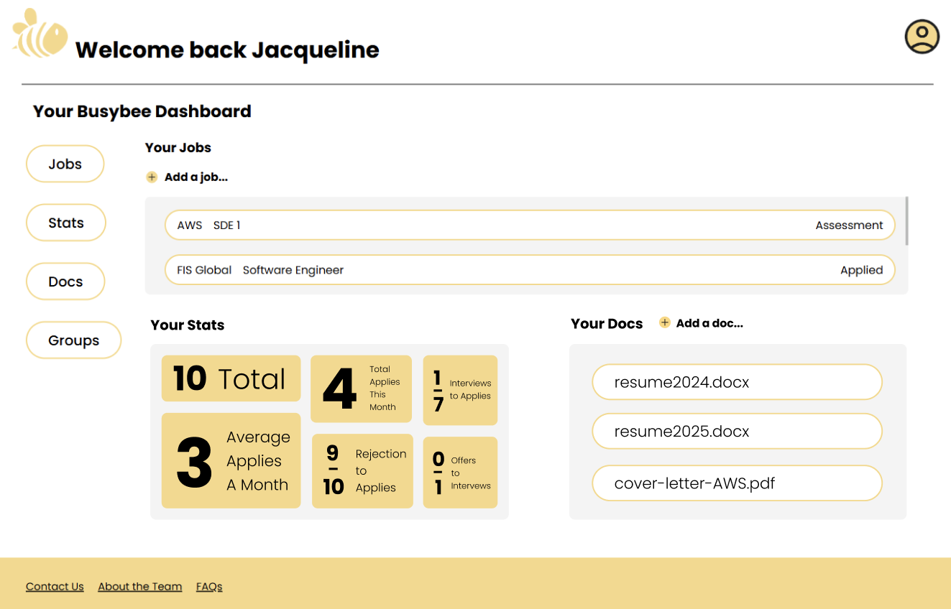

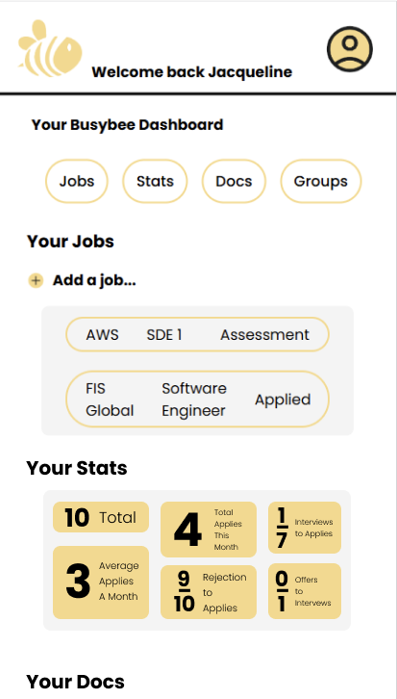
Busybee: Job Application Management System
Mason Krause, Mason Luna, Jacqueline Justice, Jason Moss
Dept. Of Computer Science and Information Technology
Abstract
Backend Design
Busybee is a web-based application designed to help job seekers organize and manage their job search. Through a centralized dashboard, users can track job applications, store documents, view statistics, and gain insight into their progress.
Busybee uses Supabase with PostgreSQL to manage structured data for users, jobs, groups, and documents. When a user logs in, related data is synced locally via JobModel, GroupModel, and DocumentModel. Users can register, log in, manage job applications, organize groups, upload documents, and view stats. Jobs and groups can be created, edited, or deleted; documents can be uploaded, viewed, or removed (but not edited) and may be linked to jobs or exist independently. The dashboard offers access to all features, including job filtering, document storage, and categorized groups. A stats system tracks progress with metrics like total applications and interview ratios. Busybee helps users stay organized and focused during their job search with a responsive frontend and real-time backend.
Background
Job seekers often juggle multiple platforms like LinkedIn, Indeed, and Glassdoor, making tracking application history and follow-up opportunities difficult. Many lose track of essential details or forget to follow up, reducing their chances of success. BusyBee addresses this by consolidating job search data into a single dashboard, promoting organization and efficiency. BusyBee empowers users to take a data-driven, structured approach to job hunting.
Figure 1: Shows the DFD0 of Busybee, outlining how users interact with the system. Users can log in, register, manage jobs and groups (create, view, update, delete), handle documents, and view statistics. This diagram illustrates the main data flows between the user and the system.
Frontend Design
Technology
The front is built with React and TypeScript, using a modular component structure for scalability and reusability. The UI features an intuitive dashboard that enables smooth navigation through the app's core functions. Styling is done with HTML and CSS. Supabase Authentication manages user login sessions and allows users to request email or password changes via links on the login form. App.js acts as the main entry point, using React Router to navigate between login and the dashboard. Once logged in, the dashboard renders its child components: navigation, header, footer, and the main view area, which displays one of five sections—jobs, groups, stats, documents, or main—based on user selection.
The system comprises the following key elements: the frontend, backend, and database. These elements work together to provide users with a structured job management experience. The frontend uses React.js and TypeScript, enabling a modular, maintainable interface with dynamic rendering and smooth routing through React Router. It is styled with HTML and CSS. It communicates with the backend via the Supabase JavaScript client, sending queries and receiving JSON response objects. Supabase, both the backend service and cloud database host, handles authentication, PostgreSQL database operations, and file storage through Supabase Storage. This integration allows for real-time updates, secure session management, and efficient user data and file handling throughout the application.
References
Acknowledgements
Supabase - https://supabase.com/docs
PostgreSQL - https://www.postgresql.org/docs/
React - https://react.dev/
Vercel - https://vercel.com/
We would like to thank Dr. John Nicholson for her support of students in the College of Science, Technology, Engineering & Mathematics, and Dr. Leong Lee for his support of students in the Department of Computer Science and Information Technology.

