Slide 1
Inverter Hybrid IC STK621-061-E
PAF-KIET

Slide 2
FEATURES
Integrates power elements (IGBT and FRD), pre-driver, and protective circuit.
Protective circuits including overcurrent (bus line), excessive temperature and pre-drive low voltage protection are built in.
Direct input of CMOS level control signals without an insulating circuit (photocoupler, etc) is possible.
Single power supply drive is possible by using a bootstrap circuit with a built-in IC.
Temperature monitor is possible by the thermistor inside the IC.
Built-in simultaneous upper/lower ON prevention circuit to prevent arm shorting through simultaneous ON input for the upper and lower side transistors. (Dead time is required for preventing shorting due to switching delay.)
SIP (The single in-line package) of the transfer full mold structure.

Slide 3
SPECIFICATIONS
VCC should be less than 500V.
Output current should be -30 to +30 amps.
Four voltage supplies are used (VD1,VD2,VD3 & VD4)
There are three high inputs (HIN) and three low inputs (LIN)
The HIN pins are 13,14 & 15 and LIN pins are 16,17 & 18.
Output Peak Current must be in the range -45 to +45 amps with PW=100Us.
VFAULT can go up to 20V.
Flatness of Heat Sink should be <0.25mm.

Slide 4
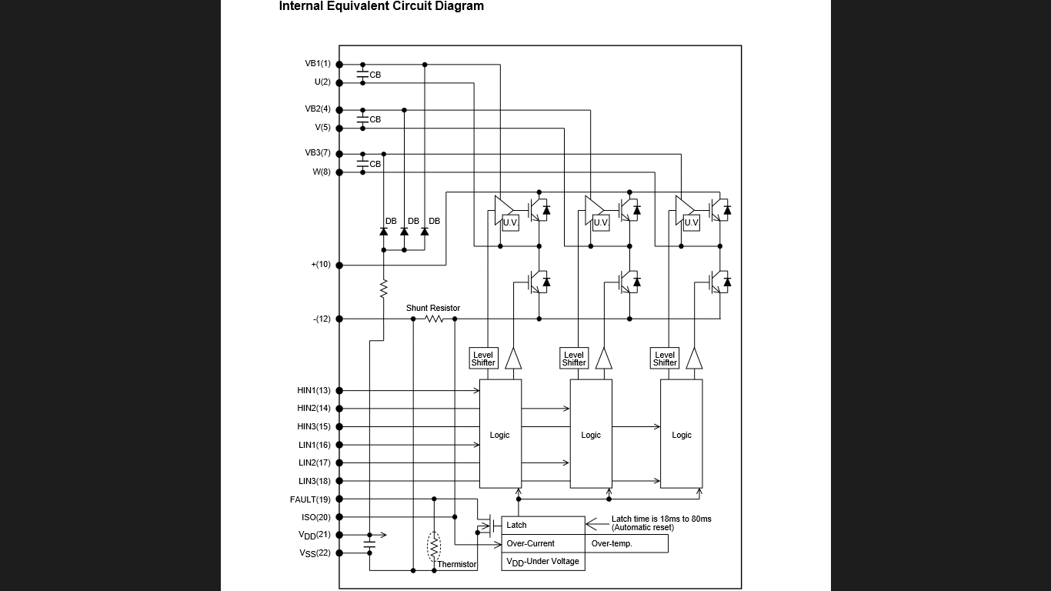

Slide 5

PRECAUTIONS
Wiring inductance must be small and snubber circuit must be used between +&- terminals of the output.
ISO Terminal (Pin 20) is used to monitor electric current. However, the over-current protection does not operate when there is short circuiting in ISO and VSS terminals.
Output form of the FAULT Terminal is open Drain.
Zener diode with 5v is connected with the inside of the signal Input Terminal. When Input exceeds 5v, a resistor must be connected between the side of the power and the signal Input Terminal.
The over-current protection feature operates only when it is possible to do circuit control normally. For safety, put a fuse on a VCC line.
When motor is connected, pin 2,5 & 8 becomes open. While the motor turns, so the soldering conditions must be appropriate.
If the negative terminal and VSS terminal are short circuited, ISD value will become lower than the inside setting value of HIC. (Not to be connected externally).

Slide 6


