Slide 1
Predicting Delinquency in Credit Card Payments
Argishti Ovsepyan
Masood Dastan
Gabriela Fichtner
Saamir Shamsie

Slide 2
Improving risk management
By analyzing personal information and historical credit data, the project will estimate the likelihood of payment defaults and facilitate the implementation of effective risk control measures.
Addressing the demand of credit assessment methods that do not require traditional credit checks has potential savings for banks and allows individuals to avoid a credit inquiry on their record.

Slide 3
Agenda
01
02
03
Data Cleaning
EDA
Modeling
04
05
Evaluation
Limitations
Process aimed at enhancing data quality
Features and their relationship with delinquency
Creating and tuning machine learning algorithms
Assessing the models performance
Constraints in the study that can impact our models

Slide 4
01
Data Cleaning
Process aimed at enhancing data quality

Slide 5
Data Source: Kaggle
Predictive Features
Education Level
Annual Income
Occupation
Days of Employment
Days from Birth
Family Status
Housing Type
(Potential) Target Variables
Current Delinquency
3 Months Delinquency
6 Months Delinquency
12 Months Delinquency

Slide 6
Enhancing data quality
Dropping Features:
Generating features:
Handling missing values:
Handling duplicates:
Custom functions:
Gender, Days Employed, and Days Birth
Age and Years Employed as well as predictive variables
Identified and created a new label for retirees and a separate label ‘missing’ for the rest
Merged dataset had 47 duplicate ID’s with different values and were dropped
The function ‘credit_approval_data_cleaner’ was utilized to do all the cleaning on both the training and test data

Slide 7
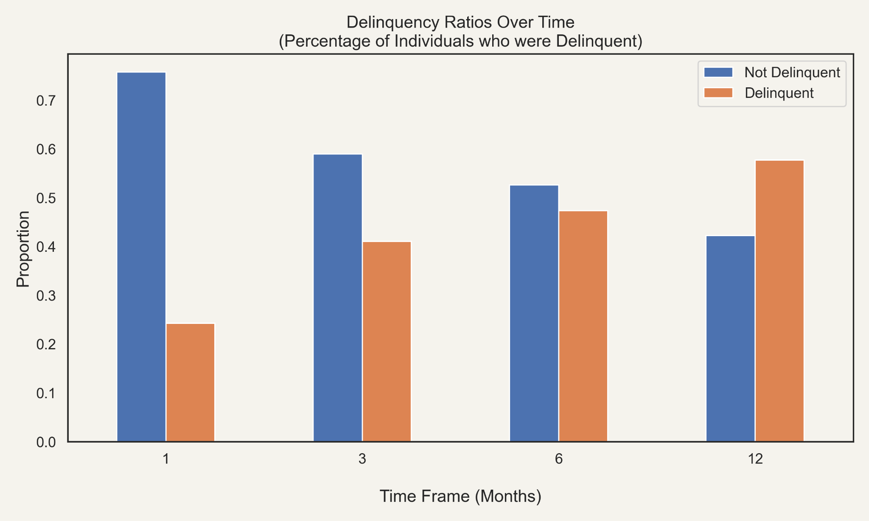

Slide 8
02
EDA
Features and their relationship with delinquency

Slide 9
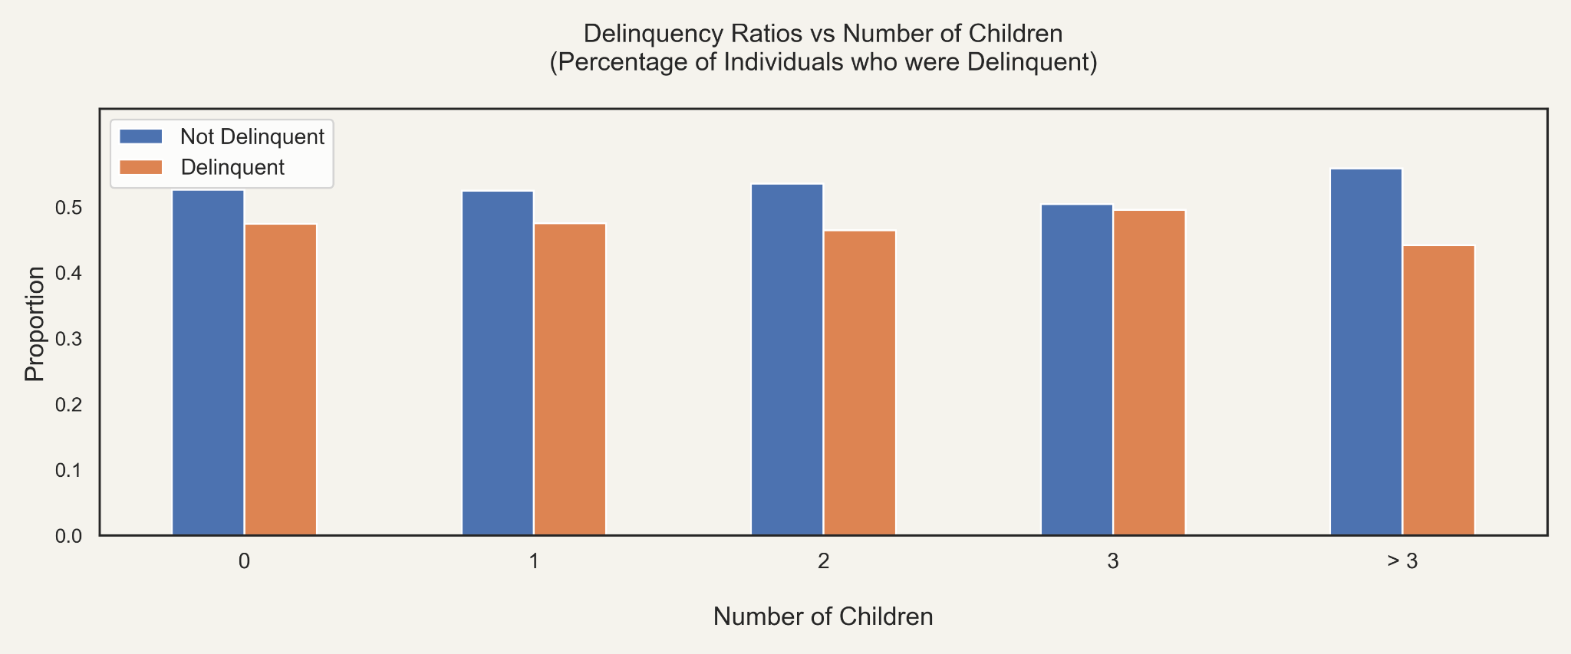

Slide 10
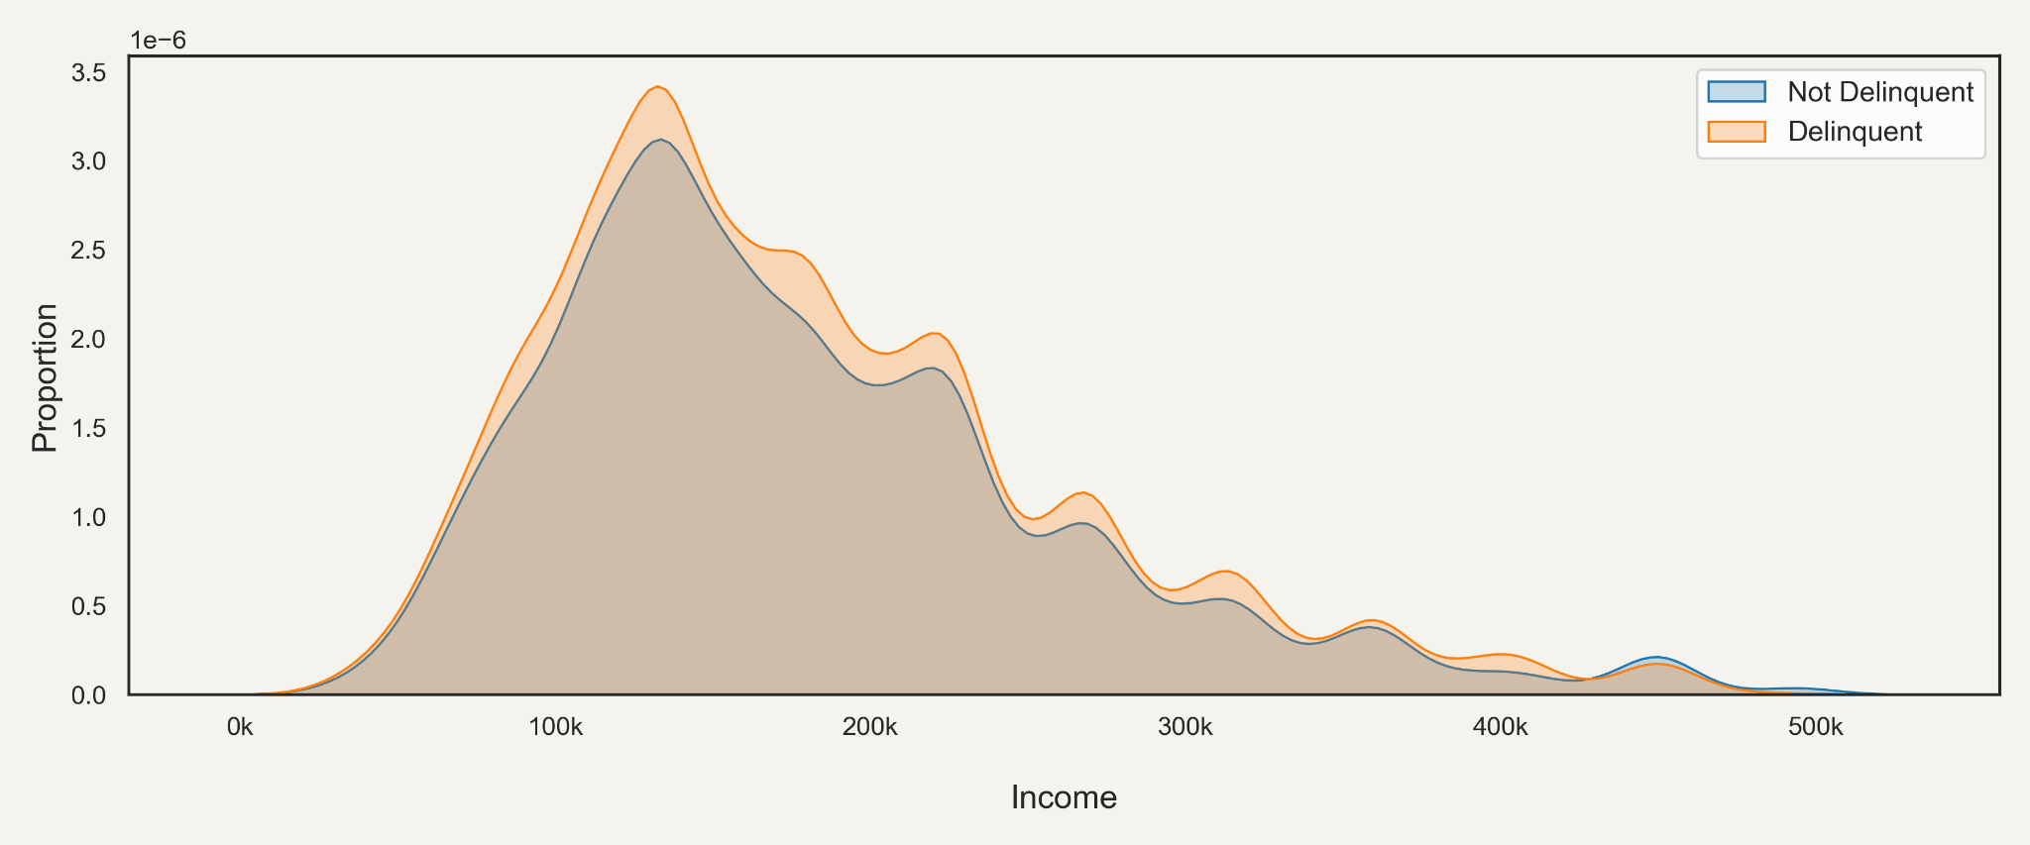

Slide 11
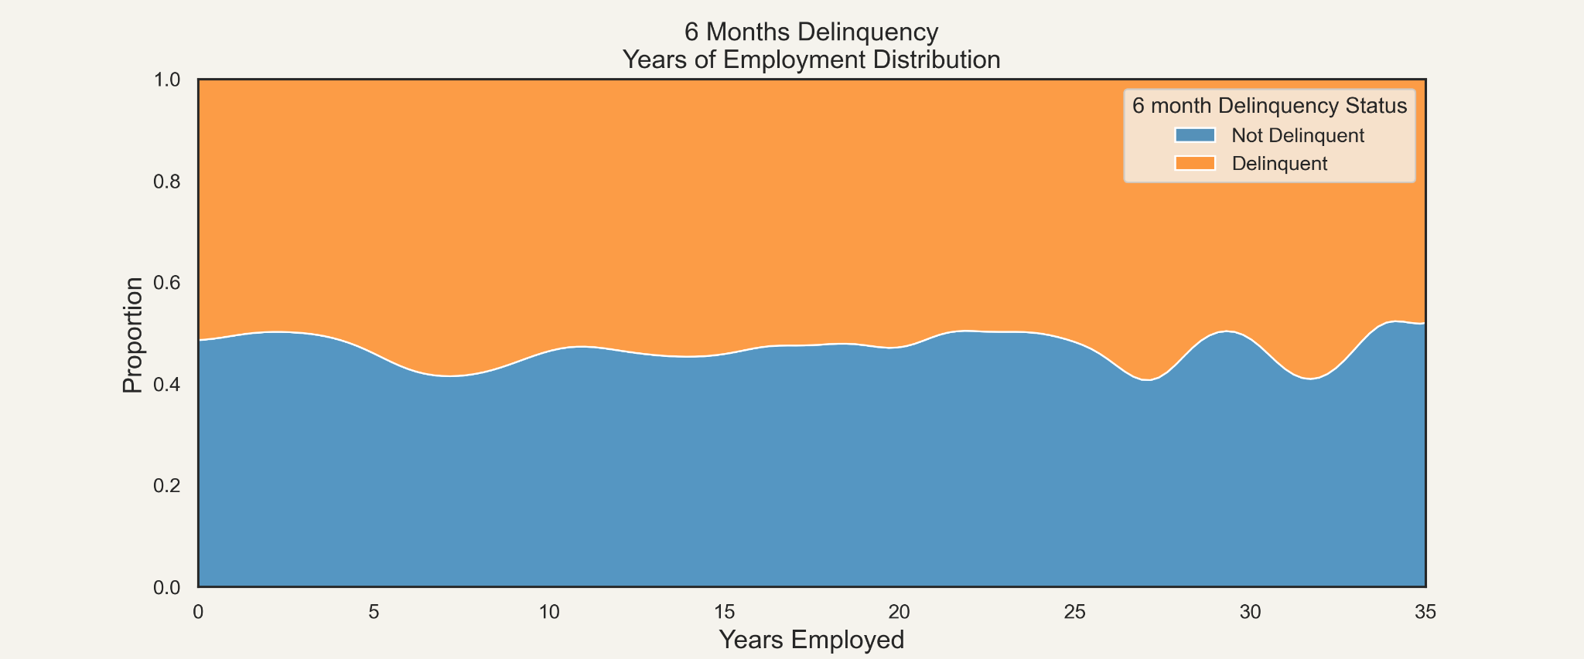

Slide 12
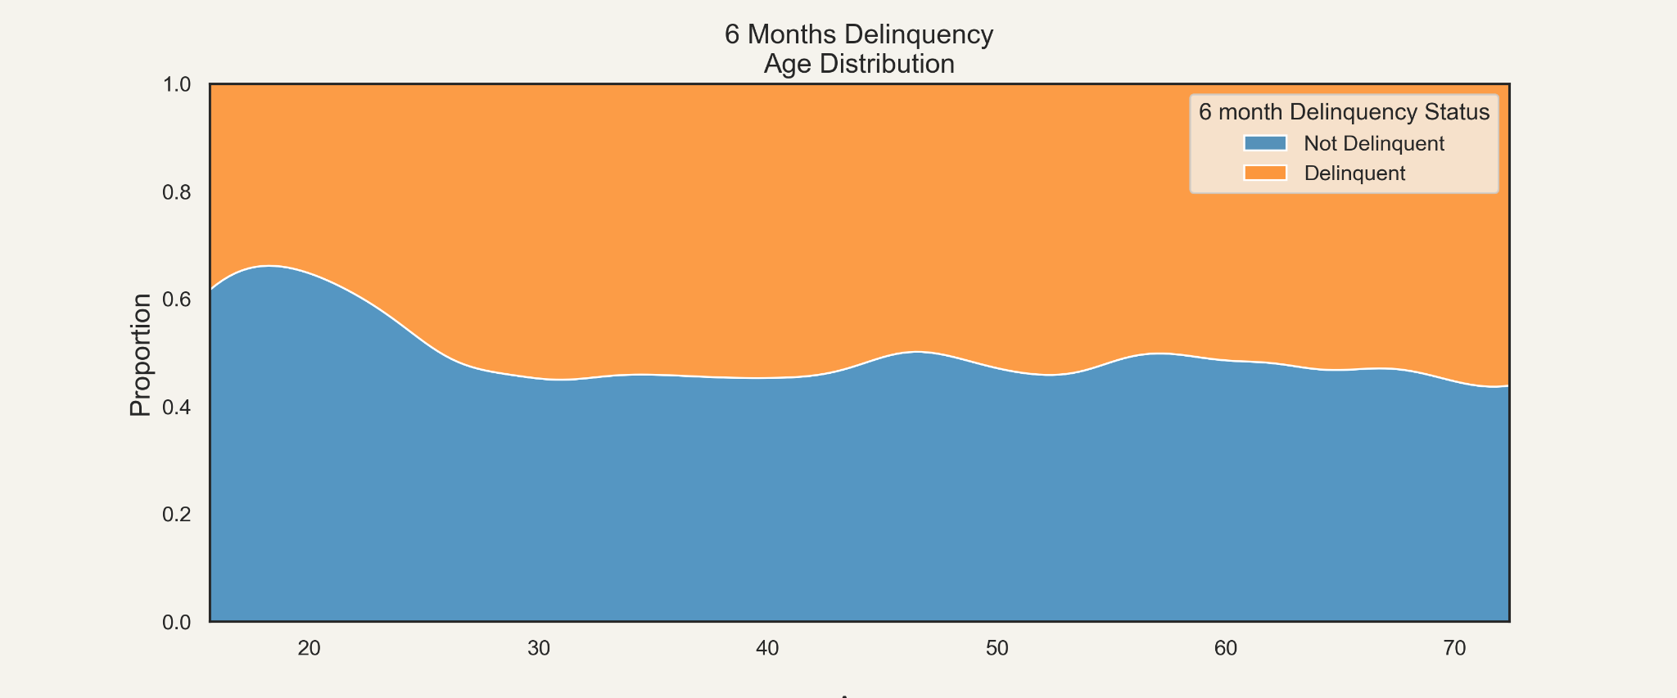

Slide 13
03
Modeling
Creating and tuning machine learning algorithms

Slide 14
Train-validation-Test Split
We split the data three ways to make sure our predictions are generalizable.

Slide 15
Models
DNN
SVC
Random Forest
AdaBoost
Gradient Boosting
Logistic Regression

Slide 16
Scores on 6-month delinquency
 | Accuracy
DNN | 62%
Logistic Regression | 75.5%
SVC | 76.7%
 | Accuracy
Gradient Boost | 79.05%
Random Forest | 79.06%
Ada Boost | 79.3%

Slide 17
04
Evaluation
Assessing the models performance

Slide 18
Best Model: AdaBoost with GridSearchCV
- 'Number of estimators': 300
- 'learning rate': 2.25
- 'max depth': None
- 'max features': 'auto'

Slide 19
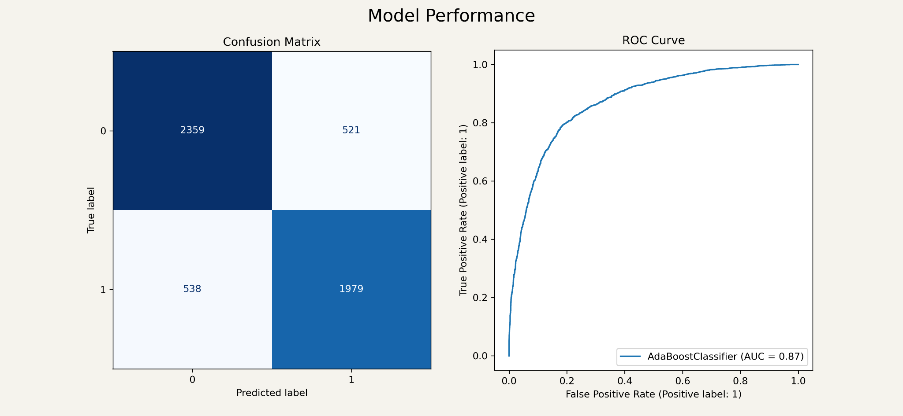

Slide 20
05
Limitations
Constraints in the data that can impact our models

Slide 21
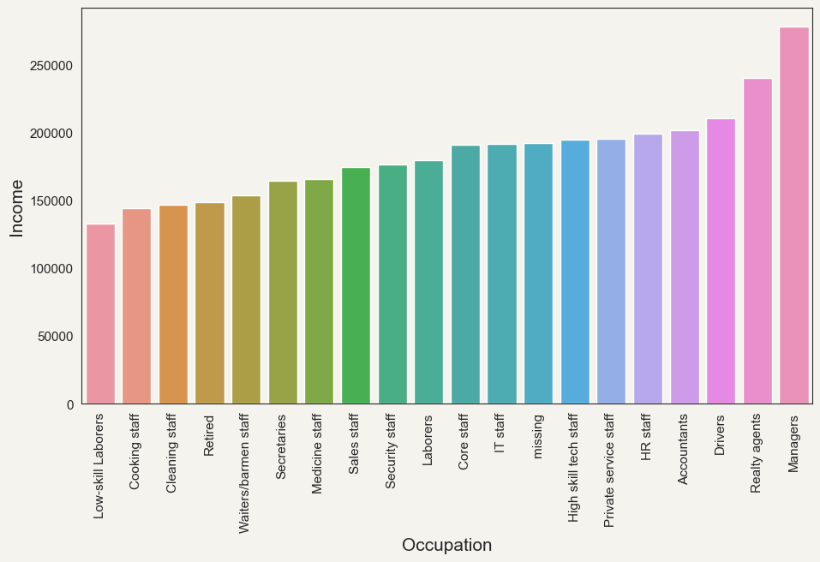
Data Limitations

Slide 22
Thanks!
Do you have any questions?

