Slide 1
Portfolio Optimisation using Machine Learning
Akshat Karnwal, Keshav Chhabra, Mohd Masood,Ramish Jamal
Group Number - 94
ML-mid sem project

Slide 2
Motivation
The Indian financial market offers unique opportunities and challenges, necessitating sophisticated strategies for investors. Nowadays, everyone wants to invest in the stock market with minimum risk so having the maximum return of investment.
This project aims to develop a stock market portfolio optimization model that combines Modern Portfolio Theory (MPT) with machine learning techniques specifically tailored for the Indian market.
In this we take the tenure and the risk the user can handle and then accordingly we give them the best distribution they should invest in the market sector wise.
A critical aspect is the creation of a predictive model to estimate stock price volatility over a 90,180 Trading days Span, providing valuable insights into future trends and aiding in diversification across large-cap, mid-cap, and small-cap stocks and different Sectors of Indian Stock Market.
The ultimate goal is to empower a investor with actionable insights and optimized strategies that enhance risk management while maximizing returns.
Our Goal is to predict stock price volatility(i.e a measure of Risk) to make an optimized portfolio.

Slide 3
Literature Review

Slide 4
Paper - 1
Link to the Paper - https://tinyurl.com/yv538ddp
Stock market is dynamic, volatile, and nonlinear, making prediction highly challenging.
Traditional methods:
Technical Analysis: Uses historical stock prices, traded volume, trends.
Qualitative Analysis: Factors in external elements like political events, economic conditions, and company reports.
Machine Learning (ML) revolutionizes stock prediction by handling large, complex datasets.
Identifies hidden patterns and non-linear relationships.
Offers better accuracy than conventional methods.
This paper focuses on:
Artificial Neural Networks (ANN) and Random Forest (RF) for predicting stock closing prices.
Models applied to five companies from different sectors.
Aim: Enhance forecast accuracy for informed financial decision-making.

Slide 5
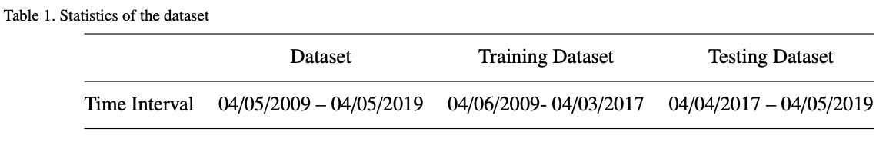
Data and Methodology
Dataset:
The dataset comprises 10 years of stock market data (2009-2019) from five companies: Nike, JP Morgan, Goldman Sachs, Johnson & Johnson, and Pfizer.
Data source: Yahoo Finance, which includes stock prices such as Open, High, Low, Close, Adjacent Close, and Volume.
Key Features Used for Prediction:
Stock High minus Low price (H-L): Captures the price fluctuation within a day by subtracting the lowest price from the highest.
Stock Close minus Open price (O-C): Measures the price change from the market’s opening to its closing, giving insight into daily momentum.
Stock price’s seven, fourteen, twenty one days moving average (7/14/21 DAYS MA): 7- Smooths short-term fluctuations to highlight trends over a week. 14-Tracks medium-term trends by averaging the past two weeks’ prices. 21-Provides insight into long-term trends, covering approximately a month of trading.
Stock price’s standard deviation for the past seven days (7 DAYS STD DEV): Measures the price volatility by calculating how much the stock price has varied over the past week.

Slide 6
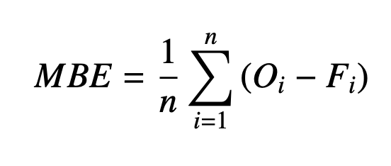
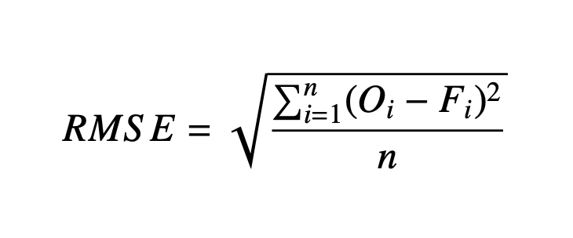
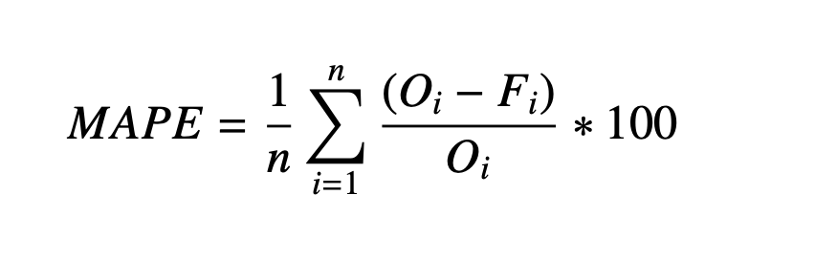
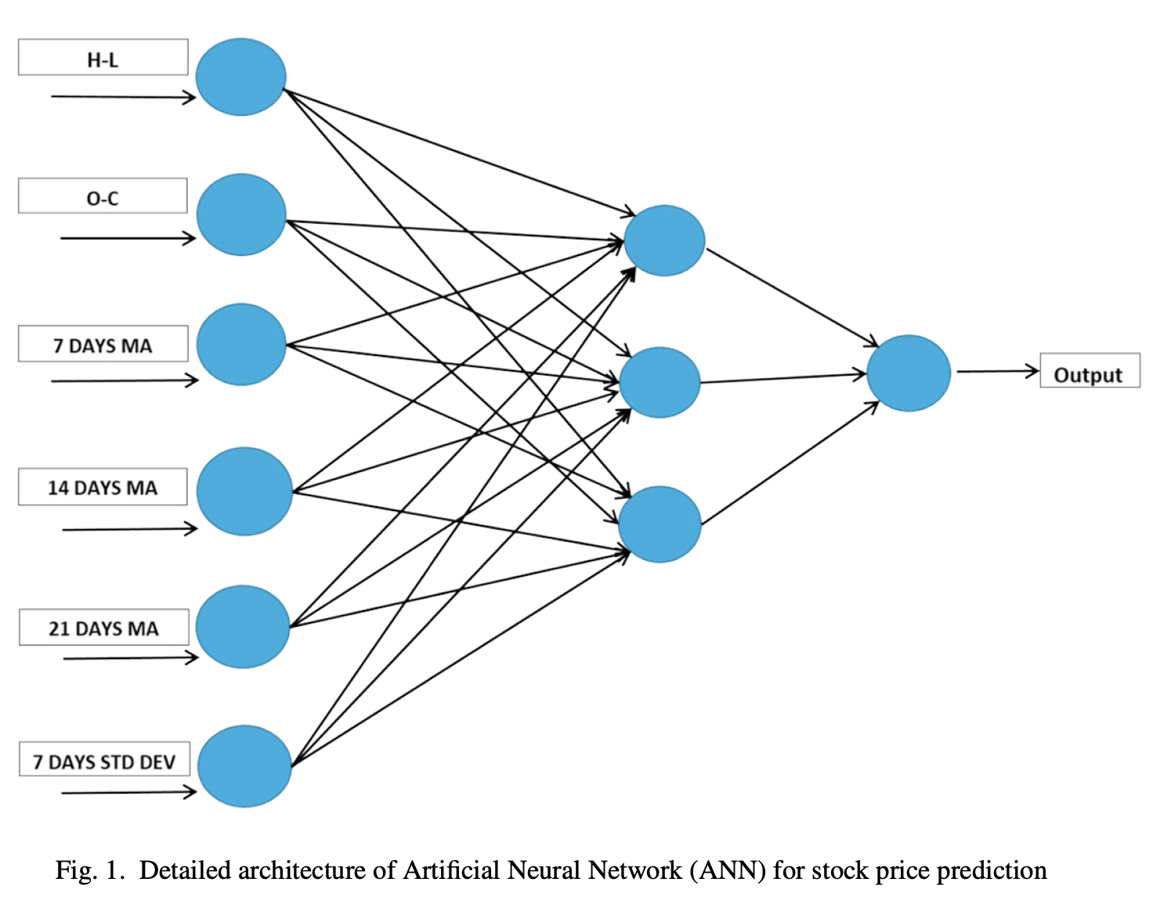
Performance Metrics Used
Root Mean Square Error (RMSE): Measures the difference between predicted and actual stock prices. A lower RMSE indicates better prediction accuracy.
Mean Absolute Percentage Error (MAPE): Evaluates the prediction accuracy by expressing errors as a percentage of actual values.
Mean Bias Error (MBE): Indicates the average bias in the model, where a positive or negative MBE shows under- or over-estimation, respectively.
You can include the following description for O and F:
O (Observed Value): The actual stock closing price from the dataset.
F (Forecasted Value): The predicted stock closing price.

Slide 7
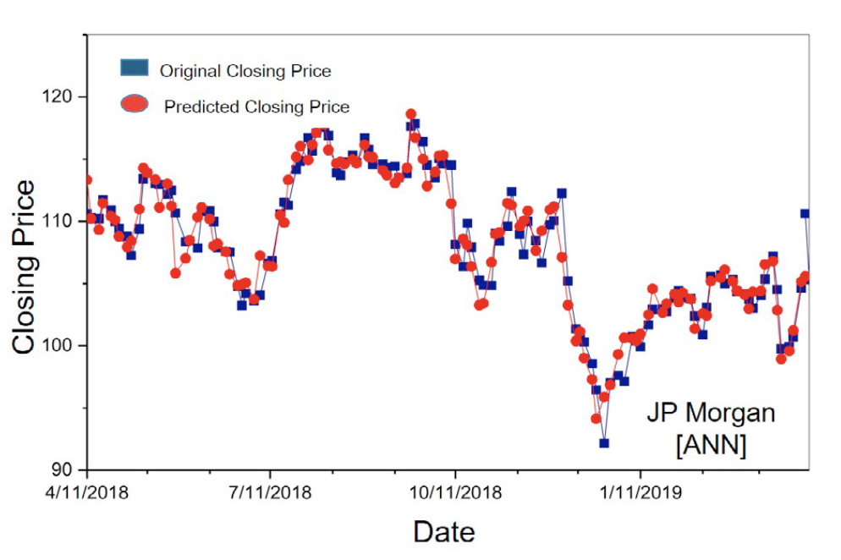
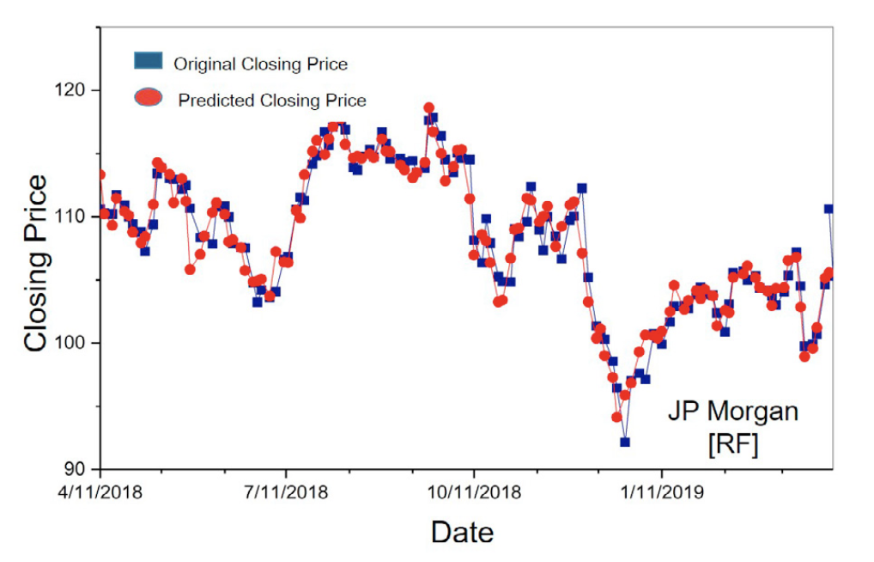
Results and Conclusion
Results Overview:
ANN vs. RF:
ANN outperforms RF in most cases, with lower RMSE and MAPE values, especially for companies like Nike and JP Morgan.
Both models are effective, but ANN provides more accurate predictions for four out of five companies.
Conclusion:
Artificial Neural Networks (ANN) proved to be the more reliable model, offering better predictive accuracy with lower error rates.
Random Forest (RF) performed well but exhibited slightly higher errors due to noise in stock data.
Future work can expand on these models by incorporating more financial indicators, external news, and market sentiment for further improvement.

Slide 8
Paper-2
Study Objective
The research investigates the application of machine learning techniques to predict long-term stock performance using fundamental analysis. Unlike traditional stock prediction methods that rely on short-term technical or sentiment analysis, this study focuses on evaluating machine learning models based on companies' financial data to guide stock portfolio strategies over extended periods.
Data and Methodology
Dataset:
The dataset comprises 22 years of quarterly financial data (1996-2017) for 70 companies from the S&P 100 index.
Data were sourced from SEC 10-Q filings, with features derived from financial statements, such as revenue, earnings, capital expenditure, and book value.

Slide 9
The initial dataset had missing values; features with over 50% missing data were removed. Remaining gaps were filled using the mean of adjacent values.
Target Variable:
The study aimed to predict a stock's quarterly relative return compared to the Dow Jones Industrial Average (DJIA). This relative measure helps control for broader market trends.
Data Preprocessing:
Percentage change between consecutive quarters was calculated for all features to remove global trends and make the dataset suitable for machine learning.

Slide 10
Target Variable:
The study aimed to predict a stock's quarterly relative return compared to the Dow Jones Industrial Average (DJIA). This relative measure helps control for broader market trends.
Data Preprocessing:
Percentage change between consecutive quarters was calculated for all features to remove global trends and make the dataset suitable for machine learning.
The dataset was split into 60% training, 20% validation, and 20% testing sets, spanning from Q1 1996 to Q4 2017.
Standardization was applied using the mean and standard deviation of the training set.

Slide 11
The dataset was split into 60% training, 20% validation, and 20% testing sets, spanning from Q1 1996 to Q4 2017.
Standardization was applied using the mean and standard deviation of the training set.
Machine Learning Models:
Feed-forward Neural Network (FNN):
Utilizes multiple layers with backpropagation for supervised learning.
Showed significant improvements when feature selection was applied, with the Portfolio Score increasing from 0.202 to 0.345 and a substantial reduction in volatility.
Required careful hyperparameter tuning, but achieved a mean quarterly relative return of 1.85%, higher than the market average of -0.0164% and outperforming the Random Forest.

Slide 12
Random Forest (RF):
An ensemble learning method that builds multiple decision trees.
Performed well initially, but showed limited improvement with feature selection, resulting in a slightly lower Portfolio Score of 0.274 and mean quarterly relative returns of 1.47%, trailing behind FNN.
Suffered from overfitting in some instances due to the larger number of decision trees.
Adaptive Neural Fuzzy Inference System (ANFIS):
A fuzzy logic-based system with five layers for processing rules.
Can model complex relationships but struggled with high-dimensional data and limited training samples, resulting in the lowest performance among the three models.

Slide 13
Key Findings
Model Performance:
All models showed the ability to outperform the market, but the Feed-forward Neural Network (FNN) delivered the best results, particularly after feature selection.
Random Forest (RF), while initially strong, did not maintain its edge over FNN when both were subjected to feature selection and aggregation techniques.
Portfolio Evaluation:
Top 20 Buy Portfolio: Portfolios constructed using the models' top stock predictions achieved mean quarterly relative returns up to 1.85% for FNN, outperforming both RF (1.47%) and the market's average of -0.0164%.
Volatility: FNN showed reduced volatility in the selected portfolios post-feature selection, indicating better risk-adjusted performance.

Slide 14
Aggregated Models:
Aggregating predictions from FNN, ANFIS, and RF (with feature selection for FNN and ANFIS) yielded the best results.
The most successful aggregation strategy (“agg3”) required all three models to agree on the top 20 stocks for selection, achieving a mean quarterly relative return of 5.11% and a 137% cumulative return over the test period.
Feature Selection:
The six most important features identified were Price-to-Book ratio (PB), Relative Return, Book Value, Price-to-Earnings ratio (PE), Capital Expenditure, and Liabilities.
Feature selection significantly boosted FNN's prediction accuracy, with a notable improvement in the Portfolio Score from 0.202 to 0.345, unlike the modest effect on RF.

Slide 15
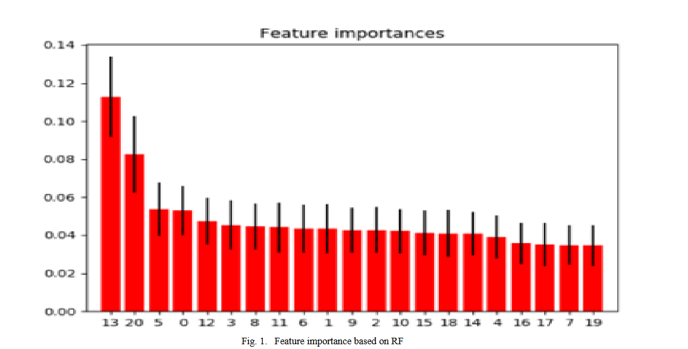
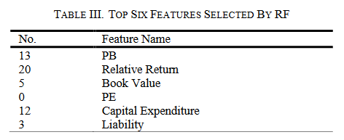
Challenges Encountered:
The limited amount of historical financial data and quarterly data frequency restricted the volume available for training.
The Efficient Market Hypothesis (EMH) implies that publicly available information is already reflected in stock prices, making predictions challenging.

Slide 16
Conclusions and Recommendations
Machine Learning Models:
Models based on fundamental analysis can be effective in constructing portfolios that outperform the market without expert intervention.
Among the tested algorithms, Feed-forward Neural Network (FNN) achieved the best performance, especially with feature selection.
Aggregation of multiple models further enhanced accuracy and portfolio stability.
Future Work Suggestions:
Expand the dataset to improve model reliability.
Incorporate additional predictive techniques, such as technical analysis and sentiment analysis, to capture different market dynamics.

Slide 17
Experiment with more sophisticated risk-adjustment methods beyond standard deviation, such as covariance matrix analysis.
Cross-validation techniques like sliding window could improve model generalizability.

Slide 18
Dataset Description
Data Link : https://shorturl.at/zV5qU
Main Folder : Contains all company stock data
Sub Folder : Each subfolder is named after a specific company (eg Company A)
Yearly CSV Files : Each folder contains various csv files representing data for each year (2000 - 2023) for each trading day

Slide 19
Each CSV File …
Date: The trading date (format: YYYY-MM-DD).
Open: The opening price of the stock on the given date.
High: The highest price the stock reached during that day.
Low: The lowest price the stock reached during that day.
Close: The closing price of the stock at the end of the trading day.
Adj Close: The adjusted closing price, accounting for dividends and stock splits.
Volume: The total number of shares traded on that date.

Slide 20
EDA ANALYSIS OF DATA
(Demonstrated for HP Cotton Stock)

Slide 21
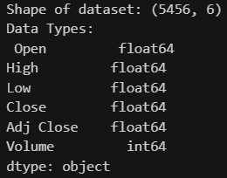
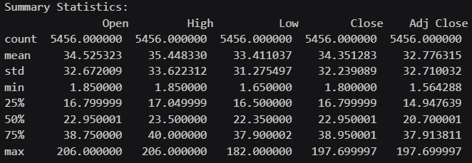
Statistical Summary

Slide 22
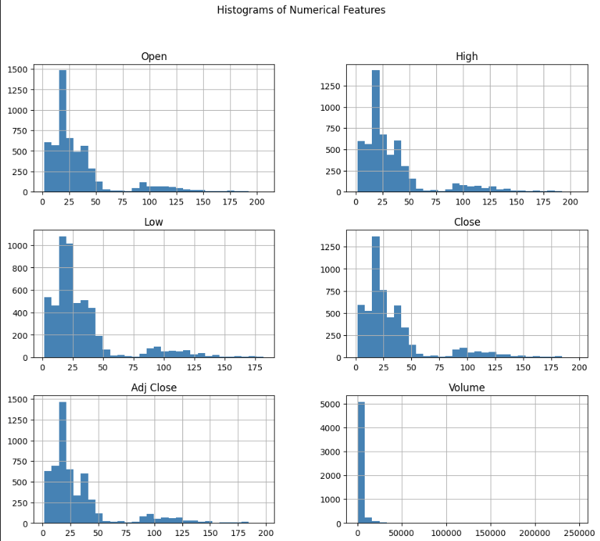
Histograms of Numerical Features

Slide 23
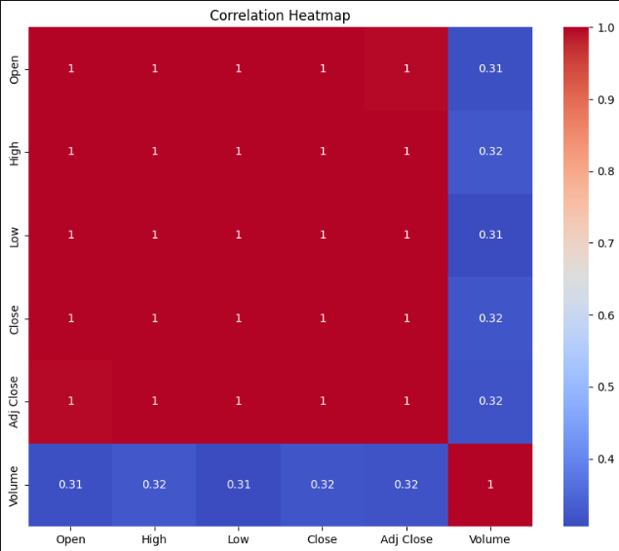
Correlation Heatmap

Slide 24
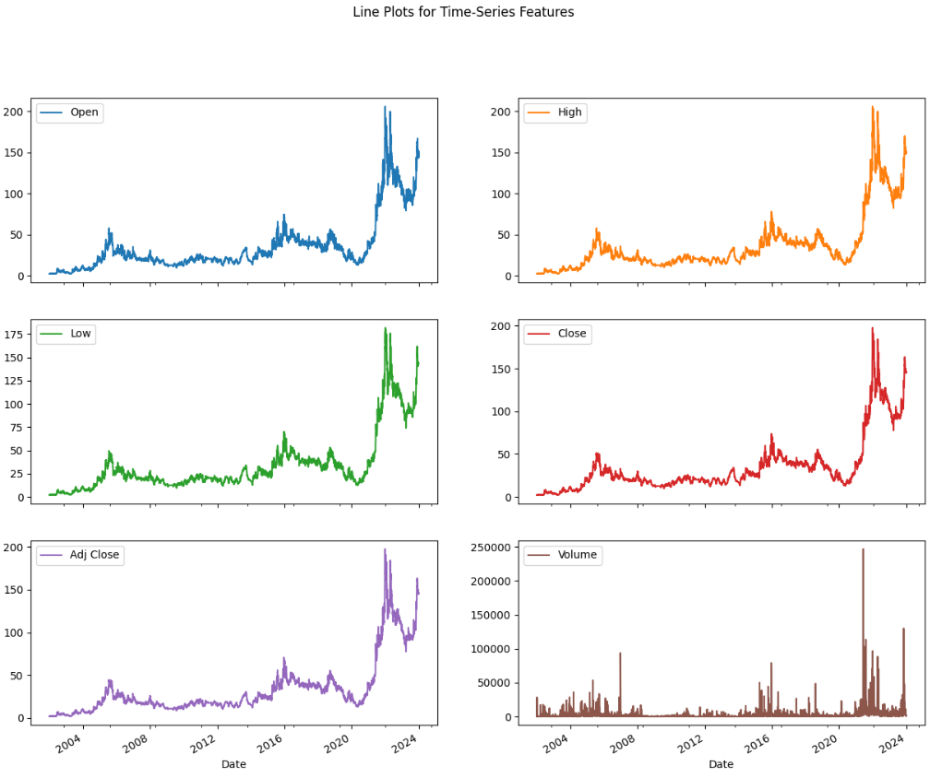
Line Plots For Time Series Features

Slide 25
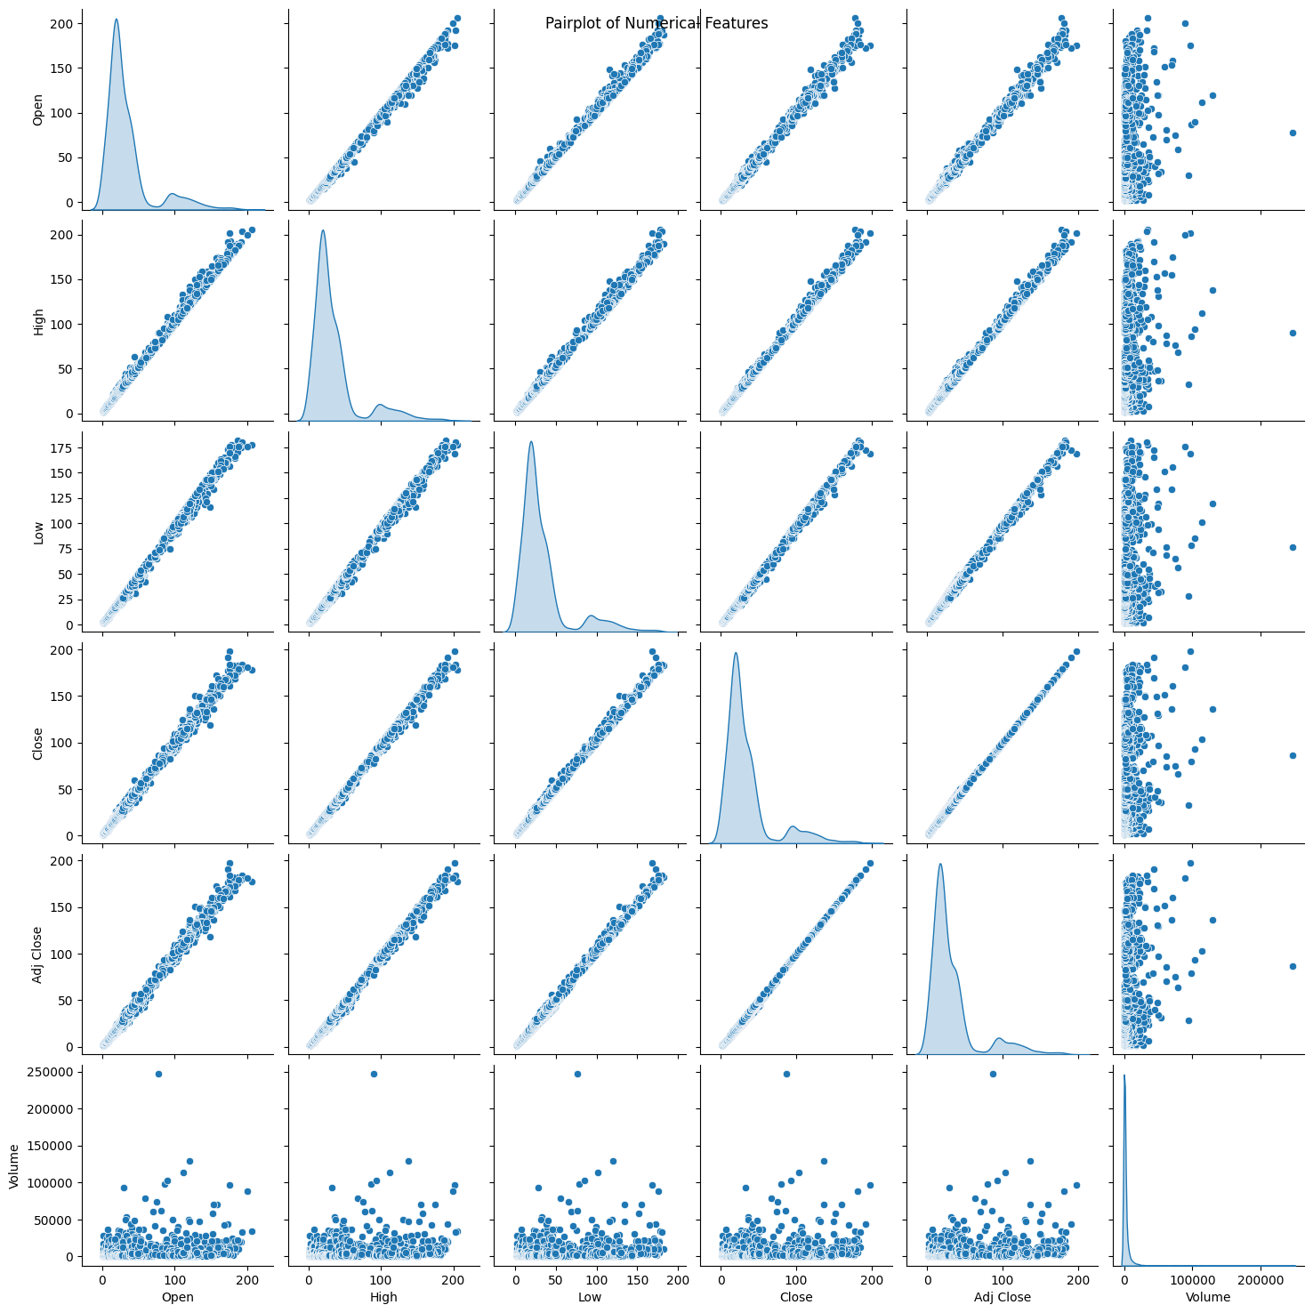
Pair Plots

Slide 26
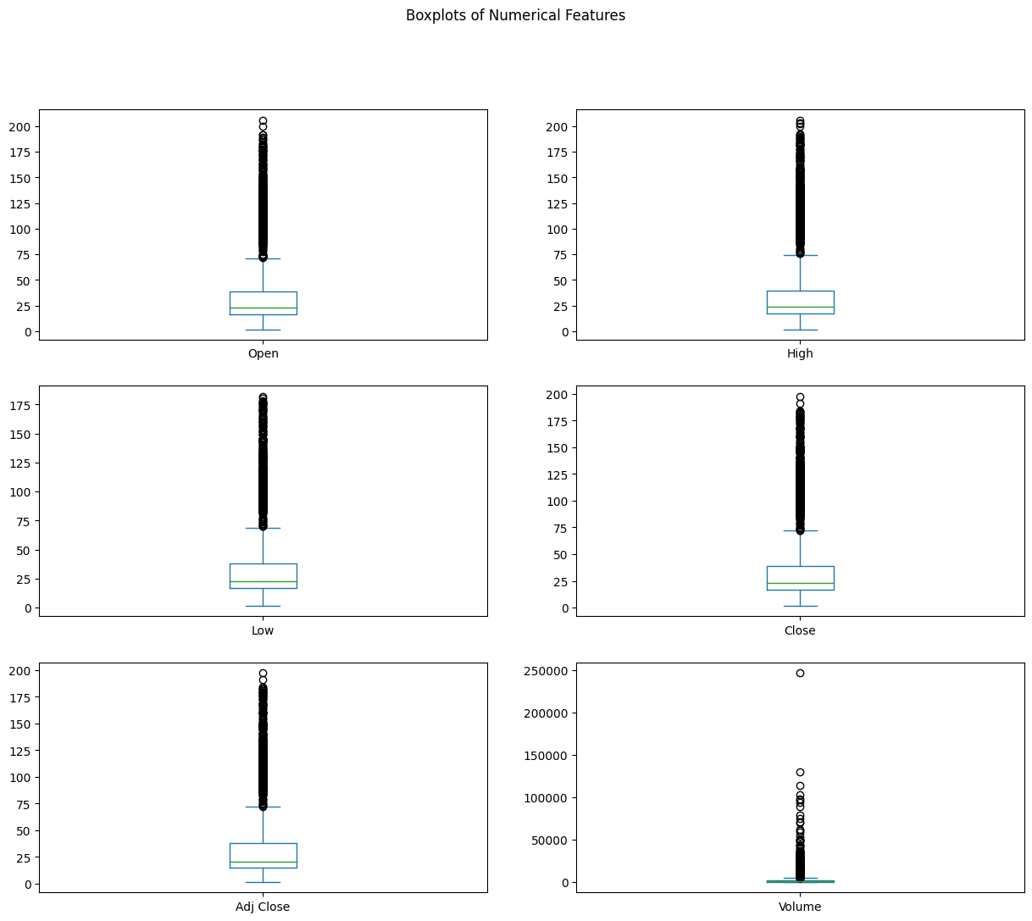
Box Plots

Slide 27
Insights of the EDA
Price Features: Highly skewed towards lower values, with outliers up to 200.
Volume Distribution: Mostly low, with rare but extreme spikes.
Correlation: Price features (Open, High, Low, Close, Adj Close) are perfectly correlated; low correlation between price and volume (around 0.3).
Price Trend: Clear upward trend post-2020.
Volume Spikes: Occasional, possibly indicating significant market events.
Statistical Summary: Median price around 23, max price above 200; high variance in volume with large outliers.
Redundant Price Information: Possible dimensionality reduction by focusing on one price feature.

Slide 28
PREPROCESSING

Slide 29
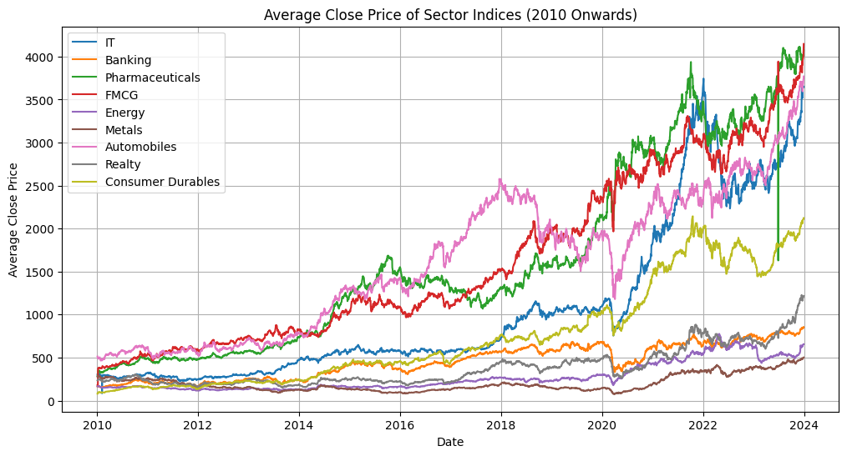
We took 10 stocks out of each sector of each 9 Sectors and made an stock Index for each Sector here is visual representation of it.

Slide 30
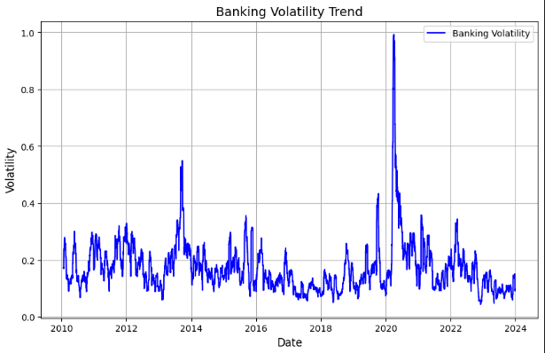
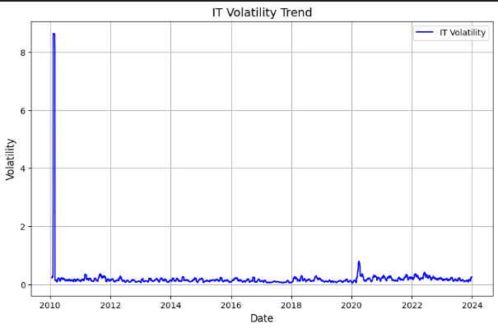
Volatility vs Date

Slide 31
Preprocessing Summary
Combining Data
all yearly data for each stock into a single file for that stock.
Filling NaN values
by averages of that columns
Handled discrete dates
dates by filling in non-trading days, making the dataset continuous
Add derived features
related to stock prices (like RSI, moving averages etc) to capture market dynamics.
Averaging data in sectors
For each sector, take average of all companies to generate combined data for a sector
Distribute companies into sector
Allot a sector (FMCG, IT etc) to each companies
Creating target Variables Creating Target Variable i.e price after 90,180 days or whatever frame we are making our model for

Slide 32





Derived Feature Engineering
Feature | Definition | Essence | Formulae
Returns | Percentage change in price compared to the previous day. | Measures daily price fluctuations; indicates market performance.
Volatility | Annualized standard deviation of returns over the past 21 days. | Assesses market risk or uncertainty over a short-term period.
Future Volatility | Predicted 21-day rolling volatility shifted 90 days forward. | Helps forecast future market conditions and trends.
Moving Average (21) | Average of closing prices over the past 21 days. | Identifies trends by smoothing daily price movements.
RSI (14) | Measures relative strength of price gains vs. losses over a 14-day period. | Highlights overbought (>70) or oversold (<30) conditions for potential reversal opportunities.
MACD | Difference between 12-day and 26-day exponential moving averages. | Momentum indicator to gauge bullish/bearish market conditions.

Slide 33
METHODOLOGY

Slide 34
Our approach
To achieve our goal of building an optimized portfolio with carefully selected stocks across various sectors, we have outlined a two-step approach:
Volatility Prediction: First, we aim to predict the volatility of a broad set of stocks and sectors for the upcoming period. Volatility serves as a key measure of the risk associated with investing in each stock.
Portfolio Optimization: Based on these predicted volatilities, we will construct an optimized portfolio that balances risk and return. By selecting stocks with the appropriate risk profiles, we aim to maximize returns while minimizing overall portfolio risk.

Slide 35




Model Evaluation Metrics
1. Mean Squared Error (MSE)
2. Mean Absolute Percentage Error (MAPE)
3. Direction Accuracy
4. Volatility (Standard Deviation of Returns)

Slide 36
Why choose Volatility?
Volatility and Risk
Definition of Volatility:
Volatility measures how much the price of a stock fluctuates over time. A stock with high volatility experiences significant price swings, both upward and downward, over short periods.
Conversely, a stock with low volatility has relatively stable prices, with smaller fluctuations.
Risk Assessment:
Higher Volatility = Higher Risk:
Stocks that show greater volatility are generally considered riskier investments. The reason is that while there is the potential for higher returns (because of the larger price swings), there is also a greater chance of experiencing significant losses.
For example, a stock might rise from $100 to $150 in a short period (50% increase) but could also drop from $100 to $50 (50% decrease) just as quickly. The larger the potential price swings, the higher the uncertainty about the stock’s future price.
Lower Volatility = Lower Risk:
Stocks with lower volatility are seen as safer investments. They tend to have more predictable price movements, which can be appealing to conservative investors who prioritize capital preservation.
For instance, a stock that fluctuates between $98 and $102 is much less likely to result in large losses compared to a stock that can jump from $80 to $120 in the same timeframe.
Notes:
Volatility measures the extent of stock price fluctuations over time, with higher volatility indicating greater price swings and increased risk. Lower volatility suggests more stable prices and reduced risk, appealing to conservative investors.

Slide 37
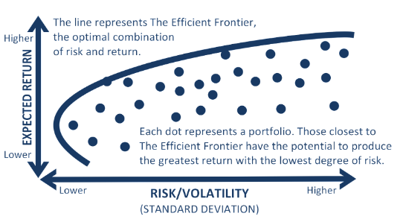
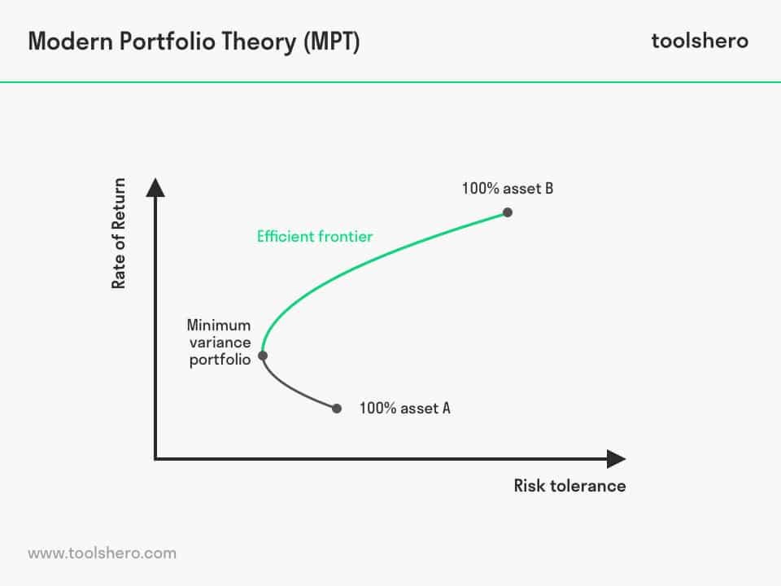
Portfolio Optimization Overview(MPT)
Objective: Allocate investments across 9 sectors to minimize risk (volatility) while aiming for an optimal return.
Method: Applied Modern Portfolio Theory (MPT) to determine optimal sector weights using:
Predicted Volatility (from model forecasts)
Actual Volatility (historical data)
Once we have the expected returns and volatilities, and have calculated the covariance matrix, we use these to determine how much capital to allocate to each sector in the portfolio.

Slide 38
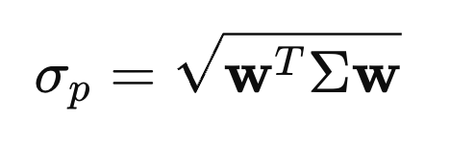
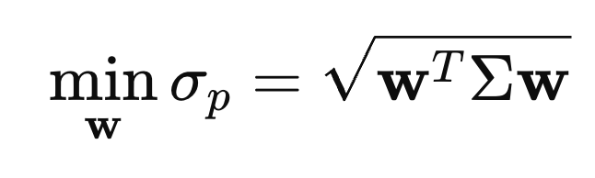
Minimize Portfolio Volatility
Portfolio volatility is defined as:
σp = √(w^TΣw)
σp: Portfolio volatility
w: Vector of portfolio weights (allocation to each sector, e.g., 10% in sector A, 20% in sector B, etc.)
Σ: Covariance matrix of sector volatilities
Optimization Problem:
To minimize the portfolio volatility σp, we solve the following optimization problem:
min w σp = √(w^TΣw)
Subject to:
Weights Sum to 1: Σ(n, i=1) wi = 1 This ensures the portfolio is fully invested.
No Short Selling or Leverage: 0 ≤ wi ≤ 1 ∀i This ensures no negative allocations or borrowing.

Slide 39
Portfolio Optimization Process
Optimization Method:
We use Sequential Least Squares Quadratic Programming (SLSQP), a standard numerical optimization method, to solve this constrained problem.
Steps in SLSQP:
Initial Guess: Start with equal weights for all sectors:
wi = 1/n, where n is the number of sectors.
Iterative Optimization:
SLSQP adjusts the weights w iteratively to minimize σp, while satisfying the constraints.
Output:
The algorithm returns the optimized weights w* and the minimized portfolio volatility σp*.

Slide 40
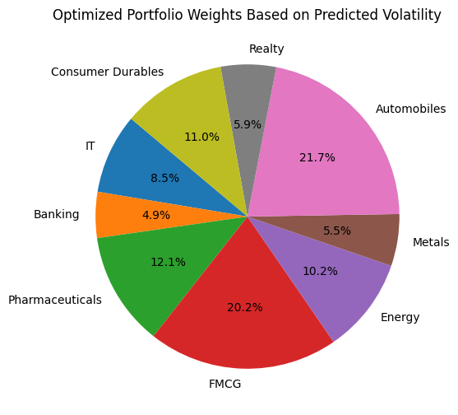
Validation and Comparison
We evaluated a portfolio Allocation for Apr-June 2023 Strategy allocation and here are the results
Max Return Strategy: Invested all funds in the sector with the highest return. This is max return that could have been achieved during that Period
Max Return: 29% return (ignoring risk).
Equal Allocation: Invested equally across all sectors.
Equal Allocation Return: 23%.
Optimized Portfolio: Based on the model’s prediction and volatility optimization.
Optimized Return: 24% return, balancing both risk and return, outperforming equal allocation while avoiding the high risk of the max return strategy.
The portfolio optimization model provides a balanced approach, delivering:
Better Return: 24% compared to the equal allocation strategy (23%).
Reduced Risk: Avoids the high-risk strategy of concentrating on a single sector for maximum return (29%).
Recommendation: Use this optimized allocation for better long-term risk-adjusted returns.

Slide 41
RESULTS AND EVALUATION

Slide 42
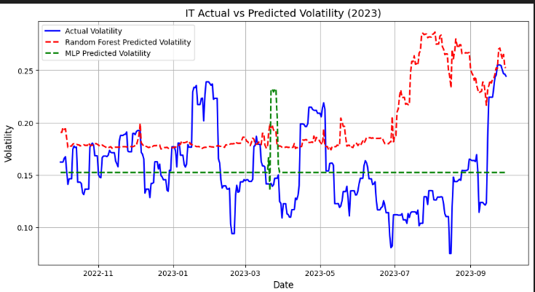
Test Results
Volatility Prediction
IT Sector

Slide 43
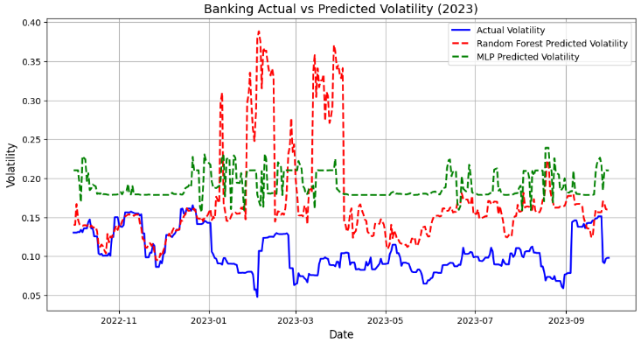
Validation
Banking Sector

Slide 44
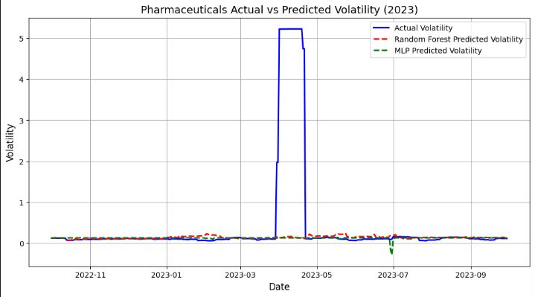
Pharmaceuticals Sector

Slide 45
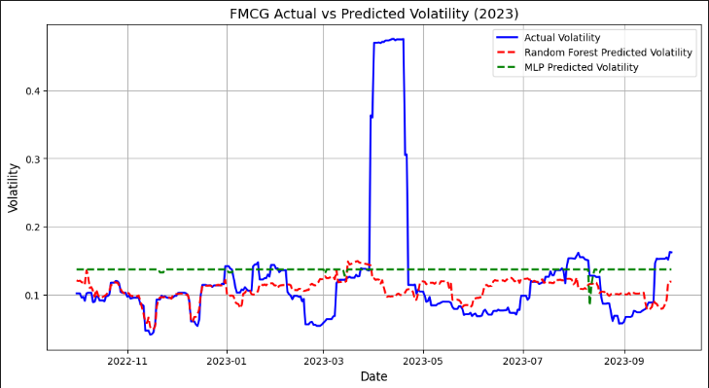
FMCG Sector

Slide 47
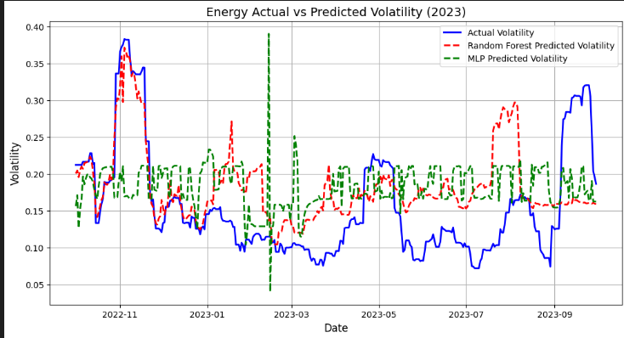
Energy Sector

Slide 48
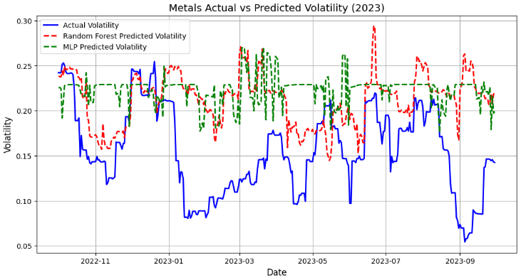
Metals Sector

Slide 49
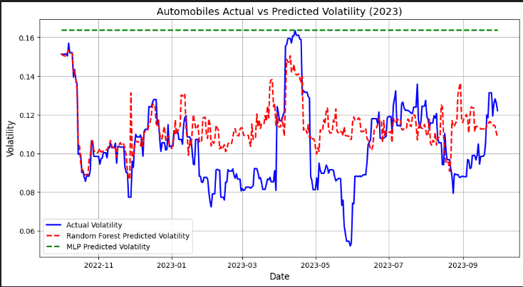
Automobiles Sector

Slide 50
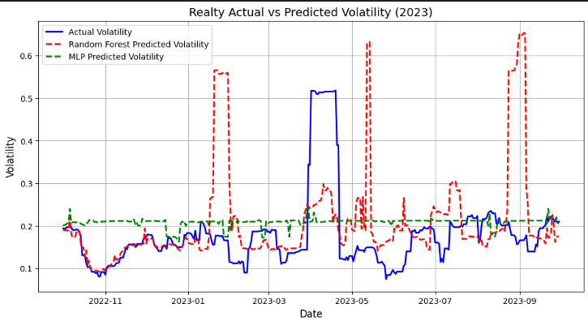
Realty Sector

Slide 51
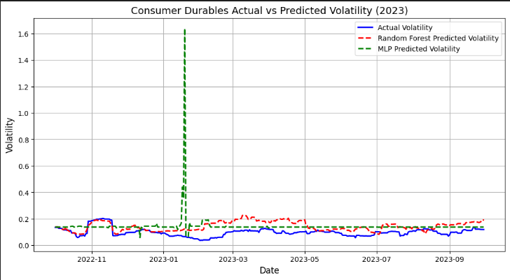
Consumer Durables Sector

Slide 52
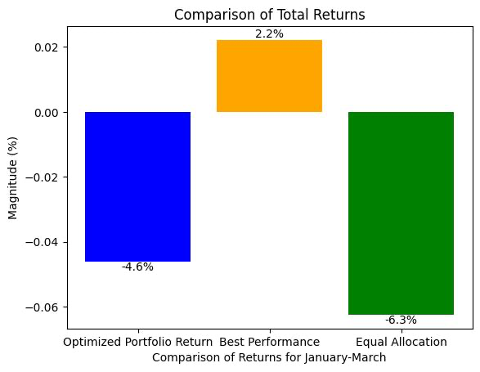
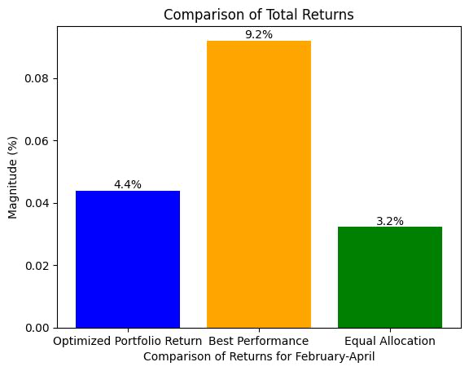
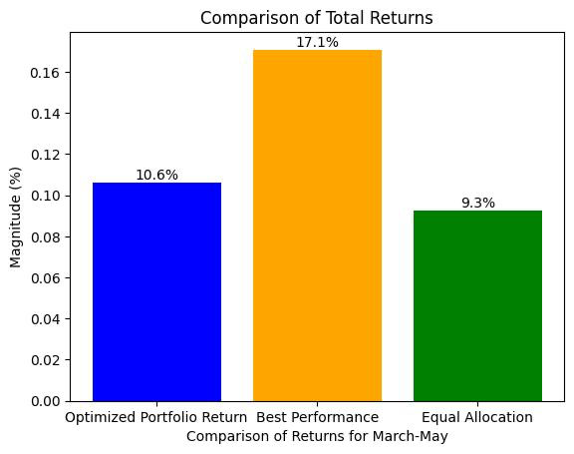
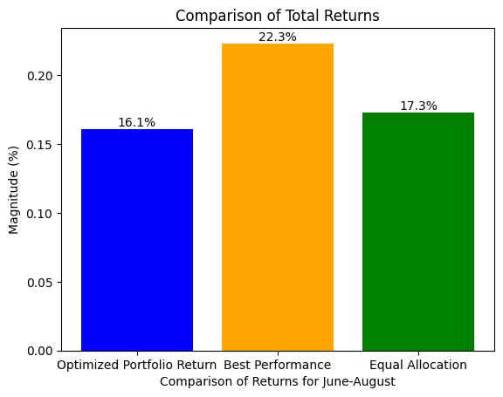
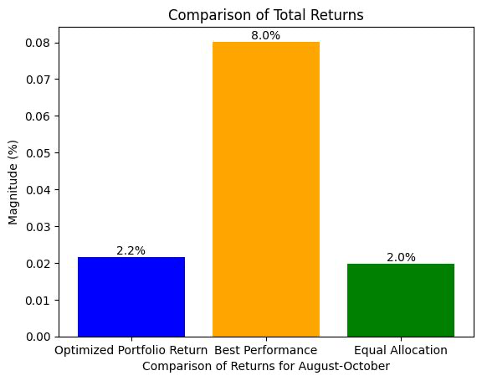
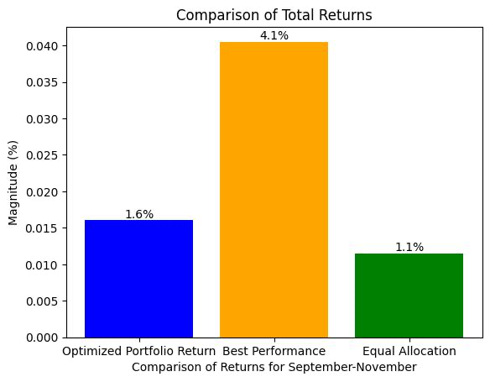
Optimization Test Results

Slide 53
Observations
Overall Performance:
The optimized portfolio return outperformed equal allocation in 6 out of 7 months, as evident from the comparison.
Monthly Insights:
January-March:
Equal allocation had a higher loss (-6.3%) compared to the optimized portfolio (-4.6%).
However, neither method beat the "Best Performance."
February-April:
The optimized portfolio (4.4%) performed better than equal allocation (3.2%).
It was closer to "Best Performance" (9.2%).
March-May:
The optimized portfolio (10.6%) significantly outperformed equal allocation (9.3%).
June-August:
The optimized portfolio (16.1%) performed well but slightly lagged behind equal allocation (17.3%).
August-October:
Equal allocation (2.0%) and the optimized portfolio (2.2%) performed similarly.
Both fell short of "Best Performance" (8.0%).
September-November:
The optimized portfolio (1.6%) outperformed equal allocation (1.1%) but was below "Best Performance" (4.1%).
Model Accuracy:
The model consistently provided better returns than equal allocation except for June-August, where equal allocation had a marginally better performance.
Best Performance vs. Model:
The "Best Performance" benchmark consistently outperformed both the optimized portfolio and equal allocation, indicating potential room for further improvement in the model.

Slide 54
Timeline
Data Collection and Preprocessing
Model Selection and Evaluation
Make optimized portfolios using predicted Volatilities
Feature Extraction,feature engineering
Predict Sector wise Stock market predictions
Evaluate predicted returns with actual returns for final evaluation of our model

Slide 55
What we going to do next?
Enhance Features: Add lag features, technical indicators (RSI, EMA), and sentiment analysis from news.
Explore Models: Test algorithms like XGBoost,etc. and implement ensemble methods.
Hyperparameter Tuning: Adjust model parameters manually based on trial and error.
Evaluate Performance: Use metrics like MAE, RMSE, Sharpe Ratio, and perform backtesting.
Document Findings: Record model performance and feature importance for future improvements.

Slide 56
Individual team members’ contributions
Contribution
1) Akshat Karnwal (2022052), Keshav Chhabra (2022247): Literature Review , Model Building
2) Ramish Jamal (2022395): Model building , Evaluation
3) Mohd Masood (2022299): Data preprocessing , Model Building

