Slide 1
Unit sales prediction
Masoud Ghodrati

Slide 2
Overview
Data overview:
Provide a summary of the data (e.g., number of stores/items/families)
Data exploration and visualization:
How sales change over months/seasons/years
How geographical locations of cities/state affect sales
What are the most popular items/families?
Are there any periodicity in sales?
Do promotion affect sales?
Data prediction:
Use ML methods (linear reg. and random forest) to predict unit sales
Split the data to train and test
Prediction and evaluation

Slide 3
Data overview
Data overview
The aim is to predict the unit sales for different items sold at different stores over a time period.
Data:
In total, the data includes:
The test data have 60 unique items that are not included in the training data.
The data covers a period of four years between Jan 2013 to Aug 2017
# stores | # states | # cities | # unique items | # item families | # classes
54 | 16 | 22 | 4100 | 33 | 337

Slide 4
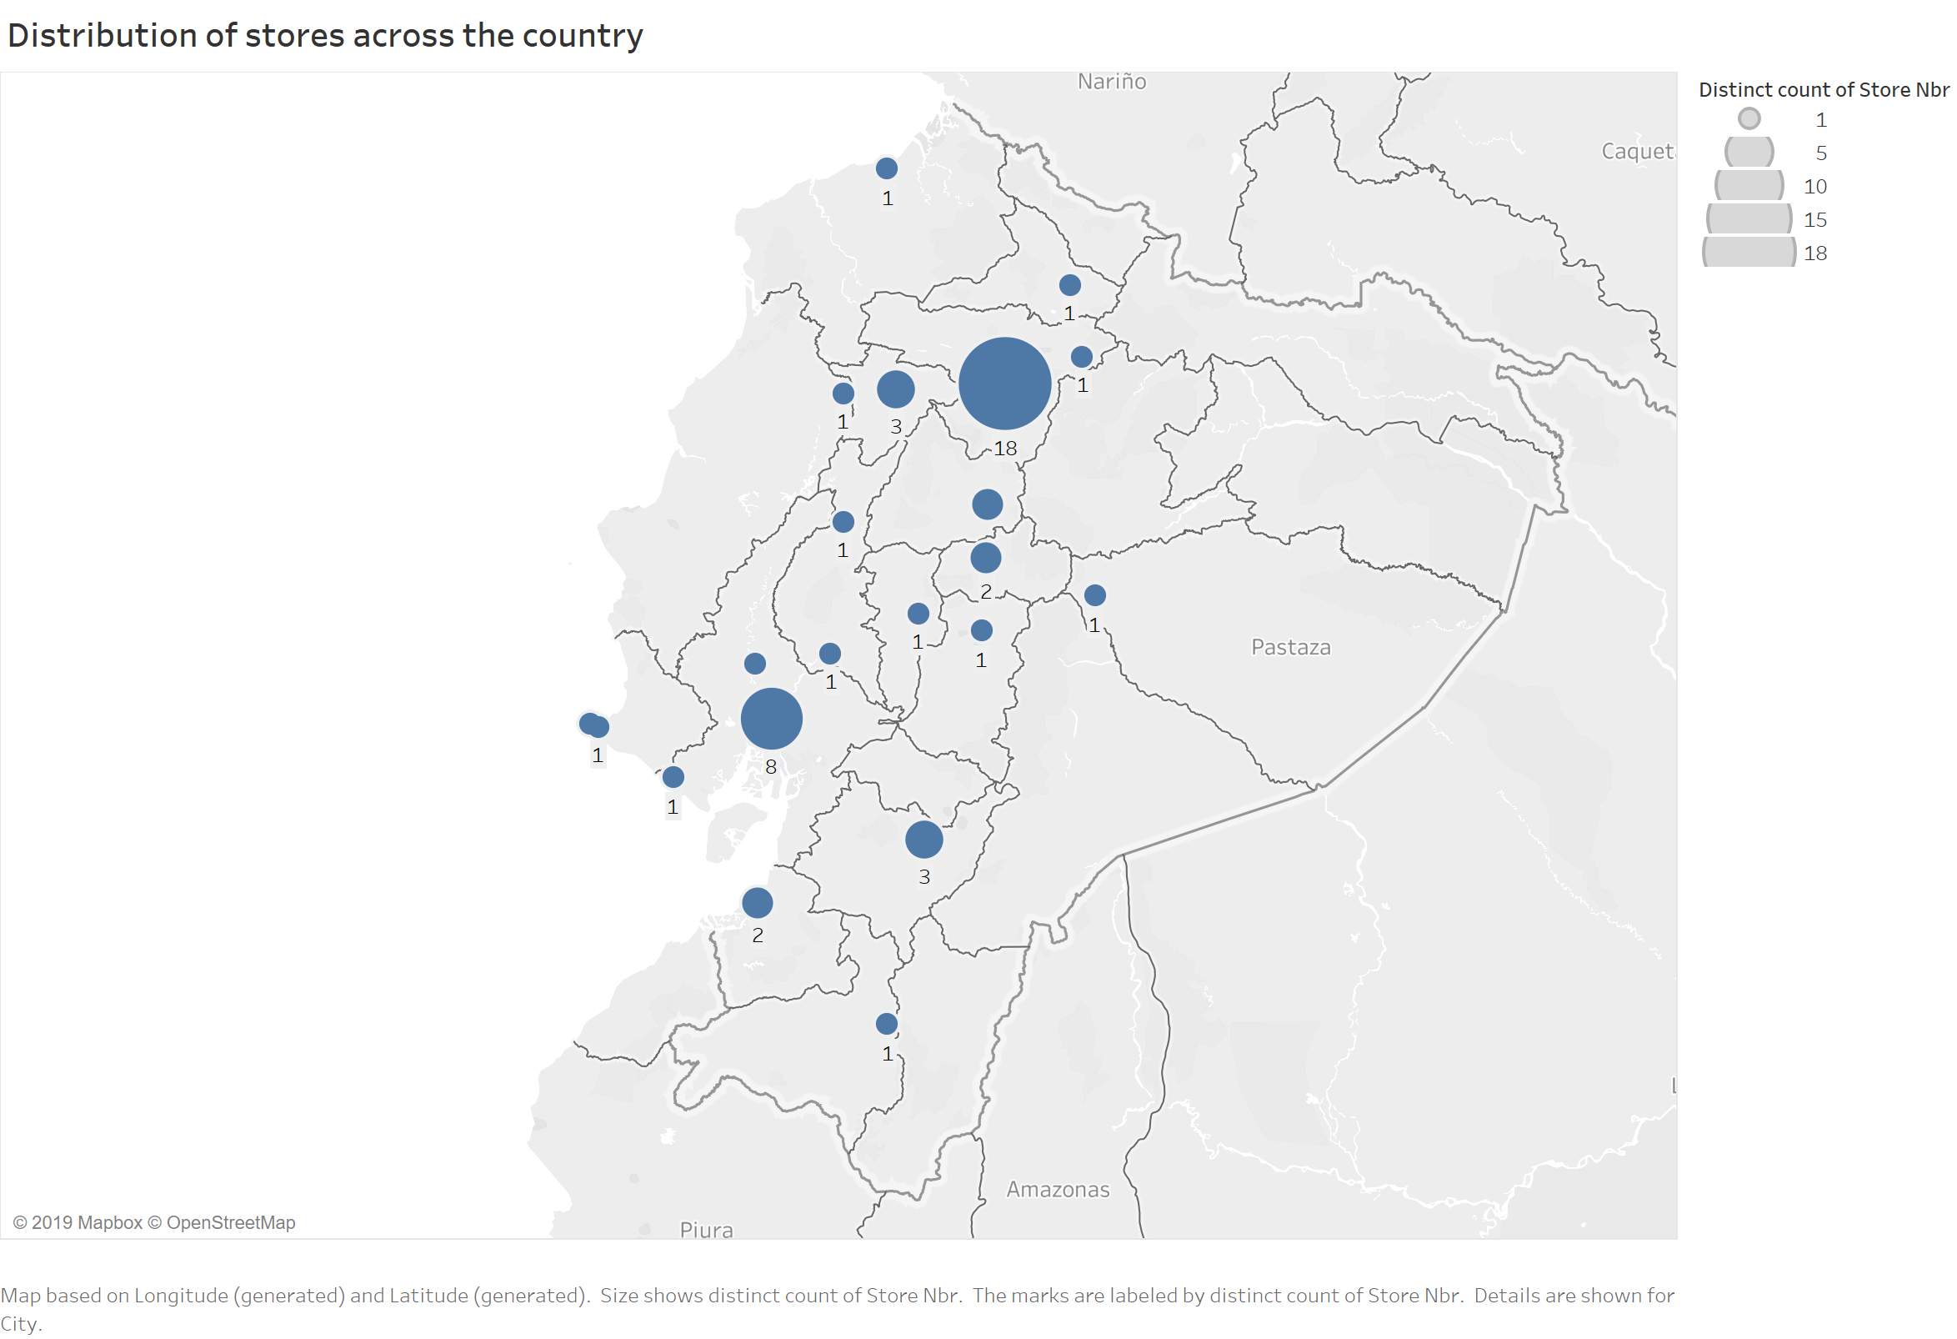
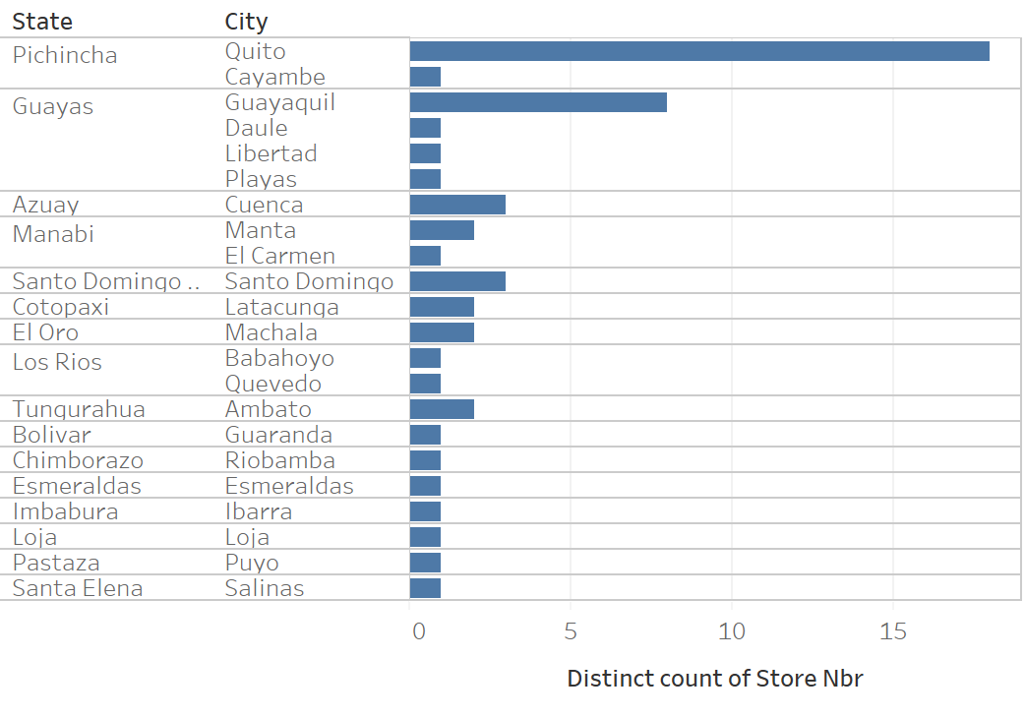
Pichincha and Guayas have significantly higher number of stores. The capital, Quito, has 18 store (34% of the whole stores).
Data visualization

Slide 5
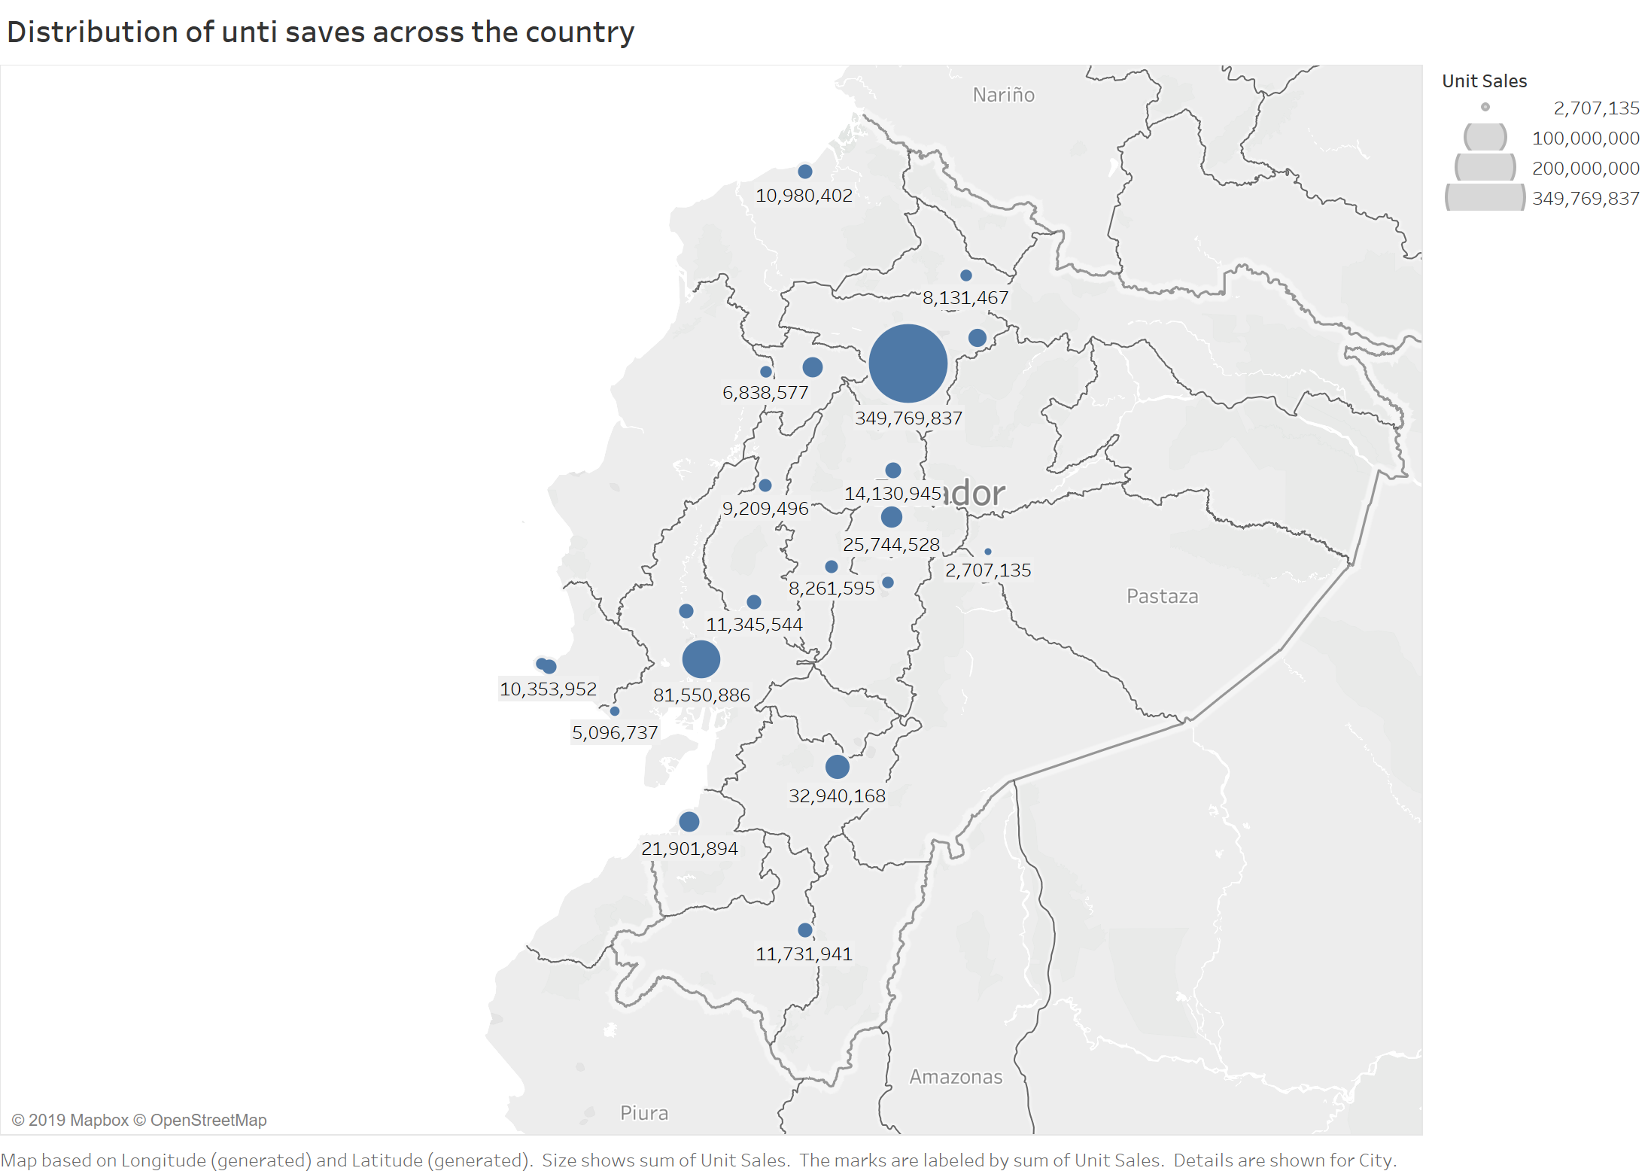
Pichincha and Guayas have also significantly higher sales (Pichincha with 53.34% and Guayas with 15.84%, totaling of close to 70% of the whole sales)
Data visualization

Slide 6
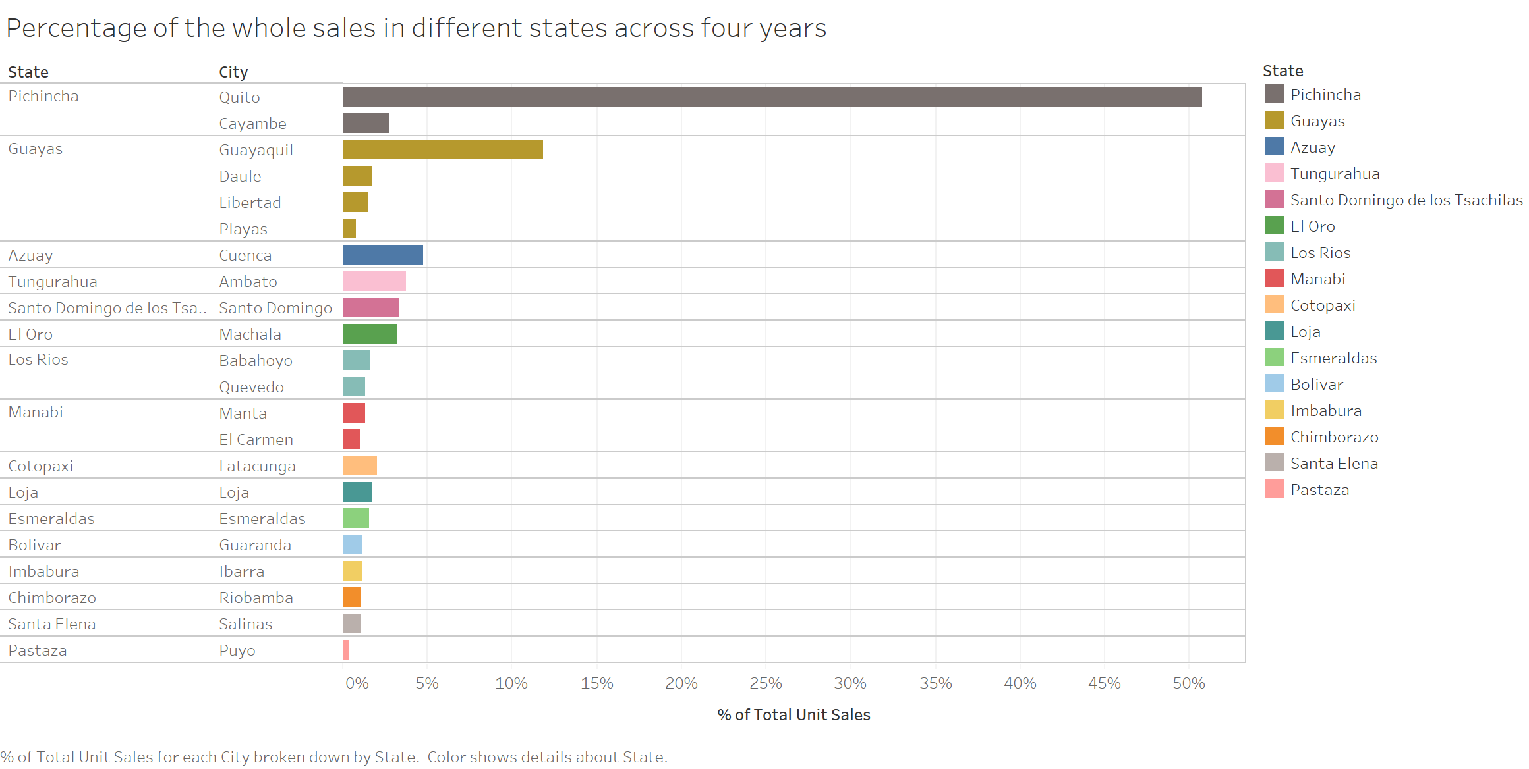
Data visualization
Almost 70% of the whole sales

Slide 7
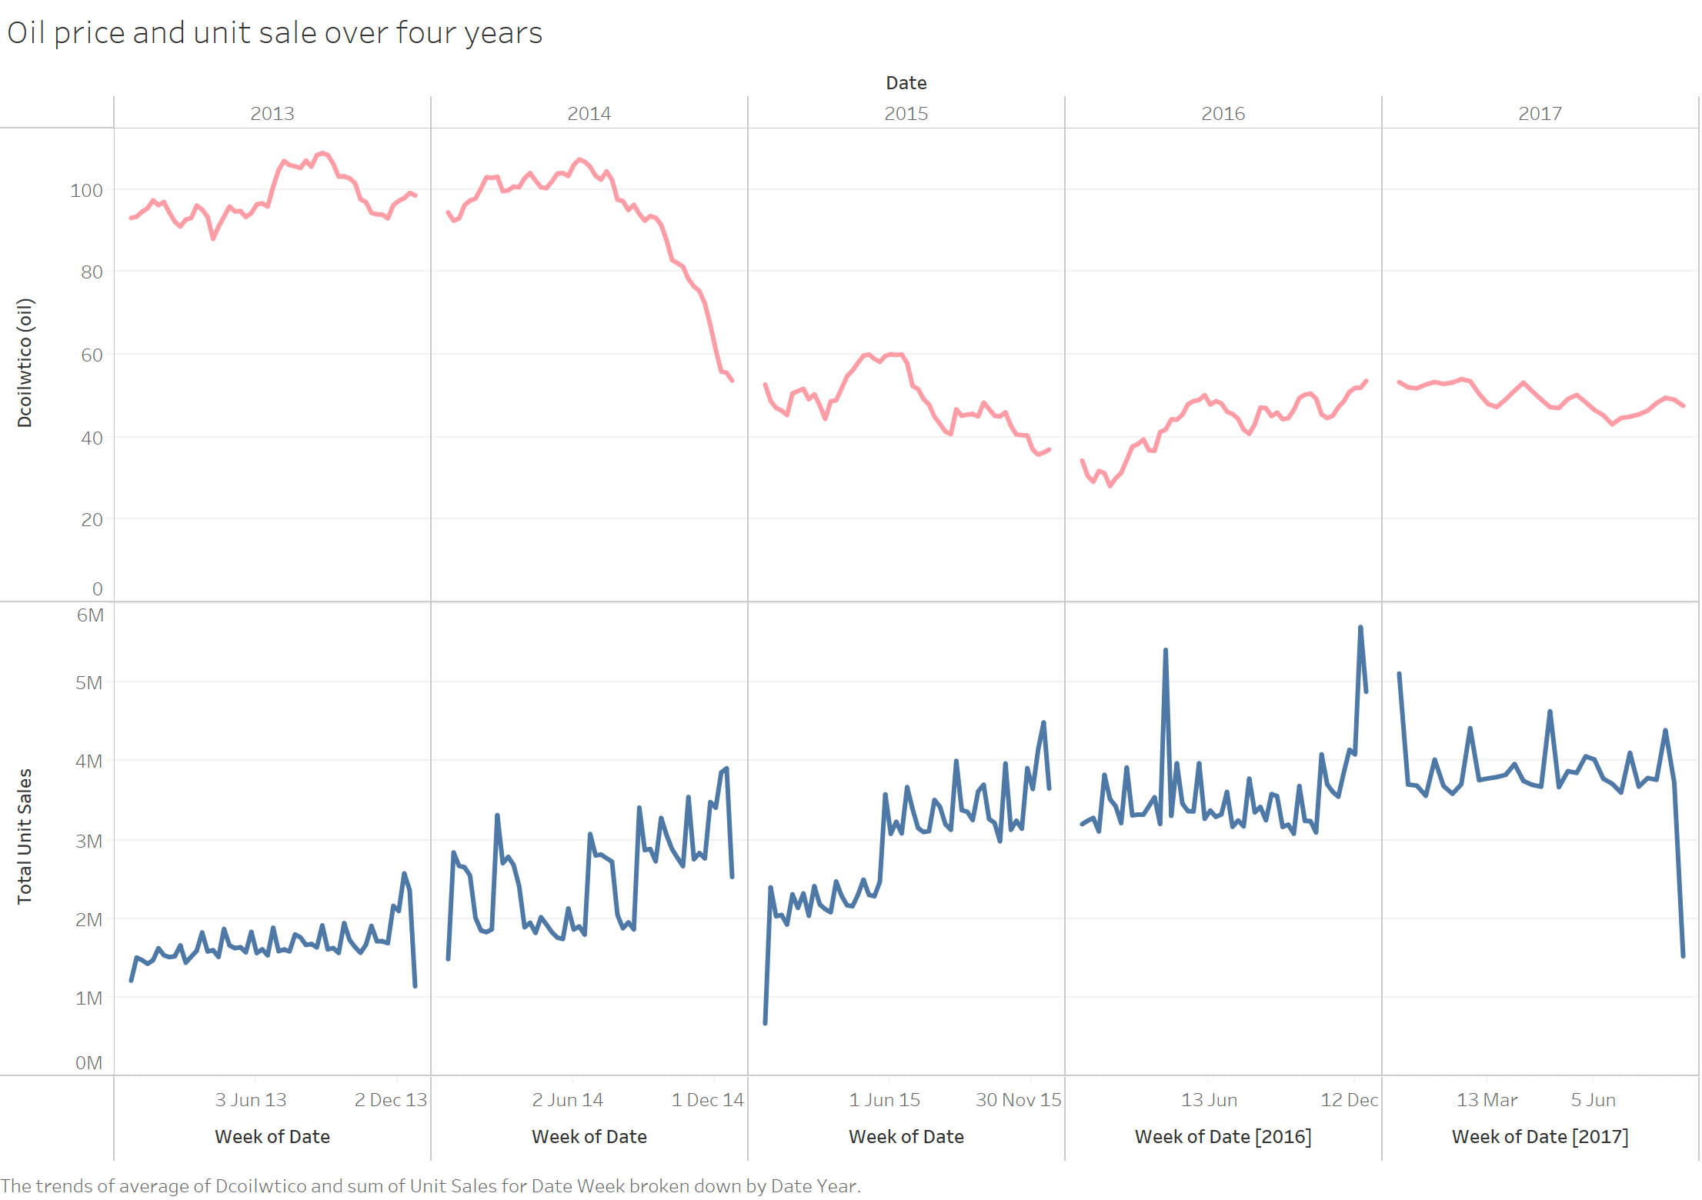
Weekly unit sales increases during the last few weeks of the year (Christmas holidays)
Small, but periodic, fluctuations across years aligned with the end of months (salaries are paid, sales increased).
Oli price doesn’t seem to affect the sale that much at least visually
Data visualization

Slide 8
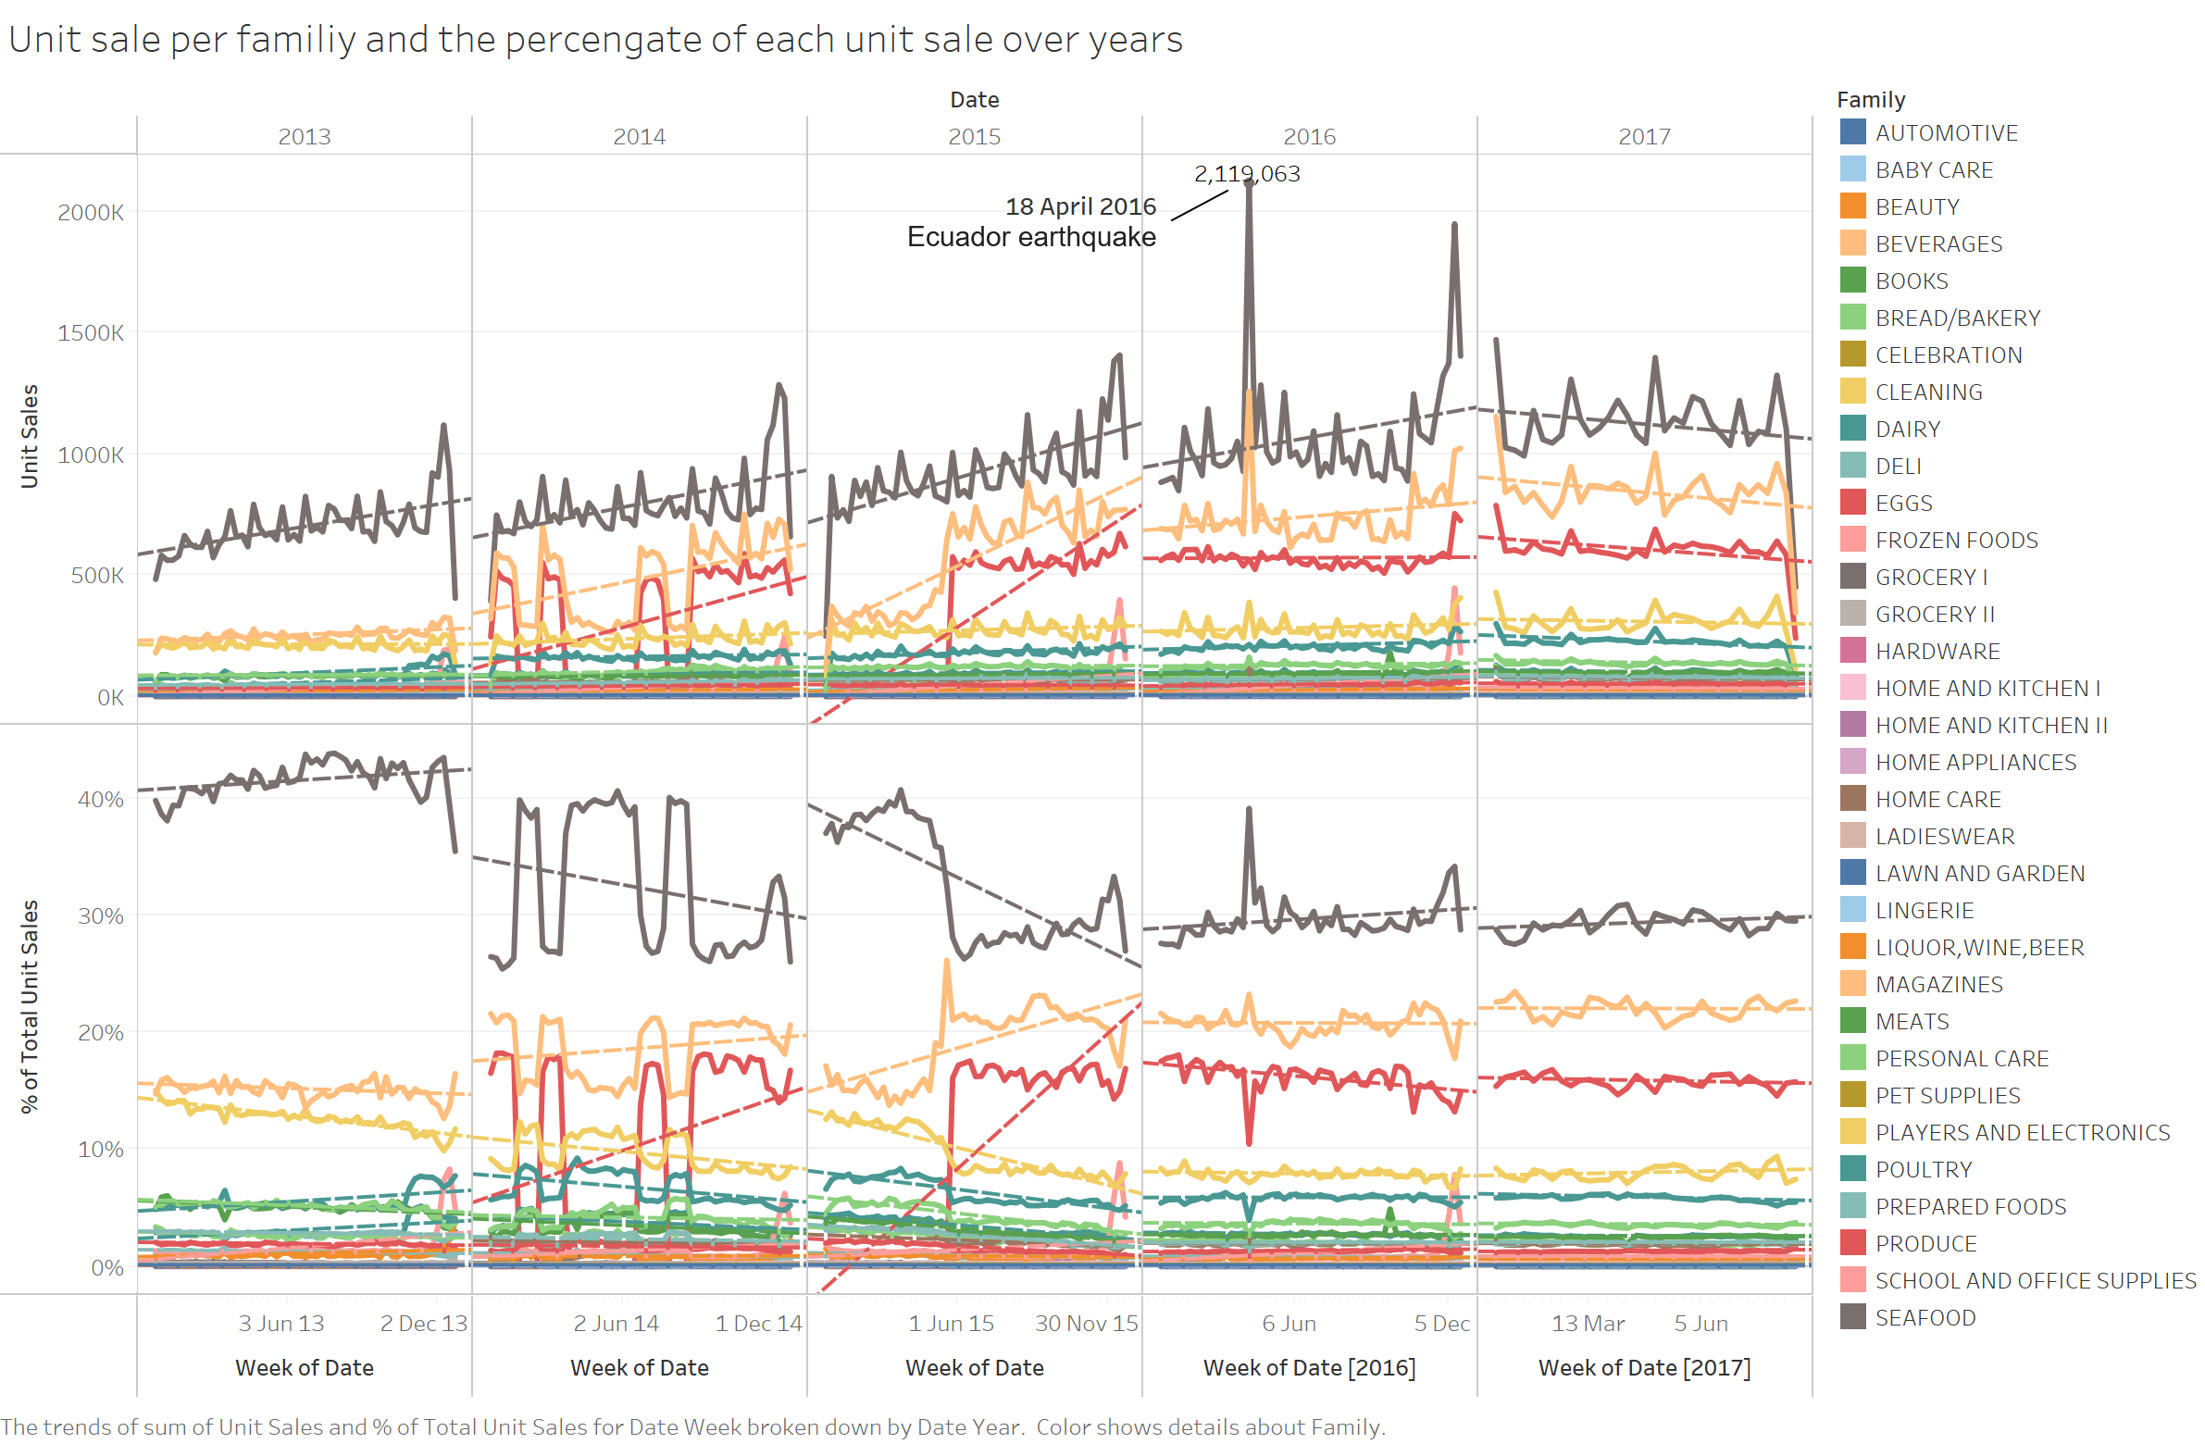
Grocery I has the highest unit sales followed by Beverages and Produce, and this trend is kept during the whole year
There is a kind of upward trend in sales towards the end of the year
A pronounced monthly periodic pattern for some item families (Grocery I, Beverages, and Produce)
Almost 63.7% of the whole sales coming from : Grocery I, Beverages, and Produce
The percentages for most families do not change a lot across the year
Data visualization

Slide 9
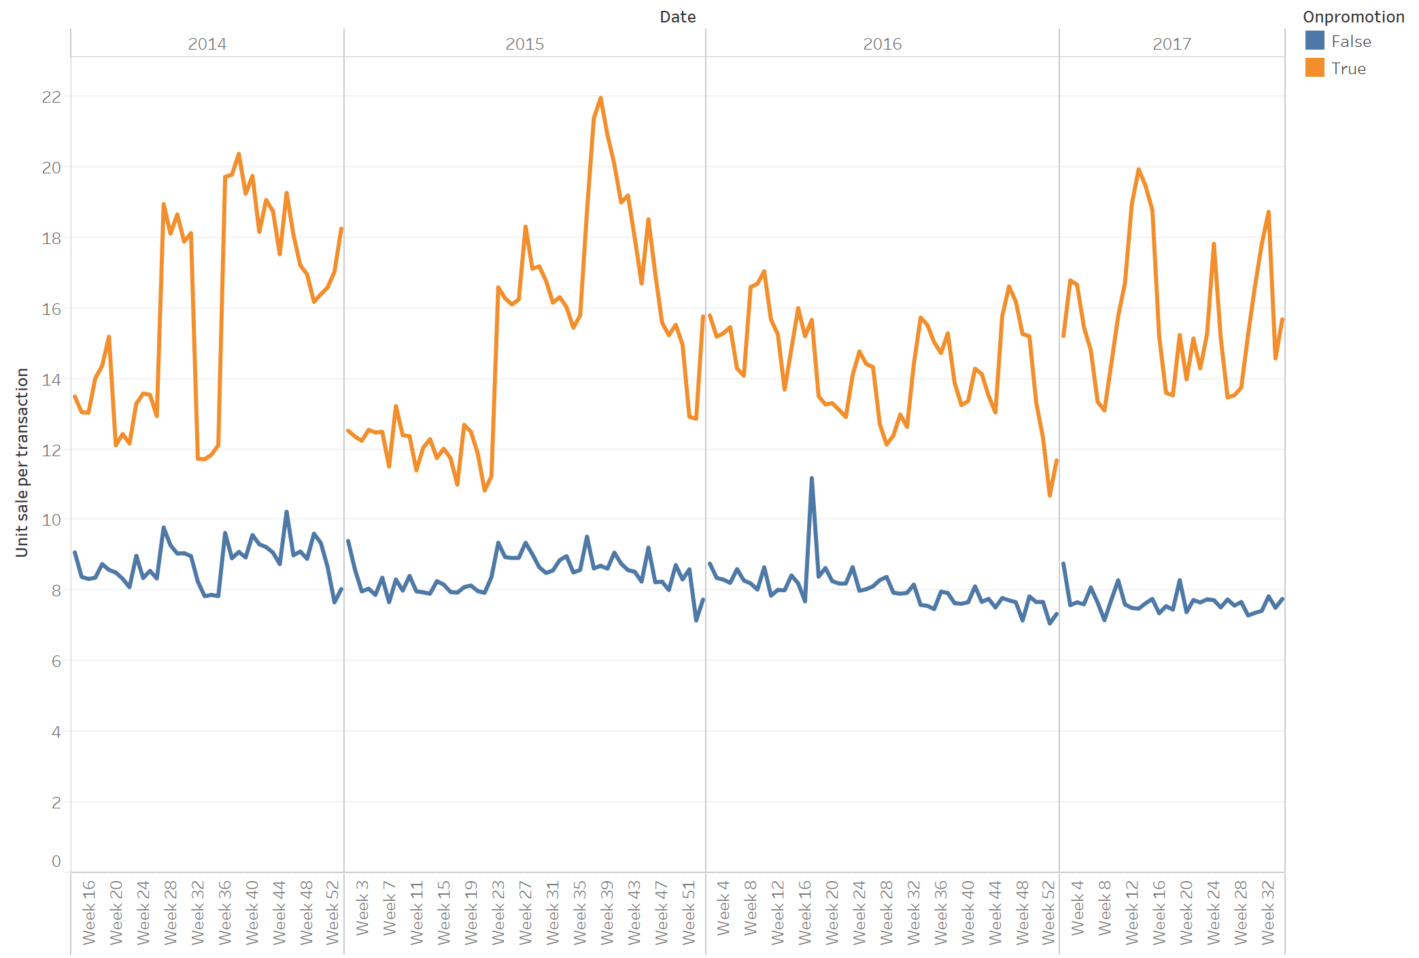
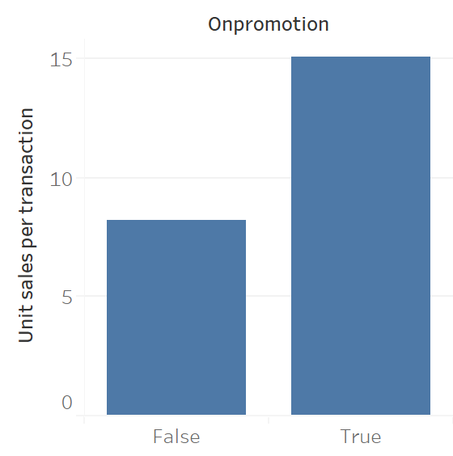
Promotion increased the sales
Data visualization

Slide 10
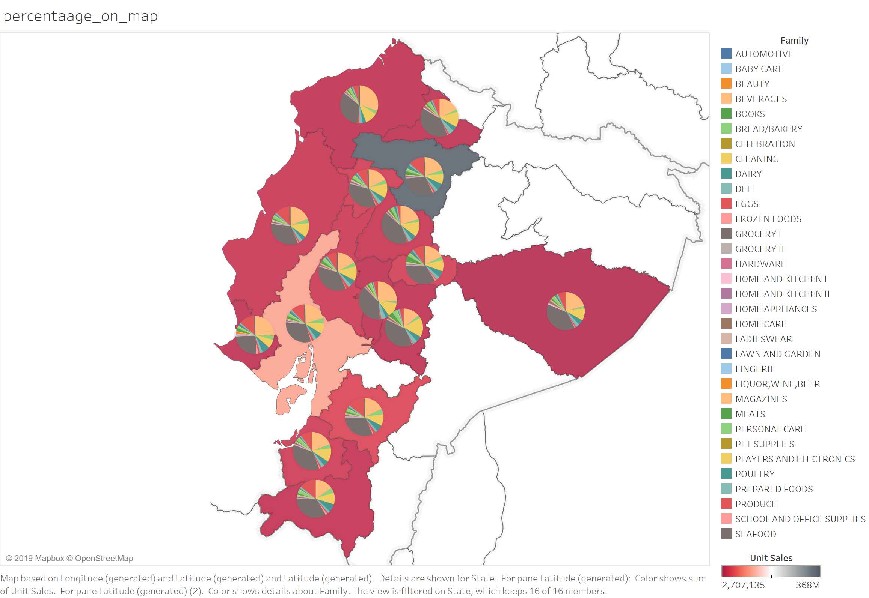
Geographical dependency of unit sales.
The geographical location does not affect the sales much. This is not surprising as Ecuador is a rather small country and the climate or season factor do not affect the sales that much.
Data visualization

Slide 11
Predicting the unit sales
Data prediction
Data preparation:
Filling the missing values (mean/median of historical data)
Merging different tables (items, stores, holidays, etc.) to make a single data
Dividing the (training) data to 1) train and 2) validation sets.
Prediction methods
Linear Regression
Random Forest Regression
Train the model using a time window of historical data (e.g., last two weeks)
Predicted the future (two weeks) unit sales
Evaluation metrics: Normalized Weighted Root Mean Squared Logarithmic Error (NWRMSLE)
Train
Predict

Slide 12
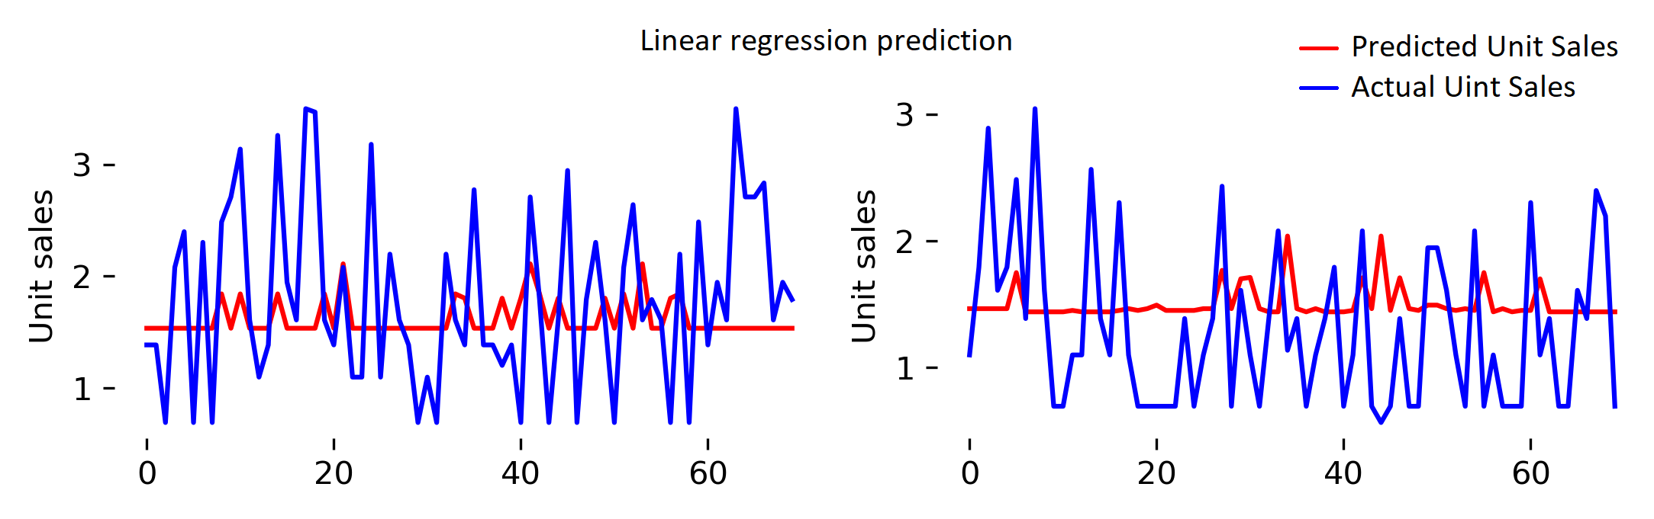
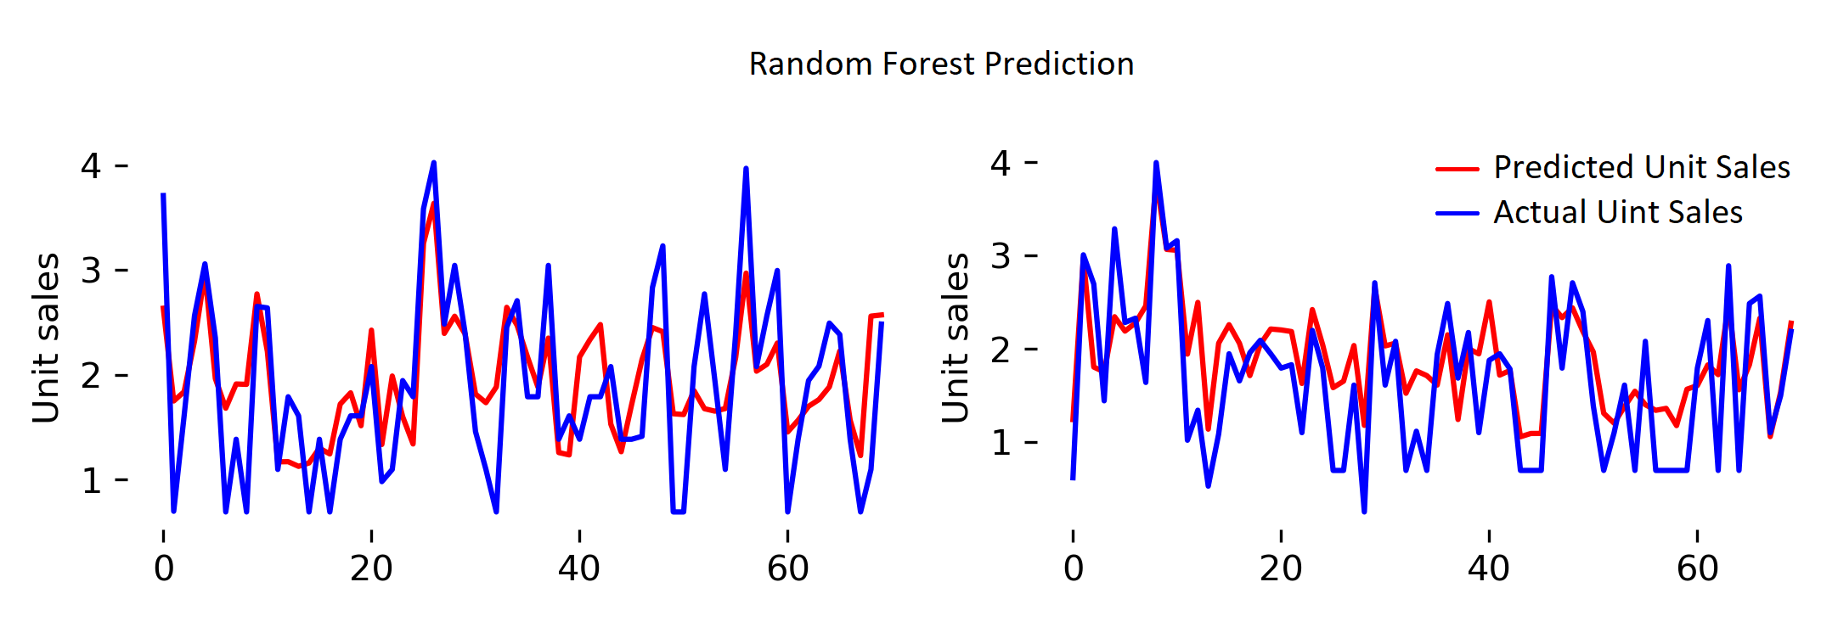
Some sample results: Random forest is reasonably good in predicting
Data prediction

Slide 13
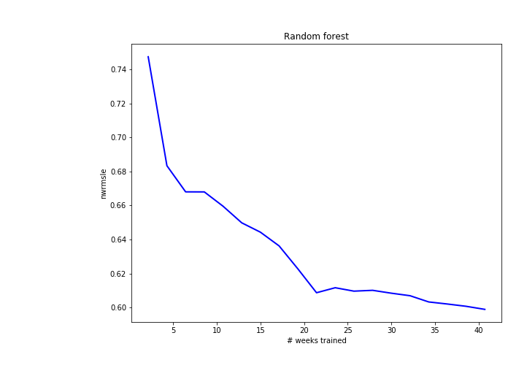
Random forest can even improve by training on more dates
Data prediction

Slide 14
Other TO DO things
From the technical side:
If I had more time, I could play with other models (e.g., NNs, LSTM, or other supervised model) and large training data to see how they perform.

Slide 15
THE END

Slide 16
Some other support visualization

Slide 17
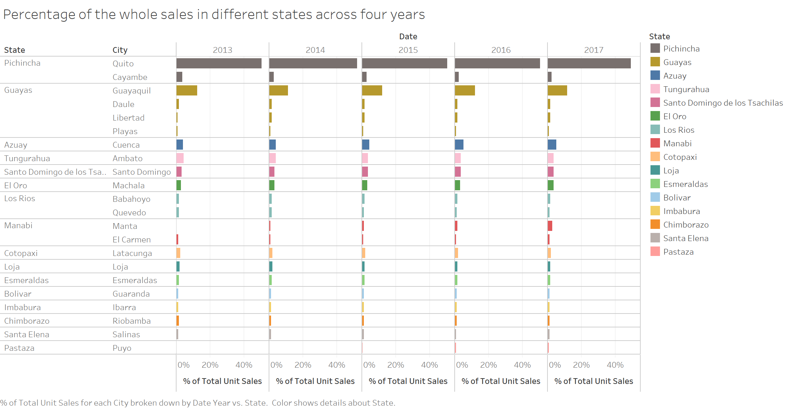

Slide 18
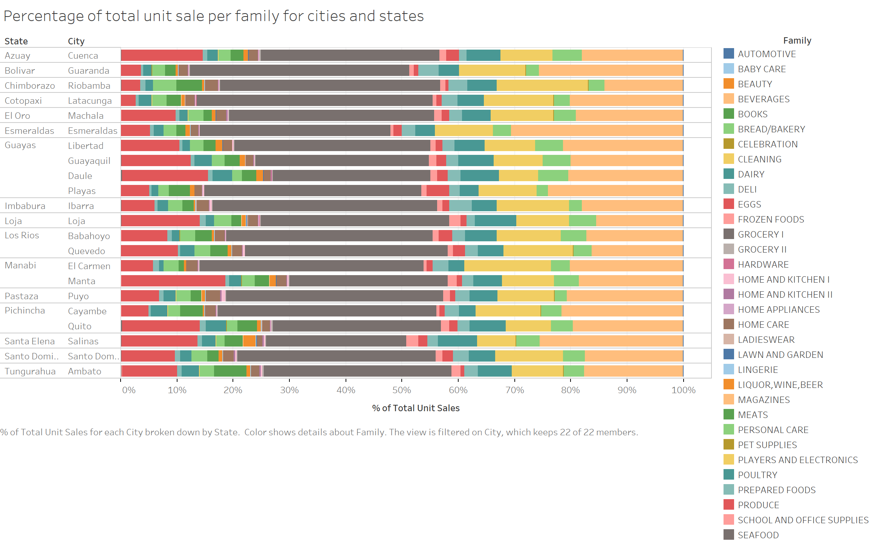

Slide 19
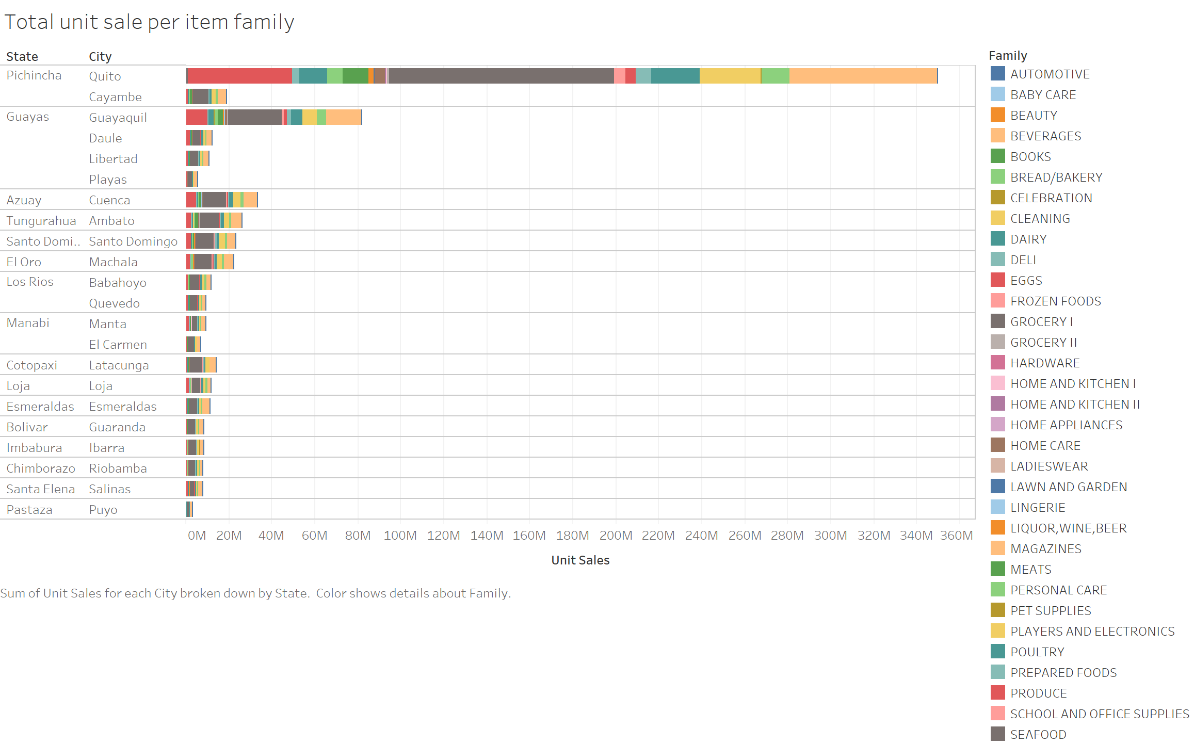

Slide 20
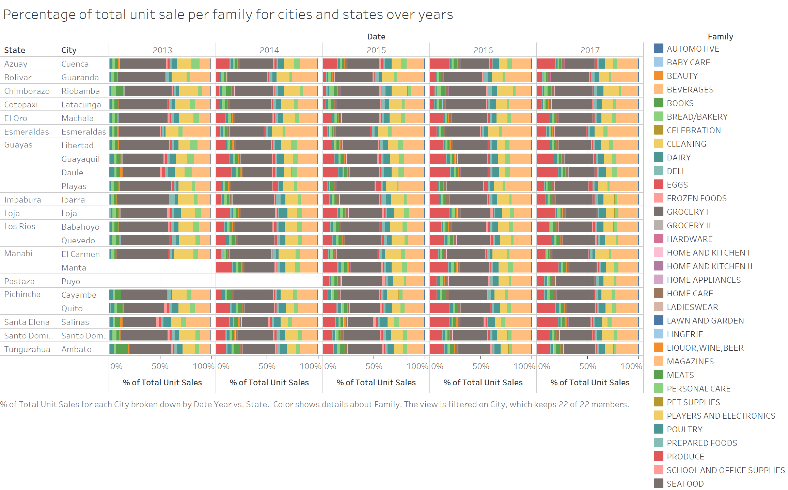

Slide 21
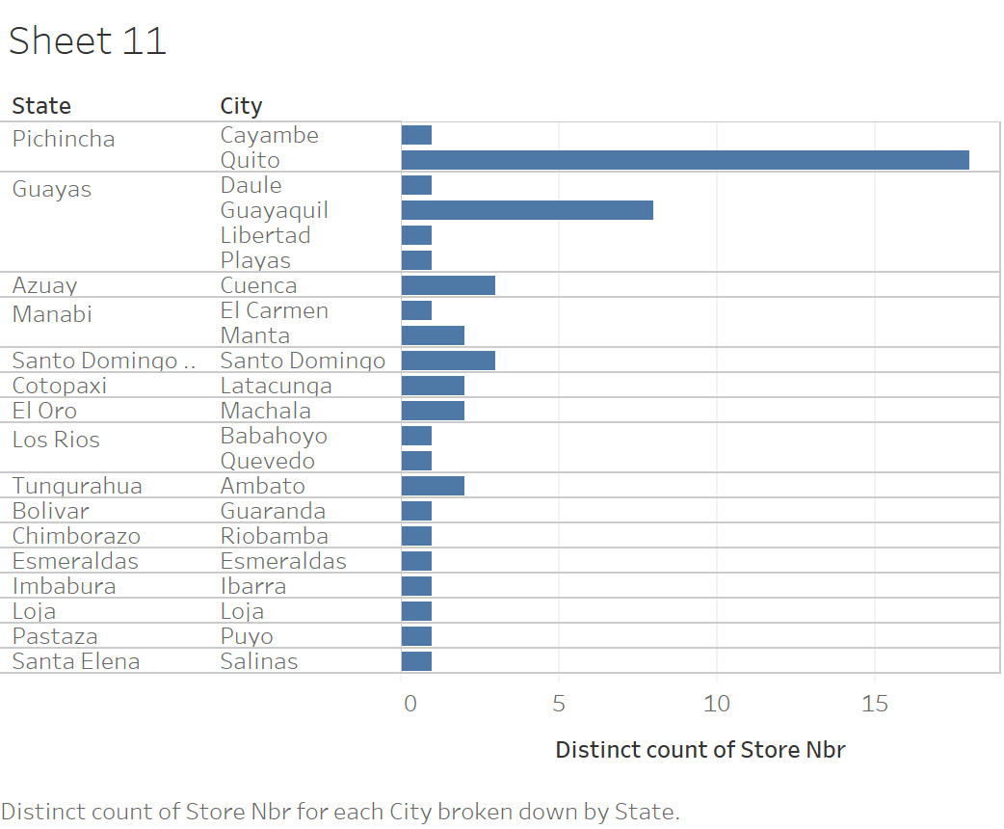

Slide 22
Feature importance
column names feature importance
2 item_nbr 0.353180
9 class 0.197827
0 id 0.104710
18 total_store_sales 0.099306
8 family 0.071201
11 dcoilwtico 0.041435
1 store_nbr 0.035127
6 type 0.024008
3 onpromotion 0.023101
7 cluster 0.017217

