Slide 1
Unit sales prediction for Favorita chain
Masoud Ghodrati

Slide 2
Overview
Data overview:
Summary of the data (e.g., number of stores/items/families)
Data exploration and visualization:
How sales change over months/seasons/years
How geographical locations of cities/state affect sales
What are the most popular items/families?
Are there any periodicity in sales?
Do promotion affect sales?
Data prediction:
Use ML methods (linear regression and random forest) to predict unit sales
Split the data to train and test set
Prediction and evaluation

Slide 3
Question
Data overview
Data
Unit sales data of Favorita stores (Jan 2013 - Aug 2017): item, store, item’s family, store’s city, …
# stores | # states | # cities | # unique items | # item families | # classes
54 | 16 | 22 | 4100 | 33 | 337
Predictive analytics
For example:
- predict unit sales for a particular item based on date and store
- predict unit sales for a new item introduced

Slide 4
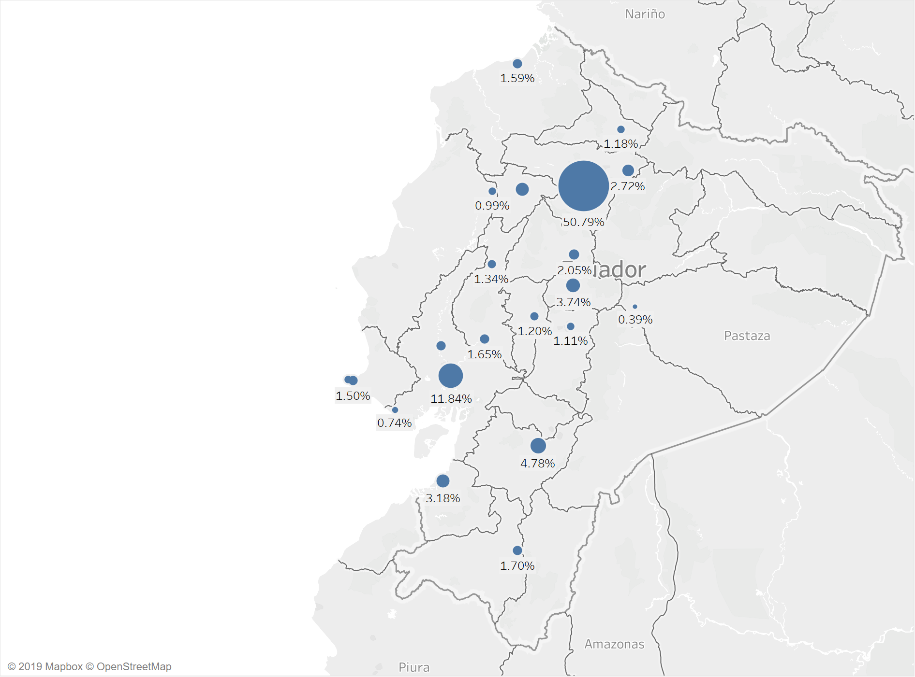
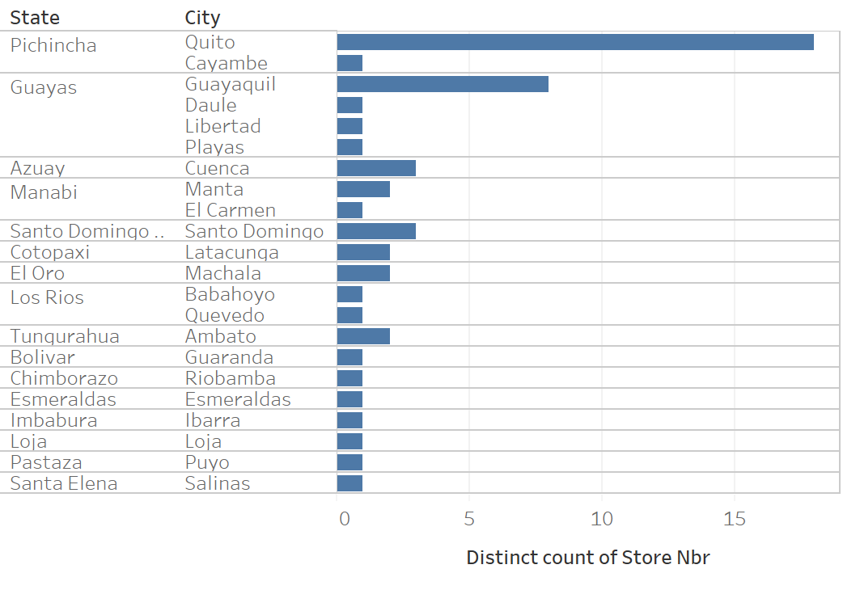
Total unit sale for individual states
Pichincha and Guayas have significantly higher unit sales (Pichincha with 53.34% and Guayas with 15.84%, totaling of close to 70% of the sales)
Data visualization

Slide 5
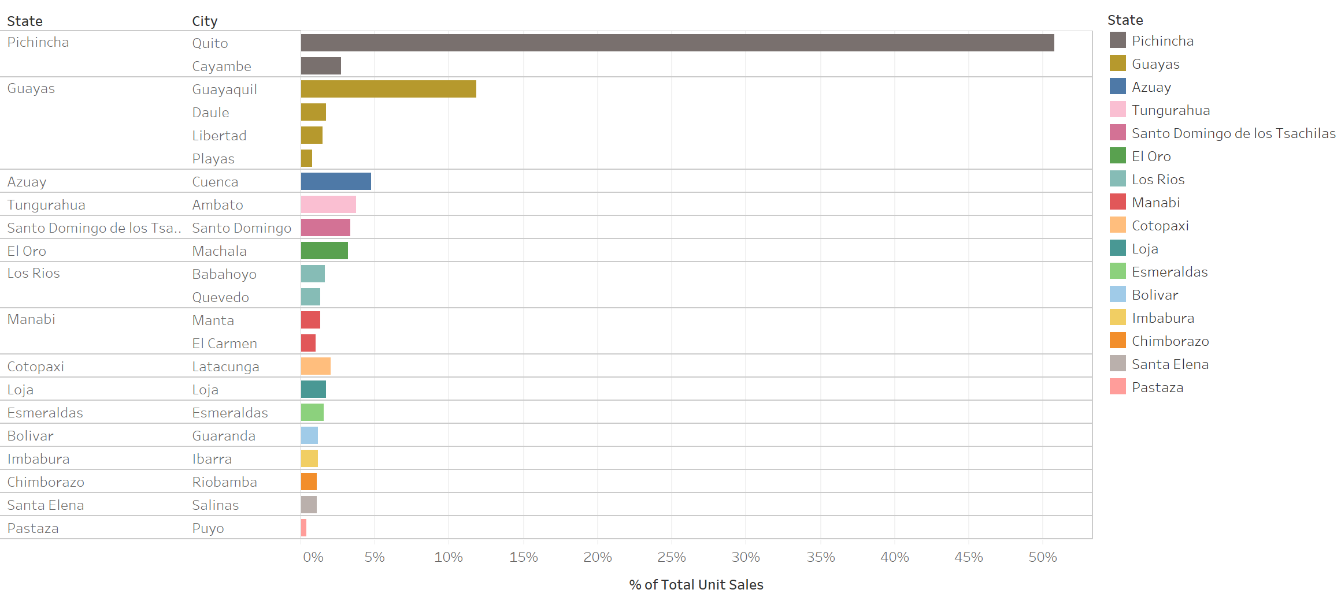
Total unit sale percentage for individual states
Data visualization
Almost 70% of the total unit sales

Slide 6
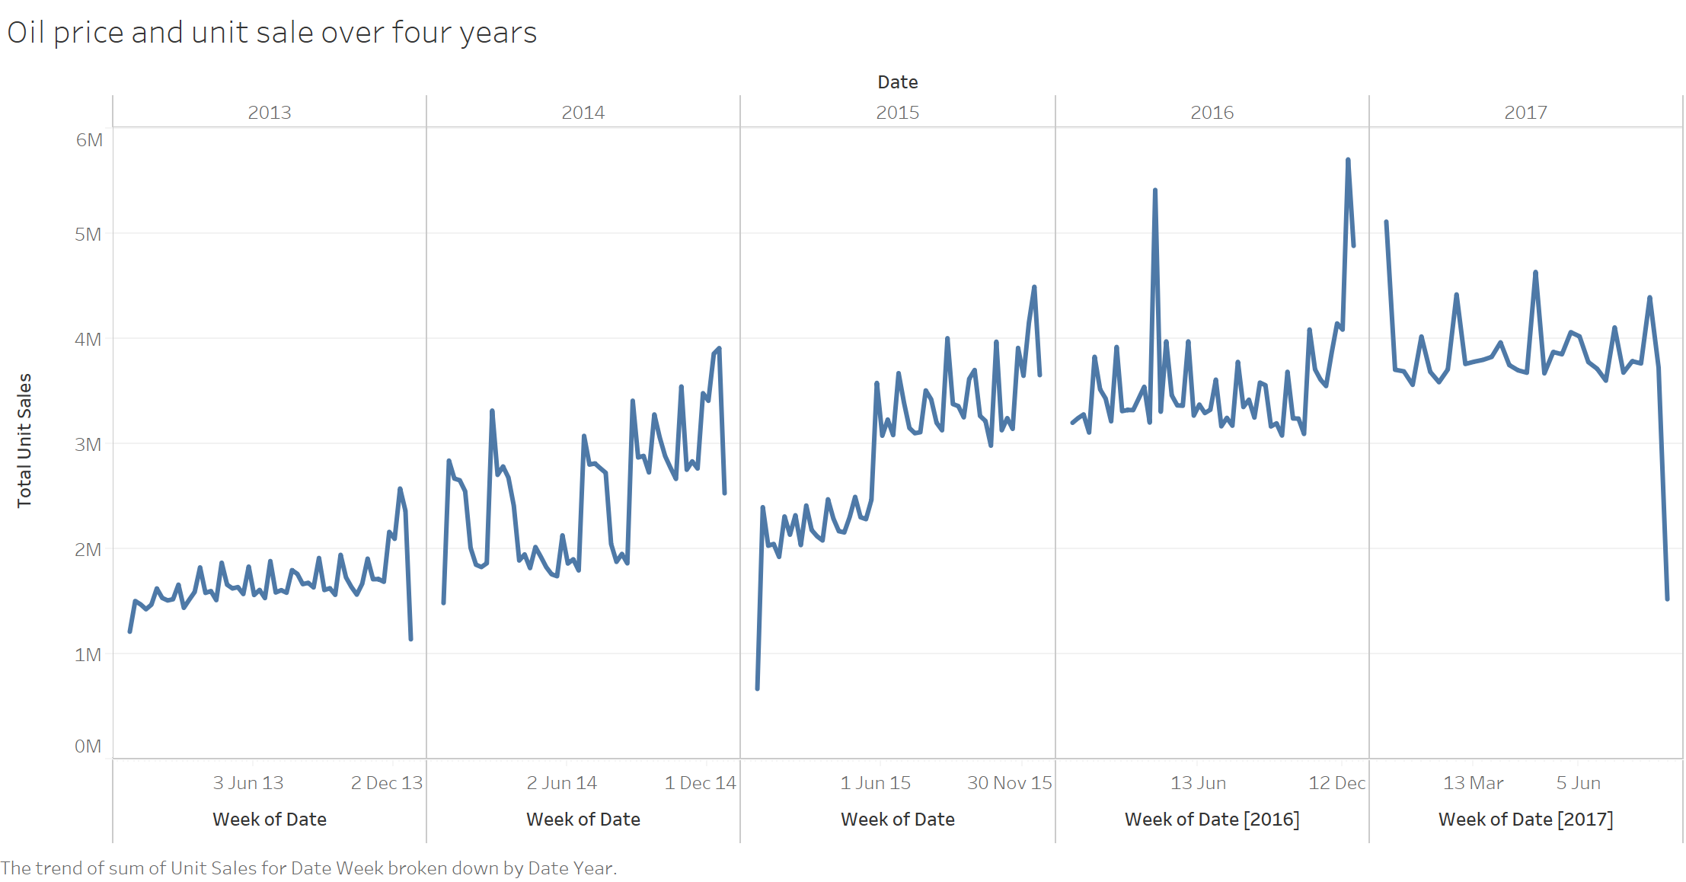
Total unit sale over four years
Data visualization
Weekly unit sales increase during the last few weeks of the year (Christmas holidays)
There’s a small, but periodic, fluctuations during a year aligned with the end of months (salaries are paid and sales increased).

Slide 7
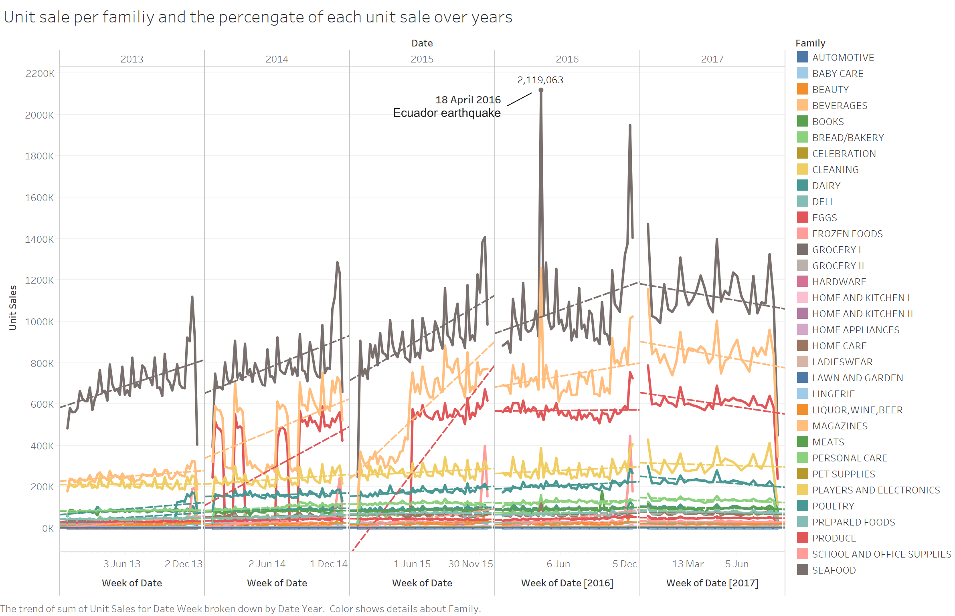
Total unit sale over four years for item families
Data visualization
Highest unit sales:
Grocery I
Beverages
Produce
Upward trend in sales towards the end of the year
Monthly periodic pattern for some item families (Grocery I, Beverages, Produce)
Almost 63.7% of the whole sales coming from : Grocery I, Beverages, and Produce

Slide 8
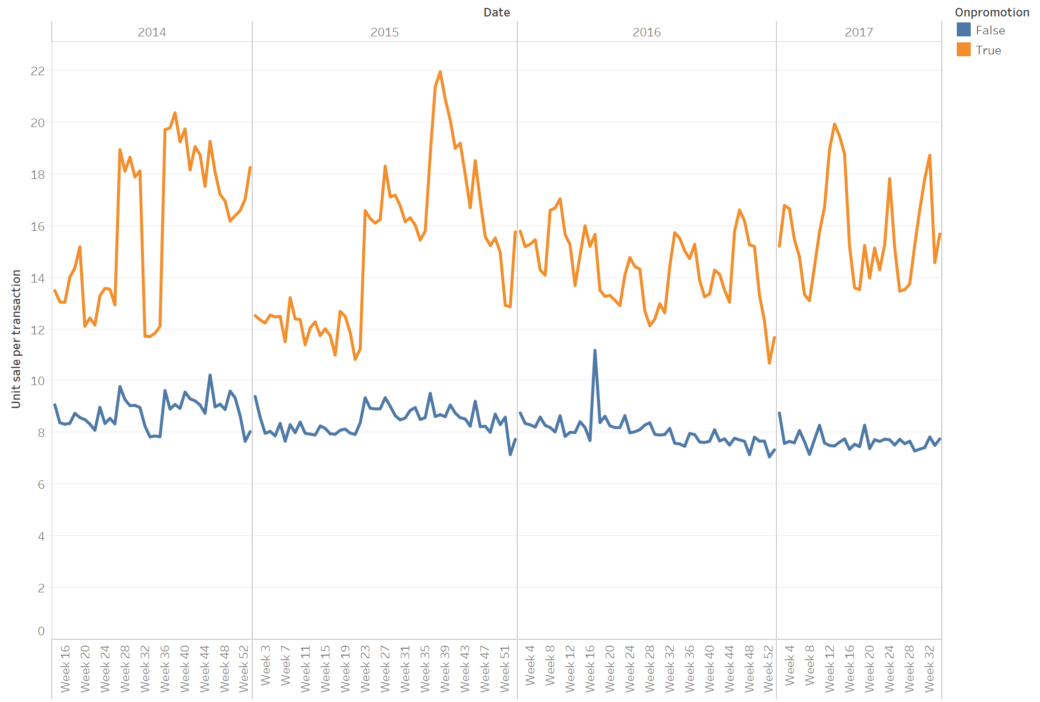
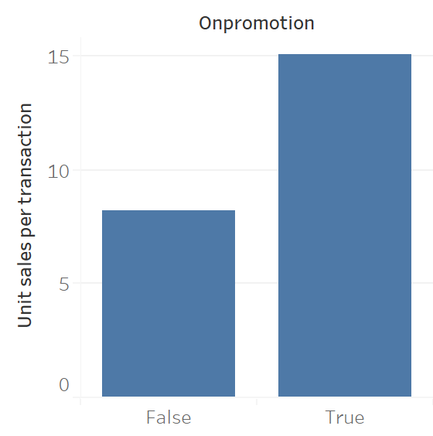
Does promotion increase the sales?
Data visualization

Slide 9
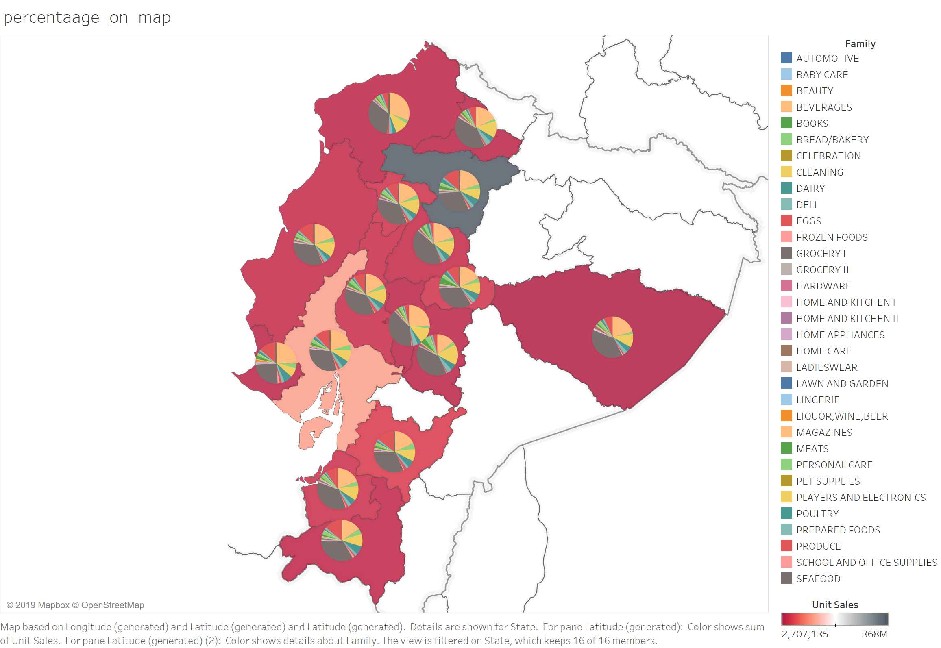
Geographical dependency of unit sales.
The geographical location does not affect the sales much.
Data visualization

Slide 10
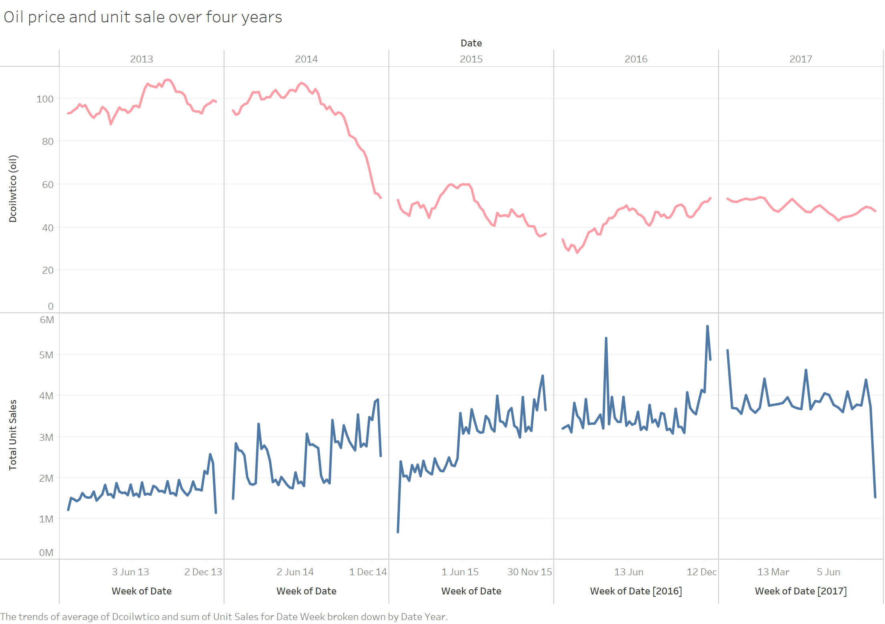
Predicting the unit sales
Data prediction
Data preparation:
Filling the missing values (mean/median of historical data)
Merging different tables (items, stores, holidays, etc.) to make a single data
Prediction method
Linear Regression
Random Forest Regression
Selection important features: recursive feature elimination
Evaluation metrics: Normalized Weighted Root Mean Squared Logarithmic Error (NWRMSLE)
Train
Validation

Slide 11
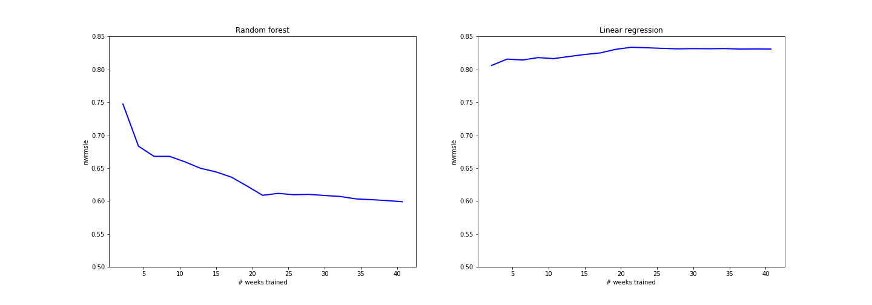
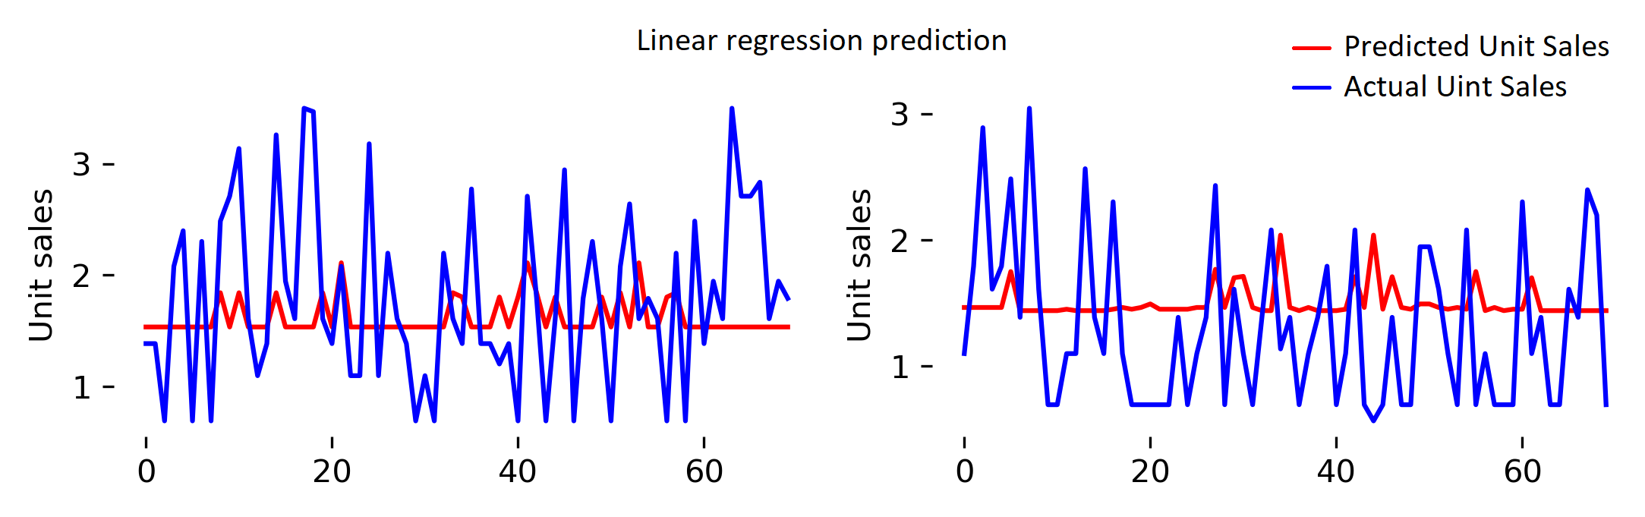
Linear regression (simpler model)
Data prediction
Worse prediction
Better prediction
items
items
Poor performance
Not improved by larger train set

Slide 12
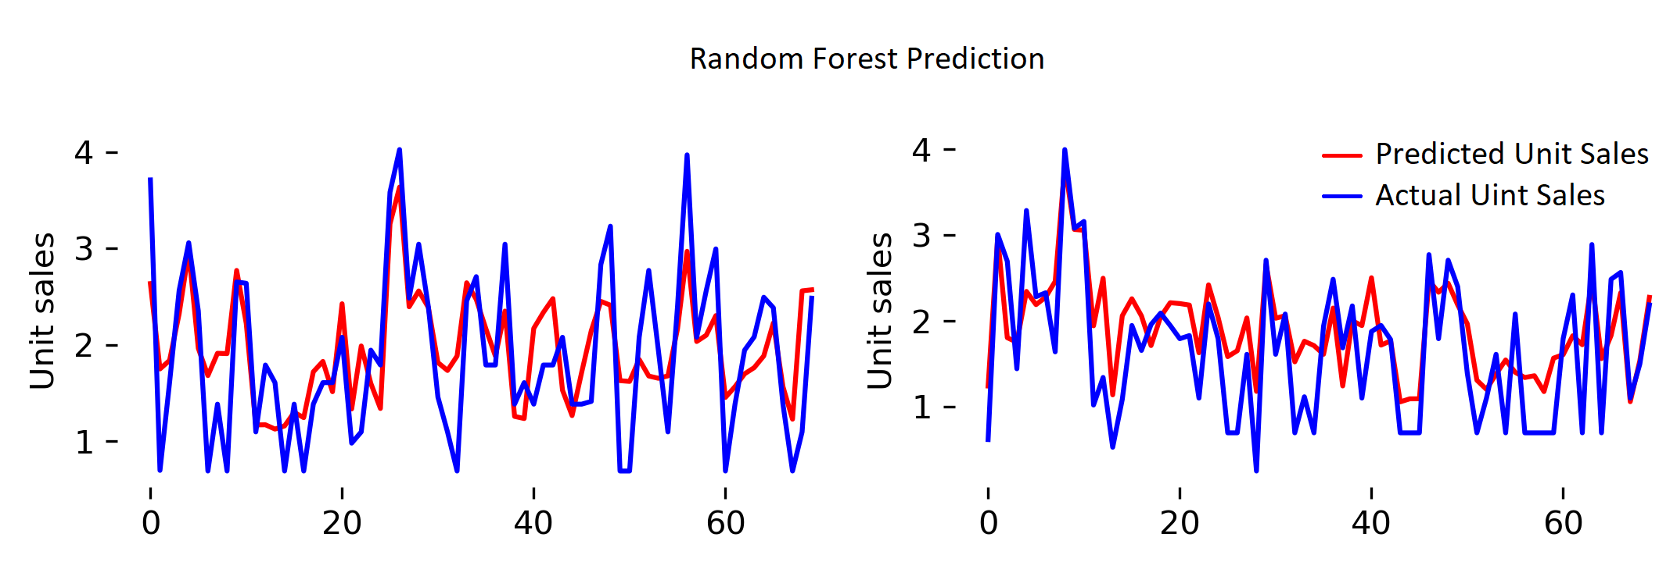
Random forest
Data prediction
Worse prediction
Better prediction
items
items
Better performance
Improved by larger train set

Slide 13
Improvements
If I had more time,
Parameter optimization
Construct features (e.g., day of the week, end of the month)
Test other models (e.g., NNs, LSTM, or other supervised model) and large training data to see how they perform.
More analysis: e.g., based on date

Slide 14
Limitations
Did not include date in feature set:
So can not answer questions related to time of sales

Slide 15
Questions?

Slide 16
Some other support visualization

Slide 17
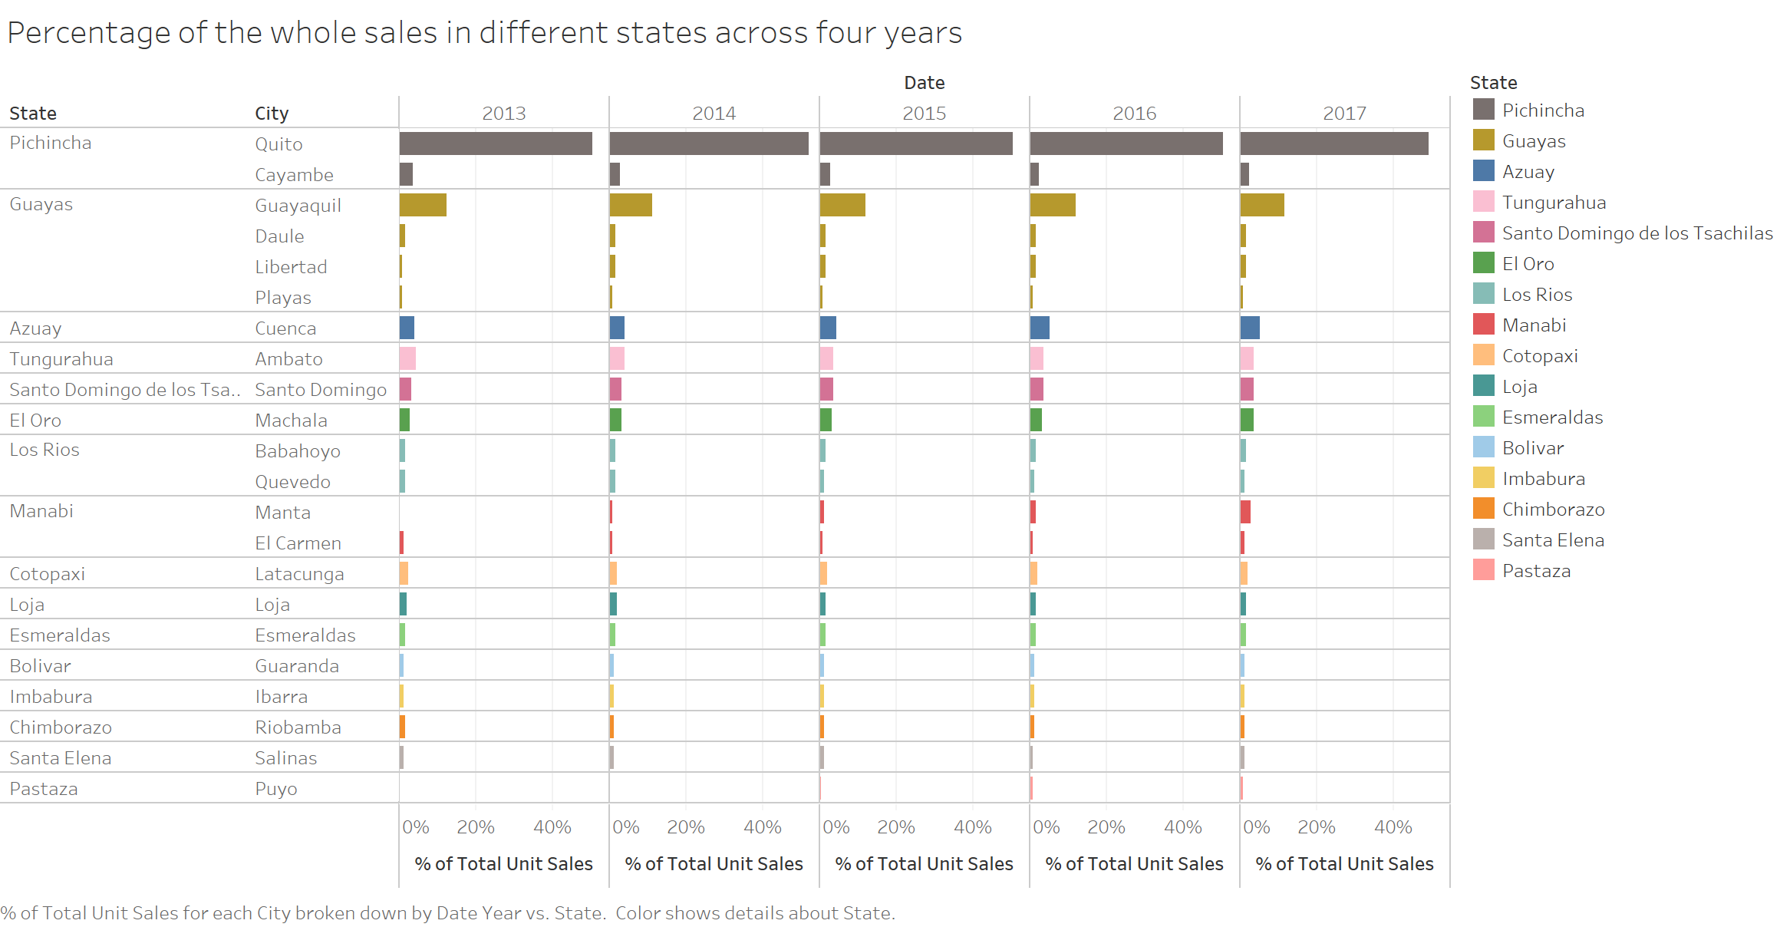

Slide 18
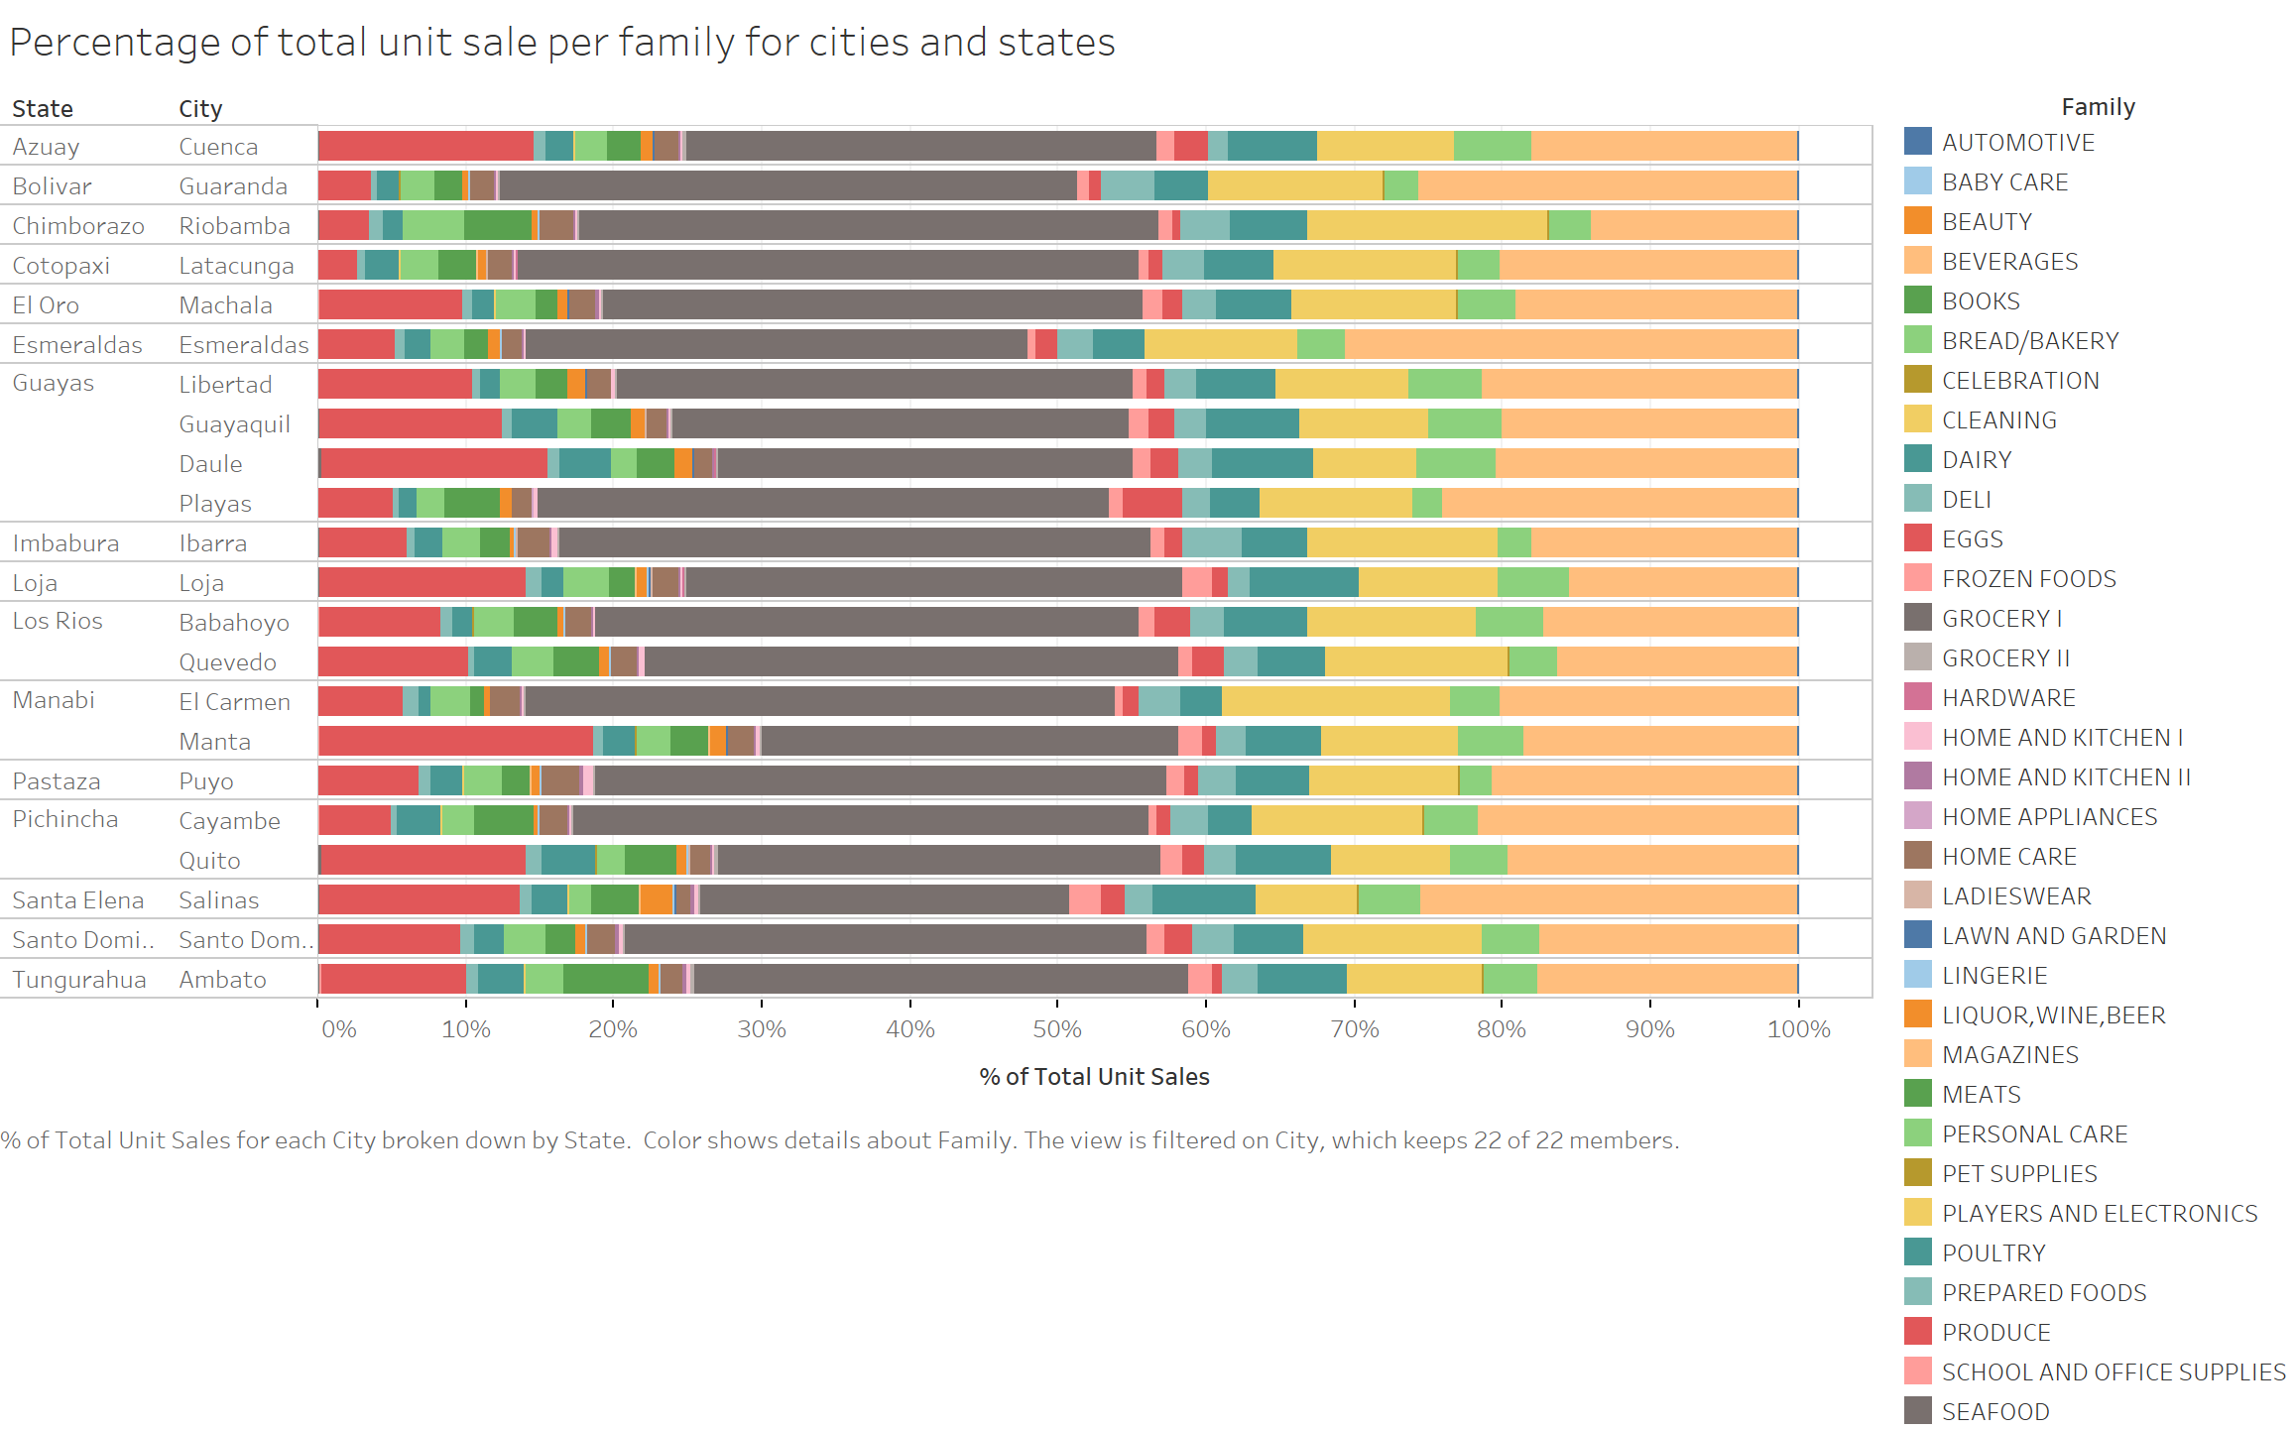

Slide 19
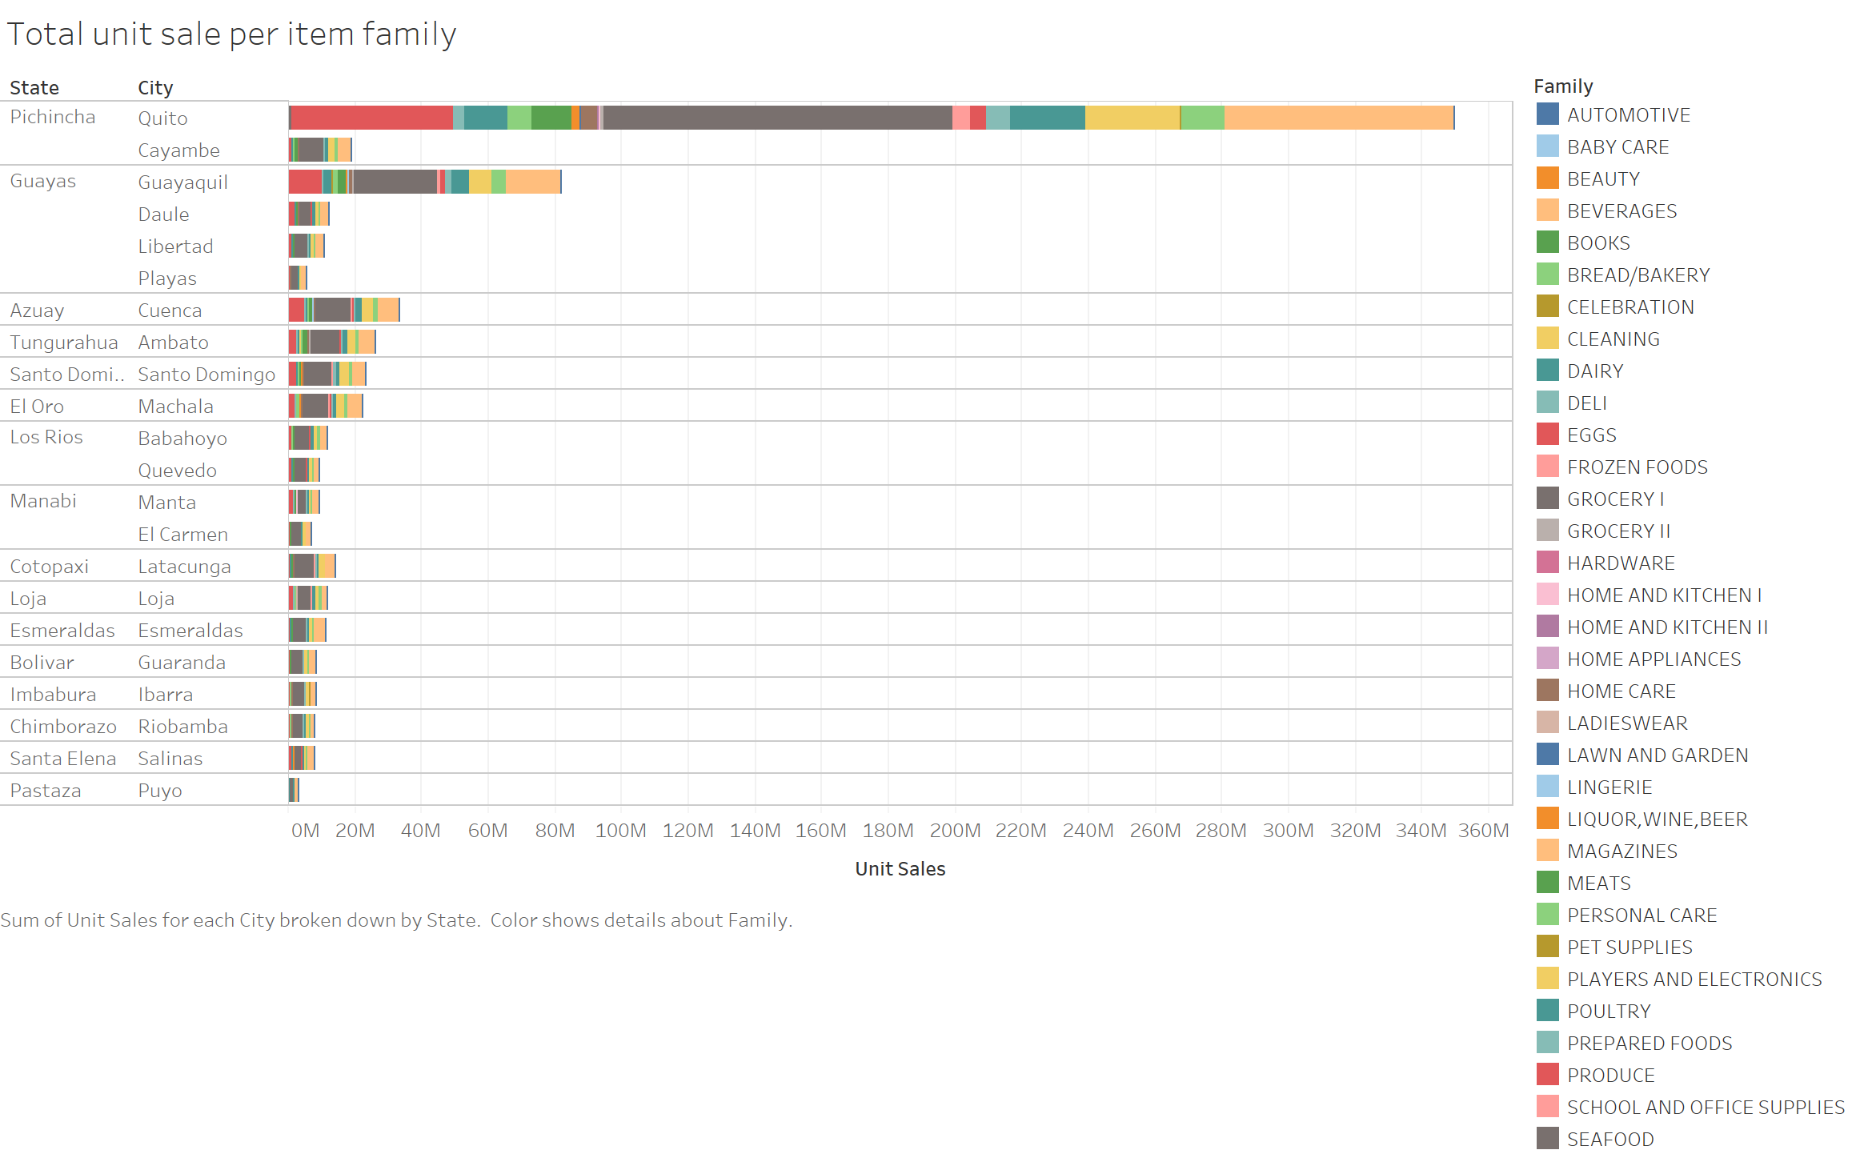

Slide 20
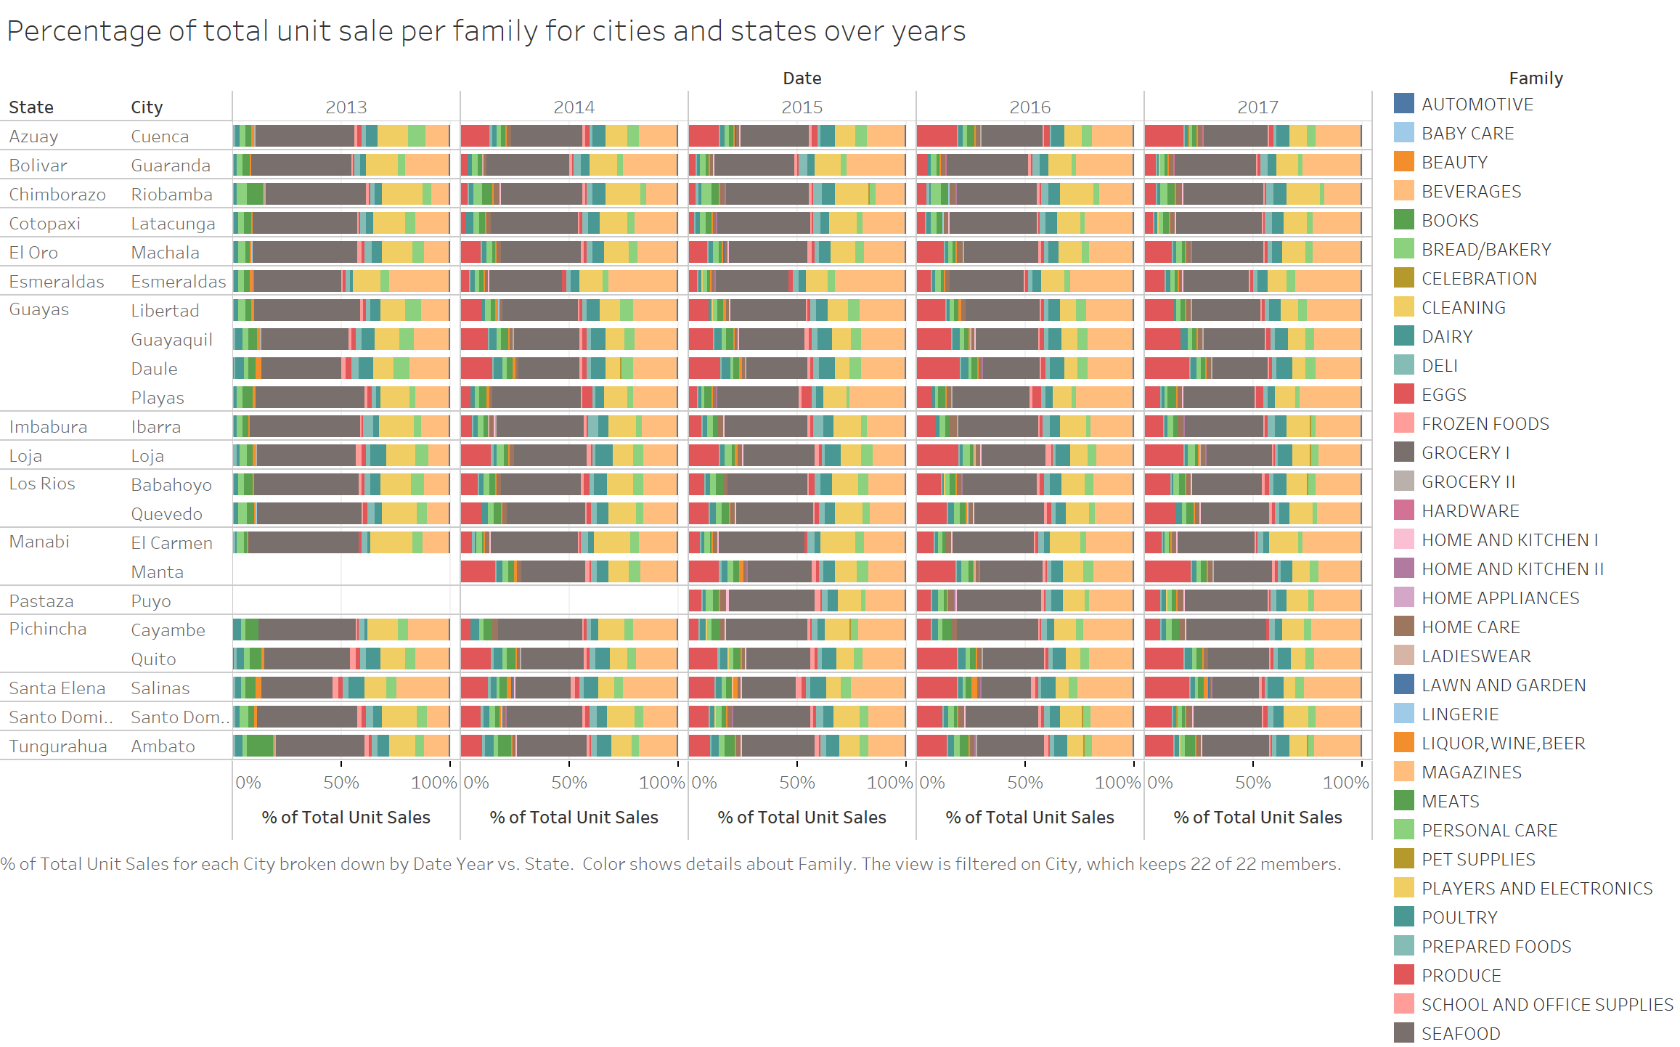

Slide 21
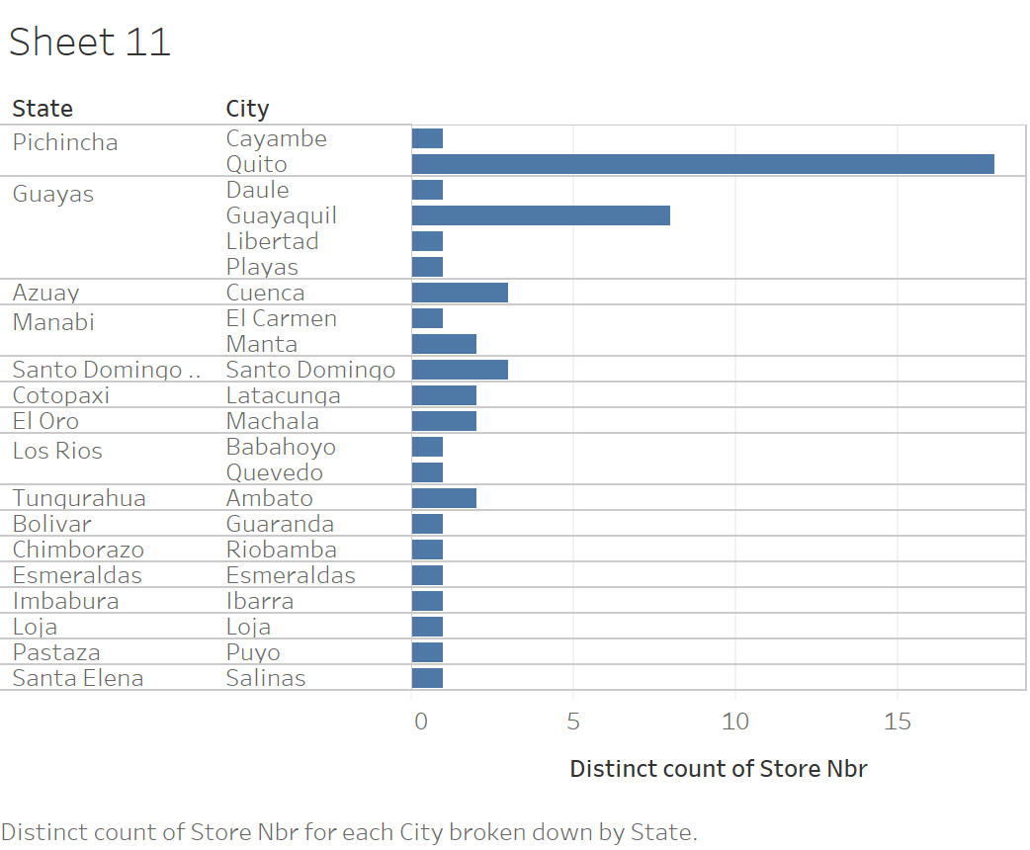

Slide 22
Weekly unit sales increase during the last few weeks of the year (Christmas holidays)
There’s a small, but periodic, fluctuations during a year aligned with the end of months (salaries are paid and sales increased).
Oil price doesn’t seem to affect the sales that much (at least visually)
Data visualization

Slide 23
Feature importance
column names feature importance
2 item_nbr 0.353180
9 class 0.197827
0 id 0.104710
18 total_store_sales 0.099306
8 family 0.071201
11 dcoilwtico 0.041435
1 store_nbr 0.035127
6 type 0.024008
3 onpromotion 0.023101
7 cluster 0.017217

Slide 24
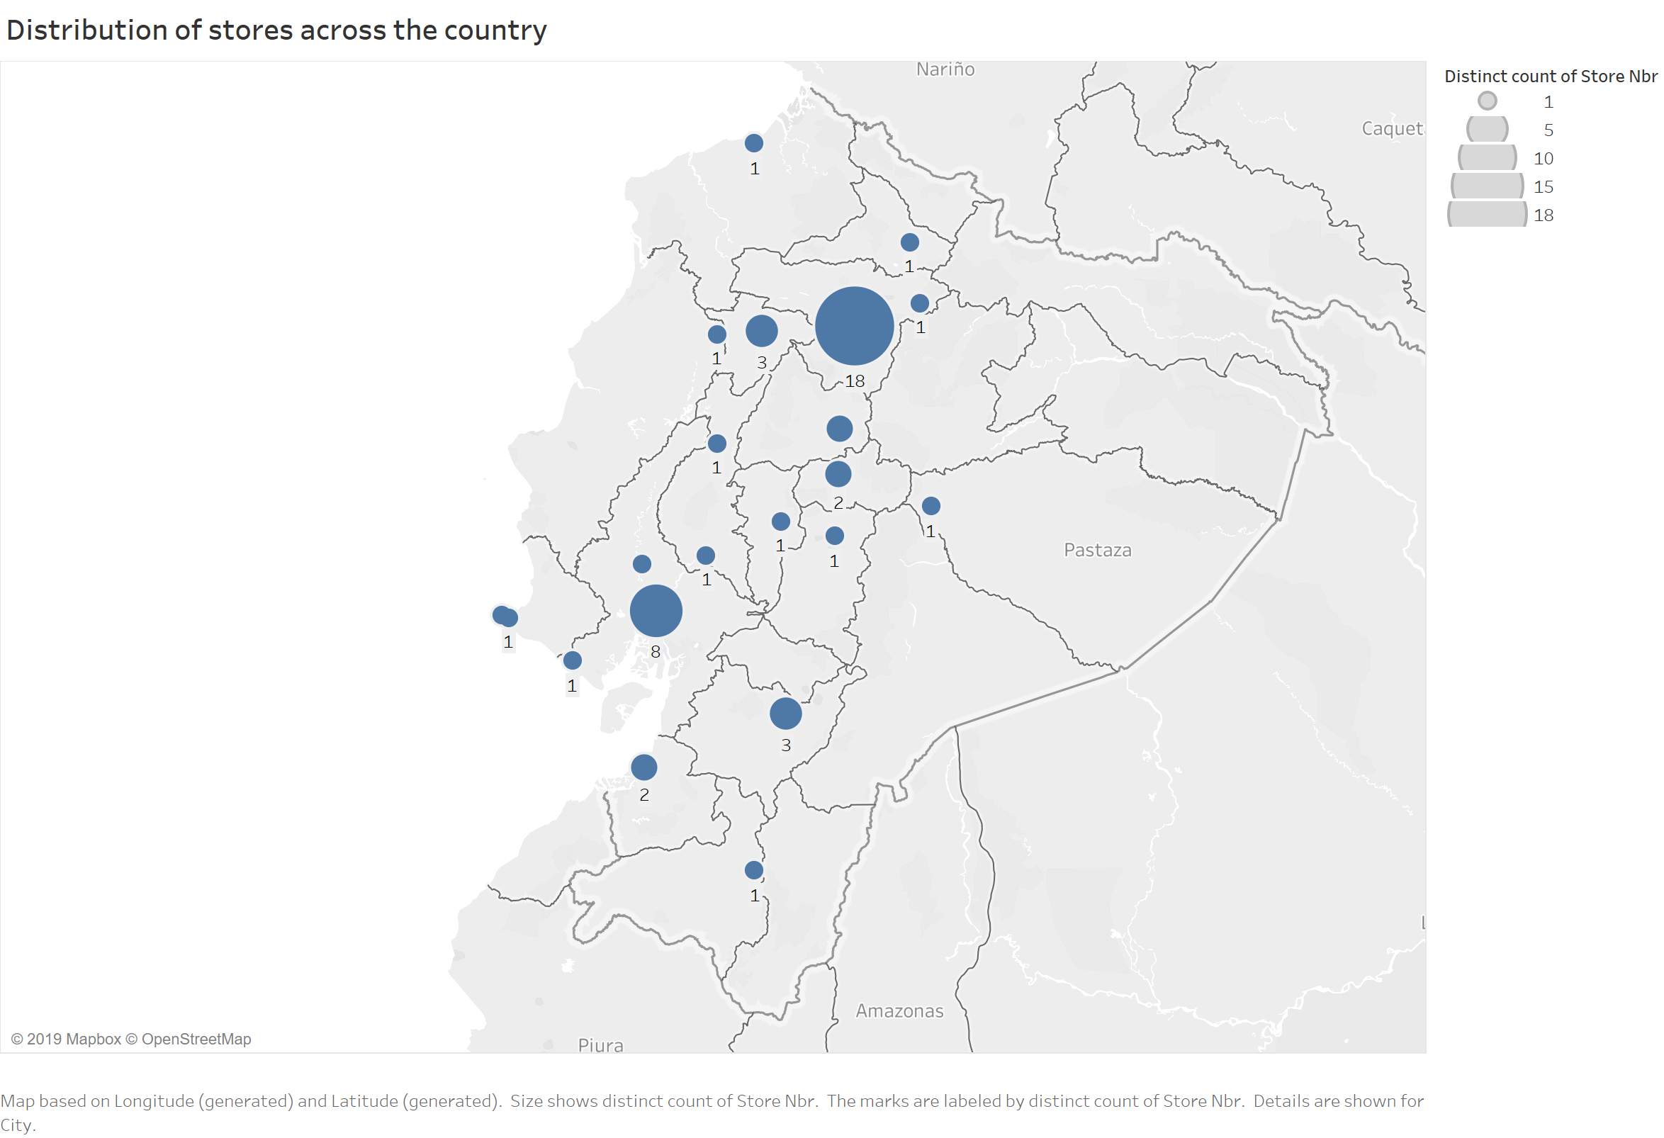
Pichincha and Guayas have significantly higher number of stores. The capital, Quito, has 18 stores (34% of the total stores).
Data visualization

