Slide 1
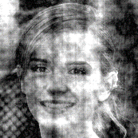
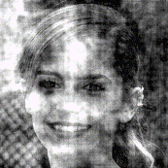
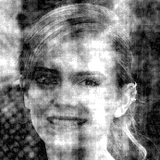
16.7 ms
16.7 ms
16.7 ms
Fixation
(0.3 - 0.6 s)
Stimulus and Decision/RT (max 1.2 s)
ITI
(1-1.2 s)

