Slide 1

Design & Construct of Public Shared E-Scooter
overview
Masoud Heidary
thanks
practice
detail
idea
Department of Electrical Engineering
Dr. Sattar Mirzakuchaki (Supervisor)
May 23, 2022, 12:00 PM

Slide 2



Types of Transportation
Private
Public
Shared
practice
overview
thanks
detail
idea

Slide 3
Private Transportation Pros
overview
Private
practice
thanks
detail
idea
Using Time
Traveling Route
Social Prestige

Slide 4
Private Transportation Cons
overview
Environmental Effects (Air Pollution)
practice
thanks
detail
idea
Traffic & Parking Problems
Long Commute Time
Non-Motorized Users
Loss Public Environments

Slide 5
Public Transportation
practice
overview
thanks
detail
idea

Slide 6
Public Transportation Cons
overview
Environmental Effect (Old Technologies)
practice
thanks
detail
idea
User Experience
Efficiency (Complexity in Management)
First Mile & Last Mile Problem
Fraud & security

Slide 7
Shared Transportation
practice
overview
thanks
detail
idea

Slide 8
Shared Transportation Pros
overview
Solve First Mile & Last Mile Problem
practice
thanks
detail
idea
Use on Demand
Smooth Traffic
Easy Parking
Environmental Benefits (No Air Pollution)

Slide 9



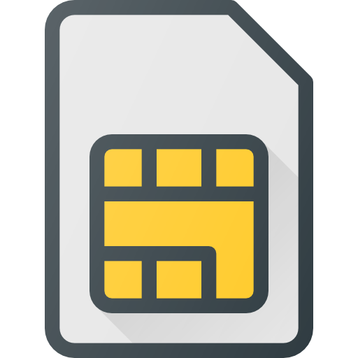

Scooter Outline
All Connections are by UART
thanks
overview
practice
detail
idea

Slide 10

Data Flow from Server to Scooter
UART
MQTT
overview
thanks
practice
detail
idea

Slide 11
Data Flow from Server to Scooter
UART
MQTT
thanks
overview
practice
detail
$ | @ | Data
idea
0 | 0 | 1 | 1 | 1 | Font LED | Lock State (2bit)

Slide 12
Data Flow From Scooter to Server
UART
thanks
overview
practice
detail
idea
UART
MQTT

Slide 13
Data Flow From Scooter to Server
UART
thanks
overview
practice
detail
UART
MQTT
idea
GPS Latitude | GPS Longitude

Slide 14




How Corpi Works ?
PWM
WS2812 Driver
GPIO
thanks
overview
practice
detail
idea
ADC
ADC
UART

Slide 15
How WS2812 Driver Works ?
Color
Buffer
PWM
Buffer
PWM
Timer
thanks
overview
practice
detail
idea

Slide 16
Corpi API (TX)
thanks
overview
practice
detail
idea
TX | @ | Throttle | Data
0 | 0 | 0 | 0 | 0 | 0 | 0 | Brake
Brake Free ➤ 0
Brake Taken ➤ 1

Slide 17
Corpi API (RX)
thanks
RX | @ | Data
overview
practice
detail
idea
0 | 0 | 0 | 0 | Front LED | Lock
Off ➤ 0
Lock ➤ 0
On ➤ 1
Free ➤ 1
Toggle ➤ 2
Find ➤ 2

Slide 18
How Sim800 Driver Works ?
Initialize
Connect to
Server
MQTT Connect
thanks
overview
practice
detail
idea
MQTT
Subscribe
MQTT
Receive
MQTT
Publish
MQTT
Keep Alive
Timer

Slide 19
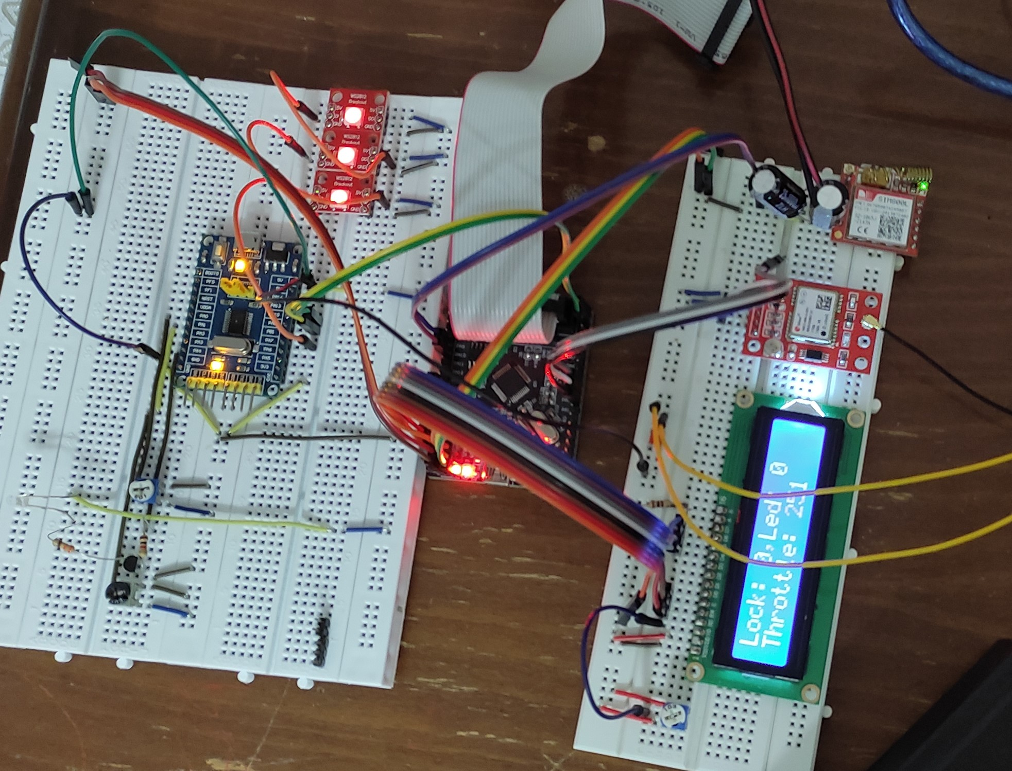
Final Output
thanks
practice
overview
detail
idea

Slide 20
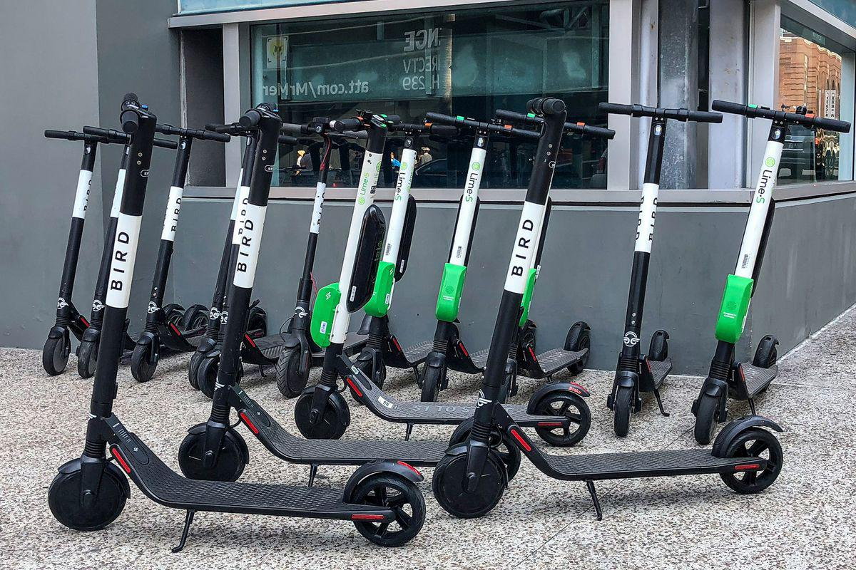
In Practice
thanks
practice
overview
detail
idea

Slide 21
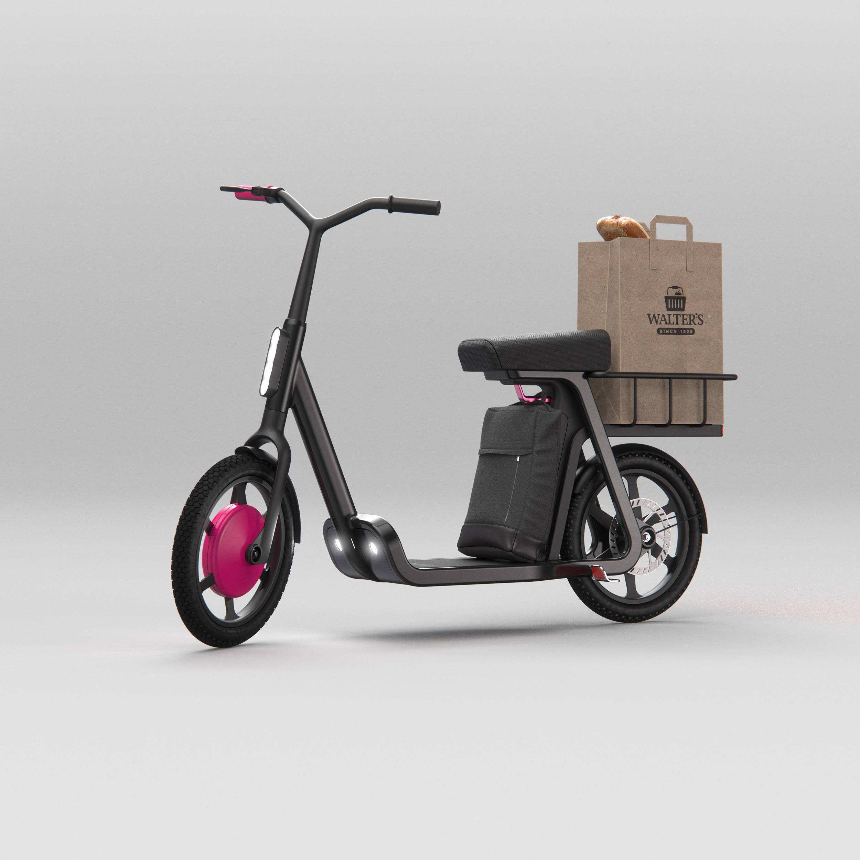
Well Designed Future
thanks
practice
overview
detail
idea

Slide 22



for Attention
GitHub
MasoudHeidary
thanks
overview
practice
detail
idea
Academic Email
MasoudHeidaryMH@gmail.com

