Slide 1
ECE 6397 – Final Project Presentation
Arockiaraj, Joanna jarockia@cougarnet.uh.edu
Edara, Pravineeth pedara@cougarnet.uh.edu
Heidary, Masoud mheidary@cougarnet.uh.edu

Slide 2
What questions are you trying to answer?
The Discovery of Alzheimer's disease from Magnetic Resonance Imaging (MRI) images collected from patients.
Classification of these MRI images into four classes (Non Dementia, Very mild Dementia, Mild Dementia, and Moderate Dementia.
The main purpose is to help of radiologists, doctors, caregivers to save time, cost, and help the patient suffering from this disease.
Can CNN-based models outperform traditional image processing methods and other classification algorithms in accurately detecting early-stage Alzheimer's disease using brain imaging data?
What are the optimal hyperparameters for a CNN model to achieve the highest accuracy in classifying Alzheimer's disease patients from healthy people?
Dataset
Dataset is taken from Kaggle.
Total Images: 6400 files
Train data: 5121 files Test data: 1279 files

Slide 3
2. Why are these interesting/important?
It is highly relevant due to the increasing prevalence of Alzheimer's disease and the urgent need for early and accurate diagnosis. By exploring the potential of CNNs in this domain, Our method contribute to the following:
Following the report from the Alzheimer’s Association, nearly, 58 lakh American people are currently living with this disease and by 2050 this range is supposed to rise to close to 14 million.
Advancement of Alzheimer's research: Identifying effective image analysis techniques can accelerate the development of diagnostic tools.
Improved patient outcomes: Early detection enables timely interventions and potentially slows disease progression.
Reduced healthcare costs: Accurate diagnosis can optimize resource allocation and prevent unnecessary treatments.
Technological innovation: Our work contributes to the broader field of medical image analysis and deep learning applications.

Slide 4
3. Previous works on Alzheimer's Detection
Earlier Methods
Stacked Autoencoder
Deep Polynomial Networks (SDPNs)
Lui et al. proposed 2 methods using zero masking and SAE for feature learning & Classification, and other method using multiphase feature approach combined with SAE for classification. Both the methods were able to achieve only around 50% – 60%.
Shi et al. employed SDPNs for classification. Separate SPDNs were used for MRI and PET data and their outputs were fused to final SDPN layer and achieved a 57% accuracy which is higher than traditional image processing techniques.
Advancements in methods
Convolutional Neural Networks
A significant improvement in classification accuracy has achieved by Gupta et al, where they used SAE and convolution techniques to learn features and obtained an accuracy of 85%.
Similar to the above method, Payan et al. performed 3D convolution with MRI data and feature maps were fed to FC layers obtained an accuracy of 89.5% classification accuracy.
Approach | Technique | Accuracy (%)
Lui et al. | SAE + Zeromask | 53.8
Jun Shi et al | SDPN | 57
Lui et al. | MPFR | 59.19
Gupta et al. | SAE + Convolution | 85
Payan et al. | SAE + 3D CNN | 89.4

Slide 5
3. Previous works on Alzheimer's Detection (continued...)
Pranao et al. 2022 approach proposes a featue extraction method. A total of six features were extracted. After the data processing, model training is carried for classifier algorithms like SVM, Logistic Regression, and Random Forest and tested with test data. The accuracies obtained have been shown in table
Salehi et al. 2020 proposed a CNN approach using a much larger ADNI dataset with 3 classes of images that achieved an accuracy of 99%.
Senthil Kumar et al. 2023 proposed a hybrid ML technique using ADNI dataset that achieved an accuracy of 99%. This is achieved by combining SVM and KNN.
Farooq et al. uses two state-of-the-art complex CNN architectures GoogLeNet and ResNet on the ADNI dataset and achieved an overall accuracy of 98.88% and 98.01% respectively.
Features | SVM | Logistic Regression | Random Forest
LBP | 52% | 51.75% | 60%
HOG | 50% | 31.3% | 58.3%
GLCM | 51.3% | 52.5% | 53.5%
GLRLM | 50.2% | 50% | 52%
TAMURA | 52% | 50% | 50.6%
SFTA | 48.9% | 42.3% | 38.7%
FUSION | 52.4% | 51.3% | 60.4%

Slide 6
4. What is your methodology?
Check for GPU availability
GPU Available
Enable memory growth
Print GPU details
No GPU
Use CPU – Slow run
Load Datasets
Load training and testing data from directories
Apply one-hot encoding
Cache and prefetch data
Build Dynamic Model
Define input shape and number of classes
Configure convolutional blocks (filters, kernel sizes)
Set up dense layers and dropout rates
Add activation functions and final activation
Compile and Train Models
Compile with optimizer and loss function
Set callbacks (e.g., LR scheduler, checkpoint)
Train and evaluate models
Plot Results
Plot training and validation accuracy
Plot test accuracy with percentage annotations

Slide 7
4. What is your methodology? (continued...)
Generate Reports
Generate classification reports (precision, recall, F1-score)
Plot confusion matrices
Visualize Predictions
Display sample predictions with actual labels
End
Conclude the process

Slide 8
4. What is your methodology? (continued...)
Model Configurations:
Model | Conv Blocks | Filters | Kernel Size | Dense Units | Dropout Rates | Activation | Max Pooling | Final Activation
1 | 4 | 32, 64, 128, 256 | 3, 3, 3, 3 | 512, 128, 64 | 0.7, 0.5, 0.3 | ReLU | Yes | Softmax
2 | 5 | 32, 64, 128, 256, 512 | 3, 3, 3, 3, 3 | 1024, 512, 256 | 0.5, 0.5, 0.4 | ReLU | Yes | Softmax
3 | 3 | 64, 128, 256 | 3, 3, 3 | 256, 128 | 0.4, 0.3 | ELU | No | Softmax
4 | 3 | 64, 128, 256 | 3, 5, 7 | 512, 256 | 0.5, 0.3 | Leaky ReLU | Yes | Softmax
5 | 4 | 32, 64, 128, 256 | 3, 3, 5, 5 | 1024, 512, 256, 128 | 0.6, 0.4, 0.3, 0.2 | Sigmoid | No | Softmax
6 | 5 | 32, 64, 128, 256, 512 | 3, 3, 3, 5, 7 | 2048, 1024 | 0.7, 0.5 | Tanh | Yes | Softmax
Notes:
Model 1: A standard model with 4 convolutional blocks and gradually increasing filters, focusing on more dense layers and higher dropout rates for regularization. Model 2: Similar to Model 1 but with an additional convolutional block, increasing the depth of the model.Model 3: Uses ELU activation and does not employ max pooling, focusing on average pooling instead.Model 4: Introduces varying kernel sizes in the convolutional blocks and uses Leaky ReLU activation.Model 5: Utilizes sigmoid activation and opts for average pooling, with a focus on larger dense layers.Model 6: The deepest model with the largest filters and dense layers, utilizing tanh activation for non-linearity.

Slide 9
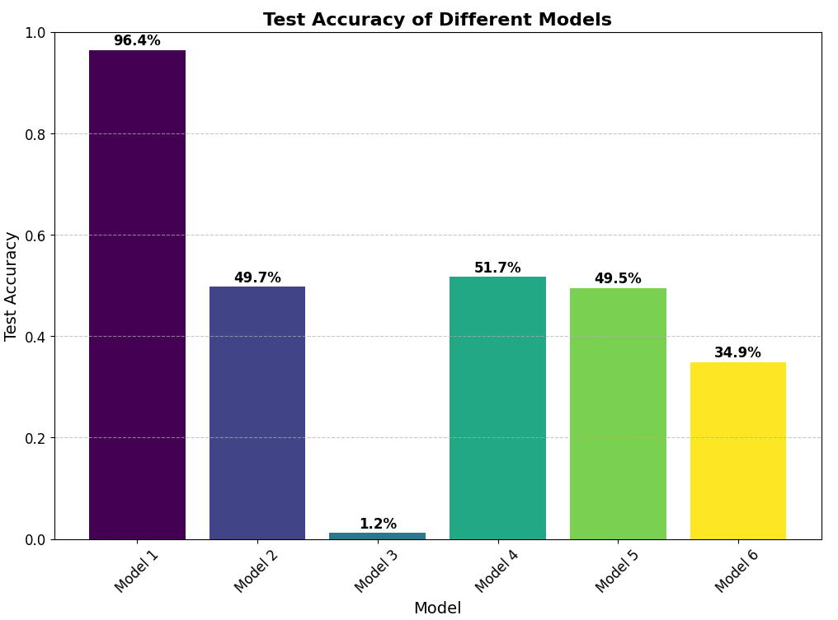
RESULTS: TEST ACCURACY

Slide 10
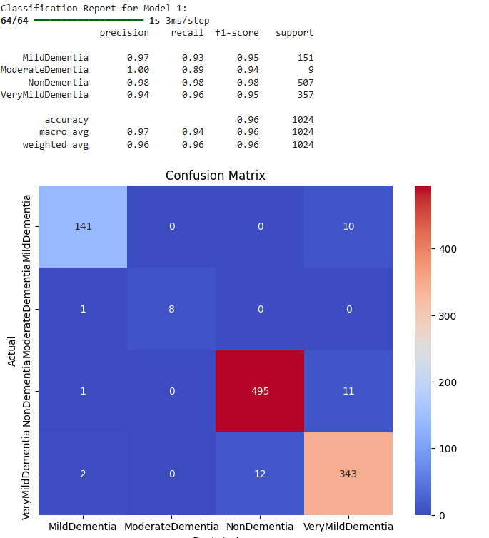
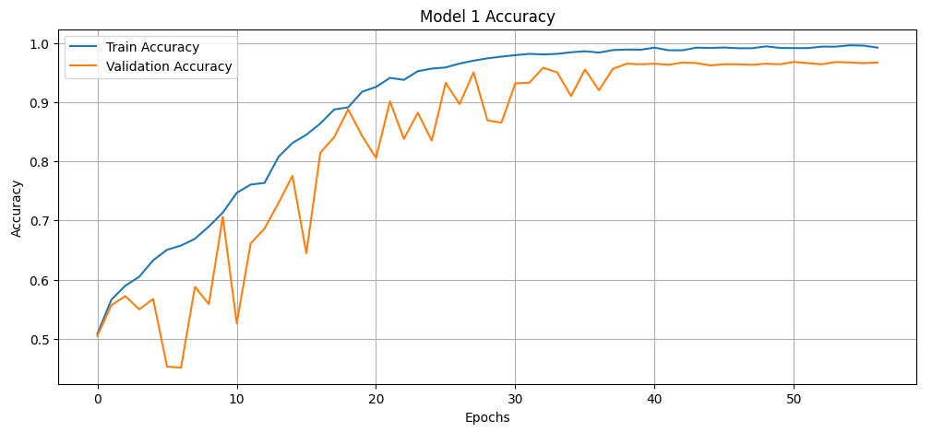
RESULTS: Model 1
Model 1 Test Accuracy: 0.9639, Test AUC: 0.9930

Slide 11
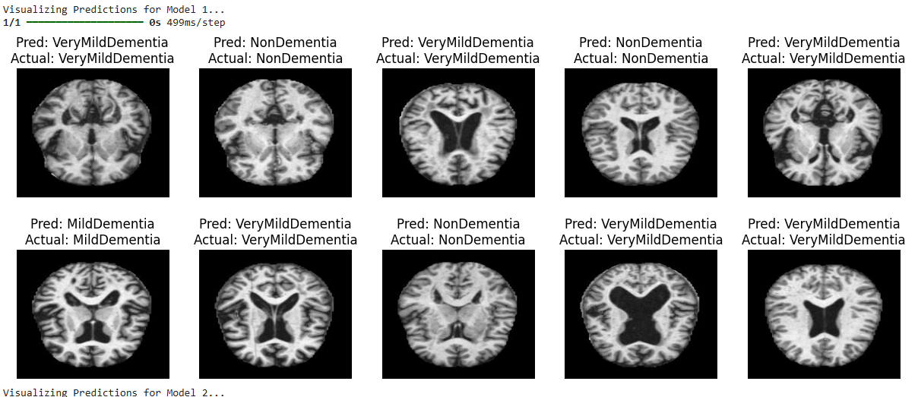
Model 1 Test Accuracy: 0.9639, Test AUC: 0.9930

Slide 12
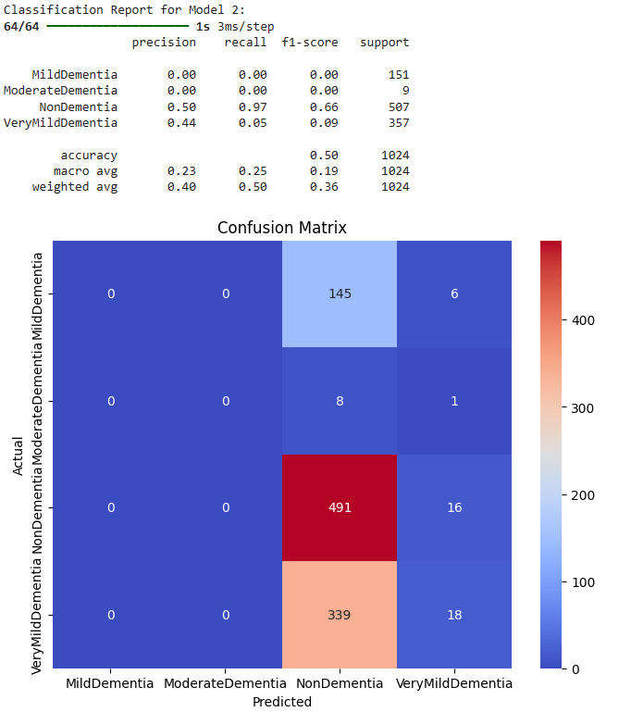
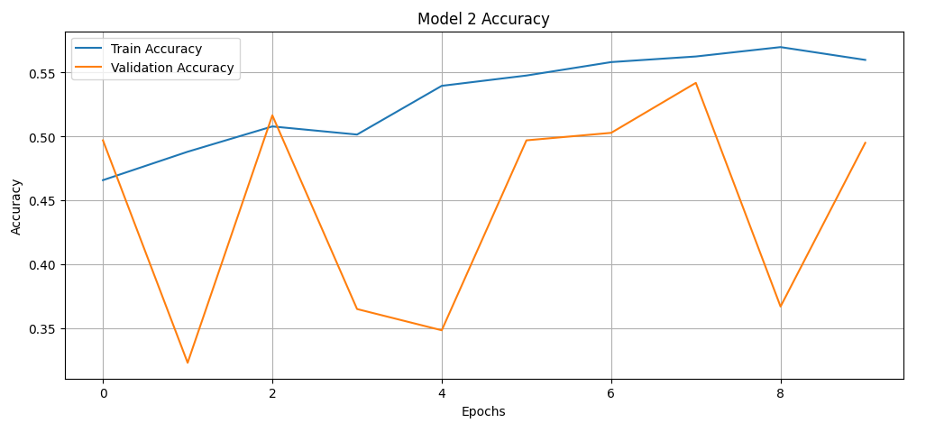
RESULTS: Model 2
Model 2 Test Accuracy: 0.4971, Test AUC: 0.6831

Slide 13
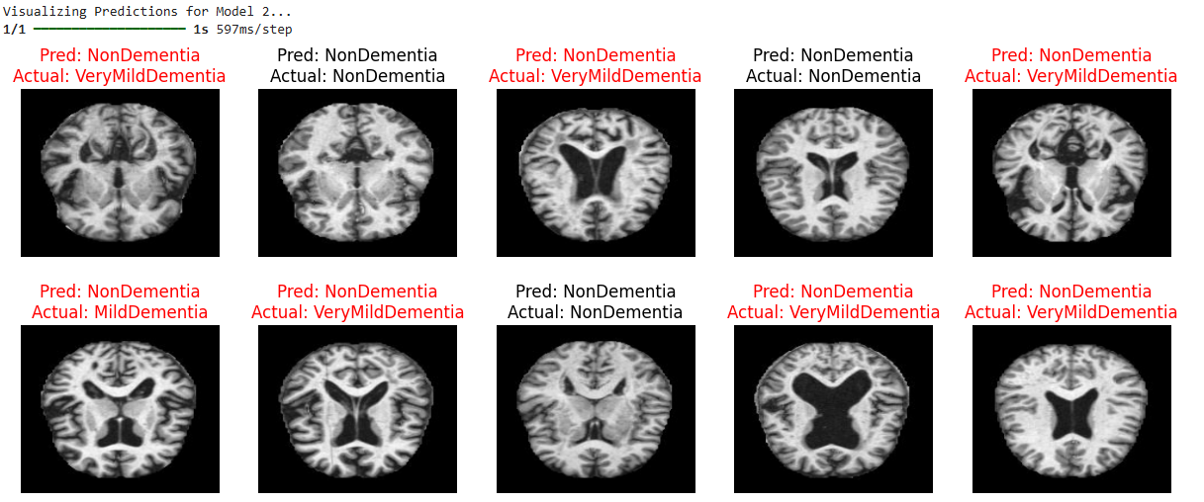
Model 2 Test Accuracy: 0.4971, Test AUC: 0.6831

Slide 14
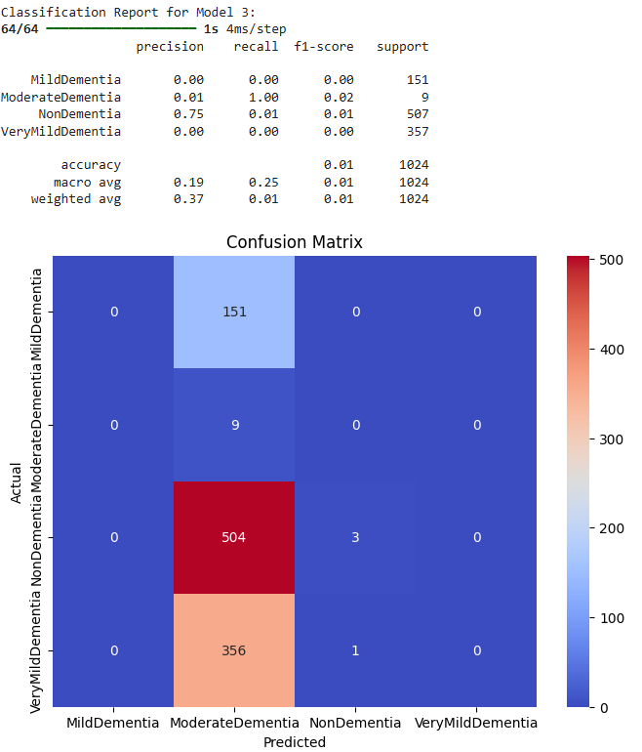
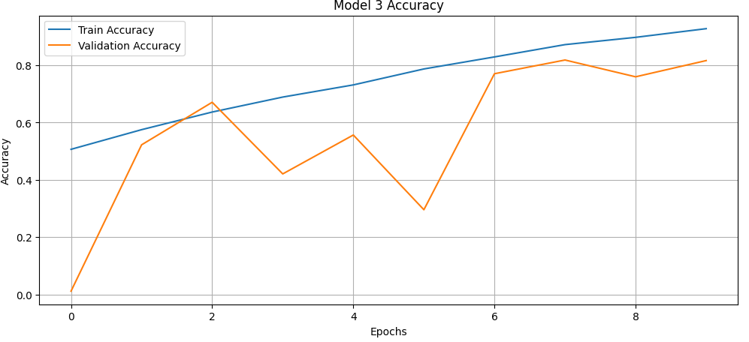
RESULTS: Model 3
Model 3 Test Accuracy: 0.0117, Test AUC: 0.3619

Slide 15
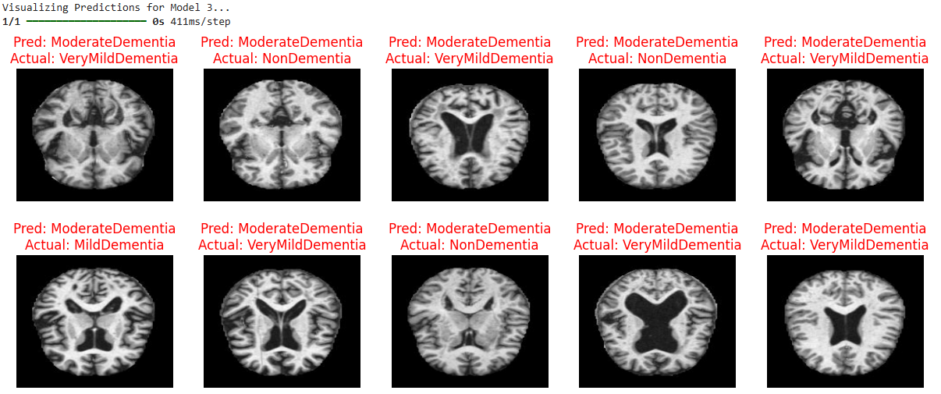
Model 3 Test Accuracy: 0.0117, Test AUC: 0.3619

Slide 16
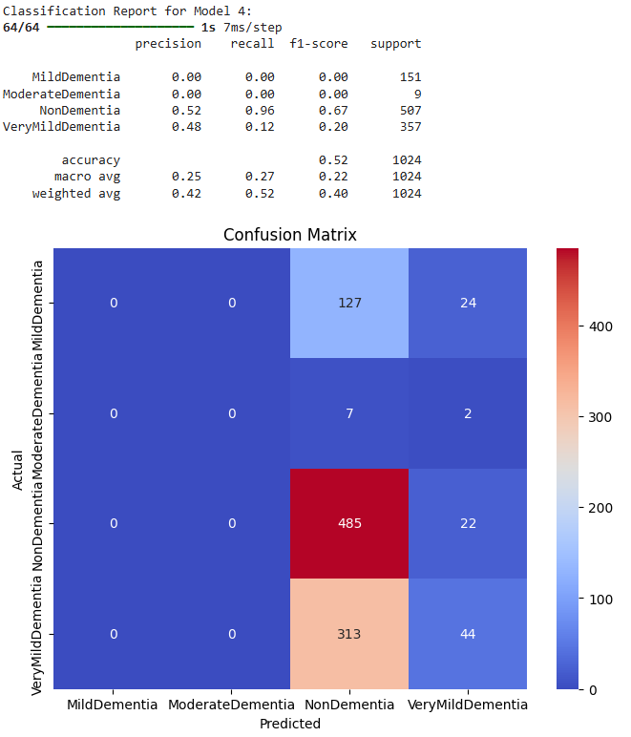
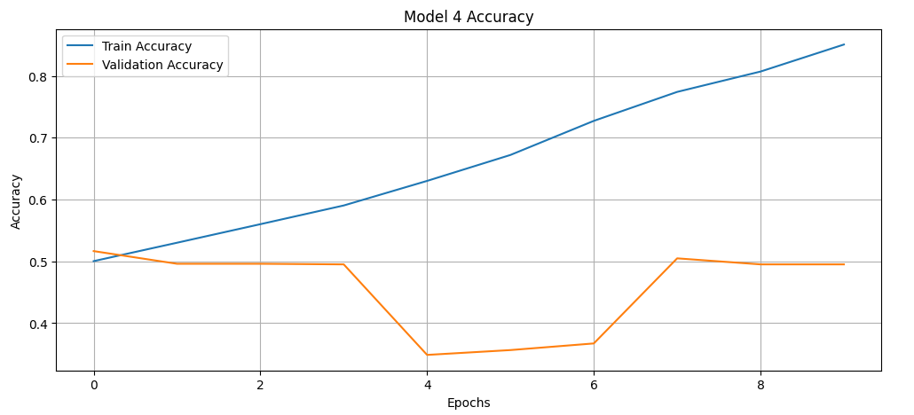
RESULTS: Model 4
Model 4 Test Accuracy: 0.5166, Test AUC: 0.7448

Slide 17
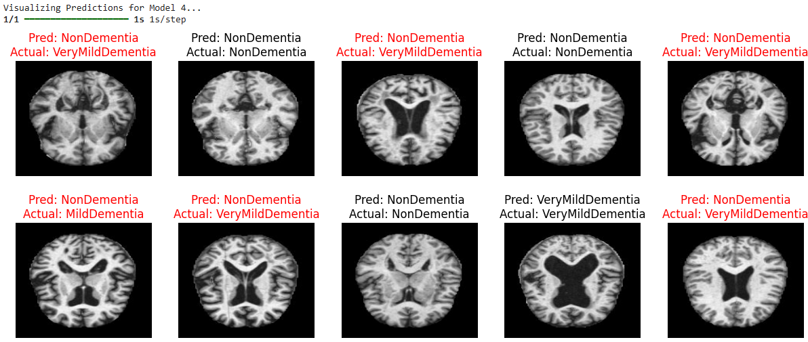
Model 4 Test Accuracy: 0.5166, Test AUC: 0.7448

Slide 18
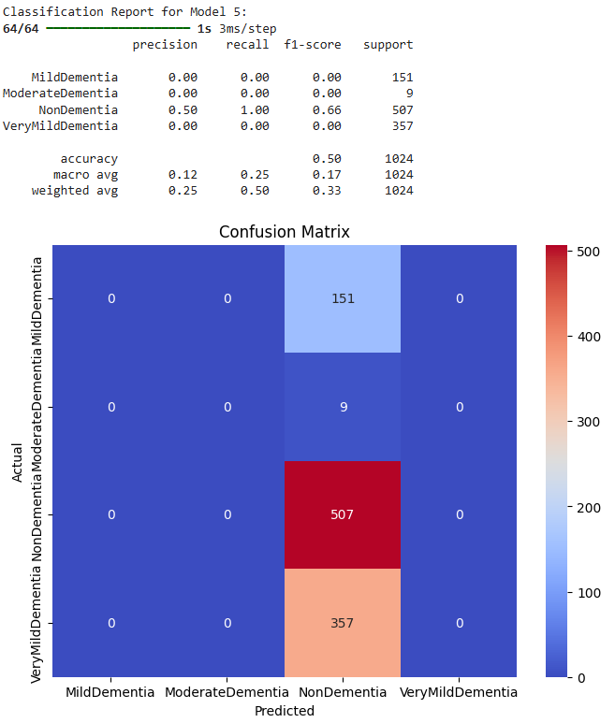
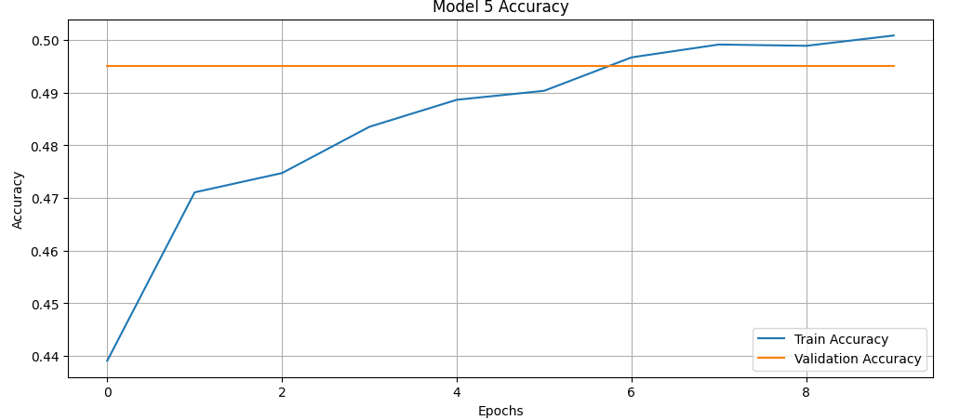
RESULTS: Model 5
Model 5 Test Accuracy: 0.4951, Test AUC: 0.7767

Slide 19
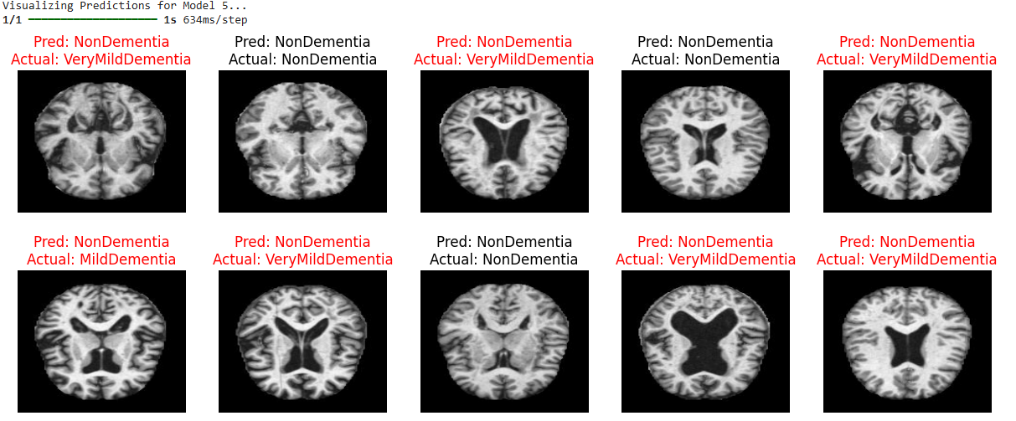
Model 5 Test Accuracy: 0.4951, Test AUC: 0.7767

Slide 20
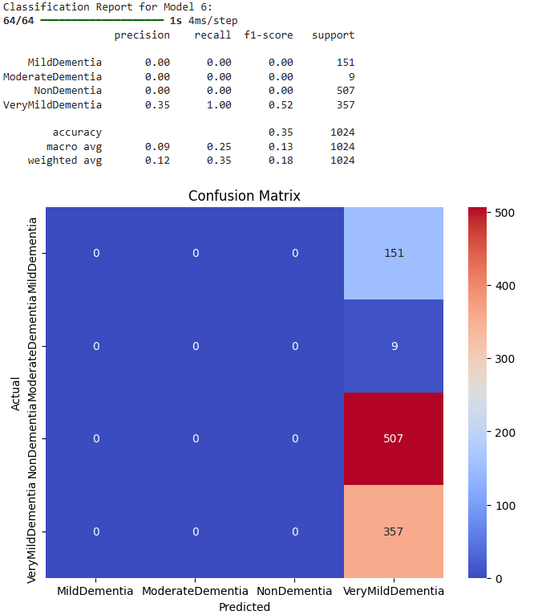
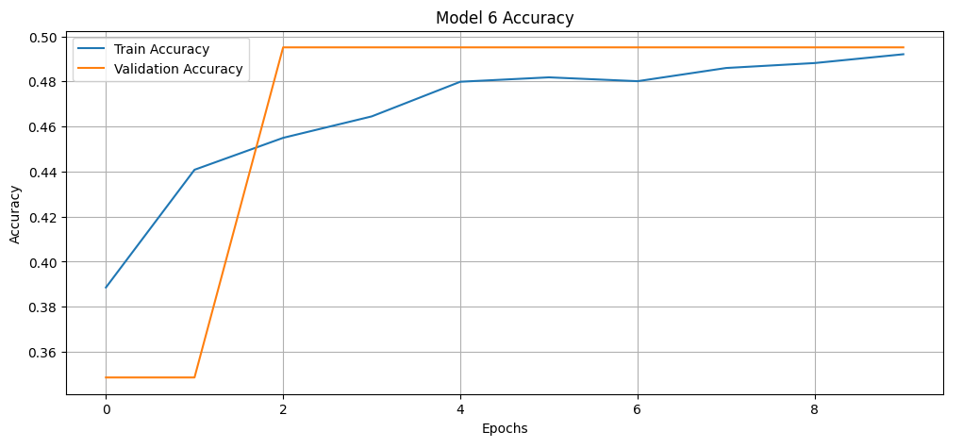
RESULTS: Model 6
Model 6 Test Accuracy: 0.3486, Test AUC: 0.6471

Slide 21
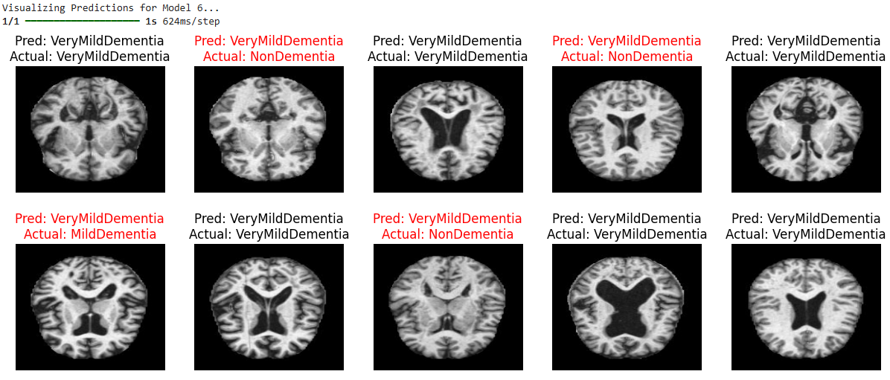
Model 6 Test Accuracy: 0.3486, Test AUC: 0.6471

Slide 22
What challenges did you face during the project execution?
Uneven distribution of data between different classes in both training and testing data. Up sampling can be done to match the count for all classes.
GPU availability in Google Colab. Several hours of runtime using CPU.Used Colab Pro for executing models(Running on GPU: NVIDIA A100-SXM4-40GB)
/usr/local/lib/python3.10/dist-packages/sklearn/metrics/_classification.py:1471: UndefinedMetricWarning: Precision and F-score are ill-defined and being set to 0.0 in labels with no predicted samples. Use `zero_division` parameter to control this behavior. _warn_prf(average, modifier, msg_start, len(result))
GitHub to share colab notebook and PPTs on README. Building a dynamic model (used HW5) as reference.
Notes:
The warning indicates that your model isn't predicting some classes at all, leading to undefined precision and F-score for those labels. You can handle this by adjusting the zero_division parameter or by improving your model's ability to predict those classes.
Use the zero_division Parameter:
The zero_division parameter allows you to control how undefined metric values should be handled:
zero_division=0: The default setting. Undefined precision or F-score is set to 0.
zero_division=1: Undefined precision or F-score is set to 1.
zero_division='warn': Emit a warning (this is what you are currently seeing).

Slide 23
What are your significant or interesting findings?
Best Model Performance
Model 1
Test Accuracy ~96%
Balanced architecture, gradually increasing filters and well configured dense layers.
Model Comparison
Model 2
Test Accuracy ~50%
Additional convolutional block and more complexity
Model 3
Test Accuracy ~1%
ELU activation ,and max pooling has been removed (importance of pooling and activation function)
Model 4
Test Accuracy ~52%
Varying kernel sizes with moderate performance
Model 5
Test Accuracy ~50%
Sigmoid activation function, and larger dense layers (lost accuracy due to complexity)
Model 6
Test Accuracy ~35%
Deepest model with the largest filters, and dense layers (losing more accuracy due to more complexity)
Notes:
The warning indicates that your model isn't predicting some classes at all, leading to undefined precision and F-score for those labels. You can handle this by adjusting the zero_division parameter or by improving your model's ability to predict those classes.
Use the zero_division Parameter:
The zero_division parameter allows you to control how undefined metric values should be handled:
zero_division=0: The default setting. Undefined precision or F-score is set to 0.
zero_division=1: Undefined precision or F-score is set to 1.
zero_division='warn': Emit a warning (this is what you are currently seeing).

Slide 24
What did you learn from your project?
Architecture Tuning
Balanced convolutional blocks and filter size
Effects of activation functions and pooling strategies
Data Processing
Data augmentation and preprocessing
Balanced datasets and their contribution to generalization
Practical Challenges
Managing GPU constrains and long training times
Handling undefined metrics in classification reports
Notes:
The warning indicates that your model isn't predicting some classes at all, leading to undefined precision and F-score for those labels. You can handle this by adjusting the zero_division parameter or by improving your model's ability to predict those classes.
Use the zero_division Parameter:
The zero_division parameter allows you to control how undefined metric values should be handled:
zero_division=0: The default setting. Undefined precision or F-score is set to 0.
zero_division=1: Undefined precision or F-score is set to 1.
zero_division='warn': Emit a warning (this is what you are currently seeing).

Slide 25
Future Work
Model Refinement
Experimenting with different optimizers
Exploring advanced regularization techniques
Potential for ensemble methods
Scalability
Extending to larger datasets or more complex tasks
Deployment in real-world settings
Optimizing inference time and large-scale data handling
Notes:
The warning indicates that your model isn't predicting some classes at all, leading to undefined precision and F-score for those labels. You can handle this by adjusting the zero_division parameter or by improving your model's ability to predict those classes.
Use the zero_division Parameter:
The zero_division parameter allows you to control how undefined metric values should be handled:
zero_division=0: The default setting. Undefined precision or F-score is set to 0.
zero_division=1: Undefined precision or F-score is set to 1.
zero_division='warn': Emit a warning (this is what you are currently seeing).

