Slide 1
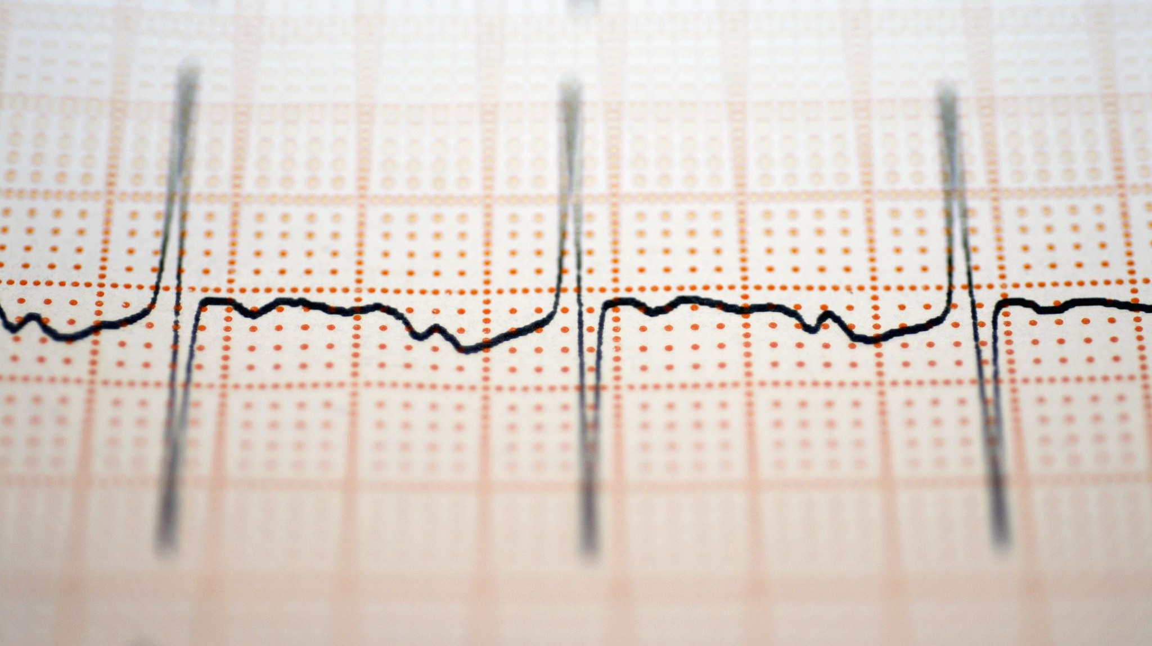
Graph-Based Temporal Learning on ECG Signals for Heart Condition Classification
Masoud Nateghi

Slide 2
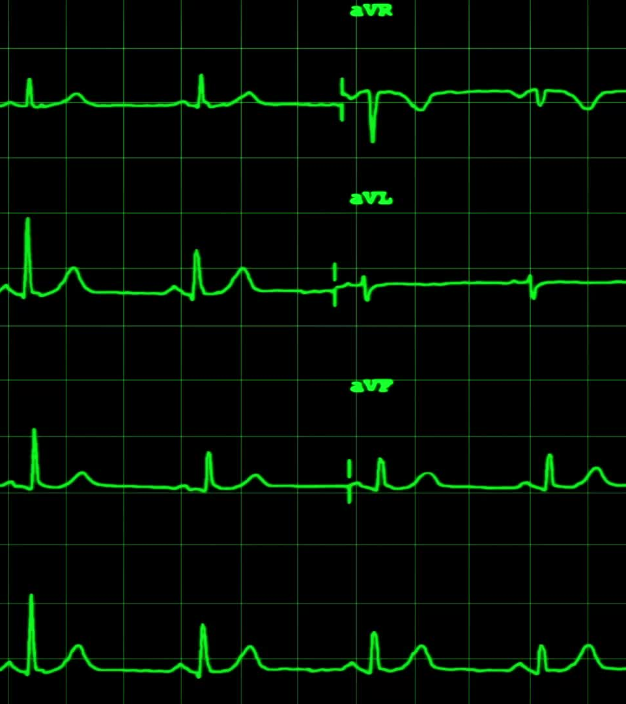
Introduction
ECG records electrical activity of the heart.
Non-invasive, widely available, and cost-effective diagnostic tool.
ECG changes can precede clinical symptoms.
Early detection directly impacts survival rates and quality of life.

Slide 3
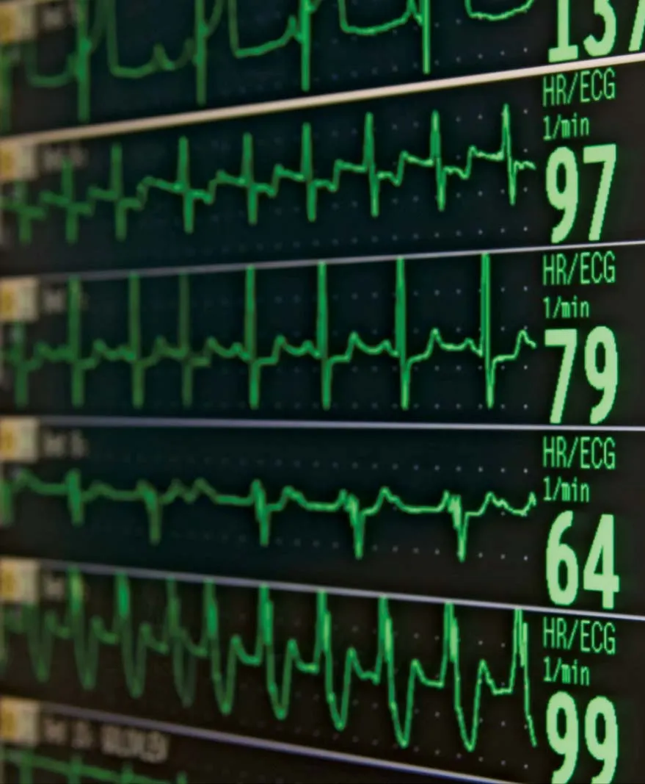
Introduction
Myocardial Infarction (MI) is responsible for millions of deaths worldwide annually.
Automated analysis of ECG can detect subtle patterns invisible to human eyes and beyond human visual interpretation
Reduces diagnostic time and improves accuracy
Potential for earlier detection of high-risk ECG patterns
Creates opportunities for preventive screening

Slide 4
Motivation
Each ECG lead can be represented as a node within a graph structure.
Features extracted from each lead’s signal serve as node embeddings.
GNNs learn complex inter-lead relationships, capturing subtle patterns indicative of myocardial infarction against other methods which treat each lead independently.

Slide 5



Methods
Feature extractor block
Number of time samples: T
Number of lead features: 32
Node embeddings $∈R^{15×32}$
Number of the leads: 15
$$x(t)∈R^{1×T}$$
1D Conv
ReLu
1D Conv
ReLu
Pooling
Features $∈R^{1×32}$

Slide 6
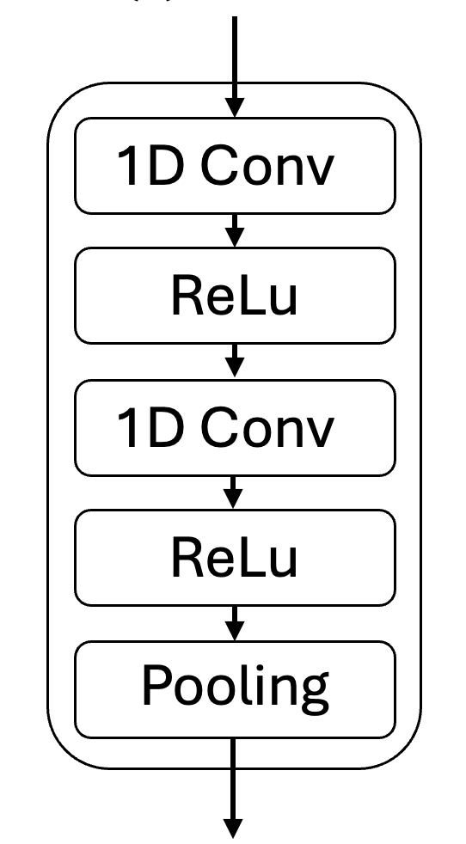
Methods
15-lead ECG
Final pipeline architecture
GNN layers used:
GCN
GAT
Dataset: PTB
549 records (384 MI/ 165 Healthy)
GNN
ReLu
GNN
ReLu
MLP
MI? 0/1

Slide 7
Results
Validation metrics
GCN outperformed GAT in all the metrics.
Possible reasons for GAT underperformance:
Overfitting due to 1.higher model complexity 2.relatively small size of the dataset
Hyperparameter tuning
Metric | GCN | GAT
Accuracy | 0.8455 | 0.80
Precision | 0.7742 | 0.7308
Recall | 0.7059 | 0.5588
F1 score | 0.7385 | 0.6333

Slide 8
Conclusions
GCN is currently more reliable on detection MI on the PTB dataset.
While GNN-based methods showed promising results, traditional ML models reported in prior works have sometimes achieved even higher performance on this dataset.
Deep learning models require large amount of data, and due to the relatively small size of dataset, it can be an edge case that ML models outperform Deep learning models.
Future work can focus on applying this architecture on a bigger dataset like PTB-XL dataset (almost 40 times bigger).

Slide 9
References
Di Cesare M, Perel P, Taylor S, Kabudula C, Bixby H, Gaziano TA, McGhie DV, Mwangi J, Pervan B, Narula J, Pineiro D, Pinto FJ. The Heart of the World. Glob Heart. 2024 Jan 25;19(1):11. doi: 10.5334/gh.1288. PMID: 38273998; PMCID: PMC10809869.
Martínez-Sellés M, Marina-Breysse M. Current and Future Use of Artificial Intelligence in Electrocardiography. J Cardiovasc Dev Dis. 2023 Apr 17;10(4):175. doi: 10.3390/jcdd10040175. PMID: 37103054; PMCID: PMC10145690.
Bousseljot, R., Kreiseler, D., & Schnabel, A. (1995). Nutzung der EKG-Signaldatenbank CARDIODAT der PTB über das Internet. Biomedizinische Technik / Biomedical Engineering, 40(s1), 317-318.

