Slide 1
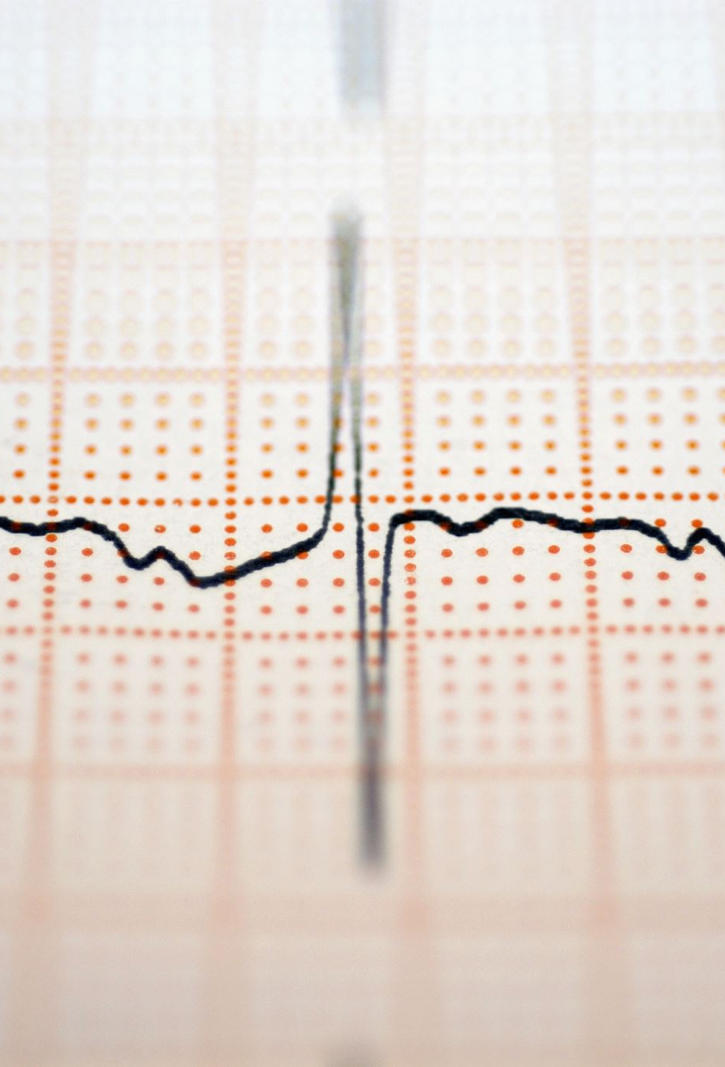
Graph-Based Temporal Learning on ECG Signals for Heart Condition Classification
Masoud Nateghi

Slide 2
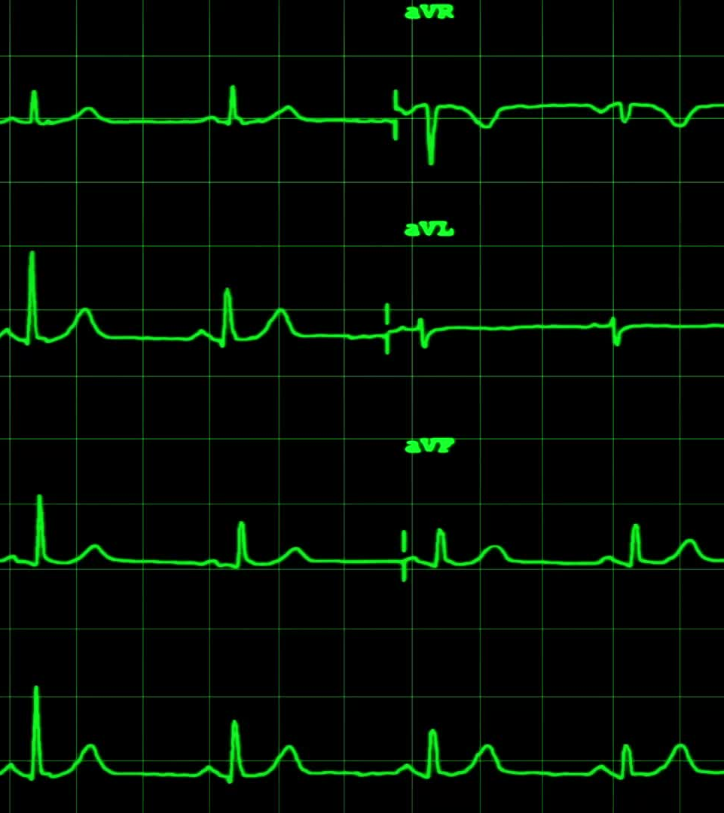
Overview
Objective: Explore graph-based learning techniques on electrocardiogram (ECG) data to classify heart conditions.
Dataset: PTB-XL – A large, annotated 12-lead ECG dataset with 21,837 records and multiple diagnostic labels.

Slide 3
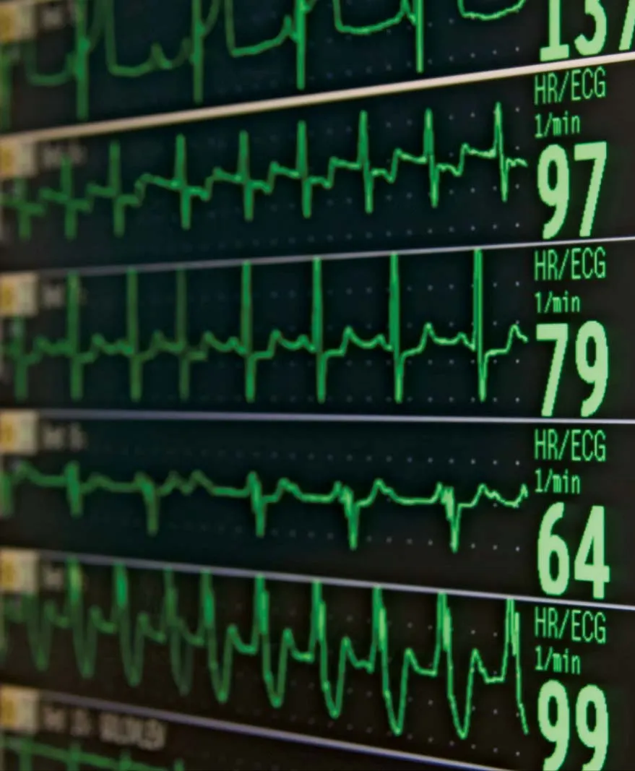
Approach
Graph Representation:
ECG signals converted into graph structures (e.g., leads as nodes, signal relationships (corr) as edges).
Models:
GNN (Graph Neural Networks) – to capture spatial dependencies between ECG leads.
GRNN (Graph Recurrent Neural Networks) – combines GNNs with RNNs to leverage temporal dynamics in ECG signals.
Goal:
Demonstrate how temporal-aware graph learning can enhance classification of heart conditions compared to standard deep learning models.

