Slide 1
Spatial-Temporal Synchronous Graph Convolutional Networks (STSGCN)
Authors: Chao Song, Youfang Lin, Shengnan Guo, Huaiyu Wan
Beijing Jiaotong University
Presenter: Masoud Nateghi

Slide 2
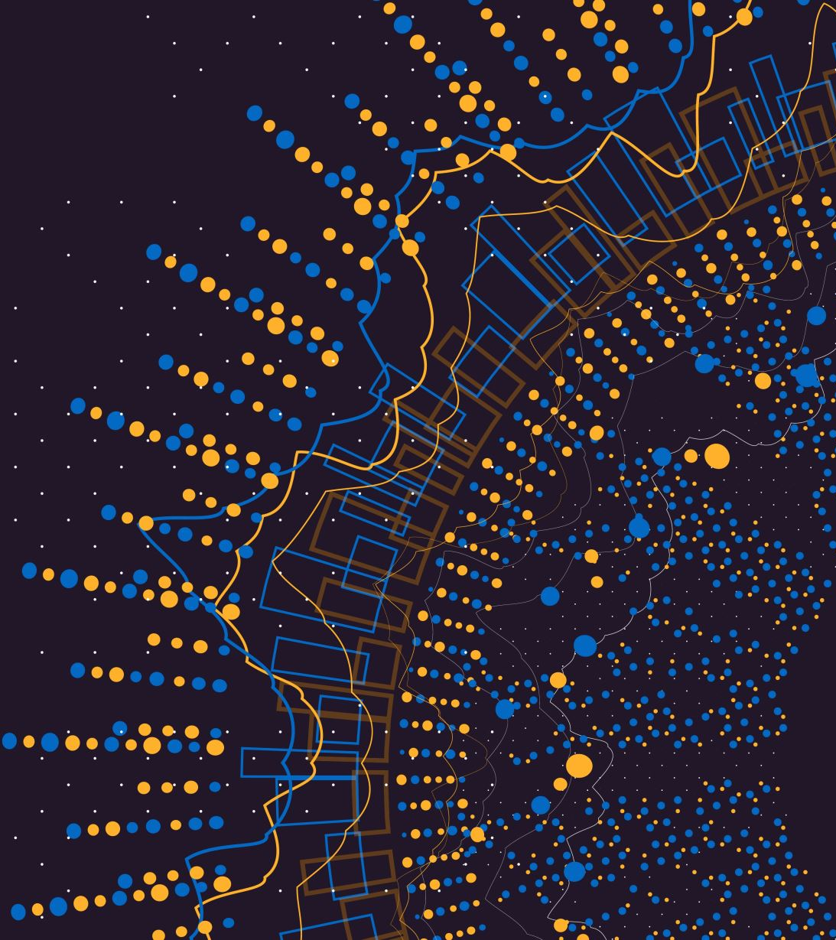
Introduction-Motivation
Forecasting spatial-temporal network data is crucial (e.g. traffic, urban planning).
Challenge: Complex localized spatial-temporal correlations and heterogeneity.
Prior work captures spatial and temporal dependencies separately — not ideal.
Different architectures for capturing temporal and spatial correlations.
Spatial-temporal correlations are not captured simultaneously.

Slide 3
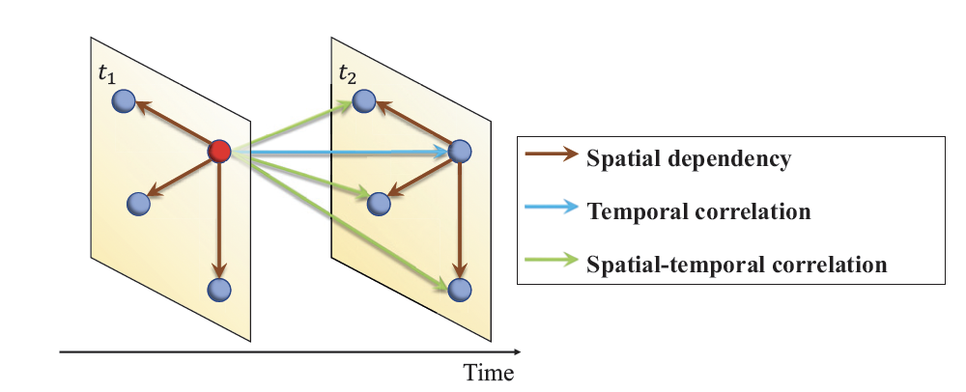
Introduction – Types of Correlation
Spatial: Same time, neighboring nodes.
Temporal: Same node, next time step.
Synchronous: Neighboring nodes across time steps.

Slide 4
Introduction - Contributions
Propose:
Spatial-Temporal Synchronous Graph Convolutional Network (STGCN)
Multi-module layer to capture heterogeneity in long-range spatial-temporal data.
Experiments:
Conducted on 4 real-world dataset to show outperformance.
Component analysis:
Identify the effect of each element of STGCN on performance.

Slide 5
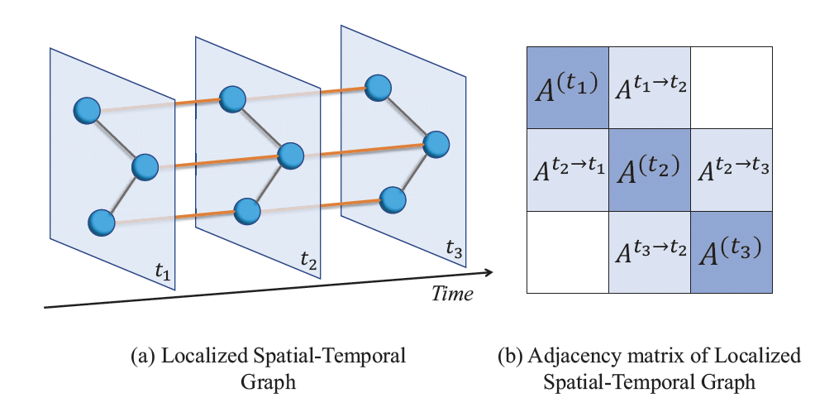
Methods-Localized Spatial-Temporal Graph
Idea:
build a model that can directly capture the impact of each node on its neighbors that belongs to both the current and the adjacent time steps.
The most intuitive idea to achieve this goal is to connect all nodes with themselves at the adjacent time steps
Add temporal and spatial embeddings

Slide 6
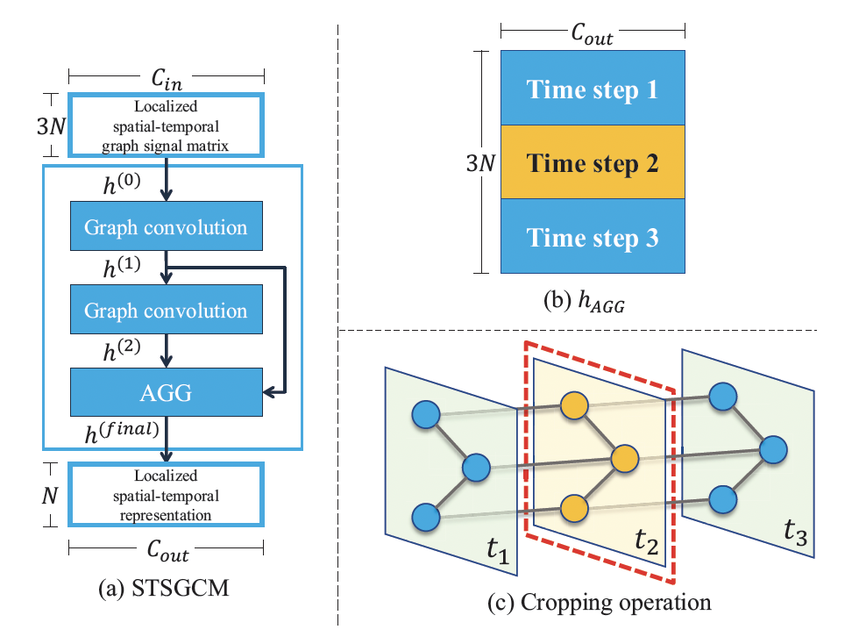
Methods - STSGCM, The Core Module
Input: Localized spatial-temporal graph
Multiple GCNs
Activation function: ReLu, GLU
Base architecture: JK-net
Aggregation layer
Cropping

Slide 7
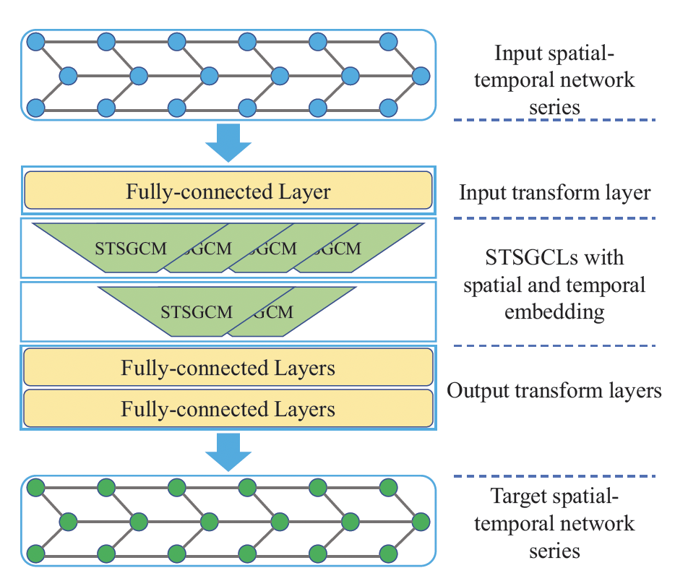
Methods – STSGCL, Capturing Heterogeneity
Cut the input into T-2 spatial-temporal localized networks
Concatenate the output of STGCMs.

Slide 8


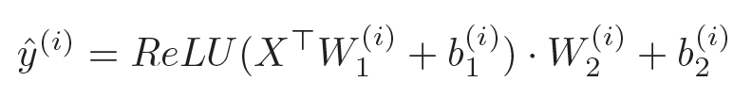
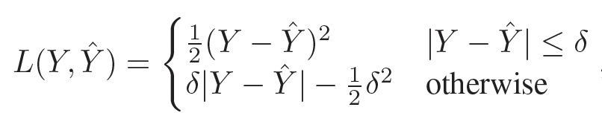

Methods– Other components
Input layer: FCN to enhance features
Output layer:
Reshaping: $→$
Generate output using FCNs
Loss function: Huber loss
Less sensitive to outliers than MSE.

Slide 9
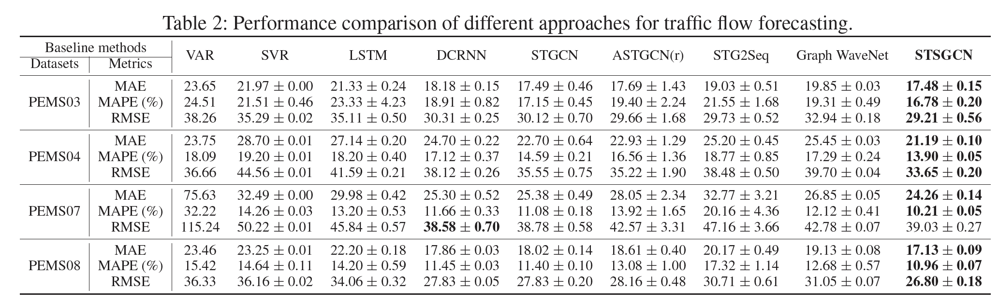
Results

Slide 10
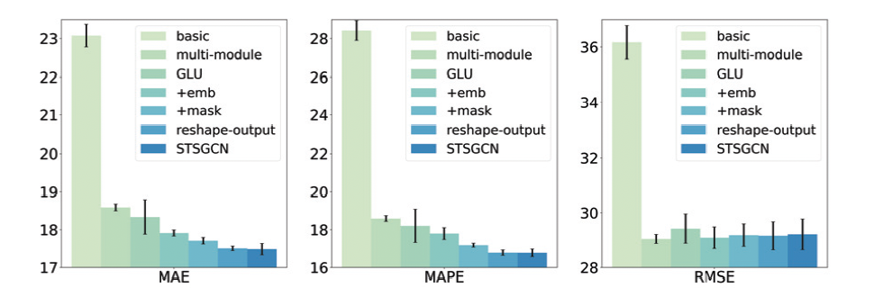
Results – Component Analysis

Slide 11
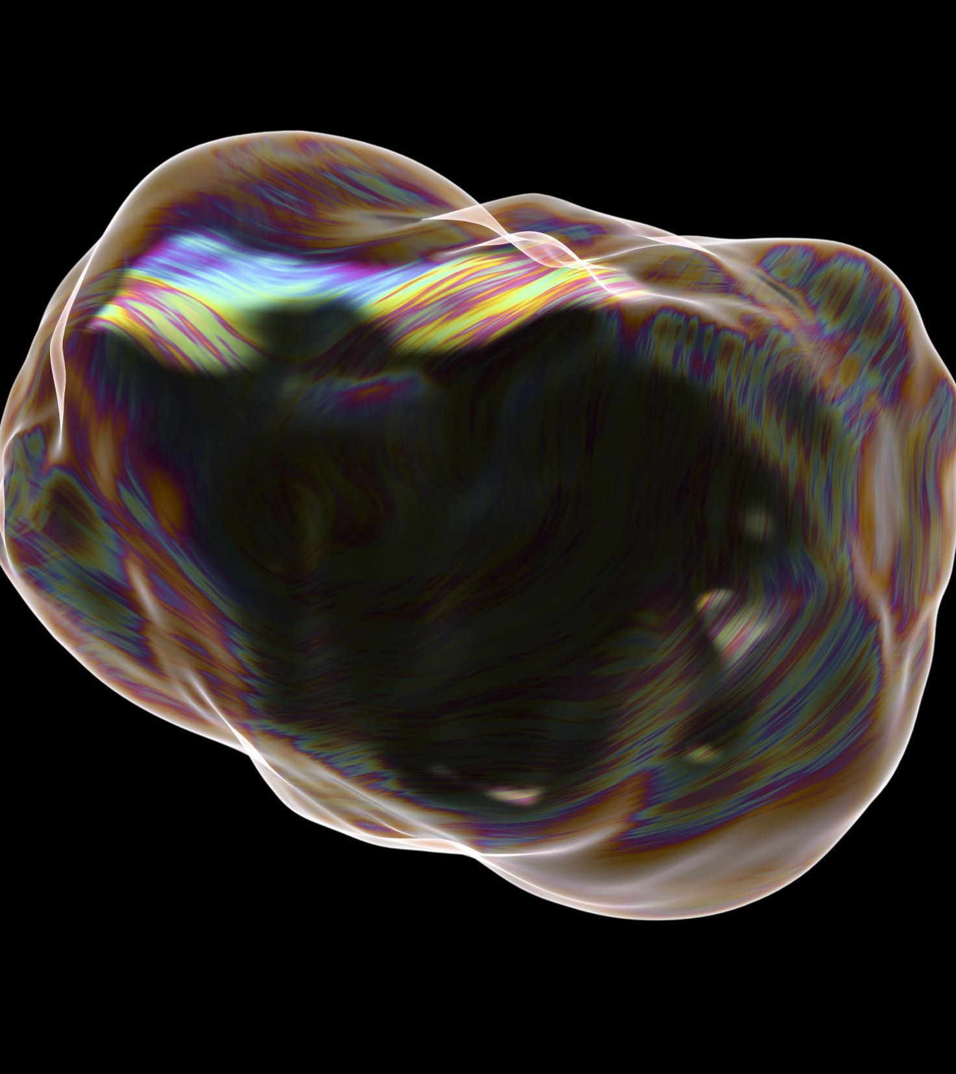
Conclusion
Capture localized spatial-temporal correlations
Adress the problem of heterogeneity,
Experiments clearly showed the outperformance of STSGCN.

Slide 12

Thank You!
Questions?

