Slide 1
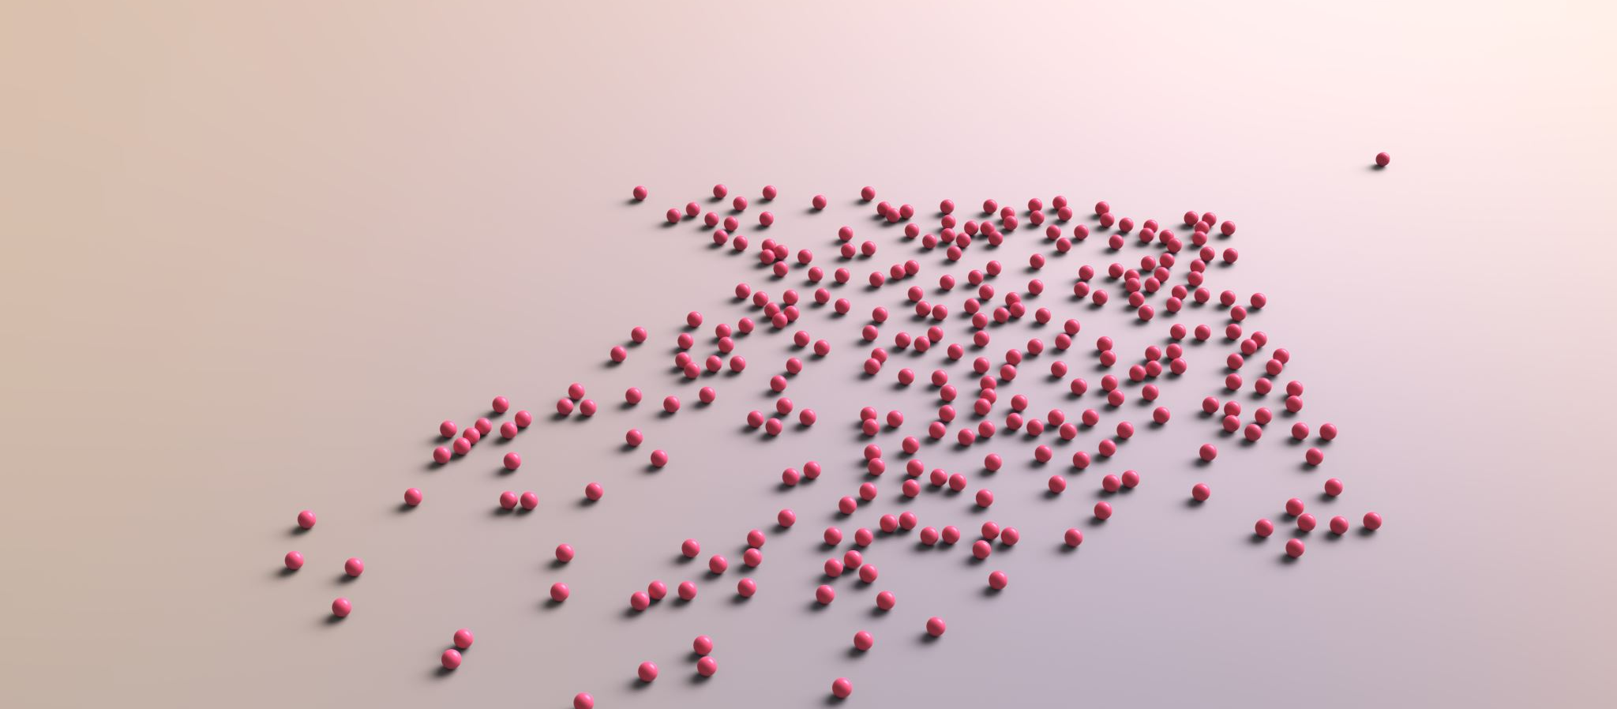
Unsupervised Clustering Project (Disney Characters)

Slide 2
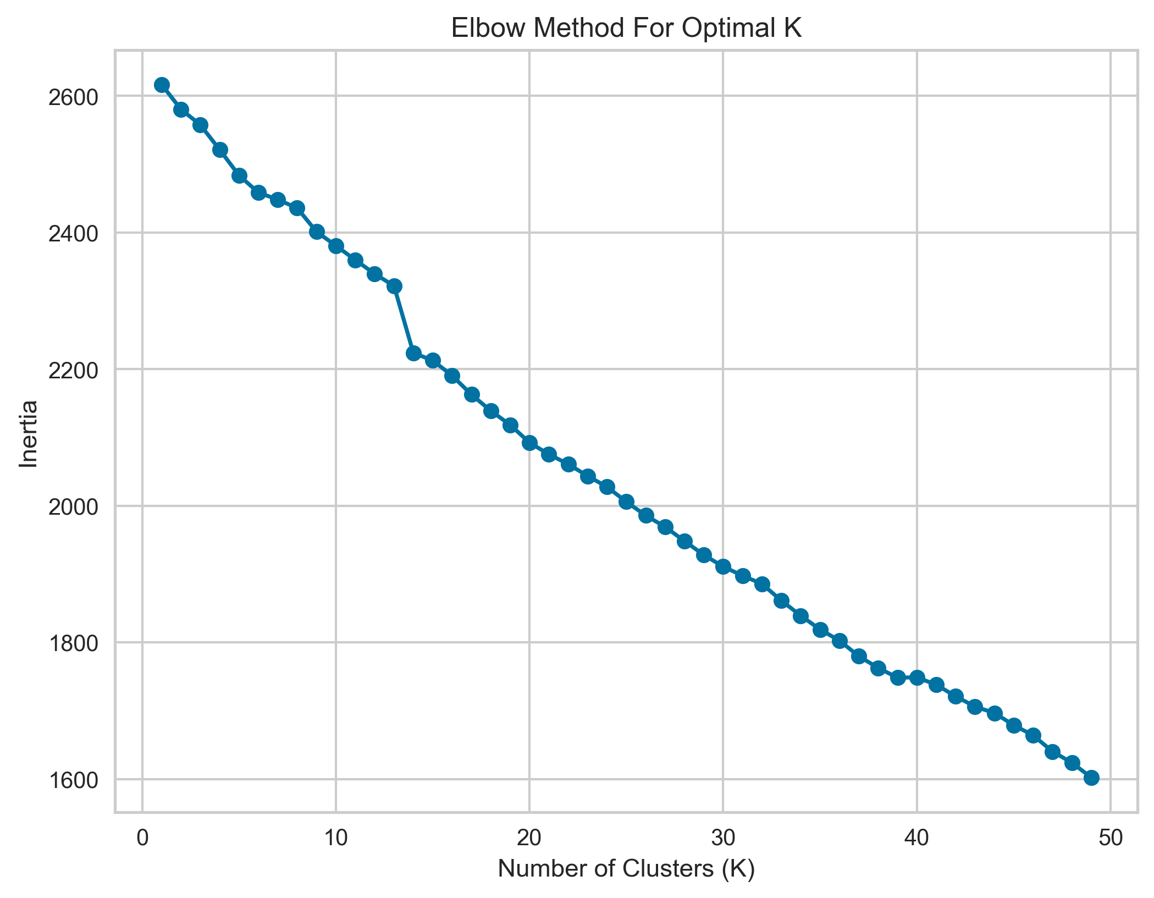

Slide 3
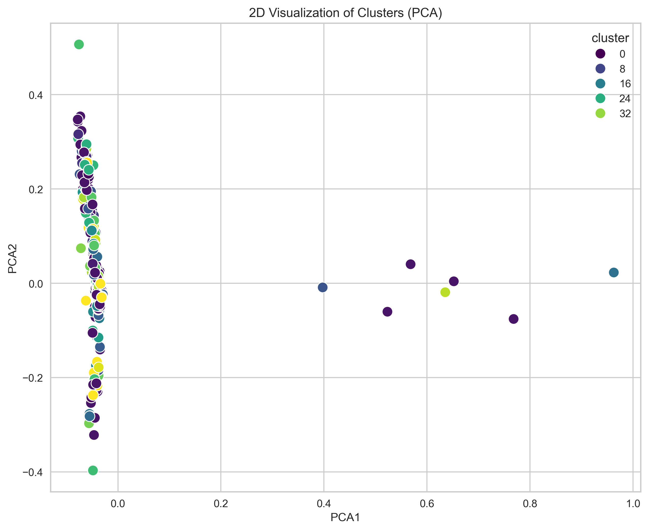

Slide 4
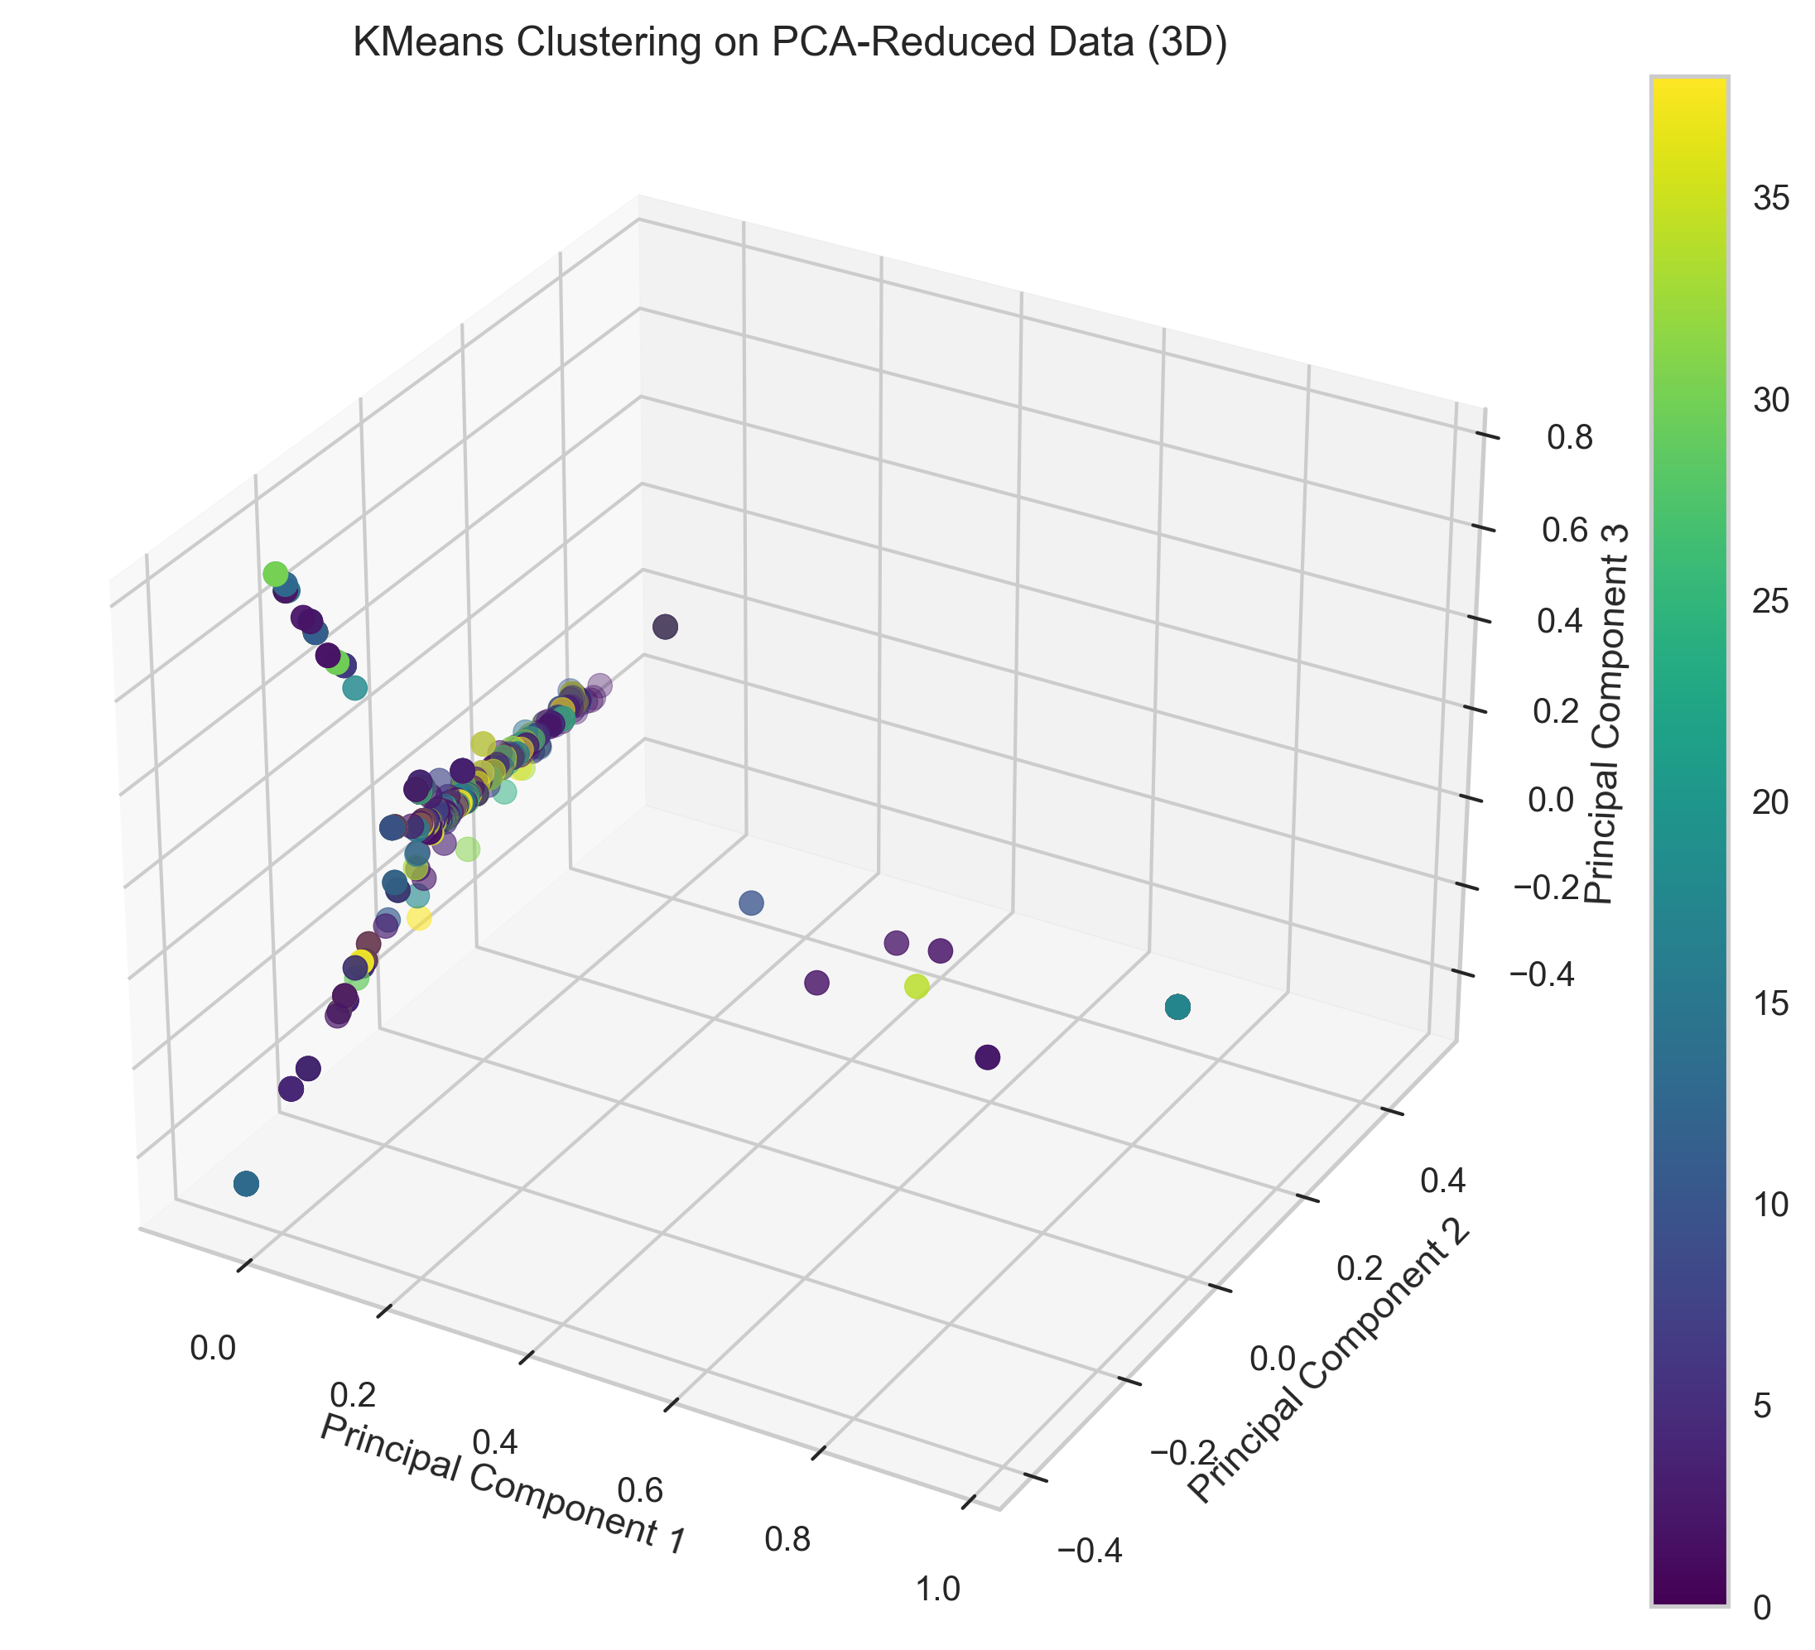

Slide 5
**Conclusion:**
By applying clustering to the Disney character data, we can uncover groups of characters that share similarities in terms of the films they appear in.
These clusters can provide insights into potential themes or types of characters in the Disney universe, which can be useful for various applications such as content recommendation or market analysis.

