Slide 1



معصومه صیدی

Slide 2
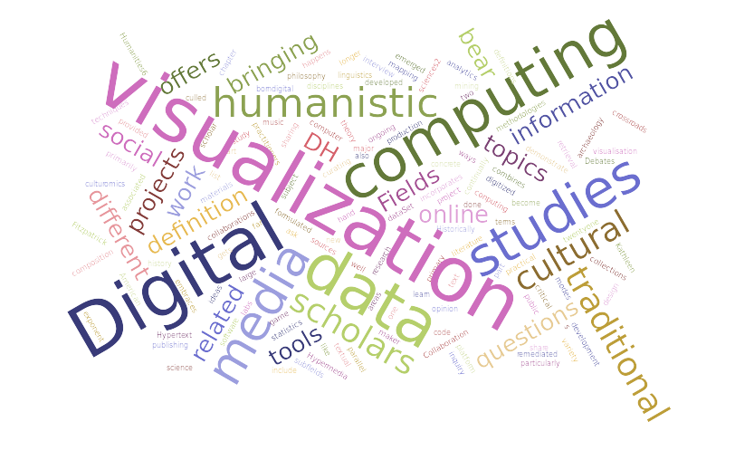
DigitAl Humanities

Slide 3
Research Fields
Digital classic
  Philology
  Epigraphy
  Inscriptions
Treebanking
  Morphological annotation
  Syntactic annotation
Data Analysis of Islamic world

Slide 4
Sample Projects
Digital Fragmenta Historicum Grecorum
Digital Athenaus
Digital Marmor
Arethusa
Inter-annotator
POS-Tagger
Open Arabic
al-Ṭabaqāt
Geographic Modeling
al-Thurayya

Slide 5
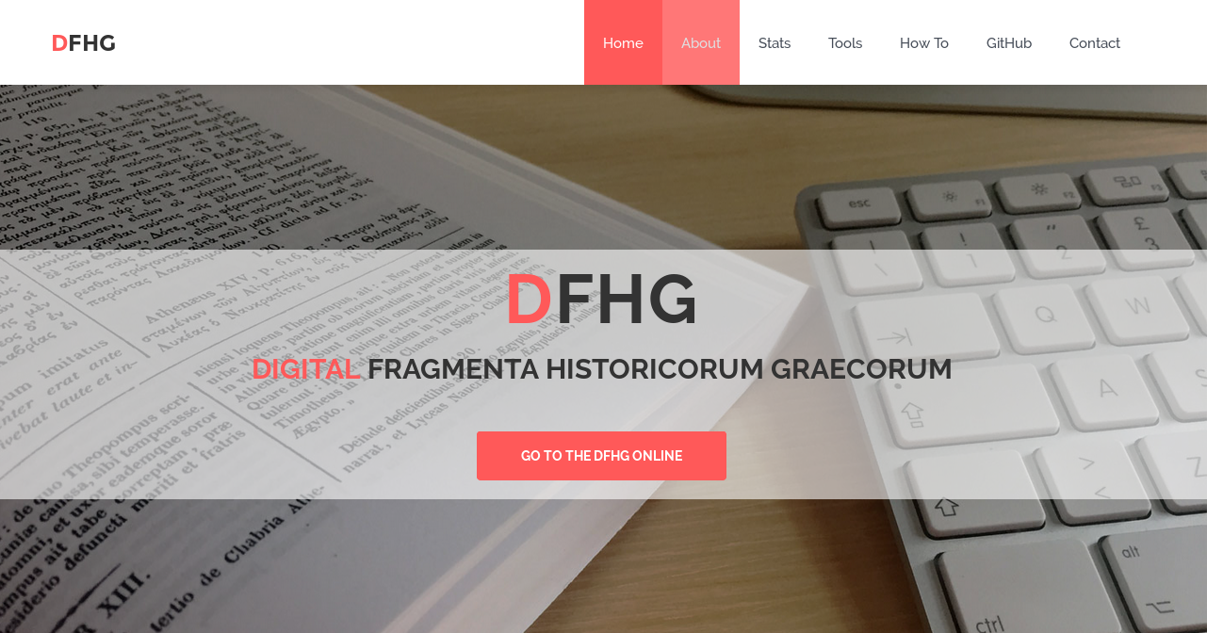
DFHG
http://www.dfhg-project.org

Slide 6
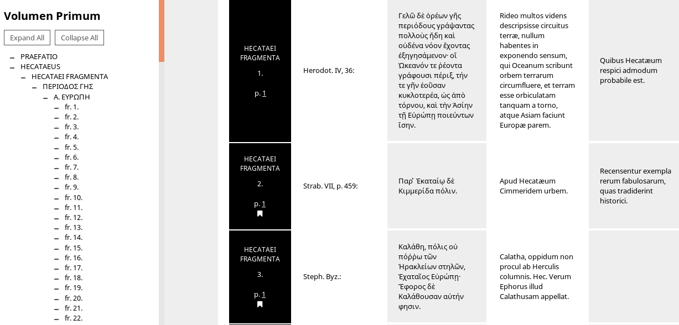
DFHG

Slide 7
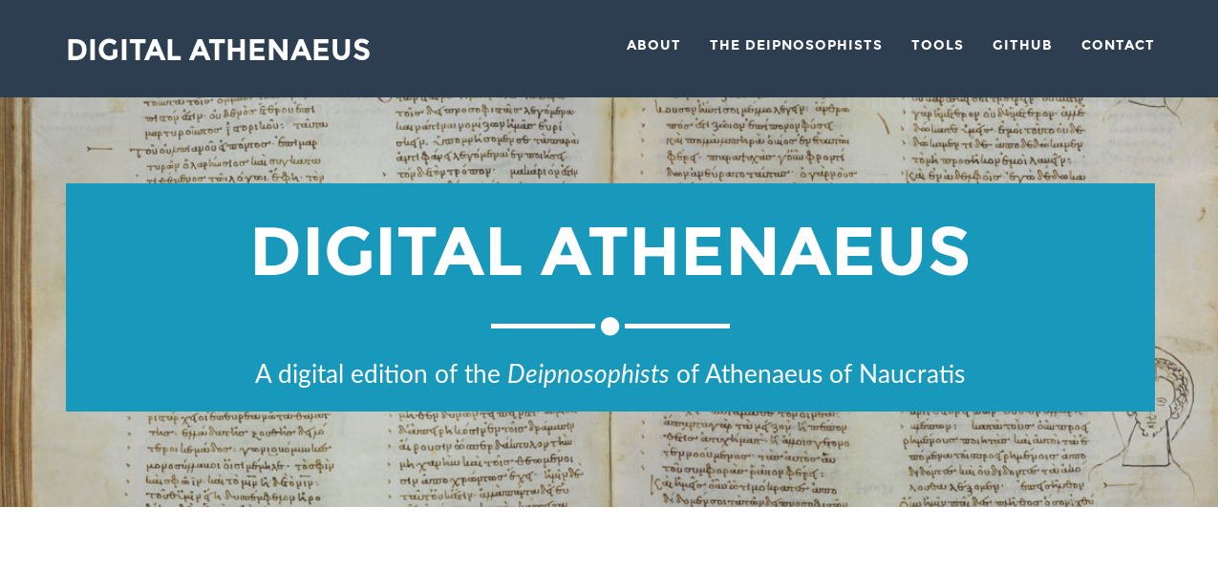
Digital Athenaues
http://digitalathenaeus.org/

Slide 8
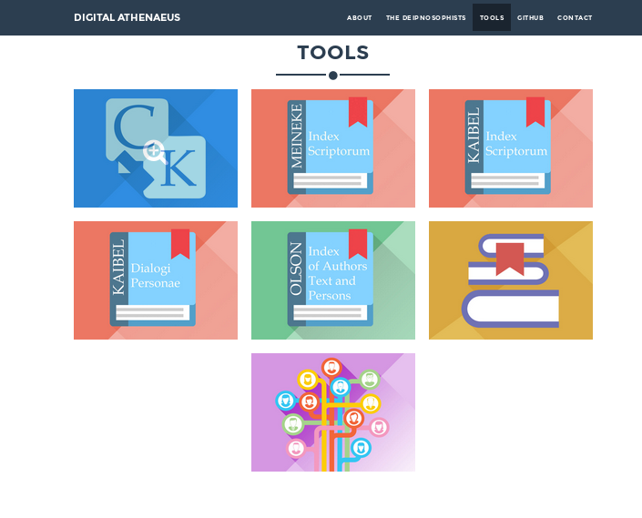
Digital Athenaues: Tools

Slide 9
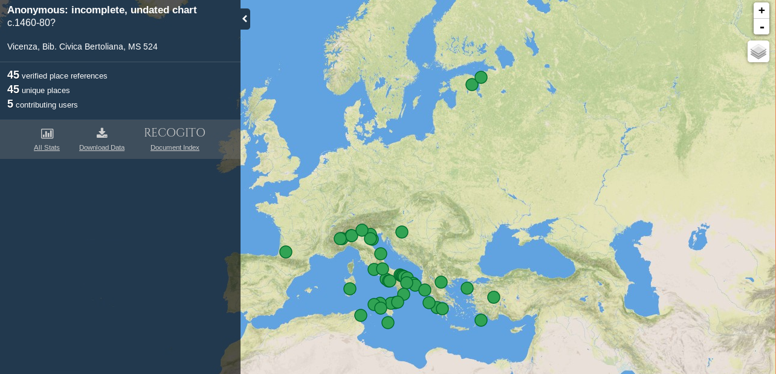
Digital Marmor

Slide 10
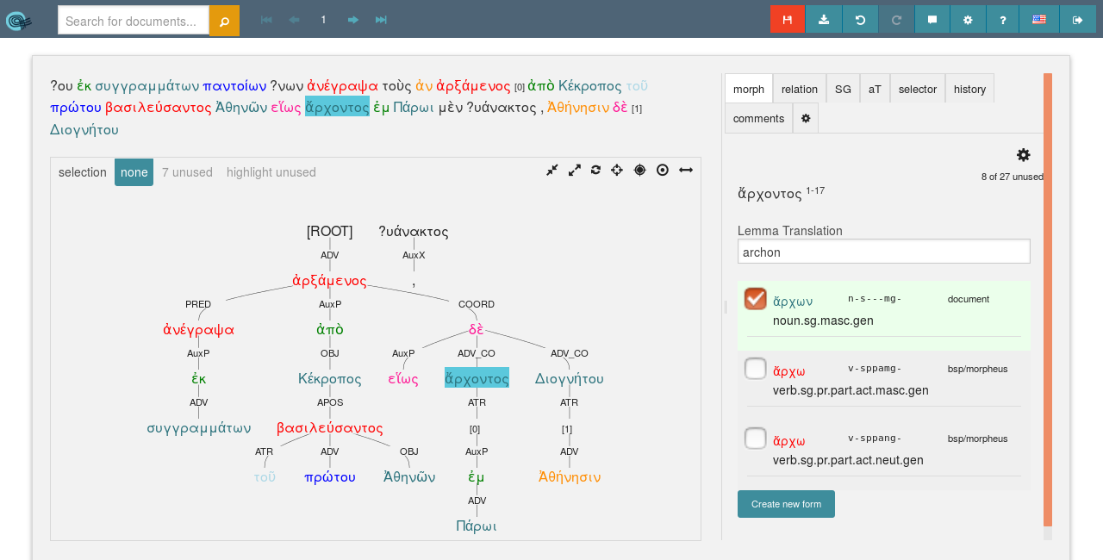
TreeBanking
http://www.perseids.org/tools/arethusa/app/#/

Slide 11
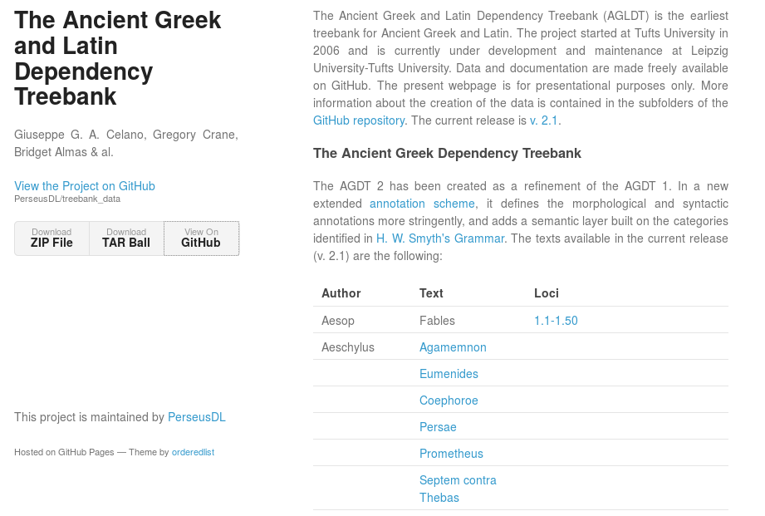
TreeBank Data

Slide 12
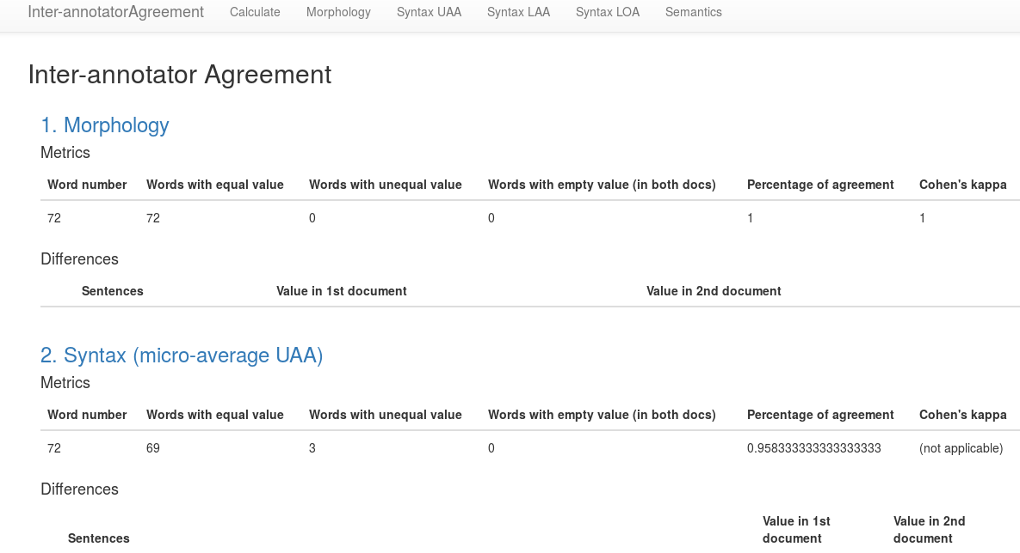
Inter-Annotator Agreement
http://l-processor.org:8984/i-agldt

Slide 13
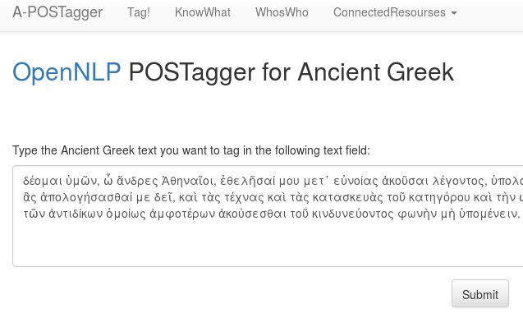
POS-Tagger
http://l-processor.org:8984/a-postagger

Slide 14
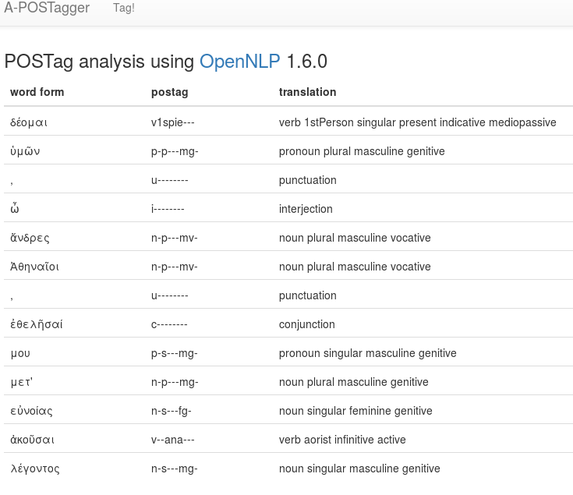
POS-Tagger

Slide 15
Open Arabic & Persian
Digital content
Machine readable
Browse and analyses
Geographical, biographical, chronological
Visualization and representation

Slide 16
Open Arabic
Machine-actionable corpus of per-modern texts
10,393 total & ca. 7,700 unique texts
http://shamela.ws/ & http://shiaonlinelibrary.com/
Encourage computational analysis
Convert into a mARkdown format

Slide 17
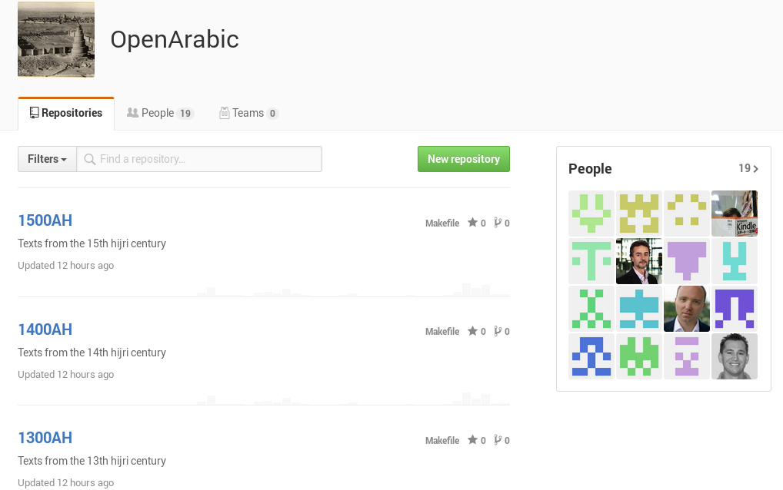
Open Arabic

Slide 18
mArkDown
Structural elements: Headers, Metadata, ...
In-text Elements: Paragraphs, Poetry, Verses, Page numbers, Notes, ...
Analytical Patterns:
  Geographical information: Divisions, Route network
  Named entities: Toponyms, Individuals, Biographical characteristics

Slide 19
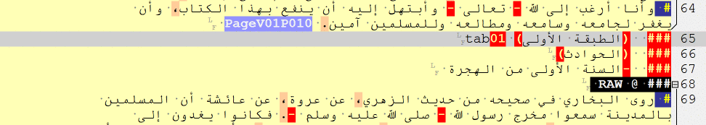
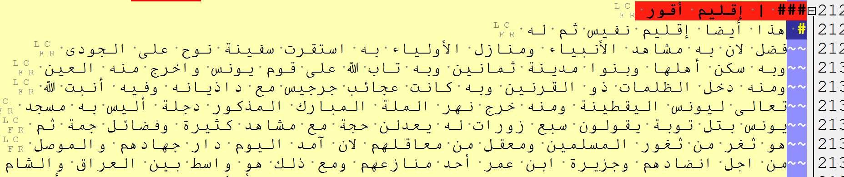
MarkDown: Structural
Headers
Paragraph

Slide 20
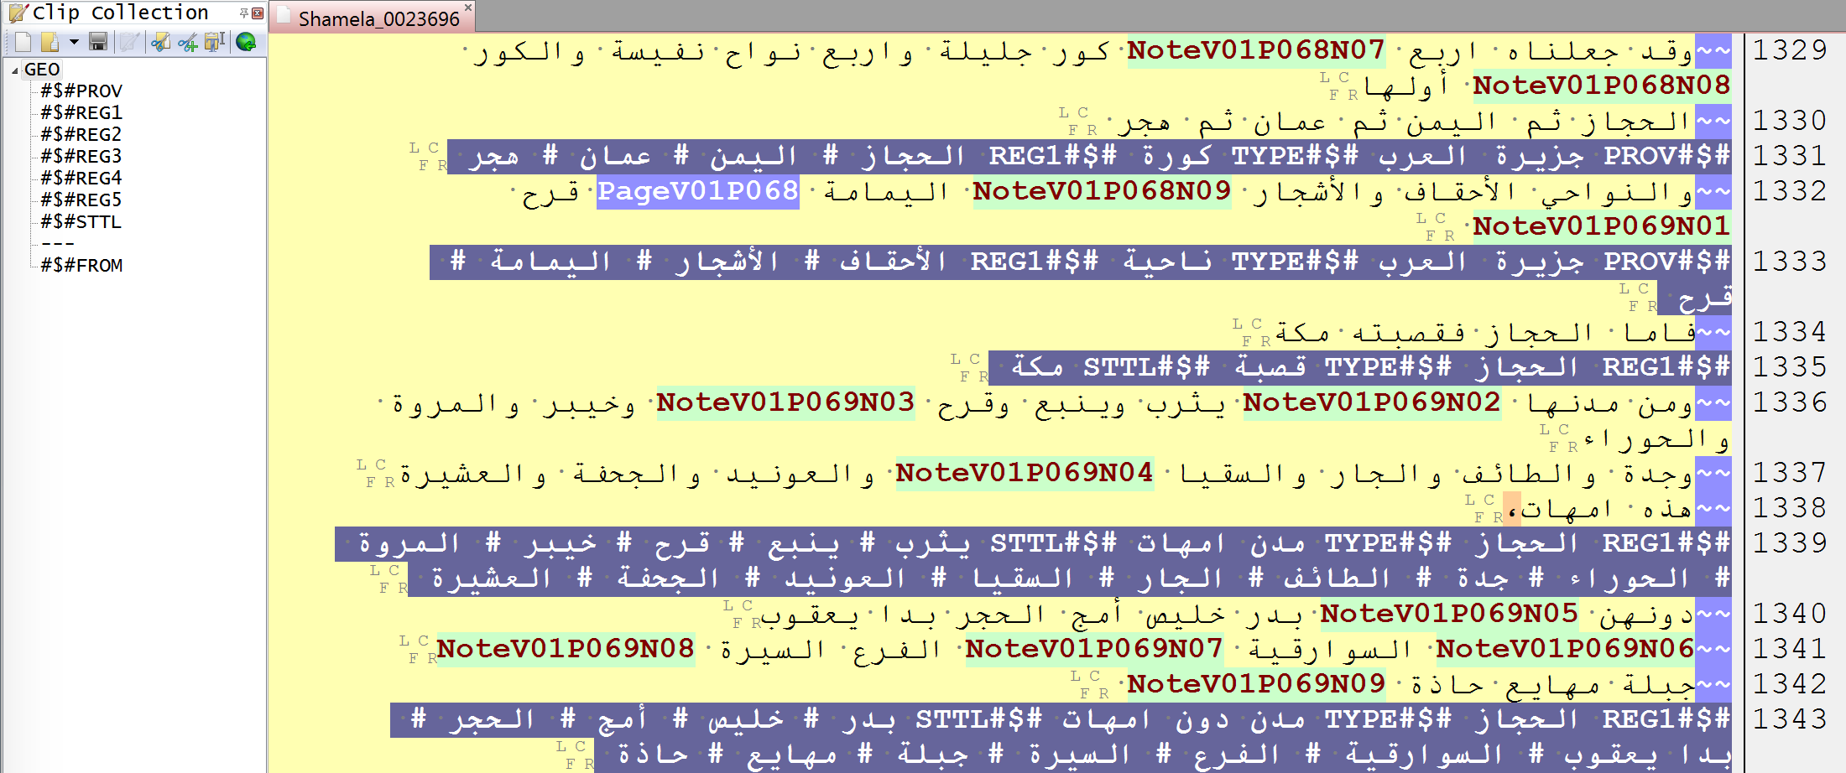
MarkDown:
Geographic Division

Slide 21
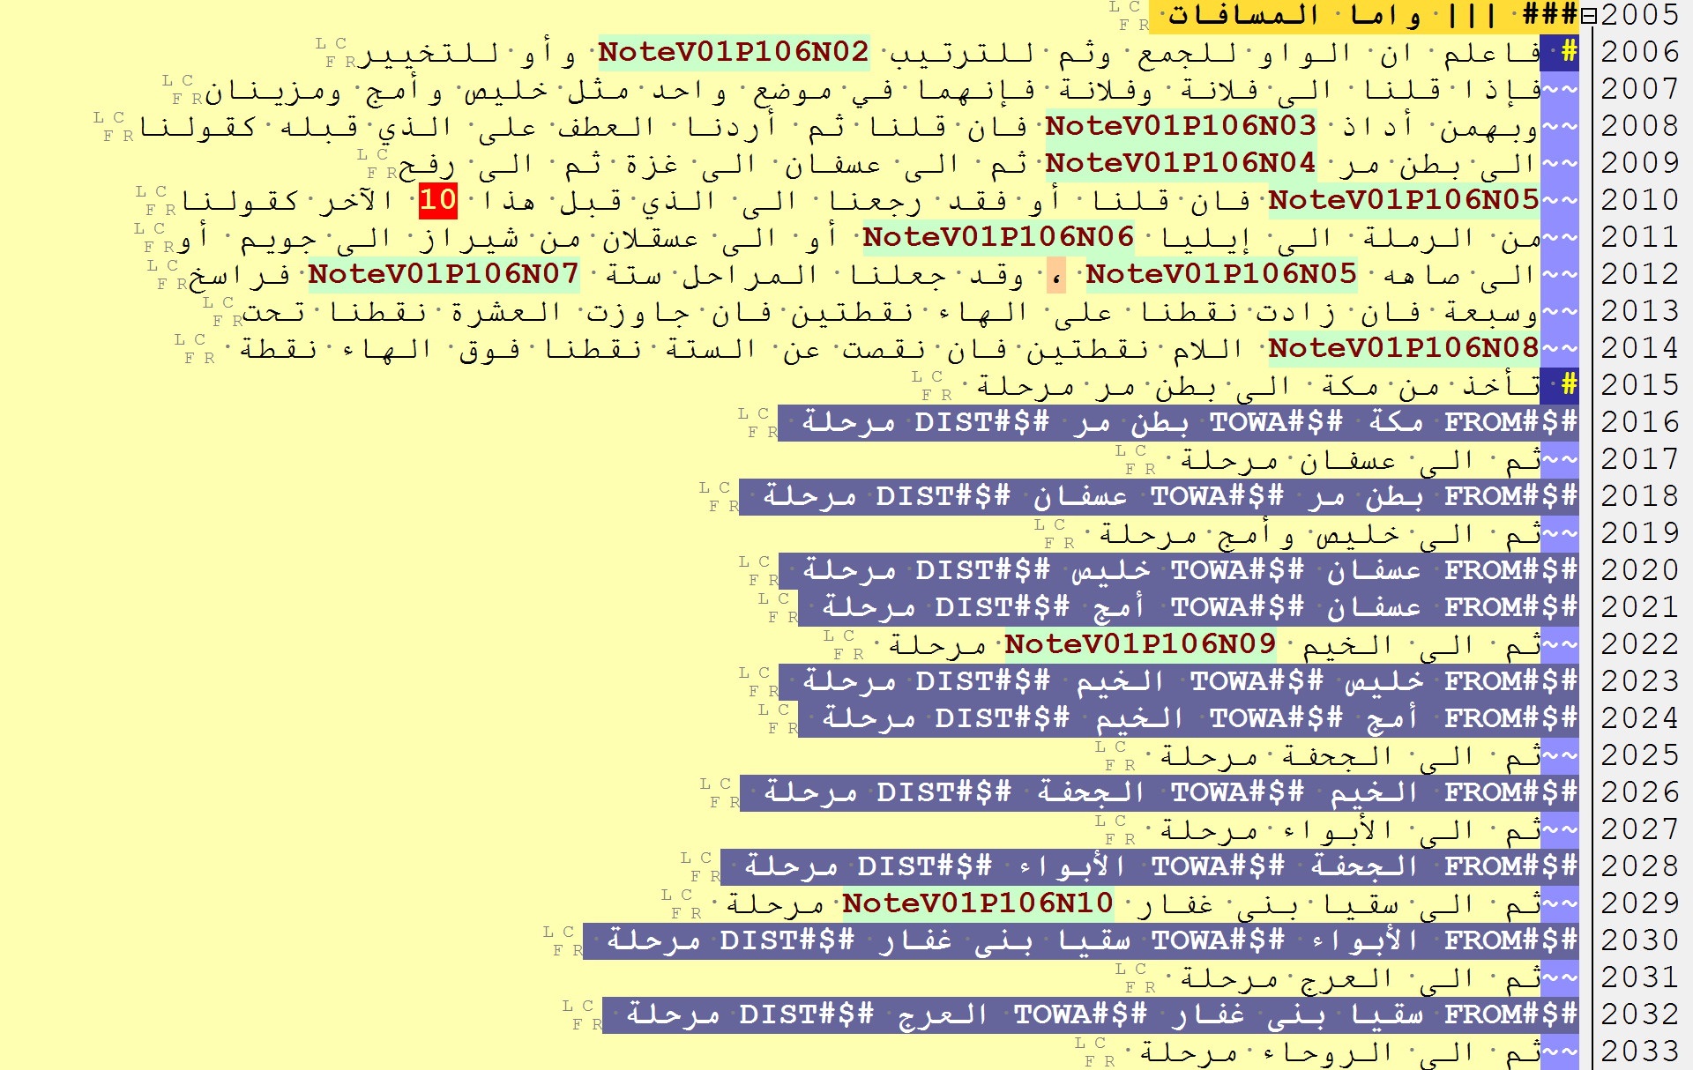
MarkDown: Routes

Slide 22
MarkDown to Analysis
al-Ṭabaqāt 2.0 (v.1.0):
  Analytical browser
  Exploratory analysis
Geographic Modeling
  Data Analysis
    Administrative division
    Route network
  Modeling
  Visualization

Slide 23
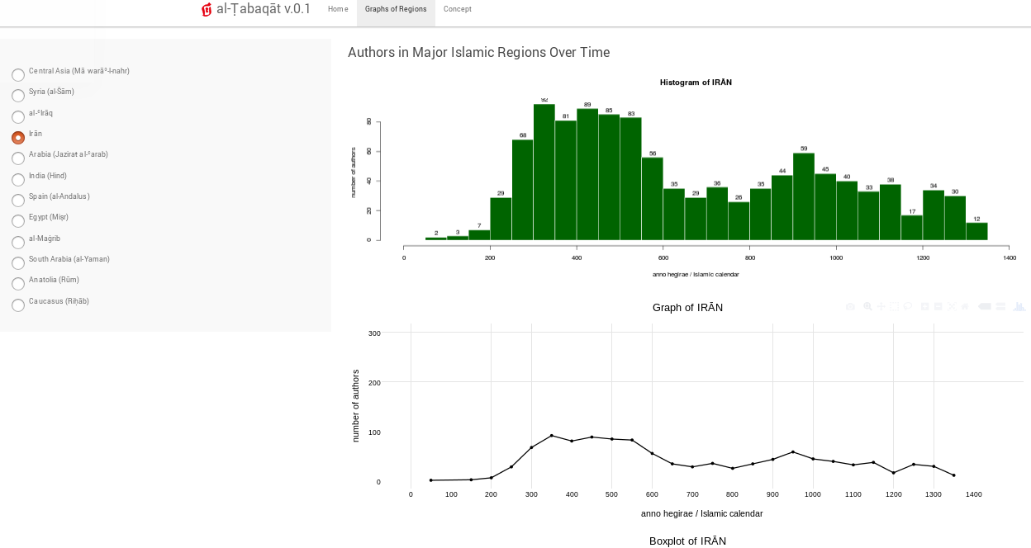
aL-Ṭabaqāt
https://maximromanov.shinyapps.io/tabaqat/

Slide 24
Geospatial Modelling
Find suitable data Structures: Quad Tree, Voronoi, …
Make them Hierarchical
Compare and Evaluate these data structure
Find Pros and Cons regarding Application

Slide 25
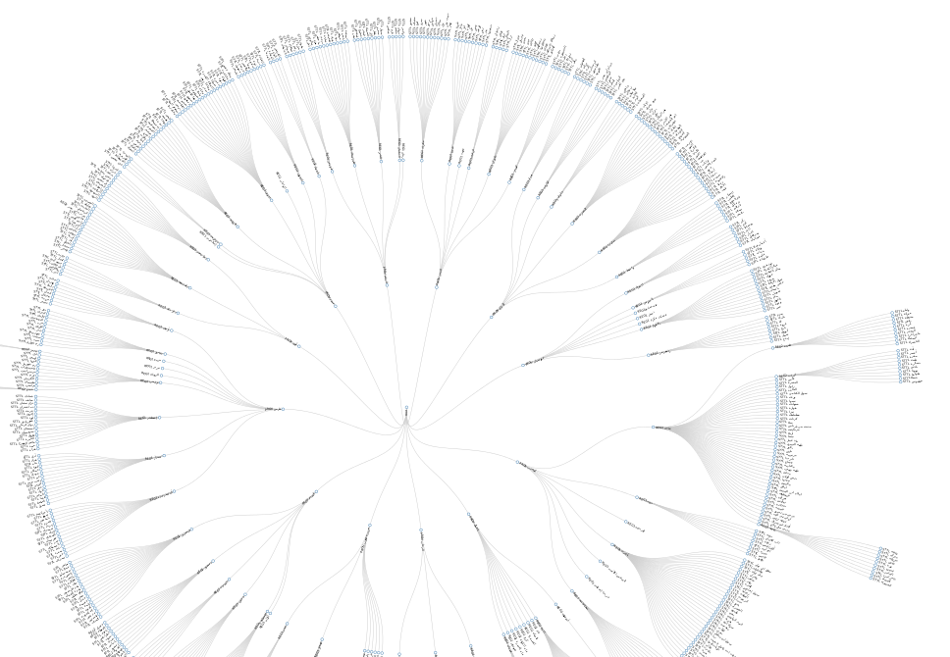
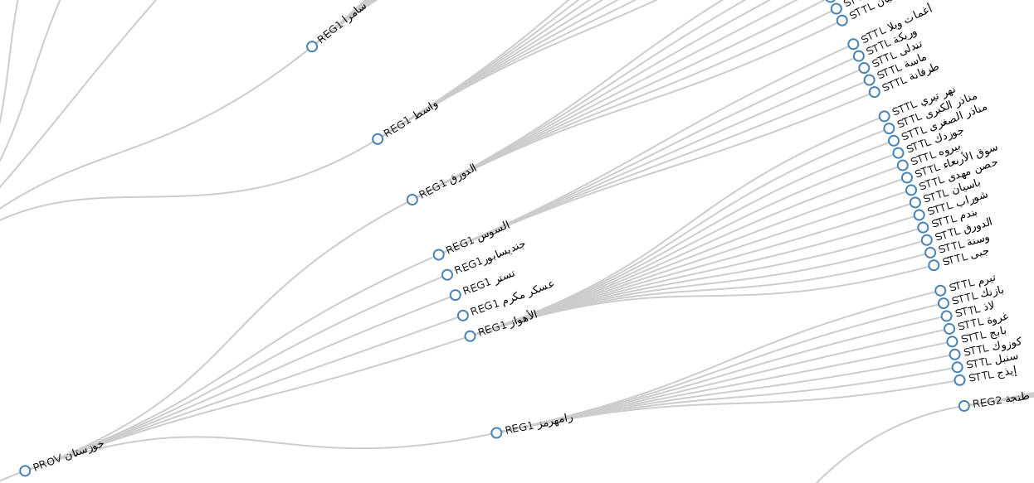
Hierarchical Model

Slide 26
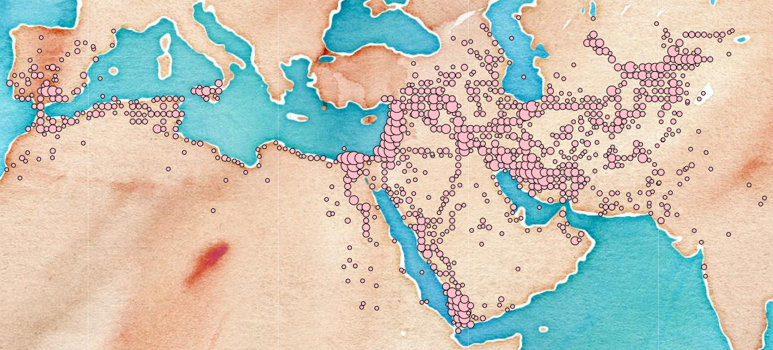
Hierarchical Model:
Quad Tree

Slide 27
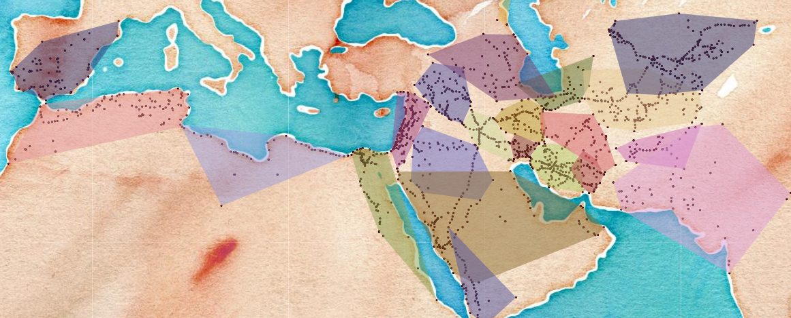
Hierarchical Model:
Convex Hulls

Slide 28
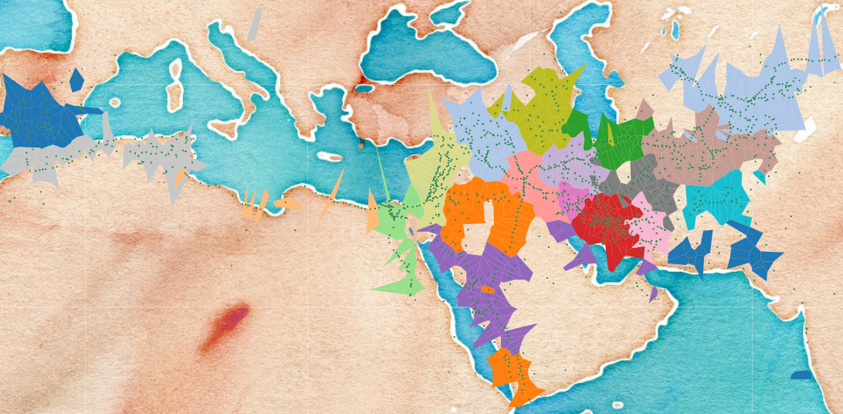
Hierarchical Model:
Voronoi

Slide 29
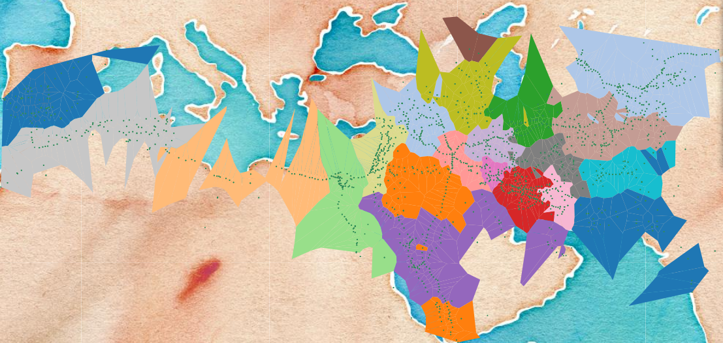
Hierarchical Model:
Voronoi Clipped By Convex Hull of Whole Data

Slide 30
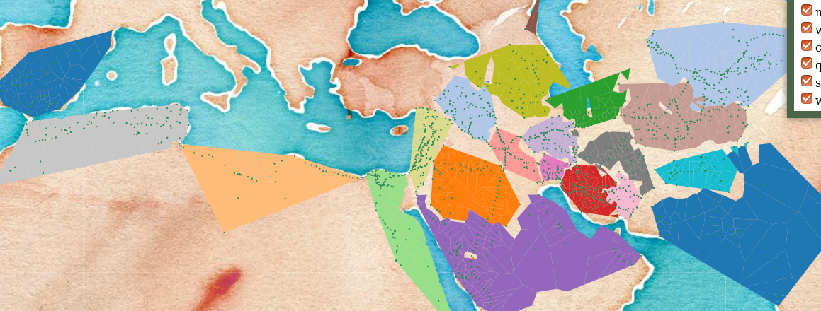
Hierarchical Model:
Voronoi Clipped By Convex Hull of Each Region

Slide 31
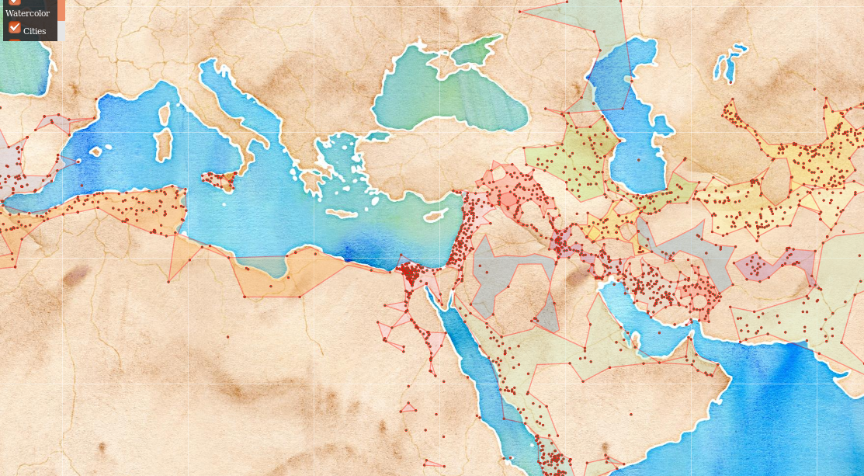
Hierarchical Model:
Concave Hull

Slide 32
Route Network:
Triangulation
Finding coordinates of old places
Using route network, distances, modern coordinates
Triangulation
Possible area
Exact coordinate

Slide 33
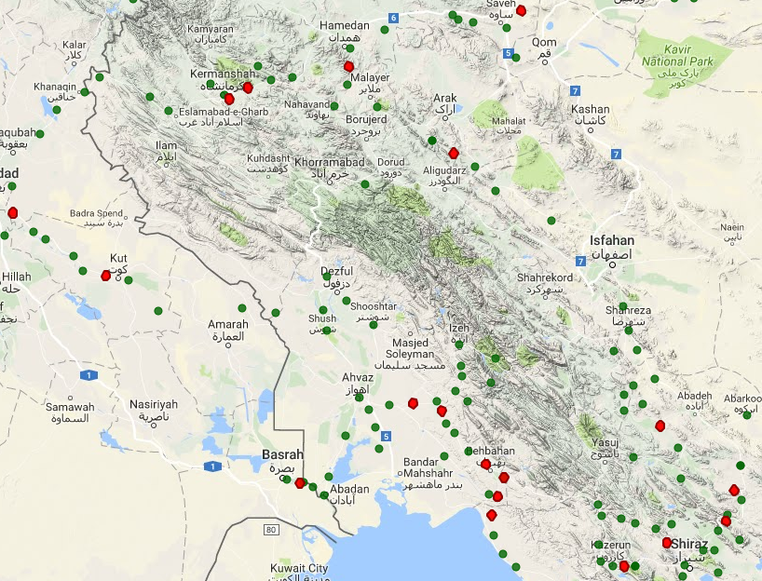
Triangulation: on Map

Slide 34
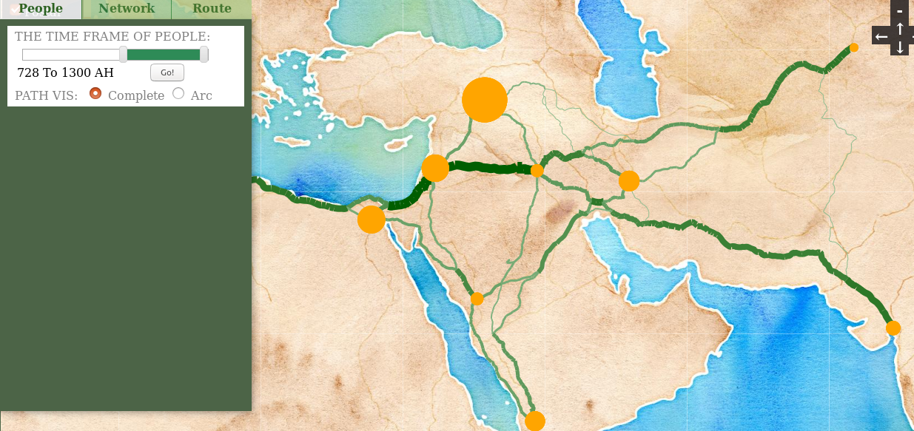
Combining Data

Slide 35
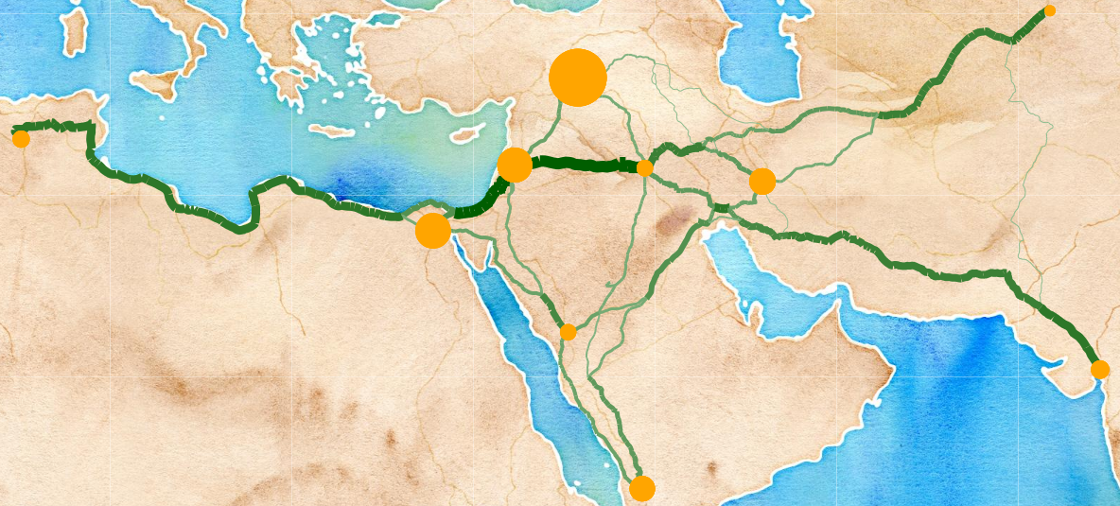
Combining Data(2)

Slide 36
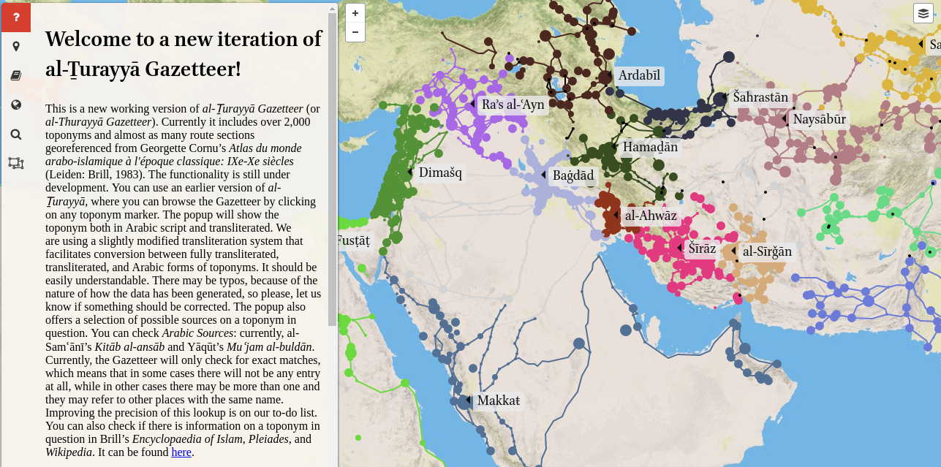
Althurayya Gazeteer
https://althurayya.github.io

Slide 37
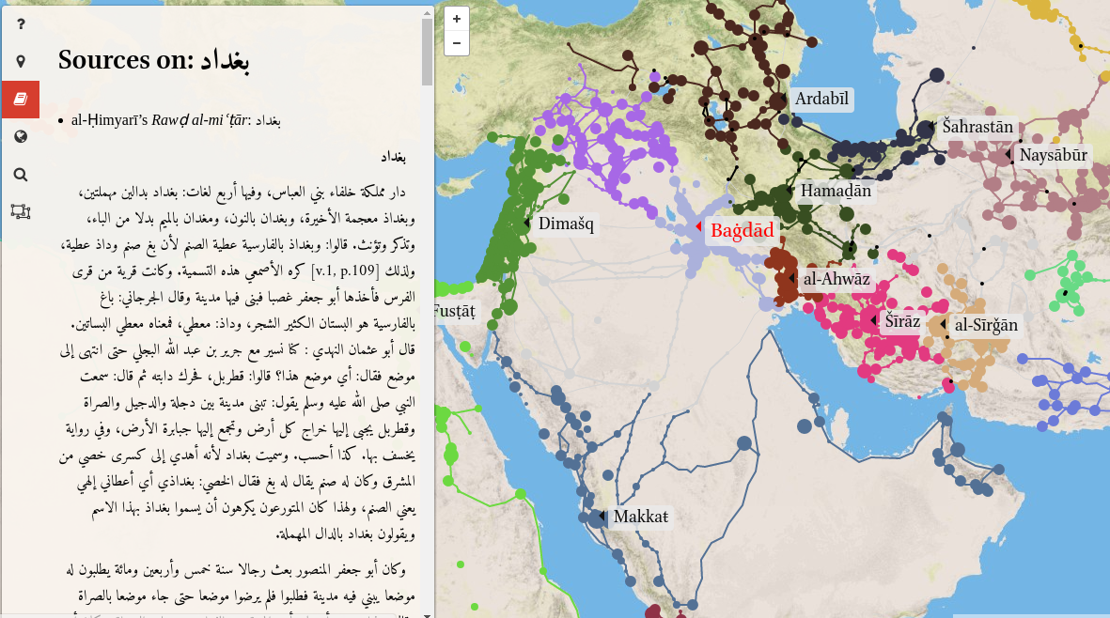
Althurayya: Sources

Slide 38
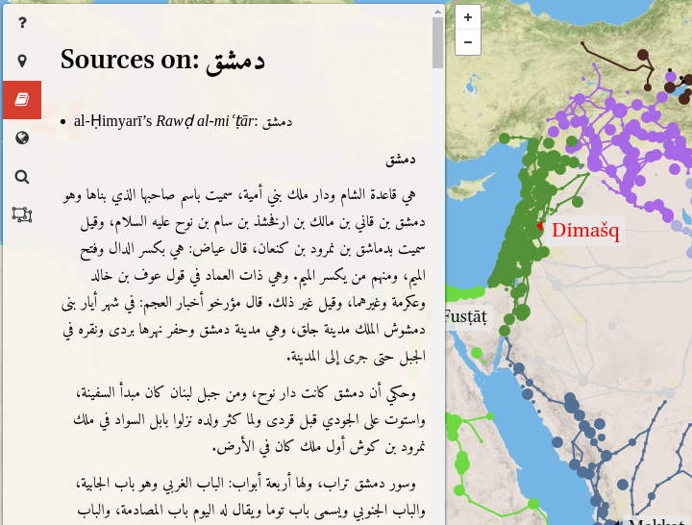
Althurayya:
Primary Sources

Slide 39
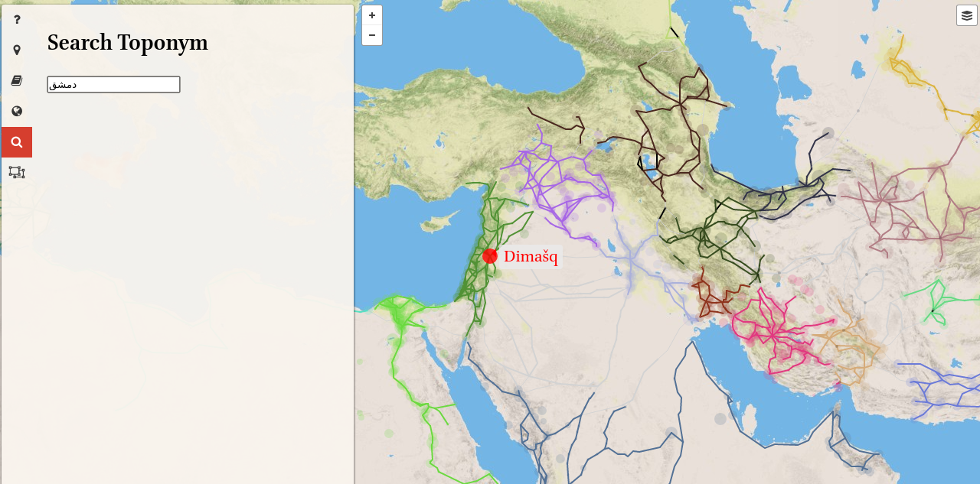
Althurayya: Search

Slide 40
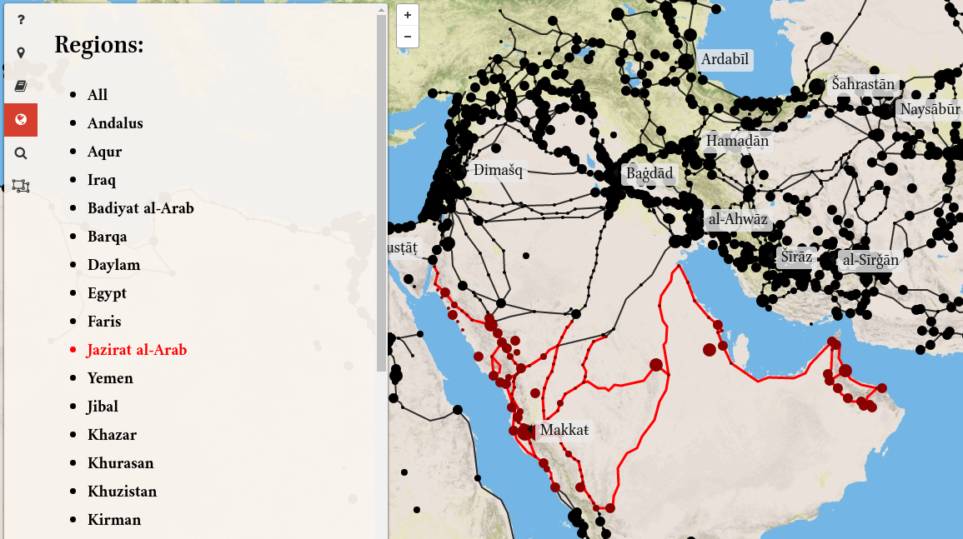
Althurayya: Regions

Slide 41
Althurayya:
More to go
Path finding
Network flood
Cartographic features
….

Slide 42
Thank You!!!
Question?

