Slide 1
A Circle class in detail

Slide 2
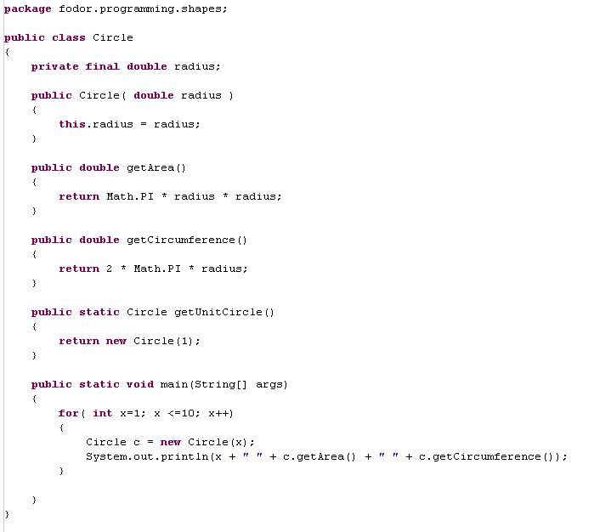
classes bring together data and methods that operate on that data

Slide 3
public means the class, method or data can be accessed from anywhere
private means the data can only be accessed from code within the class

Slide 4
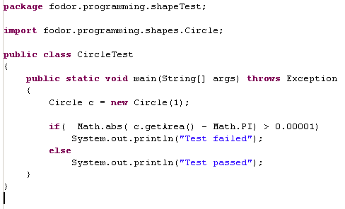
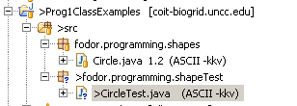
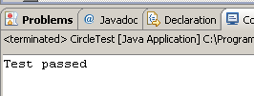
To think about this, let’s make a very simple piece of test code…

Slide 5
Because Circle is public, I can instantiate it
from another package

Slide 6
Because getArea() is public, I can
call it from another package

Slide 7
There are 4 levels of access in Java…
private – the field, method or class can only be accessed from within the class
default – (e.g. float x as opposed to private float x ) –
package level detection – can only be accessed from within the same package
protected – can only be accessed by a sub-class (but you don’t know what that is yet!)
public- can be accessed by everyone.
In general, you want to make everything private that can be made private,
because this simplifies your code by limiting the scope of your code

Slide 8
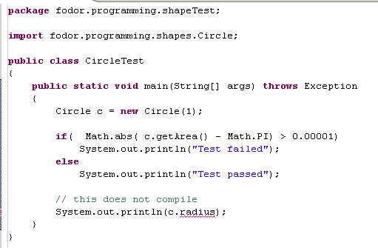

radius has private scope;
It cannot be accessed outside of class Circle.
This is encapsalation
We want to minimize the scope of all variables

Slide 9
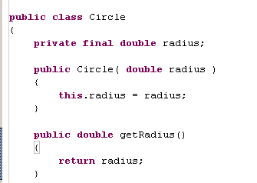
The “Java style” way to expose radius is to add a “getter” method
In Eclipse, we can do this by typing getRa and then cntrl-space and Eclipse will auto-complete.

Slide 10
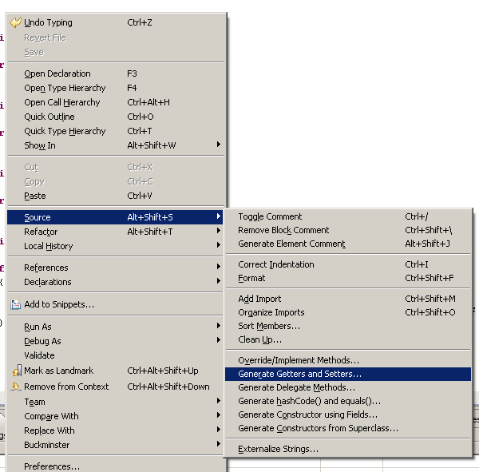
Alternatively, Source->Generate Getters and Setters ->

Slide 11
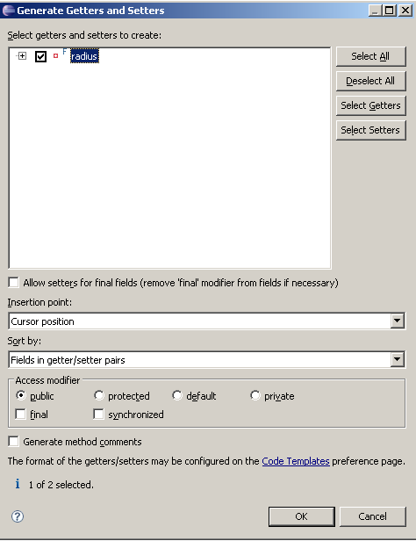
This kind of code generation is
one of the nice features of
Eclipse

Slide 12
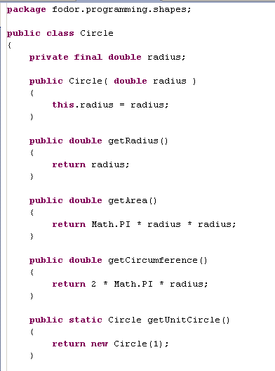
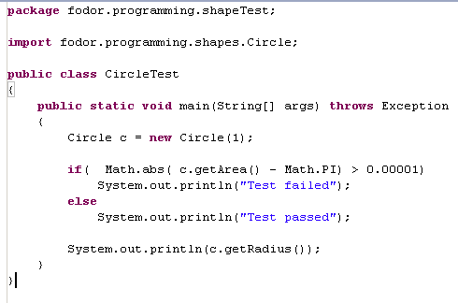

However you get there…
Our data is private – meaning it can’t be accessed from outside the class
Our data is final – meaning it must be assigned a value exactly once

Slide 13
However you get there…
Notice that we did not generate a setter for radius.
Radius is read-only.
Circle is immutable. The data cannot be changed once the object has been created.

Slide 14
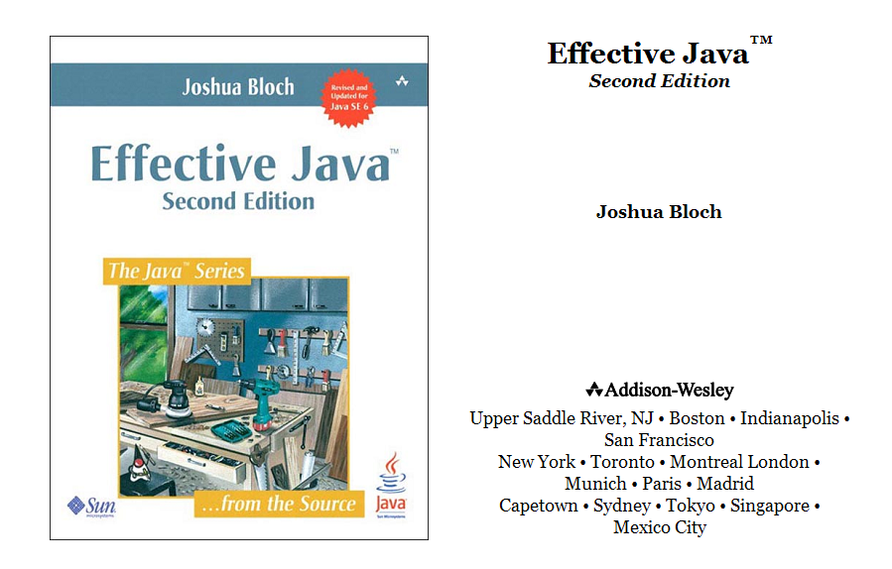
One of many tips from Effective Java… Favor immutable objects..

Slide 15
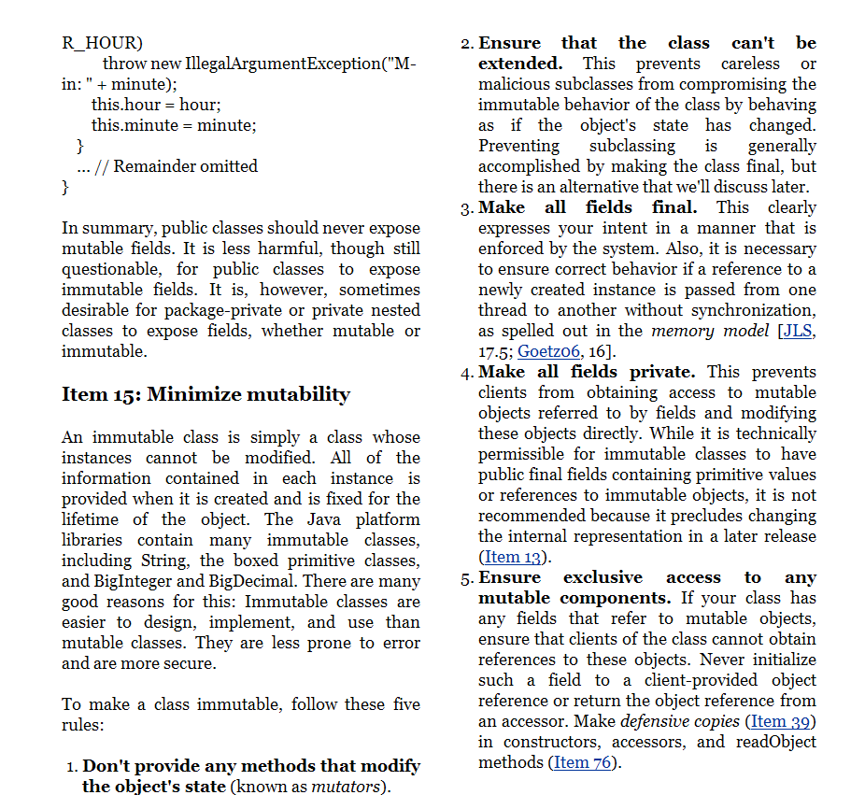
We
We can’t understand all of this yet,
but we can understand some of it.
Immutable objects are inherently simpler
than mutable objects.
Immutable objects are inherently thread-safe
(but more on that later)

Slide 16
In this case, the data is initialized in our constructor…
A constructor is a special function that
has the same name as the class.
A constructor’s job is to initialize the data
in the object.
Circle
double radius
getArea()
getRadius()
this
The pointer that refers to the data in the
current object is called “this”

Slide 17
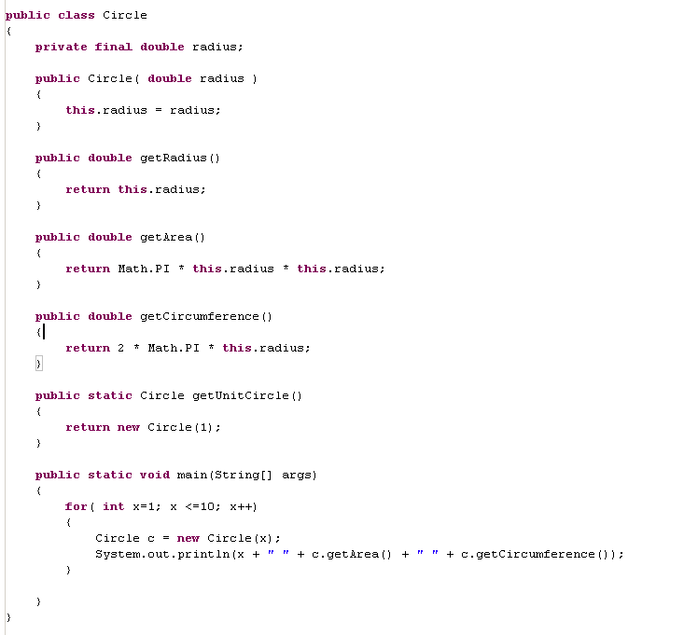
You can optionally always use
the “this” reference to refer to data.
Some people consider it good form, but
often I don’t bother…

Slide 18
In this case, the data is initialized in our constructor…
A constructor is a special function that
has the same name as the class.
A constructors job is to initialize the data
in the object.
Circle
double radius=5
getArea()
getRadius()
getCircumference()
So after the constructor executes, the data for
our circle is set (to whatever value is passed in as “radius” to the constructor).
Because Circle is immutable (this.radius is final), the radius value cannot be changed

Slide 19
c will go out of scope here
(not that it matters because the program exits!)
c
Circle
double radius=5
getArea()
getRadius()
getCircumference()

Slide 20
Next topics:
statics and non-statics
inheritance and interfaces

