Slide 1
Multi-threaded Needleman–Wunsch

Slide 2
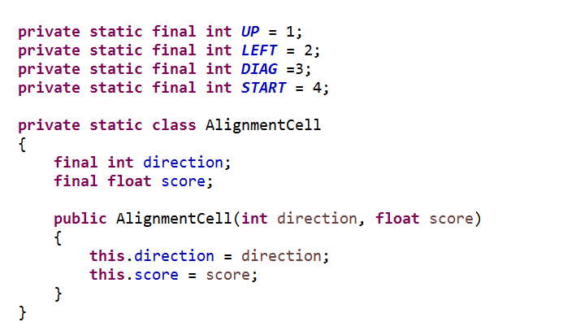
Two dimensional grid of immutable AlignmentCell objects…
https://github.com/afodor/metagenomicsTools/blob/master/src/dynamicProgramming/NeedlemanWunschMultiThreaded.java

Slide 3
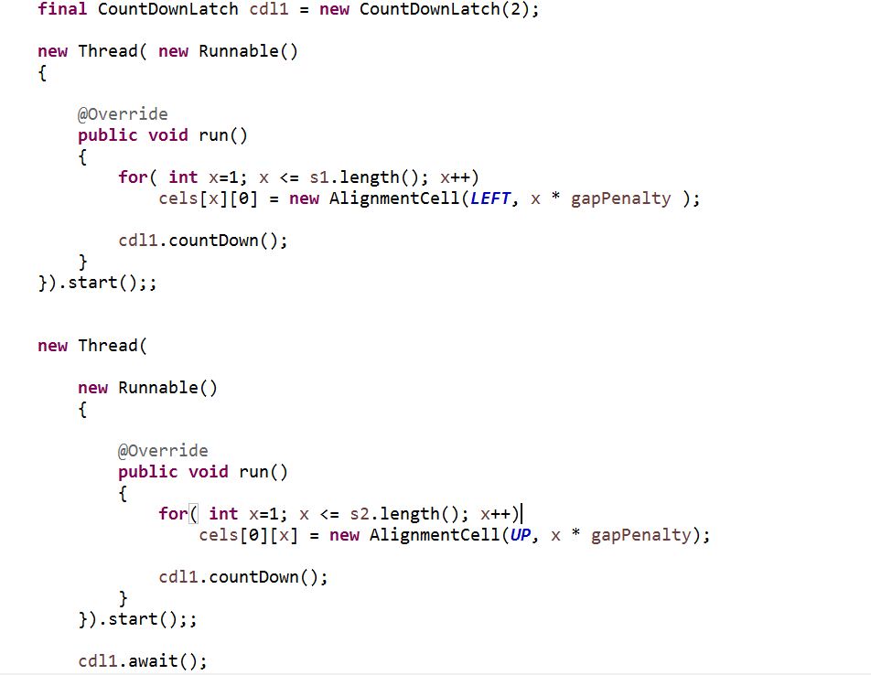
We can fill in the (linear) gap penalty trivially with two threads…
https://github.com/afodor/metagenomicsTools/blob/master/src/dynamicProgramming/NeedlemanWunschMultiThreaded.java

Slide 4
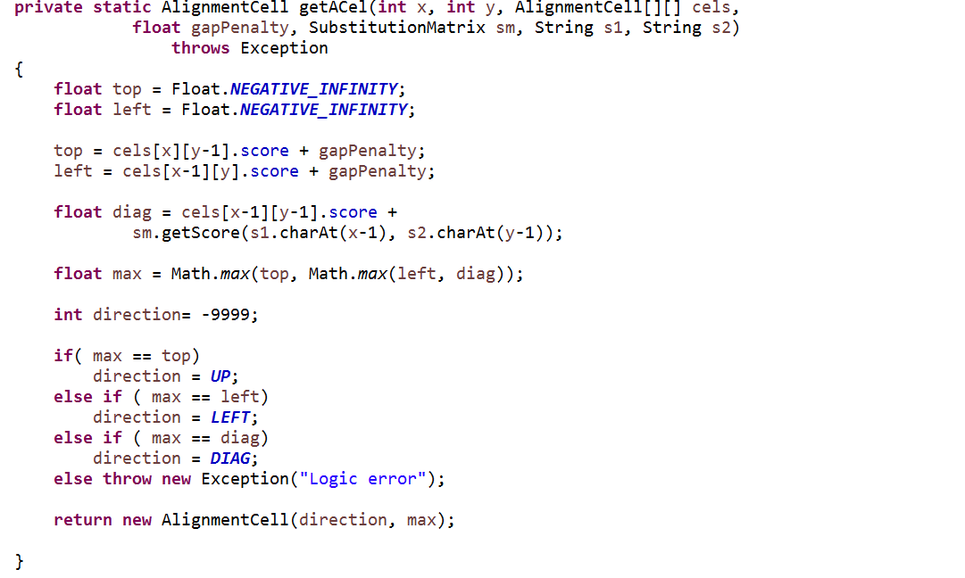
With a linear gap penalty, we can define a method to fill in a given cell…
(the checked in code also can deal with affine gap penalties, but that is not shown in this slide..)
https://github.com/afodor/metagenomicsTools/blob/master/src/dynamicProgramming/NeedlemanWunschMultiThreaded.java

Slide 5
Our strategy (in pictures….) We start two threads….
H E A G A W G H E E
0
-8
-16
-24
-32
-40
-48
-56
-64
-72
-80
P
-8
A
-16
W
-24
H
-32
E
-40
A
-48
E
-56
Each time the horizontal thread finishes, it checks to see how far the vertical thread has gotten

Slide 6
H E A G A W G H E E
0
-8
-16
-24
-32
-40
-48
-56
-64
-72
-80
P
-8
A
-16
W
-24
H
-32
E
-40
A
-48
E
-56
Let’s say when the horizontal thread is ready for the next row, the vertical thread
has finished the first two columns.

Slide 7
H E A G A W G H E E
0
-8
-16
-24
-32
-40
-48
-56
-64
-72
-80
P
-8
A
-16
W
-24
H
-32
E
-40
A
-48
E
-56
The next row doesn’t have to repeat the work of the vertical threads, saving time…

Slide 8
H E A G A W G H E E
0
-8
-16
-24
-32
-40
-48
-56
-64
-72
-80
P
-8
A
-16
W
-24
H
-32
E
-40
A
-48
E
-56
Likewise, vertical thread can start the next column at a lower point in the grid…

Slide 9
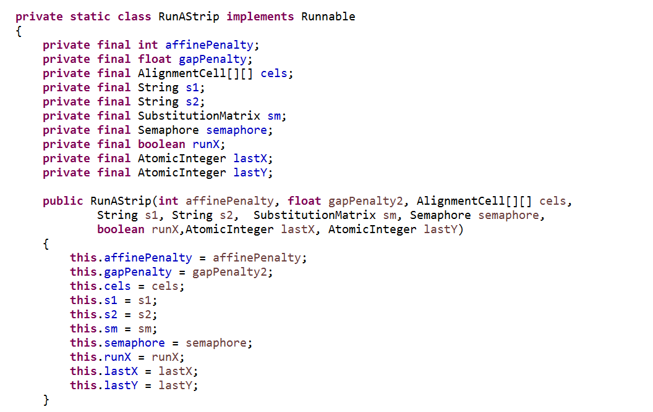
In code….
The constructor for our Worker class…
Could have just as easily used a CountDownLatch

Slide 10
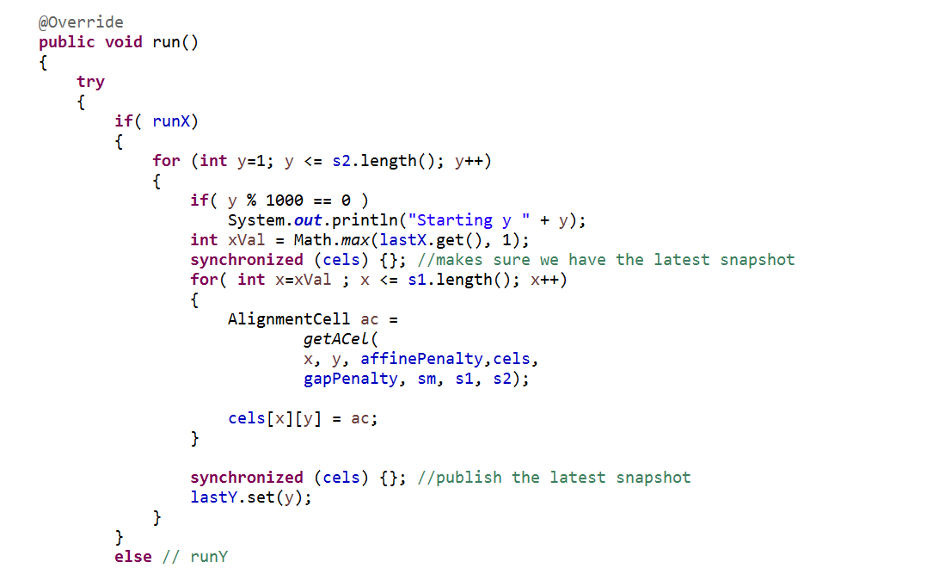
Our run method showing the horizontal thread….
Communicate to the vertical thread where it can start
The synchronized {cels} make sure we grab and publish our results after each row…

Slide 11
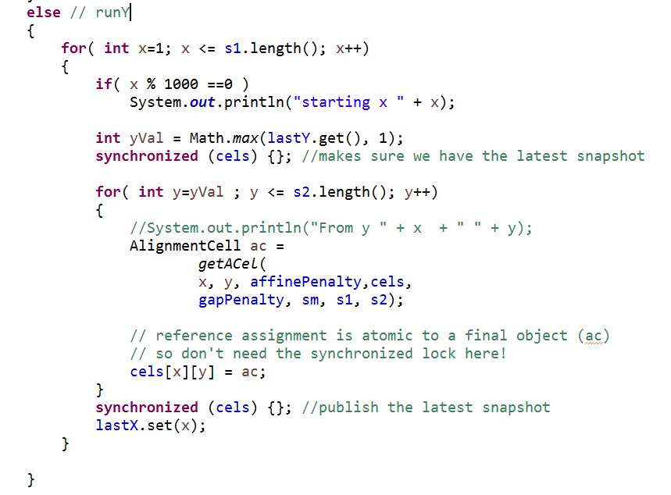
And here is the vertical thread….

Slide 12
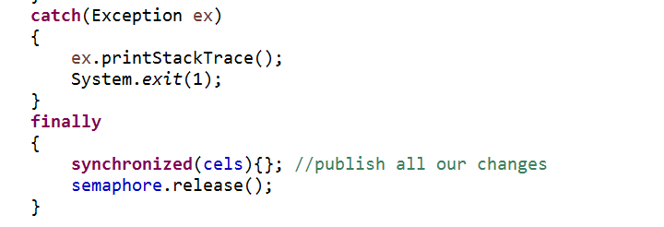
Our cleanup code at the end of the run method…
If any thread dies, they all die!
This synchronized is not really necessary
(we published at the end of each double for loop)
but will only trigger two additional locks
(one as each thread terminates) so doesn’t
really cost us that much…

Slide 13
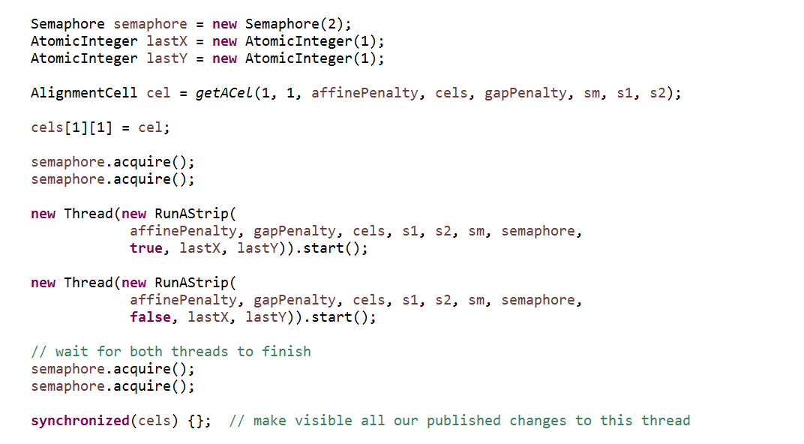
We just need to kick off and wait for these threads….
Make sure we see what the threads have published!

Slide 14
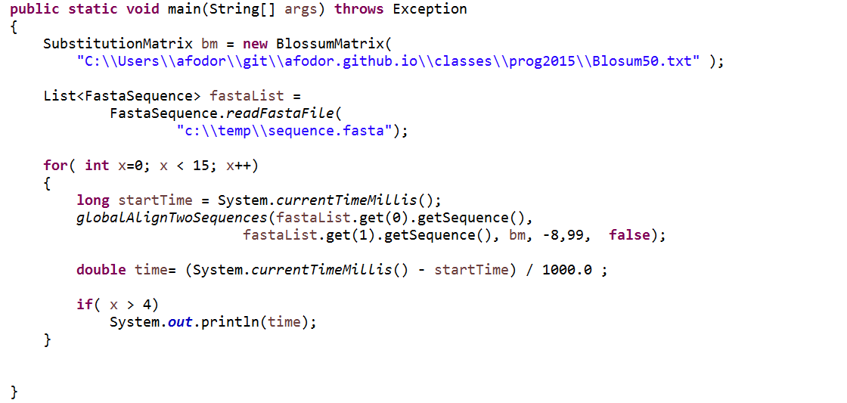
Performance testing on some file with 2 (longish ) sequences…
We allow a “burn-in” doing the alignment 5 times and then take 10 times

Slide 15
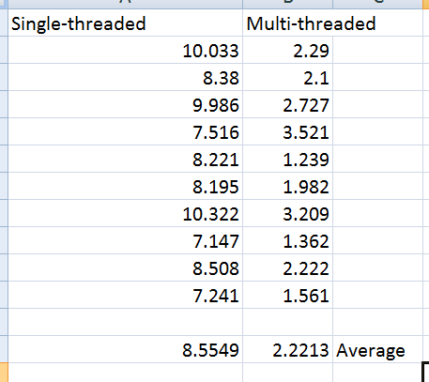
Two core machine (4 logical processors)
Multi-threaded:
Almost 4X speed-up! I have no good explanation of why the speed up is more than 2X.
Likely, some complex interaction with the multi-threaded garbage collector..
(Just running one trial, it looks like the speed up is closer to the expected 50%)
Multi-threaded: https://github.com/afodor/metagenomicsTools/blob/master/src/dynamicProgramming/NeedlemanWunschMultiThreaded.java
Single-threaded: https://github.com/afodor/metagenomicsTools/blob/master/src/dynamicProgramming/NeedlemanWunsch.java
Test file: https://github.com/afodor/metagenomicsTools/blob/master/src/dynamicProgramming/sequence.fasta

