Slide 1
P-values from two conditions under the negative binomial
Pooling variance across samples of similar means
Our example dataset through DeSeq
False Discovery Rate

Slide 2
From last time, we saw how DeSeq calculates the mean and the variance
while (i) normalizing for different numbers of sequences per lane and (ii)
ensuring that the variance is always higher than the mean
But once you have the mean and the variance for two conditions, how do you perform
gene by gene inference to generate p-values for the null hypothesis of no differential
expression?

Slide 3
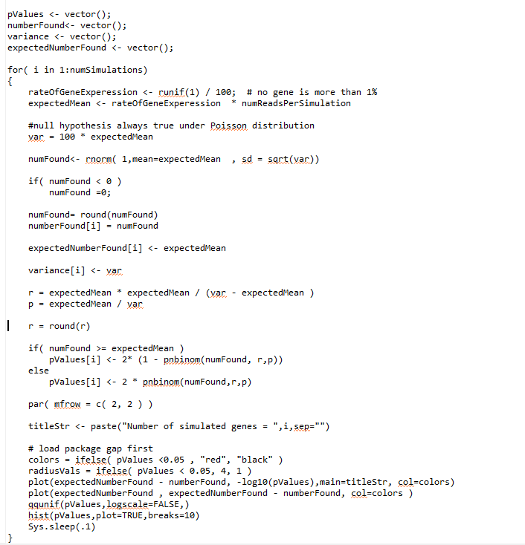
In our previous simulation
(all the way back in lecture 9),
we’ve shown that the negative
bimomial can deal with sampling
with non-constant variance.
But that was testing one sample
against a know mean and variance…
We calculate r and p
under our null hypothesis
This is two-sided test

Slide 4
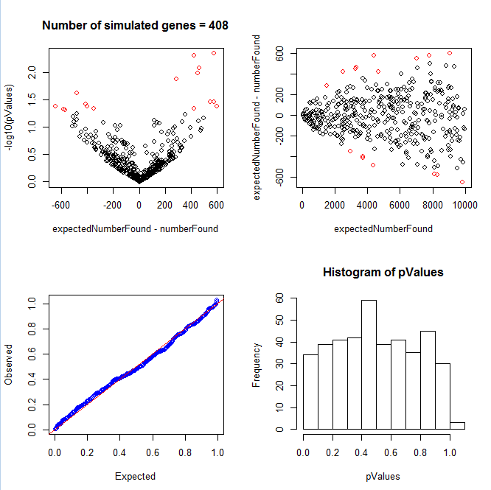
Sampling from a known mean and non-constant variance results in a uniform distribution of p-values

Slide 5
But in a real experiment we need to estimate the mean and variance from two conditions
and then perform inference.
Consider a case where in condition A I have 1,000 reads…
In condition B, I have 1,500 reads.
(Here we don’t consider replicate samples and we assume that the scaling factor Sj is
just 1 for all samples…)

Slide 6
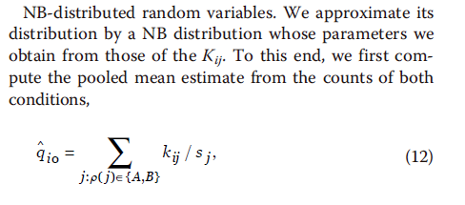
Our algorithm for inference….
Test the null hypothesis that the distribution of the counts of the two conditions is the same.
(1) Calculate the average number of sequences seen in both conditions…
In our example this is just ( 1500 + 1000) / 2 = 1250
i is the index for the gene we are interested in
j is the experiment (rna-seq sample)
s_{j} is a scaling factor that corrects for different # of sequences in each sample
(but here let’s just assume that all samples have the same sequence depth so all Sj=1)
(This is a radical simplification of the math that is actually done in the DeSeq paper
as multiple samples with Sj != 1 make things much more complicated.. )

Slide 7
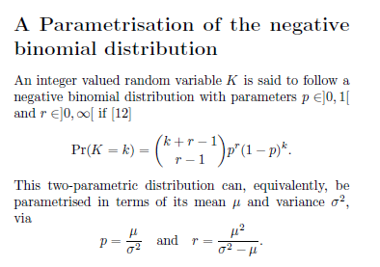
For condition A and B we calculate p and r under the null hypothesis.
Let’s say we have an estimate of the variance from both conditions…
For condition A:
1250 sequences
variance = 5000
For condition B:
1250 sequences
variance = 6000
p_{A}
= 1250/5000 = 0.25
p_{B}
= 1250/6000 = 0.208333
r_{A}
= 1250^2/(5000-1250)= 416.66
r_{B}
= 1250^2/(6000-1250)= 328.94

Slide 8


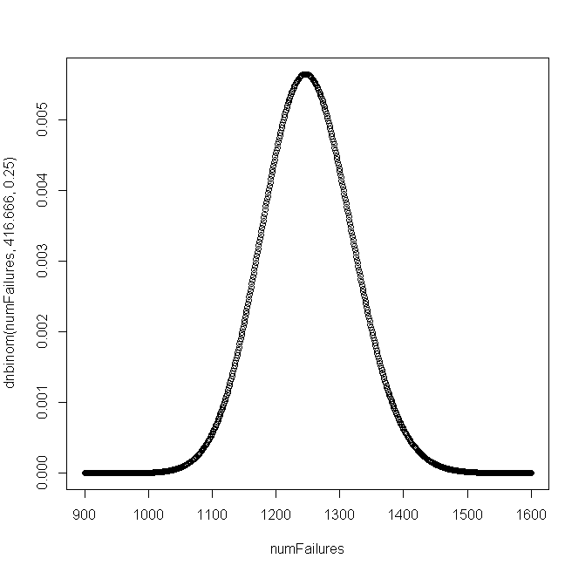
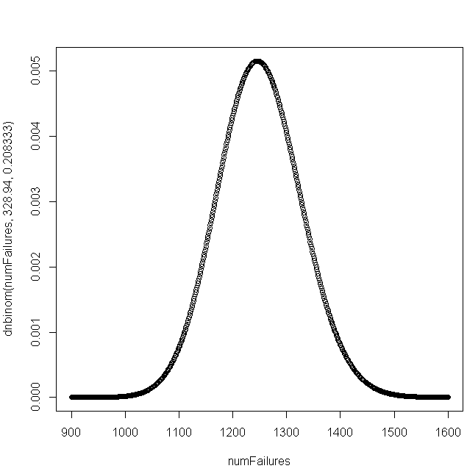
From our two sets of parameters, we can generate two PDFs under the null hypothesis
p_{A}
= 1250/5000 = 0.25
p_{B}
= 1250/6000 = 0.208333
r_{A}
= 1250^2/(5000-1250)= 416.66
r_{B}
= 1250^2/(6000-1250)= 328.94
p(a)
p(b)
Under the null hypothesis, p(a) and p(b) are independent, so we can calculate a joint
probability p(a) * p(b)

Slide 9
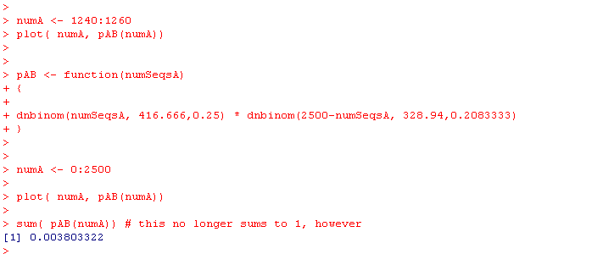
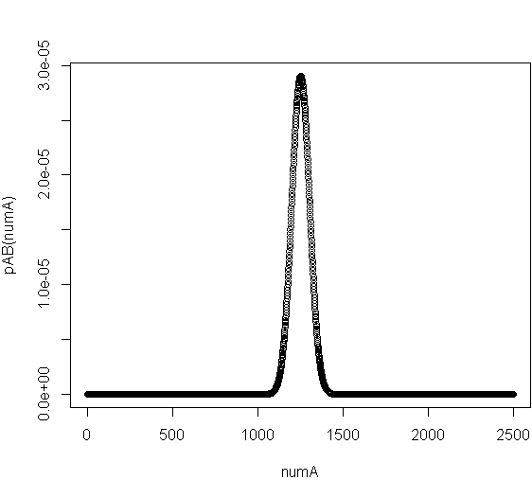
Under the null hypothesis, p(a) and p(b) are independent, so we can calculate a joint
probability p(a) * p(b)
K_{a} = the number of counts we observed in A
K_{b} = the number of counts we observed in B
p(a) * p(b) = dnbinom(K_{a,} 416.666,0.25) * dnbinom(K_{b,} 328.94, 0.208333)
There were a total of 2500 sequences we observed in A or B.
So to graph this out

Slide 10
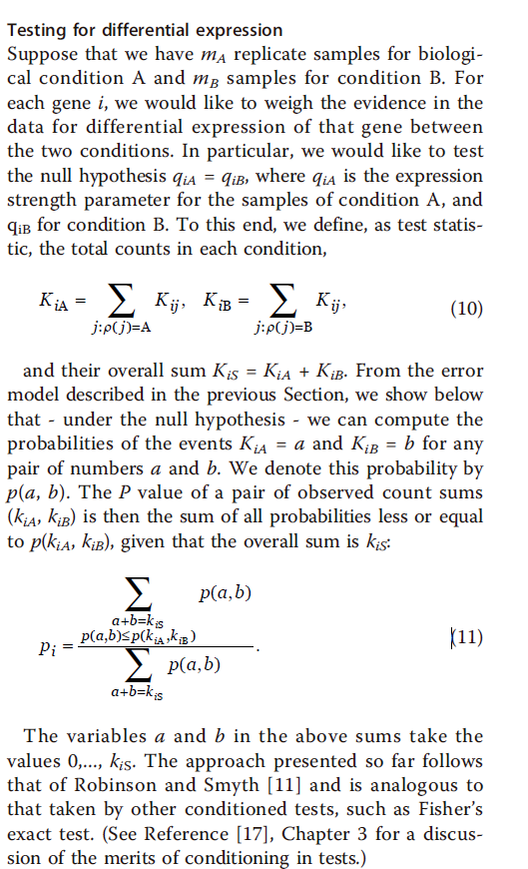
Observed: 1000 from A;
1500 from B
To do a two-sided test:
Every probability that is <= the prob for our observed data
The total area under p(a,b)

Slide 11
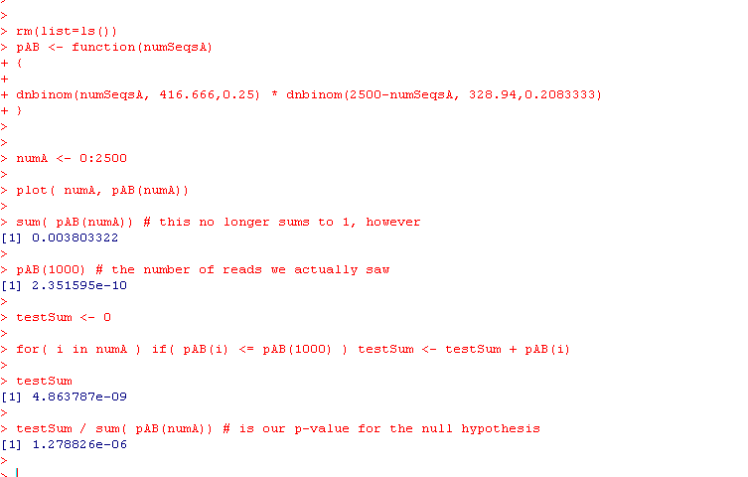
Here, finally, we can calculate the p(seeing 1000 reads in A)
(or, alternatively B as 1,500 reads) under the null hypothesis

Slide 12
P-values from two conditions under the negative binomial
Pooling variance across samples of similar means
Our example dataset through DeSeq
False Discovery Rate

Slide 13

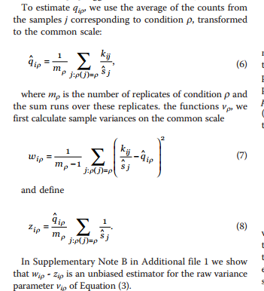

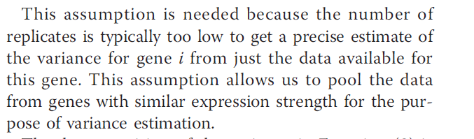
So how do we estimate the variances associated with each sample?
We could use these formulas:
But instead…
because

Slide 14
P-values from two conditions under the negative binomial
Pooling variance across samples of similar means
Our example dataset through DeSeq
False Discovery Rate

Slide 15
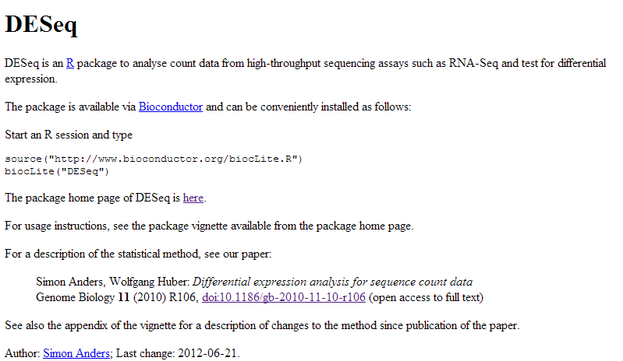
We are going to load the RNA-seq dataset into DSEQ.

Slide 16
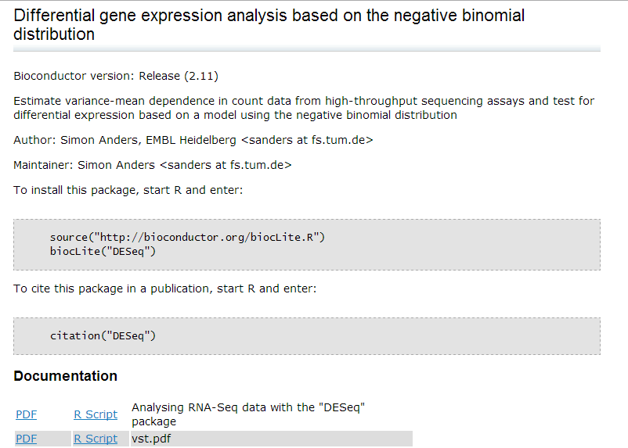
We are going to follow this vignette
(from http://bioconductor.org/packages/release/bioc/html/DESeq.html )
http://bioconductor.org/packages/release/bioc/vignettes/DESeq/inst/doc/DESeq.pdf

Slide 17

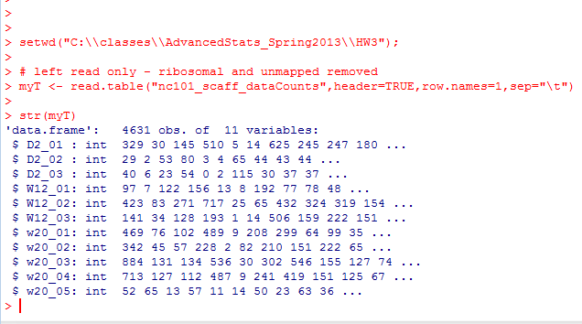
We can install DeSEQ from R…
We start by reading the data in as usual…

Slide 18
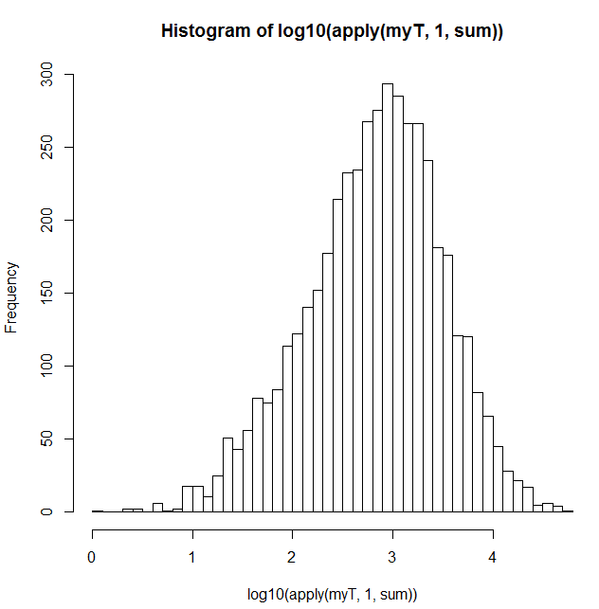


Before we even use DeSeq, we can do some nice QA/QC on the data
Here is a histogram of the number of sequences assigned to each gene..
Apply “sum” to every row in
the data frame.
Returns the number of reads for each gene…

Slide 19

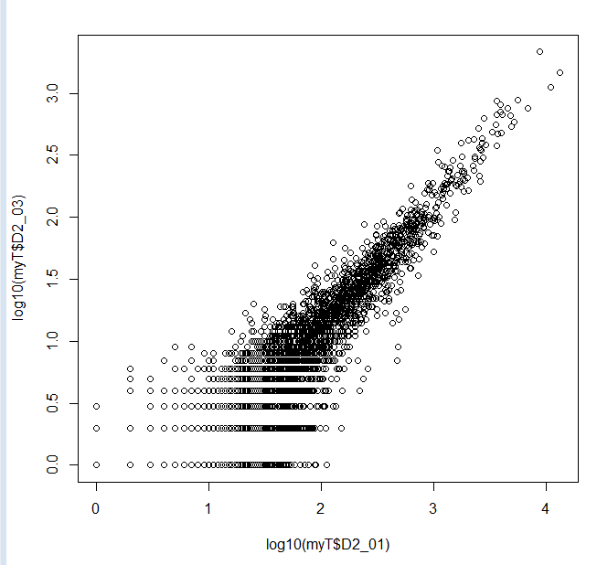
Likewise, we can ask how many reads per sample..
Sample D2_03 (with only 76,684 sequences) seems a little low.
We could think about taking it out…
However, it seems reasonably
well behaved, so we will leave it
in for now…

Slide 20

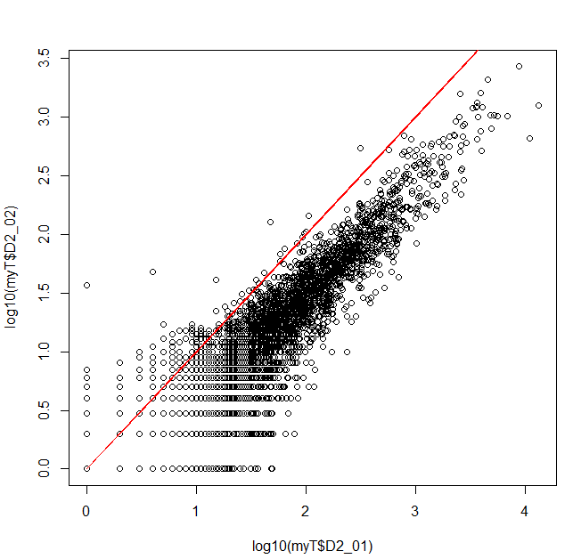
We can take some initial looks at the data…
There is, as we have seen,
a good correlation
between these 2 biological
replicates

Slide 21
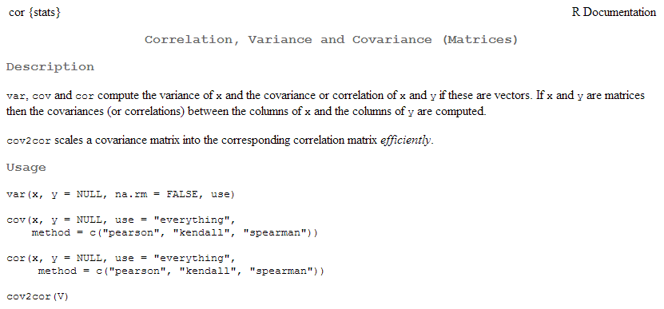
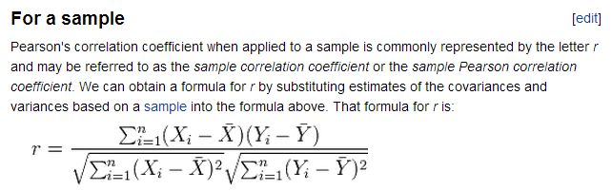
cor gives us the correlation co-efficient…
How much information about the y-axis can you get given the x-axis?
(More on this as we get to linear models in the 2nd half of the class)
http://en.wikipedia.org/wiki/Pearson_product-moment_correlation_coefficient

Slide 22
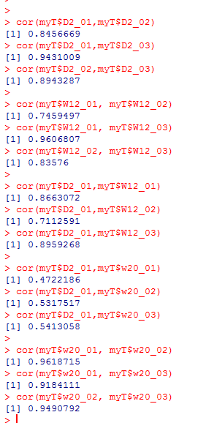
Typing a (very quick and informal) set of commands
suggests there will be a big shift between 2 days and 20 weeks
The day 2 samples seem well correlated with each other
There seems to be a little more variance in the week 12
samples
There was some shift day 2 to week 12
There was a big shift from day 2 to week 20
The week 20s are well correlated to each other

Slide 23


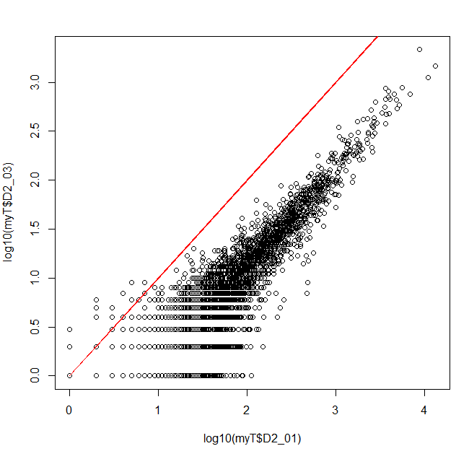
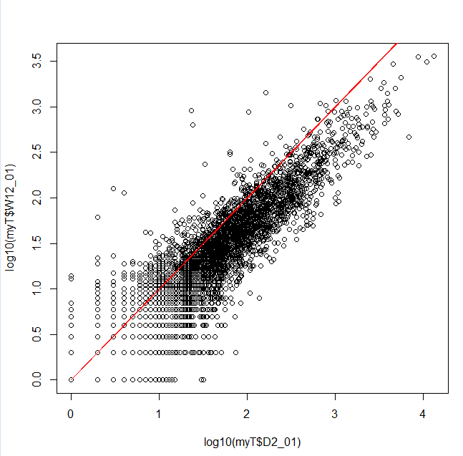
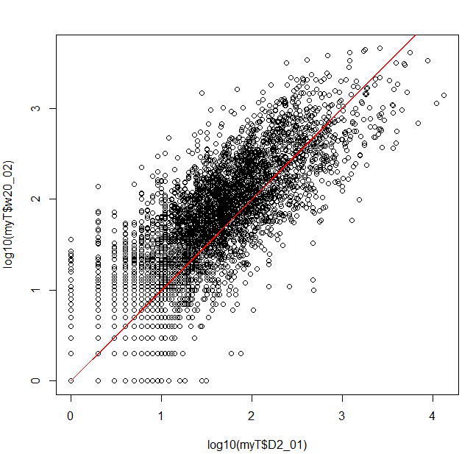
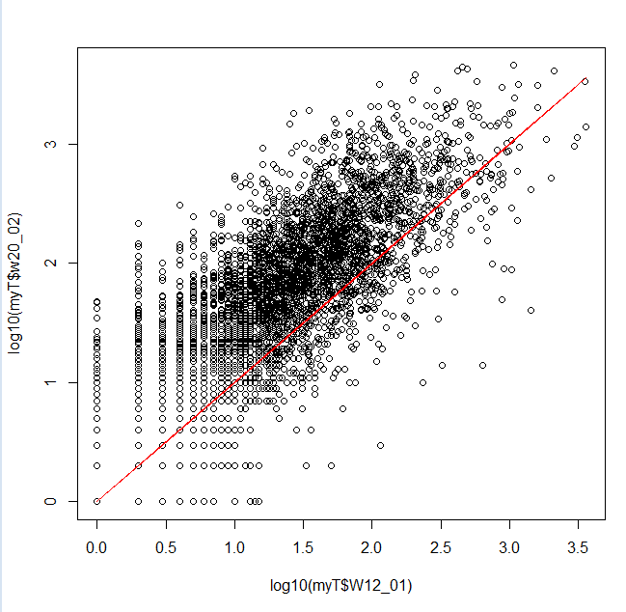


D2 vs D2
D2 vs W12
D2 vs W20
W12 vs W20

Slide 24
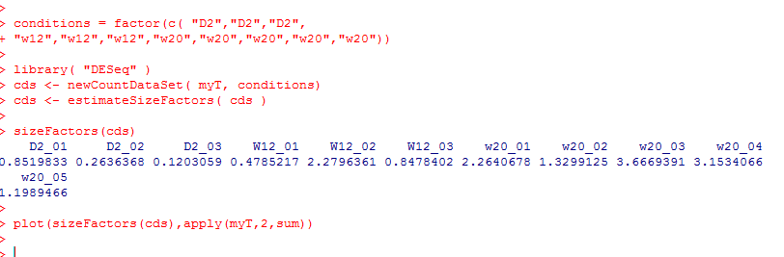
The samples are not on the red lines because each sample has a different number of sequences
The first thing we will use DeSeq for is to normalize the data
(adjust all of the samples so we can treat them as if they had an identical number of reads).
This will allow us to, for example, take an average across samples
We see that the size factor is very
closely related to the total
number of sequences in each
sample

Slide 25
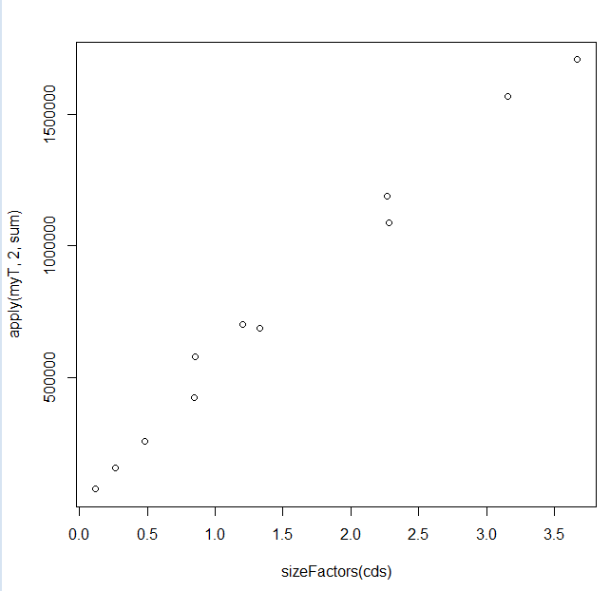
We see that the size factor is very
closely related to the total
number of sequences in each
sample

Slide 26
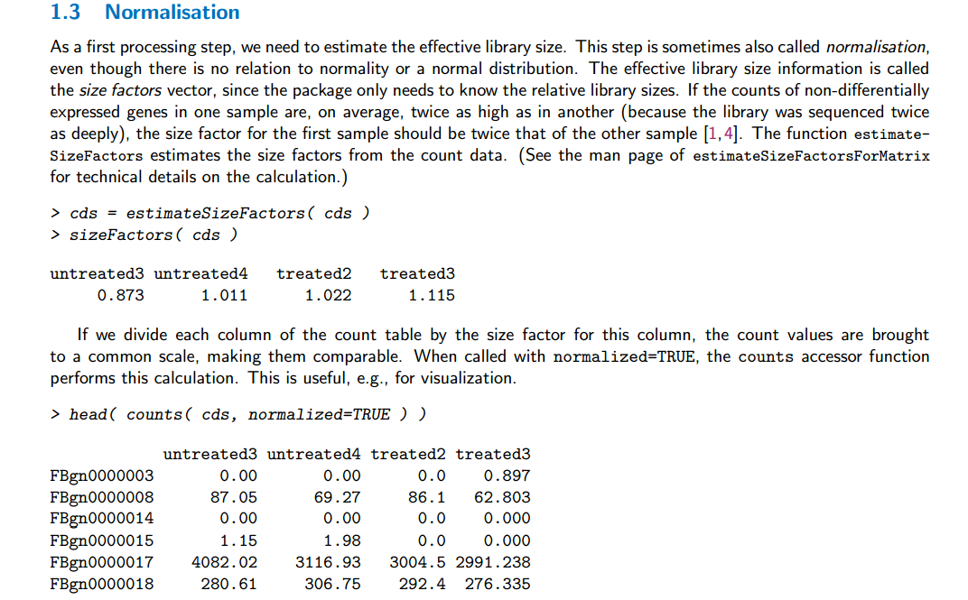
We are here following the directions in the vignette
http://bioconductor.org/packages/release/bioc/vignettes/DESeq/inst/doc/DESeq.pdf

Slide 27
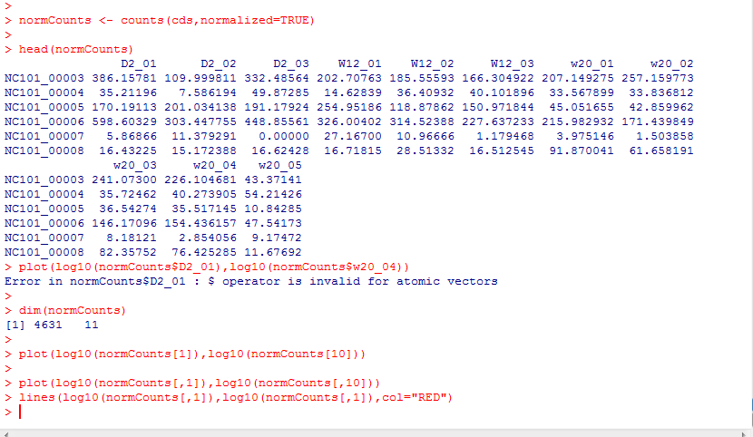
With the normalization done, scatter plots will fall on the identity lines
Accessing by names fails on the returned matrix
We retreat to column indexes

Slide 28
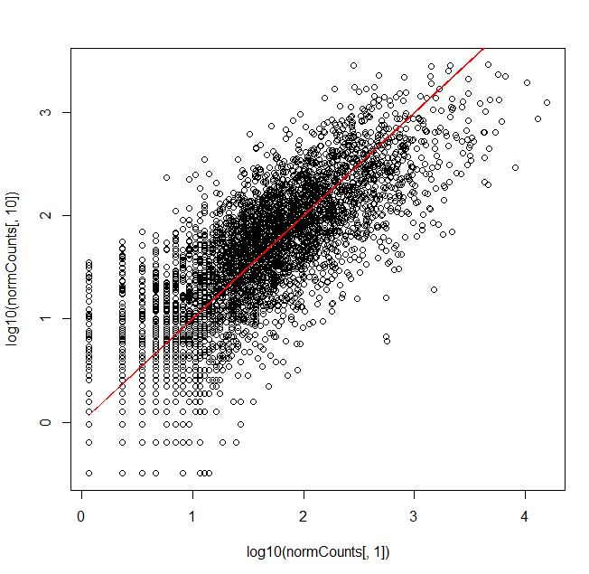
With the normalization done, scatter plots will fall on the identity lines

Slide 29
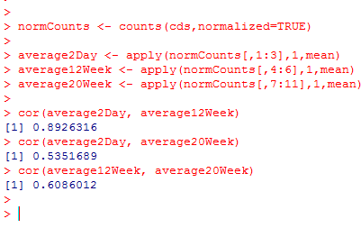
By working with average samples we only have 3 plots to worry about in our visualization

Slide 30


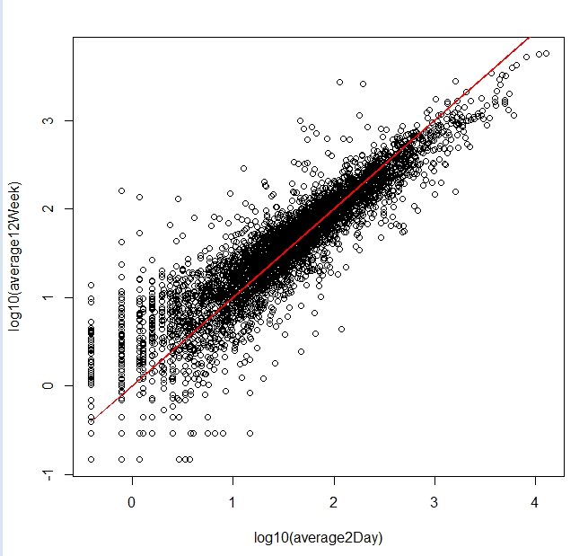
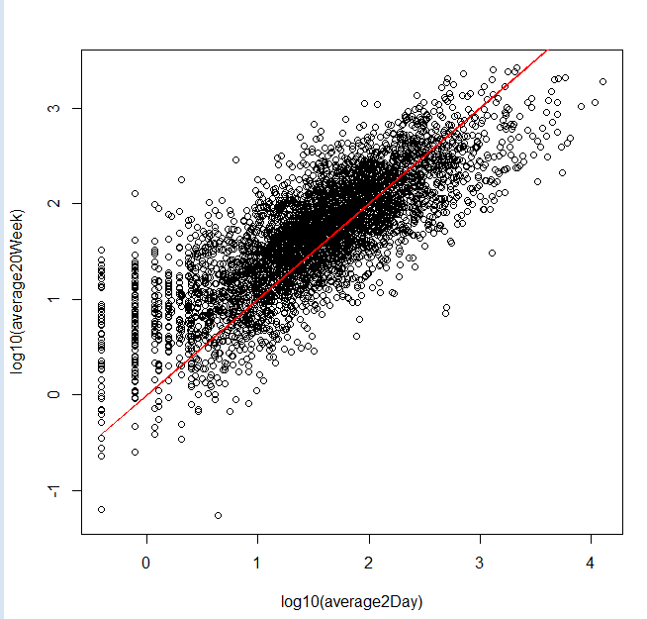
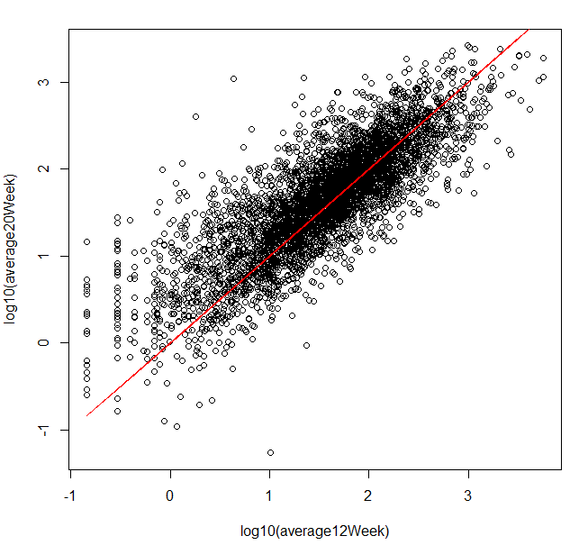

Average 2 day vs 12 weeks
Average 2 day vs. 20 weeks
Average 12 week vs. 20 week

Slide 31
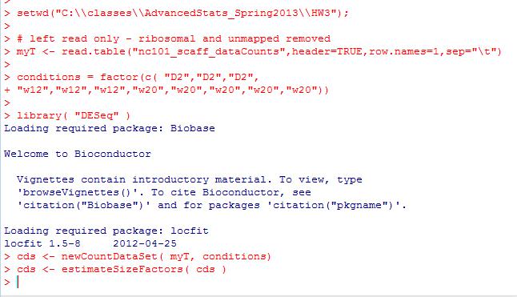
Next, we want to see which genes are differentially expressed…
We start by getting our variance estimates…

Slide 32

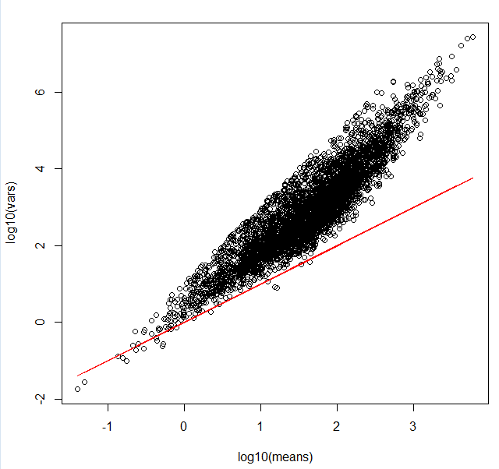
As we would expect, the Poisson assumption (“shot noise”) does not model our data
(here visualized with canonical variance)

Slide 33
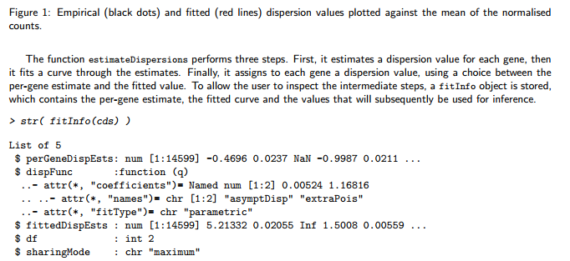
According to the vignette there are a number of sets of estimates we might be interested in…
http://bioconductor.org/packages/release/bioc/vignettes/DESeq/inst/doc/DESeq.pdf
fitInfo(cds)$perGeneDispEsts – gives us the Deseq’s formula for the variance estimated for the gene
i in condition j..

Slide 34
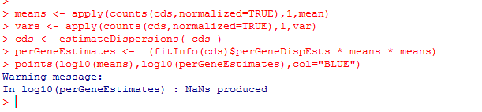
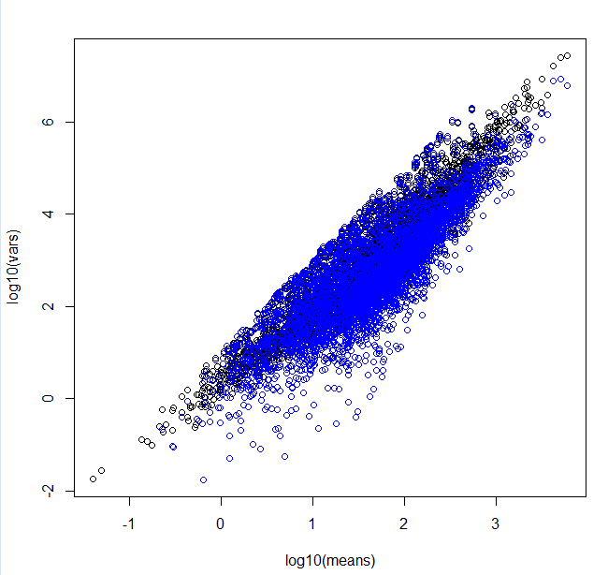
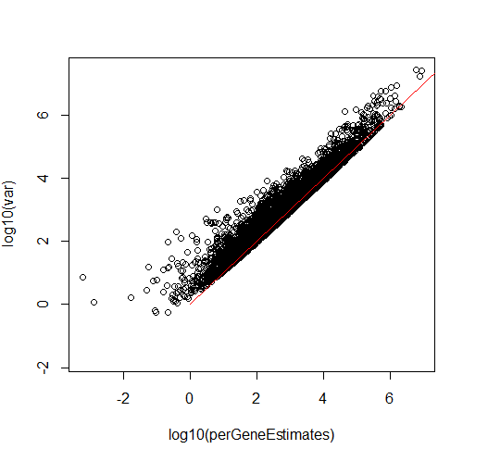
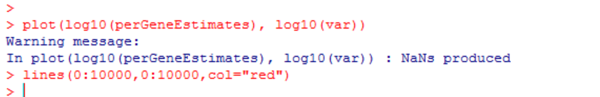
Deseq’s “per gene dispersion” is not exactly the same as canonical variance (although it is clearly related to it!)
We switch from squared
co-efficient of variation
back to variance

Slide 35
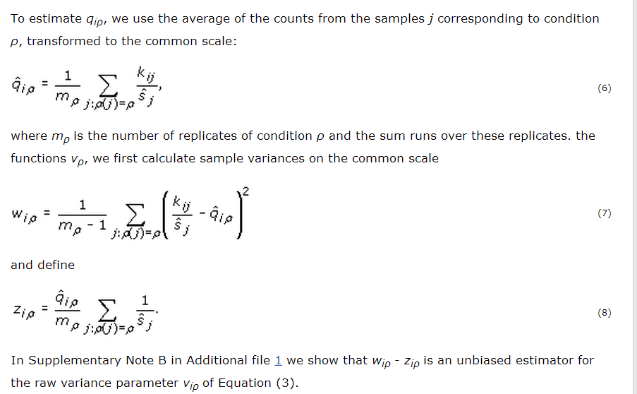
In the paper, they make an adjustment to the variance
(I’m a little unclear on why they do this, but as we will see, this adjustment will get removed by their model, so it doesn’t much matter…)

Slide 36
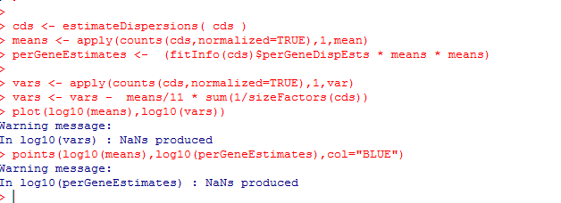
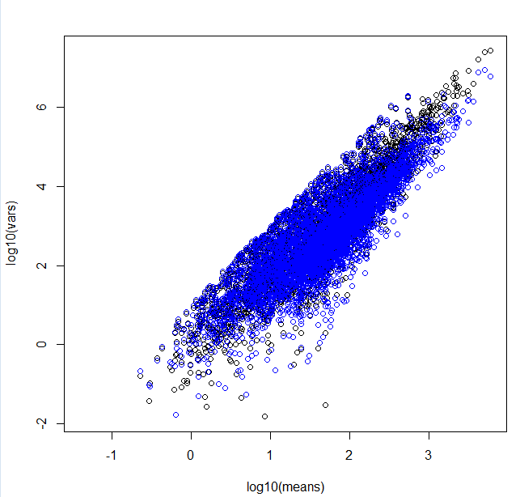
If we make a similar adjustment, we can (almost) recreate what deseq is doing…
We subtract off the zis here.
As we will see, this adjustment ends up
not mattering very much..

Slide 37
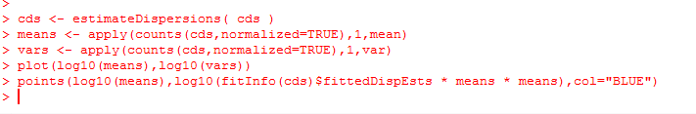
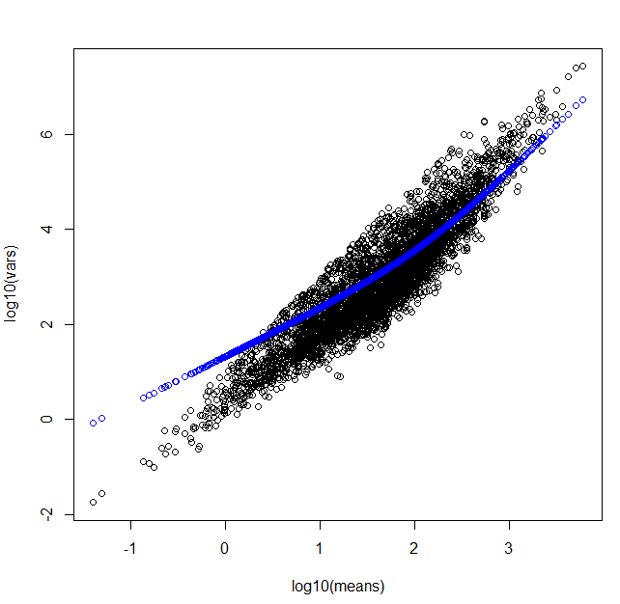
Here is the fitted line based on all of the variance.
This allows for pooling of the estimate of the variance
In the deSeq paper, this was a local
regression, but according to the
vignette it is now a two-parameter
Gamma function…
(so just some smooth function)

Slide 38

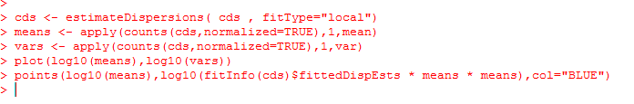
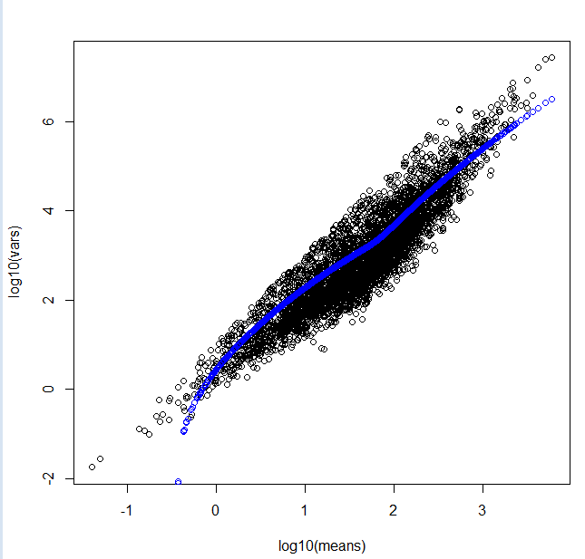
We can, if we want, switch to the “local regression” method.
You can kind of see why they switched…
Some of these variances seem much too small

Slide 39
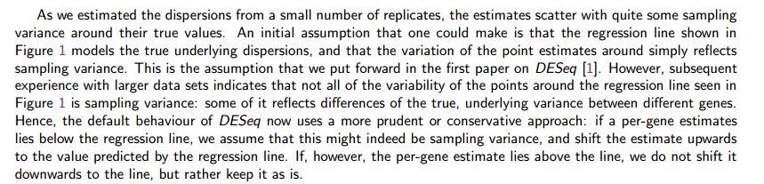
Another difference with the published paper.
In the published paper, the variance came from the fit.
In the software: the variance for downstream analysis is the max(observed variance, fit variance)
The variance used for downstream analysis can be gotten by fData(cds)[,1]

Slide 40
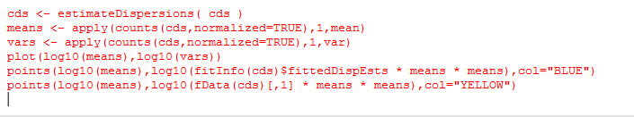

the variance for downstream analysis is the max(observed variance, fit variance)
This is why their correction doesn’t matter very much.
Essentially, for some genes,
their method sets a
“floor” of the variance.
This is conservative
(since the variance sets
the width of the
dbinomial distribution).
So the yellow ends up being
DeSeqs (somewhat complicated)
conservative estimate of the variance that is fed into the negative binomial

Slide 41


This procedure belongs in a long history of adding small constants to the variance…
(which often seems poorly justified by theory…)
Adding an arbitrary damper to the variance
(9,951 citations)

Slide 42


Finally, we are ready to perform inference
2 weeks vs. 12 weeks yields only 5 significant genes at a 10% FDR -

Slide 43



However day 2 vs. week 20 yields many more (136) significant genes

Slide 44
P-values from two conditions under the negative binomial
Pooling variance across samples of similar means
Our example dataset through DeSeq
False Discovery Rate

Slide 45


You have 20,000 genes in an rna-seq experiment.
You have two conditions (A) and (B).
You run them through DeSeq (or any other stats package).
If the null hypothesis is always true (no difference between A and B),
the p-values will be uniformly distributed…
We can model this pretty simply:

Slide 46

If we use a simple threshold of significance of 0.05, we would
expect about 1,000 genes to be called significant even if the null
hypothesis were always true..
There are 1,016 genes that have p-values <0.05
in this case where the p-values are uniform

Slide 47


One alternative:
Use as a p-value threshold Bonferroni correction.
The desired threshold / number of tests.
In this case 0.05 / 20000 = 2.5e-06
None of our p-vals reach this threshold..
At this threshold, there is a 5% chance of any false positives

Slide 48
Bonferroni correction is sometimes considered too conservative for genomics experiments.
At small sample sizes, you might have few genes with p-values smaller than the
Bonferroni thresholds.
A less conservative alternative, false discovery rate.
At a 5% false discovery rate, we expect 5% of our hits to be false positives.
This is less conservative than Bonferroni correction, where there is a 5% chance
that any of our hits are false positives.

Slide 49


One straight-forward approach to finding genes at a given false-discovery rate
Benjamini and Hochberg FDR
1. Rank all the p-values (smallest first). The rank of each value = K
2. Calculate N * p / k
where N = the # of hypotheses that you are testing
p = the “raw” (uncorrected) p-value.
3. Start at the top of the list. Go down to N * p / k > threshold
(e.g. 0.10 for 10% FDR).
N * p = # of expected false positives at a given p-value
k = # of genes actually observed at that p-value

Slide 50
Note that for the first hit (smallest p-value),
Bonferroni correction is the same as BH FDR.
(Since if k=1,
N * p / K = N * p
which is the same as multiplying the p-value by the number of hypotheses to
do the correction)

Slide 51
So in DeSeq…
FDR adjusted
p-values..
Raw p-values

