Slide 1
Lab 1:
Hello World
Eclipse
Optional:
Setting up GitHub
Publishing code to the web
Nothing to be turned in/graded in this lab.

Slide 2
Download and install Java (slides 25-28 in lecture 1):
http://afodor.github.io/classes/prog2017/Prog3-Lecture1.pptx
See if you can get “HelloWorld.java” working from the command line…
(slides 31-33 in lecture 1)
(You will need a text editor or some sort; let me know if you don’t know what
that means!)
Try and get at least this far in the lab....

Slide 3
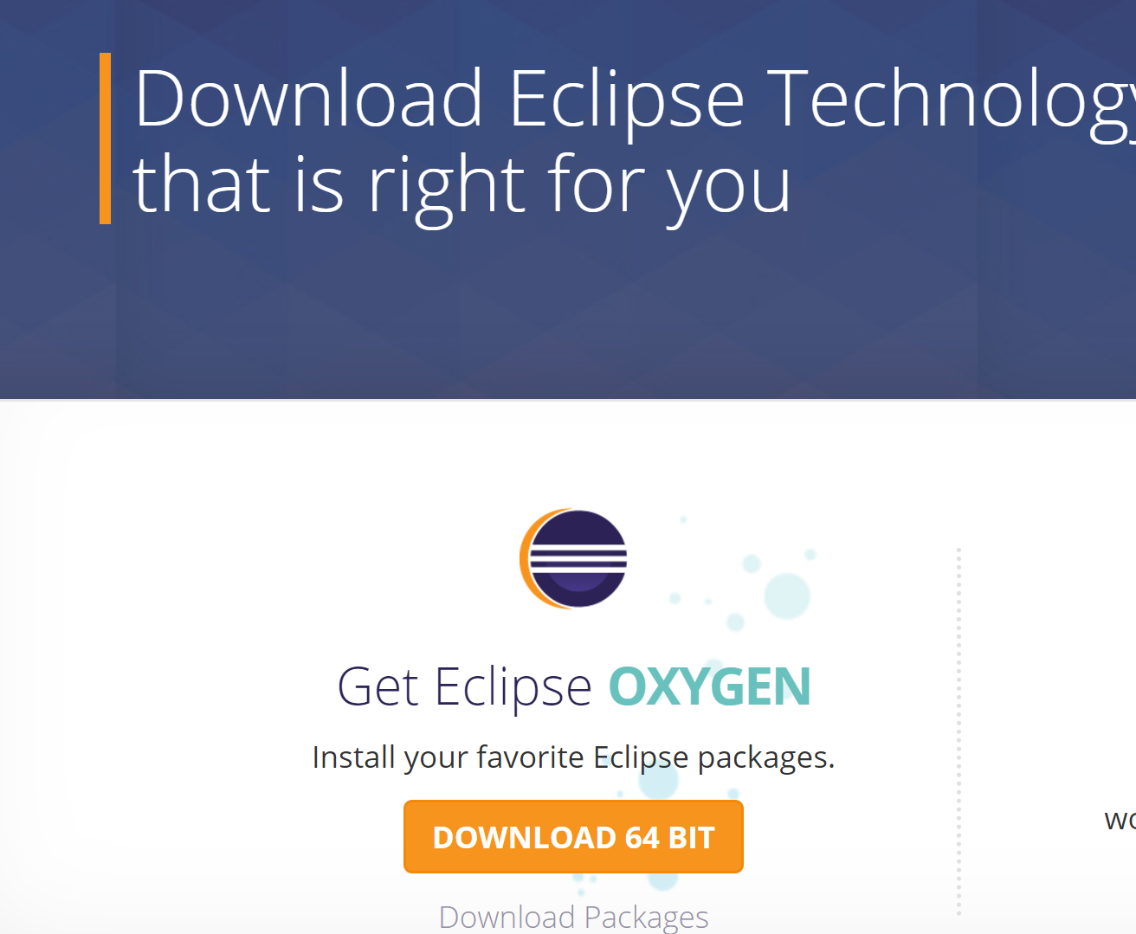
Next, download and install Eclipse… from www.eclipse.org

Slide 4
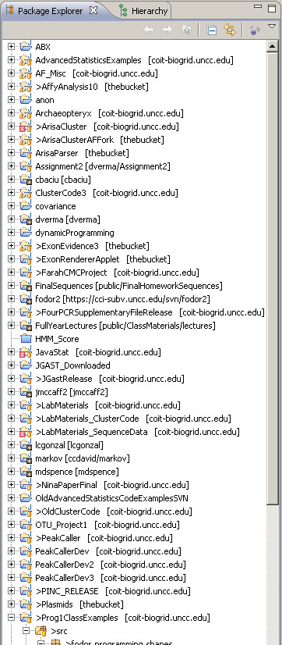
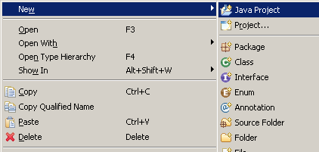
Type “Hello World” into Eclipse…
Start by right-clicking in the “PackageExplorer” area..
(You won’t have any projects if you’ve just installed Eclipse!)
Choose new JavaProject (important to make it a Java project!)

Slide 5
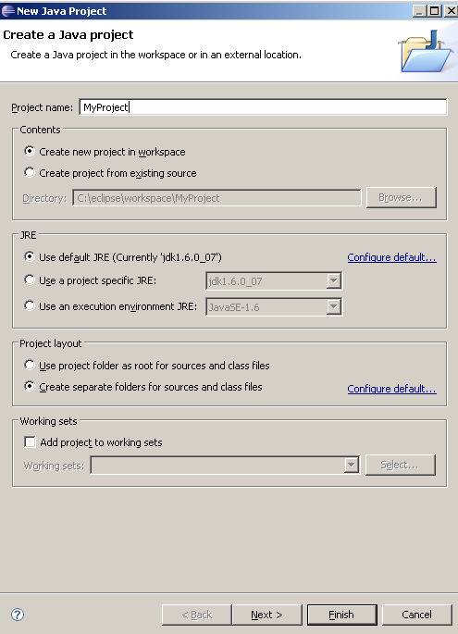
Call the project whatever you want
Hit next

Slide 6
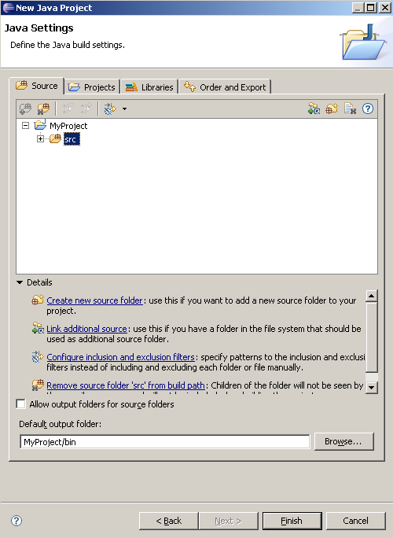
Your .java code will be in
a directory called src
Your .class code will be
in a directory called .bin
Hit finish

Slide 7
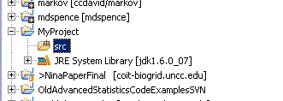
In your project window, you’ll have your project…

Slide 8
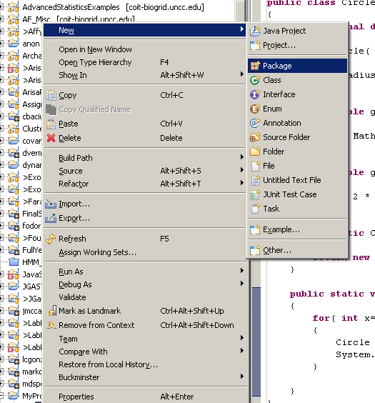
Right-click and choose
New->Package

Slide 9
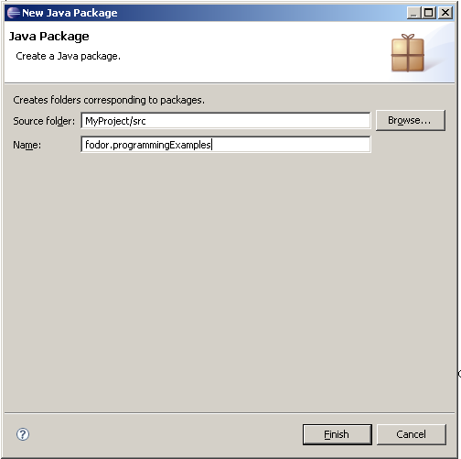
You can choose whatever
package name you want

Slide 10
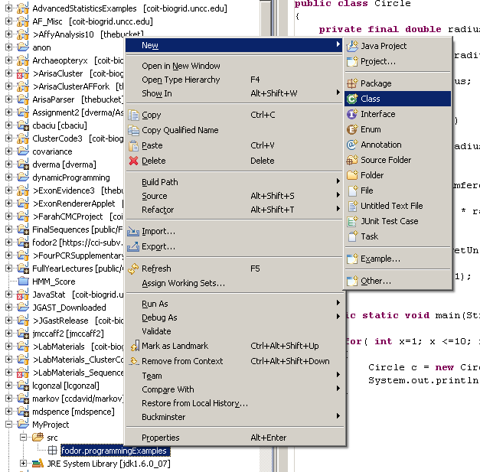
right-click and choose
new … Class

Slide 11
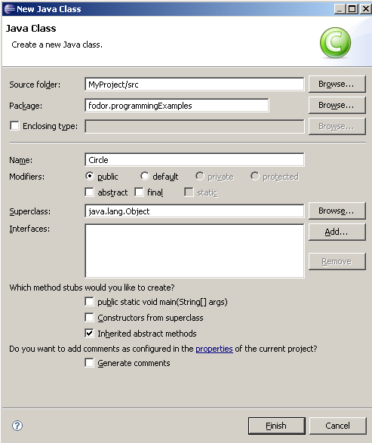
Where the code ends up
This will be the package
Type in “Hello World” or
whatever you want to call it
Inheritance
(we’ll talk about that next
but just leave this blank for
now)
Hit finish

Slide 12
Next: Optional exercise to publish your code to the internet

Slide 13
Set up a GitHub account…
https://github.com/join
For a free GitHub account, the code you commit is publically available.
If you are not comfortable with this, use an anonymous user id/e-mail
(or delete your repository at the end of the lab!).
Or pay for a private GitHub account (useful if you are working for/with people
on private projects)

Slide 14
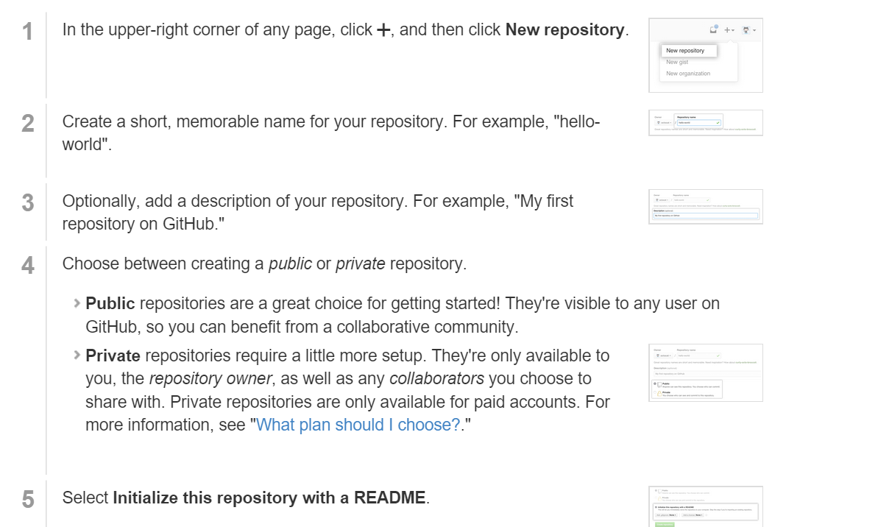
Create a github repository
We will publish our HelloWorld code to the web today

Slide 15
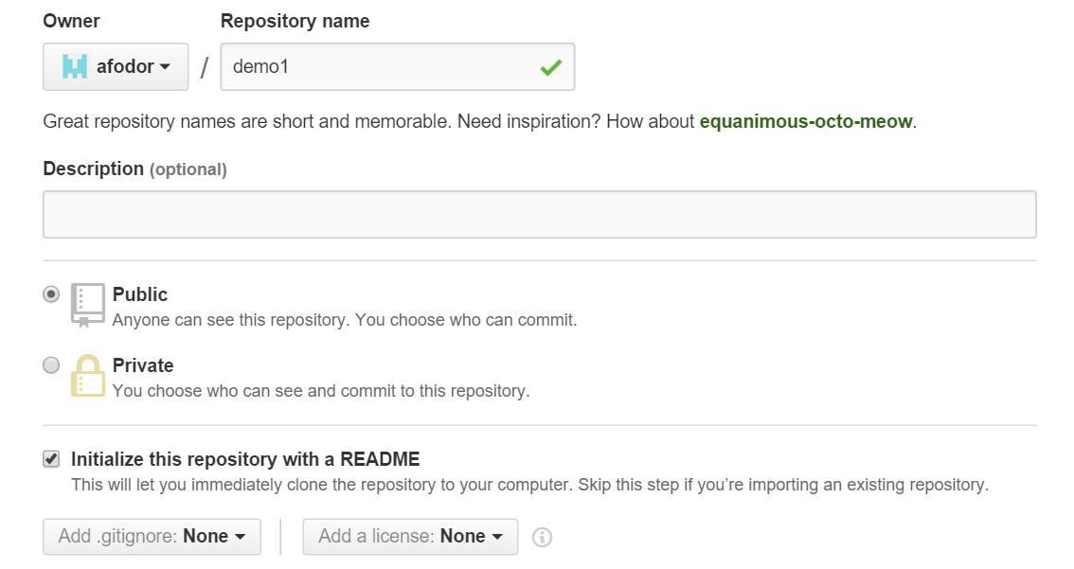
Give your repository a catchy name

Slide 16
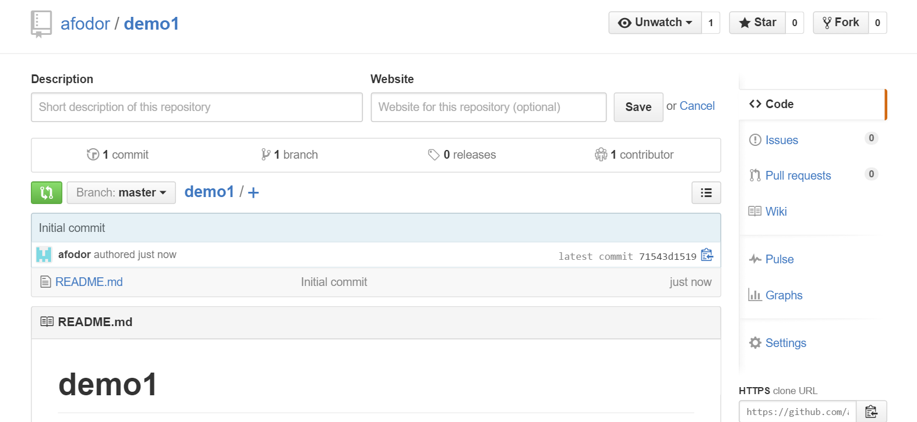
After you create your repository, it will have its own web page at GitHub

Slide 17
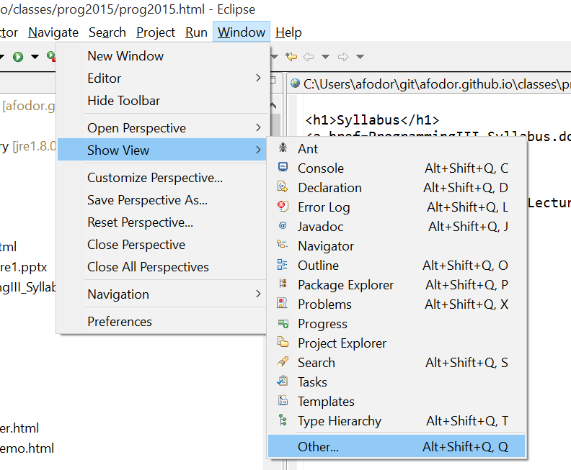
From Eclipse, “checkout” your repository….
Do “Show View”->”Other…”

Slide 18
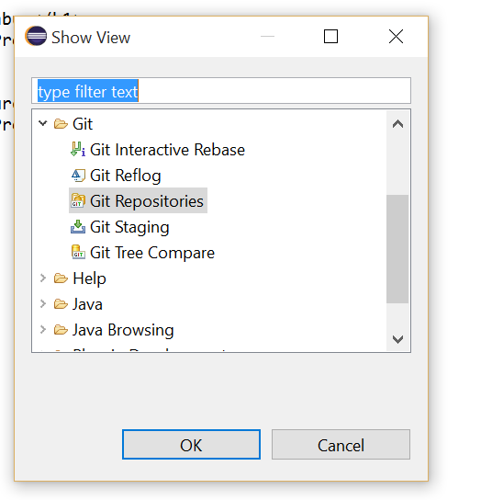
Choose “Git repositories”

Slide 19
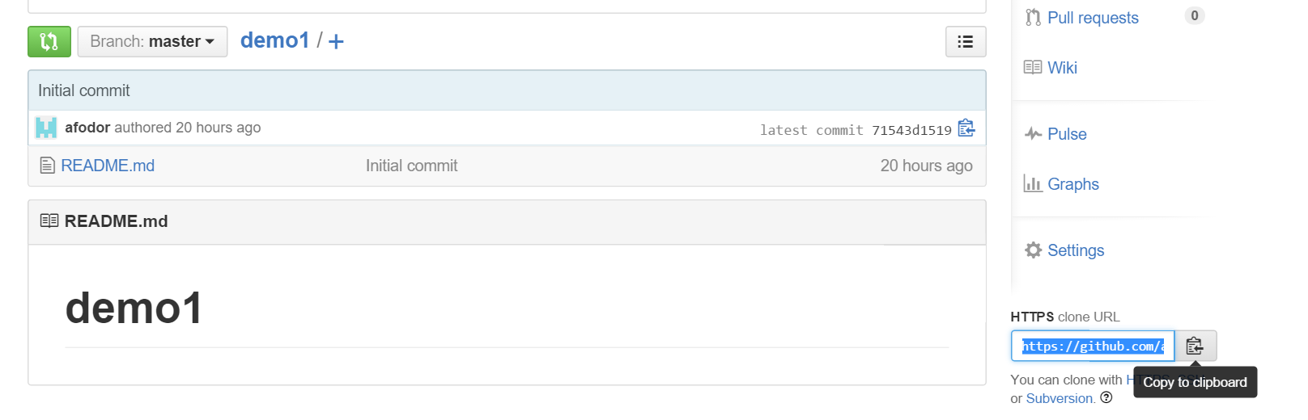
From the “github.com” web site for your project, choose “cloneURL…”

Slide 20
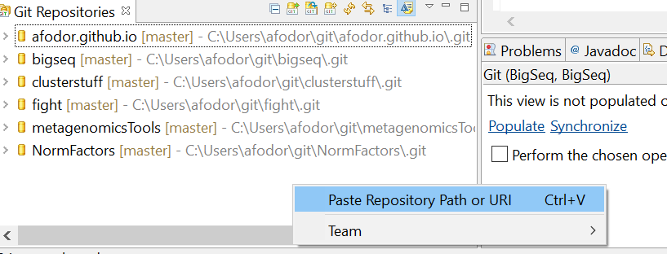
Back in Eclipse, find your “Git Repositories” window…
Right-click and choose “Paste Repository Path or URI”

Slide 21
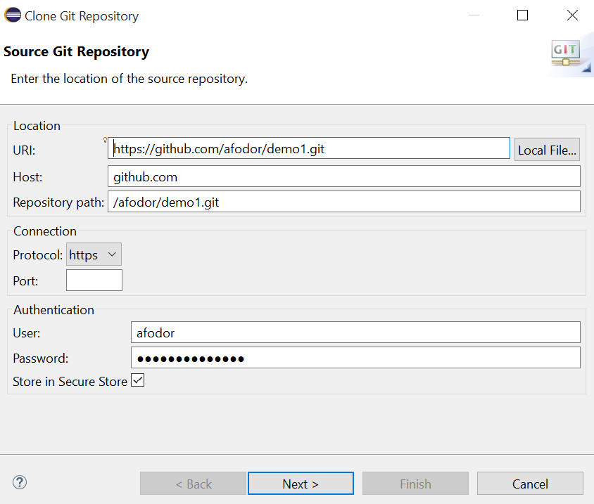
Click through the dialog screens…

Slide 22
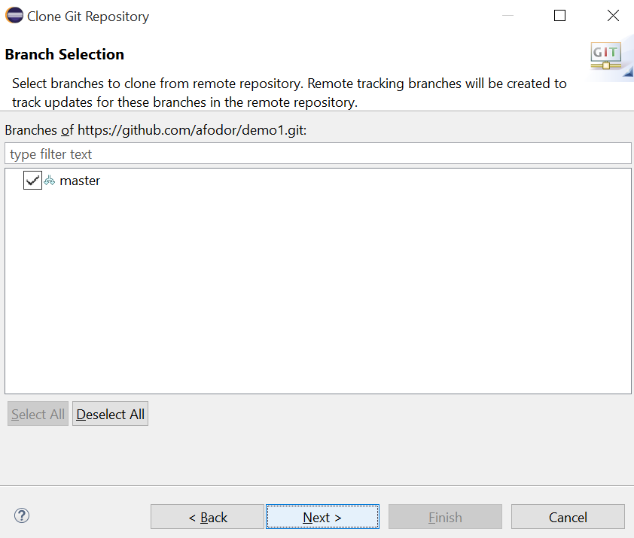
Click through the dialog screens…

Slide 23
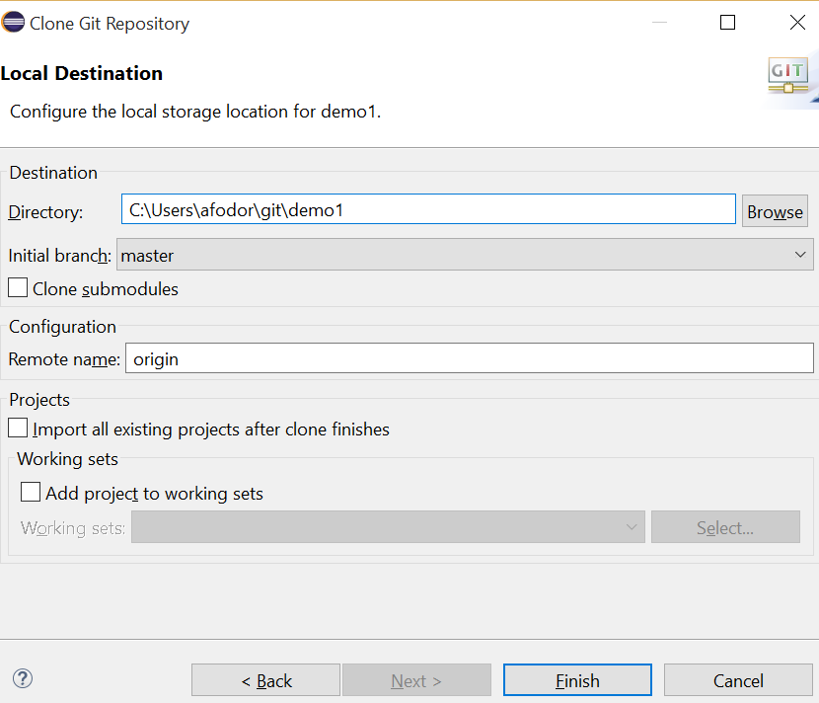
Click through the dialog screens…
remember this…

Slide 24
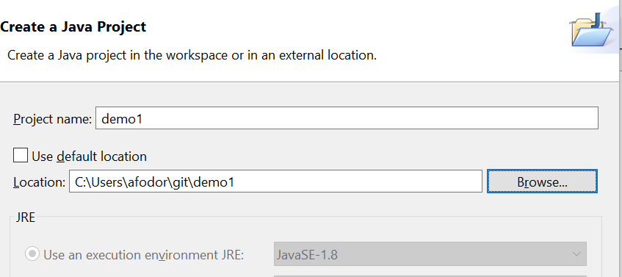
Now find the “Package Explorer” window…
Right-click and choose new -> “Java Project”
Give your new project the same name as the GIT project
Navigate to where you put your GIT project
uncheck
Click “finish”

Slide 25
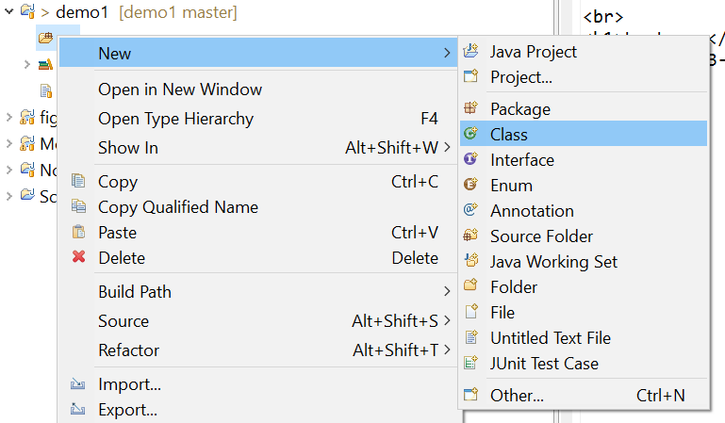
In the “src” directory in your new project, make a “HelloWorld.java” class as before
(or copy it from the file system or from another Eclipse project)

Slide 26
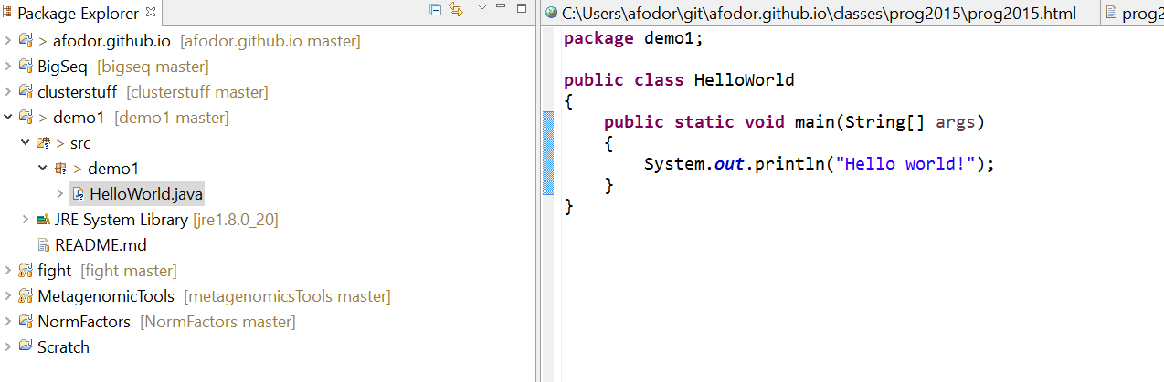

Slide 27
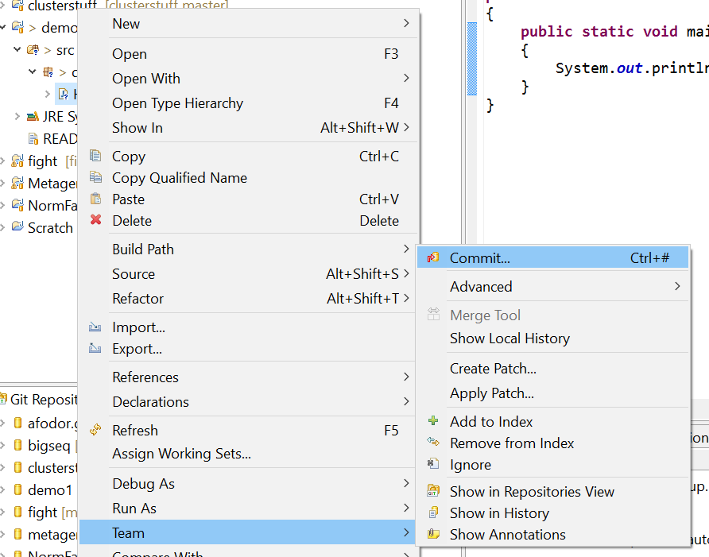
Now we will publish it to the web… In the “Package Explorer” frame, right-click and
Choose “Team→Commit”

Slide 28
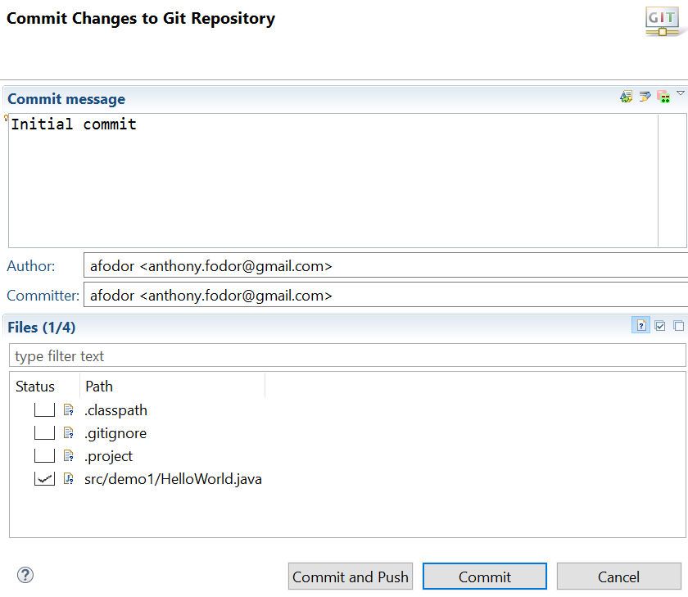
You have to type something here…
Choose (only) your class
Hit commit and push
(to push your code to GitHub)

Slide 29
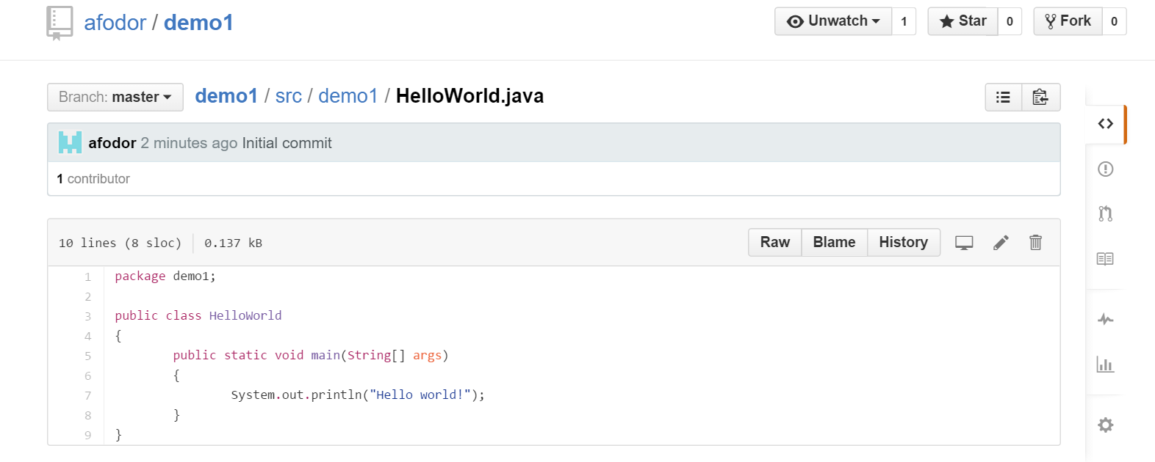
With any luck, your code is on the web.
You can invite people into your project to collaborate..
https://github.com/afodor/demo1/blob/master/src/demo1/HelloWorld.java

Slide 30
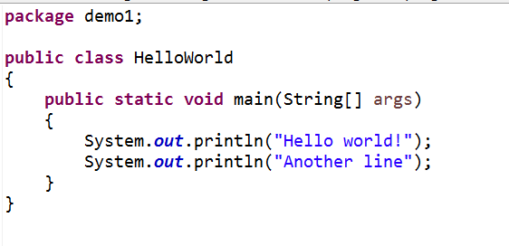
Go back to Eclipse and change your code…

Slide 31
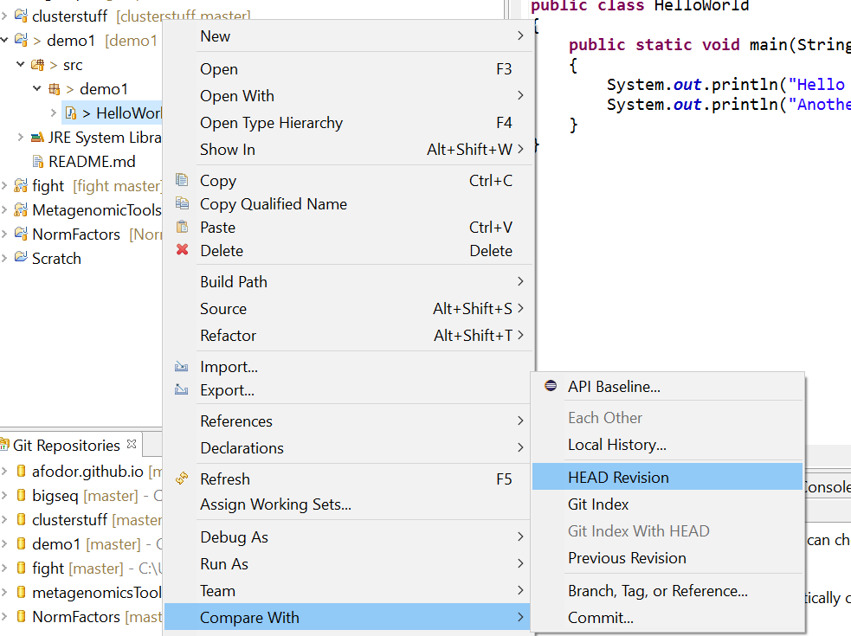
We can compare our current code to what is at GitHub
Right-click in the Project Explorer -> Compare With -> Head Revision

Slide 32
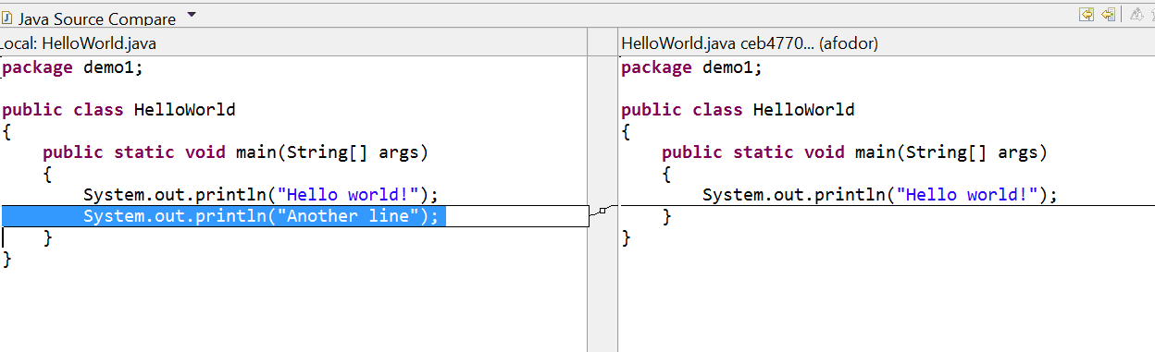
This is an invaluable tool.
Iterative development one small change at a time!
You can also replace the code with any previous version
Right click -> “Replace With…”
If you want to keep these changes, right-click -> team -> commit and they will be published

Slide 33
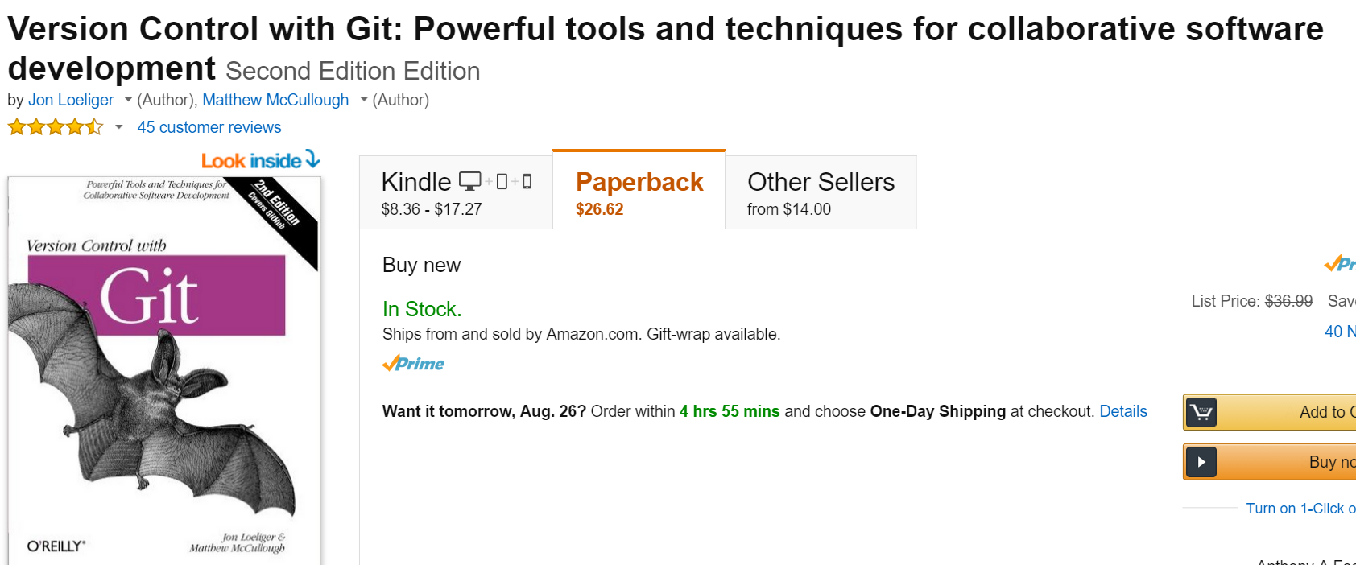
Git is a bit complex.
This is a useful reference (not sure if there is a free version).
Mastering GIT is a useful skill, but will not be a focus of the class.
I am happy to answer any GIT questions I can in lab (my knowledge of GIT is incomplete).
It takes a while to get the hang of GIT, but it very useful once you figure out the basics..

Slide 34
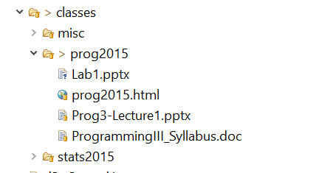
By the way, the class web site is published on Git/GitHub
I just add stuff to the directory and commit it.
Automatically backed up, shared across multiple machines,
Free to publish web site.
Pretty great…

