Slide 1
Test code (single thread)
Test code (multi-thread)

Slide 2
Testing is challenging.
Test code is often much more challenging to write than the original code.
Ideally, you would like to test what would happen to your code under every possibility.
This is impossible.
You have to balance your effort in testing against how confident you are in a piece of code.
You can’t really demonstrate that code completely lacks bugs…

Slide 3
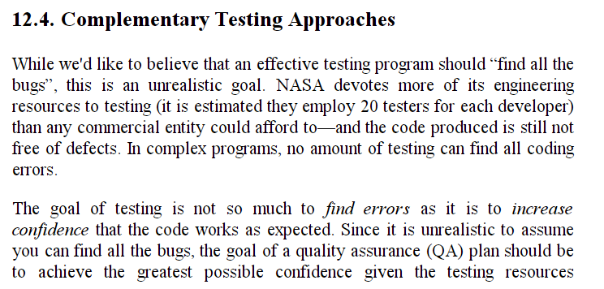
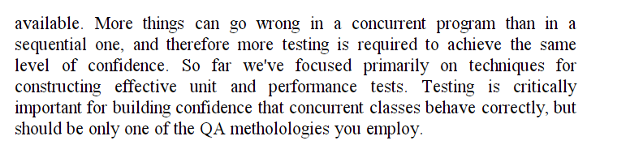

Slide 4
Consider, yet again, our FastaSequence class and its streaming wrapper class FastaSequenceOneAtATime
We can write a test harness to make sure that…
(1) We can parse at least one FastaSequence correctly
(2) We get the same answer whether we read the sequences into a List<> in memory
or read them one at a time
We assume that if we can parse one sequence correctly, that we are parsing them all correctly
(may or not be a good assumption).
FastaSequence and FastaSequenceOneAtATime each have their own code to parse the
Fasta file, so this test in some sense is a check on both classes (but they could still easily have a common bug)

Slide 5
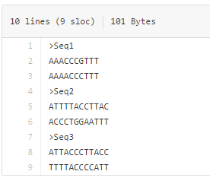
We can start by making a simple test file… (or of course we could use a real sequence file…)
https://github.com/afodor/metagenomicsTools/blob/master/src/parsers/test/someFasta.txt

Slide 6
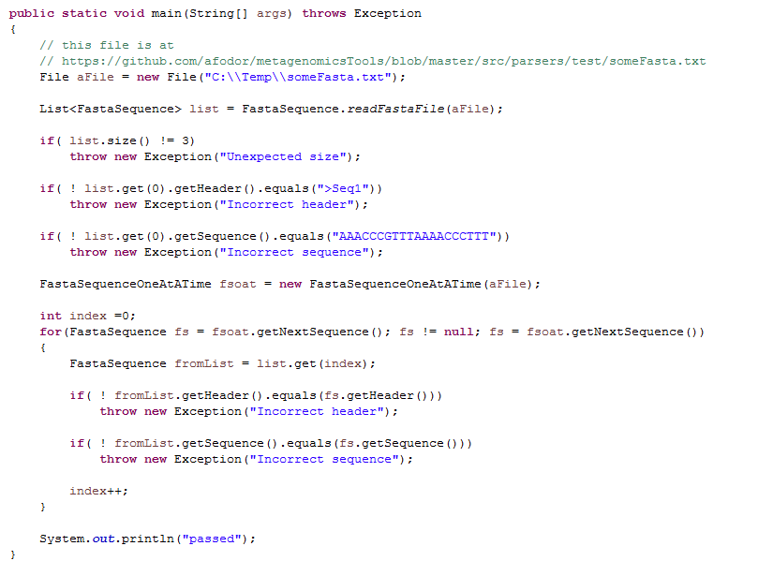
Basic sanity check
Can we parse one sequence?
Can we parse one sequence?
Do our two parsers agree?
If we get here we are good
https://github.com/afodor/metagenomicsTools/blob/master/src/parsers/test/CompareFastaAndFastaOneAtATime.java

Slide 7
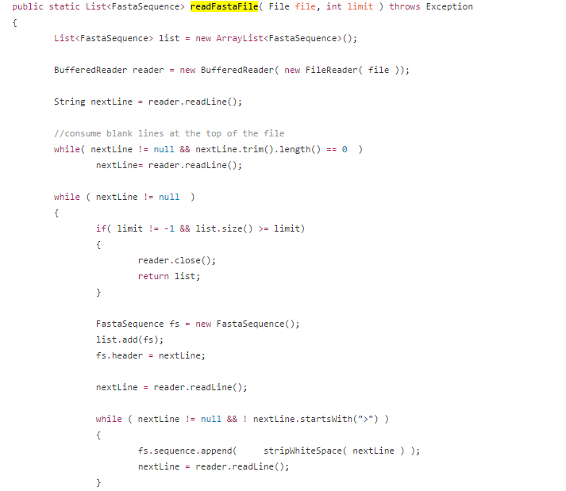
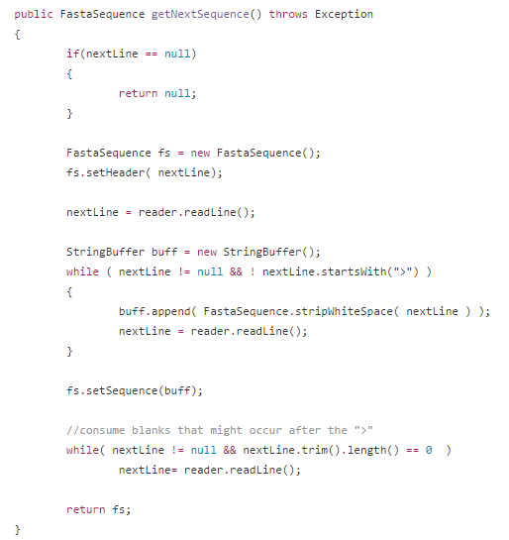
Our two parsers have overlapping code, so this test in limited in “proving” correctness
https://github.com/afodor/metagenomicsTools/blob/master/src/parsers/FastaSequenceOneAtATime.java
https://github.com/afodor/metagenomicsTools/blob/master/src/parsers/FastaSequence.java

Slide 8
Once you have the test code, the idea is you can aggressively debug and performance tune
the tested code.
By re-running the test codes after each refactor, the (hope) is that you maintain correctness
even as the implementation changes….

Slide 9
I spend a lot of time writing test code. Often this involves re-writing parsers from scratch and comparing
the results to my first parser implementation…
Having multiple people implement parsers (maybe even in different languages!) and comparing results
can be an effective test strategy…

Slide 10
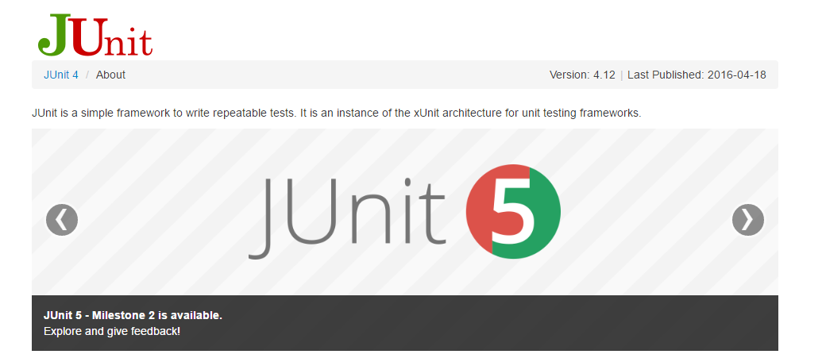
You can write perfectly good test code just throwing Exceptions,
but a lot of people use a package called JUnit that allows for a more formal declaration of tests…

Slide 11

Navigate to the plugin’s directory where you installed Eclipse…

Slide 12
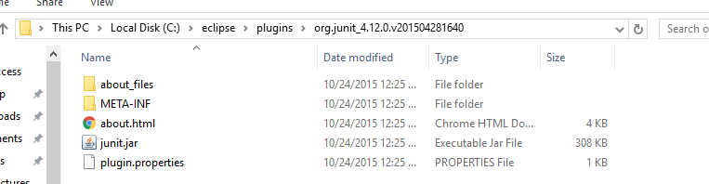
Within the junit directory you are looking for the junit.jar file

Slide 13
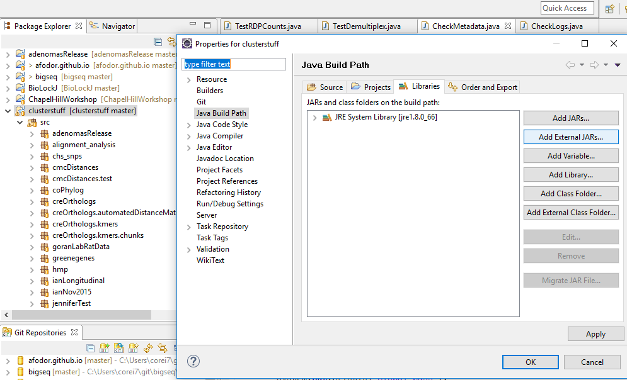
Right-click on your Java project -> choose properties -> choose “add External jar”
and add the jar file to eclipse

Slide 14
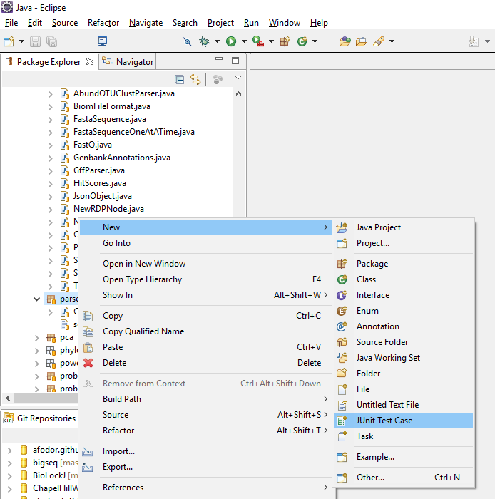
Eclipse will allow you to directly make a test
case…

Slide 15
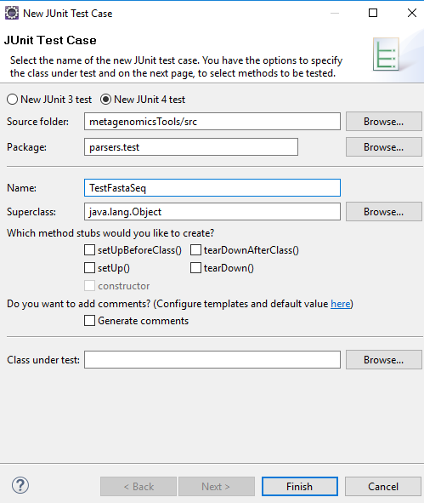
These methods are
to set up and tear
down resources
your test may need
(see Junit documentation)

Slide 16
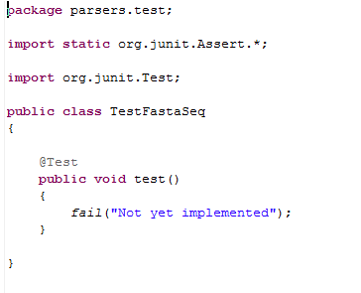
Alternatively, you can just type all this stuff directly (from any text editor….)
Eclipse doesn’t do such a good job here.
You need to add extends TestCase

Slide 17
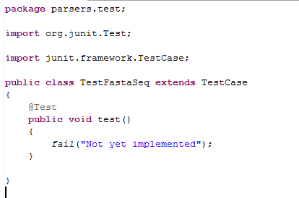
The Junit architecture will run any method that starts with
test (all lower case)
Here Eclipse has provided us with a method stub that just causes the test to fail

Slide 18
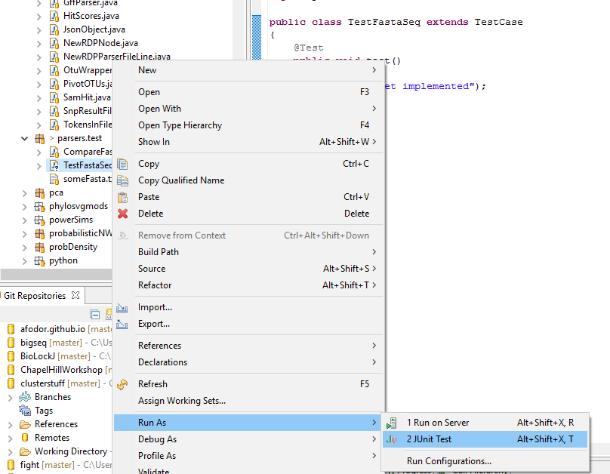
You can Run this as a JUnit test
directly from the Eclipse environment

Slide 19
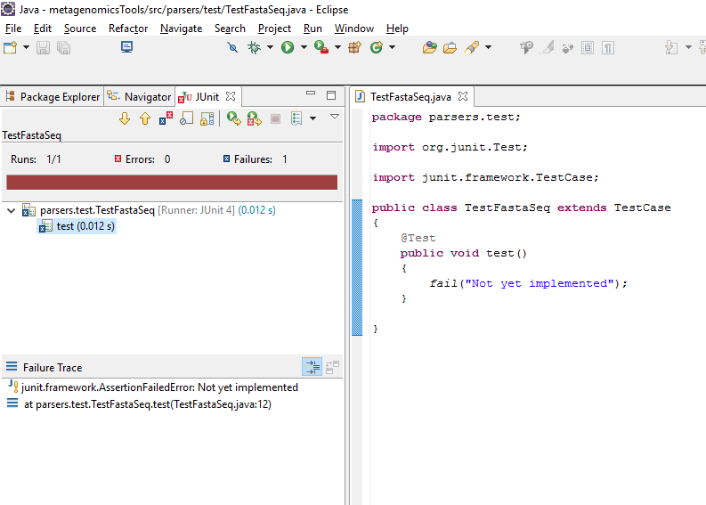
Here are test just fails (as we’ve instructed it to…)

Slide 20
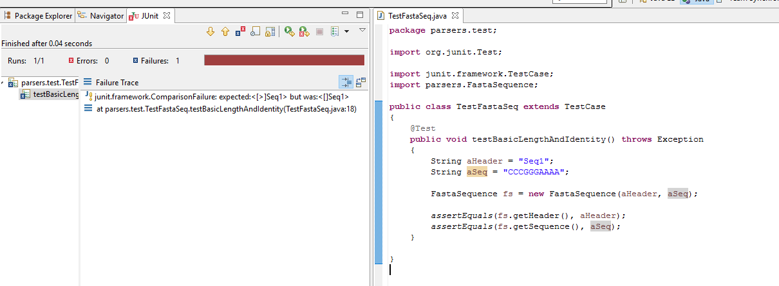
Here is a failed attempt at a very simple test case.
The problem is that getHeader() return the “>” and the test case didn’t take that into account…

Slide 21
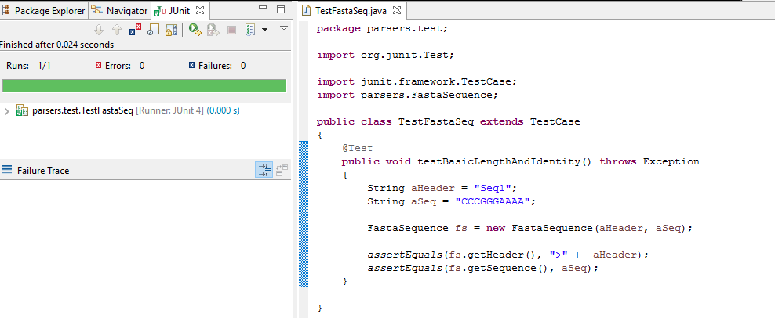
A happier version of the test…
Green is good…
https://github.com/afodor/metagenomicsTools/blob/master/src/parsers/test/TestFastaSeq.java

Slide 22
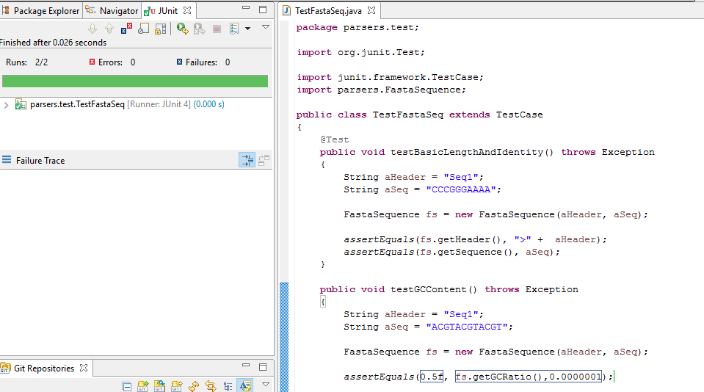
We can add more test cases to our TestCase.
Ideally, we would have a test for every public method in all of our classes…

Slide 23
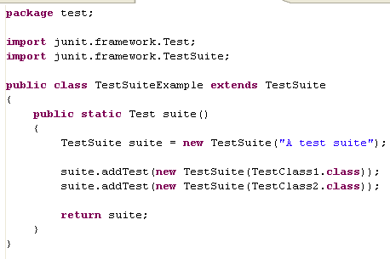
You can collect TestCases together into TestSuites

Slide 24
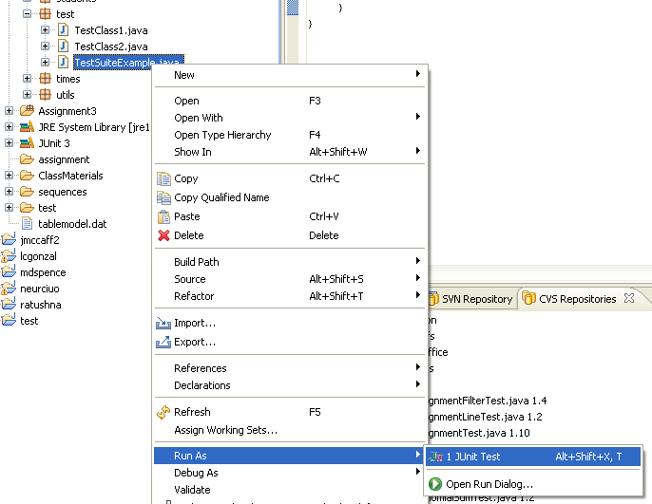
Run our Suite just like a TestCase…

Slide 25
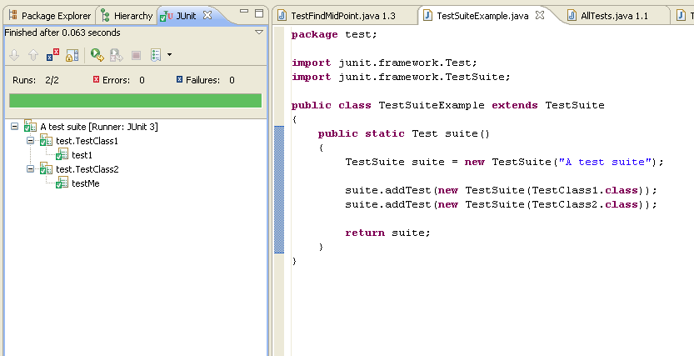
Eclipse keeps track of what tests have passed…

Slide 26
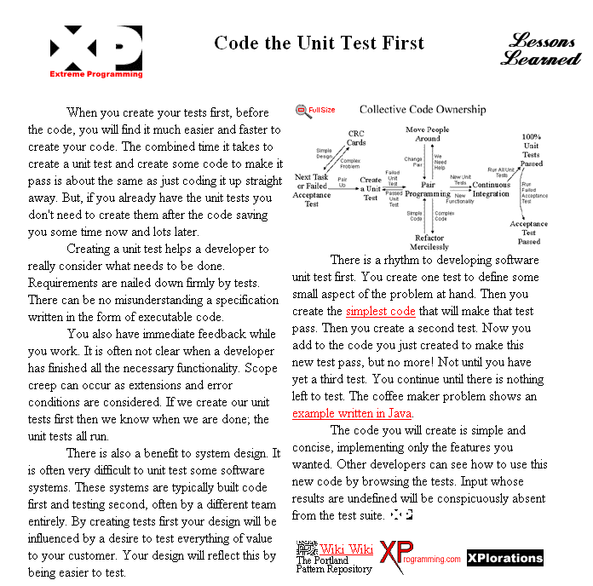
A “philosophy” of programming: Write the test first!
http://www.extremeprogramming.org/rules/testfirst.html

Slide 27
There is a real art to writing test-code.
Often, it is harder to write the test code than the code that
will be tested.
Test suites catch most, but not all, bugs.
It is impossible to test for every situation.
Microsoft uses test suties extensively.
Still ships buggy products.
Testing reduces, but does not eliminate, complexity.

Slide 28
Test code (single thread)
Test code (multi-thread)

Slide 29
The universe of things that can go wrong with multi-threaded programs is much larger than single-threaded
Multi-threading architecture can change the visibility of the code being tested.
Multi-threaded testing architecture is extremely challenging…

Slide 30
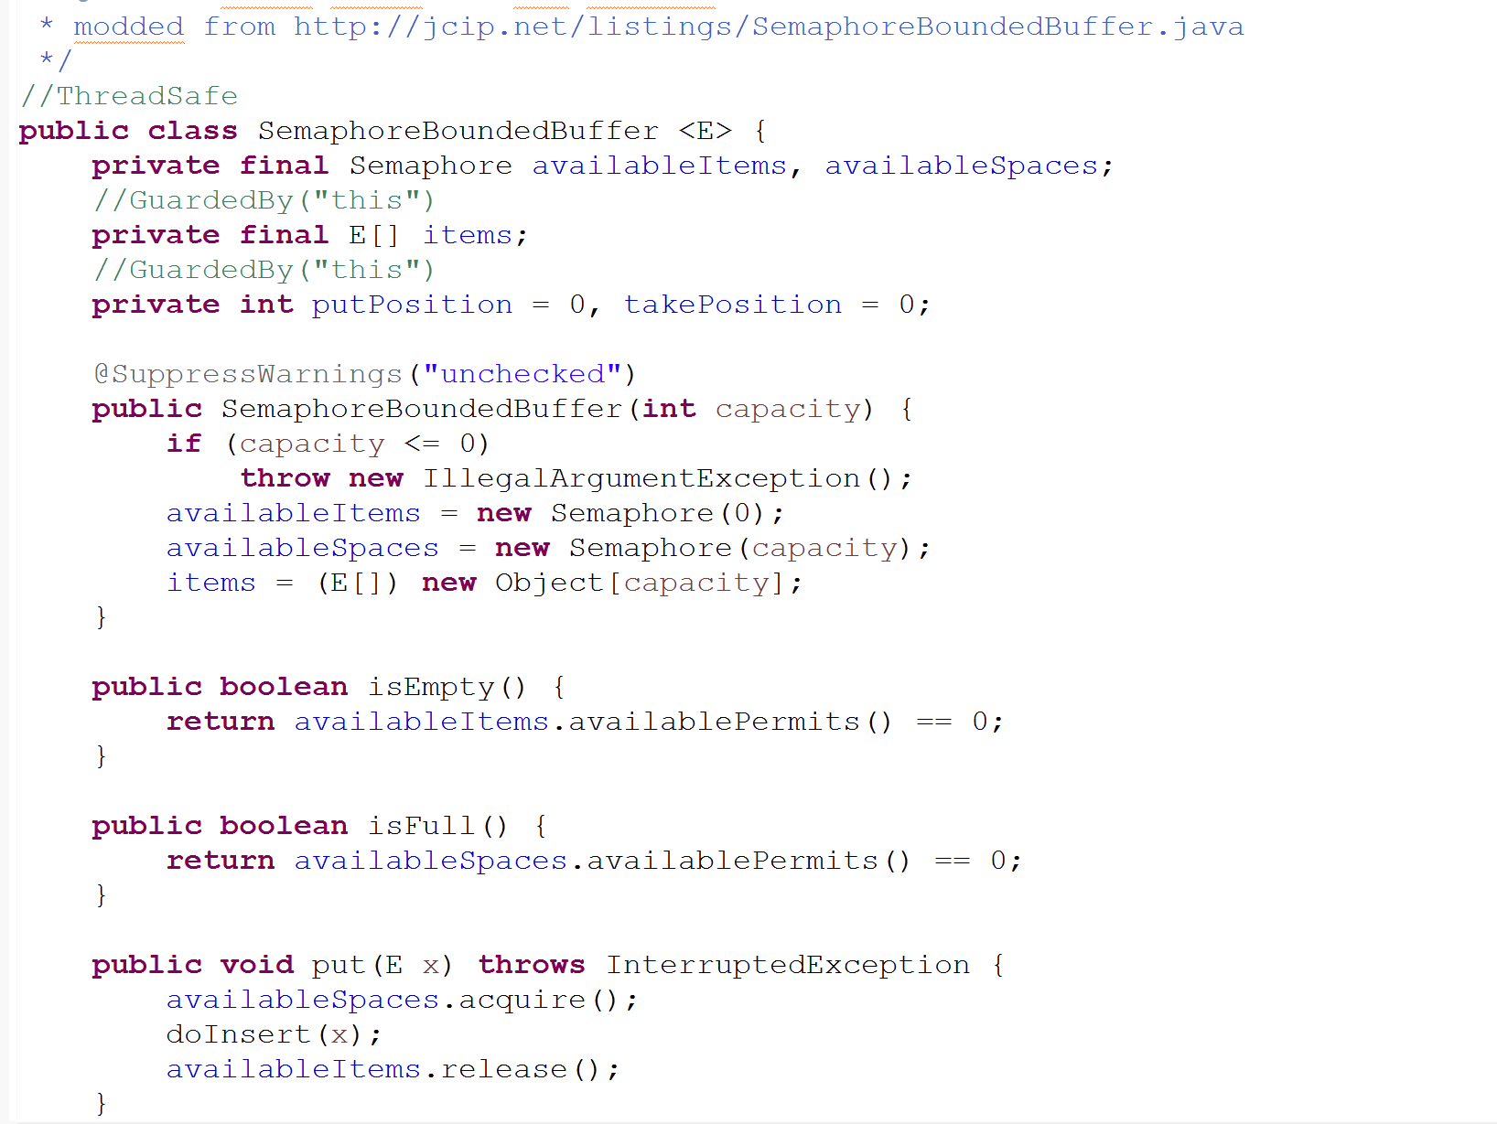
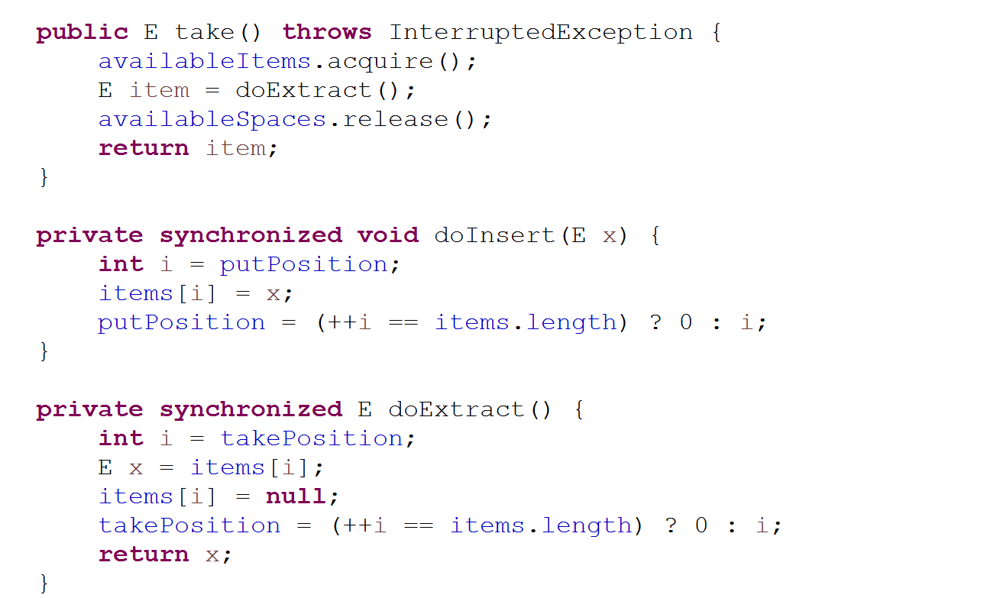
In section 12.1, the book introduces a BoundedBuffer class for testing…
https://github.com/afodor/metagenomicsTools/blob/master/src/classExamples/boundedBuffer/SemaphoreBoundedBuffer.java

Slide 31
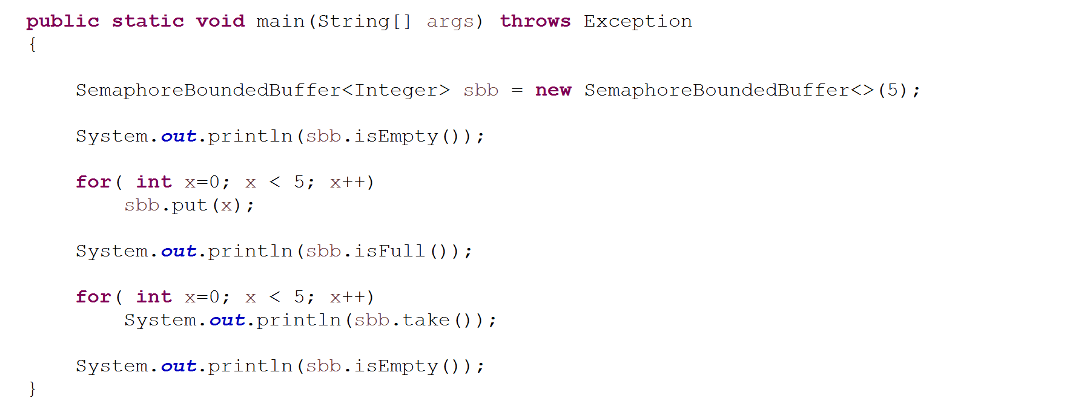
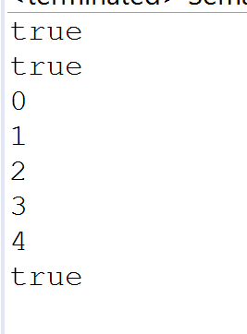
We can do some informal testing (just by eye….)

Slide 32
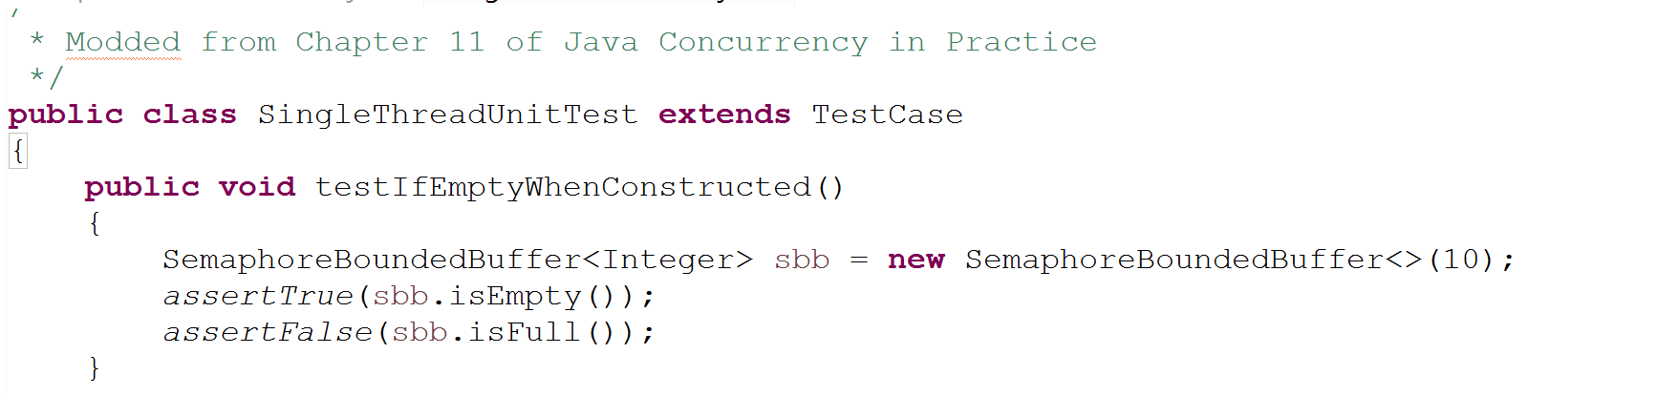
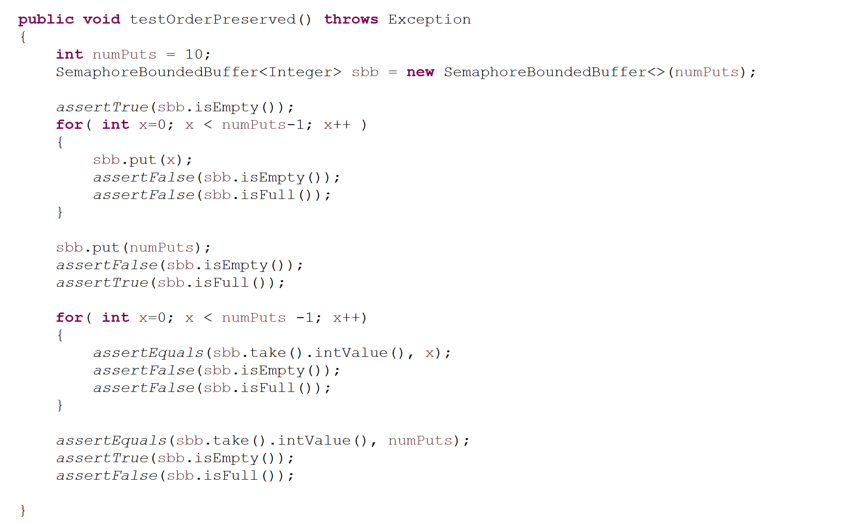
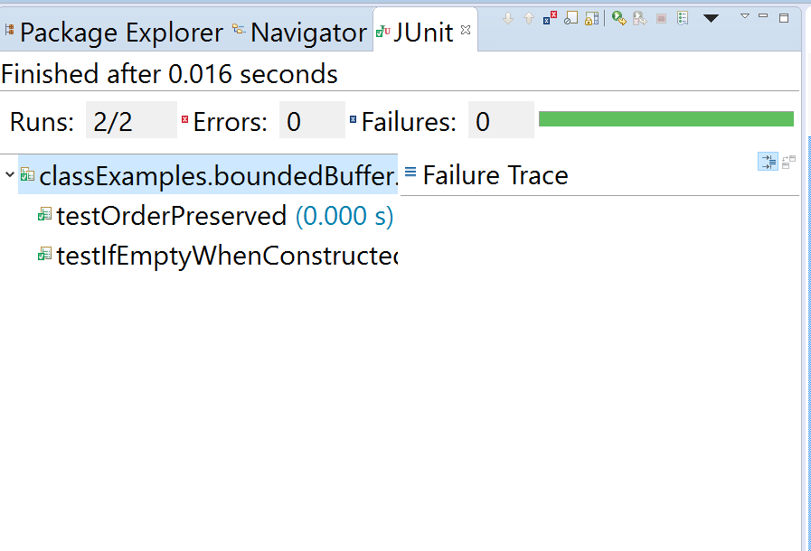
Single-threaded test cases are straight-forward (as the book points out…)

Slide 33
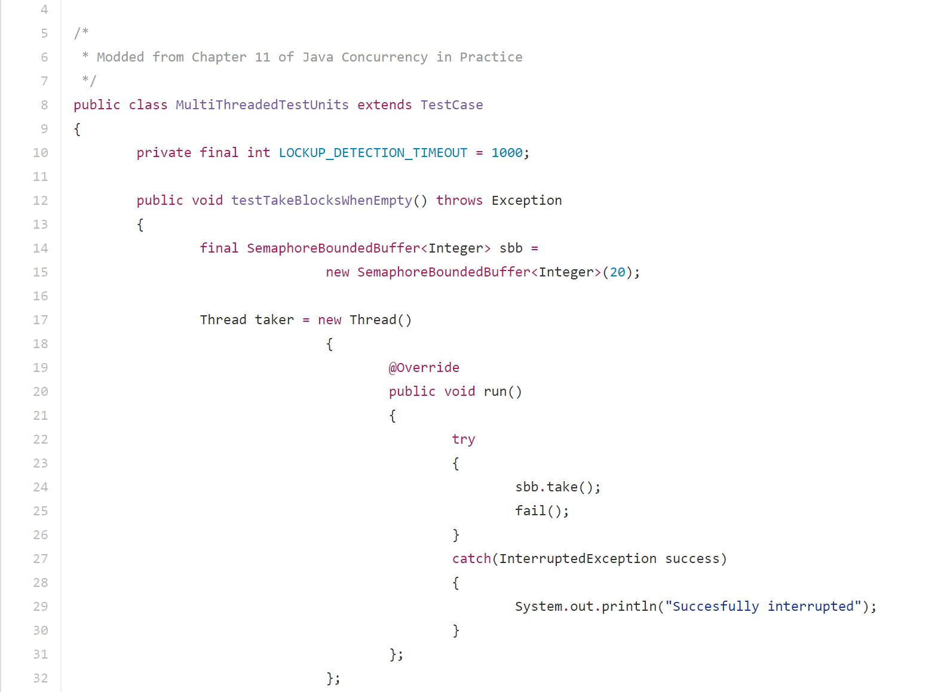
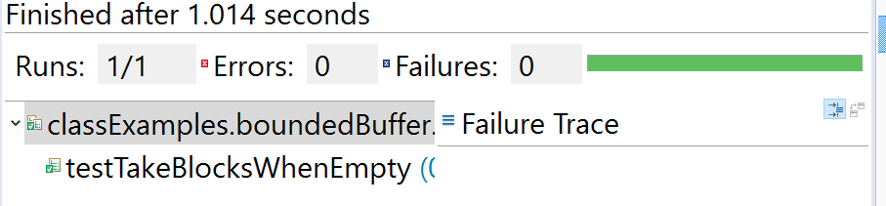
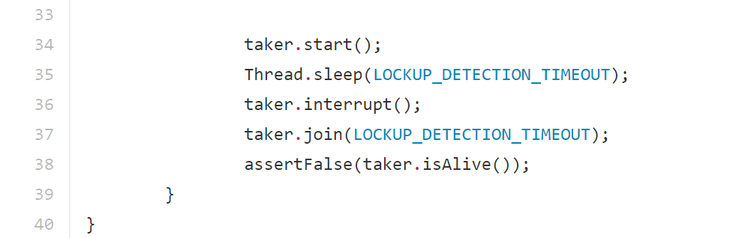
Multi-threaded testing is way trickier… Here we (following an example in Ch. 11) test that take() blocks when empty
This should block
Wait for blocking to happen
Make sure taker has exited
https://github.com/afodor/metagenomicsTools/blob/master/src/classExamples/boundedBuffer/MultiThreadedTestUnits.java

Slide 34
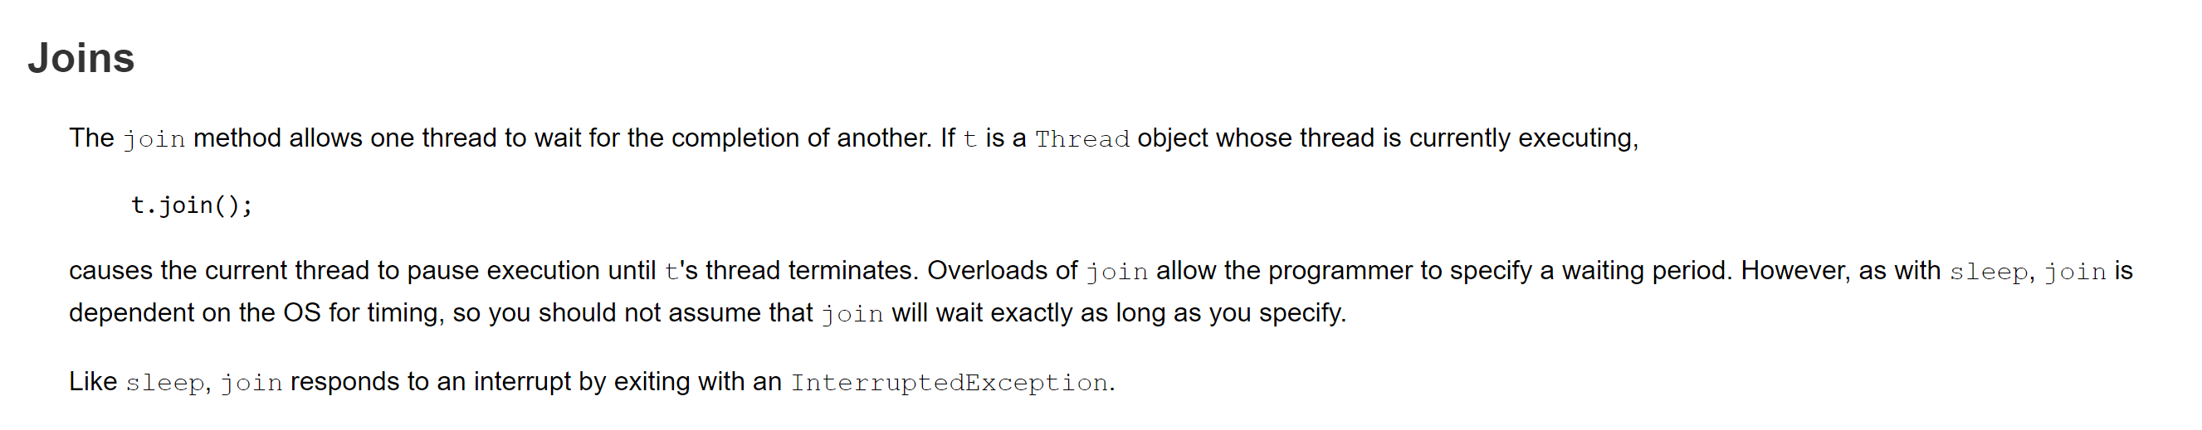
Our taker.join( TIMEOUT ) says wait in this thread for the other thread to finish
(or give up on waiting after TIMEOUT)
We fail in the testing thread if the join() exited because of the TIMEOUT
https://docs.oracle.com/javase/tutorial/essential/concurrency/join.html

Slide 35
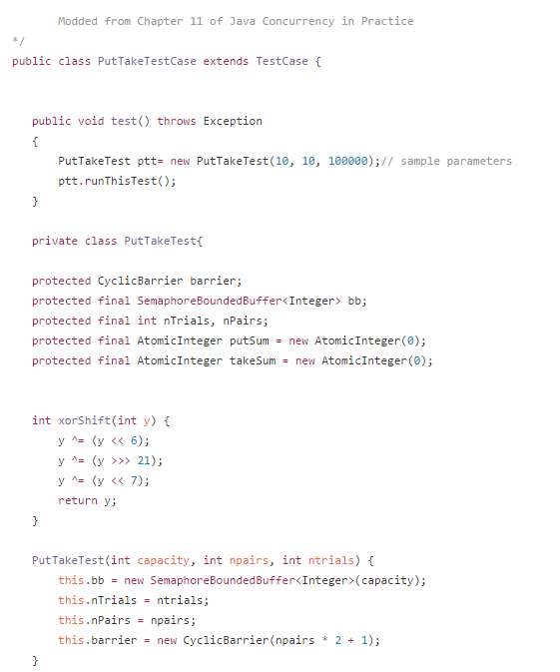
Here is a clever test that tests that in a multi-threaded environment that what goes into the
buffer is what comes out of it
The TestCase has to have a default constructor, so we wrap it around
PutTakeTest, which does not have a default constructor
A single-threaded random number generator
(because they don’t want visible guarantees of Random.nextInt() to
change how the code operates)
https://github.com/afodor/metagenomicsTools/blob/master/src/classExamples/boundedBuffer/PutTakeTestCase.java

Slide 36
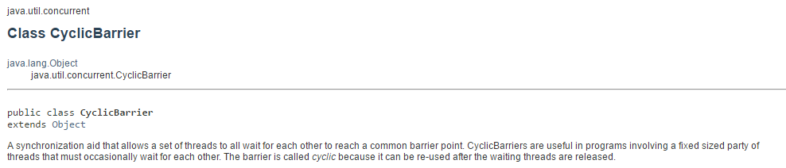
The cyclic barrier allows a group of threads to be co-ordinated. All start at the same time…

Slide 37
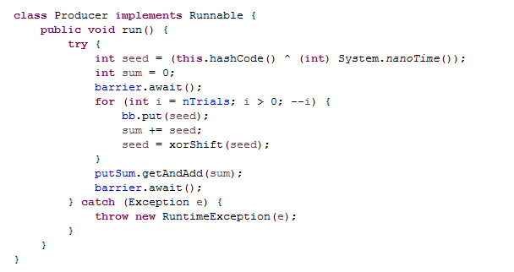
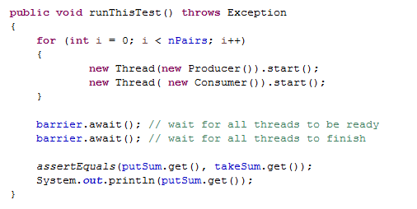
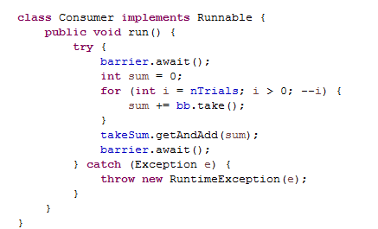

Slide 38
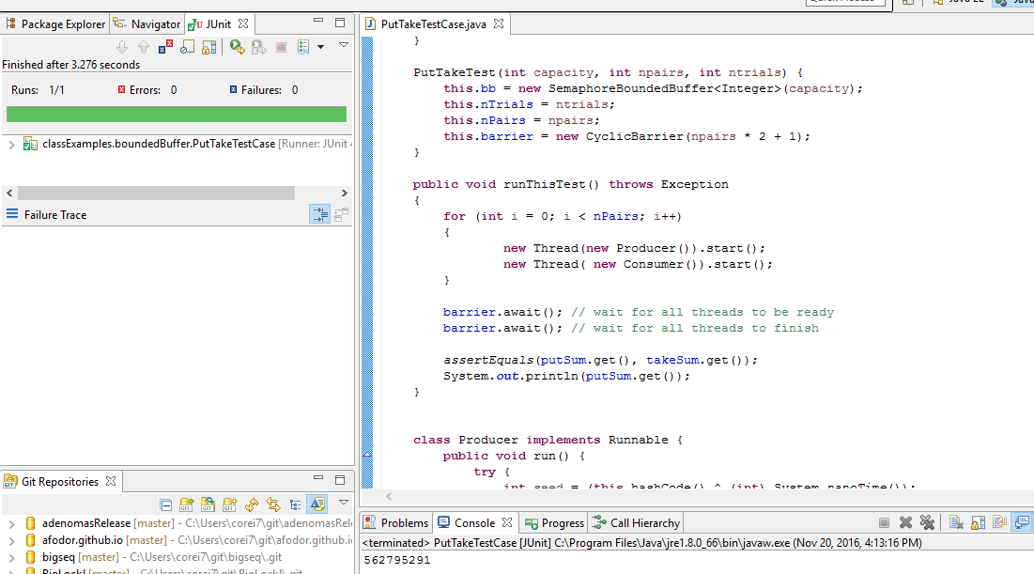
All is well with this test case and our BoundedBuffer…

Slide 39
Coming up:
Machine learning single-threaded and in parallel…

