Slide 1
Changes to the Gut Microbiome in Association with Westernization in a Chinese cohort
Anthony Fodor
UNC Charlotte
Bioinformatics and Genomics

Slide 2
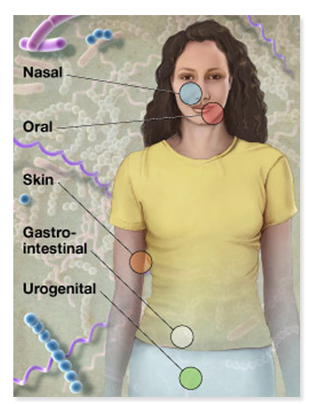

Ecosystems within our body
10 times more microbial cells than human cells
100 times more microbial genes than human genes
Both human and microbial genomes are targets
for association studies to health and disease
phenotypes
http://commonfund.nih.gov/hmp/

Slide 3
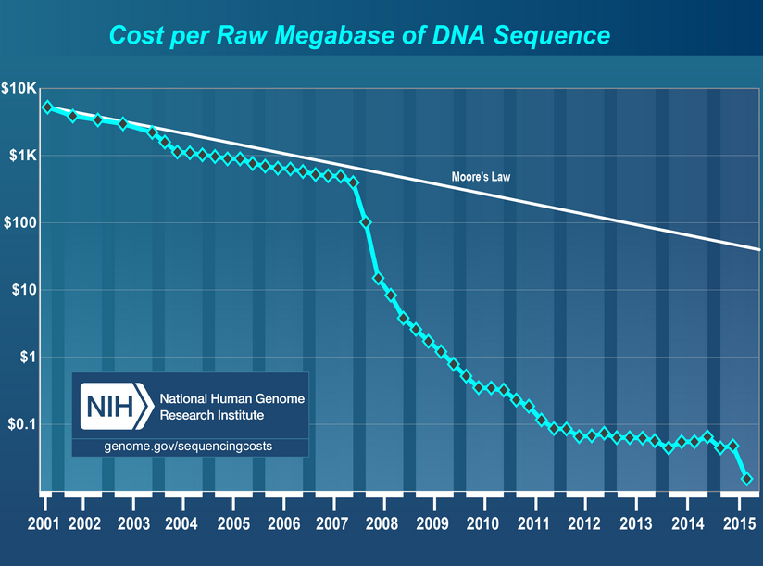
Exploration of the microbial community is made possible by cheaper sequencing technology

Slide 4

The Human Microbiome Project provided an initial description of the American microbiome
http://commonfund.nih.gov/hmp/

Slide 5
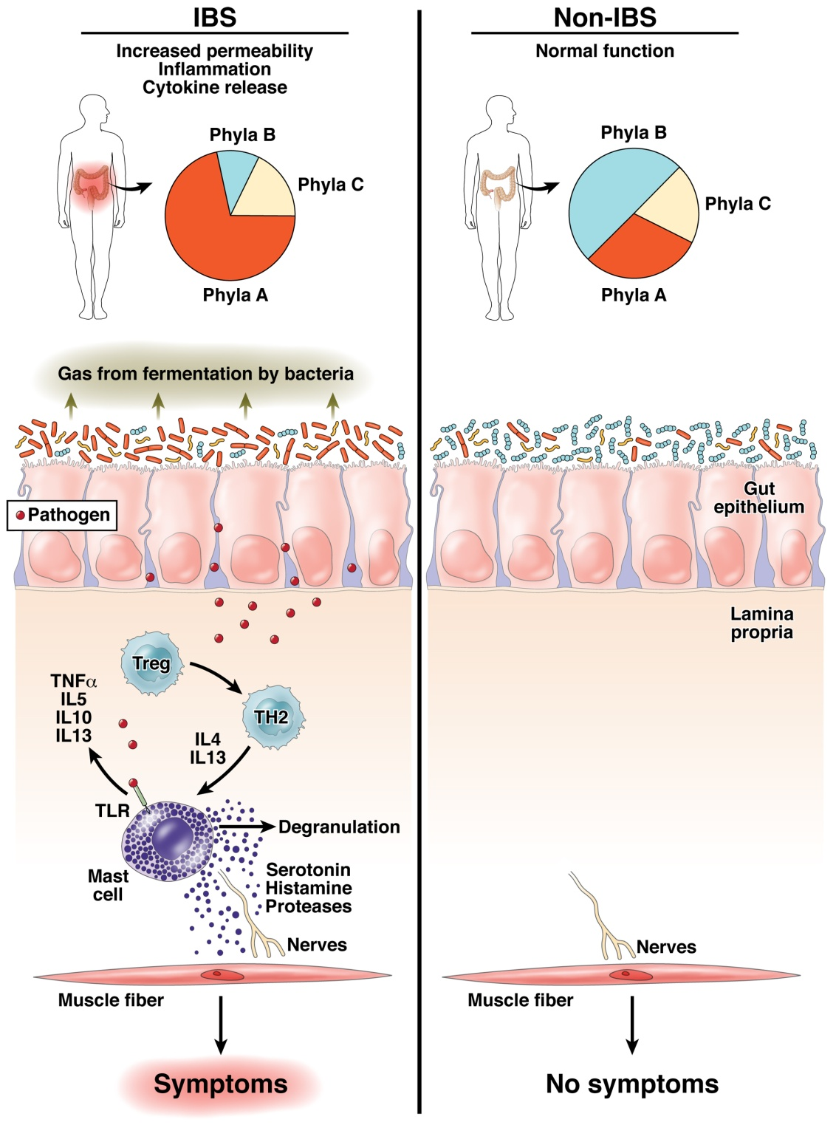
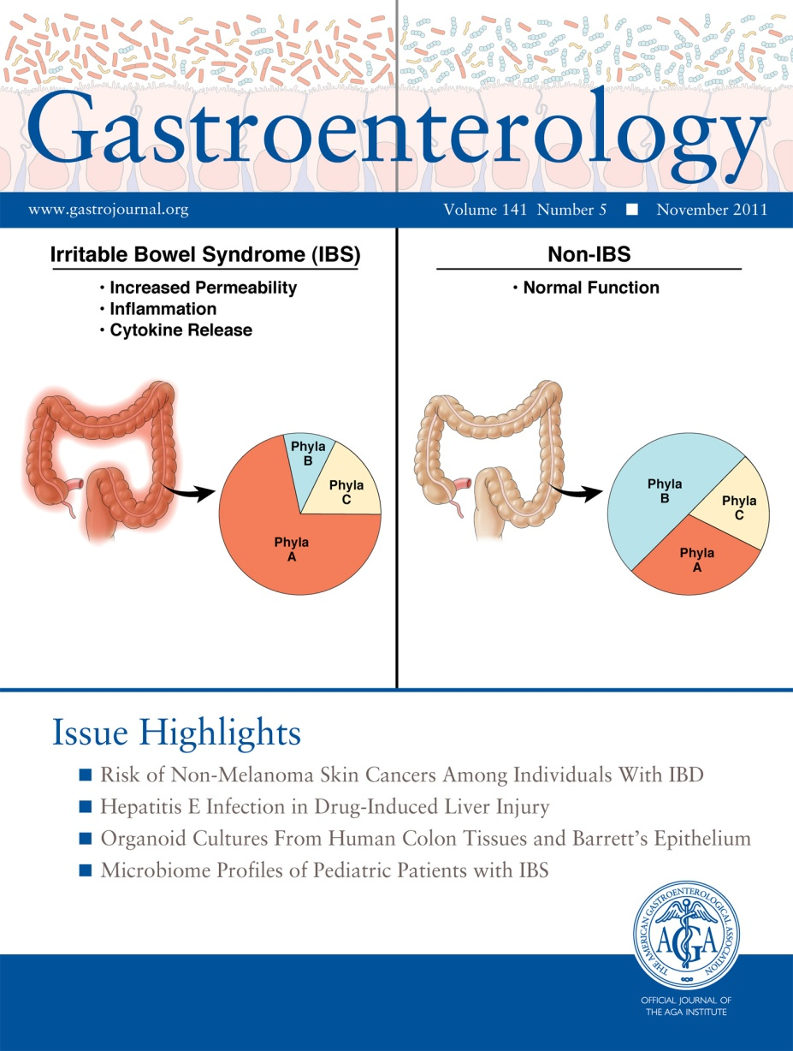
Does human variability in the microbiome impact health and disease?
Fodor & Talley. Gastroenterology. 2011

Slide 6
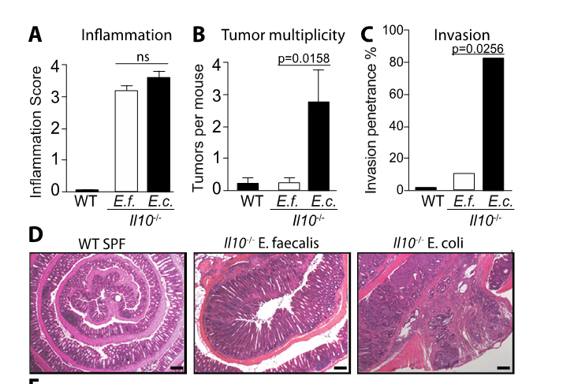
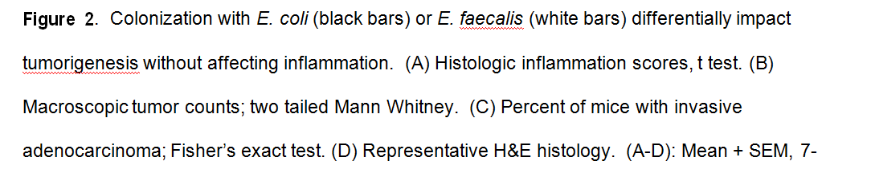
Changing gut microbes can have a huge impact on host health
http://www.sciencemag.org/content/338/6103/120.short

Slide 7
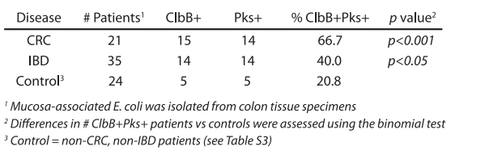
In Western cohorts, the presence of virulent strains of E. Coli is associated with disease
http://www.sciencemag.org/content/338/6103/120.short

Slide 8
There appear to be “good” and “bad” bacteria…

Slide 9
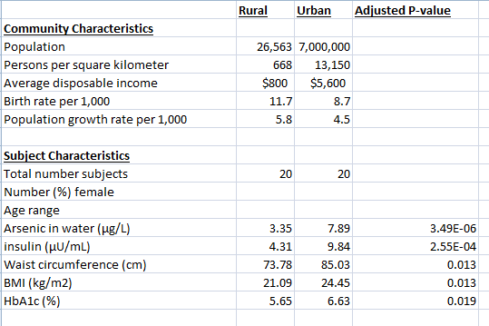
Microbiome Analysis of Forty Subjects from Hunan Province
Fecal samples ( 2 timepoints)
Microbial DNA
PCR targeting 16S rRNA gene
Illumina sequencing
Approximately 7.3 million sequences

Slide 10
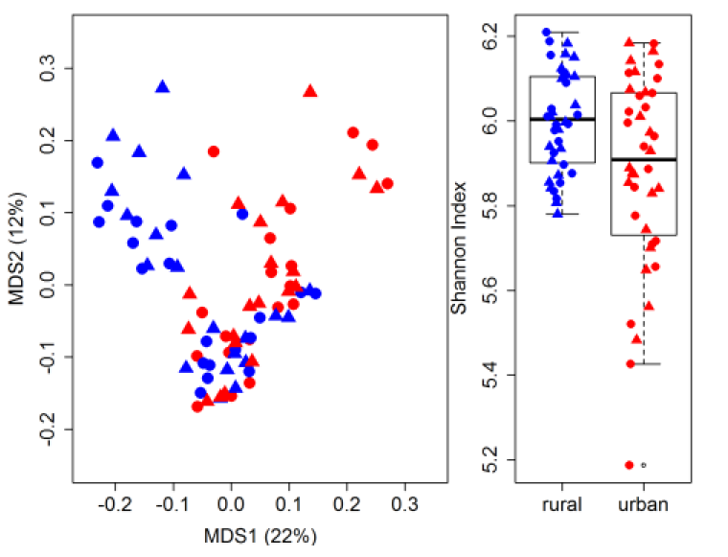
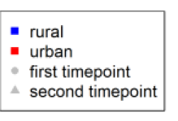
There are pronounced differences between rural and urban derived microbes

Slide 11
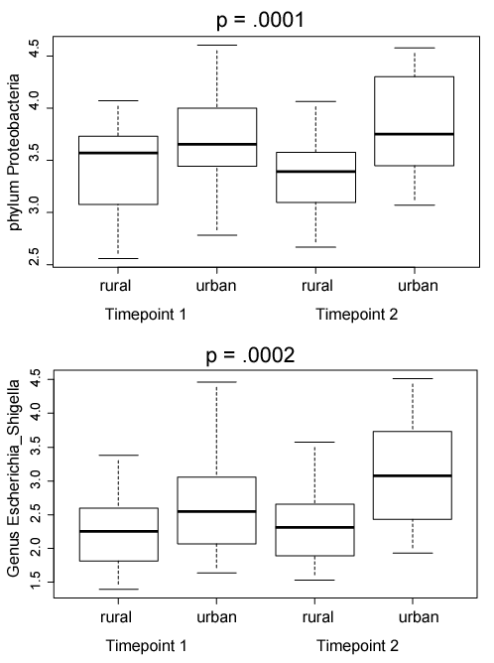
urbanization is associated with acquisition of genus Escherichia
bug = rural/urban + 1/subject
fixed
random

Slide 12
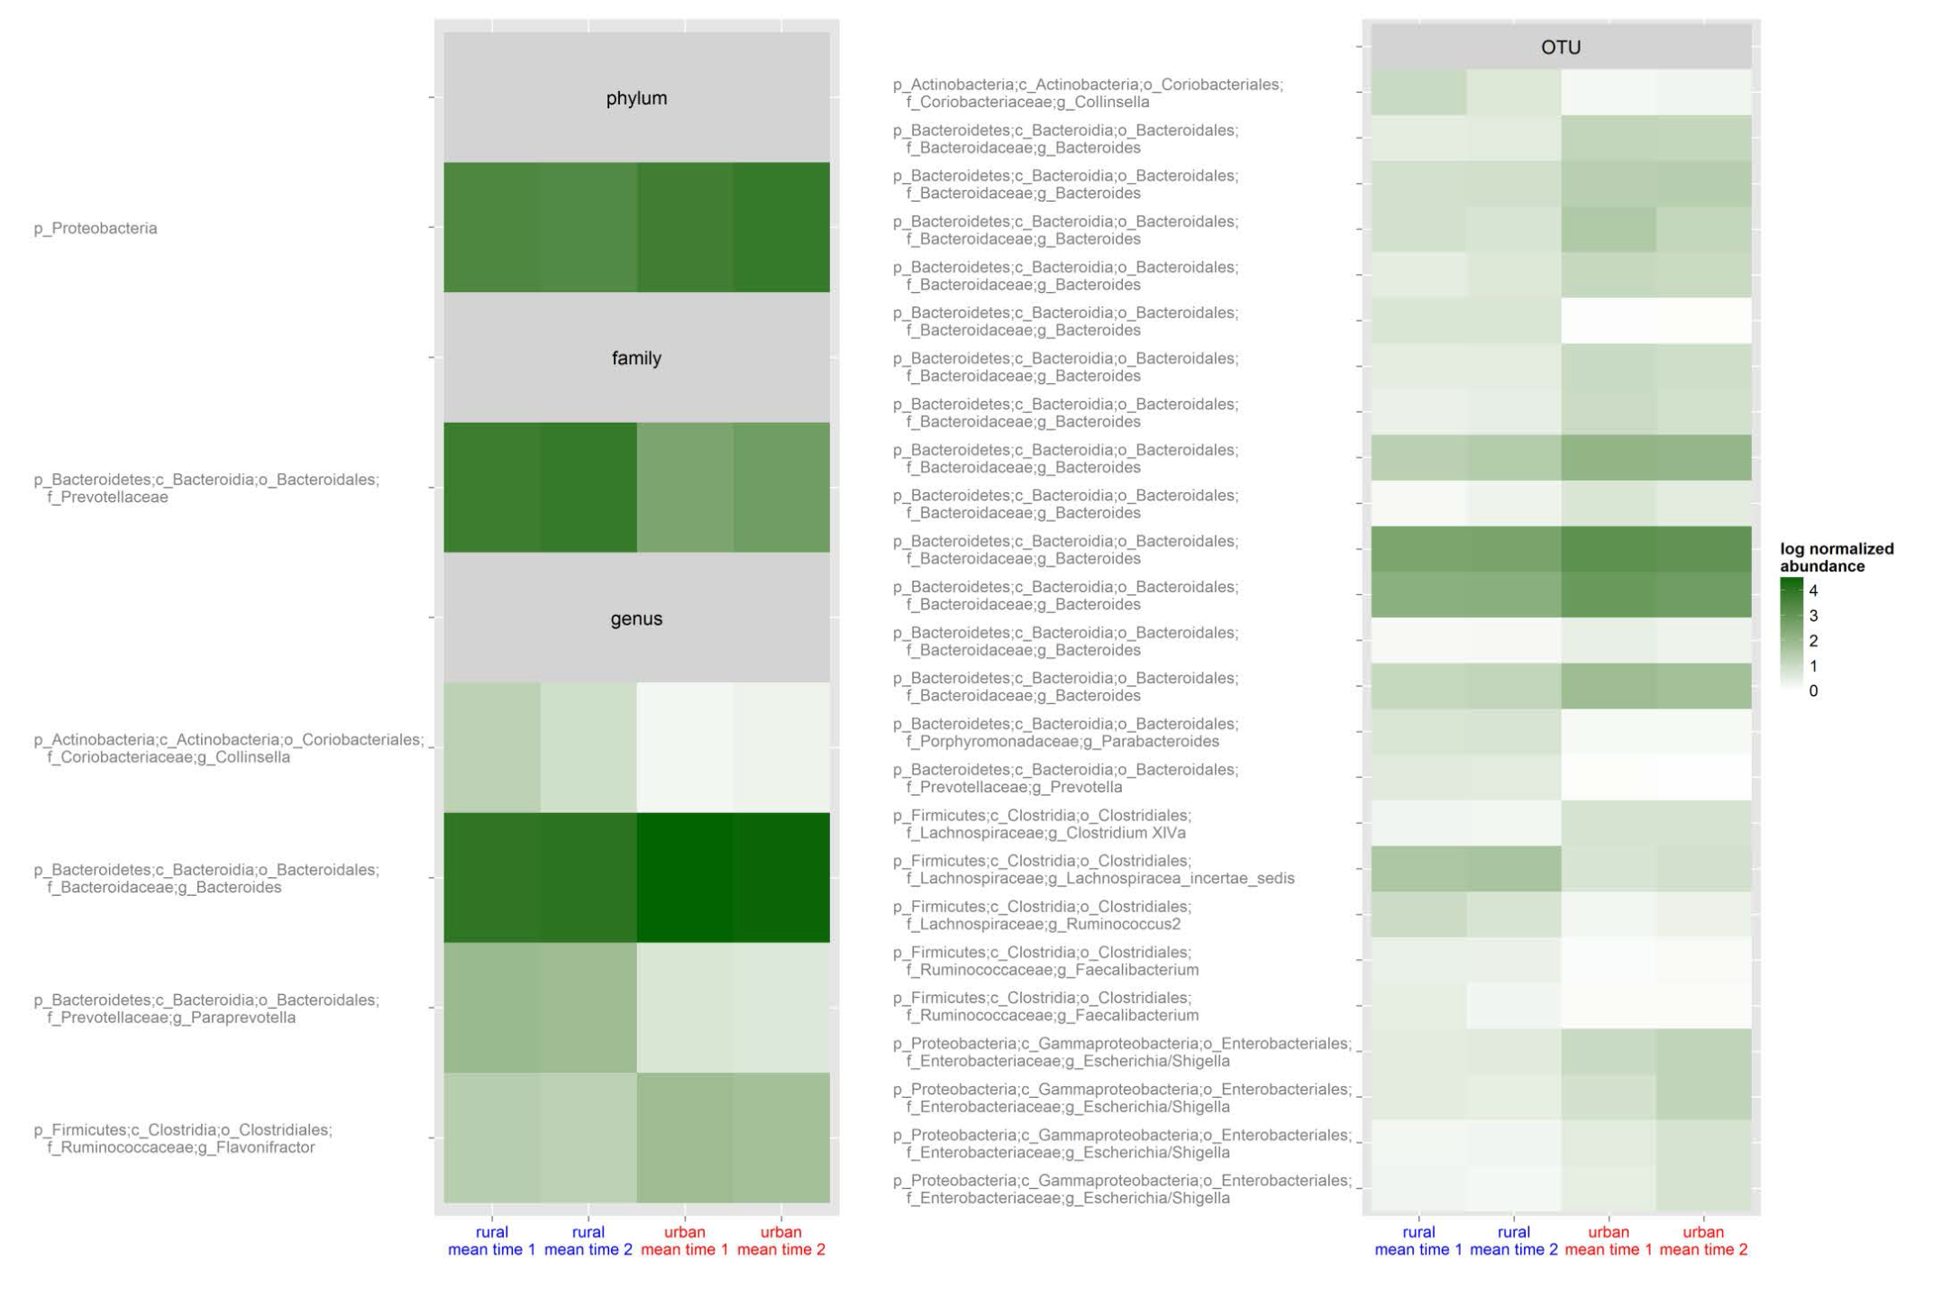
Numerous taxa are associated with rural vs. urban differences

Slide 13
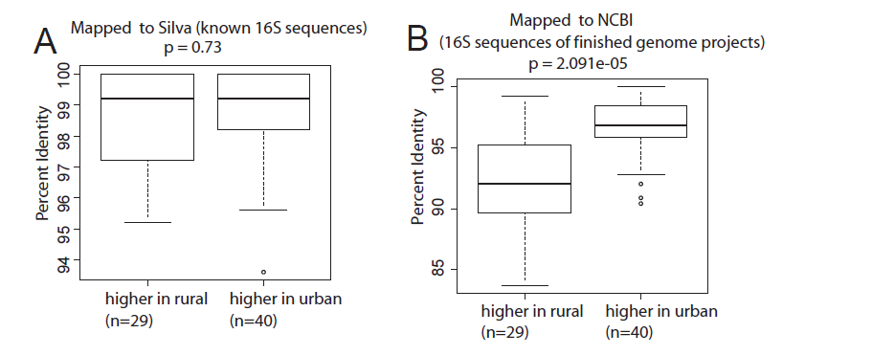
Microbes associated with rural communities are not as well studied

Slide 14
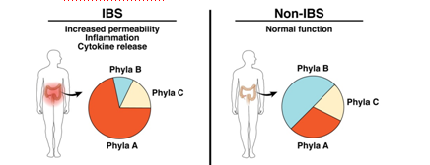
Human studies: Associations with Disease
Funded NIH grant:
16S and whole genome sequencing
Metabolomics profiling
This will generate hypotheses about
which taxa in rural populations may be
beneficial and
Mouse studies: Mechanisms of Disease
Future projects:
Isolate microbes from our cohort
Directly demonstrate benefit or harm
in mouse models of disease

Slide 15
Conclusions:
Numerous taxa are different between rural and urban populations.
E. Coli, known to be harmful is higher in urban populations.
Demonstrating the functions of other taxa will require isolation of
microbes and mechanistic experiments in animal models

Slide 16











Acknowledgements
UNC-Chapel Hill
Janelle Arthur
Annie Green Howard
Marcus Muhlbauer
Penny Gordon-Larsen
UNC-Charlotte
Ra’ad Gharaibeh
Jon McCafferty
UF- Gainesville
Christian Jobin
Raad Gharaibeh
Jon McCafferty
Marcus Muhlbauer
Janelle Arthur
Christian Jobin
Annie Green Howard
Penny Gordon-Larsen

