Slide 1
Lab 3:
As before, send code or instructions to access your repository to
afodor@uncc.edu and rlinchan@uncc.edu
Your code and/or instructions are due before class on Sep. 14th

Slide 2
This week, we are going to make a quiz to drill amio acids
The quiz works like this:
It is 30 seconds long.
The quiz ends after 30 seconds or when there is a single in-correct answer.
The program displays the full name of an amino acid (like “alanine” )
and asks the user to type in the one character code (like a)
The quiz ignores case in the answer.
The total score is the number correct answers…
Notes:
You can input a string from the use by using code like:
String aString = System.console().readLine().toUpperCase();
You can get the first character by using code like:
String aChar = "" + aString.charAt(0);
However, the readline() only works when Java is run from the command line
(not Eclipse).
You can edit in Eclipse but use the command line to run the program…

Slide 3
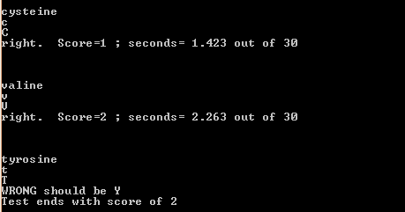
Sample output… (you don’t have to match the output exactly, but the overall information should be the same in your program)

Slide 4
Useful arrays to copy and paste:
public static String[] SHORT_NAMES =
{ "A","R", "N", "D", "C", "Q", "E",
"G", "H", "I", "L", "K", "M", "F",
"P", "S", "T", "W", "Y", "V" };
public static String[] FULL_NAMES =
{
"alanine","arginine", "asparagine",
"aspartic acid", "cysteine",
"glutamine", "glutamic acid",
"glycine" ,"histidine","isoleucine",
"leucine", "lysine", "methionine",
"phenylalanine", "proline",
"serine","threonine","tryptophan",
"tyrosine", "valine"};

