Slide 1
Class Introduction
Java
HelloWorld.java
classes

Slide 2
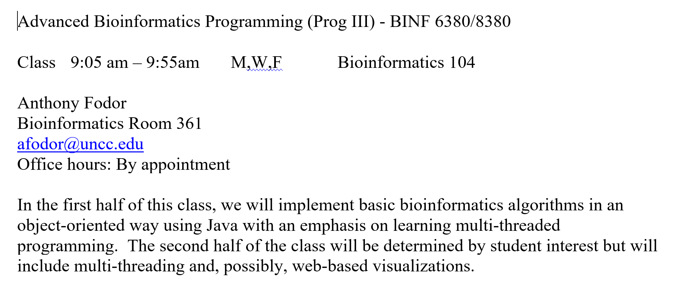

Slide 3
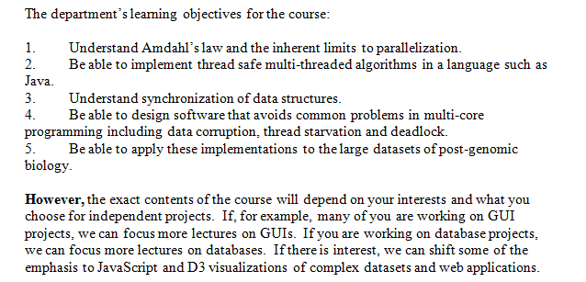

Slide 4
“Thinking in Java”
(or text book of your choice)
Java and Object Oriented Programming
( we will definitely cover)
“Effective Java ” – Josh Bloch
Using OO for multi-threading
Goetz et al -Java Concurrency in Practice
Writing concurrent programs
( we will cover; how deeply depends on your interests)
“JavaScript: The good parts”
Javascript, HTML 5 and Web applications
( depending on student interests)
“Secrets of the Javascript Ninja”
“Interactive Data Visualization for the Web”
D3, data visualization, React
( depending on student interests)

Slide 5
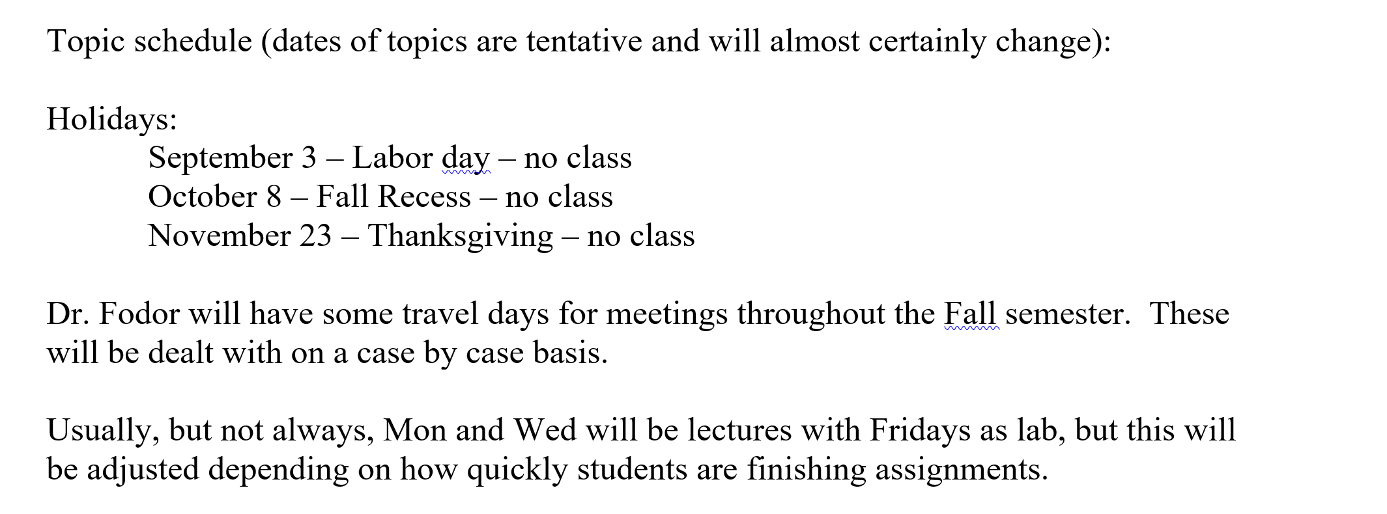

Slide 6
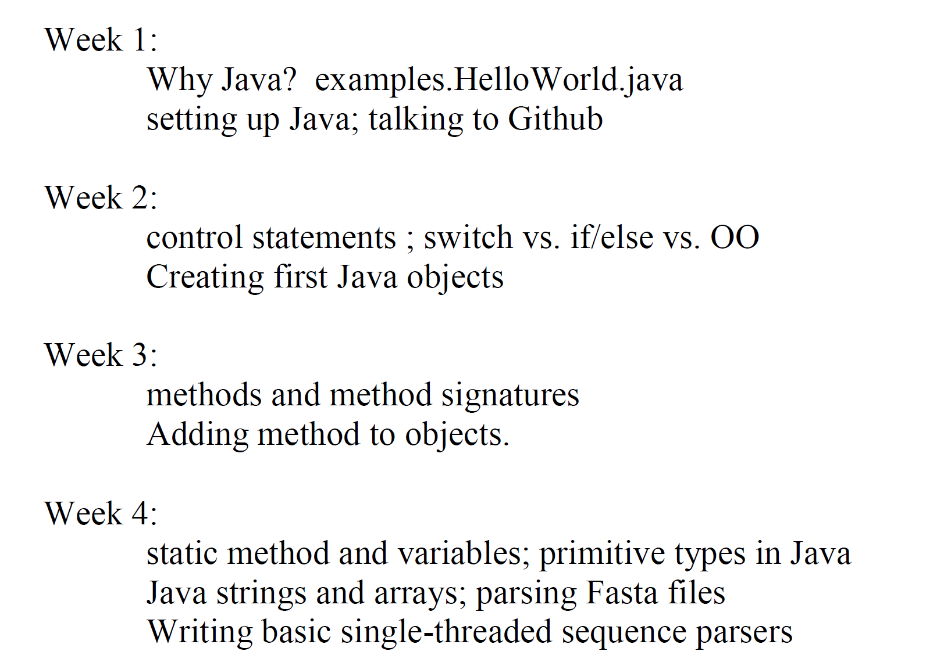
Our very tentative schedule

Slide 7
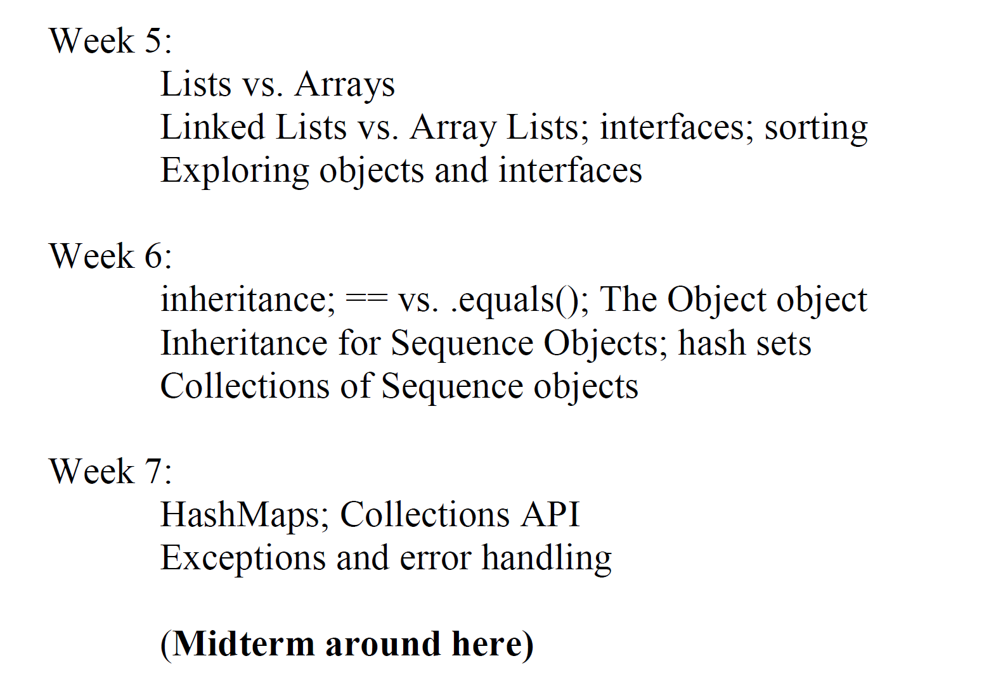
Our very tentative schedule (cont’d)

Slide 8
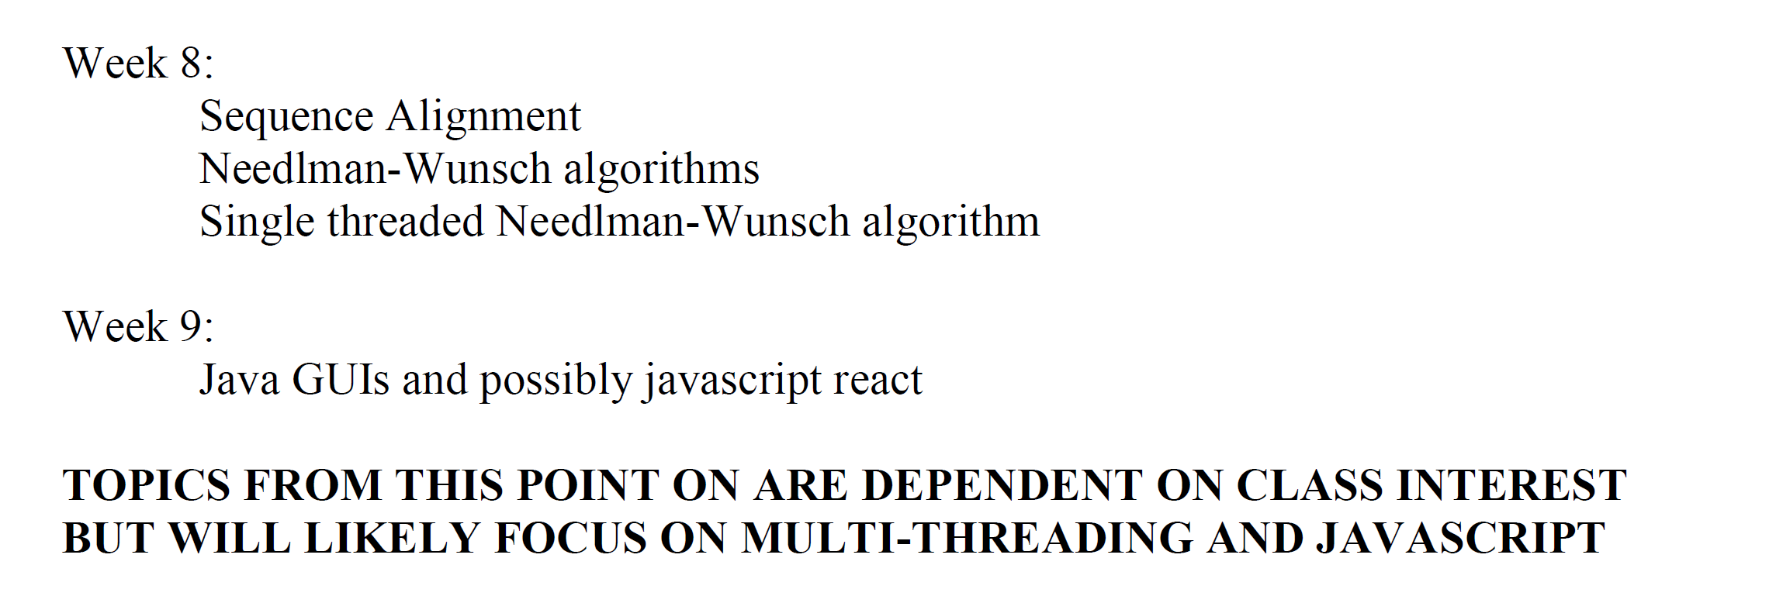

Slide 9
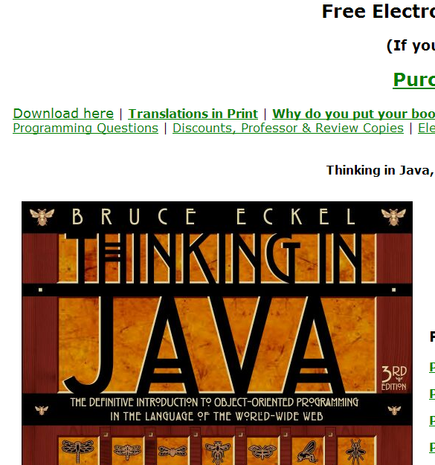
Text books…
Thinking in Java (or any other intro Java book that you are comfortable with)
http://www.mindview.net/Books/TIJ/
The 3rd edition (which is free) is fine…

Slide 10
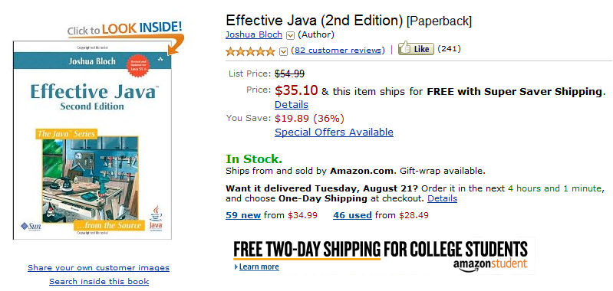
This book is free: http://it-ebooks.info/book/2614/
If you are ordering physical books, get them ordered.
You will need them soon…

Slide 11
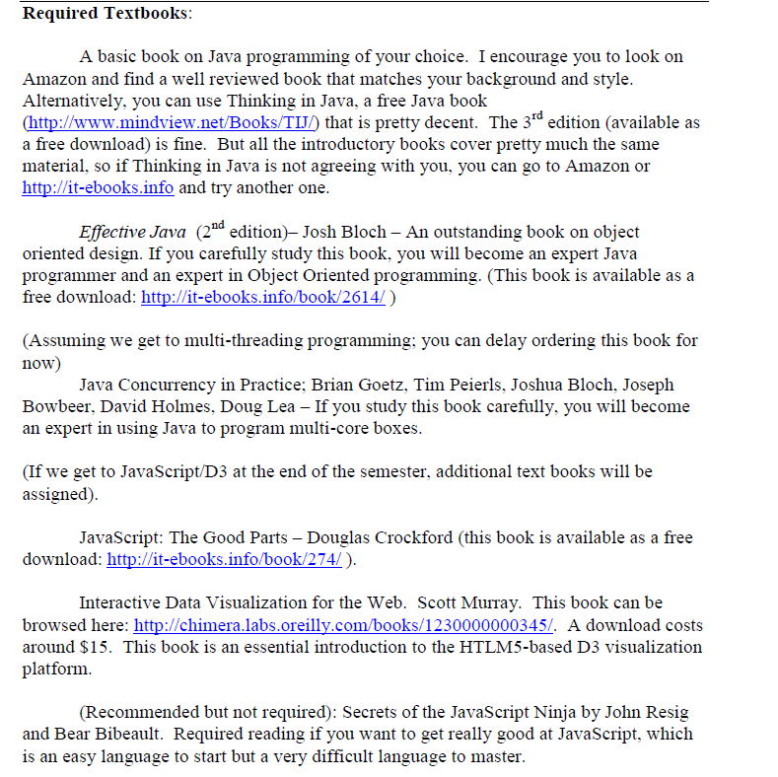

Slide 12
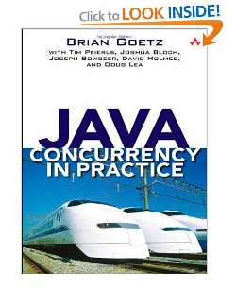
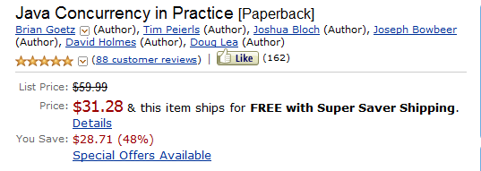
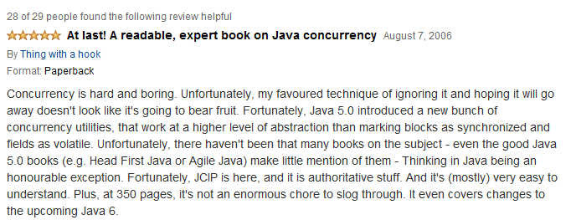
this will be a required textbook…

Slide 13
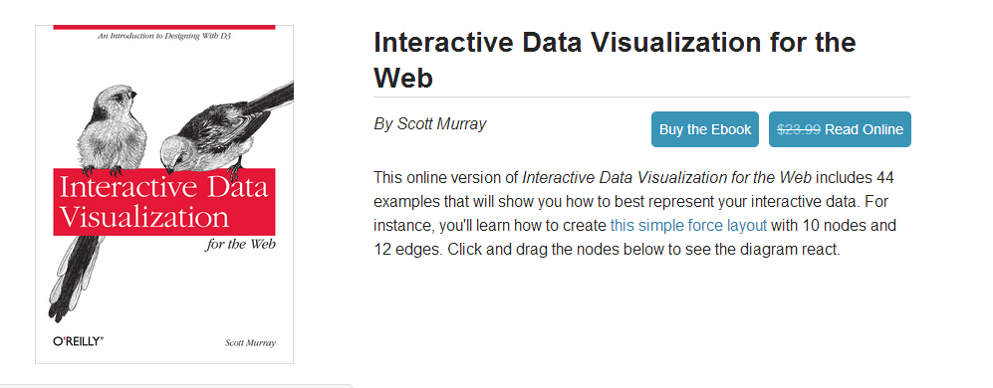
If we get this far…
This book can be browsed here:
http://chimera.labs.oreilly.com/books/1230000000345/

Slide 14
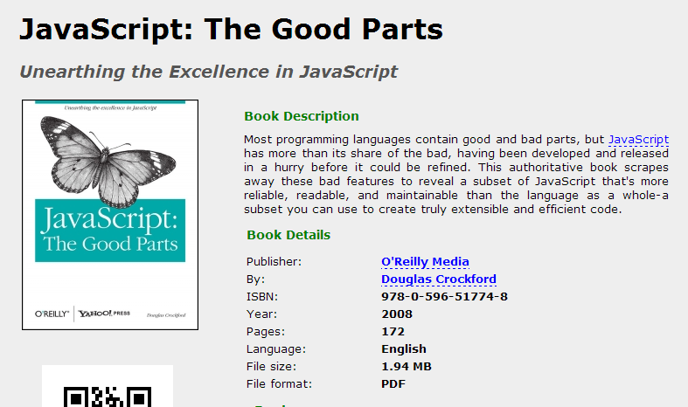
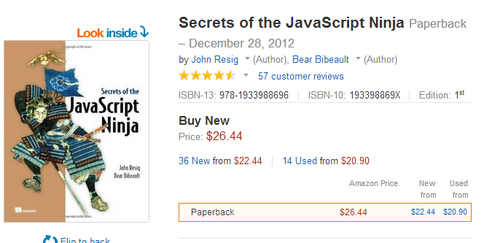
We probably won’t get this far but if we do….
This book is free…
http://it-ebooks.info/book/274/

Slide 15
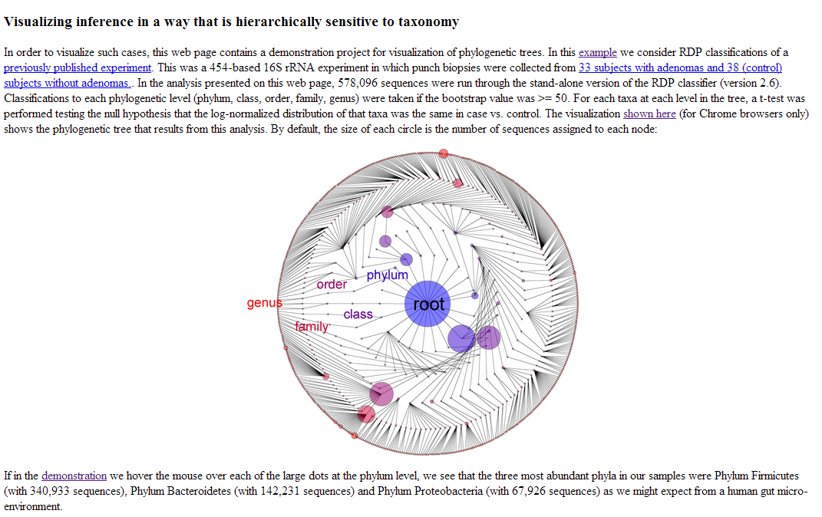
You can do some rather nice things with D3/JavaScript..
http://afodor.github.io/genomicsForceDemo.html

Slide 16
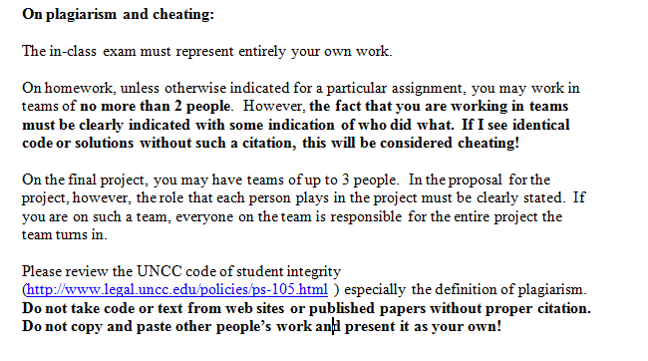

Slide 17
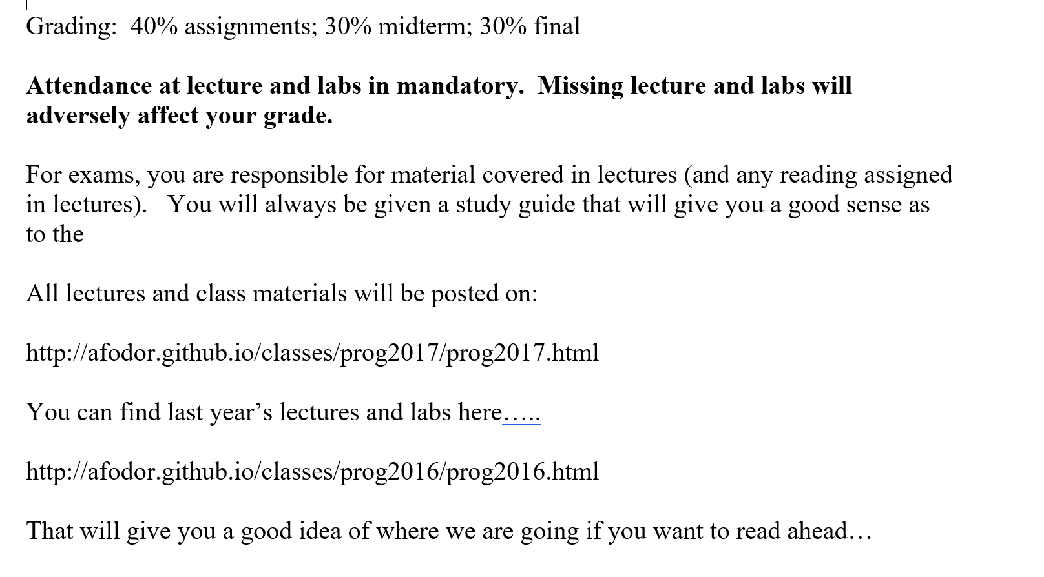
http://afodor.github.io/classes/prog2018/prog2018.html
http://afodor.github.io/classes/prog2018/prog2018.html

Slide 18
Java
HelloWorld.java
classes

Slide 19
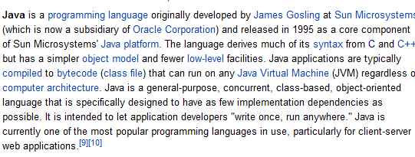
http://en.wikipedia.org/wiki/Java_(programming_language)#Principles

Slide 20
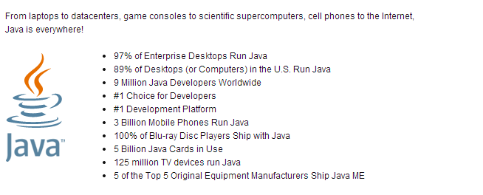
Billions of computers/devices that run some version of Java….
http://www.java.com/en/about/

Slide 21
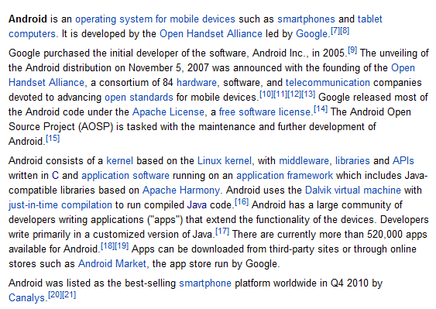
Want to write for Android???? ( I do !!!)

Slide 22
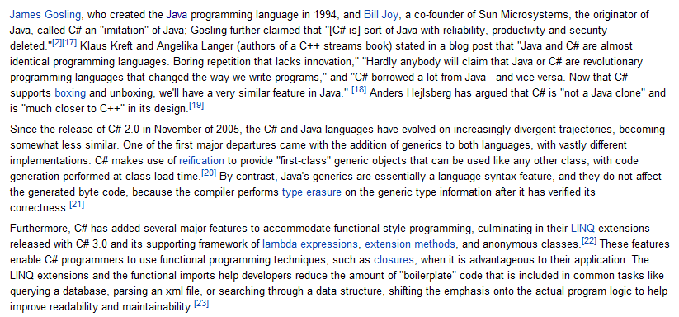
Want to learn C# and write for Windows?
Knowing Java will get you (most of) version 1 of C#.
Lot’s of interesting stuff happening in C# since 2005 that I haven’t studied!

Slide 23
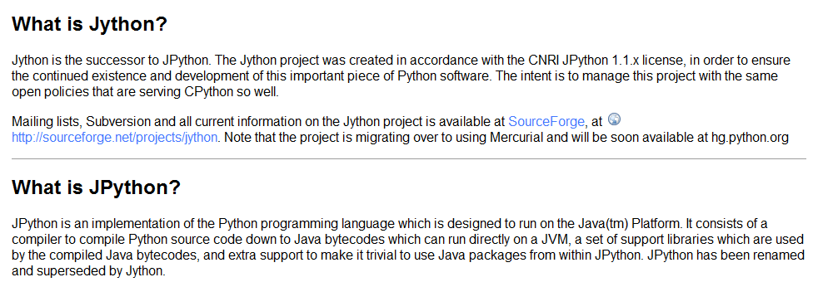
Python and Java are closely related languages.
If you know Java, Python is not hard to learn.
Python code can be compiled for the Java Virtual Machine
(and then reverse compiled into Java).
http://wiki.python.org/jython/JythonFaq/GeneralInfo

Slide 24
The C compilation model
helloWorld.c
Text file. The same on all platforms
gcc
gcc
Windows
OSX
Linux
Different binary files
(the compiler makes
a native file that will
run on the CPU of
each machine)
Binary
file
Binary
file
Binary
file
(except cygwin doesn’t really use native files, but that is another story….)

Slide 25
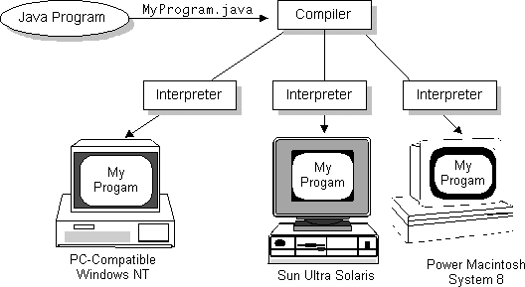
Java (and languages like C#) do something fundamentally different!
Interpreted, architecture neutral, portable
We compile to the “virtual machine” (VM)
The “virtual machine” is just a specification.
http://www.sun.com/access/articles/wp-caped/2comp.gif
The idea is to make the code more portable. The VM has a single specification.
This is more abstract and makes it easier to write cross-platform code.
You can compile Java code on Windows and run the binaries on Linux on OSX.
This works surprisingly well

Slide 26
We will write our first Java programs in our text-editors…
But soon switch to Eclipse – an Integrated Development Environment

Slide 27
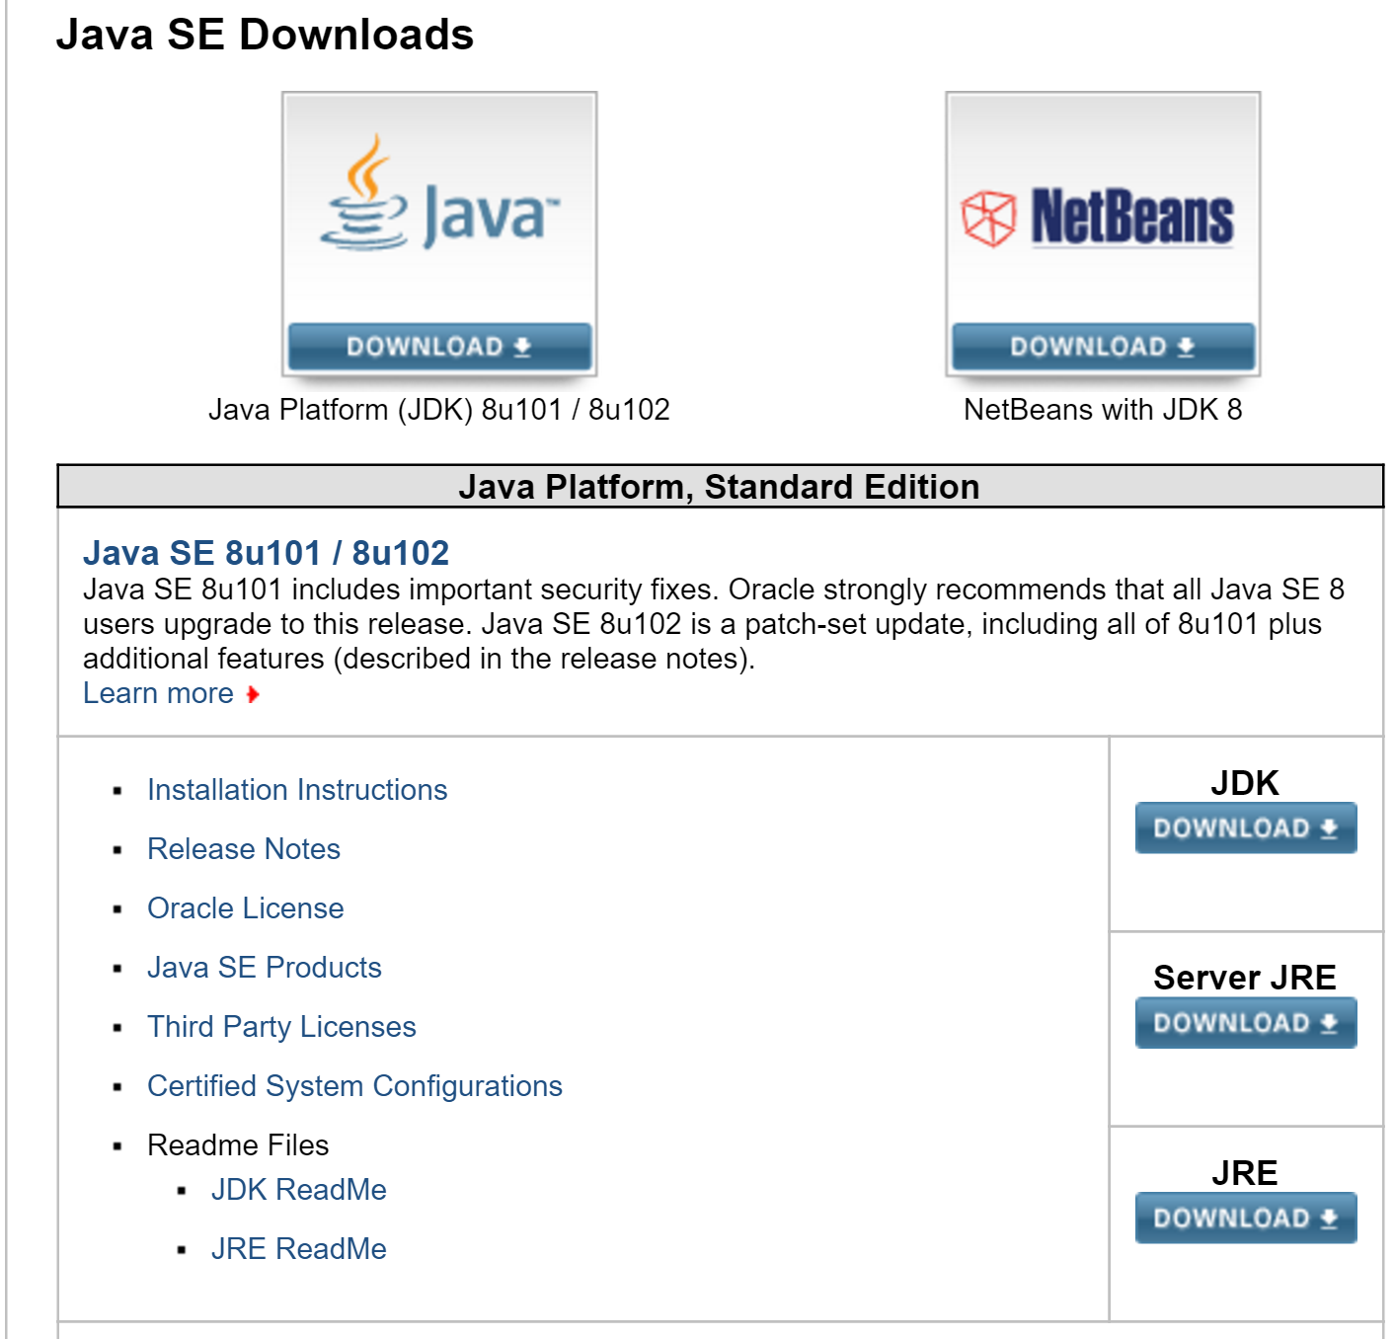
Grab the latest Java SDK for your OS (1.8 or later is fine…)
http://www.oracle.com/technetwork/java/javase/downloads/index.html
You want the JDK for your platform

Slide 28
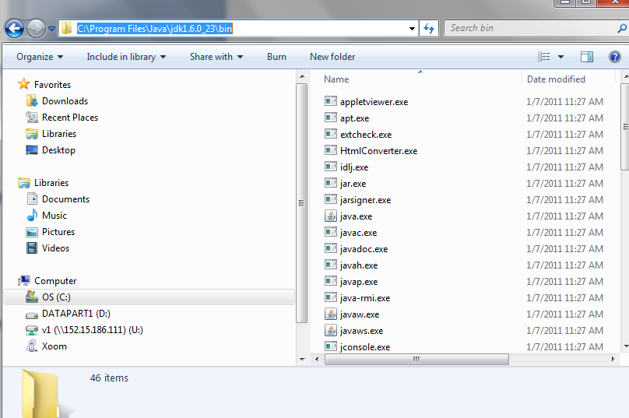
On windows make sure the Java bin directory is in your path

Slide 29
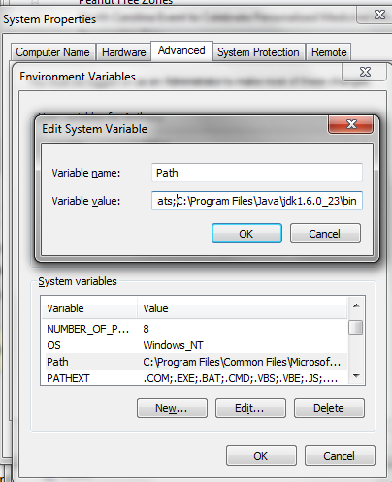
Set the path by (Windows 7) :
Control panel -> System and Security -> System ->
Advanced System Settings->Advanced -> Environment Variables -> Path -> Edit
Add “;” and then the path to the Java jdk bin directory

Slide 30
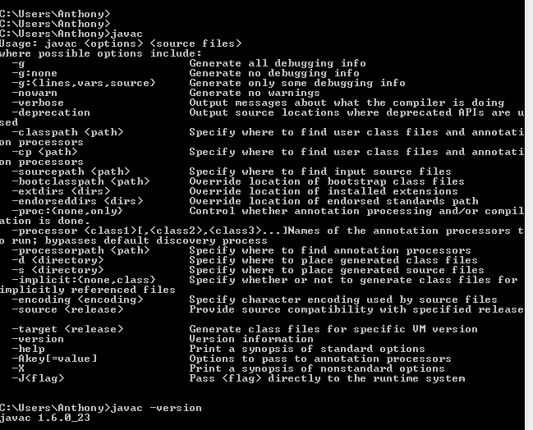
If all has gone well, if you type “javac –version” you will get the installed version of Java

Slide 31
If you can’t get Java installed on a computer you need it on, let us know.
We will figure it out!

Slide 32
Java
HelloWorld.java
classes

Slide 33
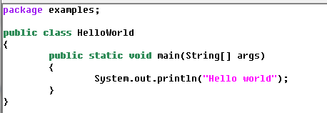
Our first Java program (Hello World of course)
Lot’s of new stuff for us to learn here….

Slide 34
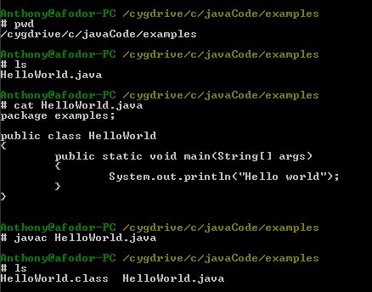
Java is very fussy about where files are.
This file is in a package called examples.
Which means that it has to be in a directory called examples on your hard drive.
And it has to be in a file called HelloWorld.java (the same name as the class)
We must be in a directory called examples
Our file has the same name as the class
We successfully compile our
Program to make the “.class” file

Slide 35
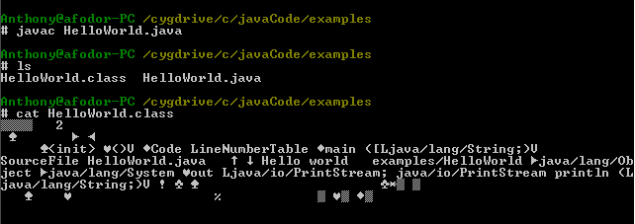
The .class file is a binary file, but a different kind of binary file than the .exe file that C created

Slide 36
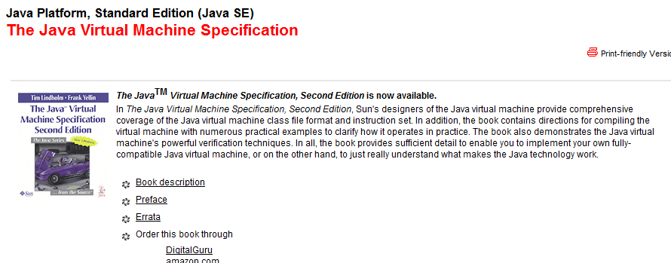
The class file is not a “native file” (like a c compiled executable HelloWorld.exe) .
It is compiled for the Java Virtual Machine (or JVM).
The Java virtual machine is just a specification ; a series of rules…
http://java.sun.com/docs/books/jvms/

Slide 37
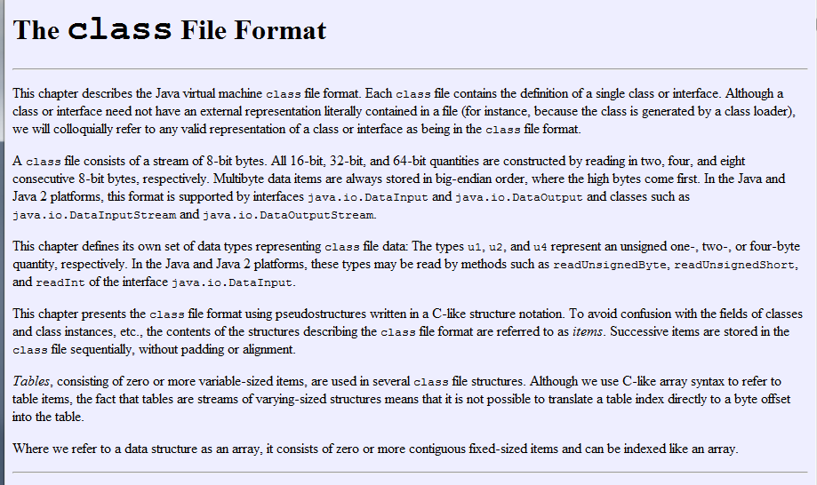
Lots of interesting stuff in JVM specification…. (but you of course don’t need to read it!)
u1, u2 and u4 are unsigned one-, two- and four-byte integers…

Slide 38
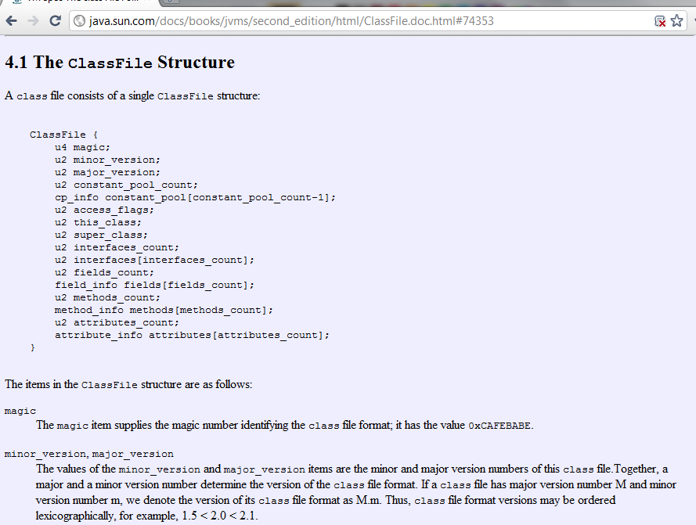
Kind of interesting to read if you want to…. (obviously you are not responsible for this material)
For example, the .class file itself can be represented as a struct

Slide 39
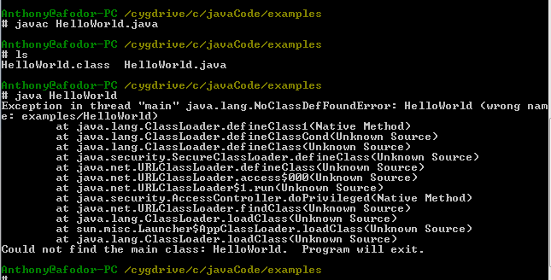
But let’s return to our example. We have successfully compiled our code to a class file.
We use the command “java” to launch the Virtual Machine and run our program.
Except it says that it can’t find it!
Why can’t it find it? What do you mean wrong name? It’s called HelloWorld.
It’s right there!

Slide 40
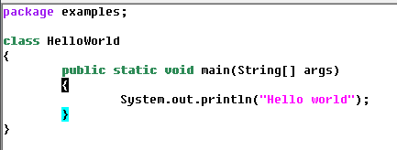
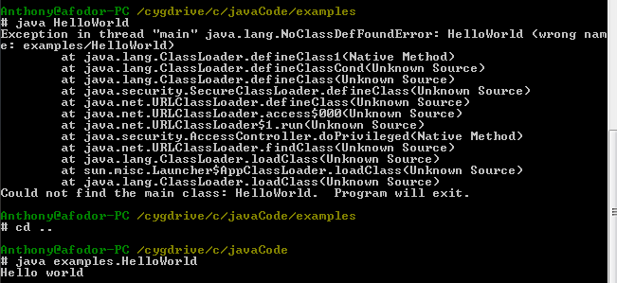
It turns out that the name of this program is not “HelloWorld”.
It is “examples.HelloWorld”
Java is very, very fussy about names…
To run the program we need to be in the base directory
(the directory that contains “examples” and use the full name
examples.HelloWorld)

Slide 41

Alternatively we can set a CLASSPATH to tell java where to look for our file…
With the classpath, I can invoke Java from anywhere.
You can specify multiple directories…
So
java –cp .;c:\javaCode;c:\someDir;
Will search in the current directory (“.”), then c:\javaCode and then c:\someDir
for the class “examples.HelloWorld” (which must be in a directory called “example”
in one of those directories).
If it can’t find it, you get the “NoClassDefFoundError”

Slide 42
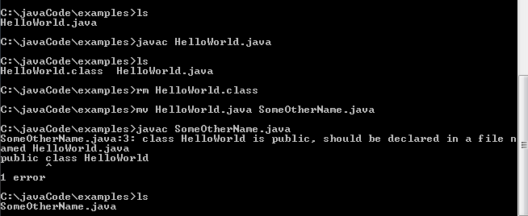
Again, if the class is called HelloWorld,
the program must be called HelloWorld.java otherwise it won’t compile
(this was done so that we can find the code where classes are defined!)
(It turns out that is only true for the public non-static class in the file
of which there can only be one, but since you don’t know yet what a
class is or what it means to be static or public, we will have to return to this later)

Slide 43
Right now (or at home): try and type in compile and run a HelloWorld.java program

Slide 44
Java
HelloWorld.java
classes

Slide 45
So what are classes?
Classes are like c’s structs, but with functions and visibility modifiers

Slide 46
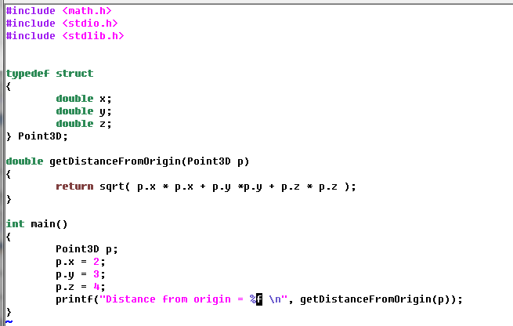

Consider a data structure that holds a three dimensional point in space.
Here this is in C…

Slide 47
This works fine but……
A function that manipulates the data points x,y and z could be written anywhere within the c program.
The object oriented approach is to try and encapsalate x,y and z.
If all a class ever needs to provide is the distance, then the underlying data
x,y and z can be hidden from the rest of the program.
The OO approach is to put the data (x,y and z) and the function that manipulates the
data in the same place (and then hide as much of the data as possible!)

Slide 48
We’ll start our exploration of Java by making equivalent Java code.
Java doesn’t have structs. It has classes.
The code that defines a “Java struct” is called a class.
The data of a “Java struct” once it is in memory is called an object…
Here c is putting the allocated struct onto the stack.
In Java all objects are allocated on the heap
So there is no strict equivalent in Java to this C code…

Slide 49
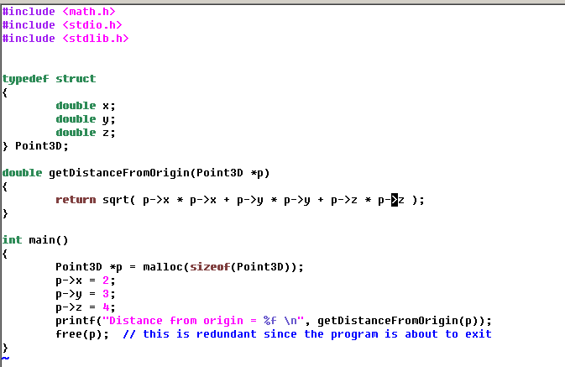
So let’s make a heap version in C….
p
Point3D
double x (undefined)
double y (undefined)
double z (undefined)
C allocates enough room for 1 Point3D object on the heap and returns a pointer to that memory

Slide 50
So let’s make a heap version in C….
p
Point3D
double x=2
double y (undefined)
double z (undefined)
We use that pointer to give values to the data in the struct

Slide 51
So let’s make a heap version in C….
p
Point3D
double x=2
double y=3
double z (undefined)
We use that pointer to give values to the data in the struct

Slide 52
So let’s make a heap version in C….
p
Point3D
double x=2
double y=3
double z=4
We use that pointer to give values to the data in the struct

Slide 53
So let’s make a heap version in C….
p
Point3D
double x=2
double y=3
double z=4
When we are done with p, we must manually free it or risk memory leaks
(in this case it doesn’t matter because the program will exit anyway)

Slide 54
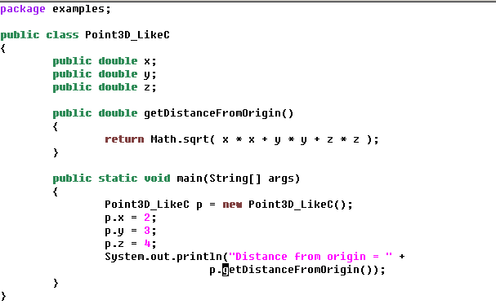
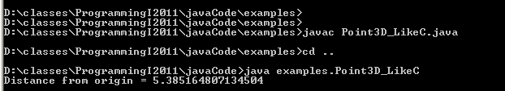
Here finally, is the Java…
(although as we will see, this code is not in the “Java style”)

Slide 55
Java
C
We can lose the annoying #includes in Java.
But we (optionally) can declare our class to be in a package.
Because the name of the class is examples.Point3D_LikeC
this helps to avoid namespace conflicts.
Technically, the package should be called something like
edu.uncc.fodorProgramming.examples so there would be zero chance of a namespace conflict.
This way a single VM could safely load programs from many people..

Slide 56
Java
C
These are the data in the class.
They define the “state” of our object in Java.
The public means any program in the Java VM can modify these data.
This is the way C structs work, but goes against the philosophy of Java,
which says that the data should be as much as possible encapsulated
(that is hidden from the rest of the program).
(Much more on that later!)

Slide 57
Java
C
The functions works the same, but with one crucial difference.
In C, we have to pass the pointer to the function.
In Java, the function is part of the class.
The function works on the data from the object on which it was invoked..
(We will see later that the pointer is still there, but is called this )

Slide 58
Java
C
p
Point3D
Point3D
Double x
Double y
Double z
Double x
Double y
Double z
p
getDistanceFromOrigin()
getDistanceFromOrigin(Point3D* p)
In C the function getDistanceFromOrigin()
is defined outside the struct,
so you must pass a pointer to the struct
you want the function to work on…
In Java, the function getDistanceFromOrigin()
Is defined inside the class.
It works on the data of the object from which
it was invoked. No need to pass the reference.

Slide 59
Java
C
p
In C, space is allocated with malloc and
a pointer is returned to the newly allocated
space.
In Java, space is allocated with the new operator.
A reference is returned to the newly created object.

Slide 60
Java
C
p
The method
getDistanceFromOrigin(Point3D* p)
is defined outside the struct.
It must be passed a pointer to the
appropriate struct…
The method getDistanceFromOrigin() is
invoked through the object p.
The function works on the data associated
with the object from which it was invoked…

Slide 61
Java
C
p
No need (or way) to manually free memory in Java.
Once the reference to the object goes out of
scope, the memory consumed by the object
is eligible to be reclaimed by the
garbage collector!
With “p=null”, you can force p to go out of scope,
but you can’t force the garbage collector to free
the memory at any particular point in time!
In C, we must free the memory manually
(although not important here because
the program is about to end).

Slide 62
Next time:
if, for and while in Java.
variables in Java.
After that:
More on Java’s object oriented approach.
Reading: Start to read your introductory Java book of choice.

