Slide 1
21 patients have cancer (case)
Of the patients that have cancer, 14 have the E. Coli infection
24 patients do not have cancer (control)
Of the patients that don’t have cancer, 5 have the E. Coli infection
(1) Make a 2 * 2 contingency table (consider case/control as cancer/non-cancer)
(2) What is the odds ratio for people with the infection vs. people without the infection?
(3) What is the risk ratio for people with the infection vs. people without the infection?
(4) Is this a case where you would expect the odds ratio and the risk ratio to be
approximately the same. Why or why not?
(This is real data from one of my papers:
http://www.sciencemag.org/content/sci/338/6103/120.full.html;
Fig. 3)

Slide 2
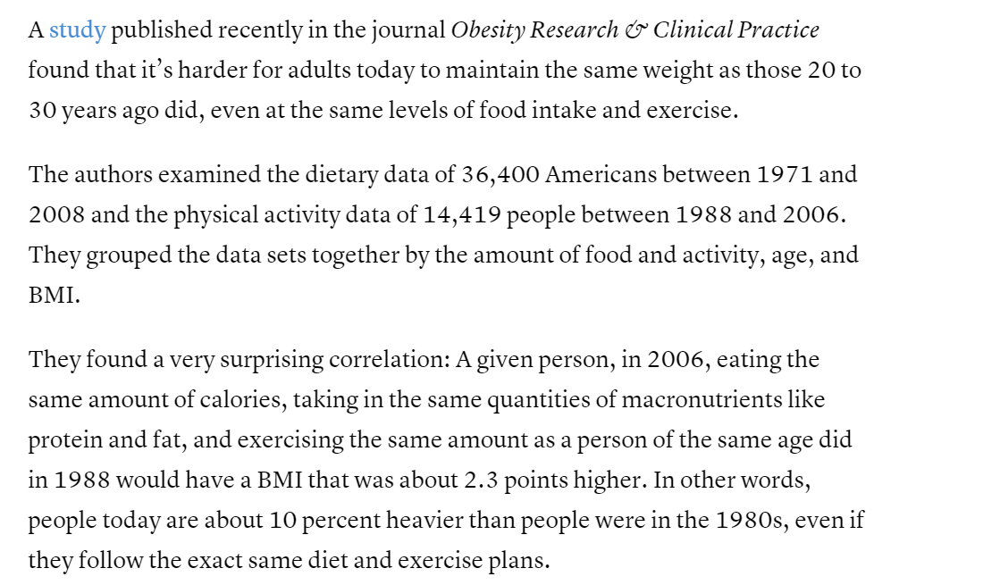
http://www.theatlantic.com/health/archive/2015/09/why-it-was-easier-to-be-skinny-in-the-1980s/407974/

