Slide 1
Contrasting the Frequentist and Bayesian inference for the binomial distribution
Numerical Approaches: The Metropolis algorithm
Numerical Approaches: Grid approximation

Slide 2
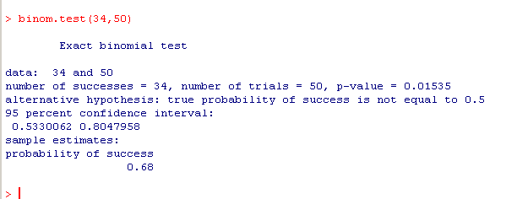
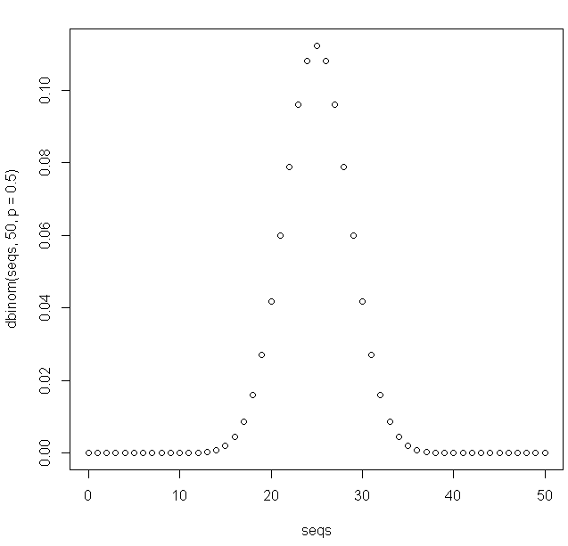
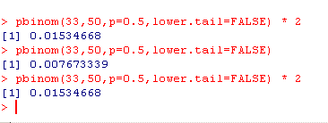
I have a coin and observe 34 heads out of 50 flips.
What is the probability that the coin is fair…
The “frequentist” (cannonical) hypothesis test
For our symmetrical PDF, twice the area
from 34 to 50

Slide 3
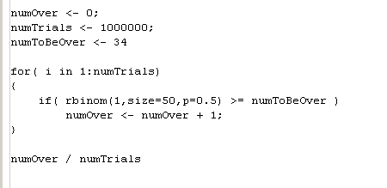

Philosophically, we think of p= 0.5 as a “fixed parameter”.
Given every possible experiment that we can do, how many times will we see
a result as or more extreme than the result we have…
In code…
Out of all the possible outcomes, what is the chance of the particular outcome that we saw?

Slide 4
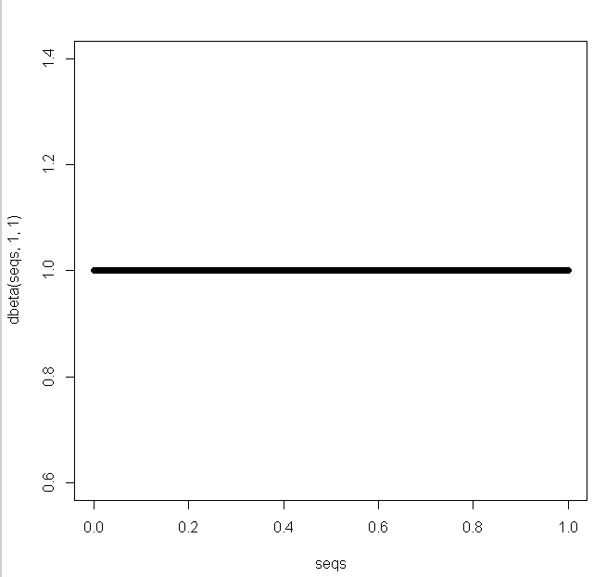
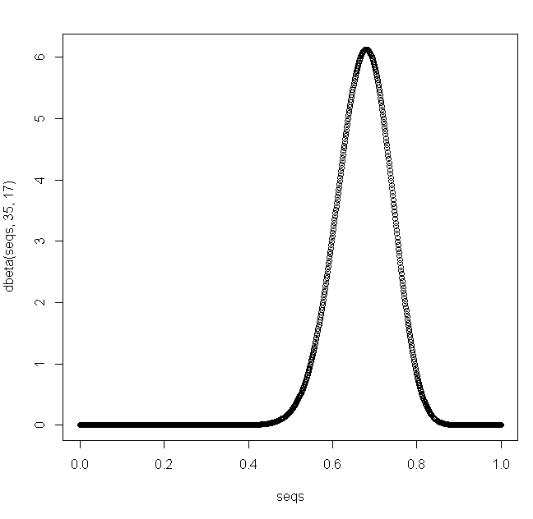

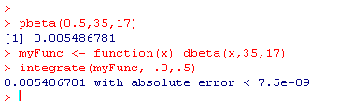
The Bayesian perspective turns this around….
We calculate the p(∏|data) which is given by the beta where alpha and beta
are the sum of our observations plus the initial settings of alpha and beta from the prior.
If we start with a uniform prior (alpha=1, beta=1)…
Then we see 34 successes (heads) and 16 failures (tails)
Now our beta distribution is alpha=35, beta=17
For a one sided-test, what area of
the probability curve is p <0.5?

Slide 5
Frequentist: Out of all the possible experiments you could have done, what fraction
had at least 34 heads? Around 0.007
Bayesian: Given that we observed 34 heads and 16 tails with a uniform
prior, how much of the area of p(∏|data) fell to the left of our assumption
of a fair coin? Around 0.005
Mathematically: These numbers are not that far apart.
Conceptually: It is a long argument in the literature.
My sense is that the math matters more than the concepts and
these two approaches are not in fact that far apart.
Put another way, there is so much noise in biology that there is
essentially no real difference between these calculations…
However, the Bayesian approach might reject the whole idea of a threshold
(e.g. p<0.05). They might say the posterior is our whole knowledge.
You will have to decide for yourself. I tend to lean towards the frequentist position..

Slide 6
Contrasting the Frequentist and Bayesian inference for the binomial distribution
Numerical Approaches: The Metropolis algorithm
Numerical Approaches: Grid approximation
HW #2

Slide 7
Let’s say I have this situation:
p(∏ | Y_{new} ) = p(∏) * p(Y_{new} | ∏ )
p(∏) is defined by beta(10,10) – nine heads and tails
The new data is 14 heads and 10 tails. (Defined by the binomial)
Let’s say that I don’t know how to do the integral (i.e. I don’t know the update rule)
(This will often be true when we are not using conjugate priors).
I can use the Metropolis algorithm to sample the posterior numerically
to approximate the posterior without solving the integral!

Slide 8
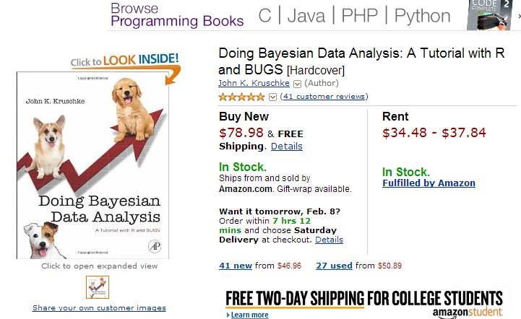
I am getting the logic (but not the code) from Chapter 7 of

Slide 9
Here is (a version) of the algorithm.
Choose some initial value of ∏_{old} ( we’ll choose 0.5)
Calculate p_{old} = p( frequency * prior ) for ∏ _{old}.
Propose a move to adjust ∏. (We will use a normal distribution for proposed moves)
So for example,
∏ _{new} = ∏ _{old} + rnorm(mean=0,sd=0.01)
∏ _{new =} max(∏ _{new} ,1)
∏ _{new =} min(∏ _{new} ,0)
Calculate p_{new} = p( frequency * prior ) for the new value of ∏.
if ( p_{new} >= p_{old}) accept the move;
Otherwise if (p_{new} / p_{old} > runif(1) ) accept the move;
If we have accepted the move, set ∏ _{old} = ∏ _{new}
Record ∏ _{old}
Repeat the move a bunch of times.
If we have chosen our moves from an appropriate distribution and done enough moves,
the distribution of ∏ _{old} values will be proportional to the posterior distribution!

Slide 10
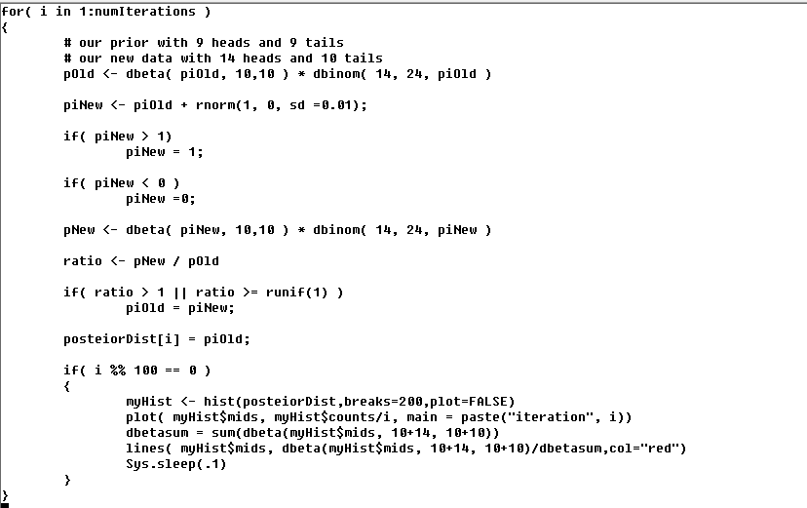
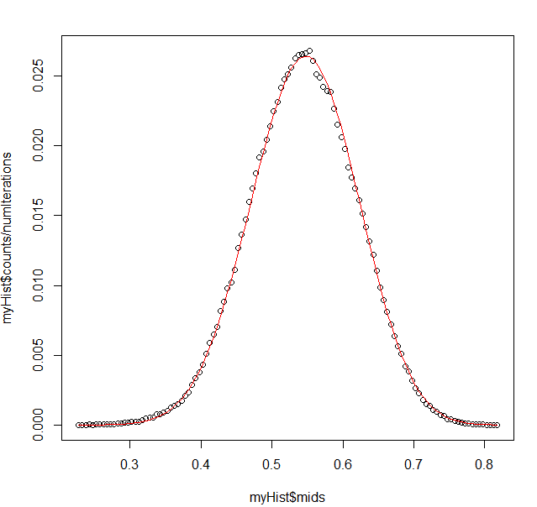
We can watch our model “walk towards” the posterior in real-time
Compare the analytical (update rule) with the numerical…
https://github.com/afodor/metagenomicsTools/blob/master/src/metropolitan/metropolitanBetaExample

Slide 11
Why does this work?
We
We again follow the logic in Chapter 7 here…

Slide 12
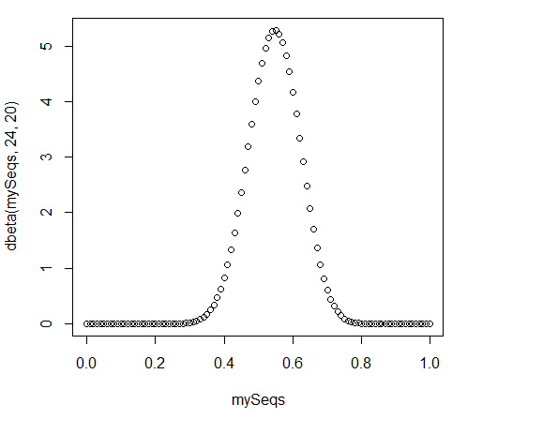
mySeqs <- seq(0,1,.01)
> plot(mySeqs,dbeta(mySeqs, 24,20))
Here is the curve that represents our poterior probability
Our current state is θ
We are considering a
move to θ + 1
P(θ) is the value of the PDF at θ
P(θ+1) is the value of the PDF at θ+1

Slide 13
Let’s call (note the lowercase p…)
p(θ -> θ+1) the probability that we accept a move from θ to θ+1
p(θ+1 -> θ) the probability that we accept a move from θ+1 to θ
Our current state is θ
We are considering a
move to θ + 1
P(θ) is the value of the PDF at θ
P(θ+1) is the value of the PDF at θ+1
(note the uppercase P)

Slide 14
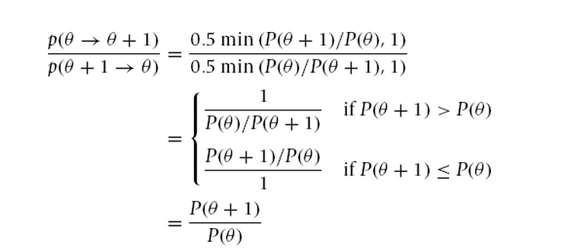
p(θ -> θ+1) = 0.5 * min( P(θ+1)/P(θ),1)
Because we might have
gone to θ-1 instead
(although this will cancel out in a bit…)
From the definition of the
Metropolis algorithm
Likewise…..
p(θ+1 -> θ) = 0.5 * min( P(θ)/P(θ+1),1)
So if we take the ratio of the two transition probabilities

Slide 15
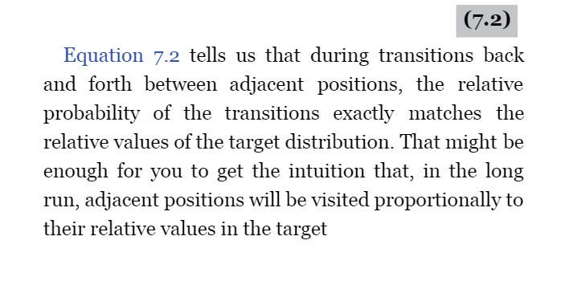

Slide 16
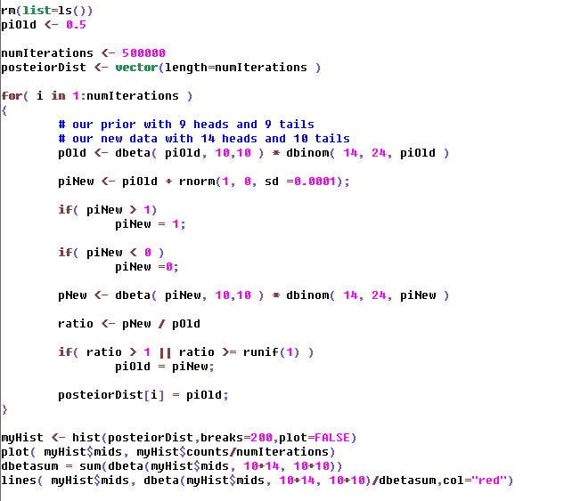
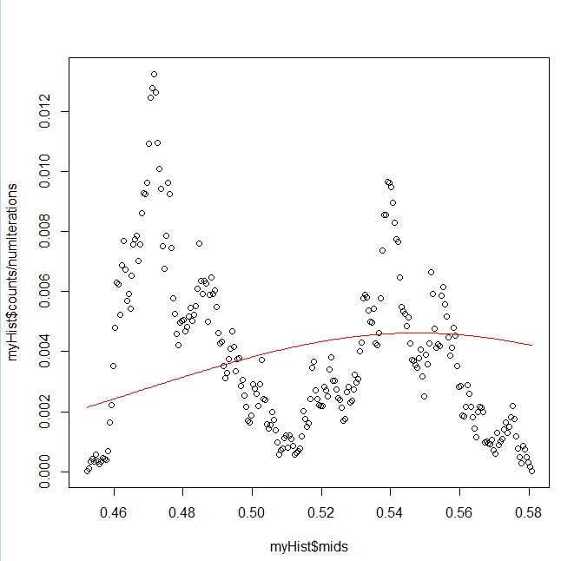
However this is not necessarily easy….
Change the step size
Trying to explore all of North America with random steps of a millimeter at a time..
Not going to work…
Our model get caught up in noise, non-reproducible local minimas and gets confused

Slide 17
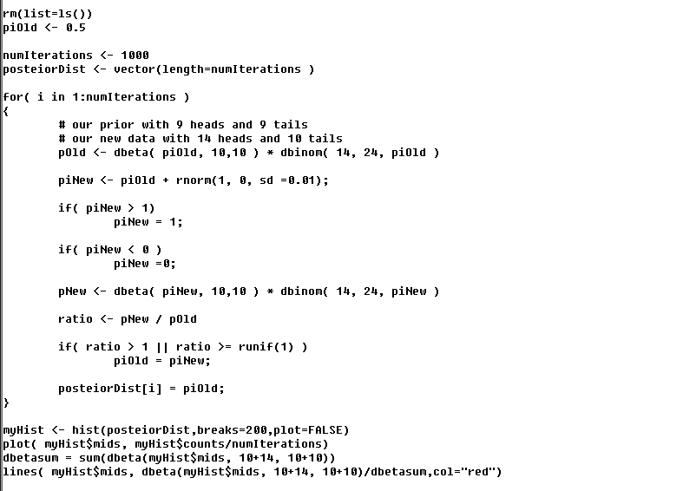
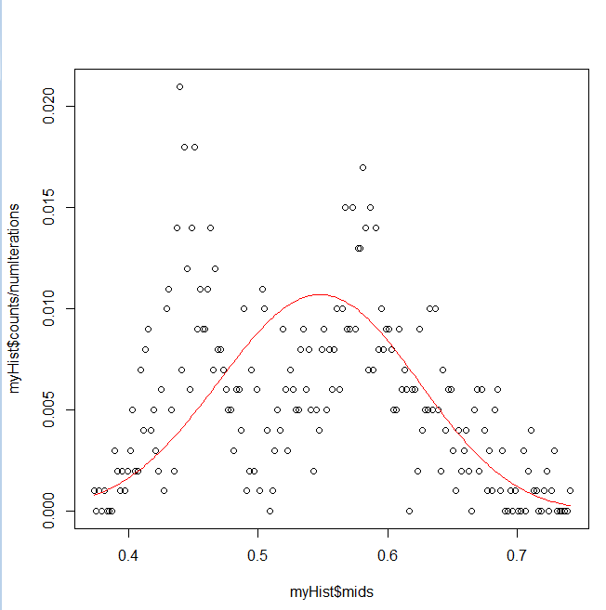
Change the number of steps
Haven’t sampled adequately…

Slide 18
“Local mimima” is the big problem…
(but not a problem for a simple distribution like a beta posterior where there are no local minima!)

Slide 19
The Metropolis algorithm is one of (many) Monte Carlo Markov Chain algorithms
Monte Carlo because it involves chance (in our “random walk”)
Markov Chain because we can consider transitions between states
θ and θ+1 with no memory of how we get to each state…
This is a first-order Markov process
This algorithm will be calculable on any prior and likelihood.
Whether it will actually converge to a useful answer
in a reasonable amount of time is harder to know..

Slide 20
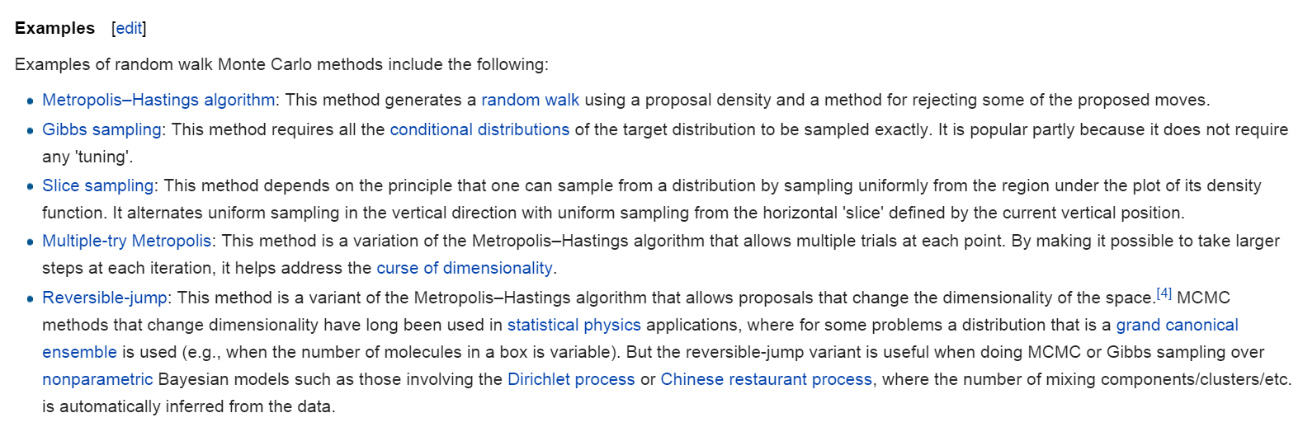
http://en.wikipedia.org/wiki/Markov_chain_Monte_Carlo

Slide 21
Contrasting the Frequentist and Bayesian inference for the binomial distribution
Numerical Approaches: The Metropolis algorithm
Numerical Approaches: Grid approximation

Slide 22
Let’s say I have this situation:
p(∏ | Y_{new} ) = p(∏) * p(Y_{new} | ∏ )
p(∏) is defined by beta(10,10) – nine heads and tails
The new data is 14 heads and 10 tails. (Defined by the binomial)
Let’s say that I don’t know how to do the integral (i.e. I don’t know the update rule)
(This will often be true when we are not using conjugate priors).
We can also use grid approximation to get the same answer…

Slide 23
I am getting the logic (but not the code) from Chapter 6 of

Slide 24
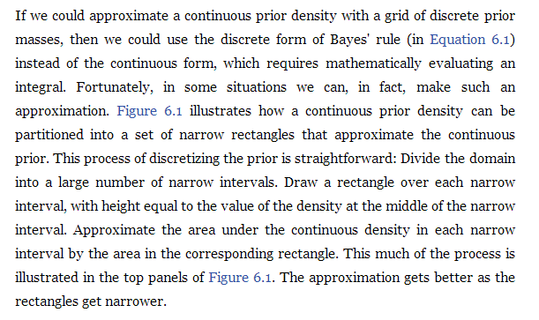
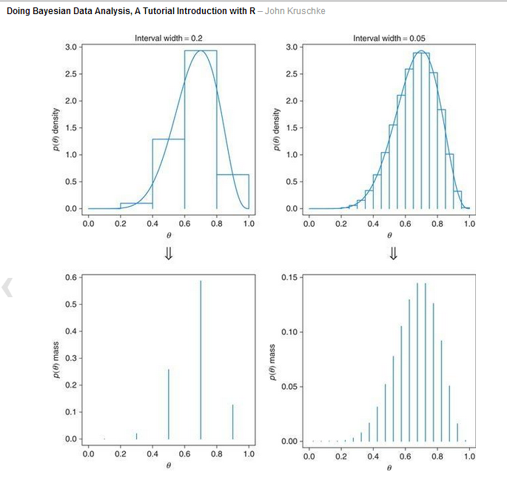

Slide 25
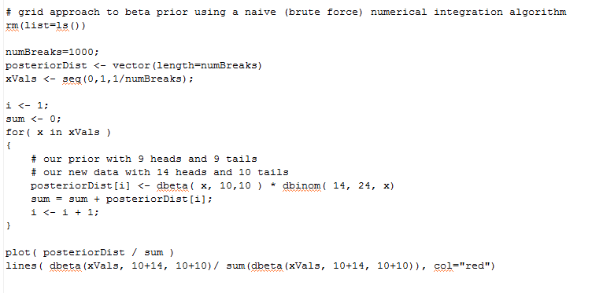
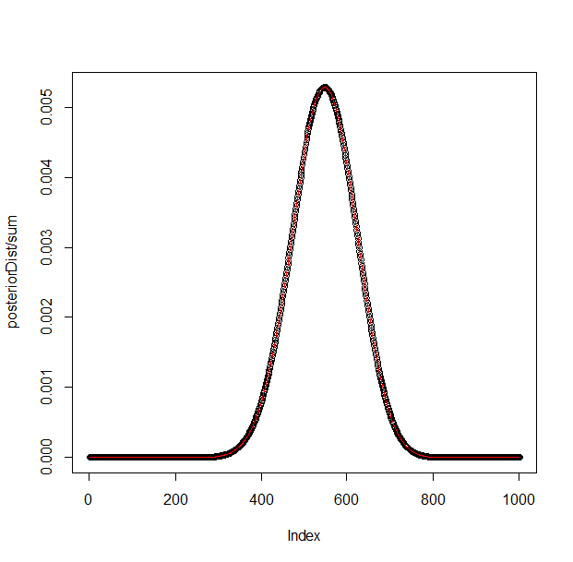
A naïve implementation is easy (and in this easy case accurate)
p(∏ | Y_{new} ) = p(∏) * p(Y_{new} | ∏ )
https://github.com/afodor/metagenomicsTools/blob/master/src/metropolitan/gridBetaExample

Slide 26
Why use monte carlo? Why not just use grid approximations to skip the integral?
For multi-dimensional datasets, one problem is the “curse of dimensionality”
If there are 10 variables in our prior * posterior, we would have to explore
a 10 dimensional space to use grid approximation!
This is usually too slow to be practical!
For mutli-dimensional models, we can’t evaluate the entire space…

Slide 27
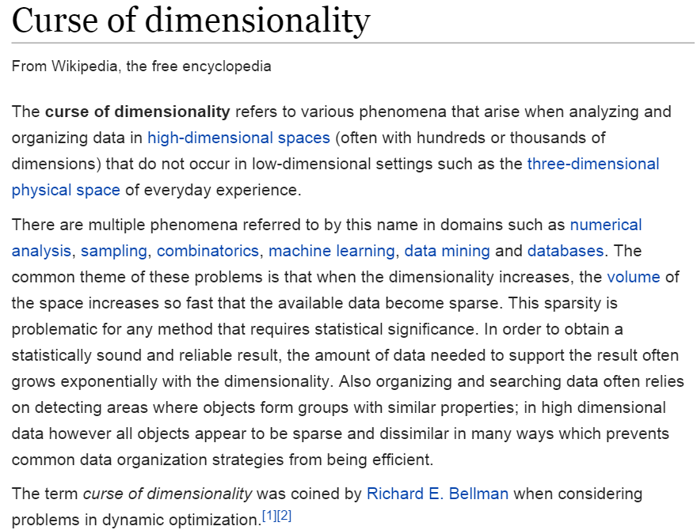
http://en.wikipedia.org/wiki/Curse_of_dimensionality

Slide 28
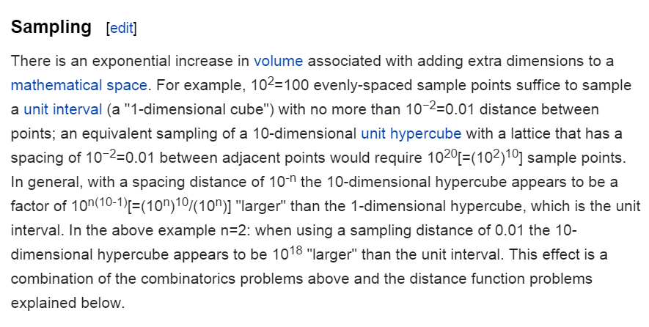
http://en.wikipedia.org/wiki/Curse_of_dimensionality

Slide 29
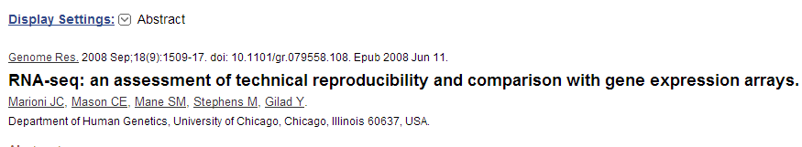
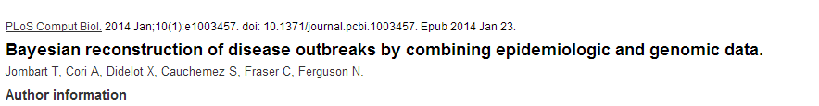
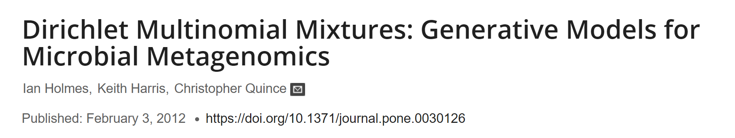
Papers we will (briefly) visit:
Use of the hyper-geometric distribution in classical inference to check for a lane
effect in RNA-seq..
http://genome.cshlp.org/cgi/pmidlookup?view=long&pmid=18550803
The Metropolitan algorithm applied to a Poisson distribution modeling changes in microbial genomes…
http://dx.plos.org/10.1371/journal.pcbi.1003457
Modeling the outcomes of sequence experiments with the Dirichlet distribution

