Slide 1
Visualizing and building statistical models on multivariate data in R
Anthony Fodor
Bioinformatics and Genomics
UNC Charlotte
http://afodor.github.io/classes/ChapelHill2018/ch.pptx

Slide 2

If you are following along with our datasets…
We will be using the data from this paper…
https://microbiomejournal.biomedcentral.com/articles/10.1186/s40168-017-0338-7

Slide 3
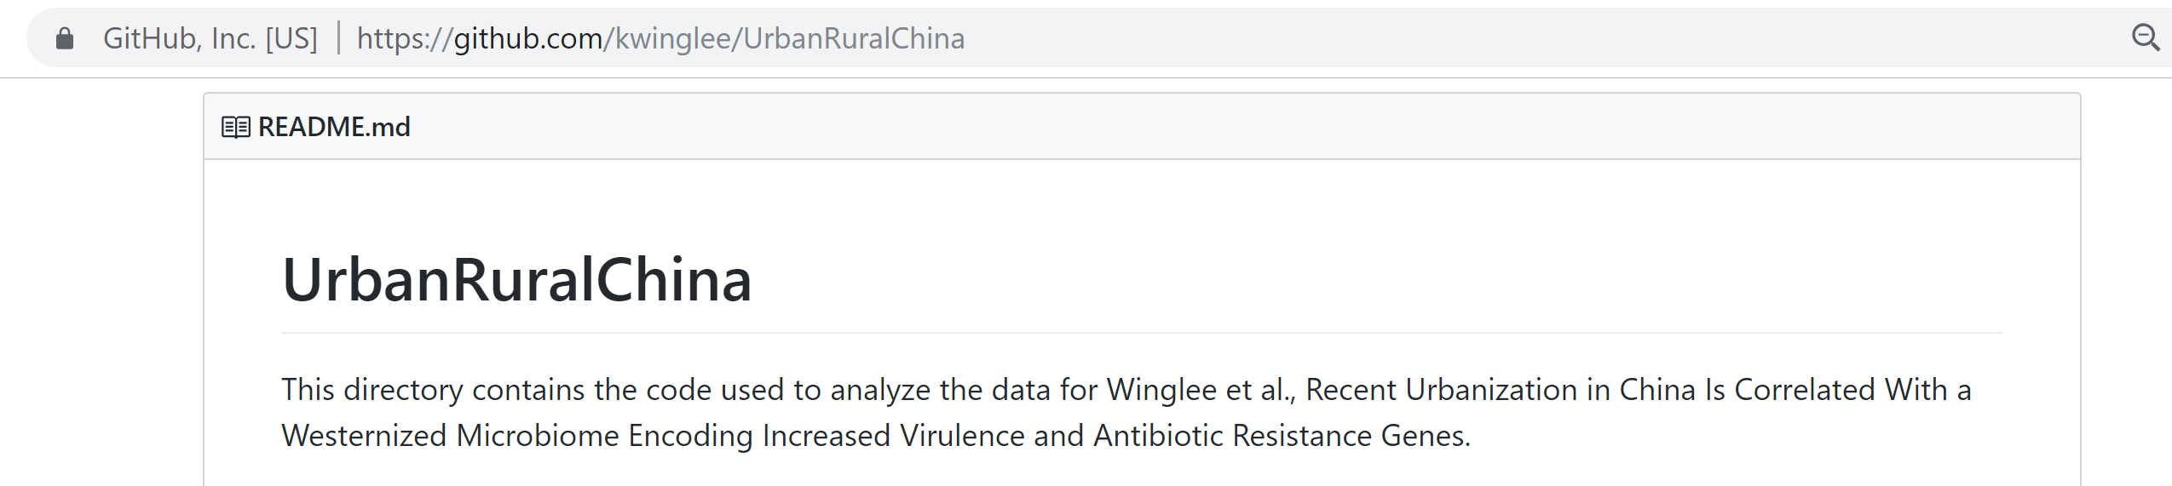

Tables and r-scripts were nicely organized by Kathryn Winglee (now of the CDC in Atlanta)
https://github.com/kwinglee/UrbanRuralChina

Slide 4
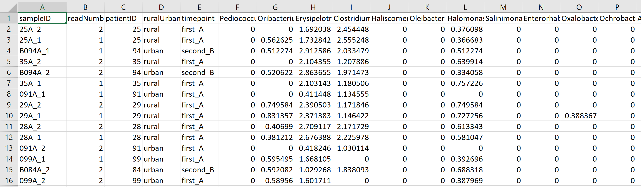
We will use this spreadsheet as our base input into R…
https://github.com/kwinglee/UrbanRuralChina/blob/master/16SrRNA/inputData/RDP/genus_taxaAsColumnsLogNorm_WithMetadata.txt

Slide 5
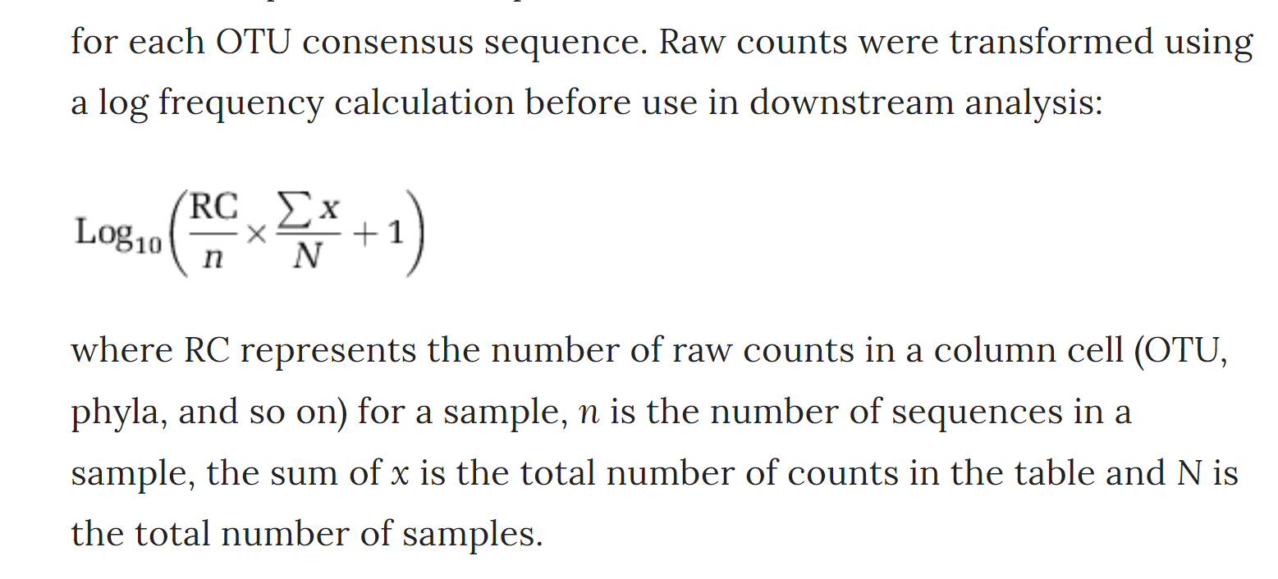
This spreadsheet has the following features:
The taxa are columns; the rows are samples
The metadata (urban vs. rural, timepoint) are in the same spreadsheet as the relative abundance
The counts are log-normalized according to the following formula
https://www.nature.com/articles/ismej2013106

Slide 6
If you have your own dataset…
We can work with you to get your data into the same format
(or to modify your R code to work with your table!)

Slide 7
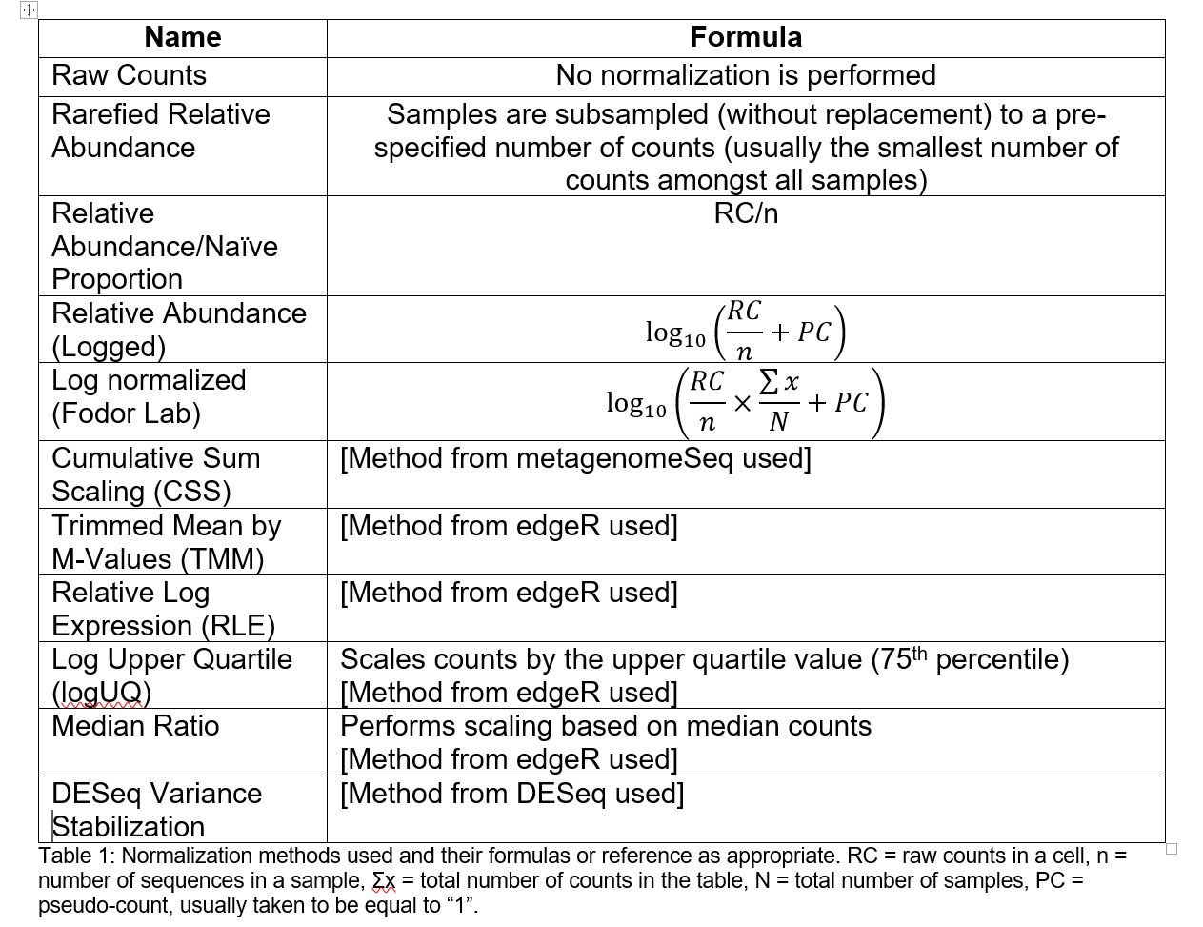
You will need to choose some normalization scheme..
(Each sequence library will be of a different depth; you need to correct for that)
The easiest (not necessarily the best) approach is to divide each cell by the total # of sequences in that sample.
This is relative abundance
Table due to :Matthew C. B. Tsilimigras (Matthew C. Brown)

Slide 8
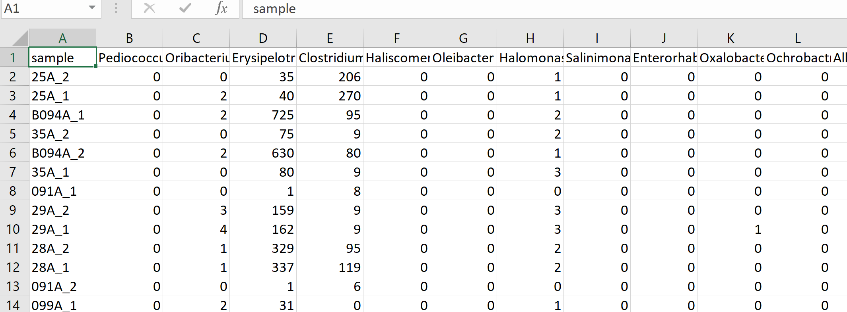
Let’s say you have a spreadsheet that is un-normalized and you want to change it to log relative abundance
https://github.com/kwinglee/UrbanRuralChina/blob/master/16SrRNA/inputData/RDP/genus_taxaAsColumns.txt
sweep(Y, 1, rowSums(Y), '/')

