Slide 1
The hypergeometric distribution/ Fisher exact test
Using the hypergeometric distribution to ask if there is a lane effect for RNA-seq
The Poisson distribution
The Poisson distribution and rnaSeq

Slide 2
The binomial distribution samples with replacement.
Flipping a coin does not change the probability of the next flip.
There are so many pairs of residues in the protein that we
(correctly or incorrectly) treat them as independent..
The background death rate of the disease is not affected by our study.

Slide 3
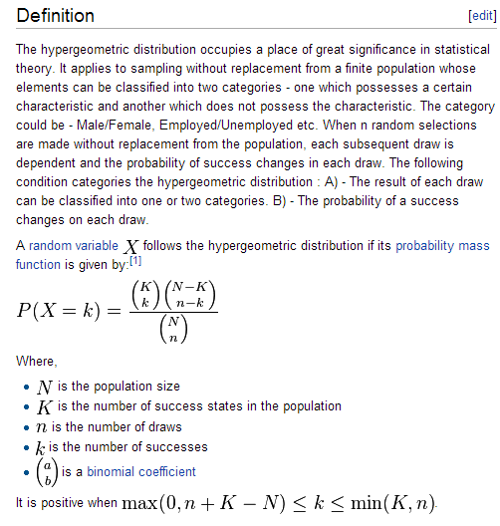
The hypergeometric distribution samples without replacement.
I have a deck of 60 cards and 20 of them are marked.
I draw 7. What is the probability that I will draw X marked cards.
Not exactly dbinom(p=20/60) because if I draw a marked card, the number of remaining marked cards changes.
From the Wiki:

Slide 4

This is not hard to understand or implement.
I have 60 cards. 20 are marked. I draw 7. What are the odds I have 3 marked?
N=60
K = 20
n = 7
k = 3
How many ways can I draw 3 marked cards * how many ways can I draw 4 unmarked cards
How many ways can I draw any 7 cards

Slide 5
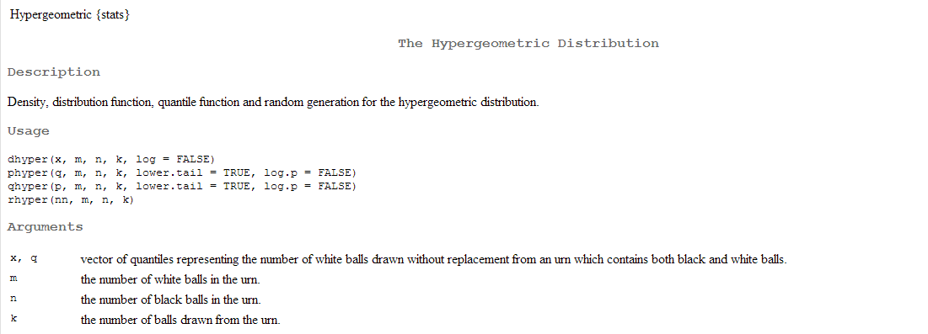
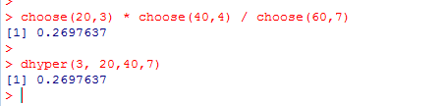
And of course, we have dhyper, phyper, qhyper and rhyper…

Slide 6

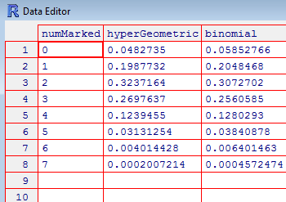
We see that the hypergeometric and binomial test in this case have close to
(but not exactly the same) PDFs..

Slide 7
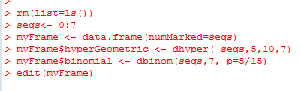
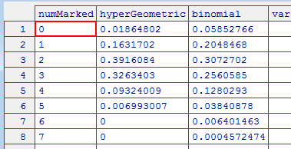
The differences between the hypergeometric and the binomial matter more when
the sample size is smaller (of course)
Here we have 5 marked cards in a deck of 15 for which we draw 7

Slide 8


If you use the hypergeometric distribution for inference, this is called the
Fisher test…
We have a clinical trial…
 | On Drug | Not on Drug
Lived | 13 | 3
Died | 2 | 16
For a one-sided test what are the odds that by chance you could have split
the people who lived with at least 13 on the drug living?
The people who live are “marked”. We drew 13 “marked” people in 15 draws.
There are a total of 16 “marked” people out of 34 people…
dhyper(13,16,18,15) +
# drawn
Number marked
and drawn
# not marked
Total # marked

Slide 9
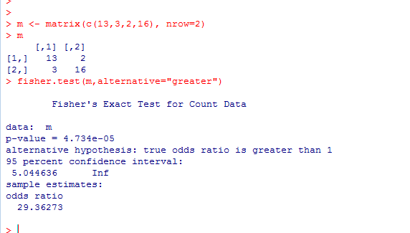
 | On Drug | Not on Drug
Lived | 13 | 3
Died | 2 | 16
Alternatively, you can use Fisher.test but you have to input the matrix…
I find the dyper(…) function easier to think about and use….

Slide 10
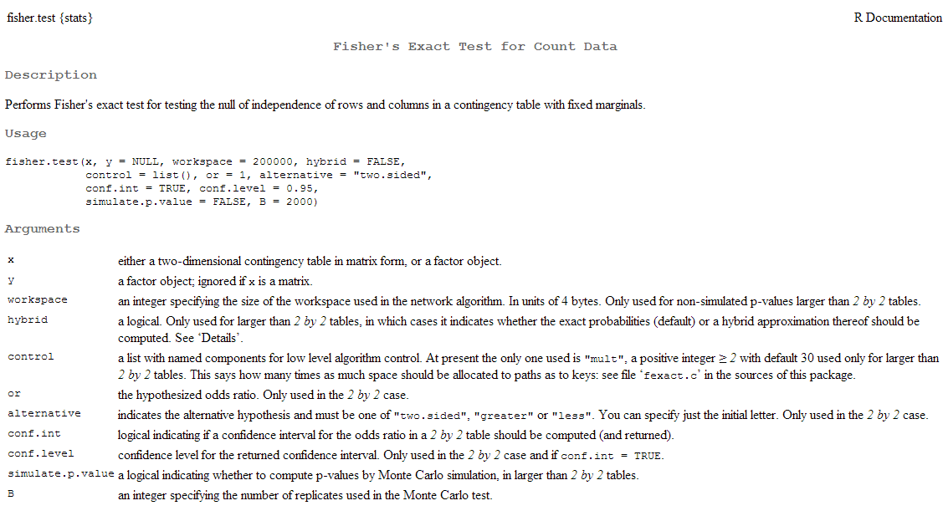
This documentation is tough going…

Slide 11
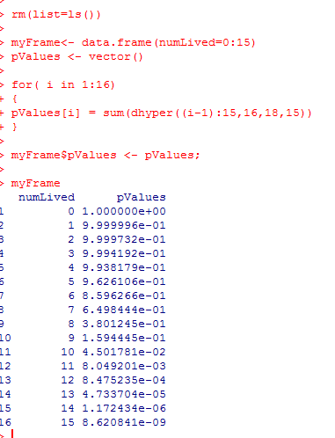
Surprisingly, the Fisher exact test can be conservative.
Because of it’s discrete nature, the only “available” p-values may not line up to 0.05.
You want to test at 0.05, but the test can’t report that.
In this case, it can only report 0.045 so if your “real” p-value is >0.045 but <0.05, the
test will report 0.16.

Slide 12
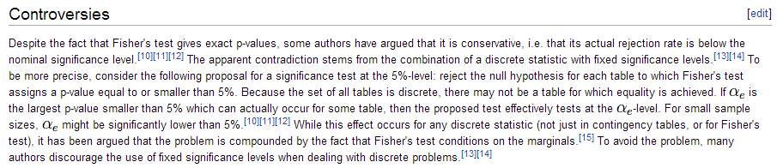
From the Wiki:
You are unlikely to get into trouble with reviewers for using the Fisher exact test, however..

Slide 13
The hypergeometric distribution/ Fisher exact test
Using the hypergeometric distribution to ask if there is a lane effect for RNA-seq
The Poisson distribution
The Poisson distribution and rnaSeq

Slide 14
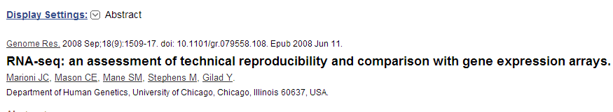
An example of the hypergeometric distribution from the genomics literature:

Slide 15
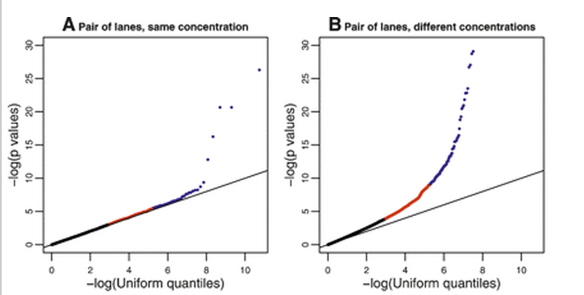
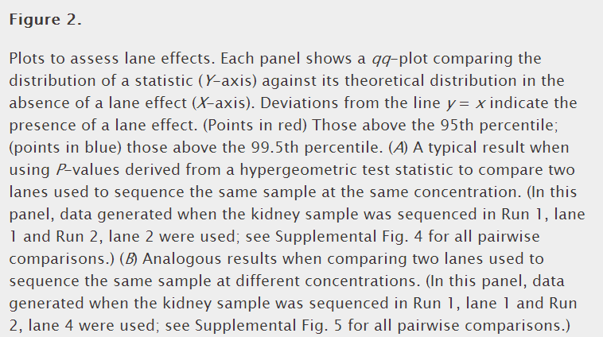
An example of the hypergeometric distribution from the genomics literature:
Is there a lane effect
In RNA-seq experiments?

Slide 16
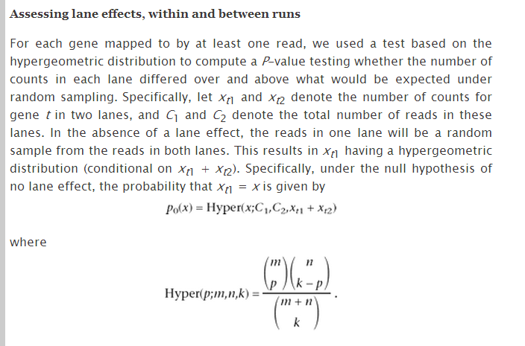
dhyper(x1,x1+x2,C1+C2-(x1+x2),C1)
To put this into R:
# drawn in lane 1
If a read is assigned to a given gene it
is marked – consider….
x1= number of marked reads in lane 1
C1 – number of reads in lane 1
x2= number of marked reads in lane 2
C2 – number reads in lane 2
Number marked
and drawn in
lane #1
# not marked
Total # marked

Slide 17
We can put it in matrix form and then use Fisher.test
x1= number of marked reads in lane 1
C1 – number of reads in lane 1
x2= number of marked reads in lane 2
C2 – number reads in lane 2
 | Lane 1 | Lane 2
From the gene | x1 | x2
Not from the gene | C1-x1 | C2-x2
m <- matrix( c(x1,x2,numReadsLane1-x1,numReadsLane2-x2 ), nrow=2)
pValue <- fisher.test(m)$p.value;

Slide 18
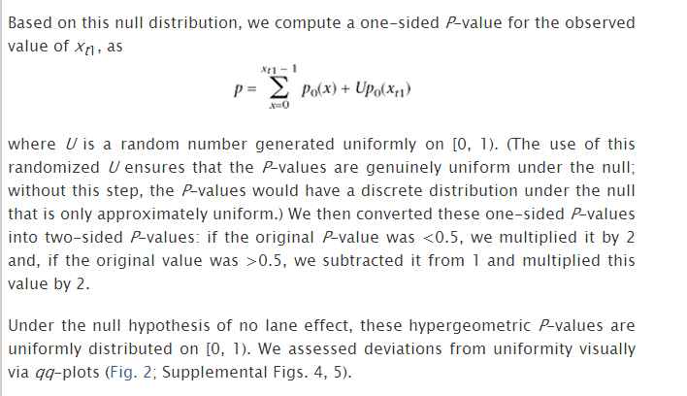
We look in the methods section of the paper for more details……
Add some small # to make up for
the discontinuous nature
Not clear what justifies this #

Slide 19

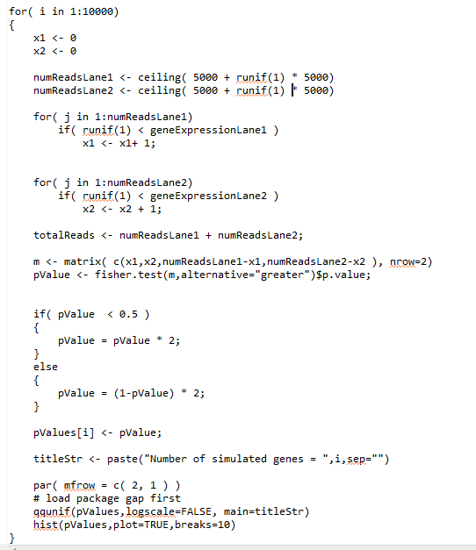
We can run this as a simulation (in this code ignoring the correction for discontinuity)
“ceiling” just rounds up
to an integer
Make this a two-sided test

Slide 20
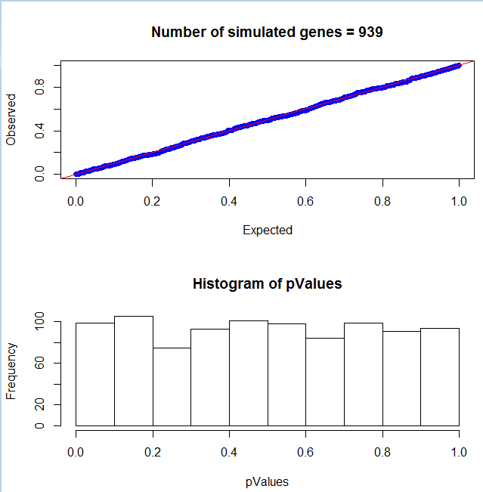
Despite the lack of correction for the conservative nature of the Fisher test, it is reasonably close…

Slide 21

This version is up on the class web site…
http://bigscience.uncc.edu/fodorstatistics2013/hyperSim.txt/view

Slide 22
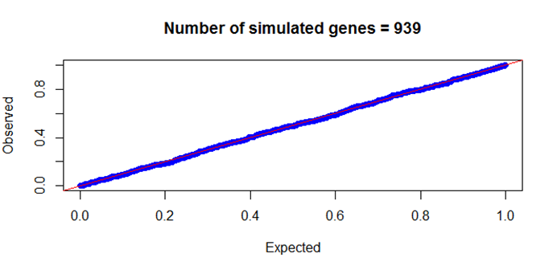
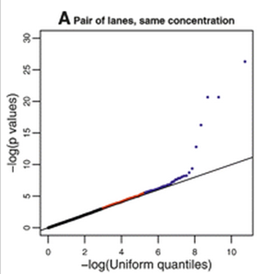
It is interesting to compare our simulation to the real lane data
Clearly the real data does have some artifacts
that effect the distribution of a few genes…

Slide 23

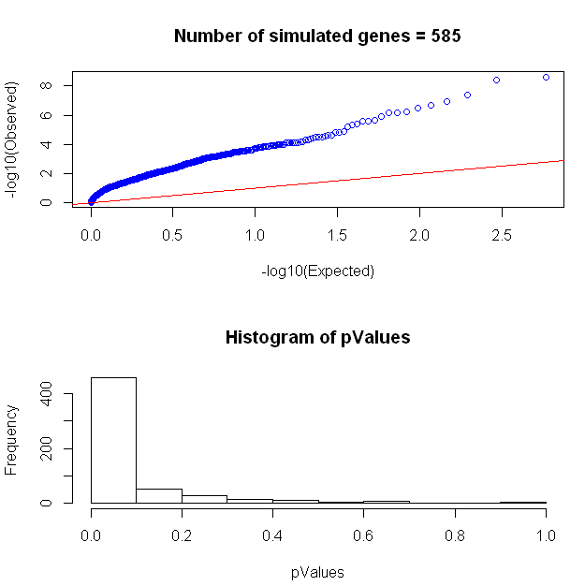
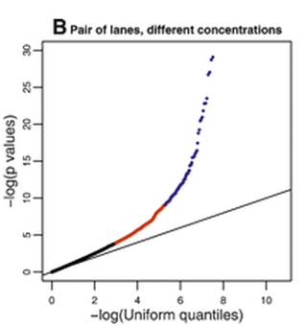
We can simulate a differential expression experiment by having the
true frequency of expression be different…
Null hypotheses
Differential expression
(Maybe the hypergeomteric model here does not describe “real” data)

Slide 24
The hypergeometric distribution/ Fisher exact test
Using the hypergeometric distribution to ask if there is a lane effect for RNA-seq
The Poisson distribution
The Poisson distribution and rnaSeq

Slide 25
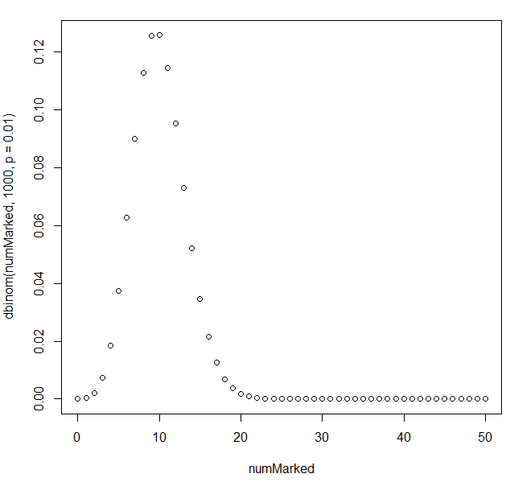

Consider a rare event:
I have a (very large) collection of cards. 1% of them are marked.
I draw 1,000 of the cards.
How many times can I expect to see the cards?
We can show this with dbinom
The expected value = n * p = 1,000 * 0.01 =10

Slide 26
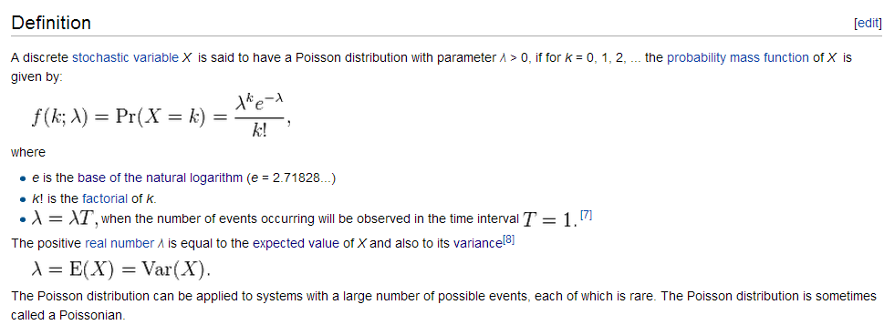
The Poisson distribution is an alternative way of modeling rare events
Here lambda is the expected value ( n * p ) that would occur in n trials.
lambda can also be thought of as the frequency of an event occurring over some set interval of time…
K is the number of successes…
http://en.wikipedia.org/wiki/Poisson_distribution

Slide 27
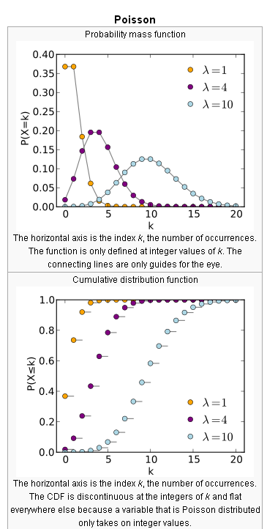
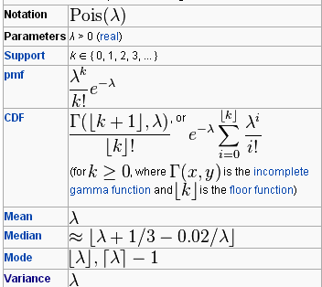
http://en.wikipedia.org/wiki/Poisson_distribution

Slide 28
For the binomial:
mean = np
variance = n * p * (1-p)
For the Poisson, p is small. (1-p) approaches 1 so…
mean = np
variance = n * p = mean
The variance and the mean for the Poisson distribution are equal!

Slide 29

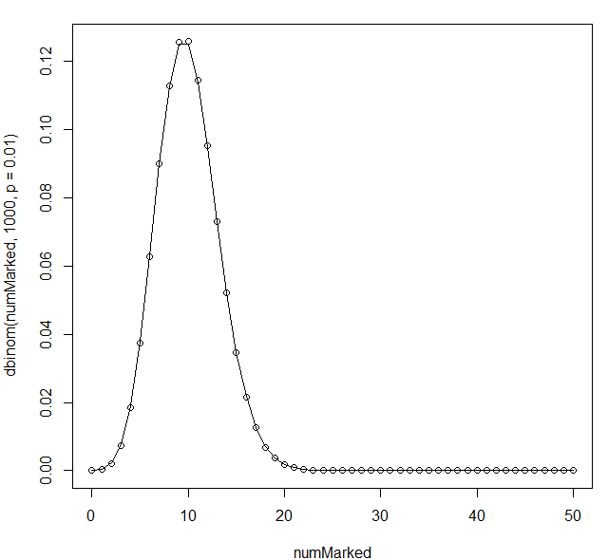
We see that the Poisson distribution nicely approximates the binomial distribution
for a large sample size…
Derivation of the Poisson from the binomial for the limiting case of an infinite # of samples:
http://www.the-idea-shop.com/article/216/deriving-the-poisson-distribution-from-the-binomial

Slide 30
Just as we can use the binomial test for inference, we can use the Poisson test for inference…
Consider an RNA seq experiment (modeled the same way as marked cards):
I have a (small) RNA-seq dataset with 100,000 reads
I have a gene that is expressed 0.1% of the time.
Expected number of reads = p * N = 100,000 * 0.001 = 100
What are the odds that I would see X sequences from this gene?
This is (almost) the same problem as for the cards…

Slide 31

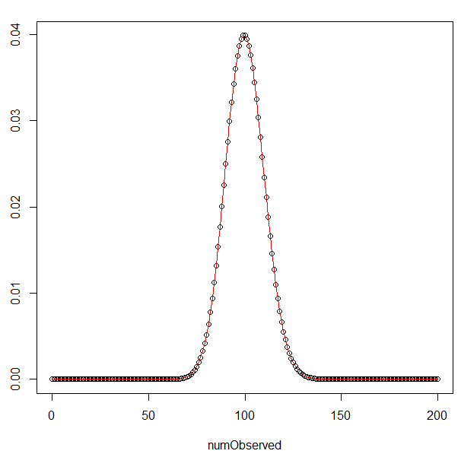
What are the odds that I would see X sequences from this gene?
This is (almost) the same problem as for the cards…
We can do inference in exactly the same
way as the binomial test…
What are the odds that I would see
130 reads if the “true” expression of the
gene was 0.001?

Slide 32
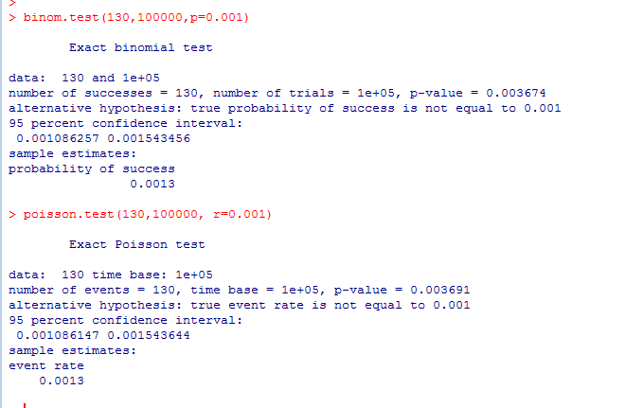
What are the odds that I would see 130 reads if the “true” expression of the gene was 0.001?
The Poisson and binomial tests will give (nearly) identical results in the limiting case of an
infinitely large sample size and small p.

Slide 33
The hypergeometric distribution/ Fisher exact test
Using the hypergeometric distribution to ask if there is a lane effect for RNA-seq
The Poisson distribution
The Poisson distribution and rnaSeq

Slide 34
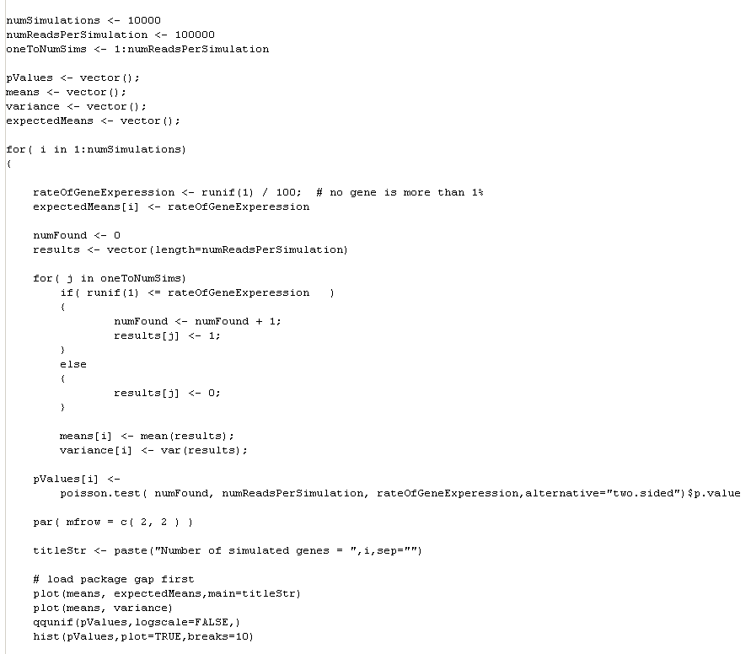
We can use the Poisson distribution to simulate an rna-seq experiment.
We call a success ( a read that belongs to the gene) “1” and a failure “0”.
Then mean = n * p = # of expected successes..

Slide 35
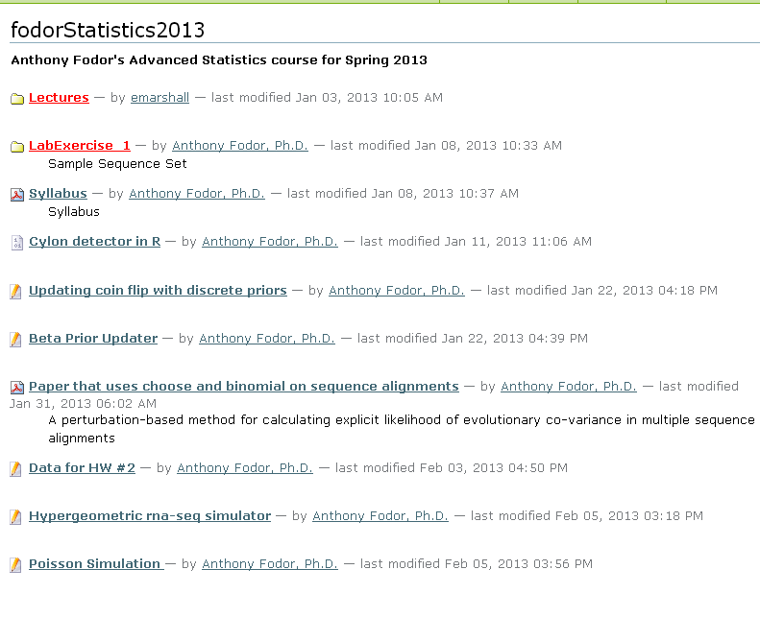
This simulation code is up at the (old) class web site…
http://bigscience.uncc.edu/fodorstatistics2013/PoissonSim.txt/view

Slide 36
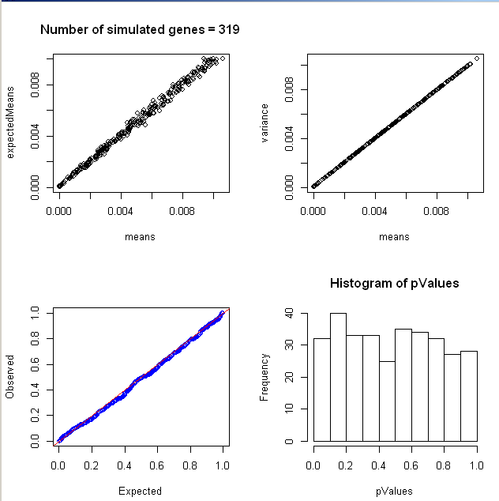
The mean does equal the variance
Our analytical
calculation of
the mean is
correct
The p-values
Generated by
the Poisson test
are uniform for a true null

Slide 37

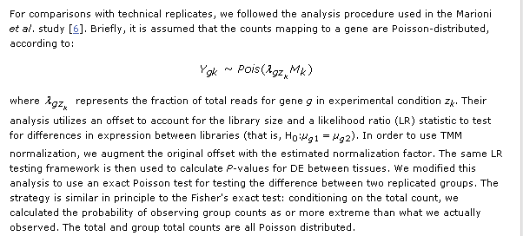
We see this exact Poisson test in use (for example) here…
This is just like the
Fisher test with no
replacement.
(Won’t matter at the
large sample size of the
# of reads in a typical
rna-seq experiment)
Set a p the background frequency observed in one lane.
What are the odds that you will see as many reads in the other lane if the real value was p?

Slide 38
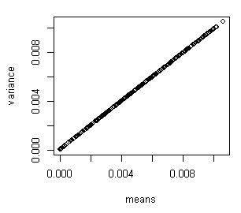
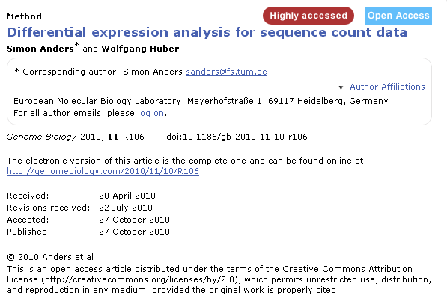
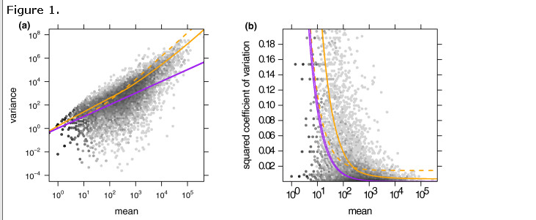
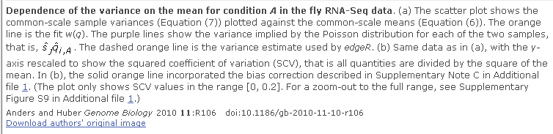
However, when we compare our simulated data to real data…
The mean-variance
relationship predicted
by the Poisson does
not hold!
Lack of independence

Slide 39

Next time:
The negative binomial distribution.
A “real” example of a MCMC walk.
Please look at this paper…
http://www.ploscompbiol.org/article/info%3Adoi%2F10.1371%2Fjournal.pcbi.1003457;jsessionid=1542C917D52714E6043BD1567B416164

