Slide 1
Basic UNIX commands
Logging into the cluster
Submitting jobs
Building Java code

Slide 2
You need to have UNIX on your client to interact with the cluster.
OS X and LINUX – should already be there.
For Windows users, I’ve been using cygwin (and will show instructions here )
Another option: Windows new BASH shell (but I haven’t tried this…)

Slide 3
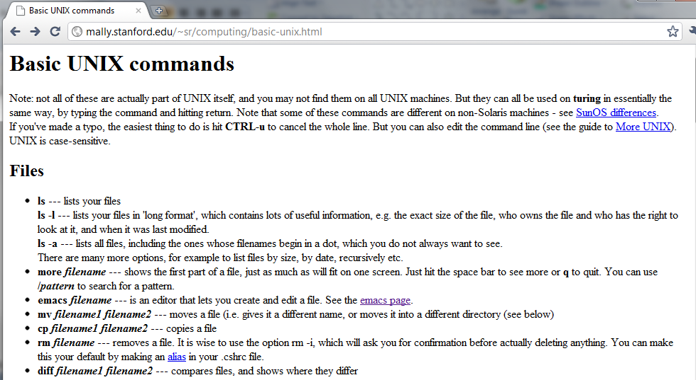
You don’t really need a book for UNIX
(although there are a lot of good ones).
Some time with a cheat sheet is helpful.
For example:
http://mally.stanford.edu/~sr/computing/basic-unix.html

Slide 4
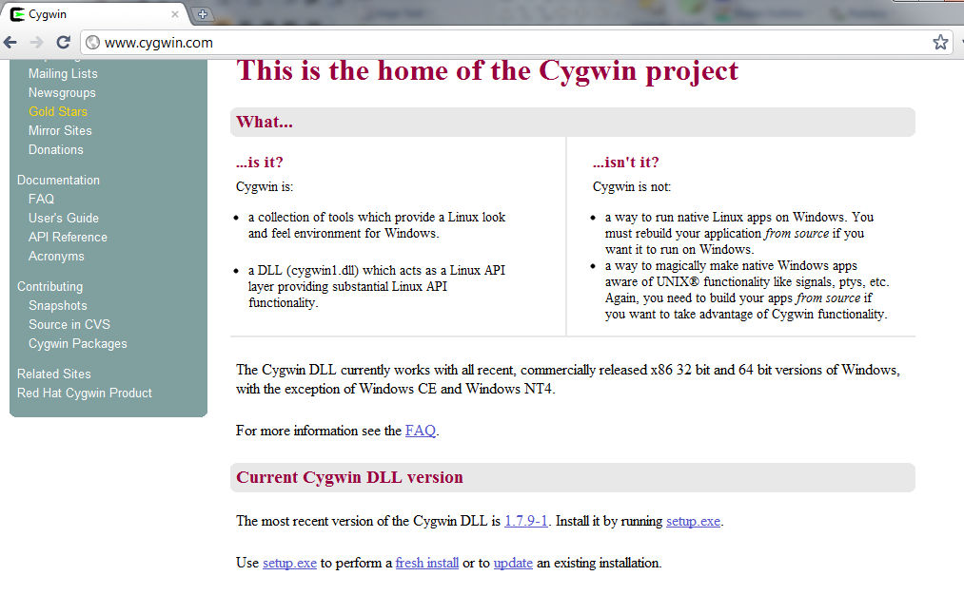
Follow the instructions to install cygwin..

Slide 5
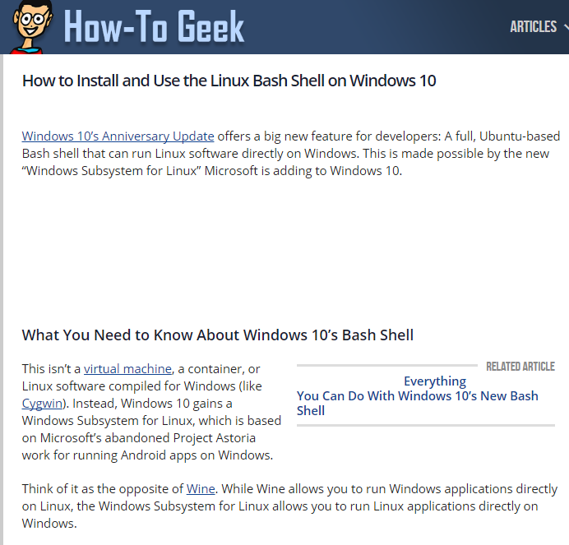
Or you can try the new UNIX package from Microsoft (not sure how well this work but you can always try…)
http://www.howtogeek.com/249966/how-to-install-and-use-the-linux-bash-shell-on-windows-10/

Slide 6
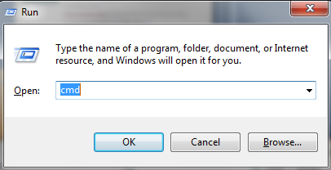
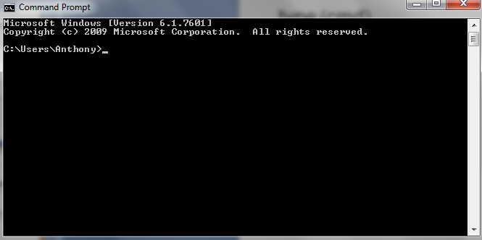
Once cygwin is installed, open up a DOS box
Hit start-r (for “run”)
type (cmd)

Slide 7
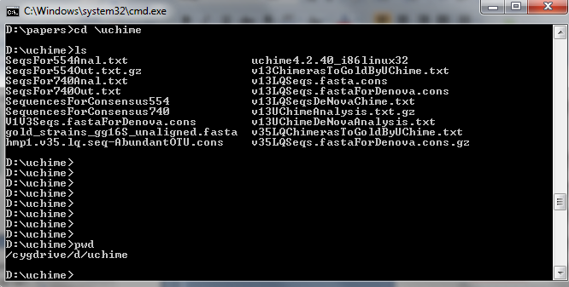
And we are ready for our first set of UNIX commands:
ls – lists the contents of the current directory
pwd – prints the current directory
more – limits the output to one screen at a time
“|” – routes the output of one command to the next
mkdir - makes a directory
cd – changes directory

Slide 8
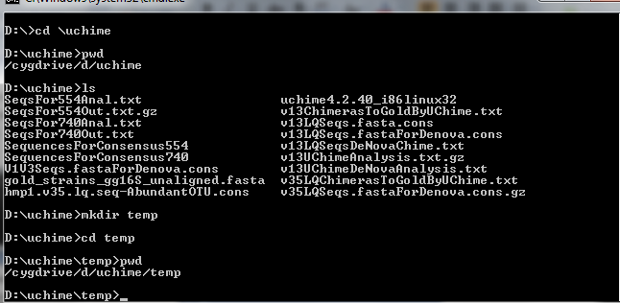
So let’s look at a series of commands
“cd \uchime” – The “\” on windows means the top directory
for that hard drive.
This will be “/” on LINUX/OS-X

Slide 9
“pwd” – print working directory
cygwin has a hack where it translates windows
naming “D:” into a UNIX name:
/cygwin/d (notice the forward slashes!)

Slide 10
“ls” – list the files that are in the directory
(if there are too many for one screen, try “ls | more” )

Slide 11
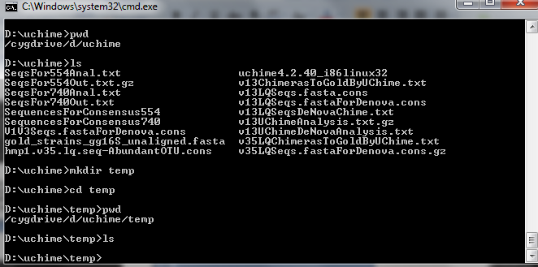
“mkdir temp” – makes a directory called “temp”
“cd temp”- change to our new directory
pwd - tell us where we are
ls – our new directory is empty (of course)

Slide 12
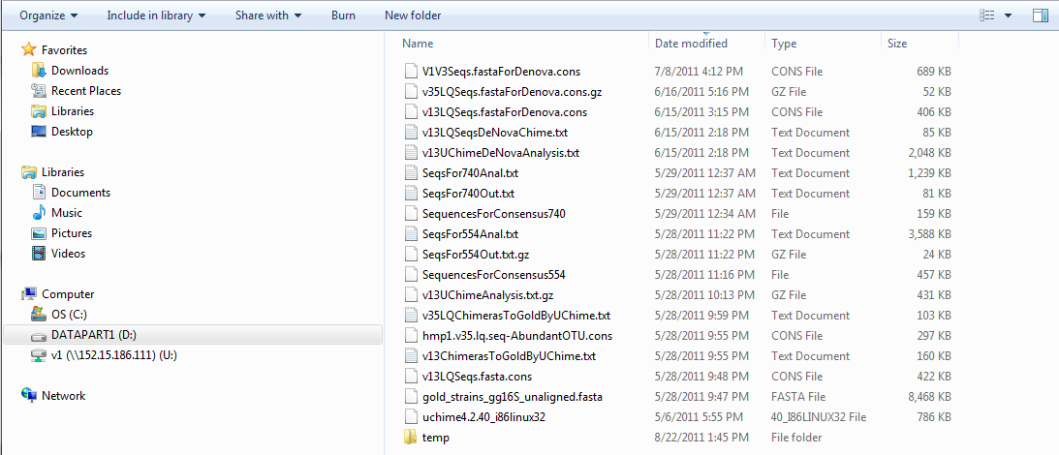
What I do on the command line has impact on the
GUI view of my directory

Slide 13
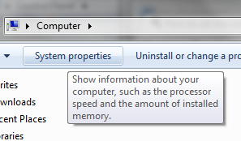
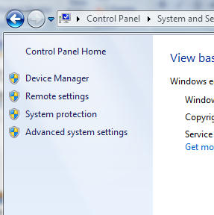
If the UNIX commands don’t work, you may need to adjust
your PATH variable.

Slide 14
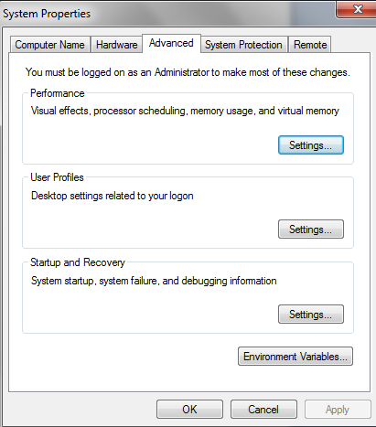
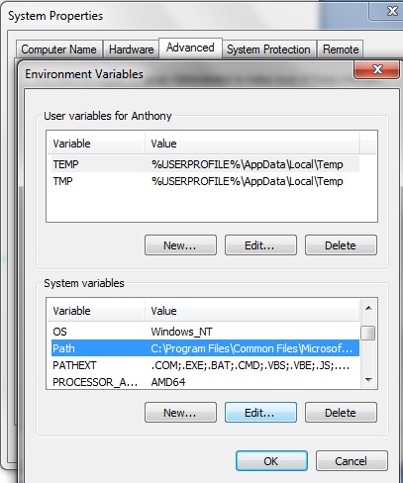
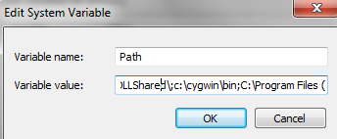
Make sure “c:\cygwin\bin” (or wherever you installed cygwin)
Is in the “;” seperated directories in the path variable

Slide 15
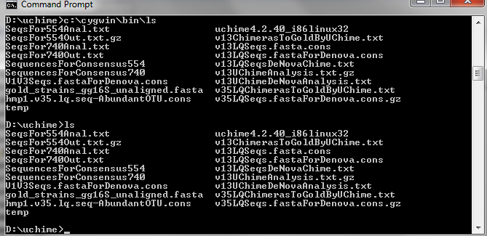
Setting a “PATH” variable means you don’t have to type
the full path
Without the path
variable:
With the path variable, Windows searches for the command
“ls” in every directory along the path…

Slide 16
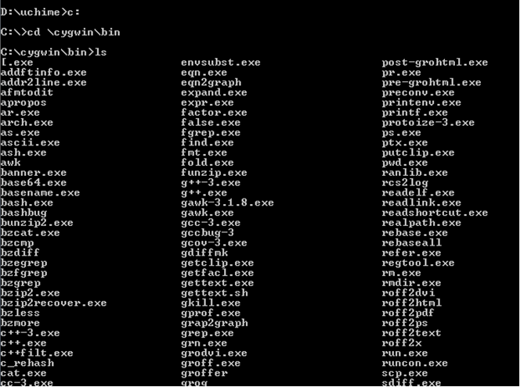
What UNIX commands has Cygwin installed on my Windows box?
C: - Windows command – change to root of C: directory
cd \cygwin\bin – change to c:\cygwin\bin
ls – list all files

Slide 17
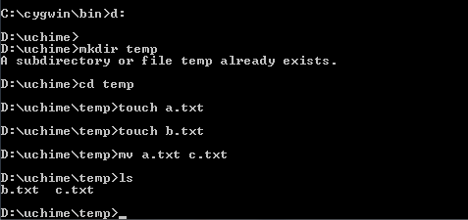
“touch” can make an empty file for us to play with
d: windows command – switch to d: drive
mkdir temp – fails: temp already exists
mv – moves (or renames) a.txt c.txt

Slide 18
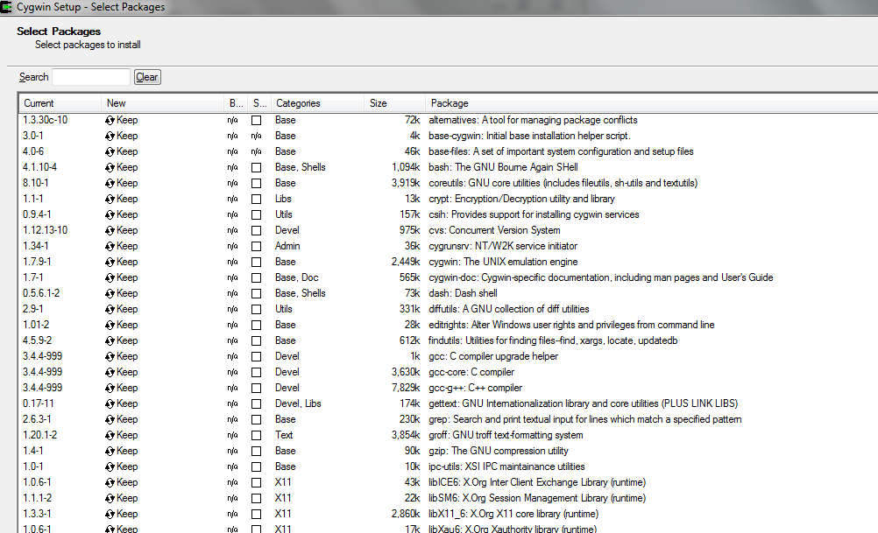
I can add more programs to Cygwin by clicking on “setup.exe”
We want to make sure gcc is installed.
This will be our C compiler! Also openssh (to talk to the cluster)

Slide 19
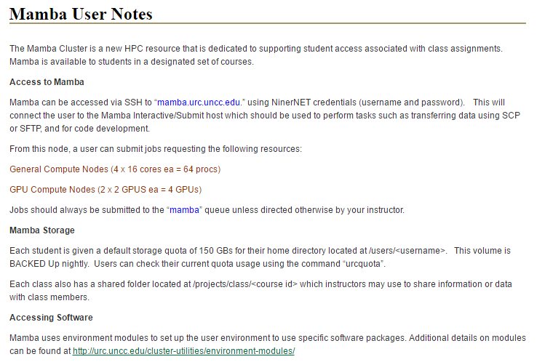
You should all have accounts on mamba:
http://urc.uncc.edu/mamba-user-notes/

Slide 20
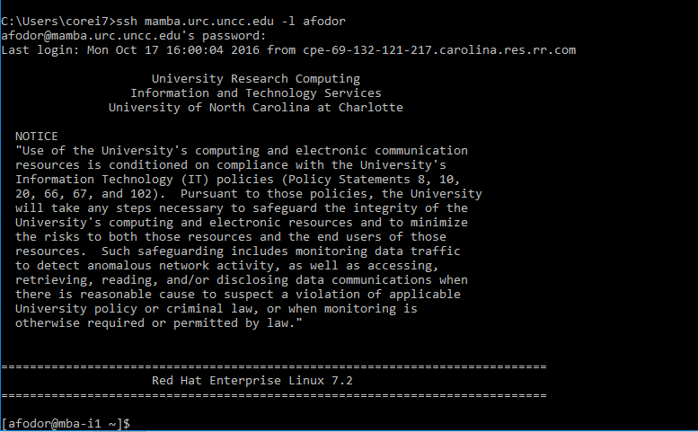
We can use the ssh command to login to our cluster account….
ssh mamba.urc.uncc.edu -l afodor
(exit will exit and get you back to your client terminal)

Slide 21
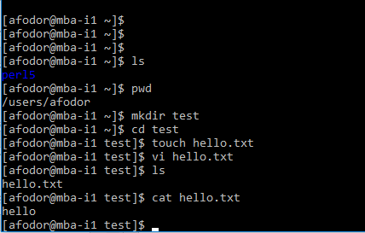
Once in the linux command line we can do linux kinds of things…
Here we create a file and edit it with a text editor..

Slide 22
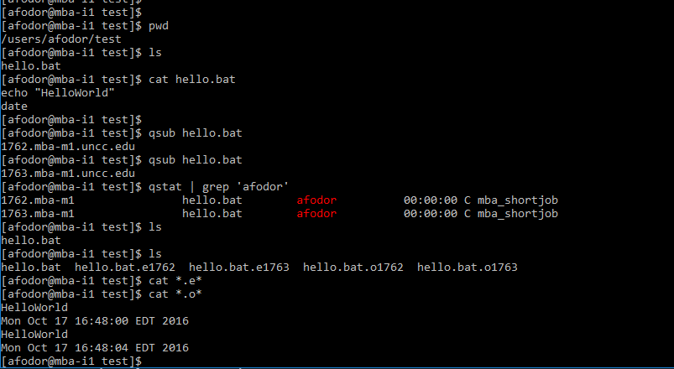
The main reason we want to use the cluster though is to submit jobs…
The cluster is based around a batch submission tool called qsub…
To get started, we use vi (or another text editor) to make a hello world test file.
Every time we type qsub, that script gets executed on one of the clusters nodes

Slide 23
Main node
qsub hello.bat
qsub hello.bat
Node 1
Node 2
Send *.e and
*.o file
Send *.e and
*.o file
Main node
qsub submits jobs
qstat monitors them

Slide 24
If you ever need to kill all your jobs…
qselect -u afodor | xargs qdel
your userid goes here..

Slide 25
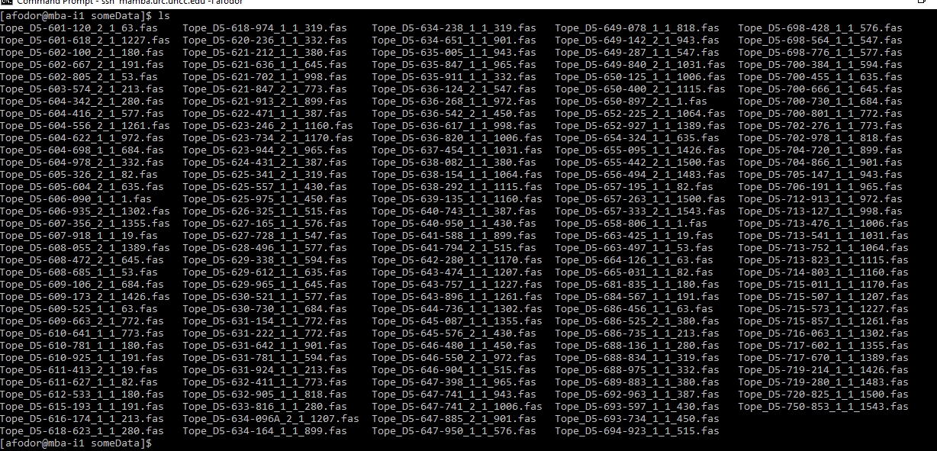
A “typical” task – use the RDP classifier to assign 16S sequences
/users/afodor/someData

Slide 26
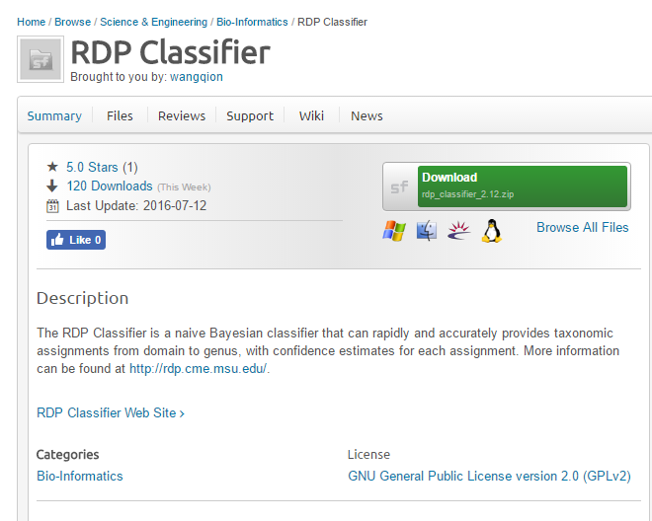
First step – install RDP classifier onto the cluster
https://sourceforge.net/projects/rdp-classifier/
Click through here…

Slide 27
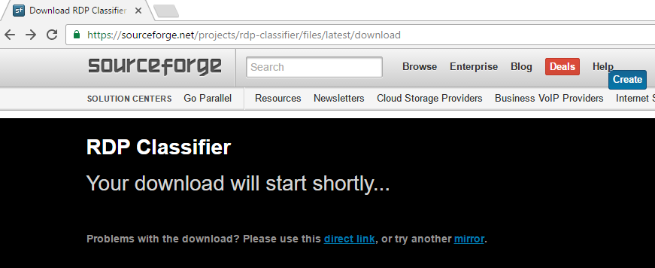
This direct link is a good target for wget
But sometimes it is easier just to download it to the client and push to the cluster

Slide 28
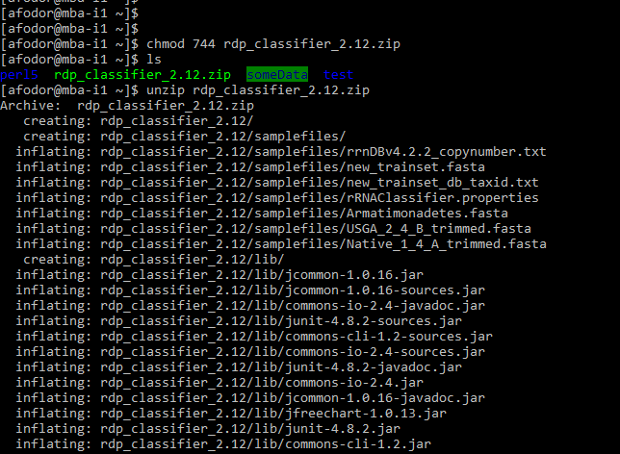
On the client, use scp to push the zipped file to the server
(you may need to make sure that the package openssh is installed from cygwin)
On the server, set the permission for the zip file and unzip

Slide 29

When all is done, this jar file should exist. Where the classifier actually lives…

Slide 30
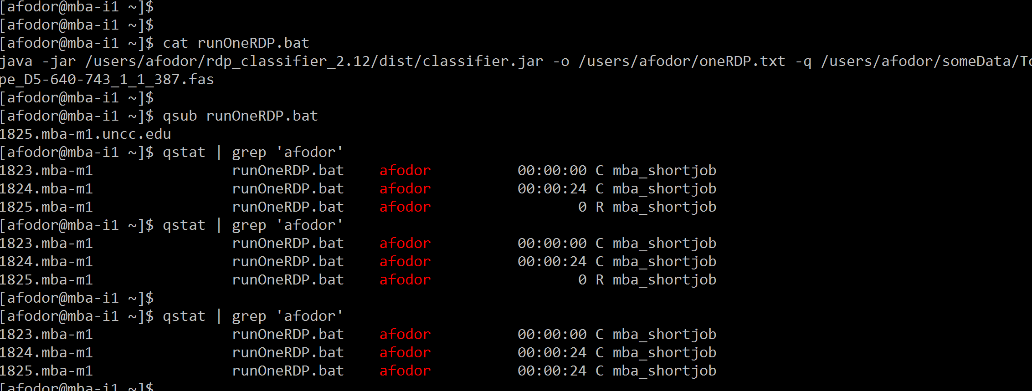
We can run the RDP classifier one at a time on our query files, but this is obviously very tedious!

Slide 31
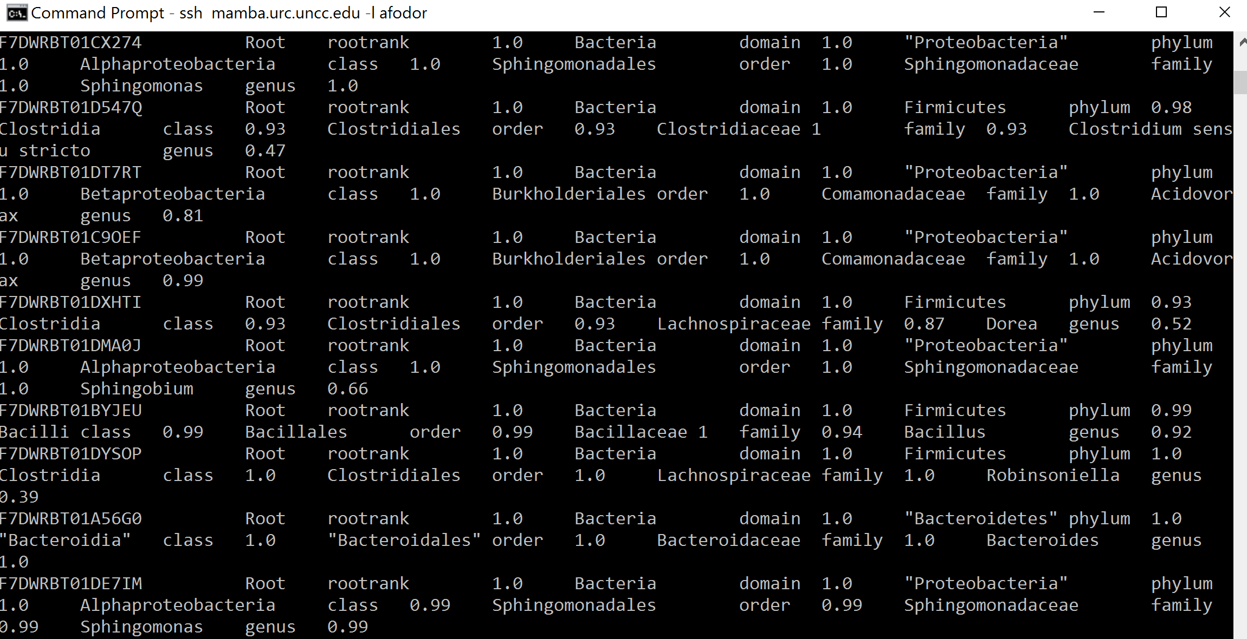
We end up with one classification file, but we need some way to run all of the classification jobs in parallel
more oneRDP.txt

Slide 32
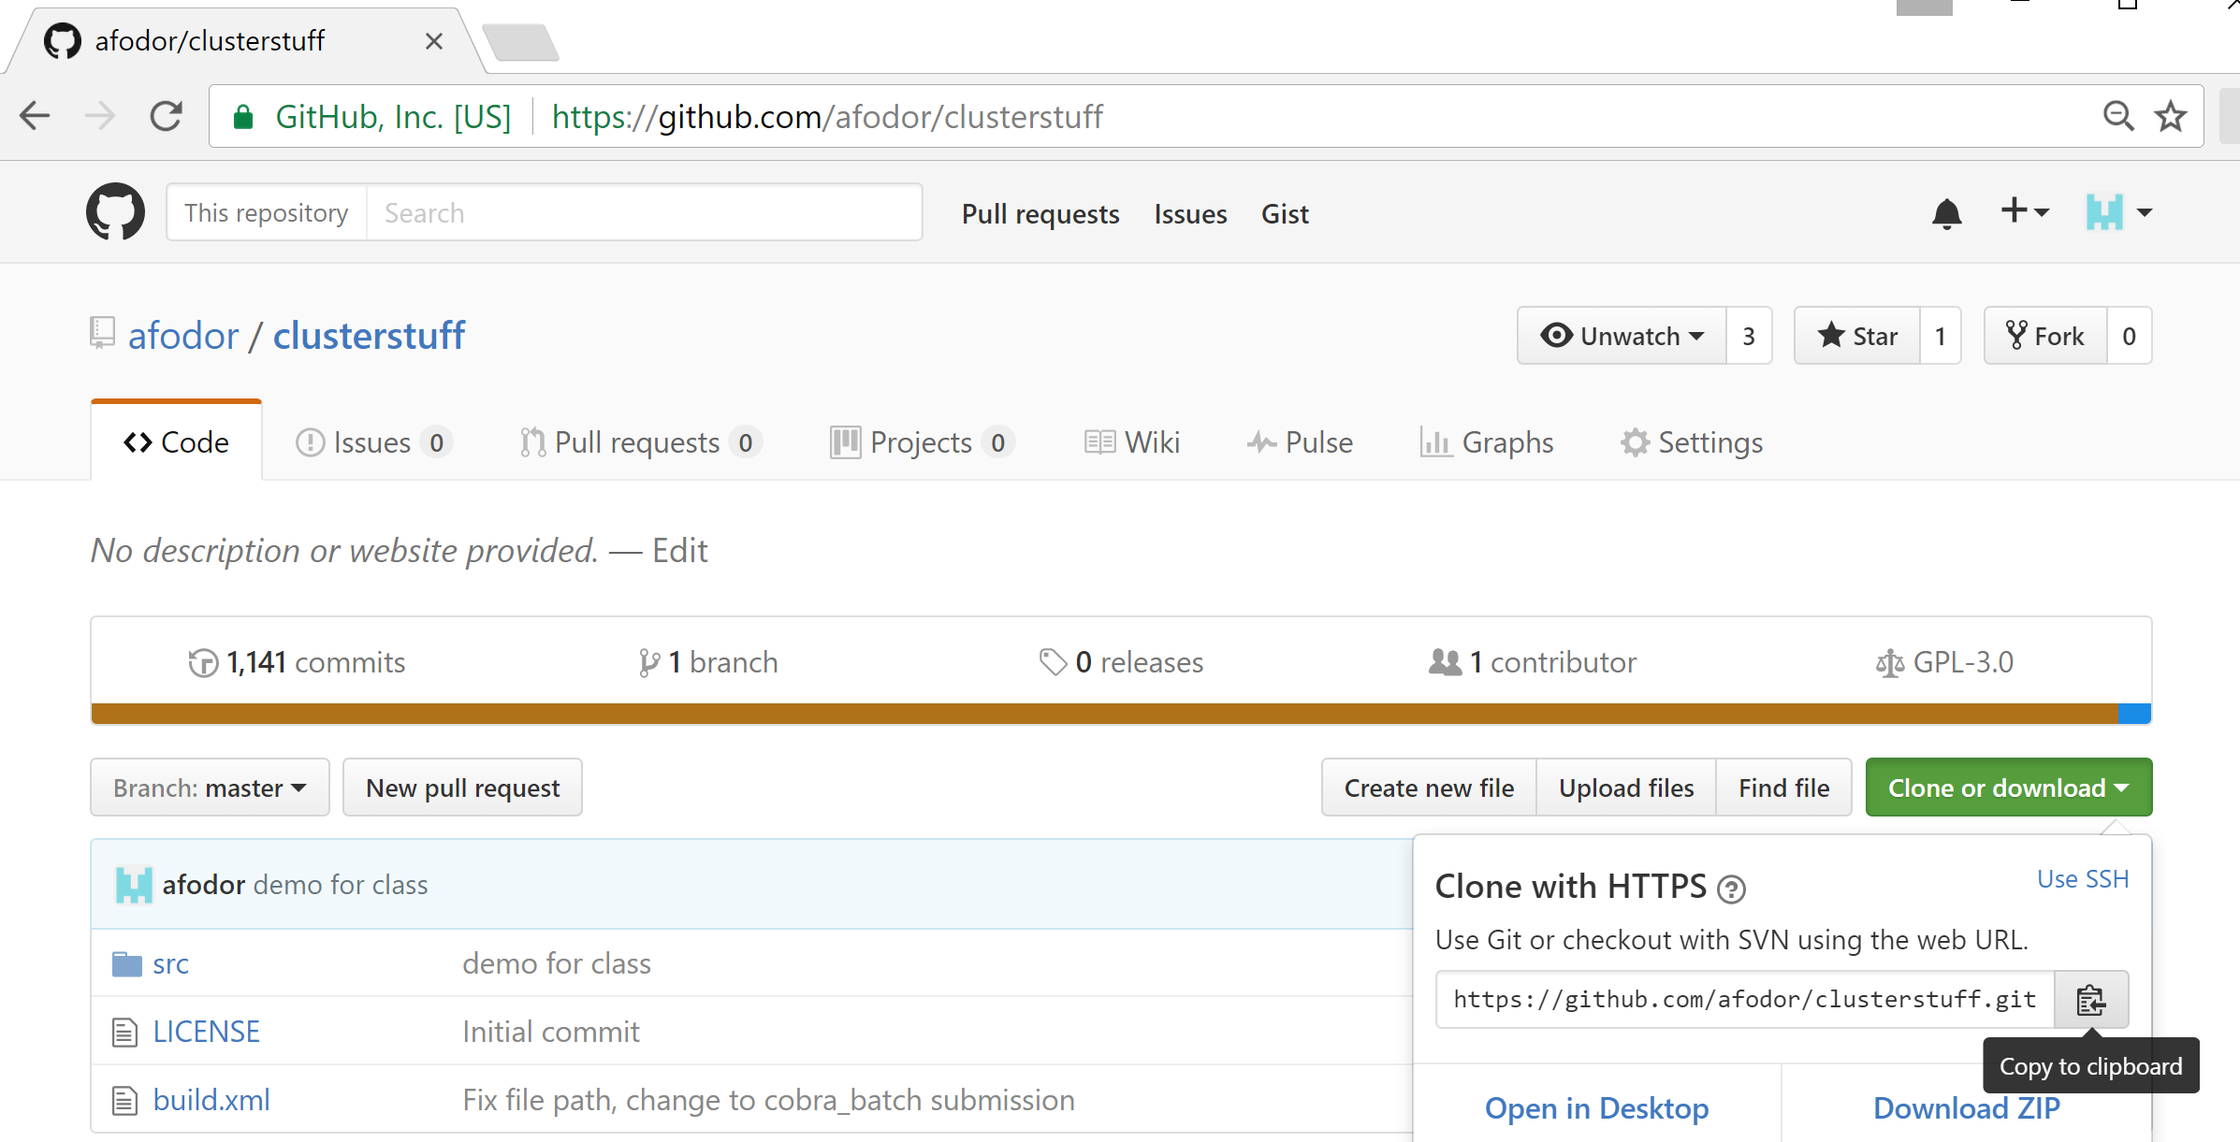
We can easily link a github repository to the cluster. This will allow us to quickly execute code on the cluster

Slide 33
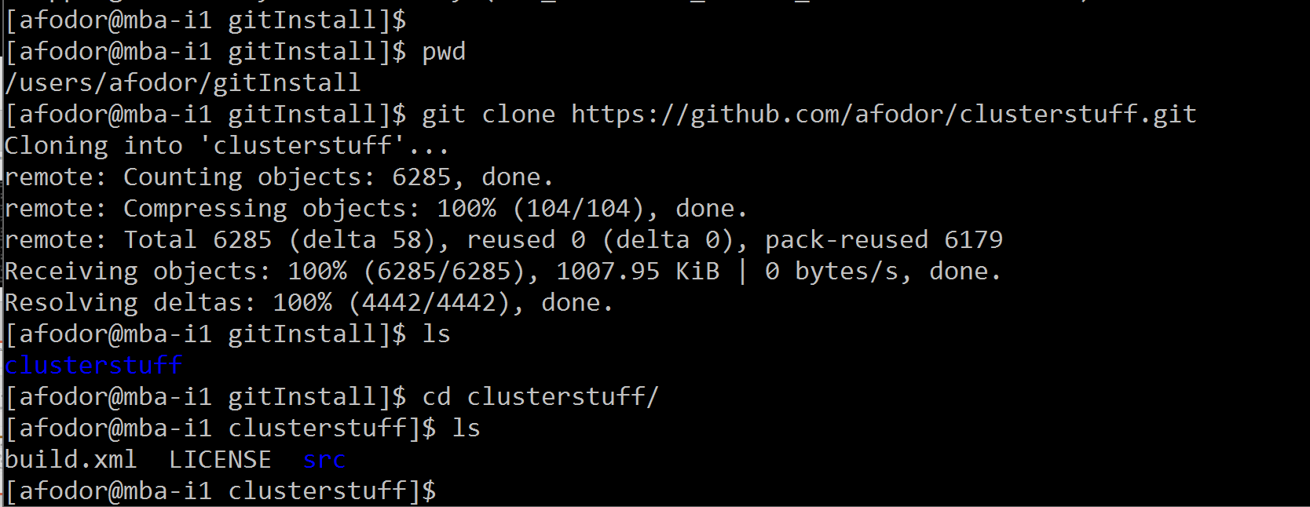
On the cluster, the first time you access the repository, you can use git clone

Slide 34
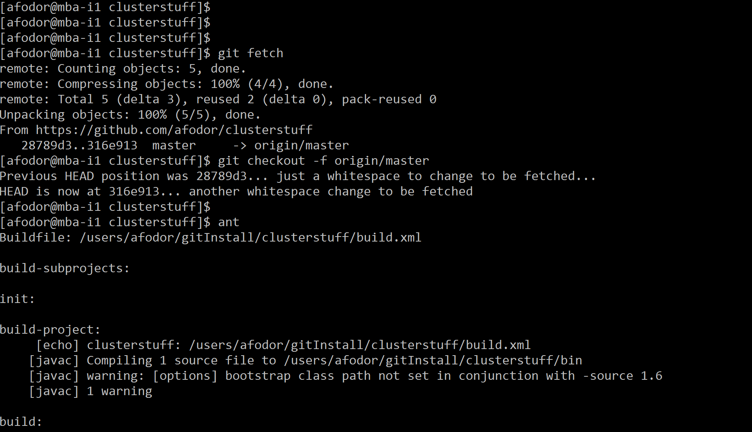
To capture any changes to the repository, use
git fetch
git checkout –f origin/master
ant

Slide 35
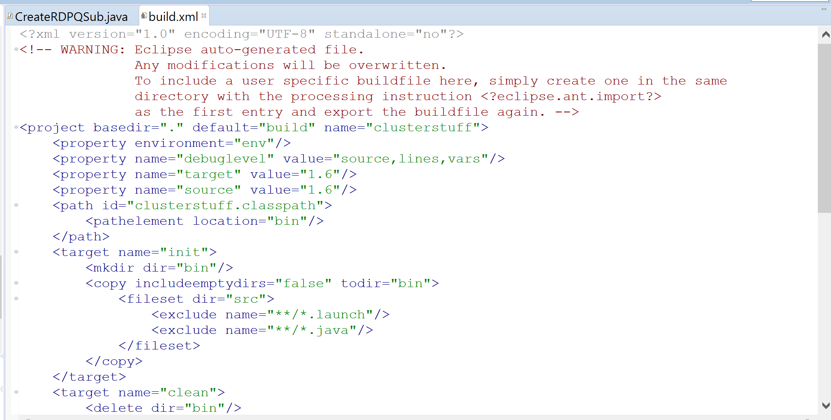
ant builds the java code (generates .class files from .java files).
You need to check in a build script, but Eclipse will generate one for you automatically.
(use File → Export from the Eclipse main window and then just check into Git)

Slide 36
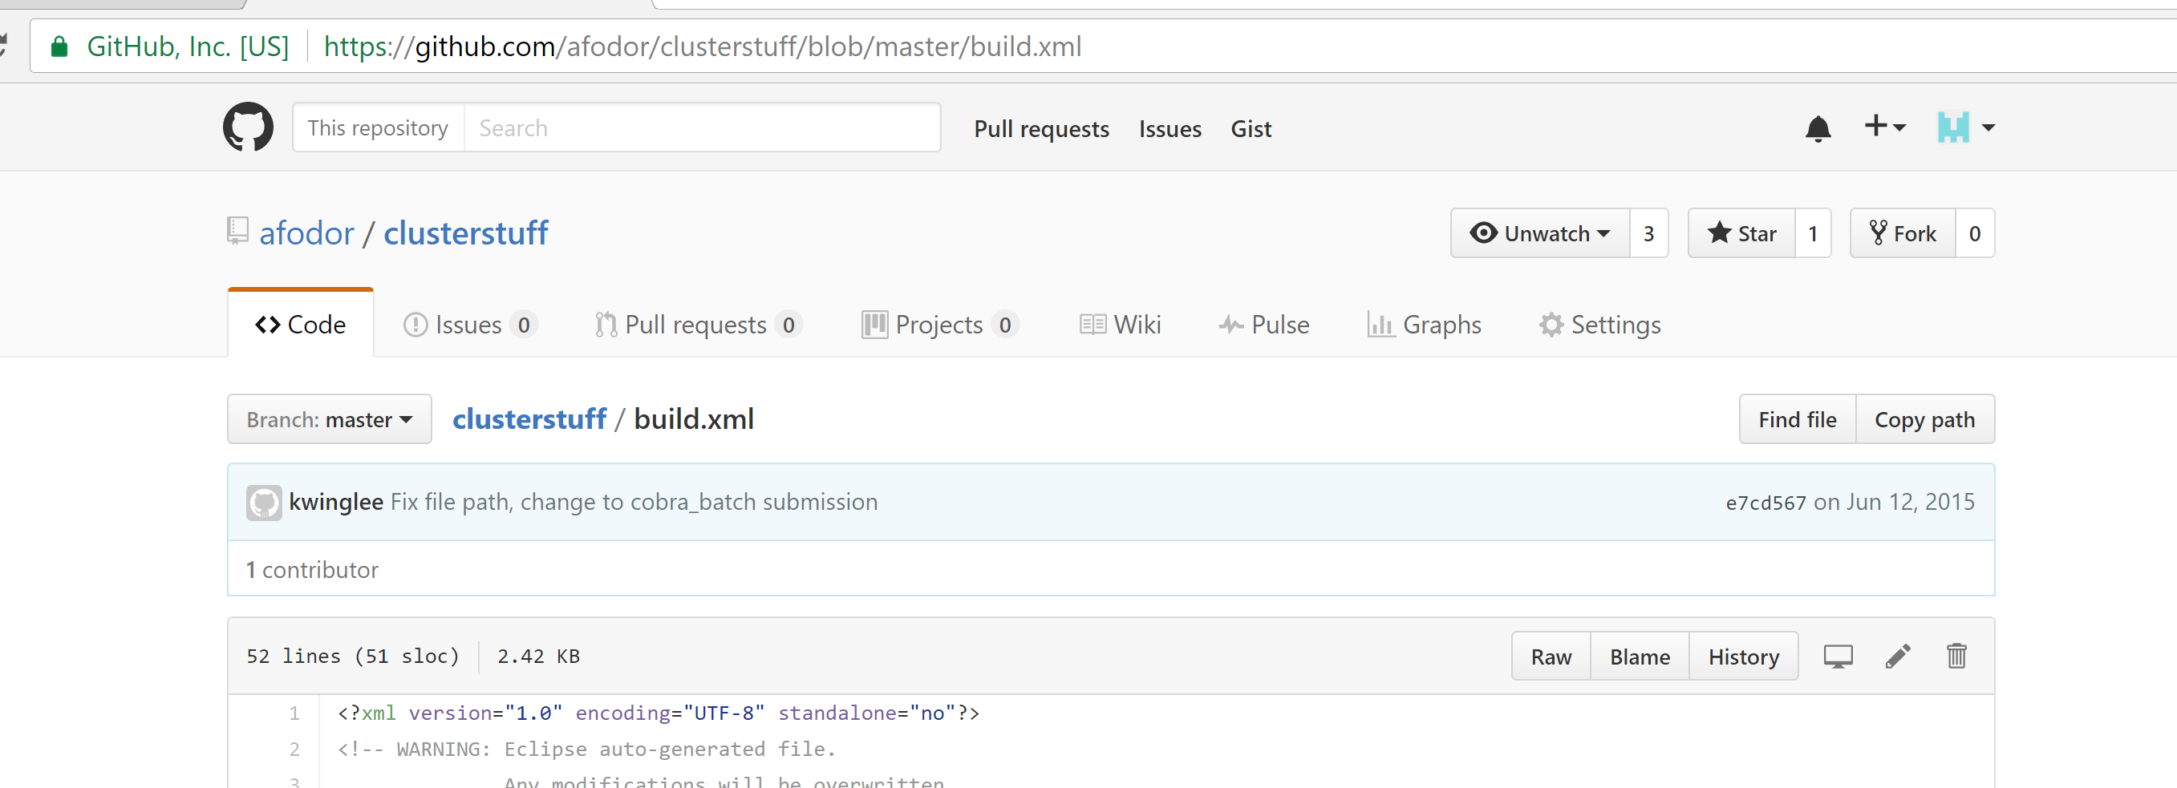
You can use the GitHub interface to check that the build.xml file made it to your repository!

Slide 37
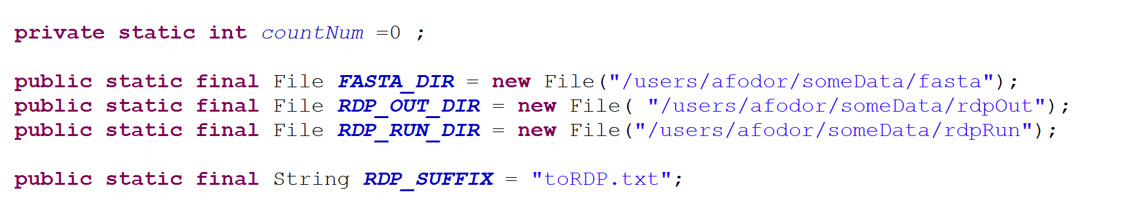
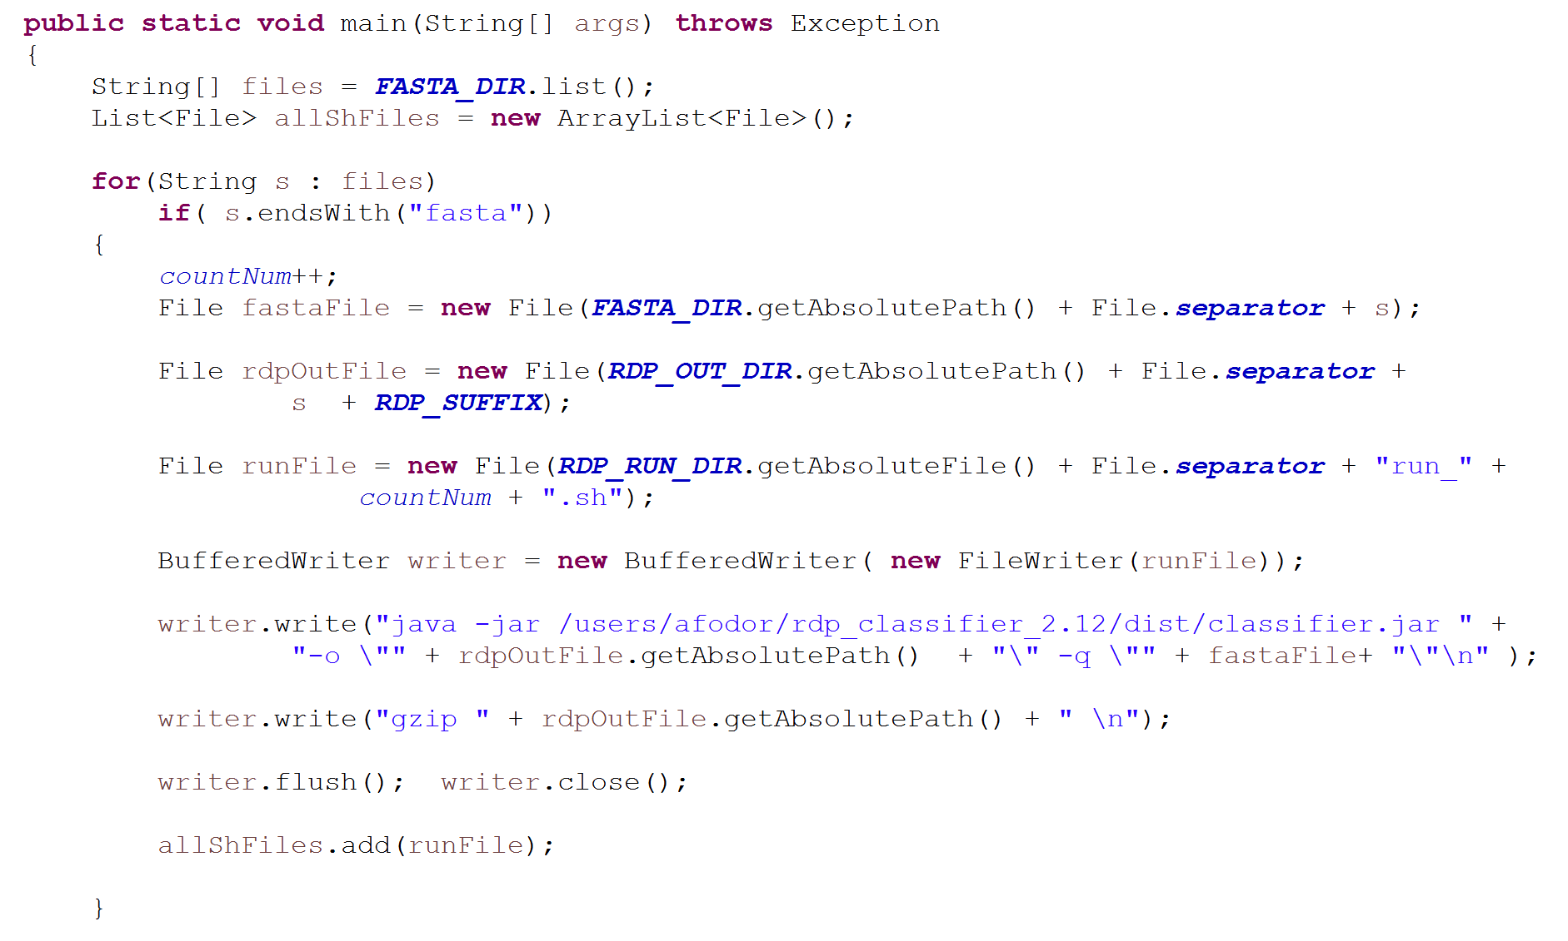
Here is code that will generate the batch scripts that we need to submit all the jobs to the cluster
https://github.com/afodor/clusterstuff/blob/master/src/mambaClassDemo/CreateRDPQSub.java

Slide 38
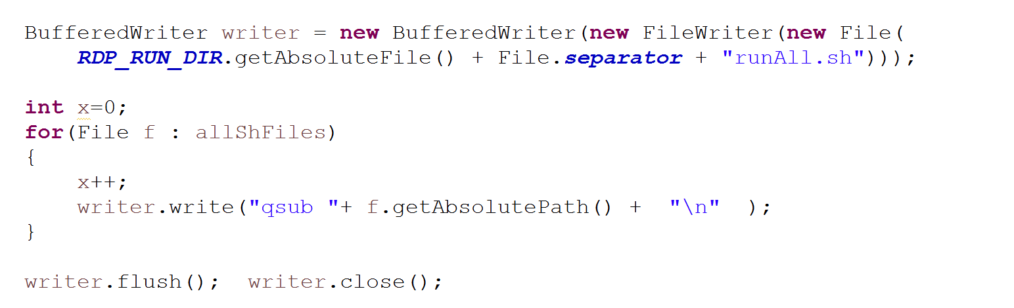
Last thing our main() method does is to write out one “runAll” file, that will submit all of our jobs for us

Slide 39
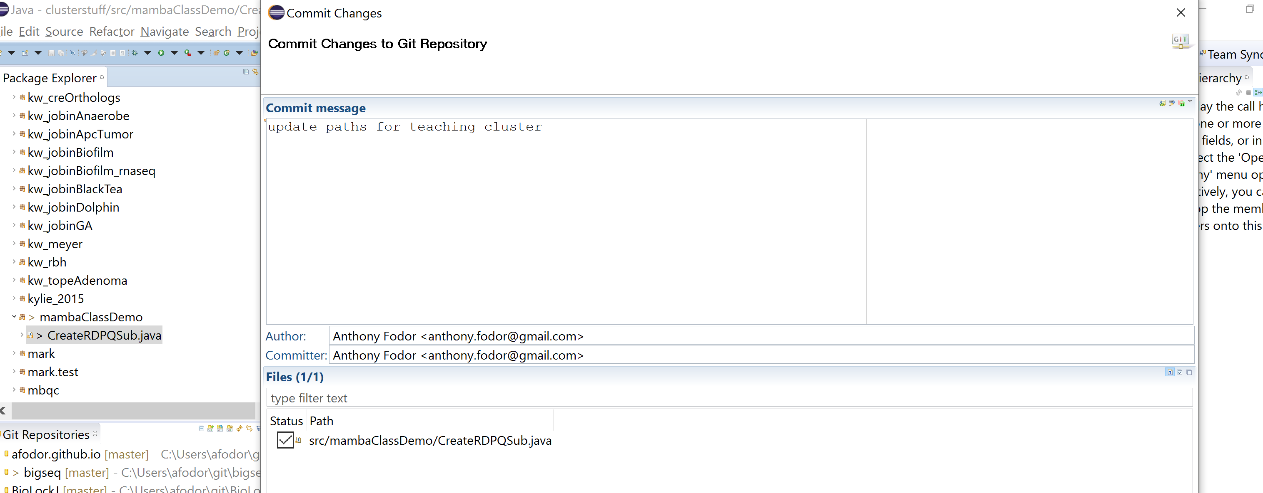
We start by committing our changes to the GitHub repository

Slide 40
A useful thing to type on the cluster is “screen”
This will allow us to open “virtual terminals”
Create a virtual terminal with cnt-a-c.
Switch between virtual terminals with cnt-a-a
Exit a virtual terminal by typing “exit”
Virtual terminals will persist on the server even if you get disconnected from
the server…
screen is pretty essential..

Slide 41
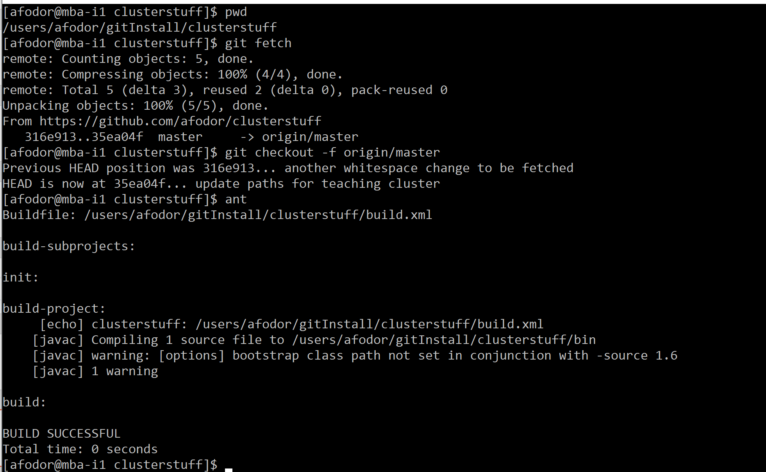
Capture the changes in our repository:
git fetch
git checkout –f origin/master
ant

Slide 42
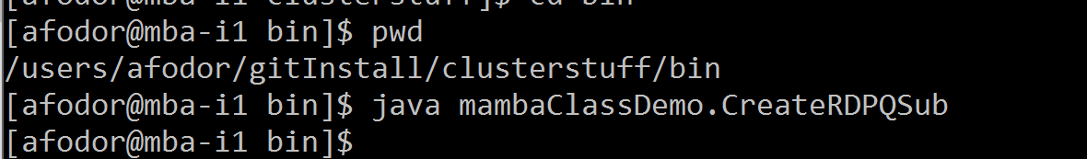
Finally, we run our scripts

Slide 43
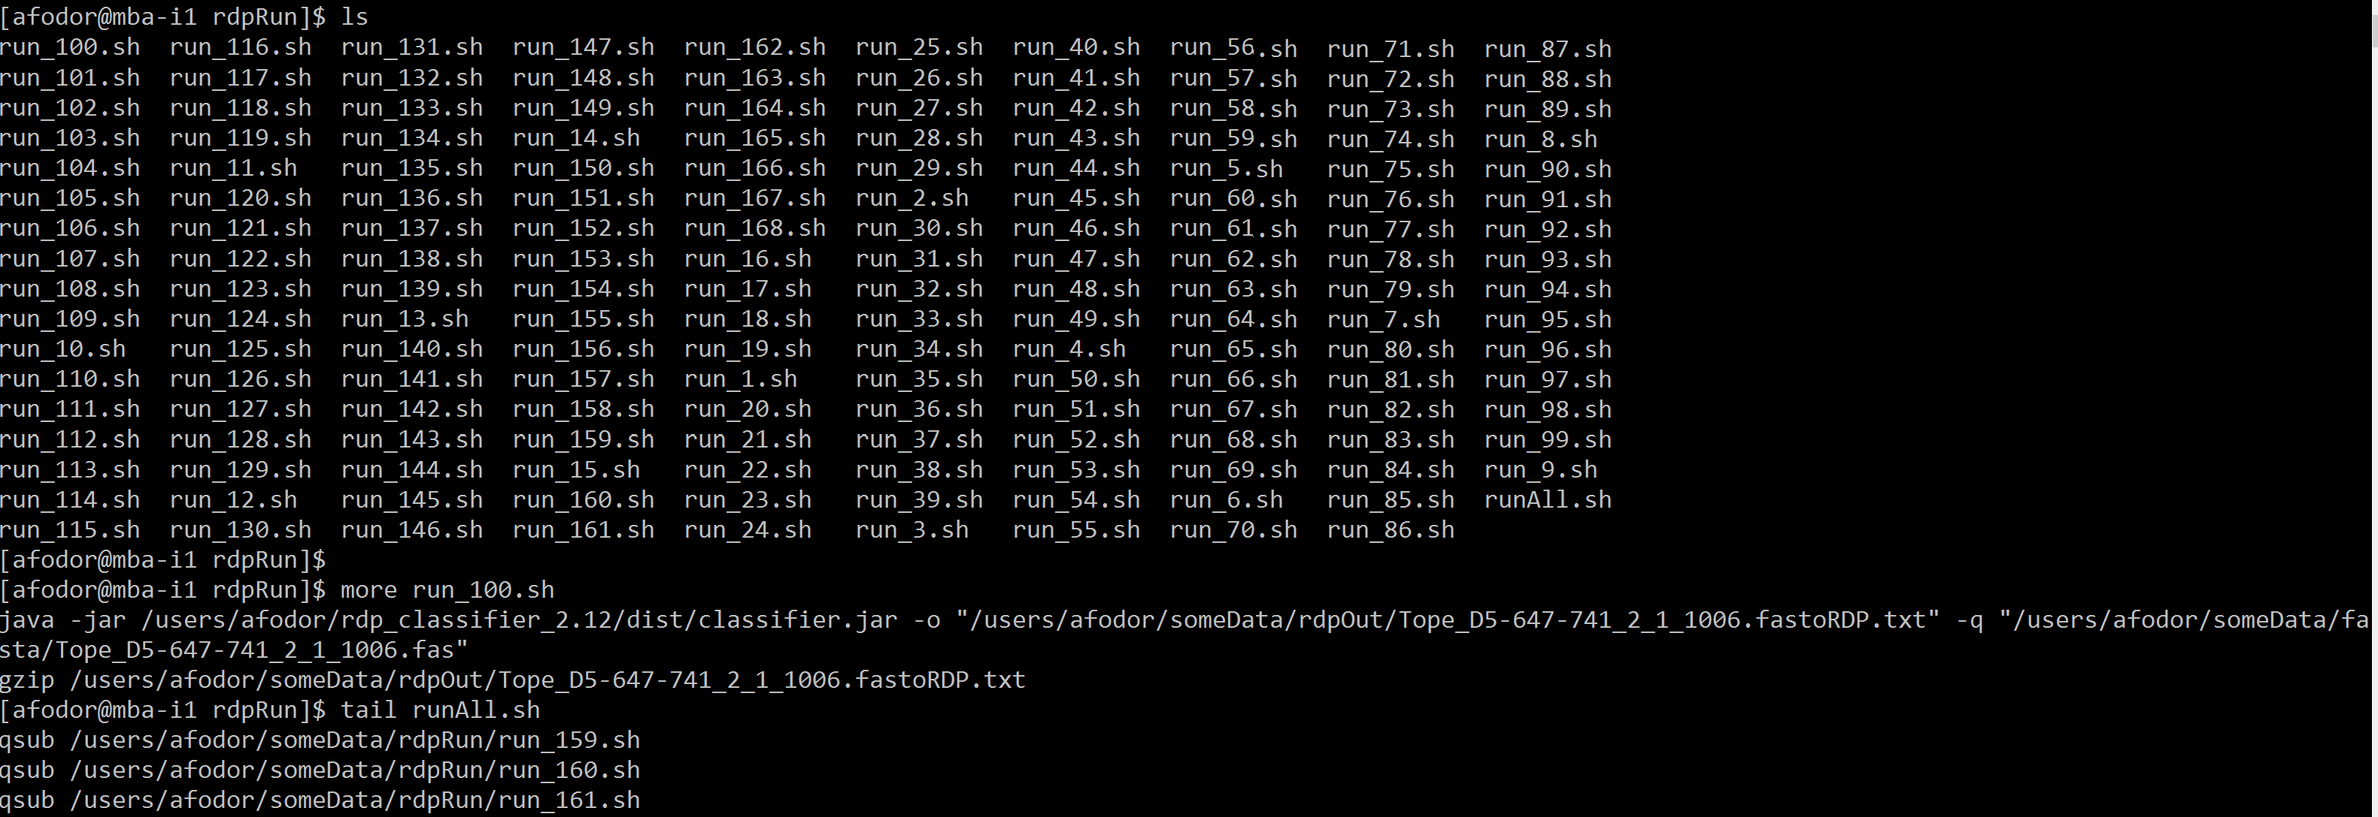
Our RDP directory looks like it has been properly populated

Slide 44
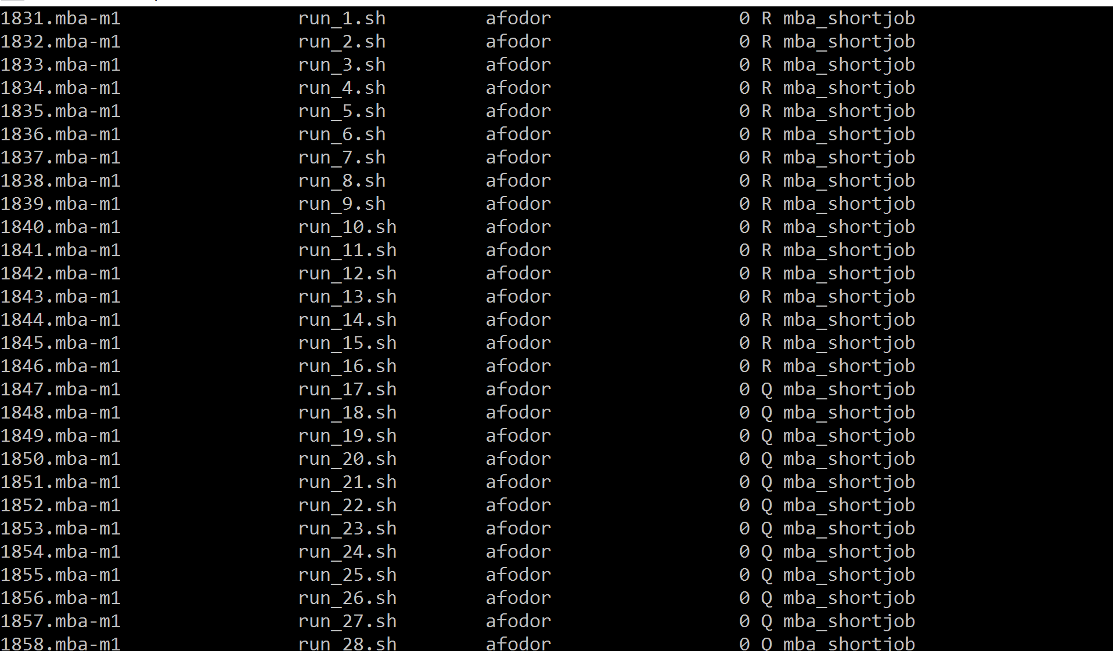
chmod 744 runAll.sh
./runAll.sh
running
queued

Slide 45
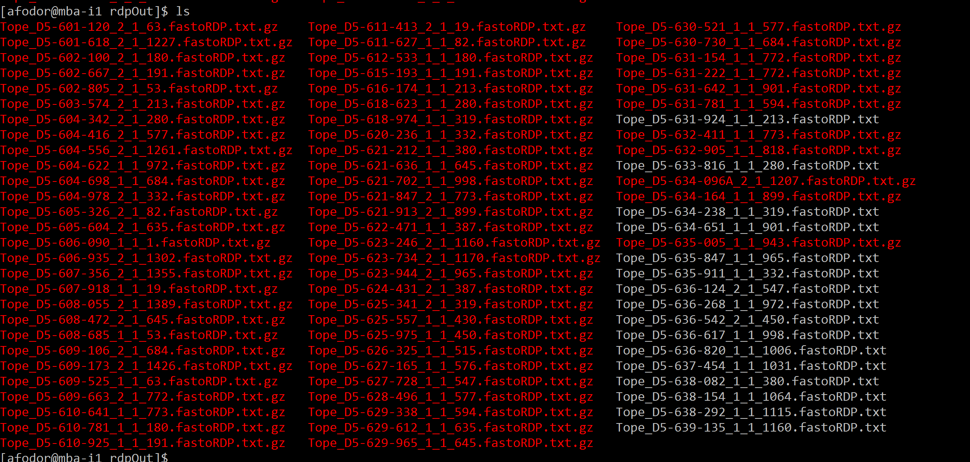
Our output file becomes appropriately populated

Slide 46
Next: Continue reading the Concurrency in Java book!

