Slide 1
Microbial Changes in Relation to Obesity, Sugar Intake and Health Status in Humans and Animal Models
Dr. Anthony Fodor
Associate Professor
Department of Bioinformatics
The University of North Carolina at Charlotte

Slide 2
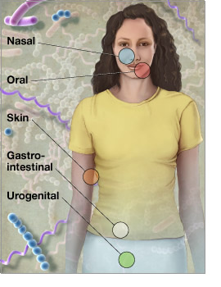
Microbes run the world!
There are as many microbial
cells in our body as human cells
There are more genes
in those microbes than human genes
http://www.genome.gov/images/feature_images/nr_hmp.jpg

Slide 3
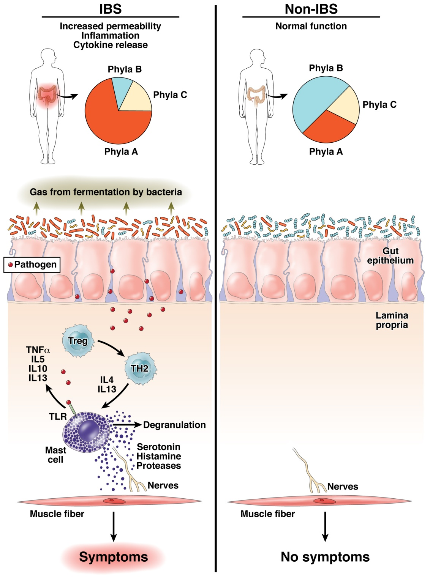
The “dysbiosis hypothesis” is central to our thinking about the role of the
microbiome in human health
Fodor & Talley. Gastroenterology. 2011

Slide 4
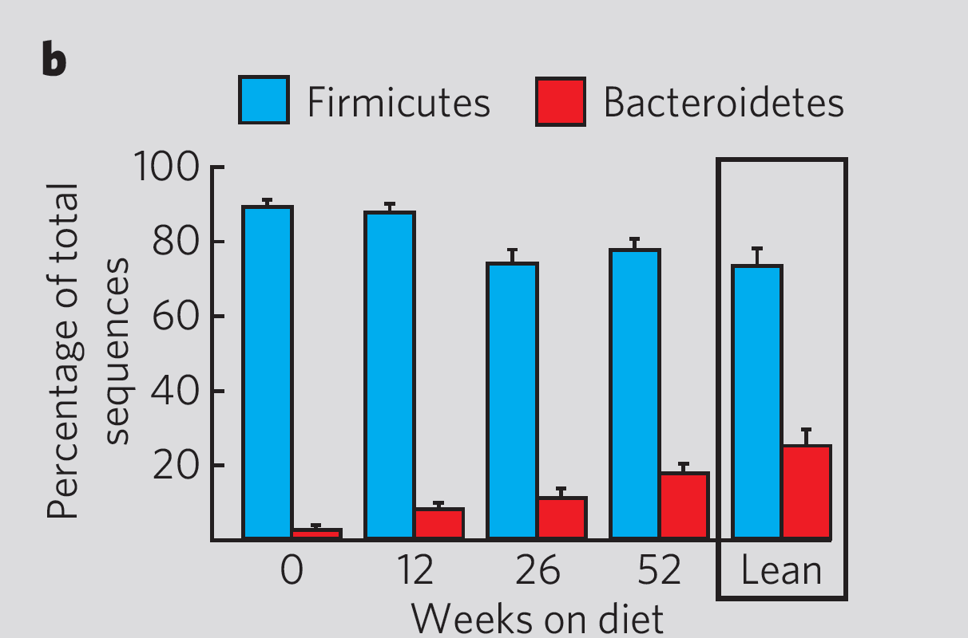
Initial results establishing a role for the microbiome in obesity were highly encouraging
2006
Ley et al - Human gut microbes associated with obesity – Nature, 2006

Slide 5
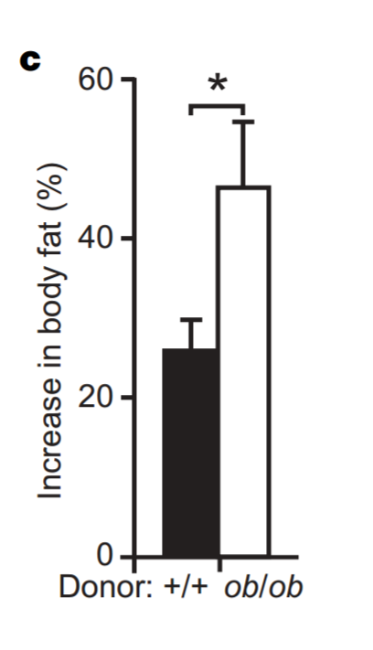
Obesity appeared to be a phenotype transferable through the microbiota
2006
Turnbaugh et al - An obesity-associated gut microbiome with increased capacity for energy harvest – Nature, 2006

Slide 6
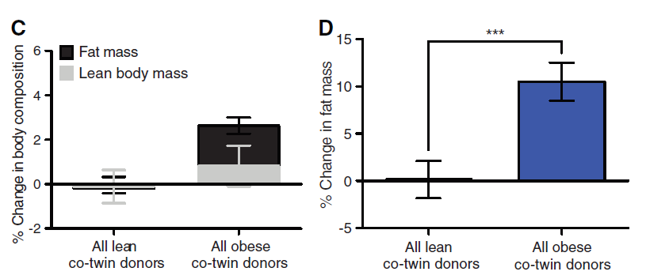
The transfer of obesity to mice via the microbiota appears replicable
2013
Ridaura et al - Gut Microbiota from Twins Discordant for Obesity Modulate Metabolism in Mice – Science, 2013

Slide 7
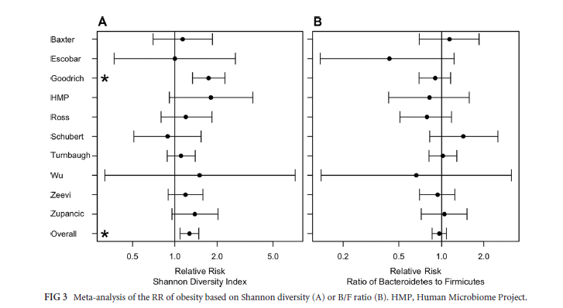
Associations in humans with the microbiota have proven much more difficult to replicate
2016
Sze and Schloss - Looking for a Signal in the Noise: Revisiting Obesity and the Microbiome– mbio, 2016

Slide 8
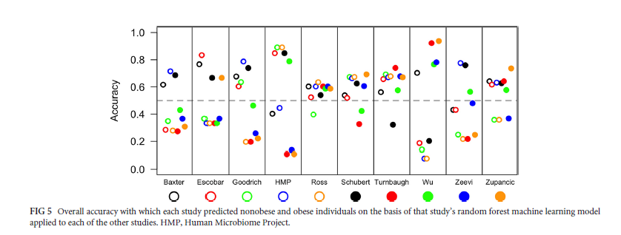
Replicability across studies appears especially poor
2016
Sze and Schloss - Looking for a Signal in the Noise: Revisiting Obesity and the Microbiome– mbio, 2016

Slide 9
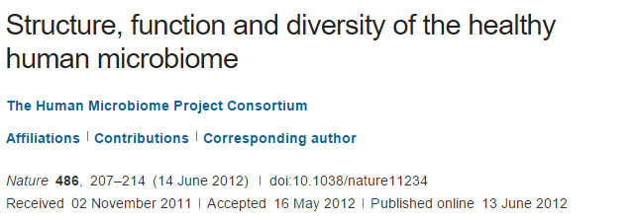
2012
We conclude that most variation in the human microbiome is not well explained by … phenotypic metadata

Slide 10
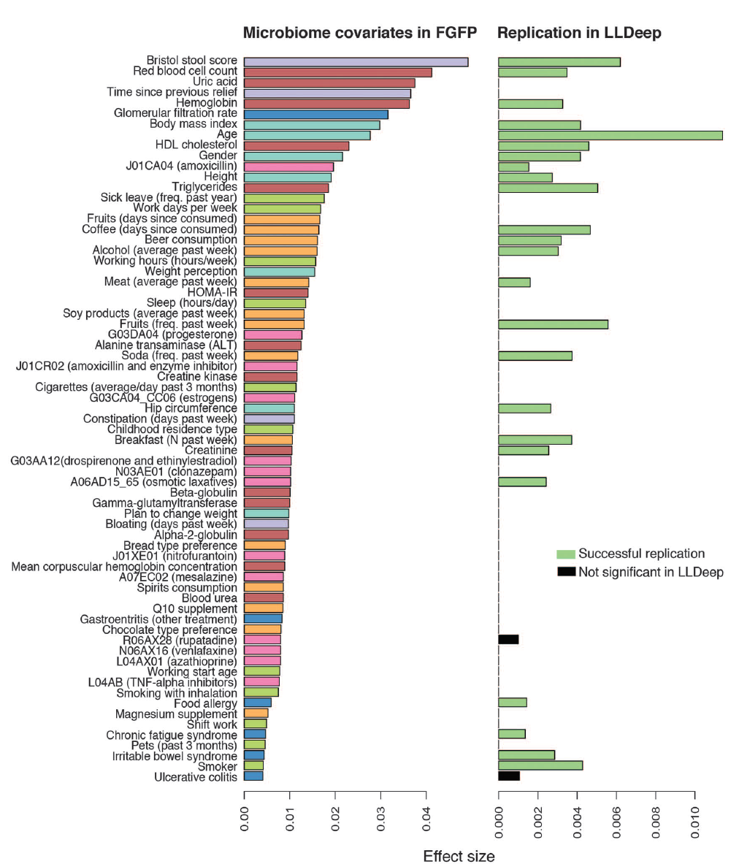
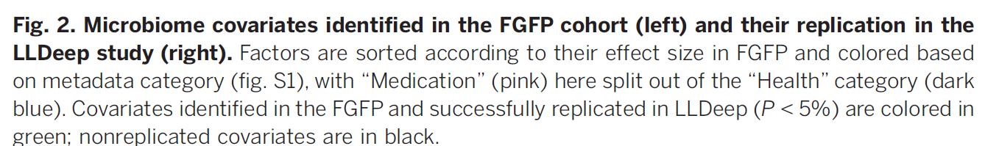
Microbial community composition and gene content is poorly associated with healthy variation
Initial analysis: 503 metadata variables
69 significant at 10% FDR
26 have analog in replication cohort
24 of these are significant
(but effect sizes in replicate cohort drop to << .01)
Power estimates suggests > 1600 subjects
needed to power BMI study…
2016
Falony et al. Population-level analysis of gut microbiome variation -Science 29 Apr 2016

Slide 11
The obesity hypothesis (2016)
The transfer of obesity to mice via the microbiota appears replicable
BMI, and apparently all other healthy human covariates,
have associations with the microbiota that are very small
Sample sizes in the thousands are appropriate for studies of healthy
human variation

Slide 12
What happens to the microbiome when you change diet?
B1
B2
D1
D2
R1
R2
V
V
V
V
V
V
Baseline 10d
Depletion up to 42d
Repletion 10d
2011
550 mg/ 60 kg
body weight
0 mg
850 mg/ 60 kg
body weight
In-patient
In-patient
In-patient
At each timepoint, a fecal sample was collected
and microbial DNA was isolated and characterized
Spencer et al, Association between composition of the human gastrointestinal microbiome and development of fatty liver with choline deficiency,2011

Slide 13
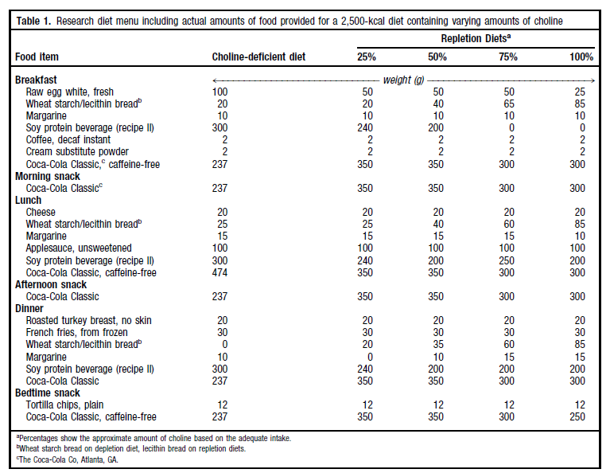
Subjects were exposed to a rigorously controlled diet…
2011

Slide 14
15 Patients
74 DNA samples isolated from fecal samples
Run on ½ of a 454-FLX LR70 plate using a “barcode” strategy
2011
213,375 16S rRNA sequences.
Average read length=264 bp.
( around $0.03 per sequence)
199,186 “usable” sequences
(Exactly match 5’-primer; length >200 bp)
Cluster into 7,514 Operational Taxonomic Units (OTUs)
in each of which all sequences are at least 97% identical
Spencer et al, Association between composition of the human gastrointestinal microbiome and development of fatty liver with choline deficiency,2011

Slide 15
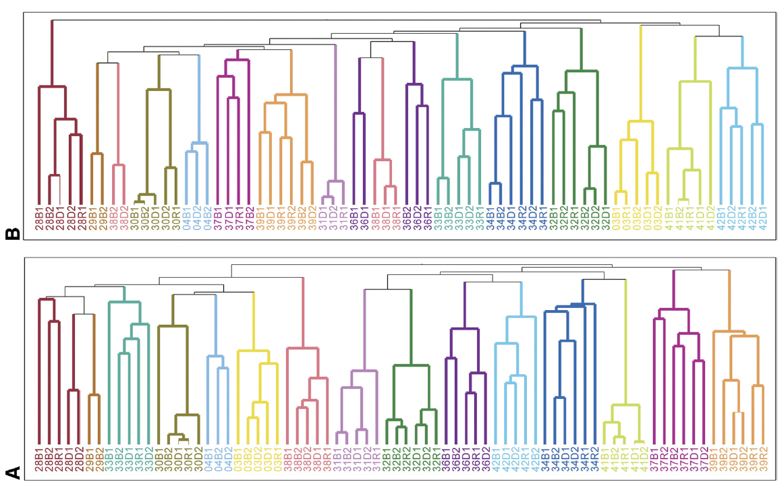
How easy it to change a microbiome?
The gut microbiome is individual, stable over time and surprisingly resistant to short-term changes in diet…
2011
Spencer et al, Association between composition of the human gastrointestinal microbiome and development of fatty liver with choline deficiency,2011

Slide 16
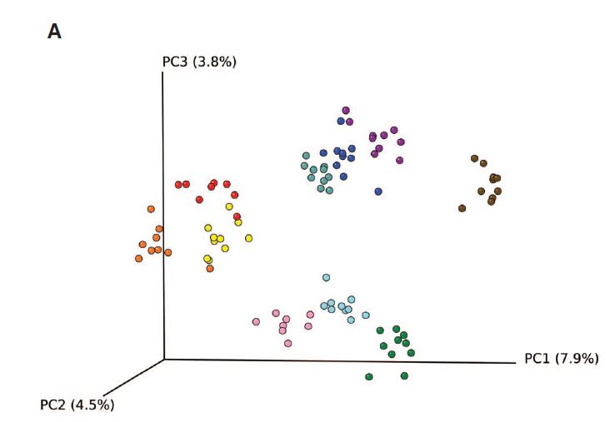
The gut microbiome is individual, stable over time and surprisingly resistant to short-term changes in diet…
2011
Wu et.al - Linking Long-Term Dietary Patterns with Gut Microbial Enterotypes, 2011

Slide 17
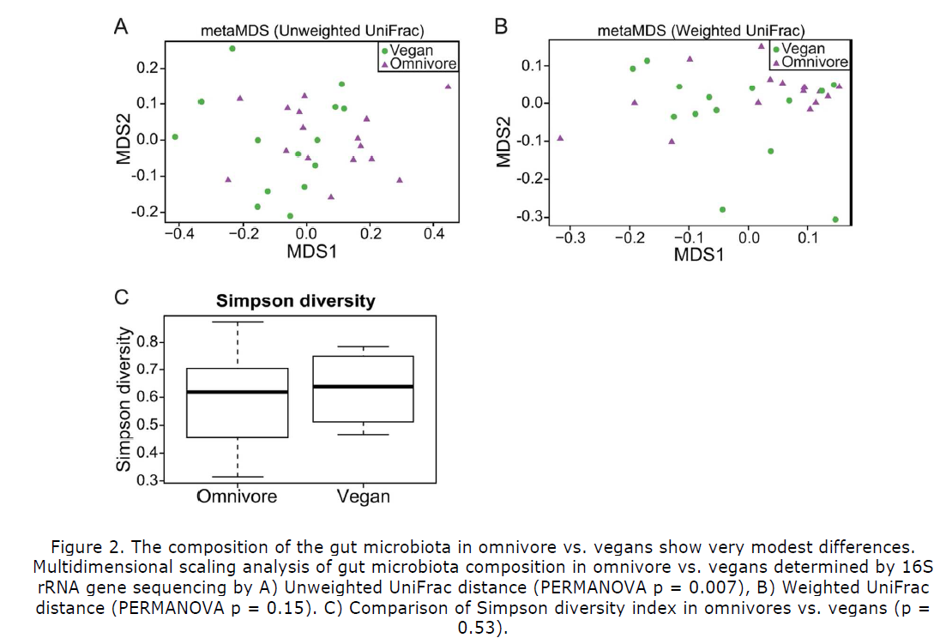
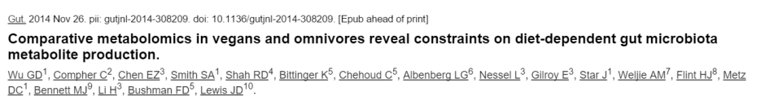
The microbiome of vegans is pretty similar to omnivores…
2014

Slide 18
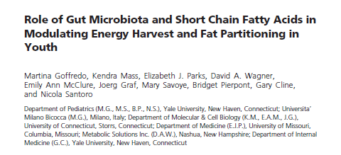
The microbiota is hard to change in adults
Can interventions be designed for earlier in life?
2016

Slide 19
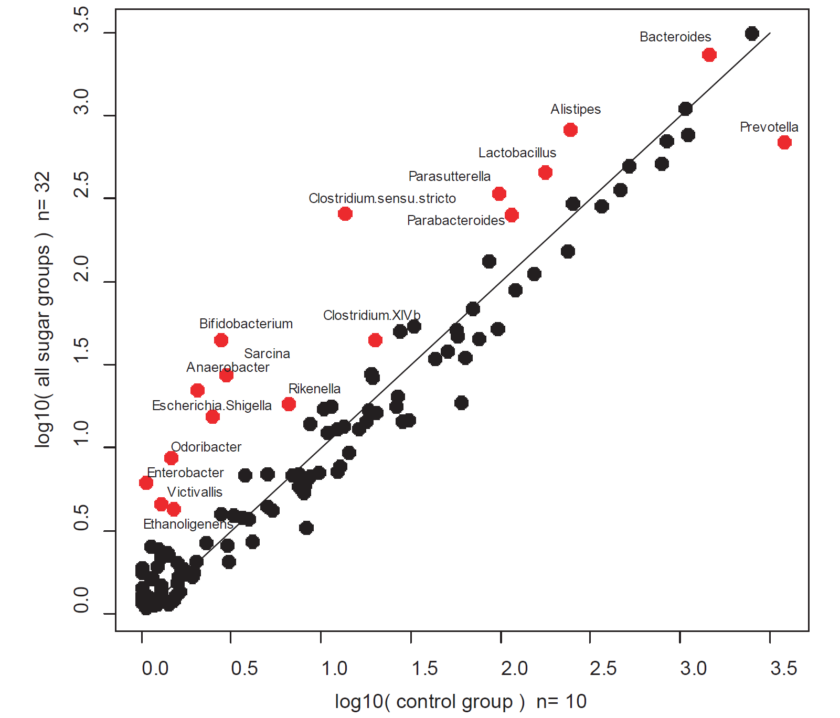
A rat model suggests the presence of sugar in the juvenile diet can have profound results on the microbiota
submitted
E.E. Noble, T.M. Hsu, R.B. Jones, A.A. Fodor, M.I. Goran and S.E. Kanoski. Early life sugar consumption affects the microbiome in rodents independent of obesity. (Submitted)

Slide 20
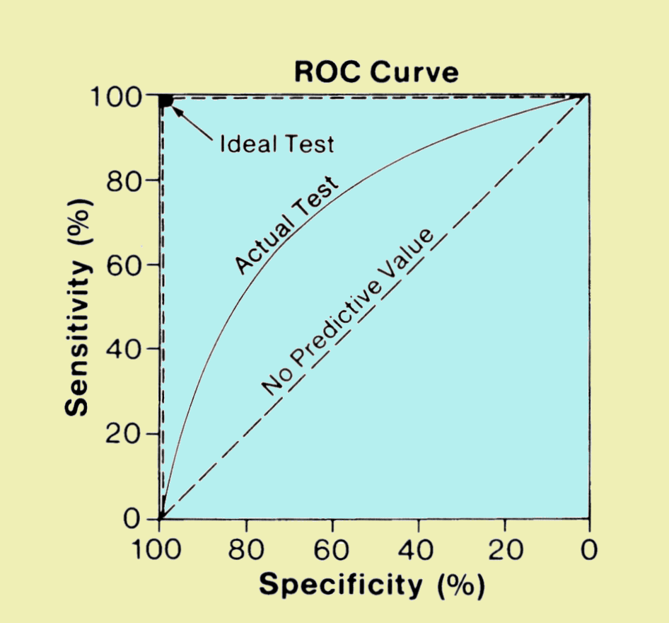
The “big data” approach to classification problems
Is a voter democratic or republican?
Voters with known affiliation
Training set
Test set
Find features
(income, zip code, gender)
that predict affiliation
Build statistical model
Make predictions on test set
Image: http://www.sprawls.org/ppmi2/IMGCHAR/1IMCHAR12.gif

Slide 21
The “big data” approach to classification problems
Is a sample case or control?
Whole-genome metagenome sequencing
on samples with known disease status
Training set
Test set
Find features
(taxa, genes)
that predict status
Build statistical model
Make predictions on test set
Image: http://www.sprawls.org/ppmi2/IMGCHAR/1IMCHAR12.gif

Slide 22
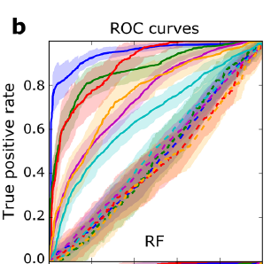
Whole-metagenome sequencing reveals effect sizes are much larger for other diseases
2016
Pasolli et al - Machine Learning Meta-analysis of Large Metagenomic Datasets: Tools and Biological Insights–
PLOS Comp. Bio, 2016

Slide 23
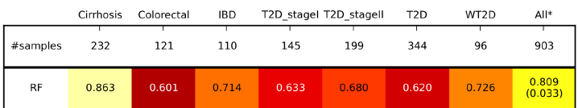
Remarkably, and perhaps disturbingly, replicability is maintained across disease states
accuracy
With regards to a microbial signature defined by whole-metagenome sequencing….
All disease states (across studies) have a good deal in common
All healthy states (across studies) have a good deal in common
2016
Pasolli et al - Machine Learning Meta-analysis of Large Metagenomic Datasets: Tools and Biological Insights–
PLOS Comp Bio, 2016

Slide 24
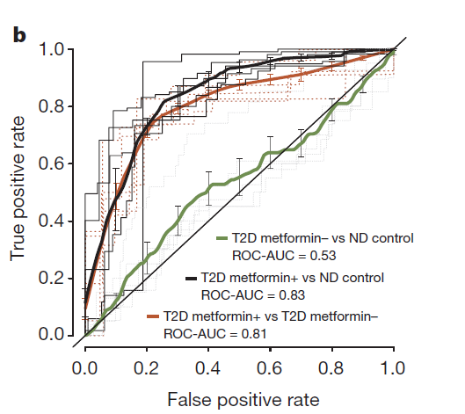
“Disease” state is heavily confounded with drug state
2015
Forslund et al Disentangling type 2 diabetes and metformin treatment signatures in the human gut microbiota– Nature, 2015

Slide 25
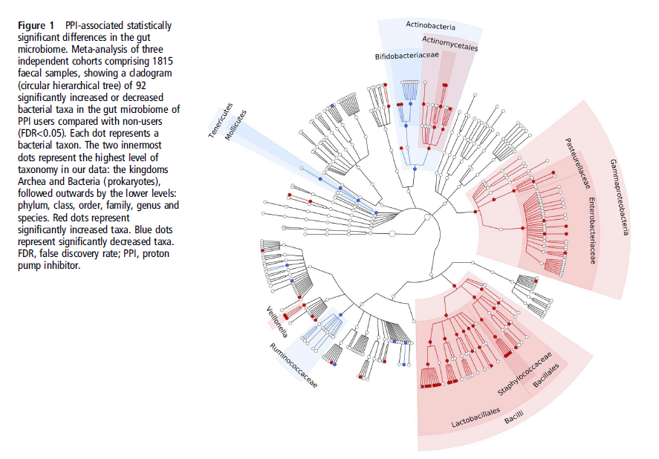
Proton pump inhibitors profoundly change the microbiome
2015
Imhann et al–Proton pump inhibitors affect the gut microbiome Gut, 2015

Slide 26
Obesity is causally linked to the microbiota via animal studies
but
Effect sizes in adult humans are very small
Human studies need thousands of participants and careful delineation of pharmacology
The adult microbiota is hard to change, which will complicate interventions.
More intervention studies are needed in youth.

Slide 27
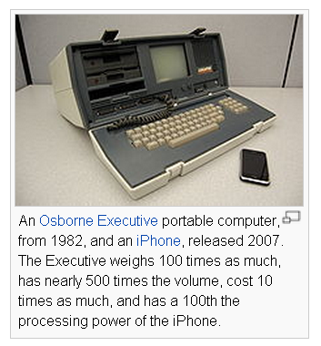
Computer then and now…
What will microbiology look like when we
can carry around whole-genome microbiome
samplers in our hand?
Will there be an iPhone sequencing app?
If you can sequence them in real time,
microbes are no longer invisible…
We are only beginning to define dysbiosis
http://en.wikipedia.org/wiki/Moore's_law

Slide 28
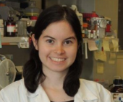











Acknowledgements
UNC-Chapel Hill
Janelle Arthur
Annie Green Howard
Marcus Muhlbauer
Penny Gordon-Larsen
UNC-Charlotte
Roshonda Barner
Ra’ad Gharaibeh
Jon McCafferty
Kathryn Winglee
UF- Gainesville
Christian Jobin
USC
Tanya L Alderete
Michael Goran
Emily Noble
Scott Kanoski
Kathryn Winglee
Annie Green Howard
Penny Gordon-Larsen
Raad Gharaibeh
Jon McCafferty
Marcus Muhlbauer
Janelle Arthur
Christian Jobin

