Slide 1
Simulating constant and non-constant variance with poisson and negative binomial inference

Slide 2
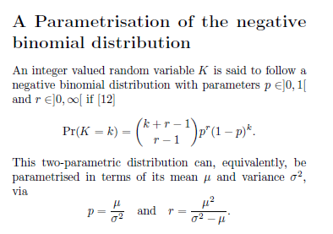
From last time:
Under a Poisson distribution
mean = variance =
prob(event) * # of samples = expected number of events
Under a negative binomial distribution:
p = prob(loss)
r = # of losses before you are removed from the tournament
mean = expected # of wins = (1-p)* r / p
variance = (1-p) * r / p * p
And re-arranging the above two equations…

Slide 3
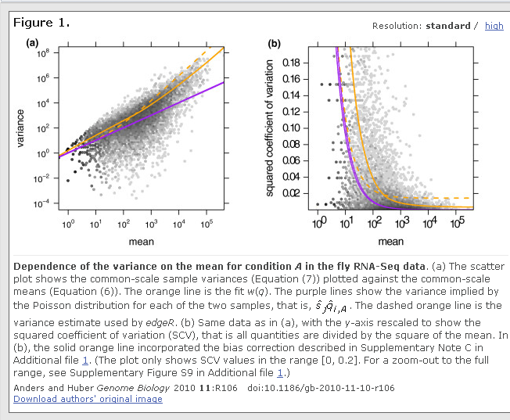
From last time, we had the observation that in “real” datasets the mean != variance

Slide 4
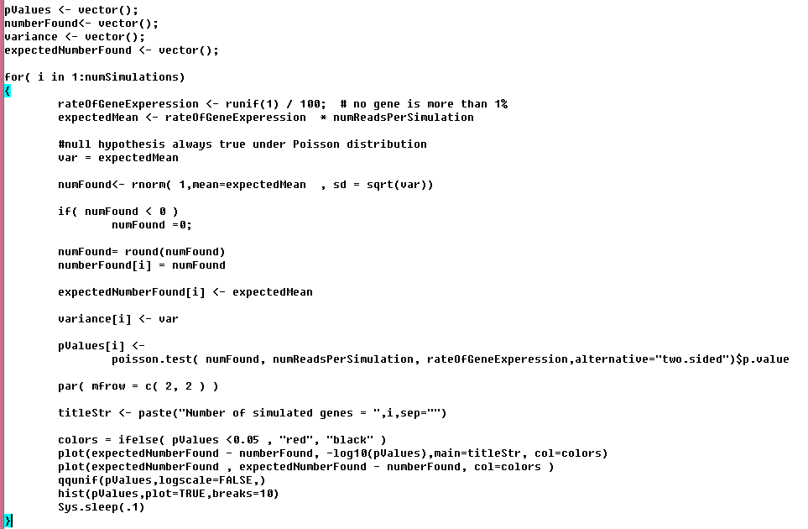
Here is a simulation under the Poisson assumption…
We sample under the
Poisson assumption
The # of sequences assigned to a gene from a normal distribution with
mean == variance
Just a two-sided Poisson test
https://github.com/afodor/metagenomicsTools/blob/master/src/classExamples/simDist/PoissonWithNormalBasedSampling.txt

Slide 5
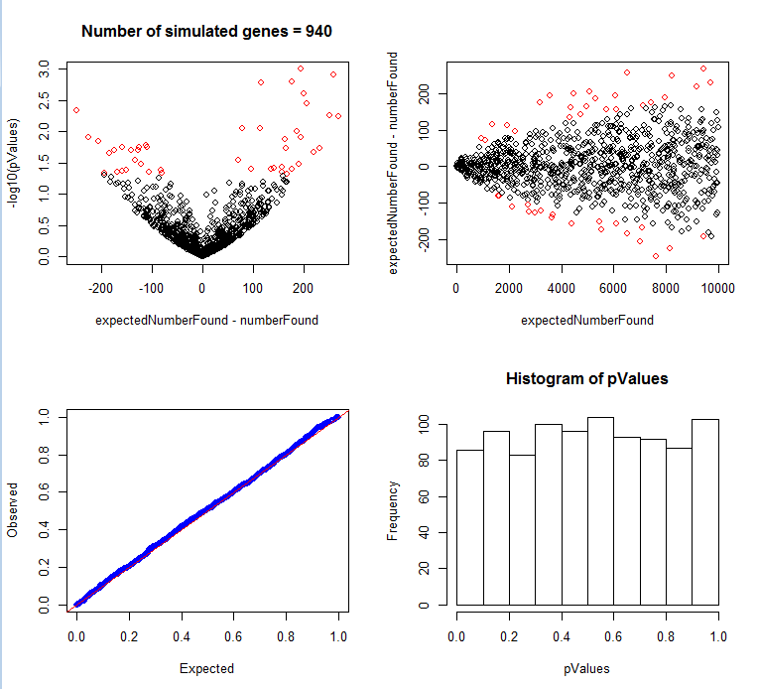
Here are the results of our simulation….

Slide 6
This is sometimes called a volcano plot (although usually it is fold-change on the x-axis)
The red symbols are p <0.05

Slide 7
This is sometimes called an “m vs. a” plot (although again usually with fold change on the y-axis)

Slide 8
As we expect under the Poisson, all the p-values are uniform…

Slide 9
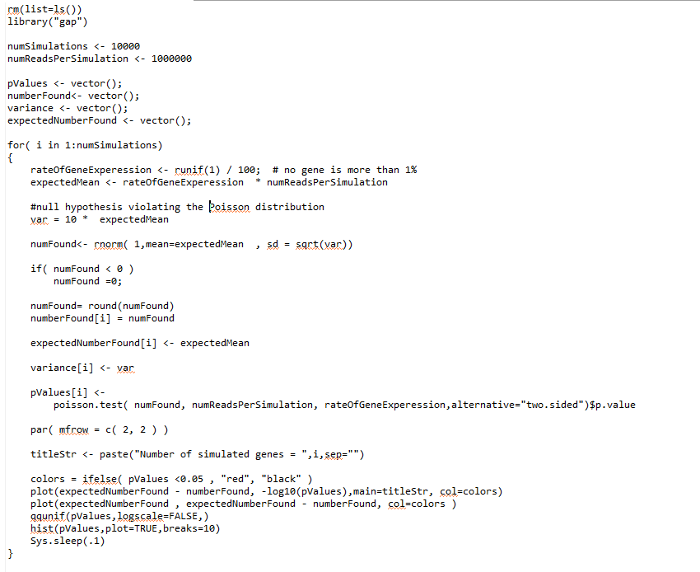
We now violate the Poisson assumption in our sampling….
The only change from the previous script

Slide 10
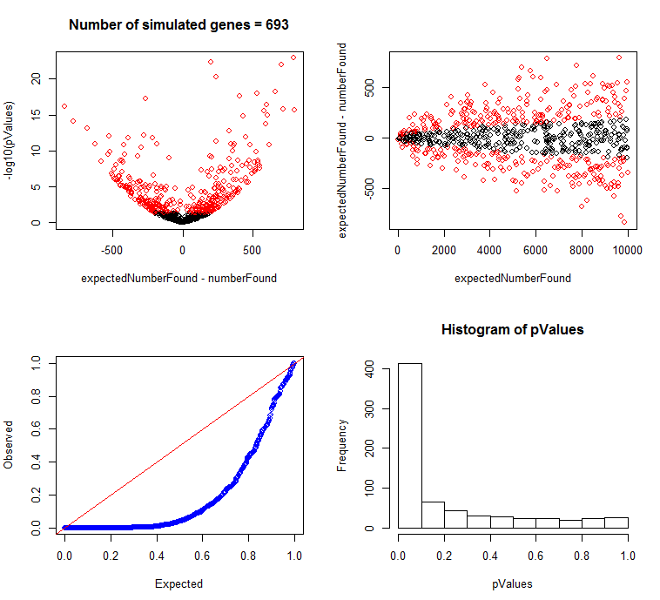
The increased variance completely breaks our Poisson test

Slide 11
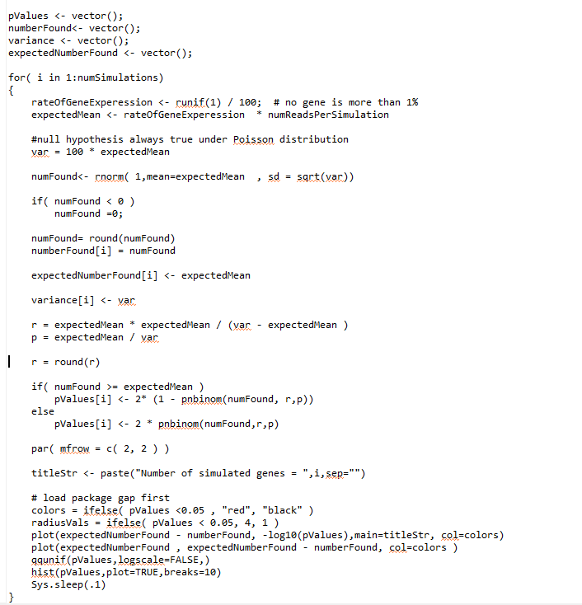
Here we use the
negative binomial
test for inference…
We calculate r and p
under our null hypothesis
This is two-sided test
https://github.com/afodor/metagenomicsTools/blob/master/src/classExamples/simDist/NegativeBinomialWithNormalBasedSampling.txt

Slide 12
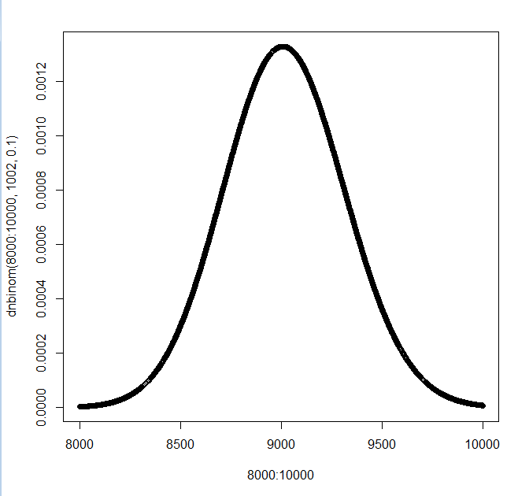
Let’s say that r = 1002 and p = 0.1
so the expected number of wins = (1-p)* r / p = .9*1002 / 0.1 = 9018
and our distribution looks like this…
If we see 8,500 “wins”, our probability is ~ 2 * pnbinom(8500,1002,.1)

Slide 13
Let’s say that r = 1002 and p = 0.1
so the expected number of wins = (1-p)* r / p = .9*1002 / 0.1 = 9018
and our distribution looks like this…
If we see 9,500 “wins”, our probability is ~ 2 *(1- pnbinom(8500,1002,.1))
We have enough sequencing depth that our curve will be approximately symmetrical
around the mean….

Slide 14
And hence our two-
sided test…
R does not have a built
in dnbinom.test

Slide 15
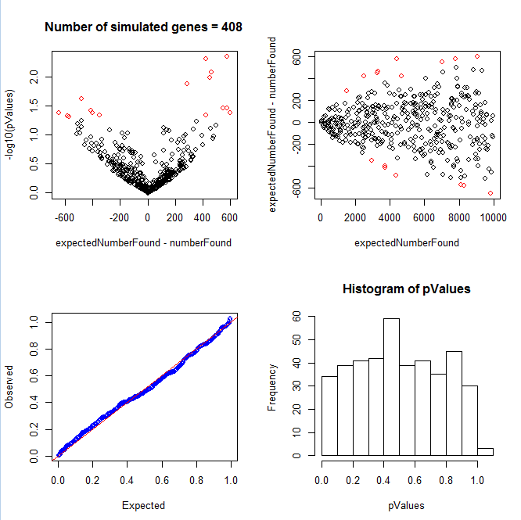
The negative binomial gets us much closer to a uniform distribution…

