Slide 1
One more PCA Example
Classification by linear models
Classification by nearest neighbor
Variance vs. bias trade-offs
The curse of dimensionality

Slide 2
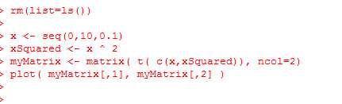
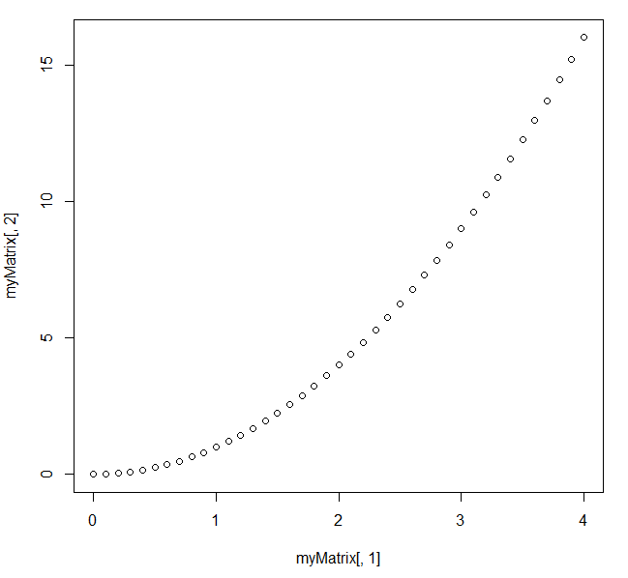
Consider the relationship between x and x ^ 2
https://github.com/afodor/metagenomicsTools/blob/master/src/machineLearningExamples/pcaRotation.txt

Slide 3
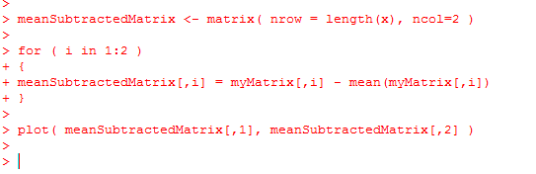
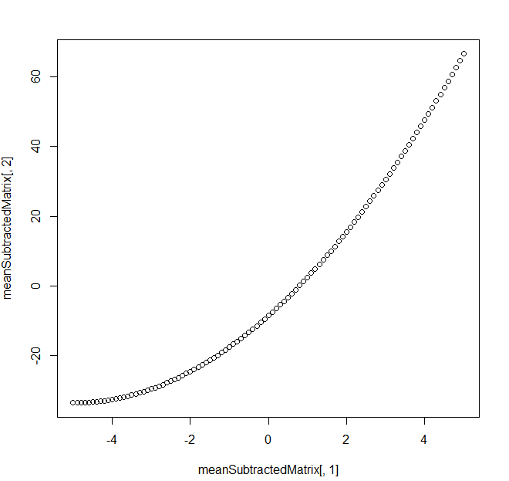
Mean subtracting doesn’t much change the basic shape…
https://github.com/afodor/metagenomicsTools/blob/master/src/machineLearningExamples/pcaRotation.txt

Slide 4
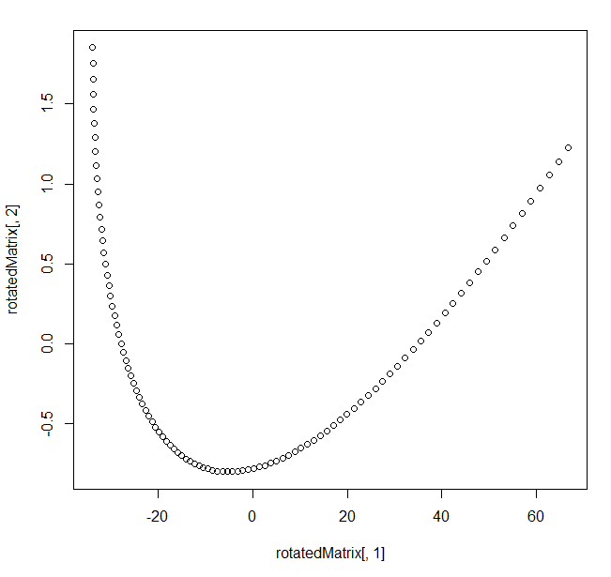
We can perform the PCA via Eigen value rotation
[200, 2] * [2,2] = [200,2]
https://github.com/afodor/metagenomicsTools/blob/master/src/machineLearningExamples/pcaRotation.txt

Slide 5
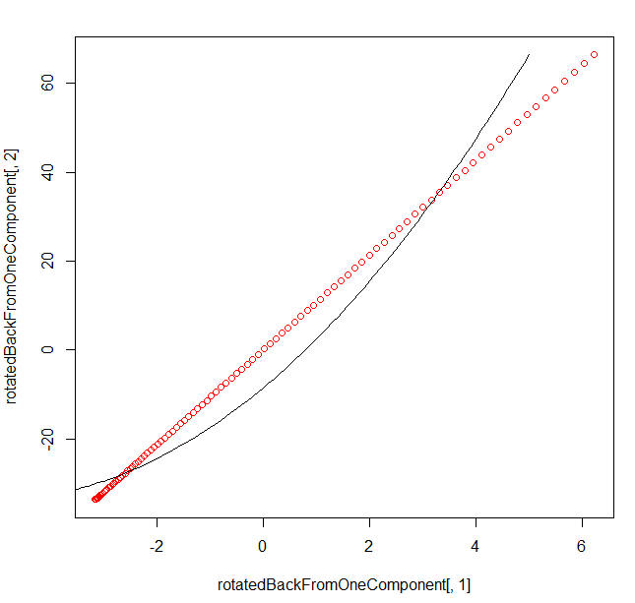
Here, we rotate it back but only use the first PCA component
[200 * 1]
[ 1 * 2 ]
= [200 * 2]
In one linear component,
we can only hold linear
Information…
https://github.com/afodor/metagenomicsTools/blob/master/src/machineLearningExamples/pcaRotation.txt

Slide 6
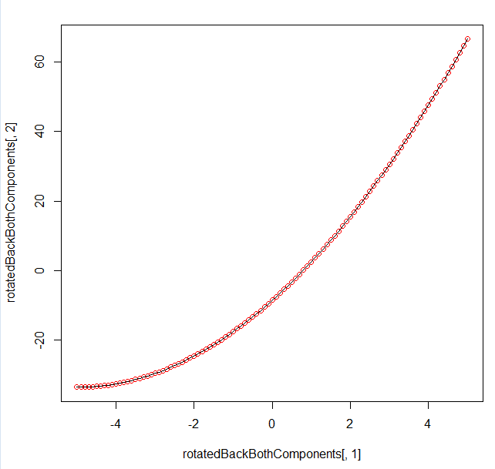
Of course, if we use both components, we can get the original data back…
[200 * 2] * [2,2] = [200 * 2]
https://github.com/afodor/metagenomicsTools/blob/master/src/machineLearningExamples/pcaRotation.txt

Slide 7
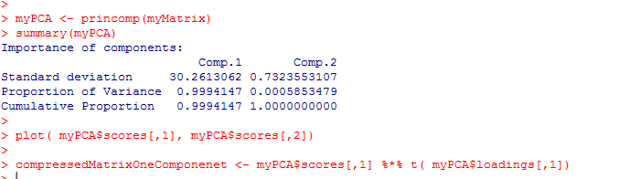
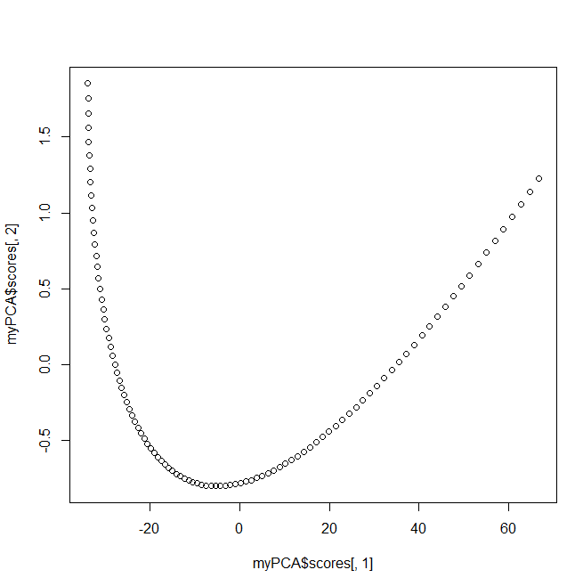
With alternative syntax (but identical results…)
https://github.com/afodor/metagenomicsTools/blob/master/src/machineLearningExamples/pcaRotation.txt

Slide 8
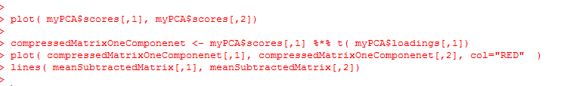
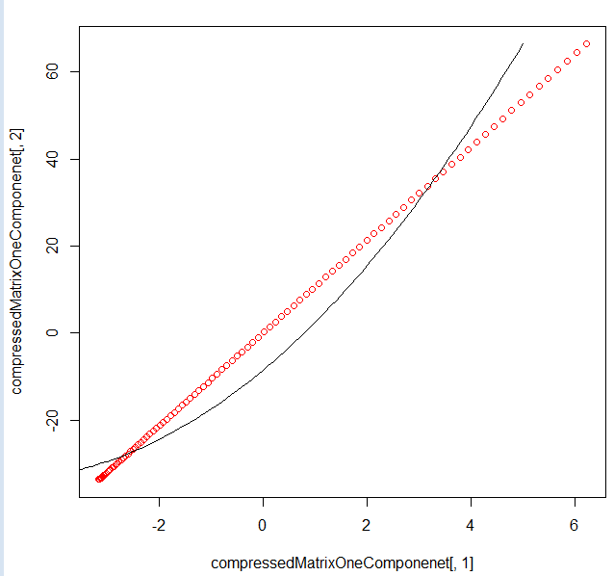
With alternative syntax (but identical results…)
https://github.com/afodor/metagenomicsTools/blob/master/src/machineLearningExamples/pcaRotation.txt

Slide 9
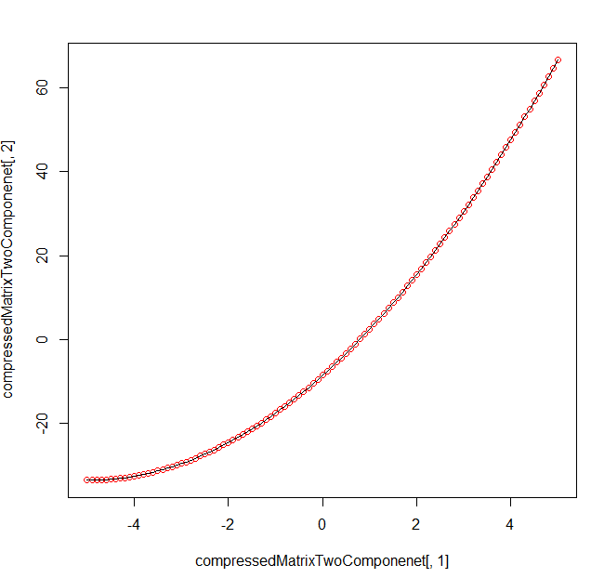
With alternative syntax (but identical results…)
https://github.com/afodor/metagenomicsTools/blob/master/src/machineLearningExamples/pcaRotation.txt

Slide 10
One more PCA Example
Classification by linear models
Classification by nearest neighbor
Variance vs. bias trade-offs
The curse of dimensionality

Slide 11
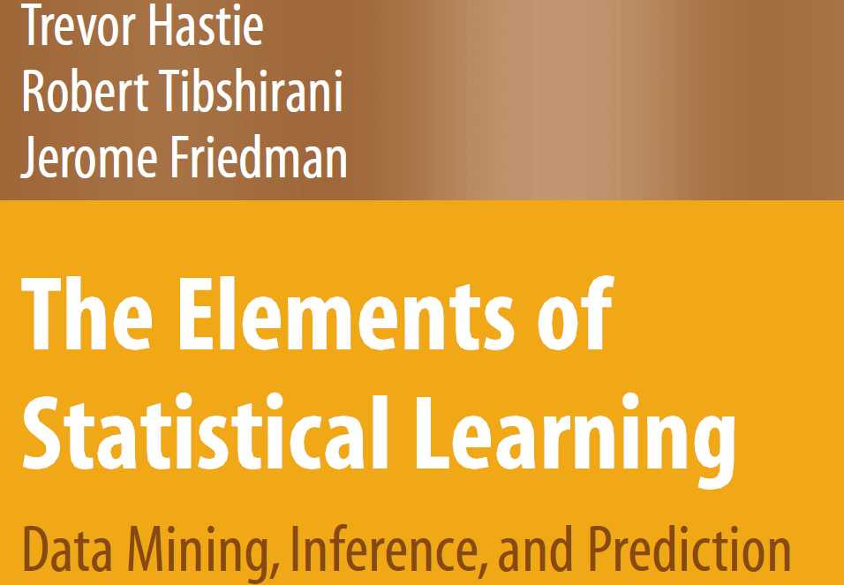
Legal download:
http://www-stat.stanford.edu/~tibs/ElemStatLearn/printings/ESLII_print10.pdf

Slide 12
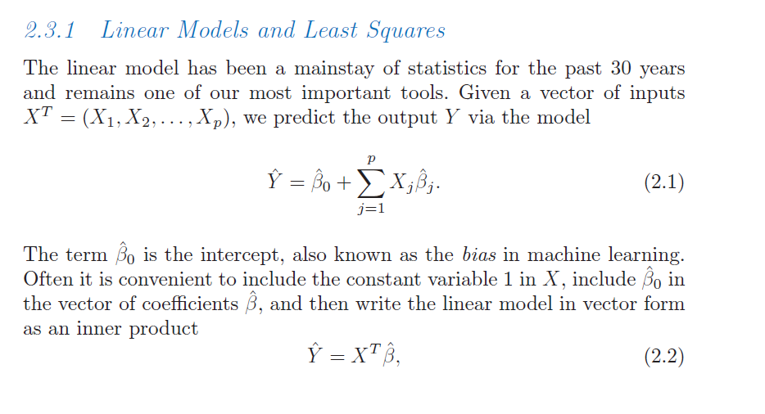
We have our (familiar) linear algebra notation for linear models..
Hastie et al: The elements of Statistical Learning
http://www-stat.stanford.edu/~tibs/ElemStatLearn/download.html

Slide 13
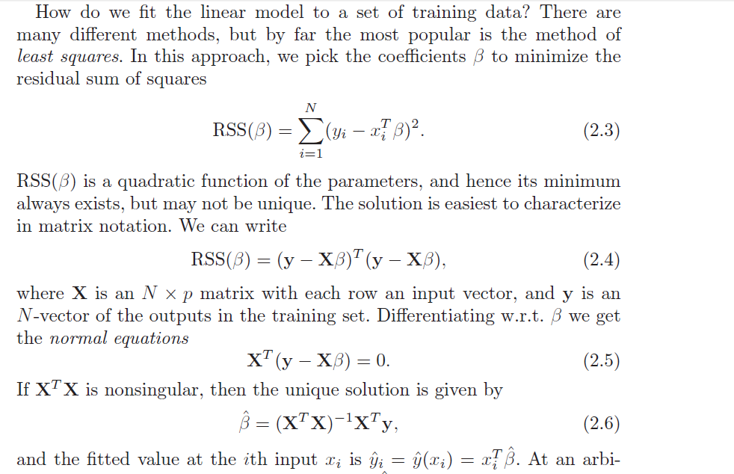

Slide 14
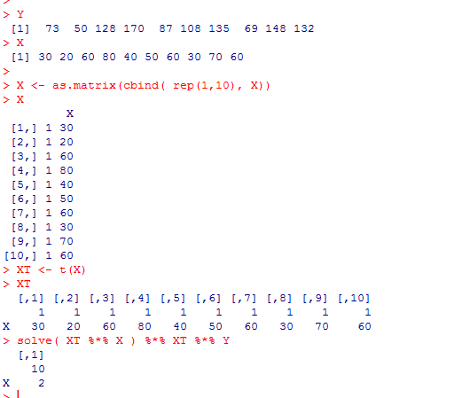
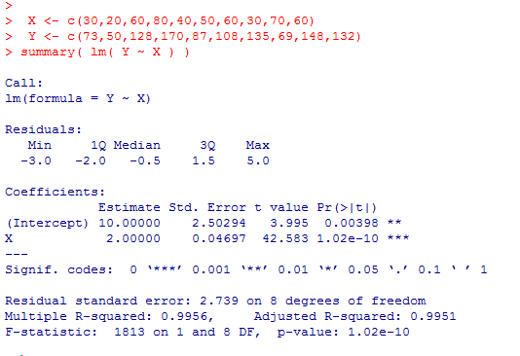

So we can find least square parameters easily with a few line of matrix manipulation
Previously, we were primarily concerned with inference
What is the probability that the true values of the parameters are 0?
Dependent on assumptions: normality, equal variance, linearity, etc.
Now we are more concerned with classification.
Given a new set of X values, how well can we predict y?

Slide 15
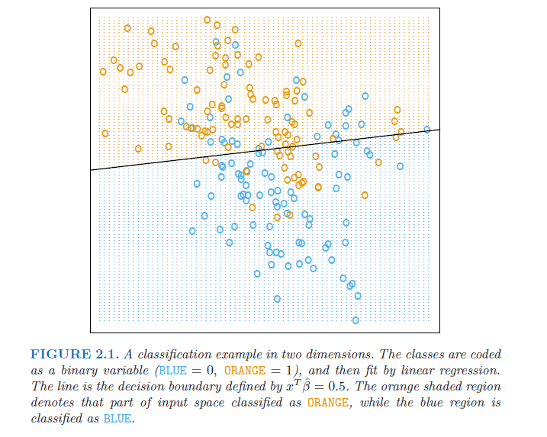
A two-dimensional classification problem…

Slide 16
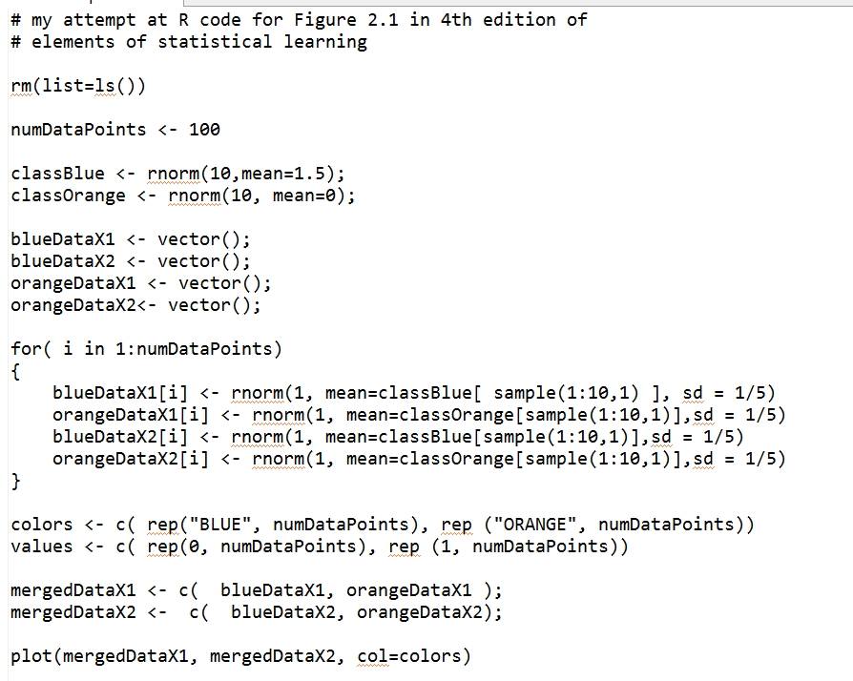
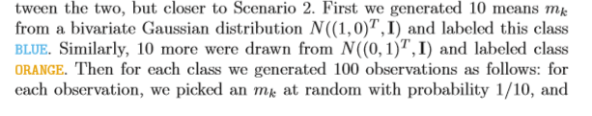
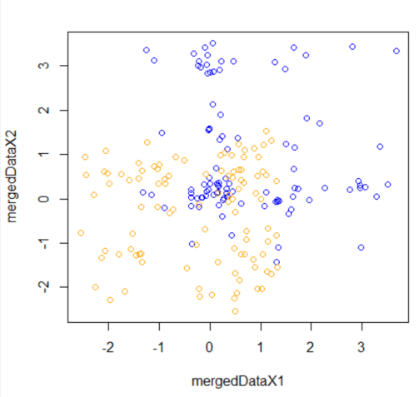
Here is code that generates a similar training set
https://github.com/afodor/metagenomicsTools/blob/master/src/machineLearningExamples/linearExampleInR.txt

Slide 17
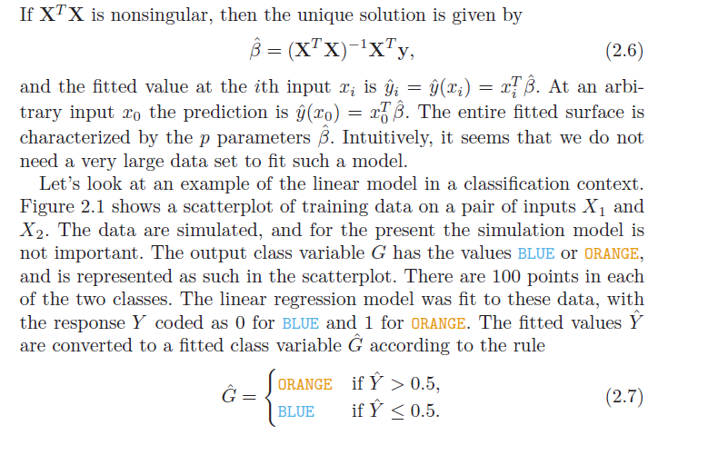
Y = B0 + B1 * X1 + B2 *X2
We want the line where Y = 0.5
0.5 = B0 + B1 * X1 + B2 * X2
X2 = ( 0.5- B0 - B1 * X1 ) / B2

Slide 18
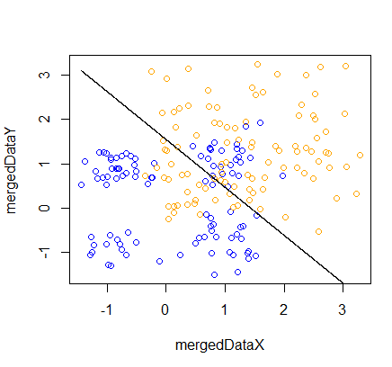
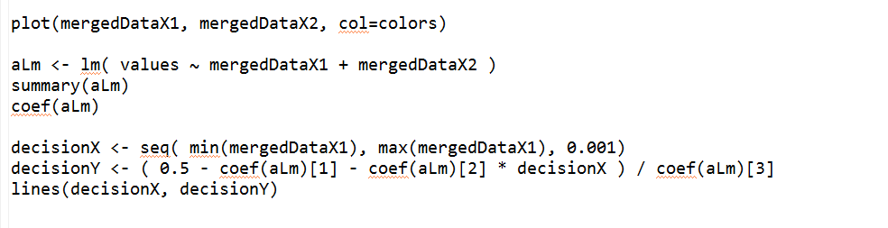
This is very easy to implement in R…
Make a linear model as usual
Solve for 0.5
https://github.com/afodor/metagenomicsTools/blob/master/src/machineLearningExamples/linearExampleInR.txt

Slide 19
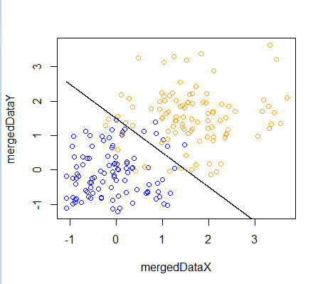
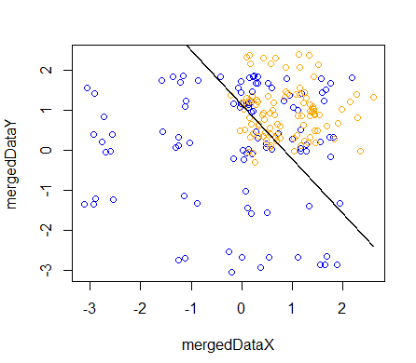
Successive runs on our simulated data set show the linear model sometimes doing
better than others…

Slide 20
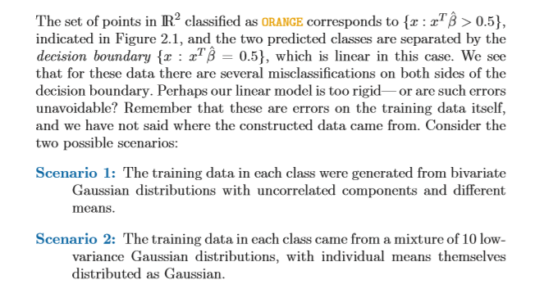

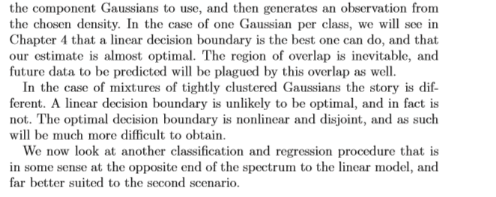
Can we do better than linear models?

Slide 21
One more PCA Example
Classification by linear models
Classification by nearest neighbor
Variance vs. bias trade-offs
The curse of dimensionality

Slide 22
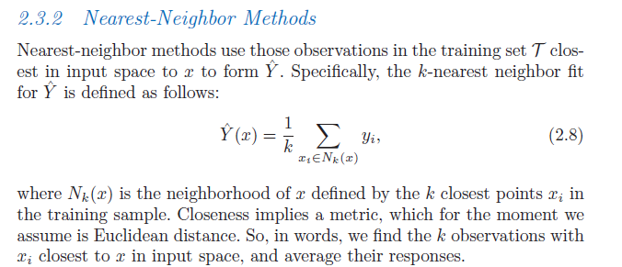

Slide 23
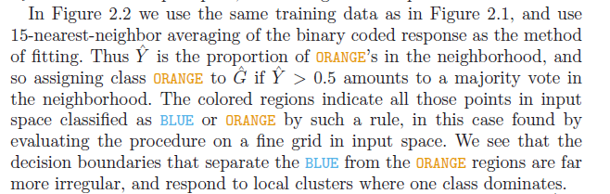
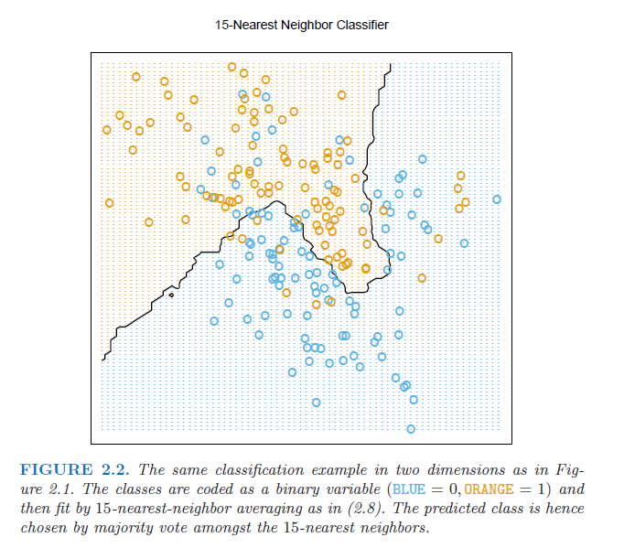
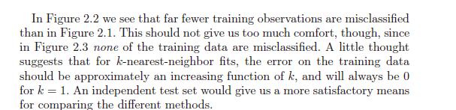

Slide 24
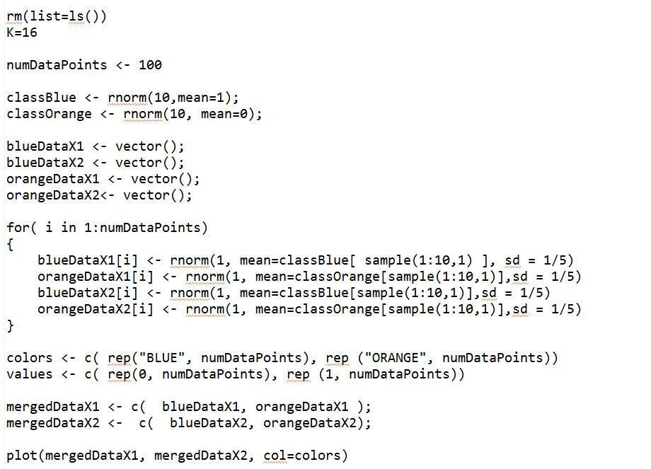
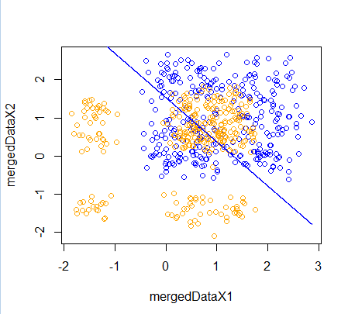
This is a (little) trickier to code up.. We start as before (with the linear fit)..
https://github.com/afodor/metagenomicsTools/blob/master/src/machineLearningExamples/nearestNeighborInR

Slide 25
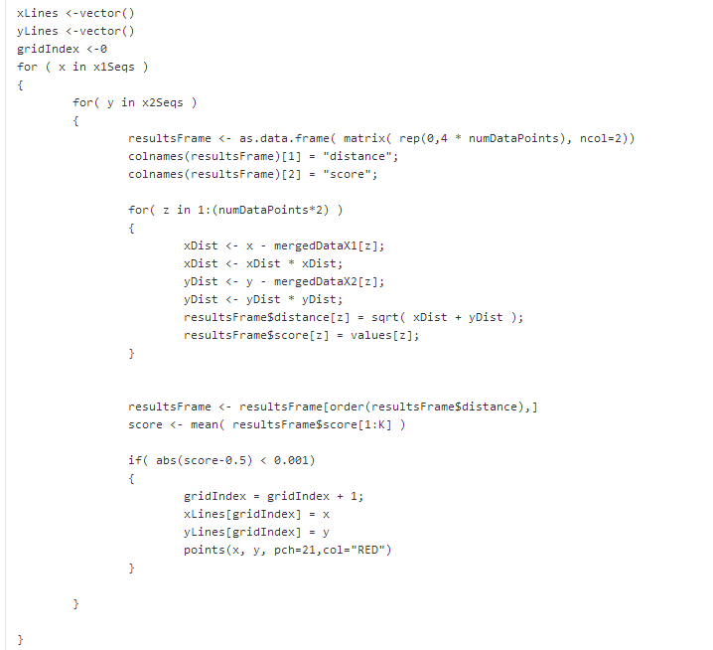
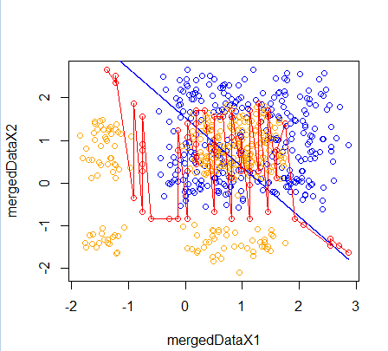
Next we add the nearest neighbor fit..
https://github.com/afodor/metagenomicsTools/blob/master/src/machineLearningExamples/nearestNeighborInR

Slide 26
Next we add the nearest neighbor fit..
Evaluate every point in the grid
Find the distance to all points in the grid
Score the nearest neighbors
Note that k has to be even for this to work!
https://github.com/afodor/metagenomicsTools/blob/master/src/machineLearningExamples/nearestNeighborInR

Slide 27
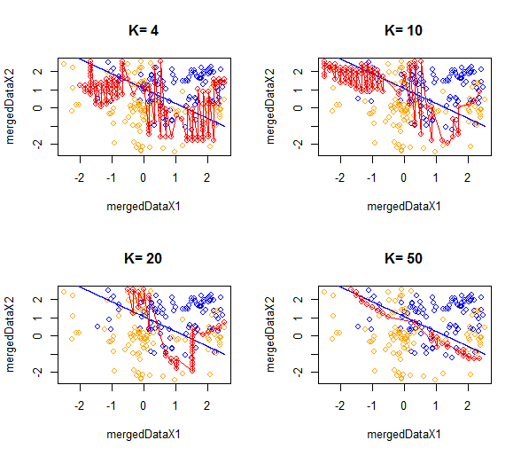
As we increase the nearest neighbor, the models become simpler…
We say we reduce variance but increase bias as k increases…

Slide 28
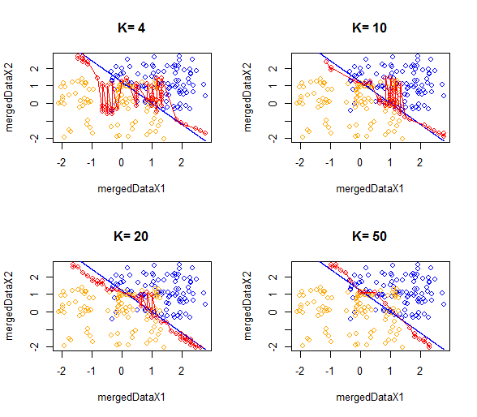

Slide 29
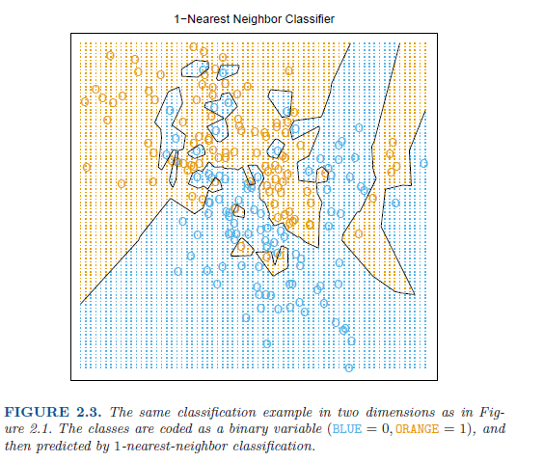
With k=1, over-fitting becomes assured..

Slide 30
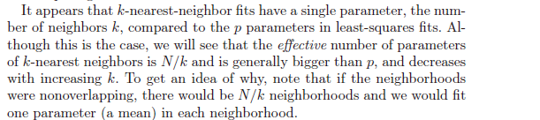
We can more easily over-fit with k-means because there are more effective parameters
How do we choose k? We can’t minimize the sum-squared errors..

Slide 31
One more PCA Example
Classification by linear models
Classification by nearest neighbor
Variance vs. bias trade-offs
The curse of dimensionality

Slide 32
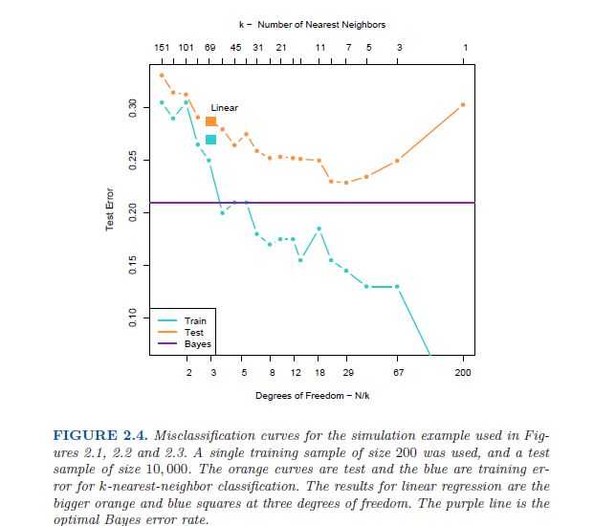
Model is
Under-trained;
High error in
Both training set
And the test set
Model is over-trained;
Low error in the training set
High error in the test set
The theoretically best
model that could be
obtained (if you knew
the “true” distributions)

Slide 33
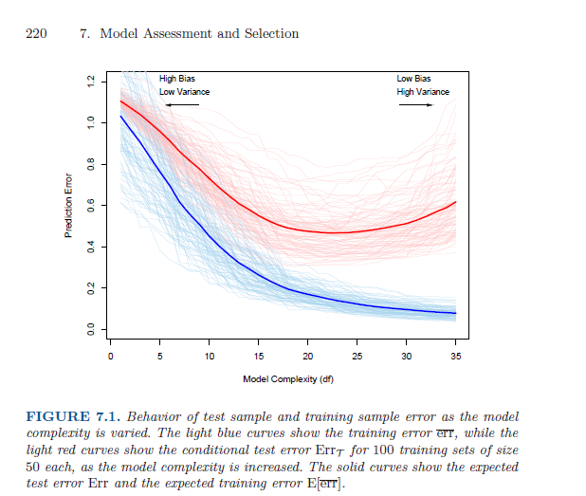
This idea of tuning model complexity to avoid over-fitting and under-fitting
is central to the book (and shows up again in Chapter 7)

Slide 34
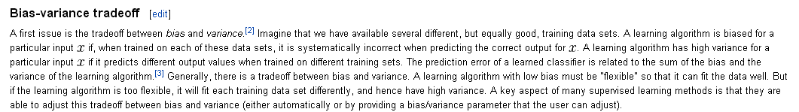
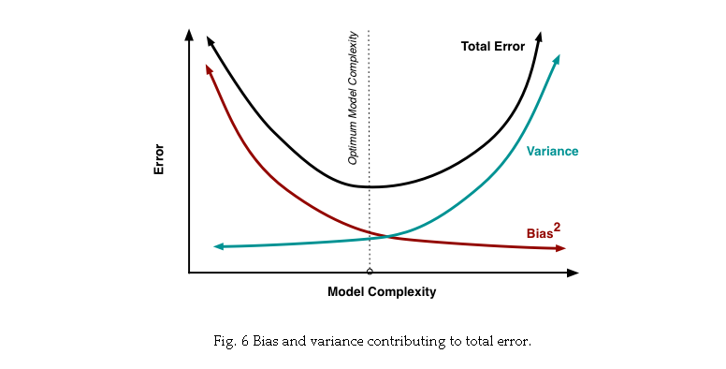
http://scott.fortmann-roe.com/docs/BiasVariance.html

Slide 35
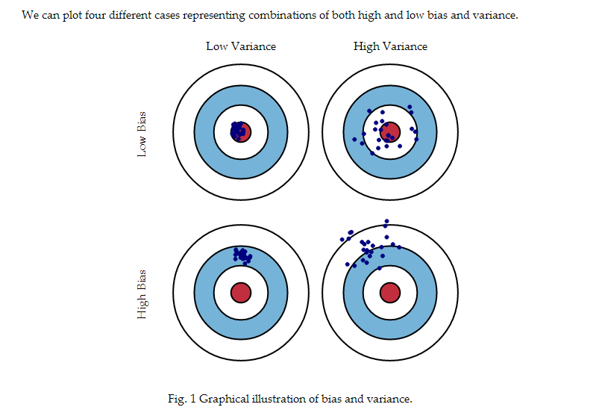
http://scott.fortmann-roe.com/docs/BiasVariance.html

Slide 36
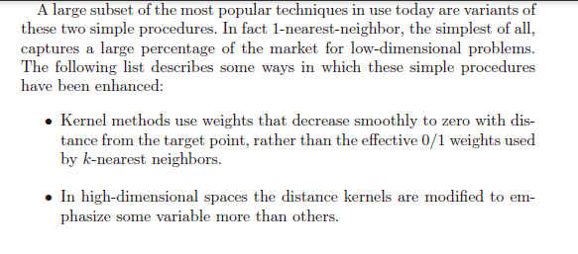
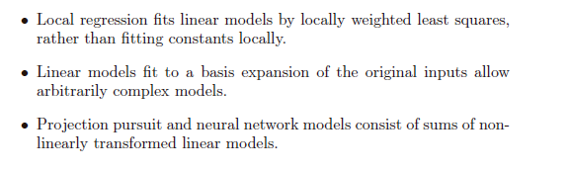

Slide 37
One more PCA Example
Classification by linear models
Classification by nearest neighbor
Variance vs. bias trade-offs
The curse of dimensionality

Slide 38
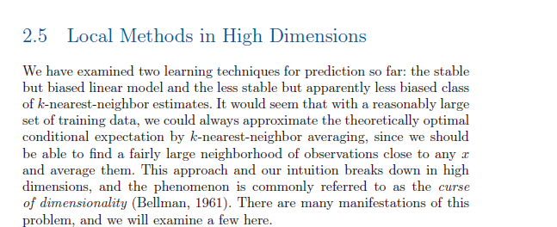
Lots of math towards the end of chapter 2 that we won’t cover…
But this is sort of interesting..

Slide 39
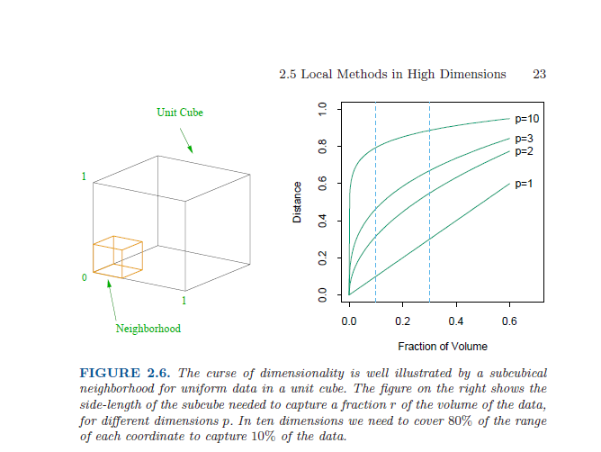
If we have a line, covering 10% of the line take 10% of the total pixels of the line
For a square: I want to cover 10% of all the data. How much of each side (d) do I need?
d ^ 2 = 0.10 ; d = 0.10 ^ (1/2) = 0.31
For a cube: I want to cover 10% of the data: How much of each side (d) do I need?
d ^ 3 = 0.10 ; d = 0.10 ^ (1/3) = 0.46
For 10 dimensions: d ^ 10 = 0.10 ; d = 0.10 ^ (1/10) = 0.794

Slide 40
So for K-means, the “local” space in high dimensions is not local at all!
You’ll need data on the full range of inputs (which you almost certainly will not have)
So we can’t use simple linear models or simple k-nearest neighbors in
high-dimensional space!

