Slide 1
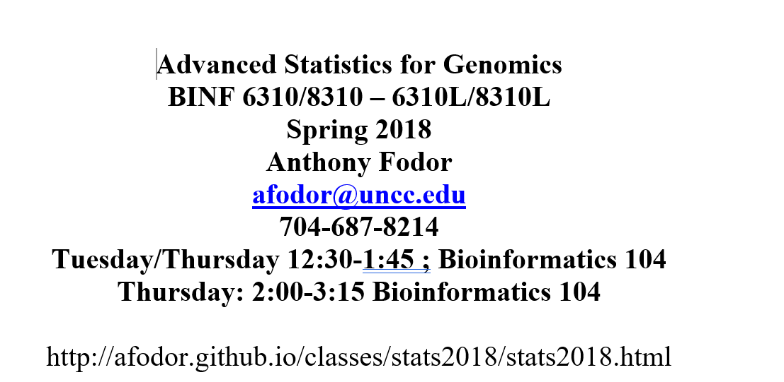

Slide 2
Reading for Thursday:
“Vassar stats book”: http://vassarstats.net/textbook/
Chapter 1 “Principles of Measurement”
Chapter 2: “Distributions”
(or equivalent in your favorite canonical statistics text book).
(The above is presumably review).
In “The Art of R Programming” –
Chapter 1 – “Getting started” –
Chapter 2- “Vectors”
or equivalent chapters here: http://heather.cs.ucdavis.edu/~matloff/132/NSPpart.pdf
If you are getting a non-electronic copy, get this book ordered!

Slide 3
Review of the syllabus
Empirical Distributions
Mean, median and variance
Bioconductor for next-gen sequence datasets
Lab exercise

Slide 4
Required textbook…

Slide 5
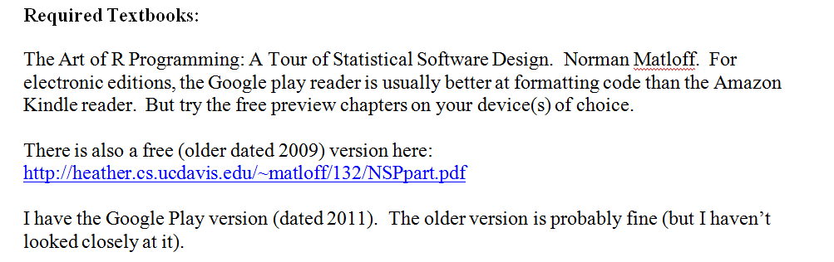

Required:
If you are getting a print copy, order it ASAP…

Slide 6
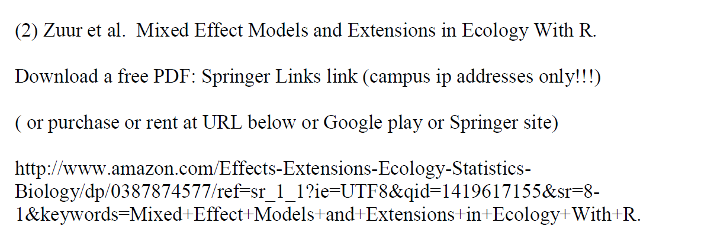


Required:

Slide 7
Recommended textbooks…

Slide 8
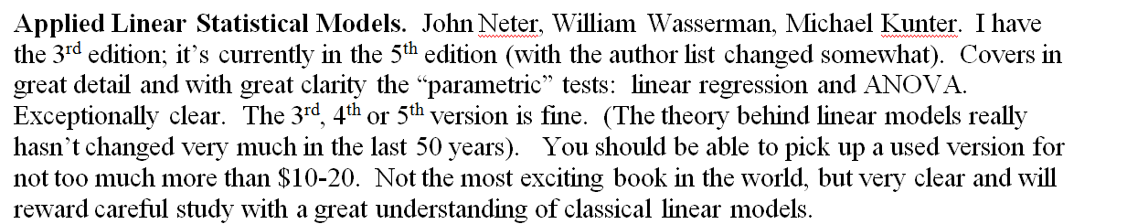

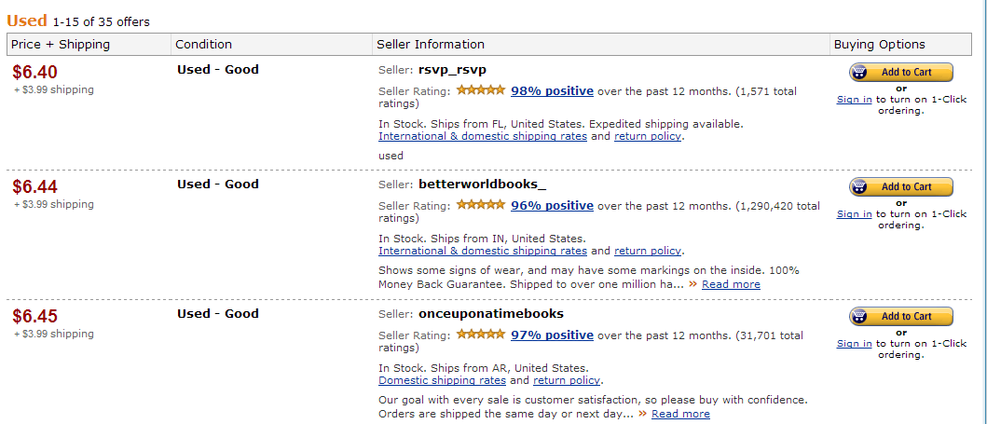
Recommended textbooks…
http://www.amazon.com/gp/offer-listing/025608338X/ref=sr_1_5_olp?ie=UTF8&qid=1357529565&sr=8-5&keywords=applied+linear+statistical+models&condition=used

Slide 9

Recommended textbooks…
Either edition of this book is fine, but new or used is going to be around $40.
It really is an outstanding book (but dense!). It is worth the investment of time and money

Slide 10

Optional depending on interest:
This is a great book, but is insanely over-priced!
We will touch on some of the stuff in here, but it won’t be a central focus.
If you think you will be implementing Bayesian stats in your pipelines, it might be worth having

Slide 11

Doing Bayesian Data Analysis: A Tutorial with R and BUG. John K. Kruschke. More approachable, but also not quite as clear or concise as the Bolstad book. Very nice chapters on Monte Carlo approaches to Bayesian analysis, but a bit heavy on the Bayesian proselytizing for my taste. Also quite expensive. Overall, though, a very engaging text. If you get the Google electronic edition, make sure that your device(s) can show the scanned versions (which are DRM’ed ) as the equations in the default view are illegible.
Be sure to read sample
chapters on the device
of your choice to make
sure formatting is ok
before purchasing…
Optional depending on interest:

Slide 12

Optional depending on interest:
Recommended:
It’s about $30-$40 and will make your life easier, but is not strictly required.
More useful as a reference than as a tutorial…

Slide 13
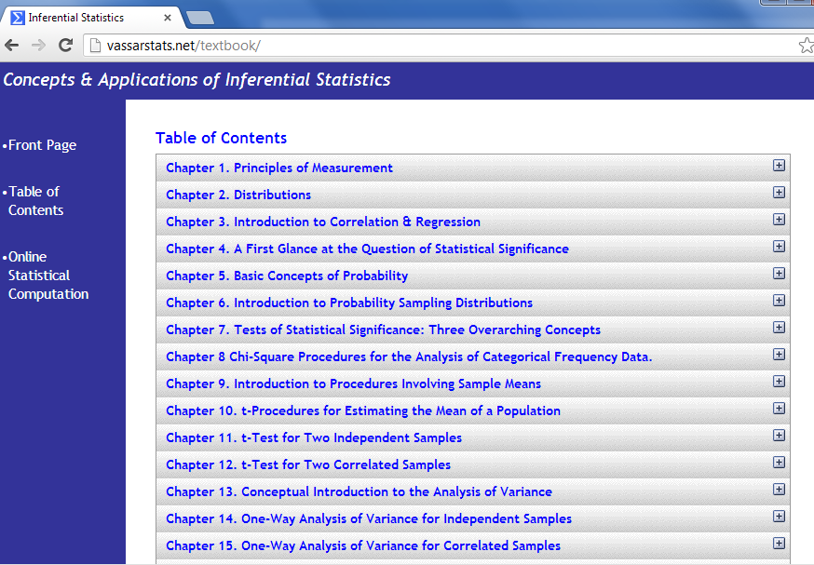
On-line resources:
Vassar stats book
http://vassarstats.net/textbook/
You will need at least one book that covers canonical statistics.
Start with this one (it is free) and then if it is not working for you, consider alternatives…

Slide 14
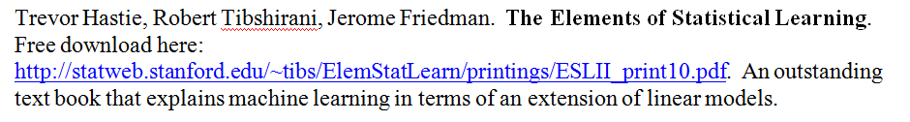

Legal download:
http://www-stat.stanford.edu/~tibs/ElemStatLearn/printings/ESLII_print10.pdf

Slide 15
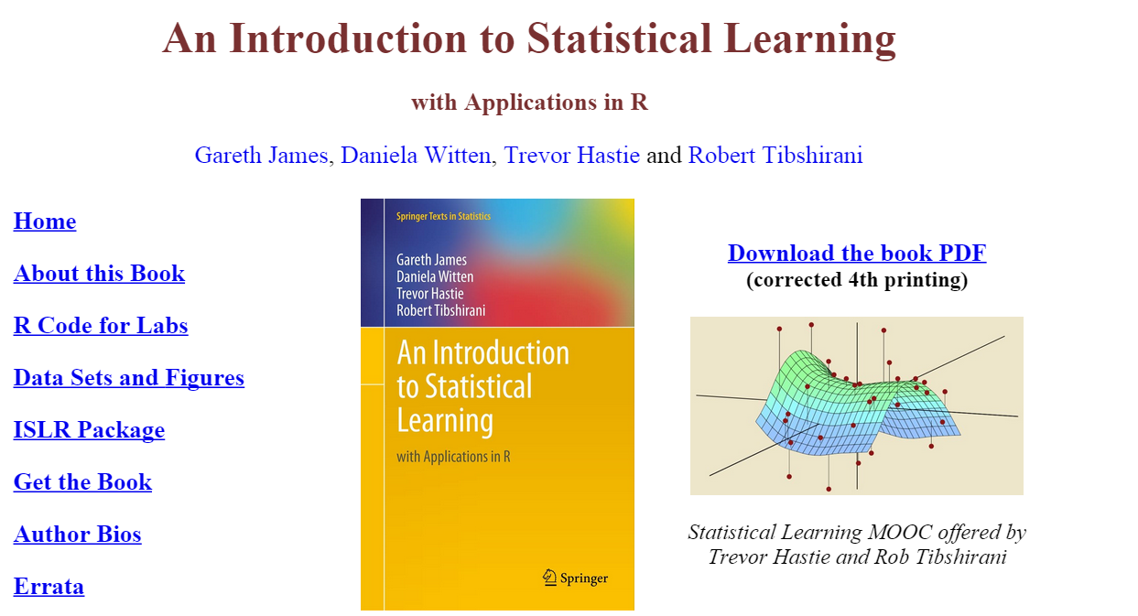
A less mathematical treatment of the same material….
http://www-bcf.usc.edu/~gareth/ISL/

Slide 16
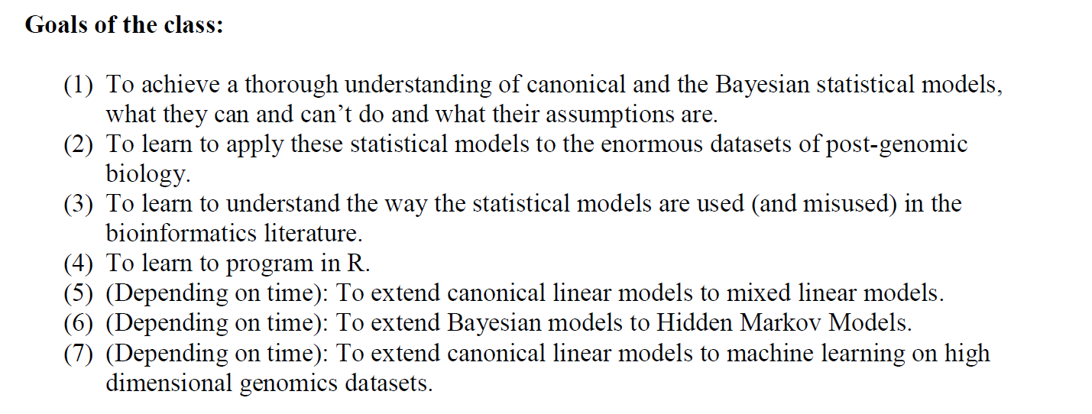

Slide 17
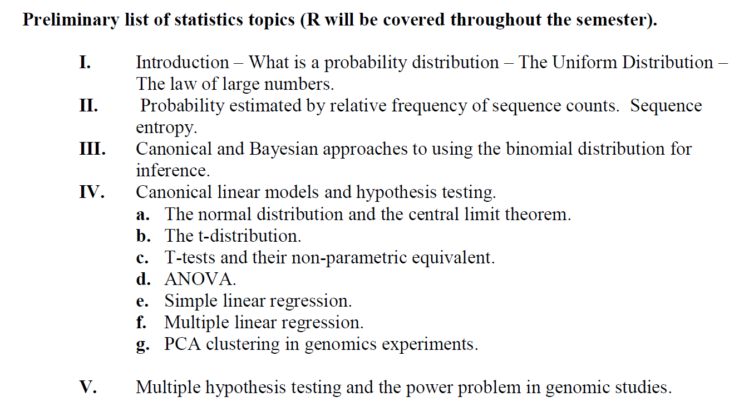

Slide 18
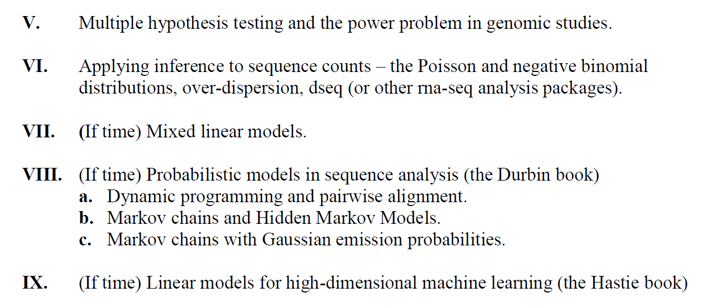

Slide 19
Review of the syllabus
Empirical Distributions
Mean, median and variance
Bioconductor for next-gen sequence datasets
Lab exercise

Slide 20
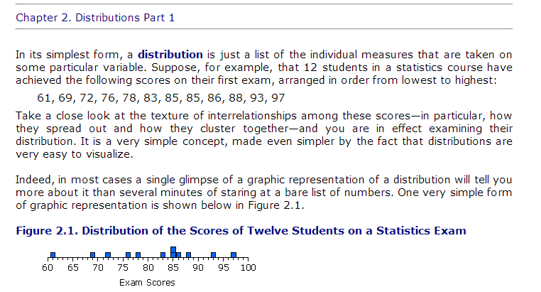
Empirical distributions – a set of data that has been observed (or is capable of being observed)
For example: 12 exam scores
http://vassarstats.net/textbook/

Slide 21
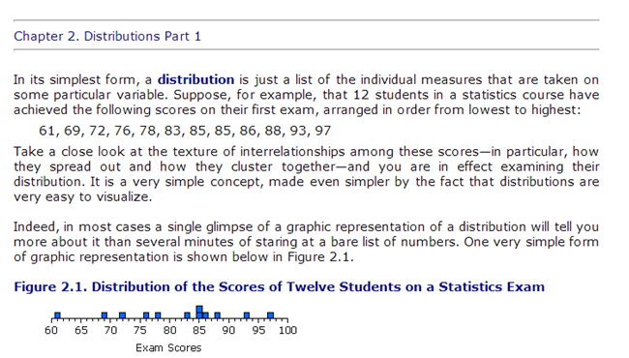
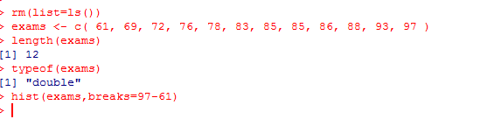
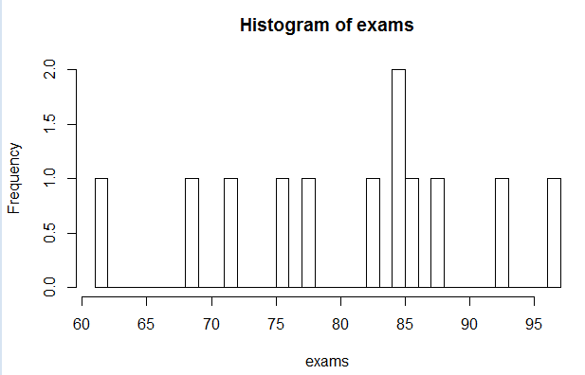
In R, we can create a vector that will hold our empirical distribution.
A vector in R is a one-dimensional ordered list of data.
All of the data in an R vector must be of the same type.

Slide 22
rm(list=ls()) - removes everything in the R workspace
exams <- c( 61, 69, 72, 76, 78, 83, 85, 85, 86, 88, 93, 97 )
Make a vector with the data and point to it with the reference “exams”
length(exams) – returns the length of our vector
typeof(exams) – returns the type of our vector (floating point numbers)
hist(exams,breaks=97-61) – Make a histogram with a separate bin for each possible grade

Slide 23
If we just do hist(exams), we get the default number of bins

Slide 24
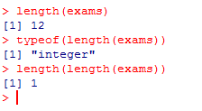
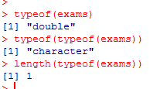
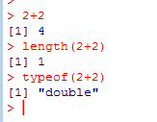
There are no single pieces of data in R. Everything is a vector
length returns a vector (of size=1) that holds the length of the input vector
typeof returns a vector (of size=1) that holds the string that describe the vector
“2+2” returns a vector of length 1…

Slide 25
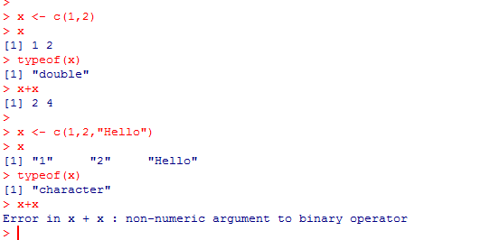
Everything in an R vector must be of the same data type.
R will find the common data type…
In the second case, the common data type is character.
The + operator is not defined for “character” so x + x fails in the second case…

Slide 26
Review of the syllabus
Empirical Distributions
Mean, median and variance
Bioconductor for next-gen sequence datasets
Lab exercise

Slide 27
Let’s return to our empirical distribution:
For all distributions, we can define measures mean, median and variance:

Slide 28
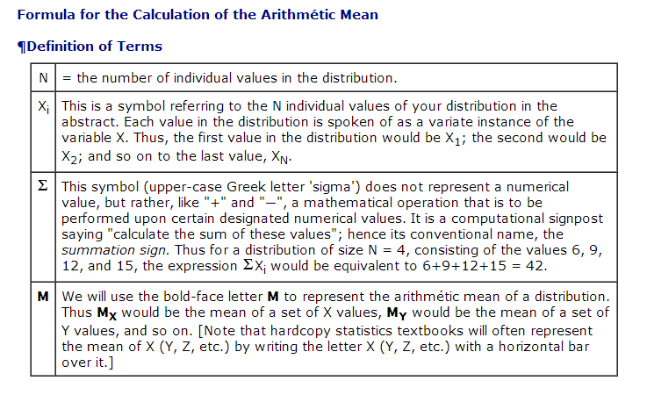
mean = sum(measurements) / # of measurements
mean is sensitive to outliers…
http://vassarstats.net/textbook/

Slide 29
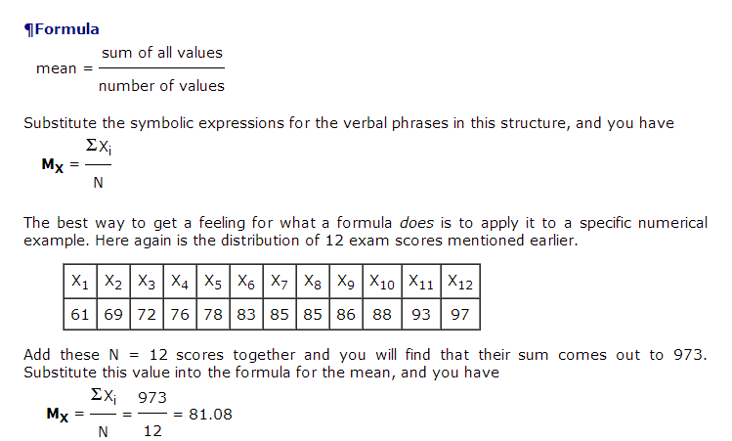
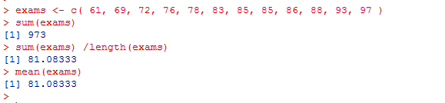
http://vassarstats.net/textbook/

Slide 30
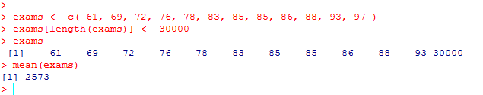
The mean calculation is sensitive to outliers…
Vectors are 1-indexed in R (unlike C/C++/Java data structures)
exams[length(exams)] <- 30000 changes the last data point.
We see the mean is changed.
We say that arithmetic mean is not robust to outliers.

Slide 31
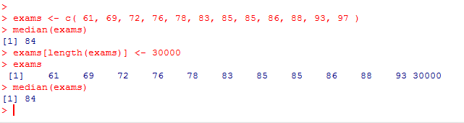
The median is just the middle value.
For an even set of numbers, it is the average of data above and below the middle
in the sorted list of data..
Notice the median does not change when the outlier is introduced.
We say that median is robust to outliers.

Slide 32
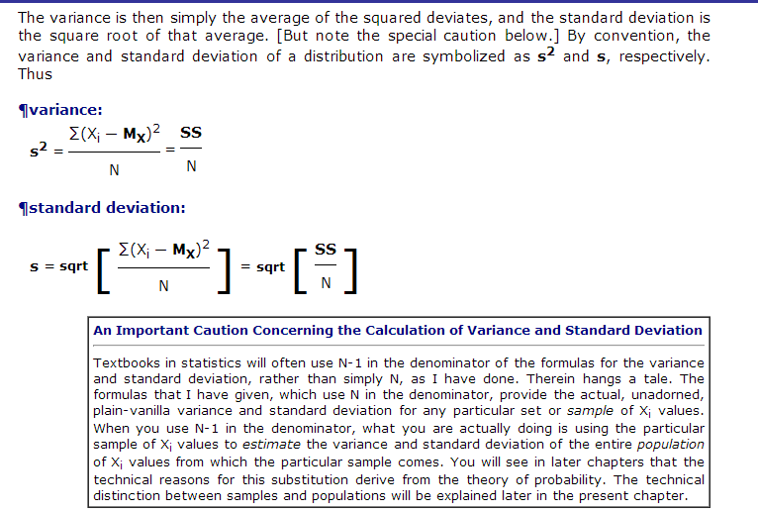
Variance (for “sample mean”)

Slide 33
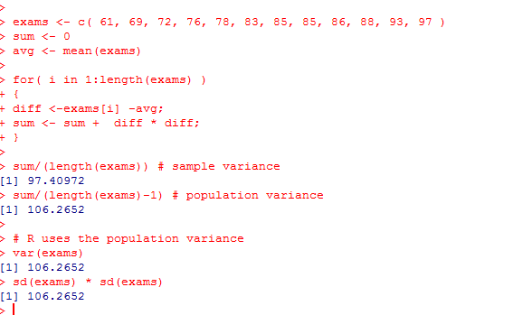
R uses the population variance (n-1 in denominator).
If you know the mean ahead of time, you can use the sample variance.
Otherwise (as is usually the case), you estimate the mean from your data,
lose 1 degree of freedom and use the population variance (with n-1 in the denominator)
Standard deviation is the sqrt(variance)

Slide 34
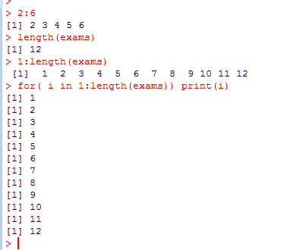
Notice I have a for loop here.
I index my vecor with [] (like arrays in Java).
: is sequence generator operator
(returns a vector)
1:length(vector) returns a vector with the
Integers 1 through 12.
The for loop iterates through these 12 vectors

Slide 35
Review of the syllabus
Empirical Distributions
Mean, median and variance
Bioconductor for next-gen sequence datasets
Lab exercise

Slide 36
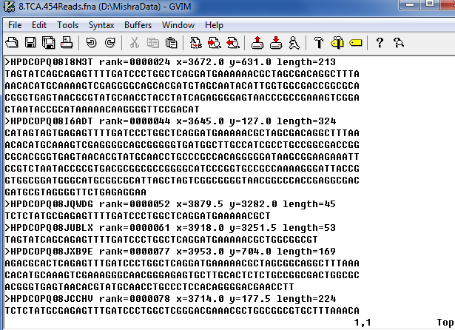
Even these simple metrics can be useful in looking at next-gen sequencing experiments.
A 454 sequencing experiment

Slide 37
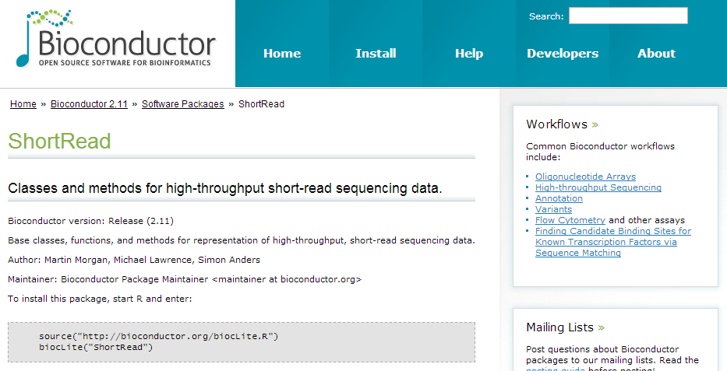
We will use the readFasta method in the BioConductor “shortReads” library

Slide 38
If we are connected to the internet, we can easily install the library..
source("http://bioconductor.org/biocLite.R") #this only needs to be done once
biocLite("ShortRead") #this only has to be done once
library("ShortRead") #this needs to be done with every new R session
?readFasta
example(readFasta)

Slide 39
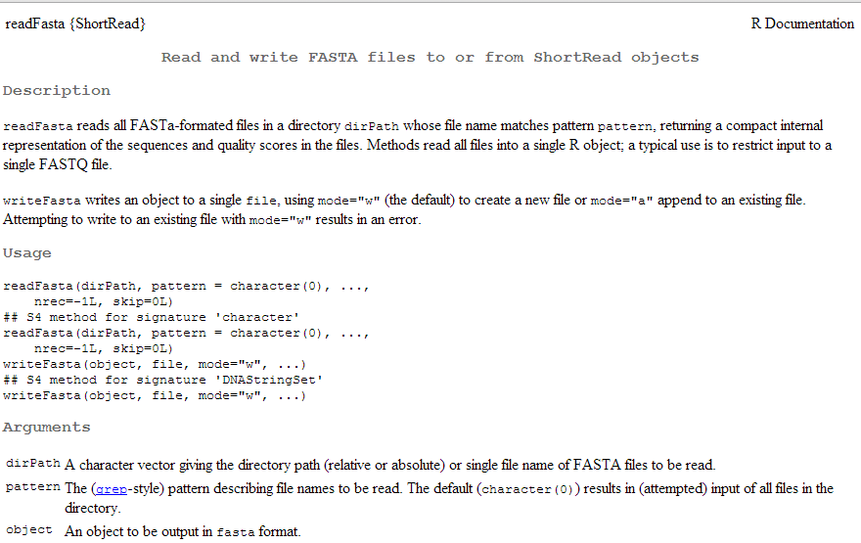
Here is the help file for readFasta

Slide 40
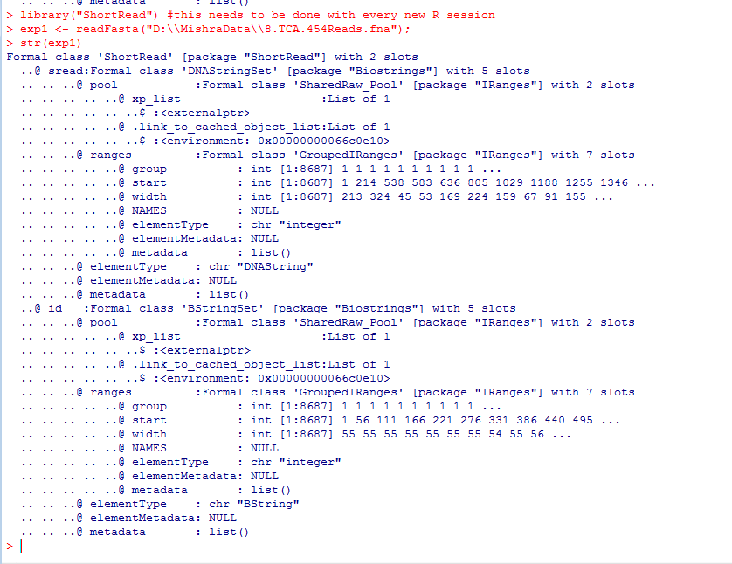
The hard thing with using other people’s libraries in R. Figuring out where your data are!
str() is structure…

Slide 41
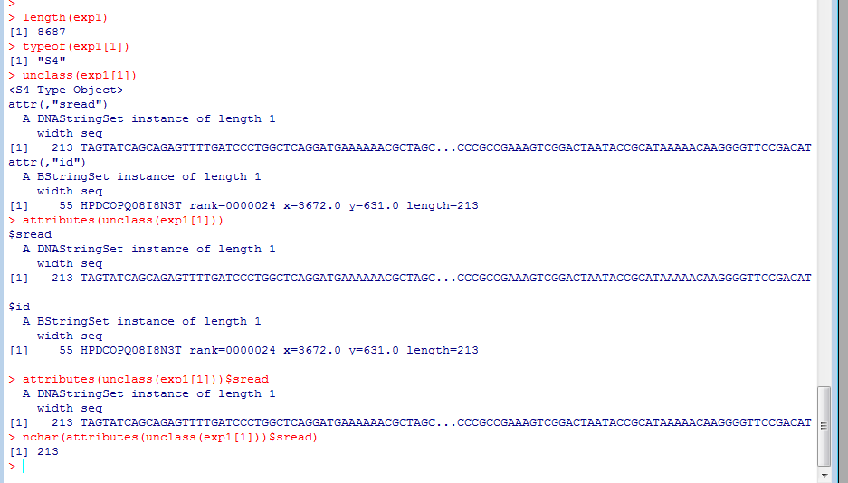
Here is one way to get the length of the first sequence…
This is an “S4” r object (more on that later)
Pull the attributes out (attributes are like fields in Java)
The field we want is sread
That seems to work but is far from ideal (among other problems it will be slow in a loop)

Slide 42
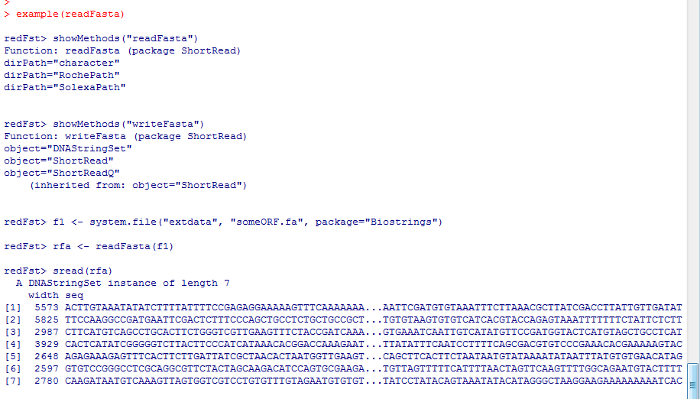
Typing example(fastaRead) gives us another idea
sread is a function provided to help us out..

Slide 43
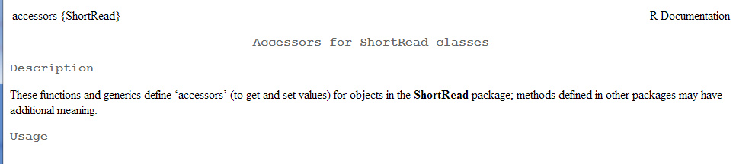
Here is the man page for sread (which we get to by typing ?sread)

Slide 44
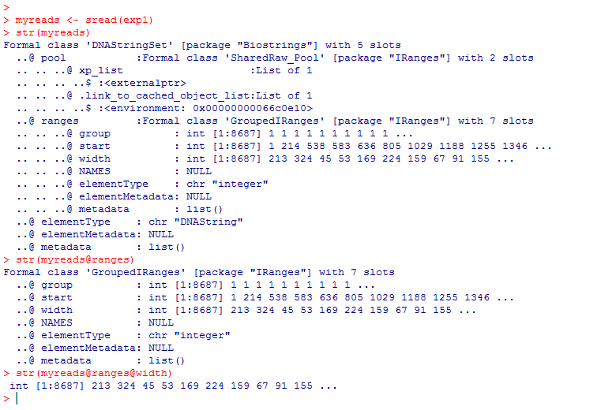
Much better! myreads@ranges@width is the vector of sequence lengths already put there for us by sread
(@ is evidently a selection operator for S4 classes ; more on this later)

Slide 45
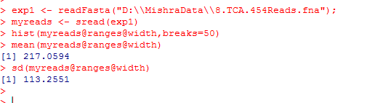
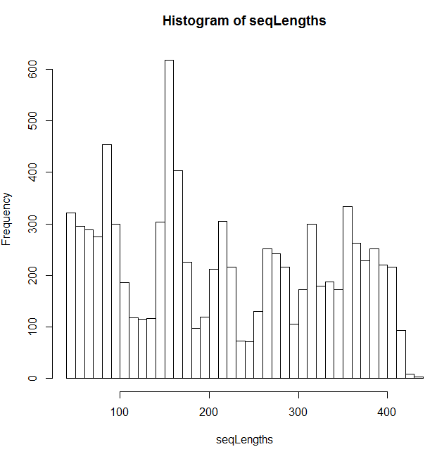
Looking at our data, this was not a good sequencing run
SD is too high (about half of mean)
Distribution is a mess!

Slide 46
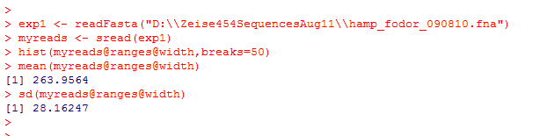
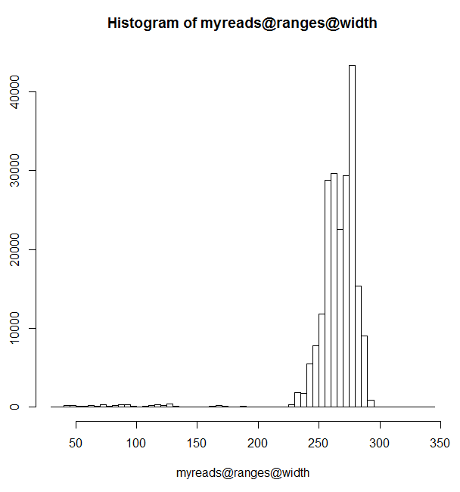
Here is a different (better) sequencing run…
Reasonable standard deviation
(about 10% of mean)
Nice tight distribution

Slide 47
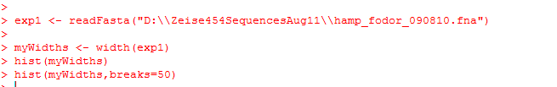
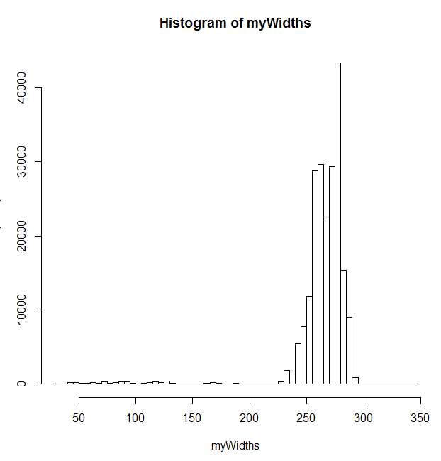
(From Raad Gharaibeh)
A more direct way to get the widths…

Slide 48
R commands you should understand and practice from this lecture:
rm(list=ls())
ls()
length()
typeof()
hist()
mean()
median()
sd()
var()
str()
c()
The : operator
R concept you should understand at this point:
vector – one dimensional array with data all of the same type

Slide 49
Lab exercises (for Thursday afternoon at 2:00)
Use the mean and sd functions to calculate the mean and standard deviation
of the following numbers { 2.3, 4.3 ,1.2 , 3.4, 8.3, 12.2 }
(2) Use mean and sd in R to calculate the average and sd of { 4,5,6 …. 678,679,680 }
(the set of every positive integer between 4 and 680)
(3) Download and unzip (using gzip –d ) these sequences:
http://fodorlab.uncc.edu/sites/fodorlab.uncc.edu/files/media/Hamp_Fodor_090810.tar.gz
Using Bioconductor from R determine :
How many sequences are in the dataset? What is the mean and SD of the lengths?
Display a histogram of the lengths.
Use R commands to try and figure out the information in the BioConductor objects
BONUS: Display a histogram of the GC content of the sequences.
(This can be done entirely in R or using Java or another language to dump data to R)
Show these to me before you leave Thursday afternoon (but nothing to hand in yet…)

Slide 50
Reading for Thursday:
“Vassar stats book”: http://vassarstats.net/textbook/
Chapter 1 “Principles of Measurement”
Chapter 2: “Distributions”
(or equivalent in your favorite canonical statistics text book).
(The above is presumably review).
In “The Art of R Programming” –
Chapter 1 – “Getting started” –
Chapter 2- “Vectors”
or equivalent chapters here: http://heather.cs.ucdavis.edu/~matloff/132/NSPpart.pdf
If you are getting a non-electronic copy, get this book ordered!

