Slide 1
Disease detectives – Attack rate, relative rate , odds ratio, case fatality
(made up data….)
60 people attended a fair. 40 of them got sick.
120 people did not attend the fair. 10 of them got sick.
First thing for any data like this, make a two by two contingency table…
Label each row and column
 | Got sick (case) | Did not get sick (control)
Attended the fair | 40 | 20
Did not attend the fair | 10 | 110
Once you have your table, re-read everything;
Make sure all the numbers add up!!

Slide 2
60 people attended a fair. 40 of them got sick.
120 people did not attend the fair. 10 of them got sick.
60 people attended the fair
 | Got sick (case) | Did not get sick (control)
Attended the fair | 40 | 20
Did not attend the fair | 10 | 110

Slide 3
60 people attended a fair. 40 of them got sick.
120 people did not attend the fair. 10 of them got sick.
 | Got sick (case) | Did not get sick (control)
Attended the fair | 40 | 20
Did not attend the fair | 10 | 110
120 people did not attended the fair
Your first contingency table will (if you are like me) be wrong, so double check it…

Slide 4
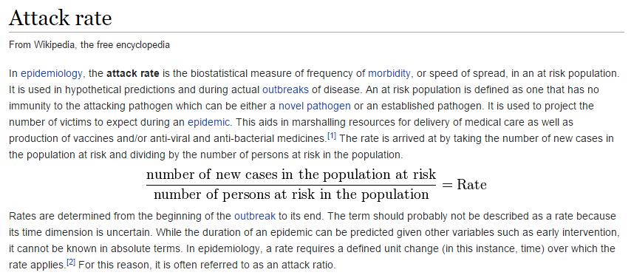
 | Got sick (case) | Did not get sick (control)
Attended the fair | 40 | 20
Did not attend the fair | 10 | 110
For people who attended the fair, what is the attack rate?
It seems as if they will (usually) ask about the attack rate in the vulnerable population

Slide 5
 | Got sick (case) | Did not get sick (control)
Attended the fair | 40 | 20
Did not attend the fair | 10 | 110
For people who attended the fair, what is the attack rate?
= 40 / ( 40 + 20 )
# of people who got sick
# of people who attended the fair
= 2/3 = 66.67%
If you attend the fair, you are at a 2/3 risk of contacting the disease

Slide 6
What is the relative risk of attending the fair?
The relative risk is the ratio of attack rates of attending the fair vs. not attending the fair
 | Got sick (case) | Did not get sick (control)
Attended the fair | 40 | 20
Did not attend the fair | 10 | 110
Attack rate for attending the fair: 40 / (40 + 20) = 0.67
Attack rate for not attending the fair: 10 / ( 10 + 110 ) = 0.077
The relative risk is the ratio of these two numbers 0.67 / 0.077 = 8.67

Slide 7
The odds ratio is another way of thinking about how dangerous the fair is.
 | Got sick (case) | Did not get sick (control)
Attended the fair | 40 | 20
Did not attend the fair | 10 | 110
If you attended the fair, what are the odds that you got sick….
= 40 / 20 = 2
If you did not attend the fair, what are the odds that you got sick…
= 10 / 110 = 0.09
The odds ratio is 2 / 0.09 = 22.2
If the population is small and the disease is common, and you are asked to choose
between the odds ratio and risk ratio, choose the odds ratio…

Slide 8
If the population is large, and the disease is rare,
the odds ratio is approximately equal to the risk ratio
(Made up data…)
1,000,000 people live in Charlotte ; 1% of them have the disease.
500,000 people live in Chapel Hill; 0.5% of the have the disease.
What is the risk ratio of living in Charlotte relative to Chapel Hill?
= .01 / .005 = 2
What is the odds ratio
 | Got sick (case) | Did not get sick (control)
Charlotte | 10,000 | 990,000
Chapel Hill | 2500 | 497,500
=( 10,000 / 1,000,000 ) / (2,500 / 500,000) = 2

Slide 9
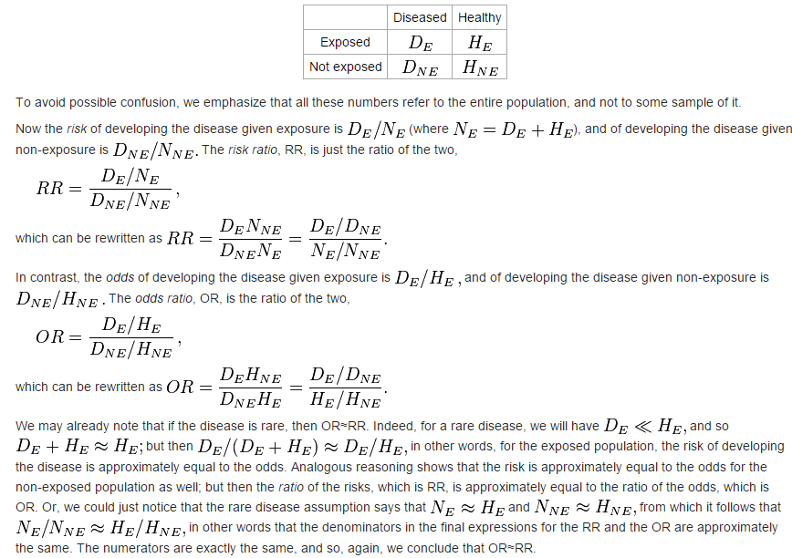
For those of you who are more mathematically inclined…
https://en.wikipedia.org/wiki/Odds_ratio

Slide 10
 | Got sick (case) | Did not get sick (control)
Attended the fair | 40 | 20
Did not attend the fair | 10 | 110
If you attended the fair, what are the odds that you got sick….
= 40 / 20 = 2
If you did not attend the fair, what are the odds that you got sick…
= 10 / 110 = 0.09
The odds ratio is 2 / 0.09 = 22
Alternatively (like on your study guide), you can do
= (40 * 110 ) / (10 *20 ) = 22
Since you may be able to do that faster…

Slide 11
These are the same…
40
110
40
*
20
20
=
10
10
110
40
110
*
=
= (40 * 110 ) / (10 *20 ) = 22
10
*
20

Slide 12
Case fatality rate:
The ratio of people with the disease who die from it
 | Got sick (case) | Did not get sick (control)
Attended the fair | 40 | 20
Did not attend the fair | 10 | 110
Of the people who got sick, 25 died. What is the fatality rate?
25 / (40 + 10 ) = 0.5

