Slide 1
Lab #9:
Due before class 11/16/2017 to afodor@uncc.edu and mbrown67@uncc.edu
Put “Lab #9” in the subject (by request, we have 2 weeks to allow a “catch up”
period)…
This lab runs a supervised classification program from multiple threads…

Slide 2
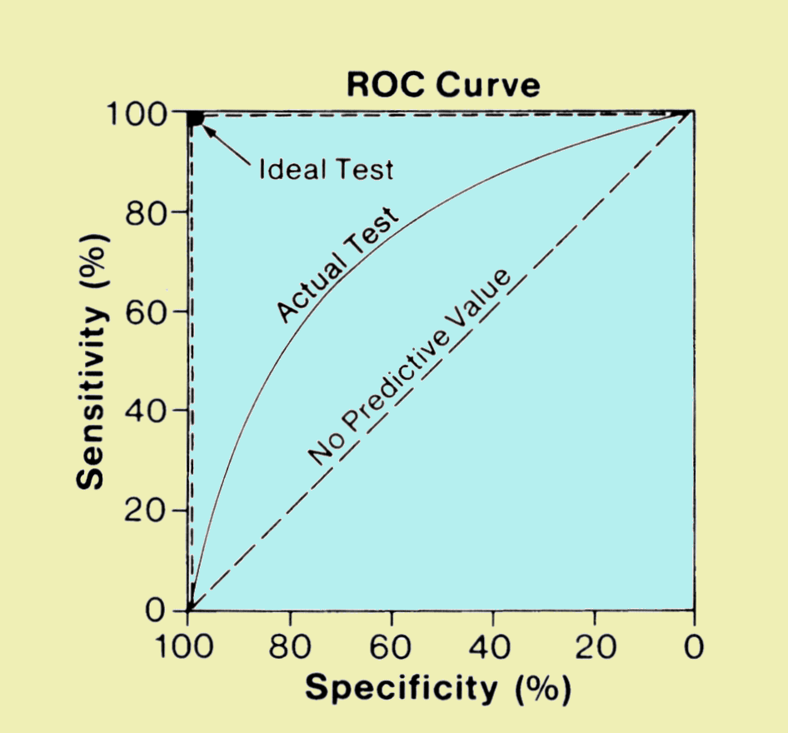
The “big data” approach to classification problems
Is a voter democratic or republican?
Voters with known affiliation
Training set
Test set
Find features
(income, zip code, gender)
that predict affiliation
Build statistical model
Make predictions on test set
Image: http://www.sprawls.org/ppmi2/IMGCHAR/1IMCHAR12.gif

Slide 3
The “big data” approach to classification problems
Is a sample case or control?
Whole-genome metagenome sequencing
on samples with known disease status
Training set
Test set
Find features
(taxa, genes)
that predict status
Build statistical model
Make predictions on test set
Image: http://www.sprawls.org/ppmi2/IMGCHAR/1IMCHAR12.gif

Slide 4
We are going to use the weka program (a Java classification suite)
to run the random forest generator on a colorectal andenomas
case-control set…
Start by installing Weka from here:
http://www.cs.waikato.ac.nz/~ml/weka/
Or just grab the jar files from here:
https://github.com/afodor/WekaExamples/blob/master/weka-src.jar
https://github.com/afodor/WekaExamples/blob/master/weka.jar
Select your top project folder in Eclipse..
Right-click: use properties->Java Build Path -> Add External Jar
to add the weka.jar
(To see the source code, hover over a Weka object (like Instances, see next slides)
and hit “F3” in Eclipse. Eclipse will ask you where the source code is.
Navigate to wherever you have weka-src.jar ).

Slide 5
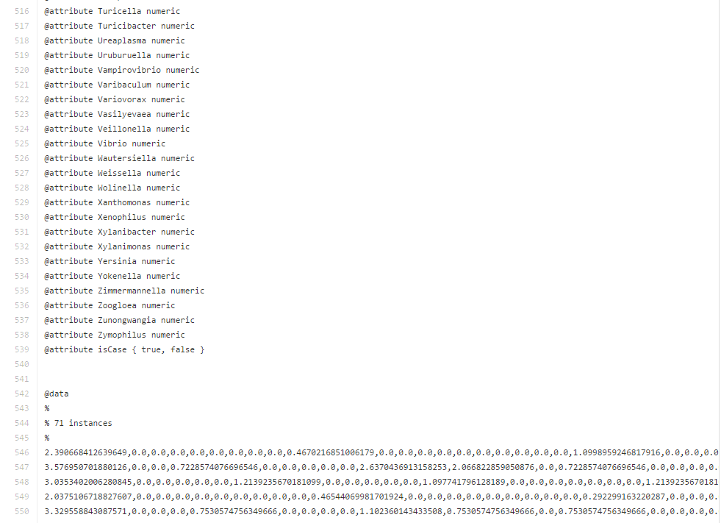
The data file is here…
https://github.com/afodor/afodor.github.io/blob/master/classes/prog2016/pivoted_genusLogNormalWithMetadata.arff
genra from PCR experiment
Patient did or did not have colorectal adenomas

Slide 6
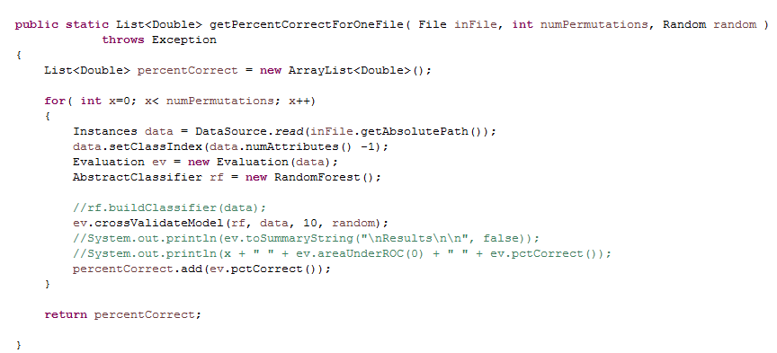
This code performs 10-fold cross validation…
https://github.com/afodor/WekaExamples/blob/master/src/examples/TestClassify.java
Your job is to run 100 (or some other large number) of these.
Do this twice: once with 4 threads (invoking this function 4 times in parallel
with numPerumtations set to 25).
Once with one thread (invoking the function single-threaded with numPermutations
set to 100)
Answer the following:
What is the average percentCorrect you observed?
How many CPUs are on your system
(call Runtime.getRuntime().availableProcessors();)
What speedup do you see (if any)

