Slide 1
ROC curves in WEKA
Visually estimating variance via null permutations

Slide 2
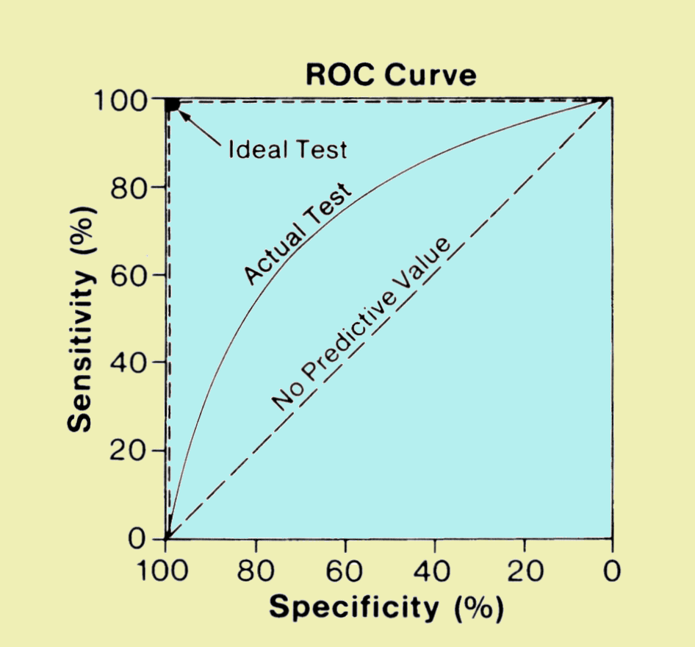
As we reviewed in lab, an ROC curve is a efficient visualization to observe classification performance
The “big data” approach to classification problems
Is a voter democratic or republican?
Voters with known affiliation
Training set
Test set
Find features
(income, zip code, gender)
that predict affiliation
Build statistical model
Make predictions on test set
Image: http://www.sprawls.org/ppmi2/IMGCHAR/1IMCHAR12.gif

Slide 3
The “big data” approach to classification problems
Is a sample case or control?
Whole-genome metagenome sequencing
on samples with known disease status
Training set
Test set
Find features
(taxa, genes)
that predict status
Build statistical model
Make predictions on test set
Image: http://www.sprawls.org/ppmi2/IMGCHAR/1IMCHAR12.gif

Slide 4
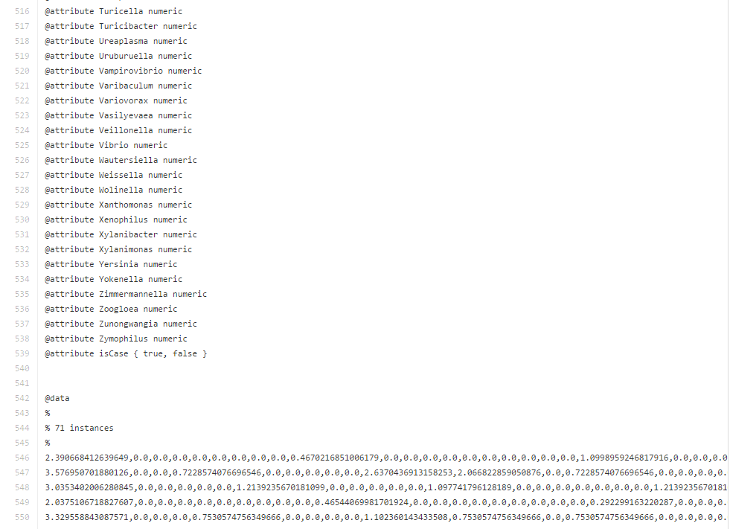
Our data file contains data from 71 patients…
https://github.com/afodor/afodor.github.io/blob/master/classes/prog2016/pivoted_genusLogNormalWithMetadata.arff
genera from PCR experiment
Patient did or did not have colorectal adenomas

Slide 5
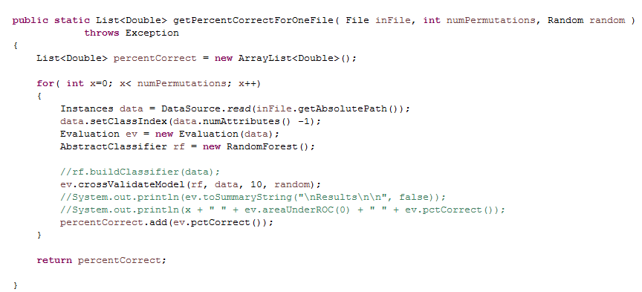
This code performs 10-fold cross validation…
https://github.com/afodor/WekaExamples/blob/master/src/examples/TestClassify.java
You will remember the 10 fold cross validation code…

Slide 6
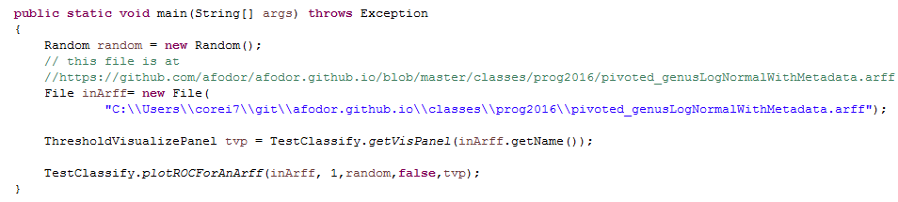
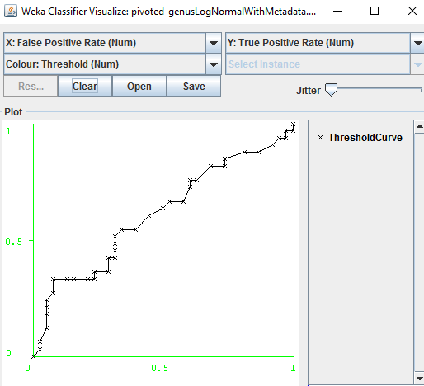
We can easily visualize the ROC code associated with this ten-fold cross validation
https://github.com/afodor/WekaExamples/blob/master/src/examples/RunOneROCCurve.java

Slide 7
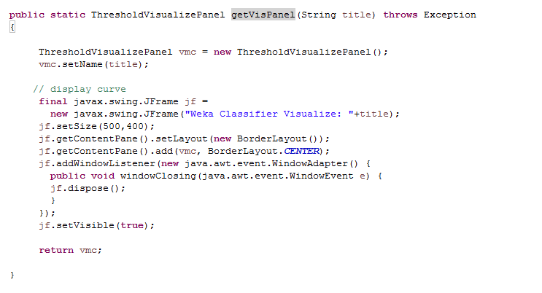
Our initial method just creates a “ThresholdVisualizePanel” and returns it…
Nothing we haven’t seen many times before in this class.
The ThresholdVisualizePanel is just a JPanel (AWT component) that knows how to draw ROC curves
https://github.com/afodor/WekaExamples/blob/master/src/examples/TestClassify.java

Slide 8
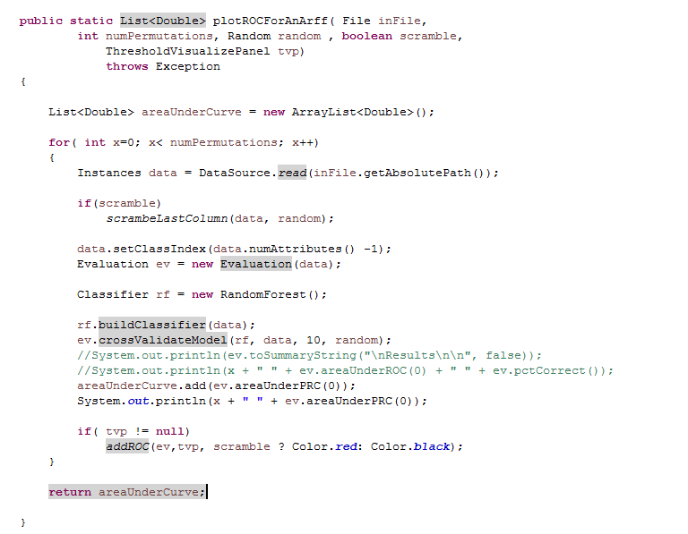
This method proceeds as before, building a classifier and testing it via ten-fold cross-validation
but we add a line for visualization
https://github.com/afodor/WekaExamples/blob/master/src/examples/TestClassify.java

Slide 9
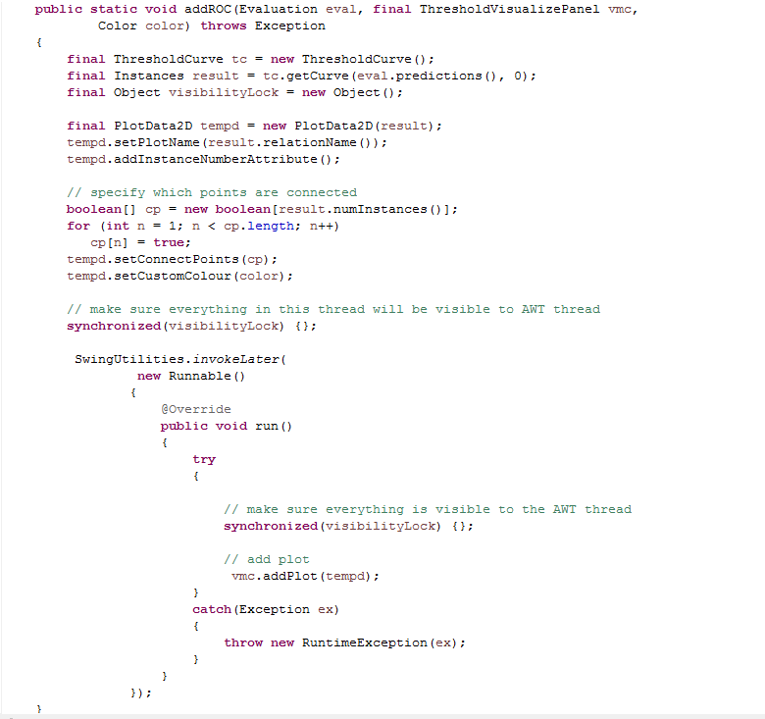
This code does the calculations of true positive and
true negative
All of the helper classes are stack confined,
but do not make visibility guarantees
Force visibility to any other thread that grabs this lock
Make sure AWT thread has full visibility
Actually write the plot; should happen on AWT thread
https://github.com/afodor/WekaExamples/blob/master/src/examples/TestClassify.java

Slide 10
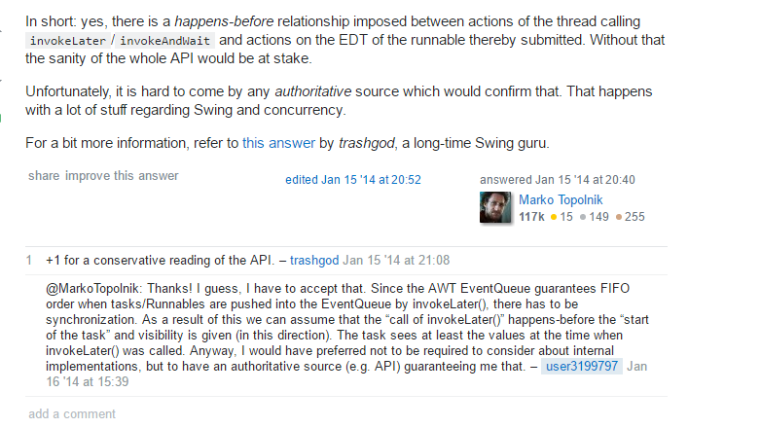
Do I need to manually force the visibility?
Probably not, but the documentation is a bit unclear, so better safe than sorry.
(It is a very small performance hit to grab the lock twice….)
http://stackoverflow.com/questions/21147240/is-happens-before-relation-given-in-case-of-invokelater-or-invokeandwait

Slide 11
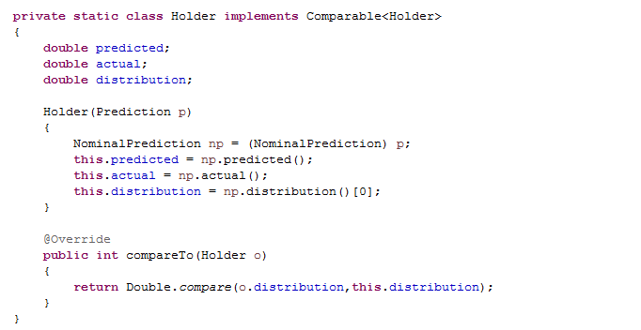
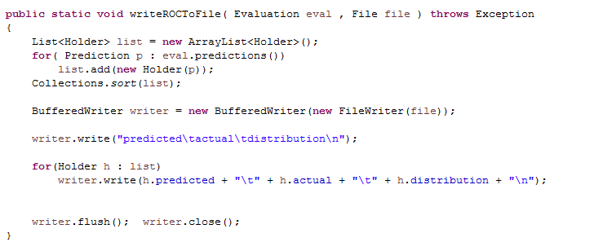
We can easily write out the ROC data to a file if we want to use an alternative visualization
or analysis platform….
https://github.com/afodor/WekaExamples/blob/master/src/examples/TestClassify.java

Slide 12
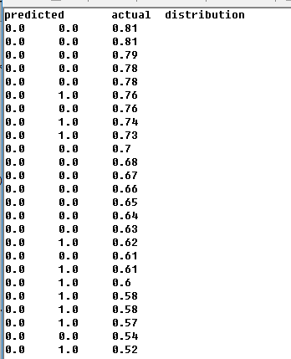
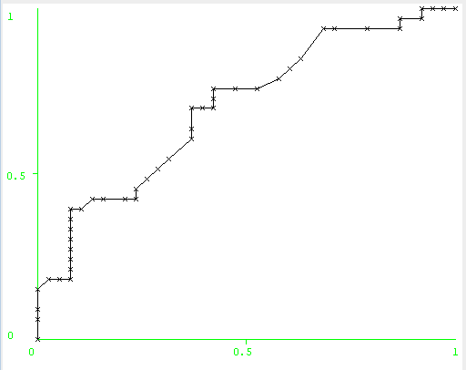
The “distribution” variable shows how much confidence the predictor has in each prediction and is
used to order the ROC curve

Slide 13
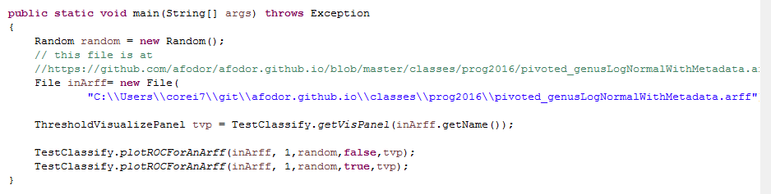
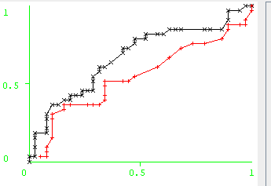
We can compare our “true” classification to
a classification with the case/control labels scrambled
https://github.com/afodor/WekaExamples/blob/master/src/examples/RunOneROCCurve.java

Slide 14
Our data gets scrambled
Our color turns red
https://github.com/afodor/WekaExamples/blob/master/src/examples/TestClassify.java

Slide 15
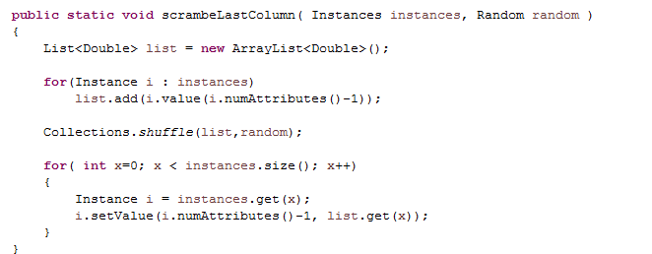
Scrambling the columns is trivial…
https://github.com/afodor/WekaExamples/blob/master/src/examples/TestClassify.java

Slide 16
We can easily do this for multiple permutations…
https://github.com/afodor/WekaExamples/blob/master/src/examples/TestClassify.java

Slide 17
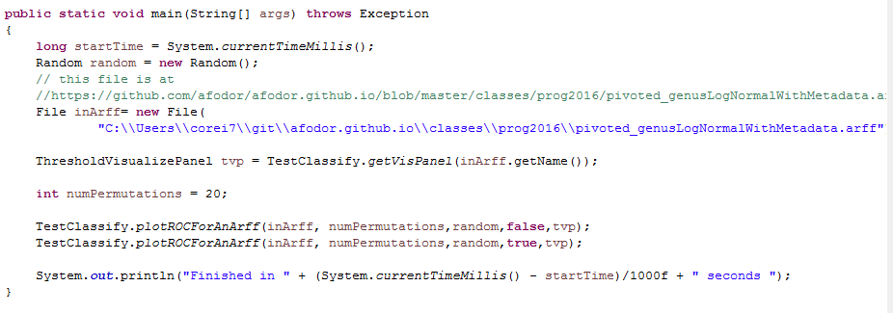
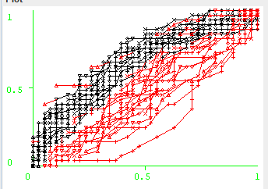
https://github.com/afodor/WekaExamples/blob/master/src/examples/RunOneROCCurve.java

Slide 18
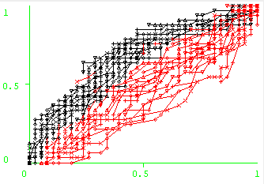

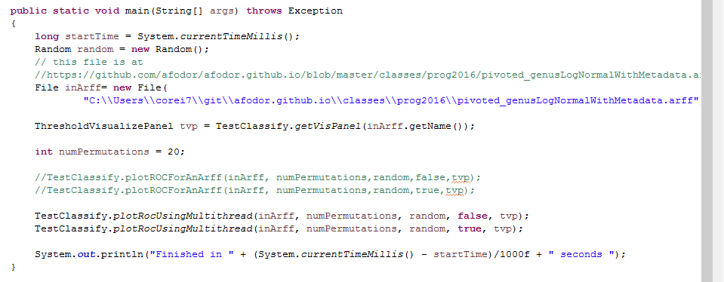
Multi-threaded application seems straight-forward…
A very robust 7.87 fold speedup on an 8 core box!
https://github.com/afodor/WekaExamples/blob/master/src/examples/RunOneROCCurve.java

Slide 19
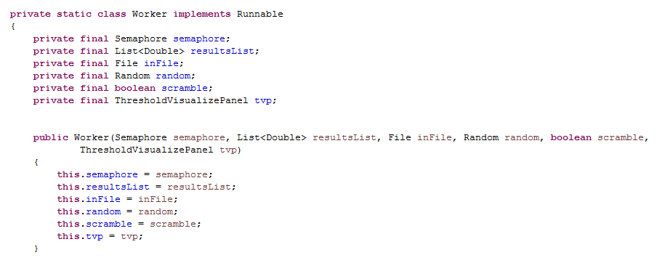
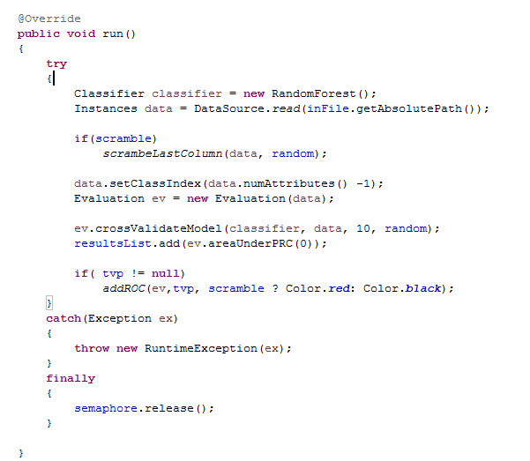
How do we make this multi-threaded? Start (as usual) by making a Worker class. Not much will be shared between workers..
Remember that everything here
is stack-confined up until the
drawing, which is confined to the
AWT thread and hence is single-
threaded!
https://github.com/afodor/WekaExamples/blob/master/src/examples/TestClassify.java

Slide 20
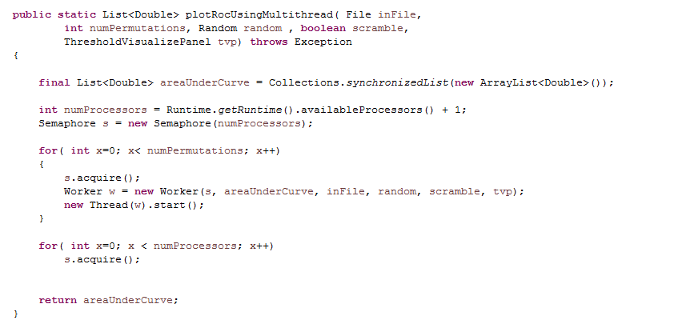
The semaphore remains a very easy to implement and flexible way to split work up between threads..
https://github.com/afodor/WekaExamples/blob/master/src/examples/TestClassify.java

