Slide 1
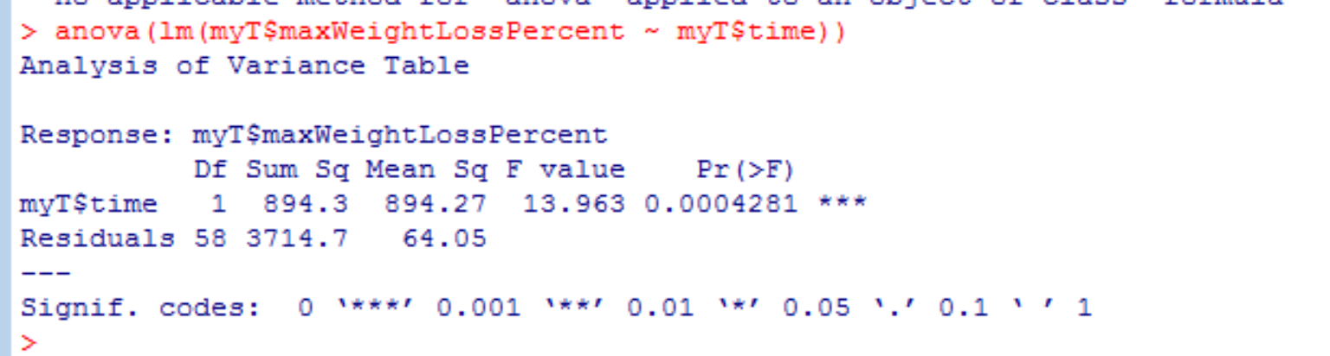
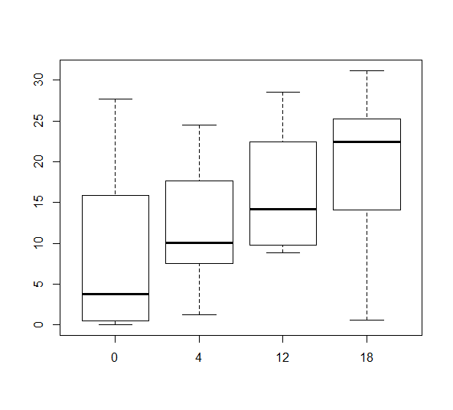
Initial observations (before considering microbiome data)
maxWeightLossPercent is correlated (increases) with time
(Would we expect this based on the way it is calculated?)
r-squared = 18%
maxWeightLossPercent
Time

Slide 2
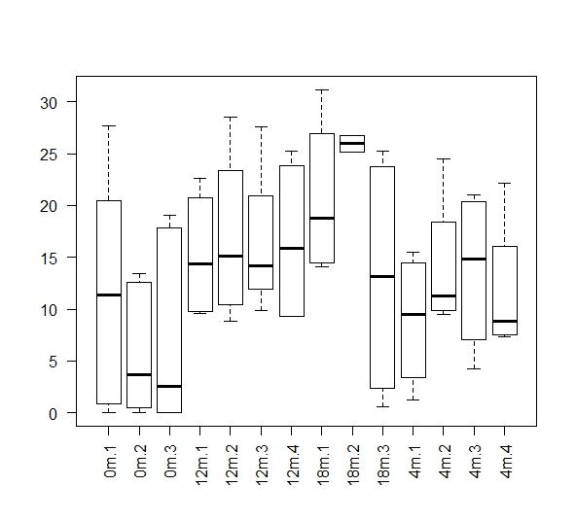
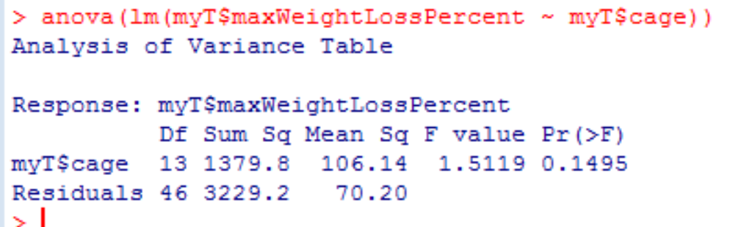
maxWeightLossPercent is not strongly dependent on cage….
maxWeightLossPercent

Slide 3
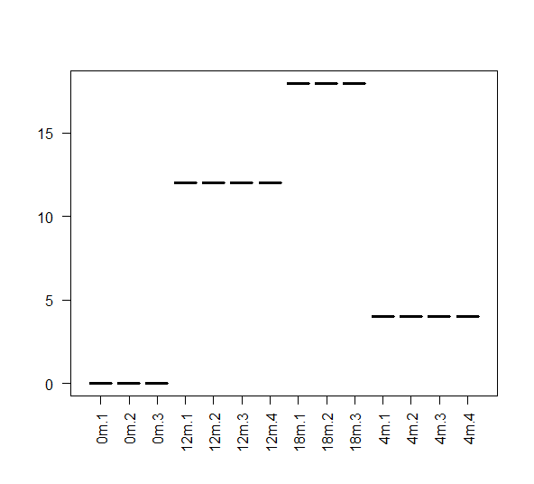
Time (by design) is much more correlated with cage
Time

Slide 4
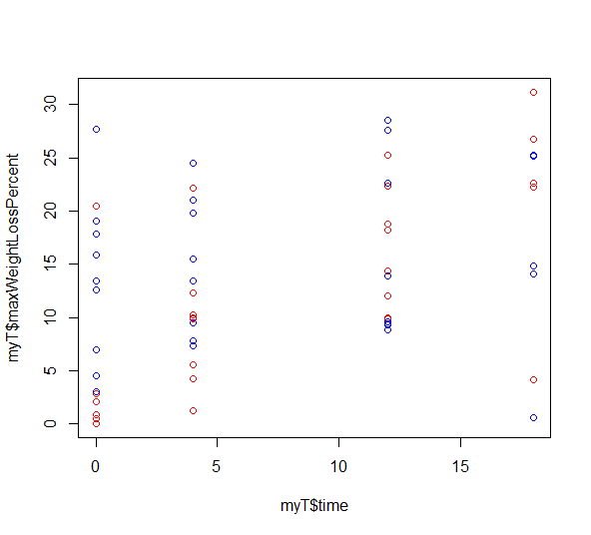
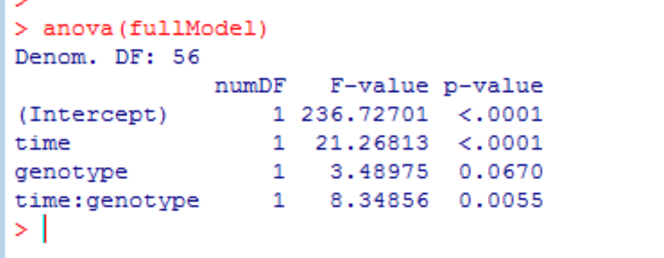
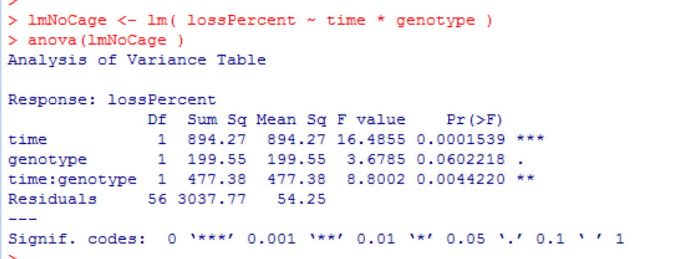
There may be interactions between time and genotype effects on maxWeightLossPercent
Modeling with cage as random variable
plot( myT$time , myT$maxWeightLossPercent ,col= ifelse(myT$genotype == "KO", "RED", "BLUE"))
(ko = red)
Modeling ignoring cage
Models at: https://github.com/afodor/metagenomicsTools/blob/master/src/scripts/ting/mixedModels.txt

Slide 5
Initial analysis:
Take the most derived OTU table (rightmost tab in Excel spreadsheet)
Log Normalize
PCoA with Bray-Curtis

Slide 6
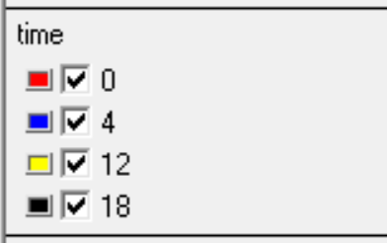
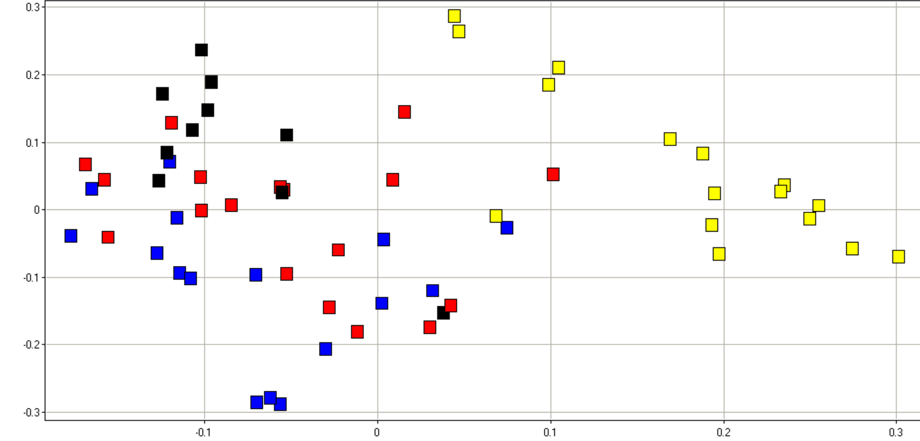
Clear separation of microbial community by time
MDS 2 (21%)
MDS 1 (27%)

Slide 7
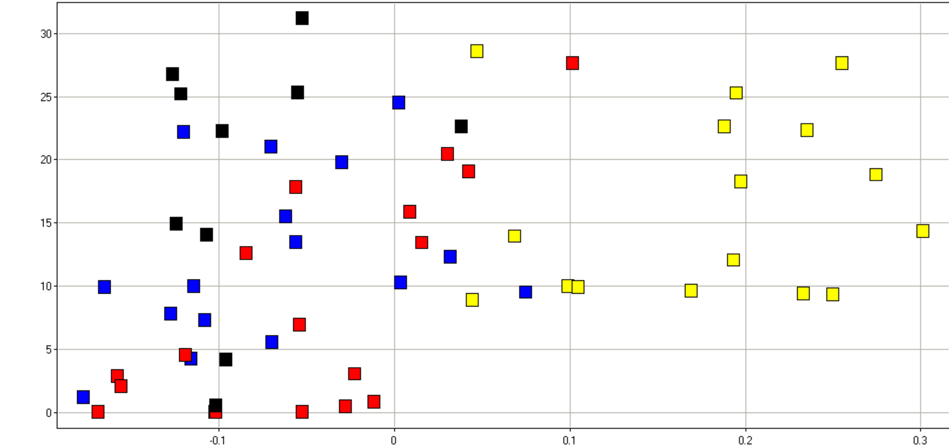
Weak correlation of MDS1 with maxWeightLossPercent
maxWeightLossPercent
MDS 1 (27%)

Slide 8
Next analysis:
Run univariate tests (one variable at a time) against each OTU.
Statistical tests are summarized in attached file “pValuesOtu.txt”
Visualizations are in “boxplots.pdf”
Code is at:
https://github.com/afodor/metagenomicsTools/blob/master/src/scripts/ting/visualizations.txt
(works on attached file otuAsColumnsLogNormPlusMetadata.txt )

Slide 9
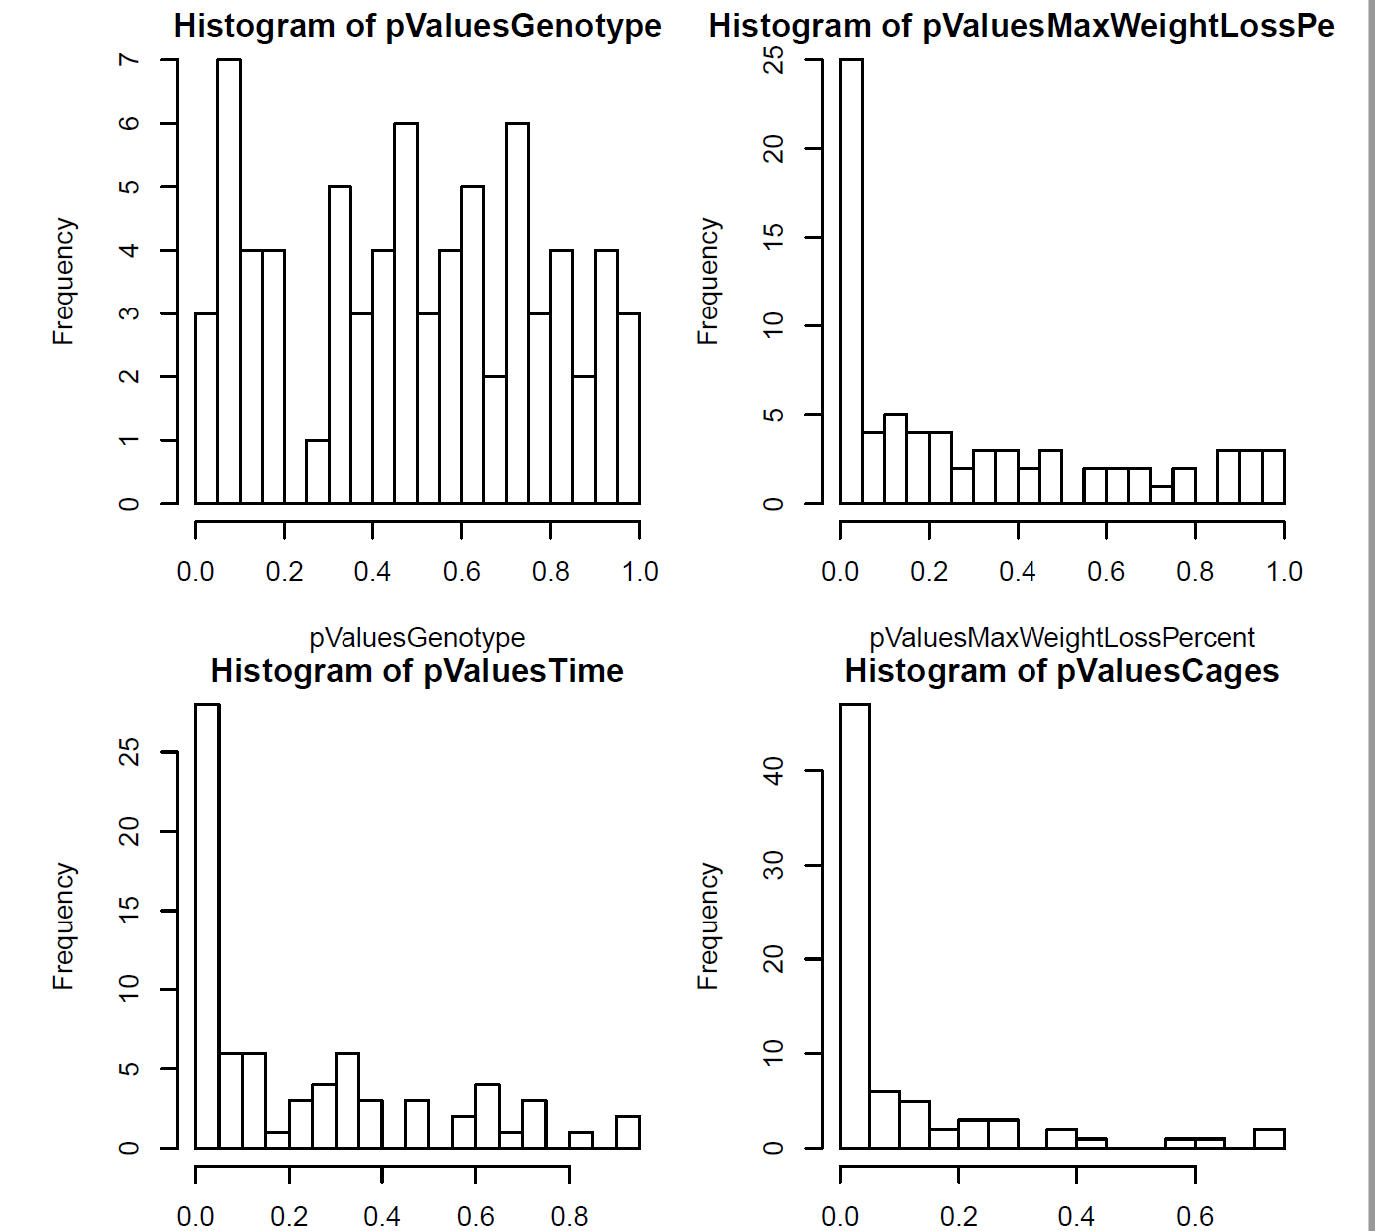
Summary: In univariate tests, significant hits for time, maxWeightLossPercent and cage
Hits are significant but are modest (but not miniscule) in effect size.
Not much significant for genotype
Cage: 48/73 significant at 10% FDR
Weight %: 15/73 significant at 10% FDR
Time: 24/73 significant at 10% FDR

Slide 10
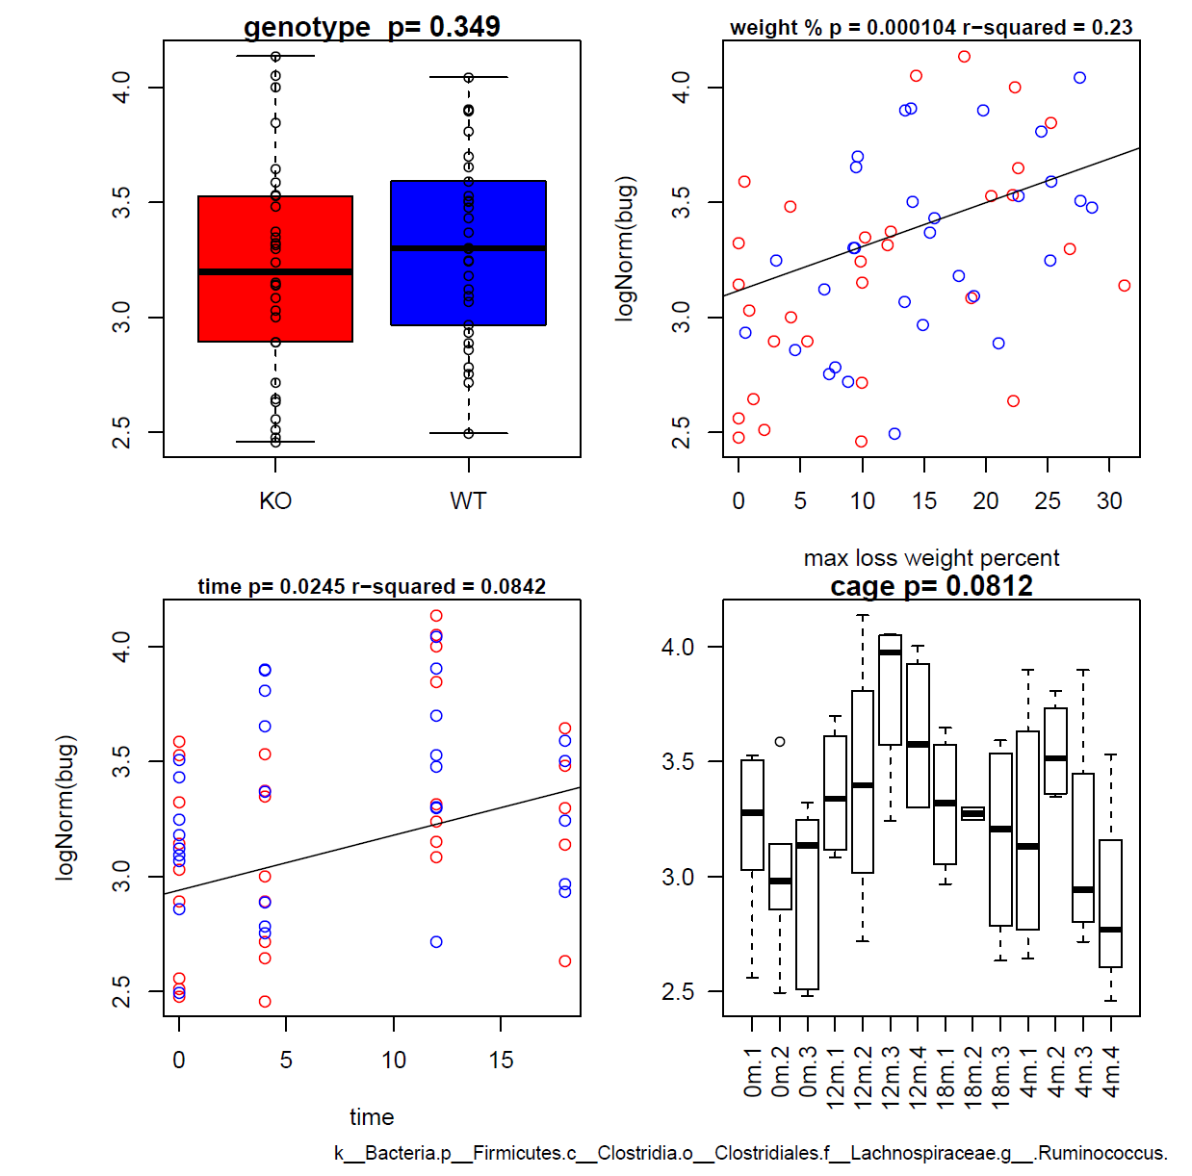
Our most compelling hit for weight….

Slide 11
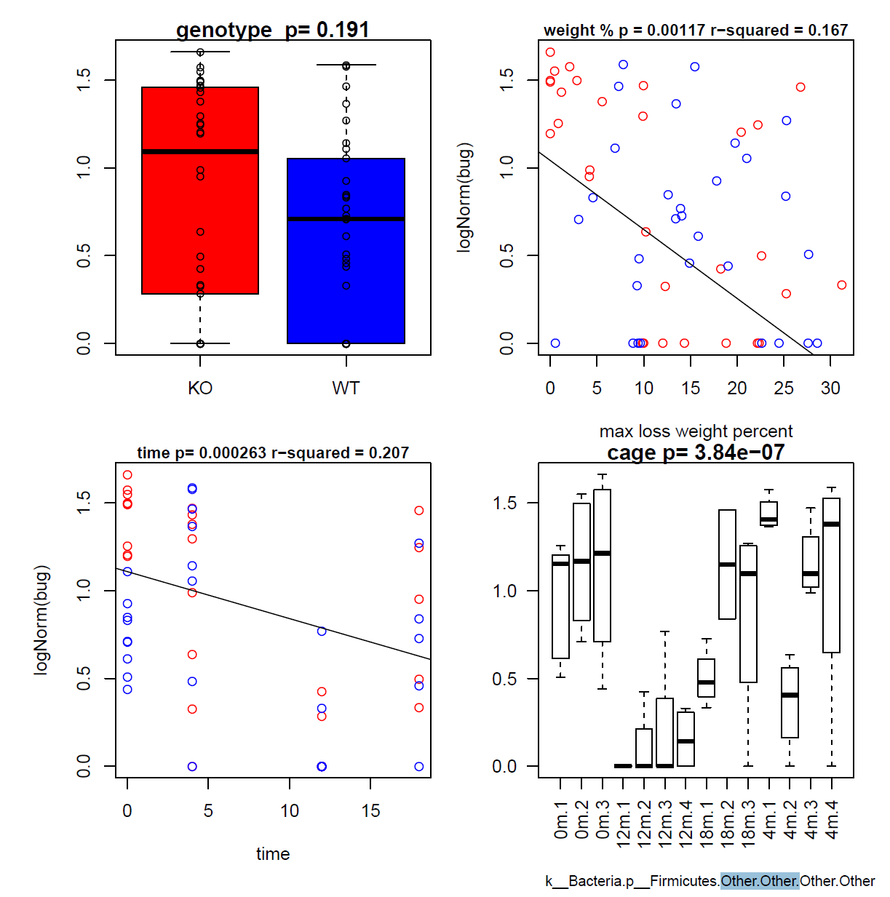
Our 2nd most compelling hit…

Slide 12
Conclusions:
Time and cage have effects on the microbial community and on % weight gain.
Timepoint 12 is perhaps an outlier relative to other timepoints
Todo:
Extend univariate (one variable at a time) to more complex models for the microbial data.
Our ability to separate correlated variables is always limited but there are tricks we can try
(mediation analysis, extend mixed linear models to the microbial community).
Would we expect % weight change to be correlated with time? I need a better understanding of this
before attempting the next round of statistical modeling…
Repeat at higher phylogenetic levels…

