Slide 1
The multinomial distribution is the multi-dimensional extension of the binomial distribution
The Dirichlet distribution is the multi-dimensional extension of the beta distribution

Slide 2
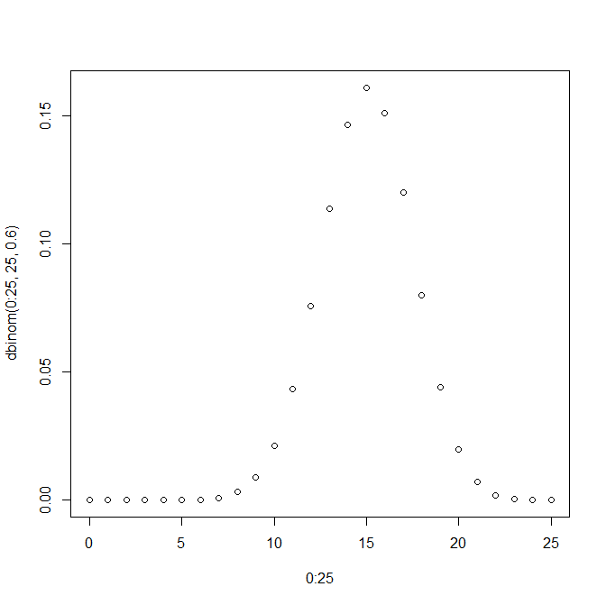
The binomial distribution tells us the probability of getting K heads in N flips of a coin…
For example…
plot( 0:25, dbinom(0:25, 25, .6))
N = 25 flips
K = 0:25 heads
p(head) = .6

Slide 3
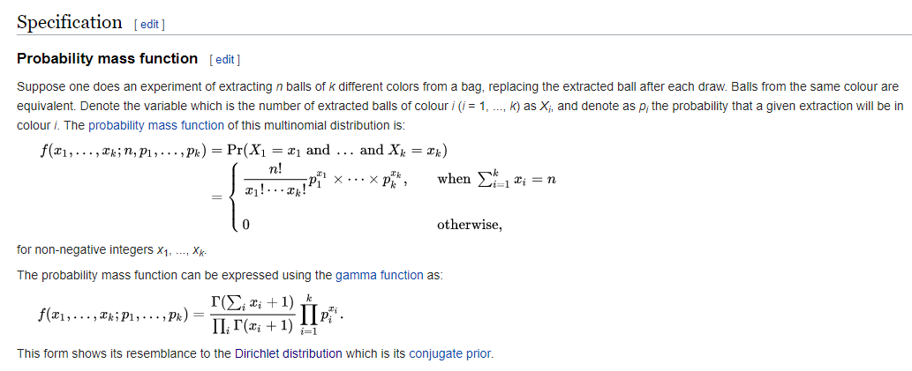
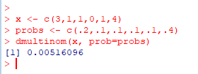
We can extend this naturally to dice
Consider a die with
P(1) = .2; p(2) = .1; p(3) = .1 ; p(4) = .1 ;p(5) = .1; p(6) = .4
What is the probability in 10 rolls of rolling:
https://en.wikipedia.org/wiki/Multinomial_distribution
This is given by the multinomial distribution
Rolls | # of times observed
1 | 3
2 | 1
3 | 1
4 | 0
5 | 1
6 | 4
(where the order does not matter)

Slide 4
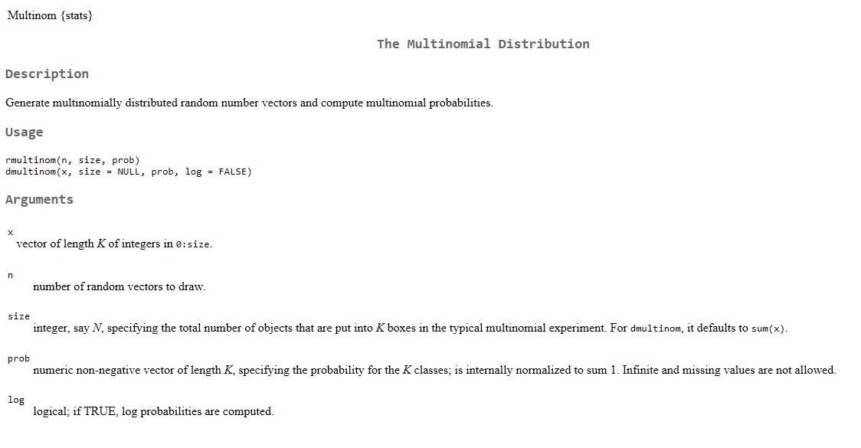

Slide 5
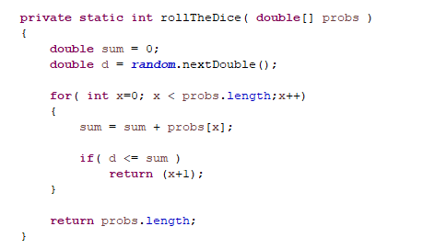
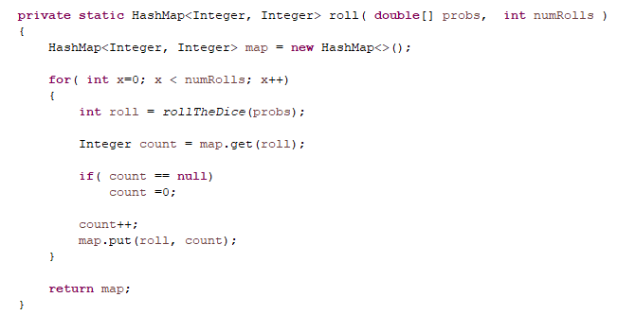
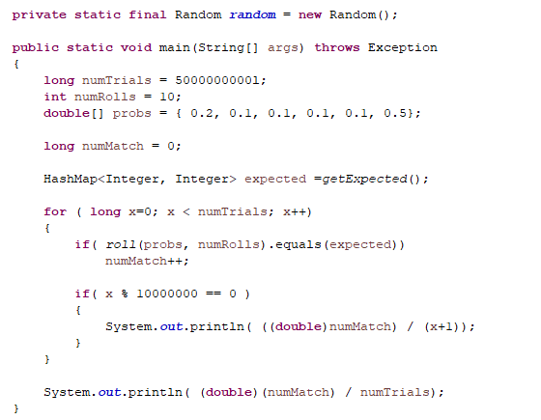
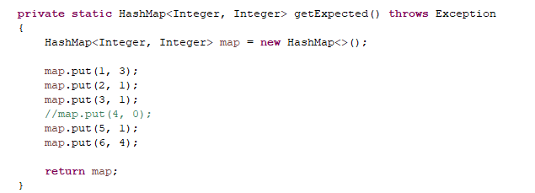

Sanity check #1: If we roll 10 die a large # of times, we will see the target distribution the expected number of times
https://github.com/afodor/metagenomicsTools/blob/master/src/classExamples/TestMultinomial.java

Slide 6
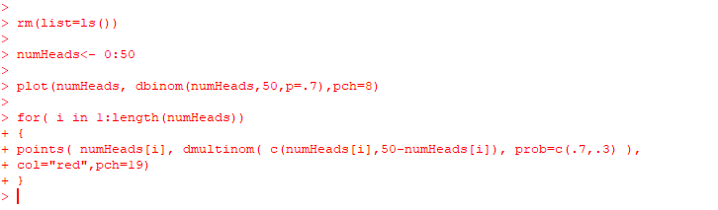
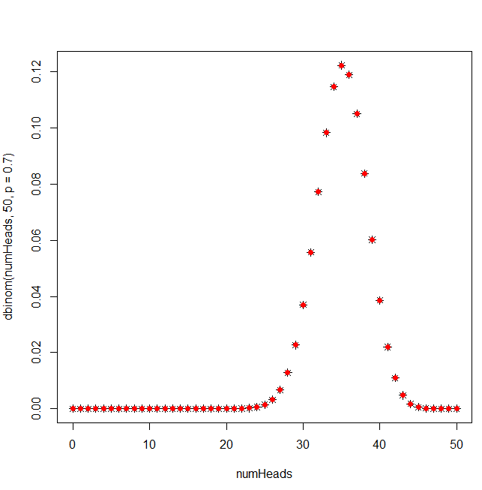
Sanity check #2: We can recover the binomial distribution as a special case of the multinomial distribution
(a two-sided die is equivalent to a coin…)

Slide 7
The multinomial distribution is the multi-dimensional extension of the binomial distribution
The Dirichlet distribution is the multi-dimensional extension of the beta distribution

Slide 8
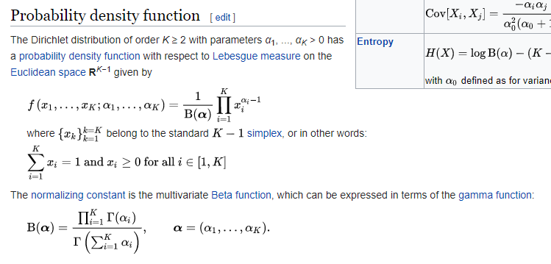
Just as we can extend the binomial distribution to the multinomial distribution,
we can extend the beta distribution to the Dirichlet distribution…
The Dirichlet distribution holds one constant for each side of the die
https://en.wikipedia.org/wiki/Dirichlet_distribution

Slide 9
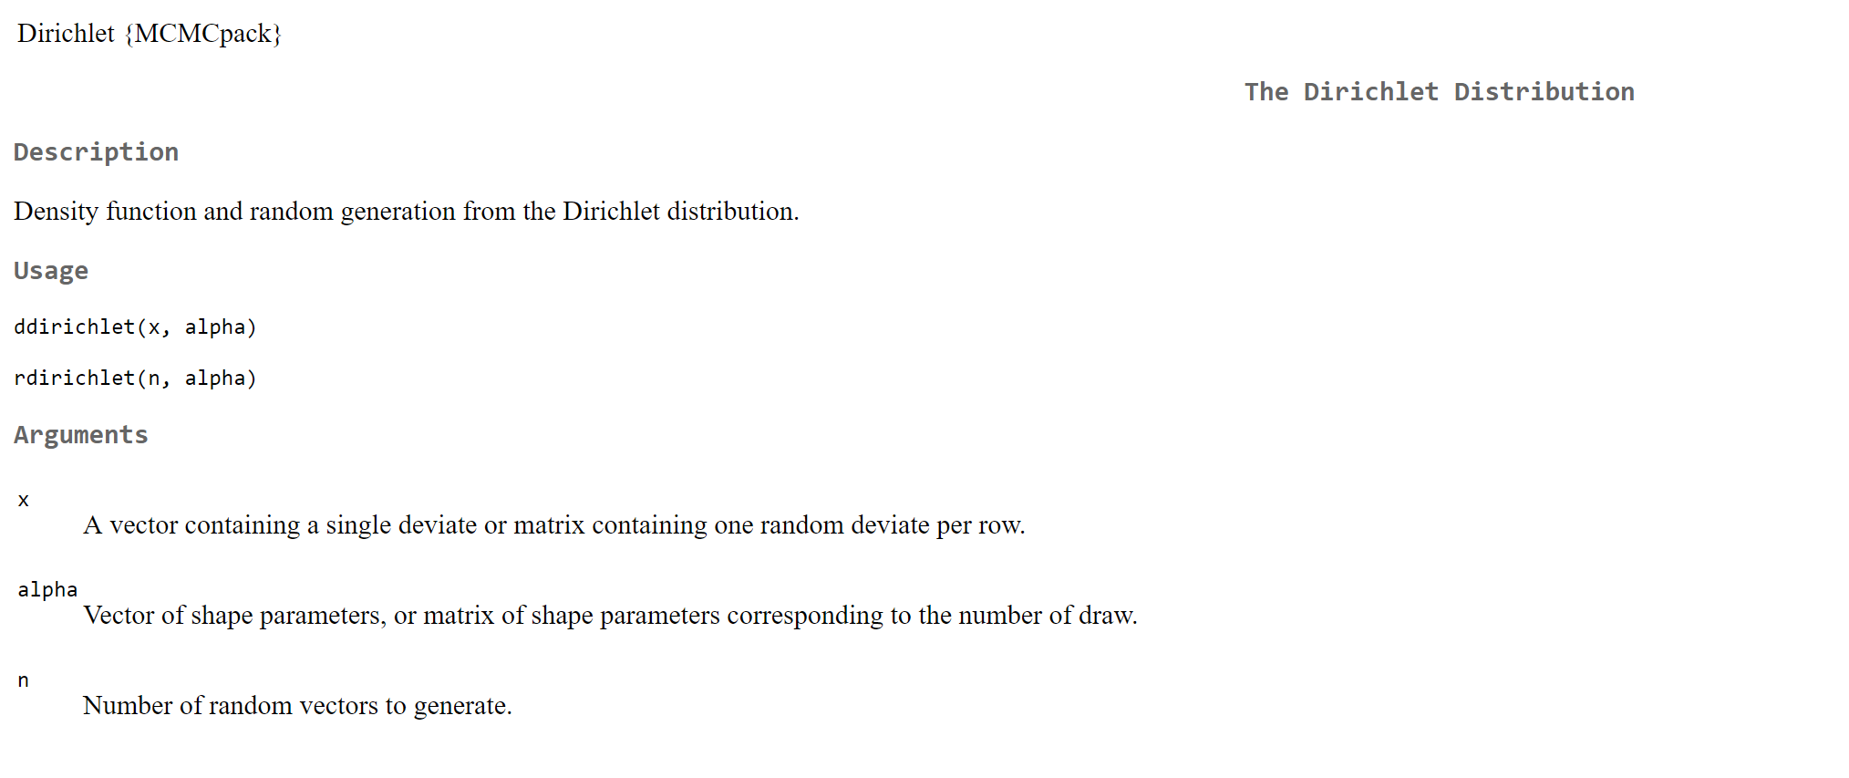

Slide 10
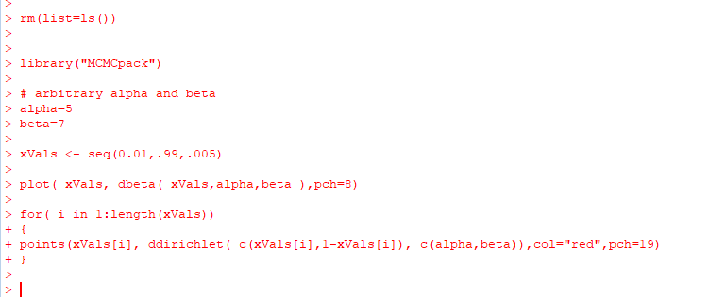
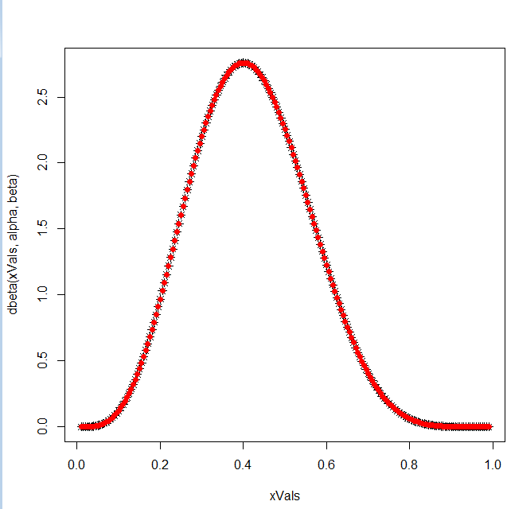
We can recover the beta distribution from the Dirichlet distribution

Slide 11
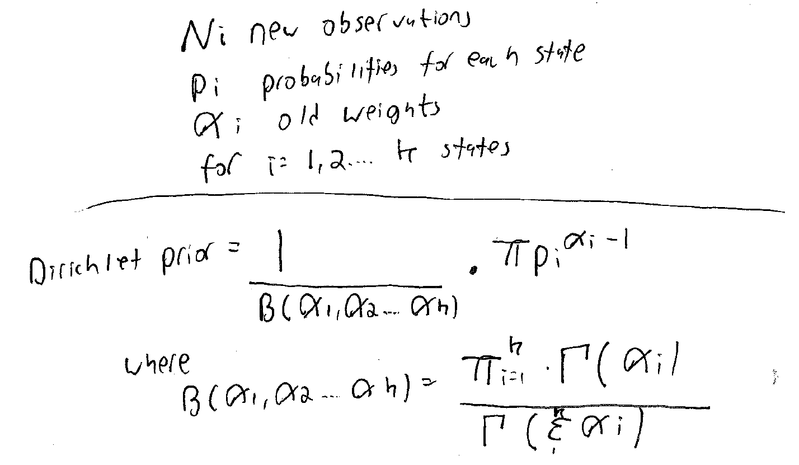
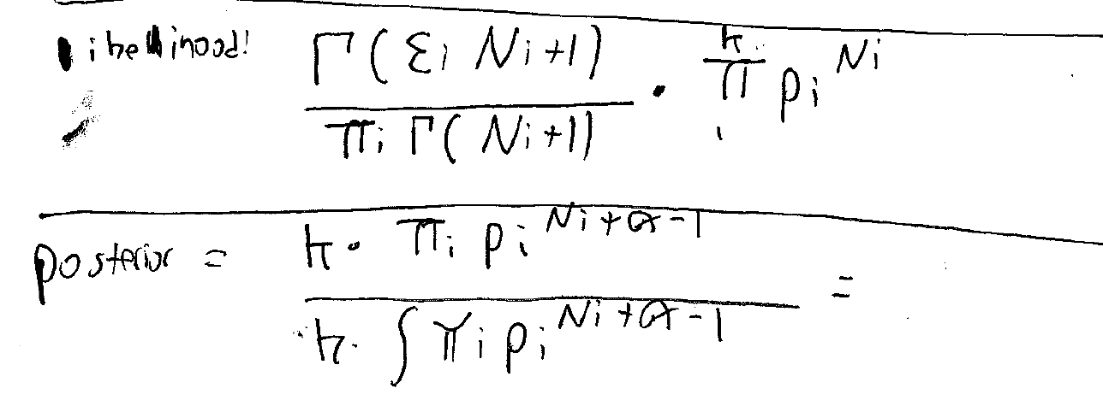
The Dirichlet is the conjugate prior of the multinomial.
The update rules for the Dirichlet work in the same way as for the beta (add 1 for each observation..)

Slide 12
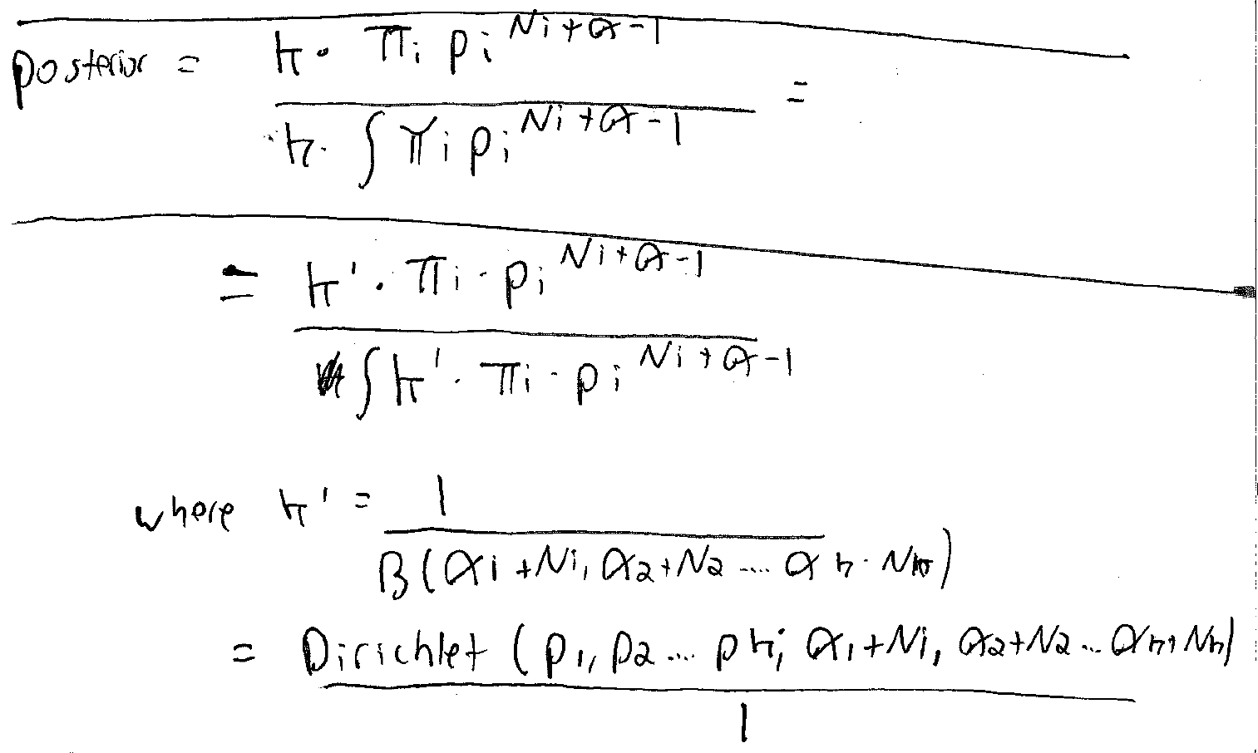
The Dirichlet is the conjugate prior of the multinomial.
The update rules for the Dirichlet work in the same way as for the beta (add 1 for each observation..)

Slide 13
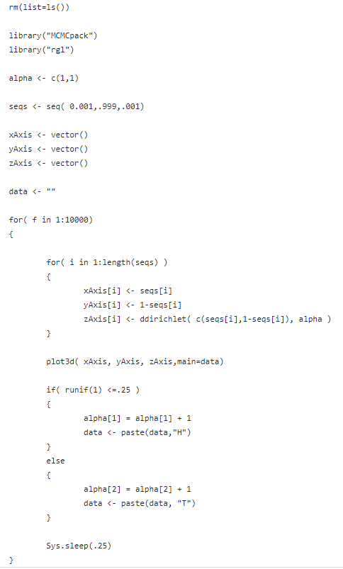
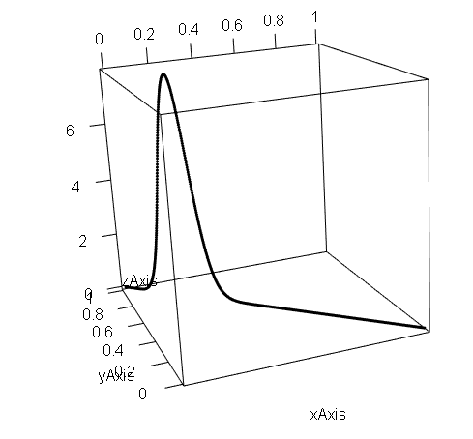
Because all the x values have to sum up to 1, the Dirichlet is described by a R^{(k-1)} subspace.
Our belief in the number of heads perfectly describes our belief in the
number of tails, so you capture the Dirichlet for a coin
in (2-1) = 1 dimension.
https://github.com/afodor/metagenomicsTools/blob/master/src/classExamples/dirichletUpdateCoinFlip.txt

Slide 14
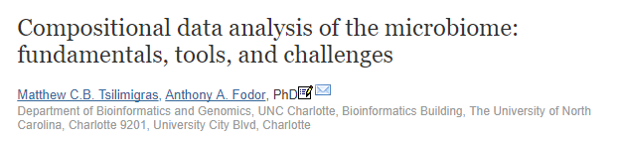
The Dirichlet describes compositional data. Data that sums to a constant.
Relative abundance.
In terms of genomics, RNA-seq (and microbiome) data are also compositional.
We will talk more about this later (but if you are interested you can read this…)

Slide 15
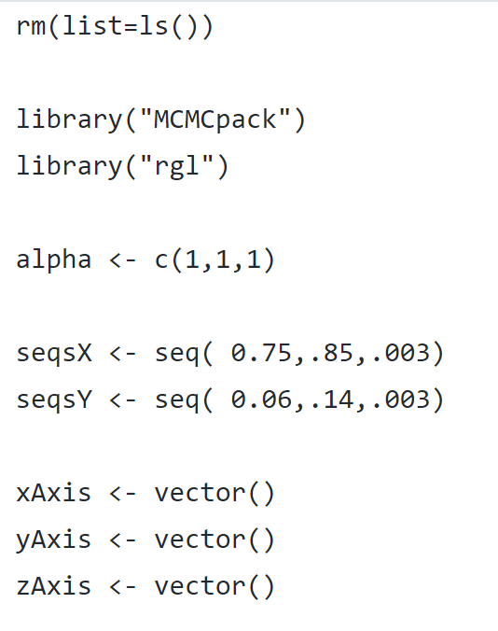
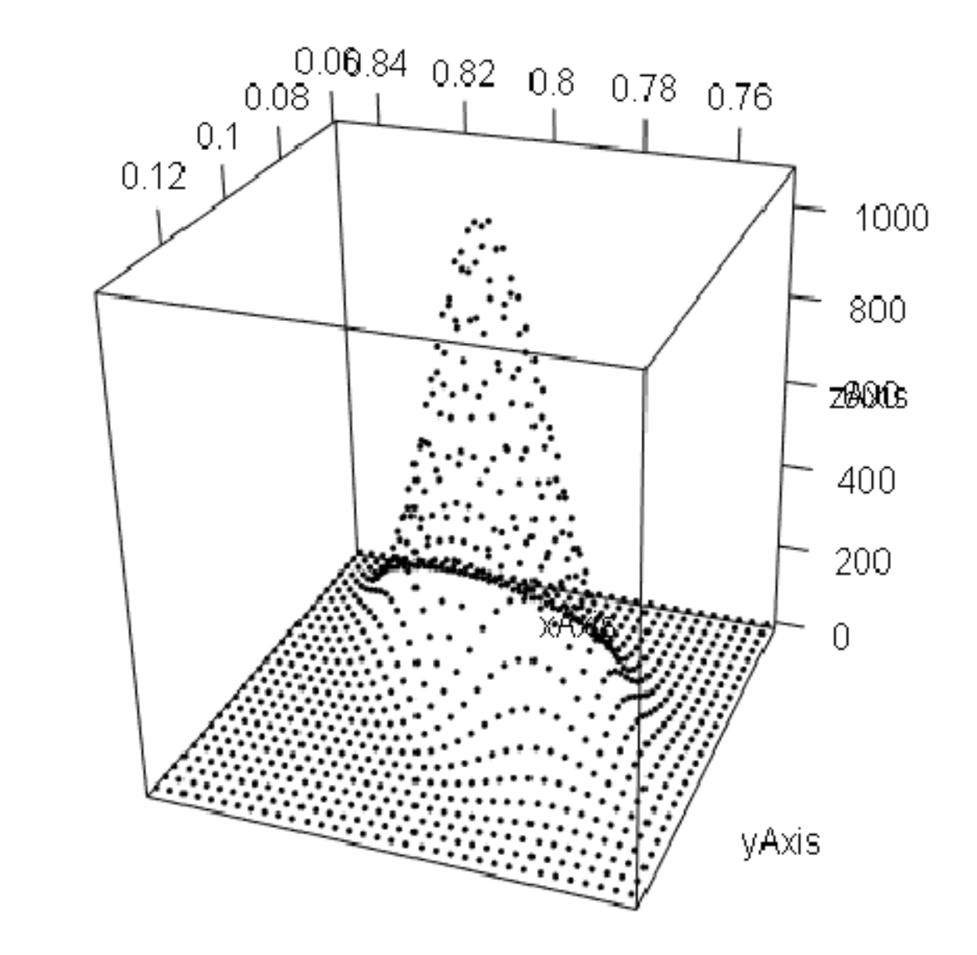
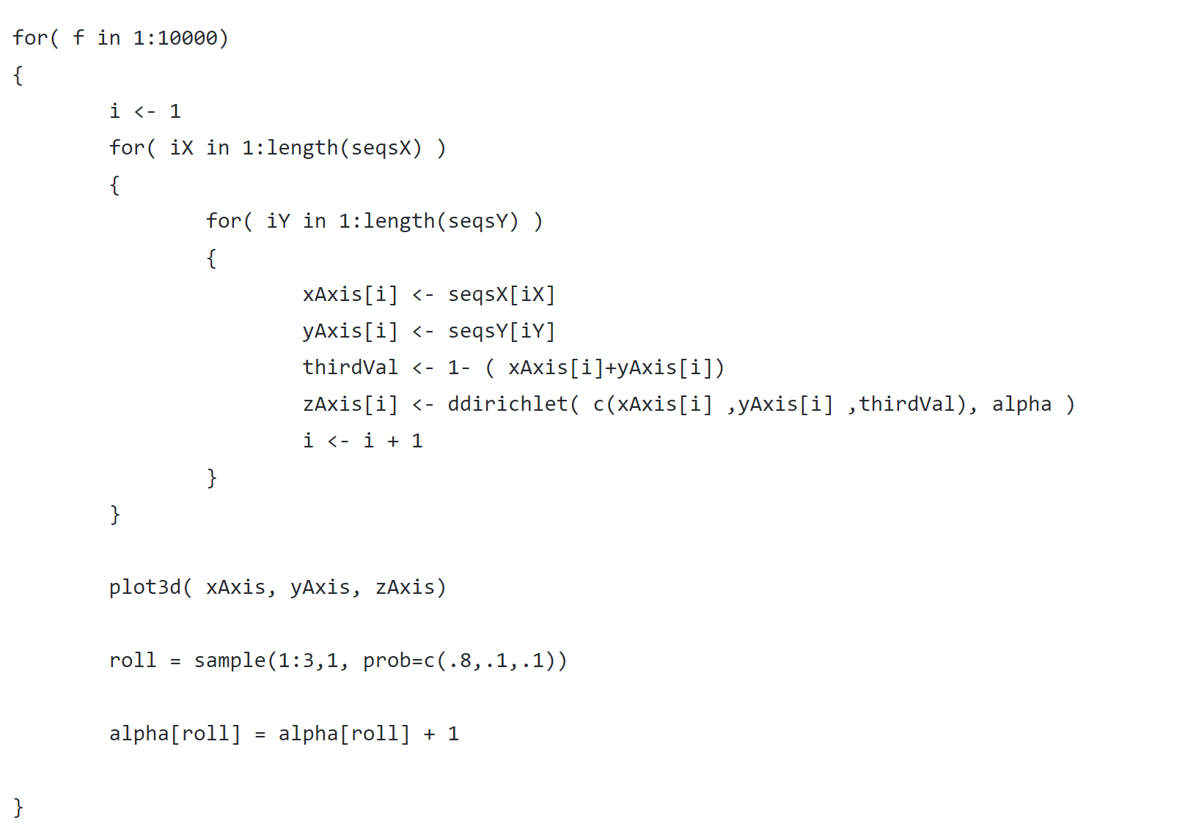
We can capture our beliefs about a 3 sided die in 2 dimensions (but that is the most # of sides we can graph!)
https://github.com/afodor/metagenomicsTools/blob/master/src/classExamples/dirichletUpdateThreeSidedDie.txt

Slide 16
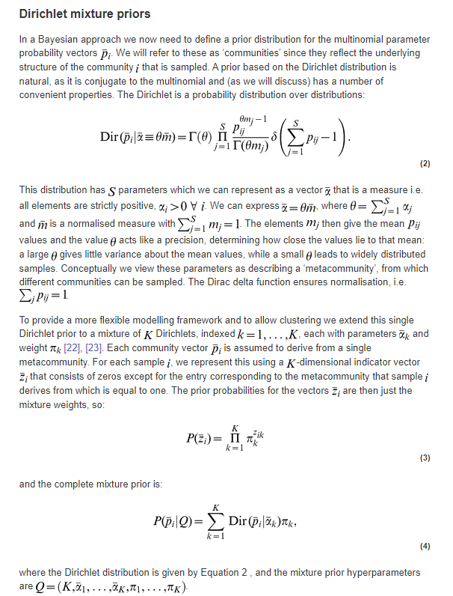

Because the Dirichlet is compositional, it can be used
to model a mixture of different communities identified by
sequencing data
Here the Dirichlet distribution is used to cluster a complex
community into K number of states, each represented
by their own Dirichlet

Slide 17
