Slide 1
One more PCA Example
Generalized linear models – Poisson distribution
Generalized linear models – Negative binomial distribution
Generalized linear models – logistic regression (binomial distribution)

Slide 2
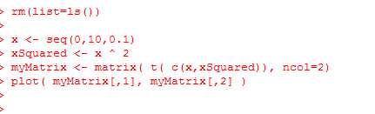
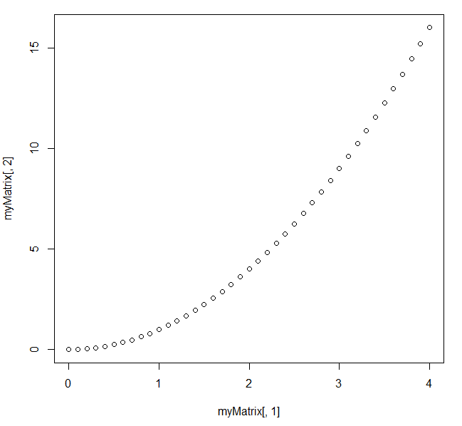
Consider the relationship between x and x ^ 2
https://github.com/afodor/metagenomicsTools/blob/master/src/machineLearningExamples/pcaRotation.txt

Slide 3
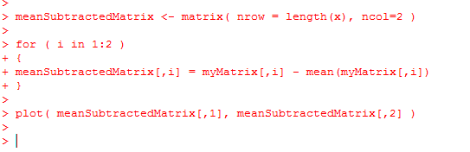
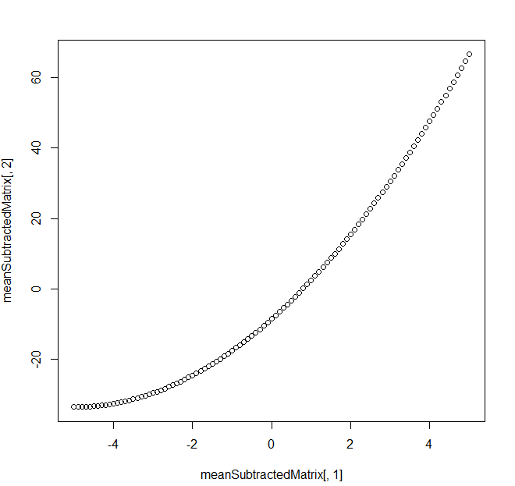
Mean subtracting doesn’t much change the basic shape…
https://github.com/afodor/metagenomicsTools/blob/master/src/machineLearningExamples/pcaRotation.txt

Slide 4
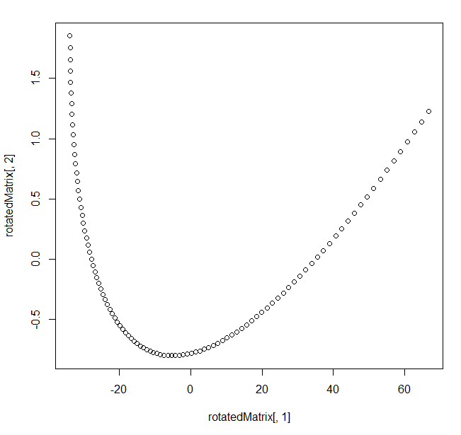
We can perform the PCA via Eigen value rotation
[200, 2] * [2,2] = [200,2]
https://github.com/afodor/metagenomicsTools/blob/master/src/machineLearningExamples/pcaRotation.txt

Slide 5
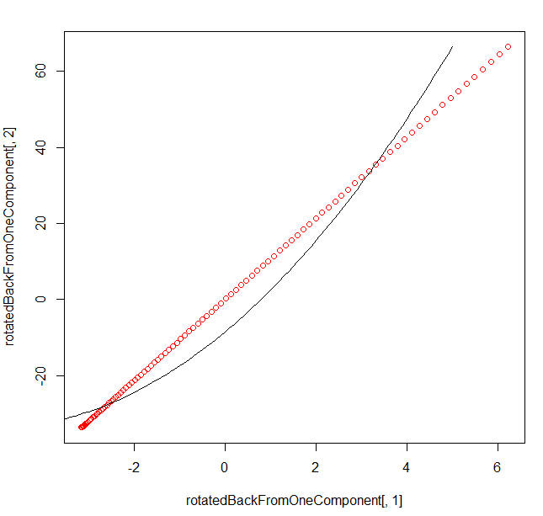
Here, we rotate it back but only use the first PCA component
[200 * 1]
[ 1 * 2 ]
= [200 * 2]
In one linear component,
we can only hold linear
Information…
https://github.com/afodor/metagenomicsTools/blob/master/src/machineLearningExamples/pcaRotation.txt

Slide 6
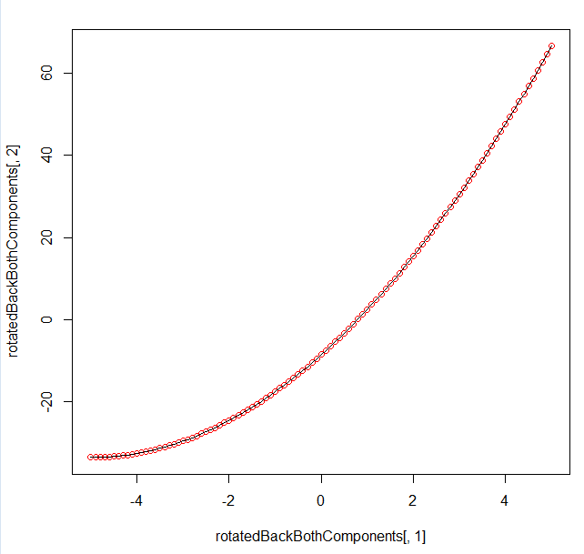
Of course, if we use both components, we can get the original data back…
[200 * 2] * [2,2] = [200 * 2]
https://github.com/afodor/metagenomicsTools/blob/master/src/machineLearningExamples/pcaRotation.txt

Slide 7
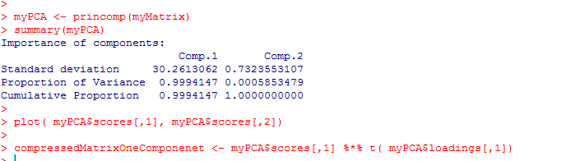
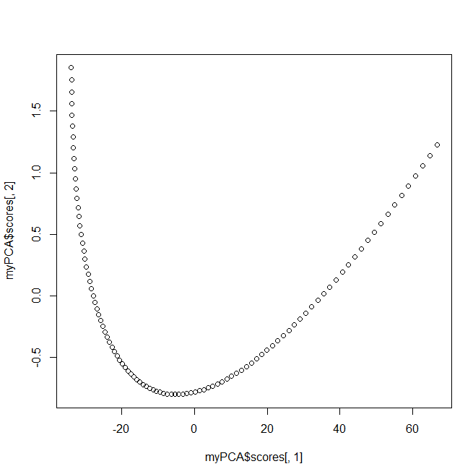
With alternative syntax (but identical results…)
https://github.com/afodor/metagenomicsTools/blob/master/src/machineLearningExamples/pcaRotation.txt

Slide 8
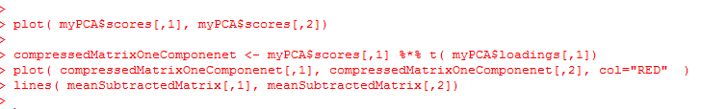
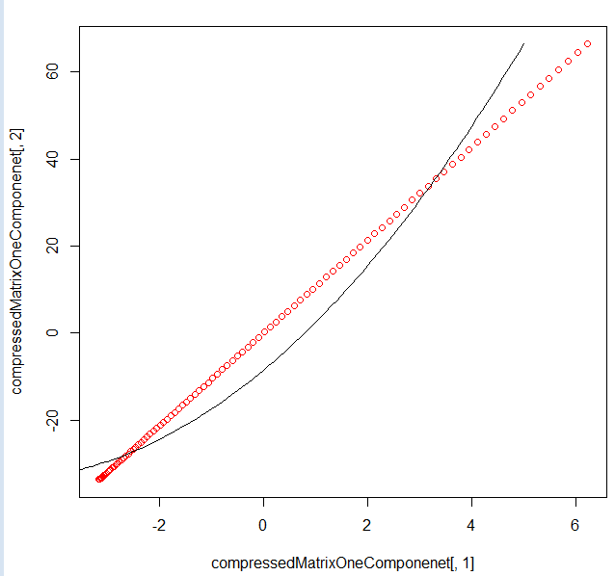
With alternative syntax (but identical results…)
https://github.com/afodor/metagenomicsTools/blob/master/src/machineLearningExamples/pcaRotation.txt

Slide 9
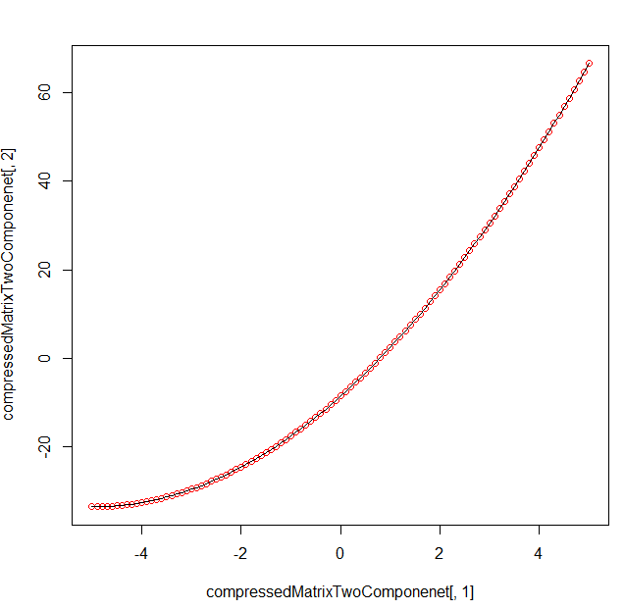
With alternative syntax (but identical results…)
https://github.com/afodor/metagenomicsTools/blob/master/src/machineLearningExamples/pcaRotation.txt

Slide 10
One more PCA Example
Generalized linear models – Poisson distribution
Generalized linear models – Negative binomial distribution
Generalized linear models – logistic regression (binomial distribution)

Slide 11
Consider this data set from section 9.5 of the Zuur book
(data from http://www.highstat.com/Book2/ZuurDataMixedModelling.zip
rm(list=ls())
setwd("C:\\books\\zuurData")
RK <- read.table("RoadKills.txt",header=TRUE, sep="\t")
plot(RK$D.PARK, RK$TOT.N, xlab = "Distance to park",ylab = "Road kills",ylim=c(-30,130))
https://github.com/afodor/metagenomicsTools/blob/master/src/classExamples/poissonVsNegativeBinomial

Slide 12
We can of course easily fit a linear model to these data…
plot(RK$D.PARK, RK$TOT.N, xlab = "Distance to park",ylab = "Road kills",ylim=c(-30,130))
M0 <- lm( RK$TOT.N ~ RK$D.PARK )
plot(RK$D.PARK, RK$TOT.N, xlab = "Distance to park",ylab = "Road kills",ylim=c(-30,130),main=paste( "linear AIC=", format(AIC(M0),digits=5)))
xRange<- seq(from = 0,to = 25000, by = 1000)
linearMeans <- coef(M0)[1] + coef(M0)[2] * xRange
lines( xRange, linearMeans)

Slide 13
The model, of course, assumes a constant variance of the residuals…
library("Hmisc")
meanR <- mean(residuals(M0))
standardError = sqrt(sum( (residuals(M0)-meanR)^2 / ( length(residuals(M0)) - 2 )))
errbar(xRange, linearMeans , linearMeans + standardError , linearMeans - standardError ,add=TRUE)
Here we add +/- SD to our graph…

Slide 14
Definitely some problems with this fit…
Variance doesn’t appear constant across whole range
Systematic bias in the residuals
The model predicts negative road kills
at high distance;
This doesn’t make a lot of sense…

Slide 15
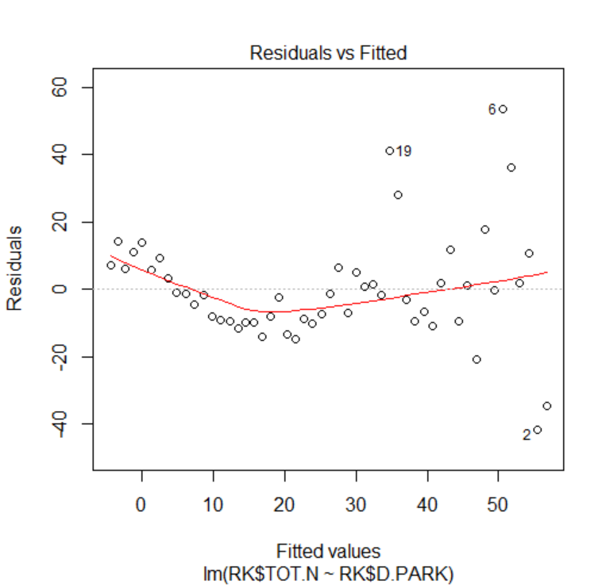
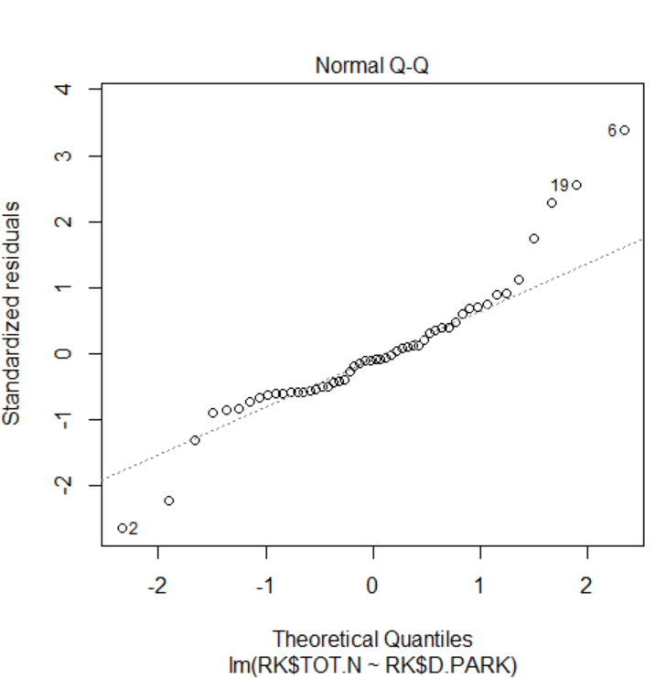
We can see the systematic variation in the residuals by typing “plot(M0)”

Slide 16
It would be nice if we could have a model based on counts that allows us to vary the
variance ;
We will see that we can build a model based on the negative binomial distribution that
fits the bill.
But let’s first (for simplicity) consider a model based on the Poisson distribution.

Slide 17
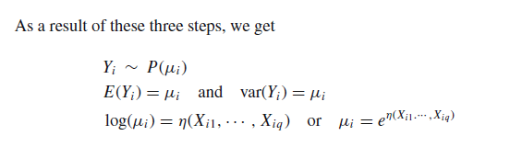
A generalized linear model has three components…
Zuur book (section 9.3)
Our data is Poisson distributed
The mean and variance are given by the
Poisson
The model value mean is a function of our
explanatory variables
The “link” function
In a Poisson, mean = n*p and p can’t be negative!
The exponential term ensures only positive model means!

Slide 18
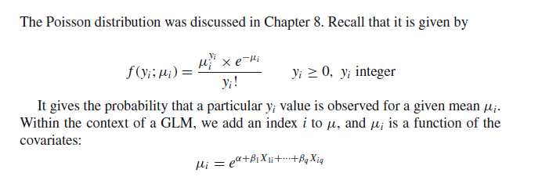
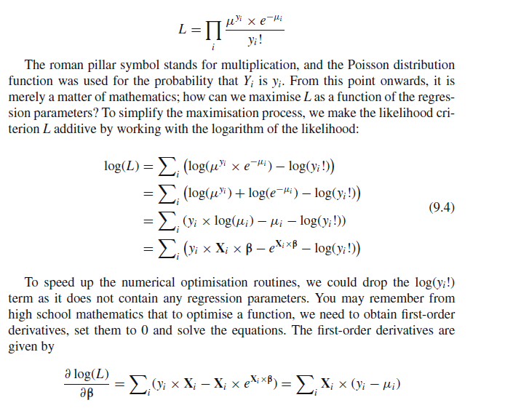
Put this all together and it will produce a likelihood function (Zuur book section 9.4)..
Our data are Poisson
distributed
The model mean is a function of our
explanatory variables
And we are ready to find the maximum likelihood

Slide 19

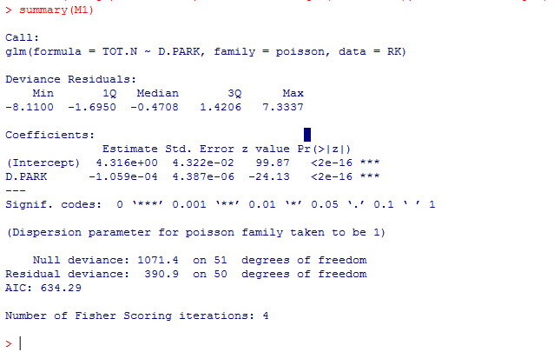
M1 <- glm(TOT.N ~ D.PARK, family = poisson, data = RK)
plot(RK$D.PARK, RK$TOT.N, xlab = "Distance to park",ylab = "Road kills",,main=paste( "Poisson AIC=", format(AIC(M1),digits=5)),ylim=c(-30,130))
modelMeans <- exp( coef(M1)[1] + coef(M1)[2]* xRange)
lines(xRange, modelMeans )
# variance equals the means
errbar(xRange, modelMeans, modelMeans + sqrt(modelMeans), modelMeans - sqrt(modelMeans),add=TRUE)
https://github.com/afodor/metagenomicsTools/blob/master/src/classExamples/poissonVsNegativeBinomial

Slide 20
Too many data points outside the variance
The assumption that variance = mean is not a good fit for this data
Does not go below zero
(which is good)

Slide 21
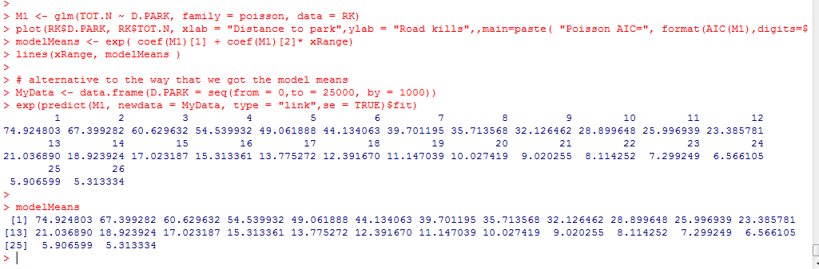
We can use “predict” to get the line for our model, but it is good to know that we can do
it ourselves…

Slide 22
One more PCA Example
Generalized linear models – Poisson distribution
Generalized linear models – Negative binomial distribution
Generalized linear models – logistic regression (binomial distribution)

Slide 23
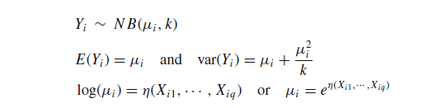
We can relax the assumption that the variance equals the mean with the negative
binomial distribution..
We add one parameter that adjusts the variance
Shotgun noise + additional variance
The “linkage” equation is the same as Poisson…

Slide 24
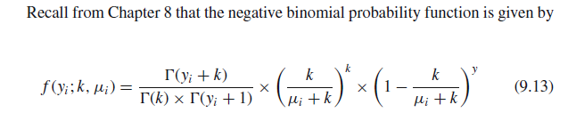
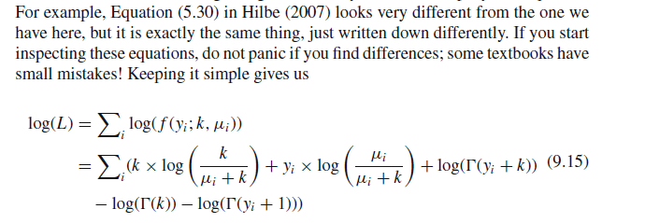

We put this all together (Zuur book Chapter 9) to get our likelihood function….
!
We have our likelihood function to maximize!
(Once we plug in that
)

Slide 25

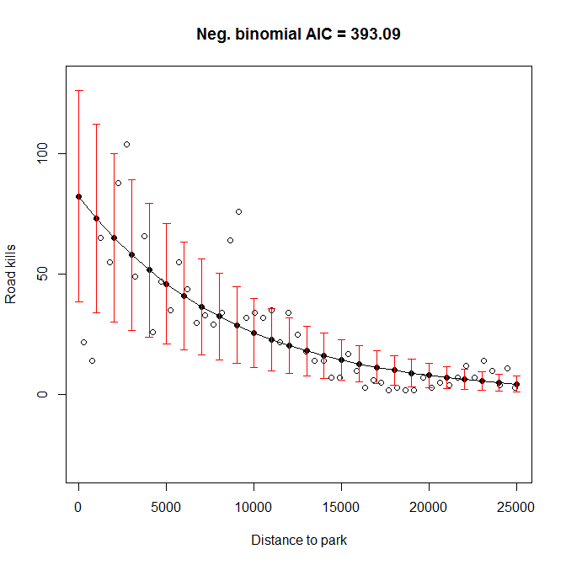
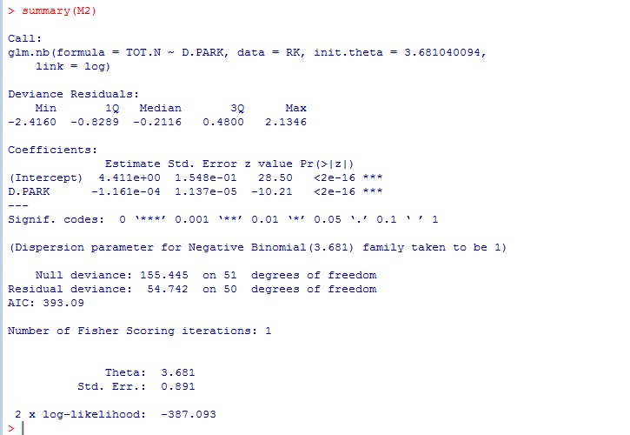
library("MASS")
M2 <- glm.nb(TOT.N ~ D.PARK, data = RK)
model2Means <- exp( coef(M2)[1] + coef(M2)[2]* xRange)
plot(RK$D.PARK, RK$TOT.N, xlab = "Distance to park",ylab = "Road kills",main=paste( "Neg. binomial AIC =", format(AIC(M2),digits=5)),ylim=c(-30,130))
lines(xRange, model2Means)
vars = model2Means + model2Means^2 / M2$theta
errbar(xRange, model2Means, model2Means + sqrt(vars), model2Means - sqrt(vars),add=TRUE, errbar.col="RED")

Slide 26
We capture large
variance at high
road kills
Our model doesn’t go below zero

Slide 27
Negative binomial seems like the best fit…
But the differences between the models are in some ways subtle..
They all capture the basic shape of the relationship..

Slide 28
One more PCA Example
Generalized linear models – Poisson distribution
Generalized linear models – Negative binomial distribution
Generalized linear models – logistic regression (binomial distribution)

Slide 29
What about binary variables.
voting democratic or republican
has cancer/does not have cancer

Slide 30
Here we simulate a classification problem (more on this later)
rm(list=ls())
numDataPoints <- 100
classBlue <- rnorm(10,mean=1);
classOrange <- rnorm(10, mean=0);
blueDataX1 <- vector();
orangeDataX1 <- vector();
for( i in 1:numDataPoints)
{
blueDataX1[i] <- rnorm(1, mean=classBlue[ sample(1:10,1) ], sd = 1/5)
orangeDataX1[i] <- rnorm(1, mean=classOrange[sample(1:10,1)],sd = 1/5)
}
colors <- c( rep("BLUE", numDataPoints), rep ("ORANGE", numDataPoints))
values <- c( rep(0, numDataPoints), rep (1, numDataPoints))
mergedDataX1 <- c( blueDataX1, orangeDataX1 );
plot(mergedDataX1, values,col=colors)
https://github.com/afodor/metagenomicsTools/blob/master/src/machineLearningExamples/logisticRegressionSims.txt

Slide 31
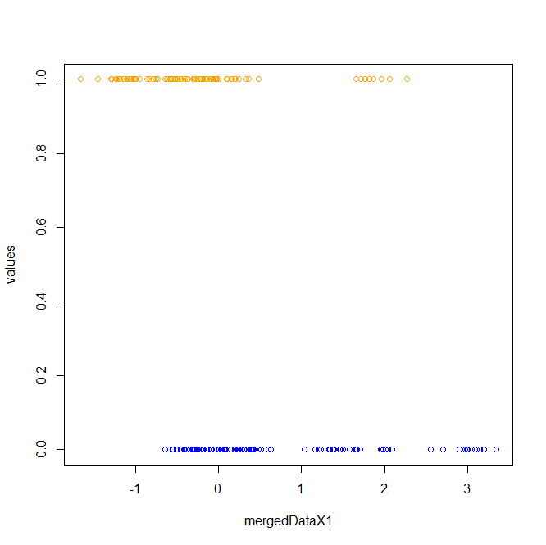
plot(mergedDataX1, values,col=colors)

Slide 32
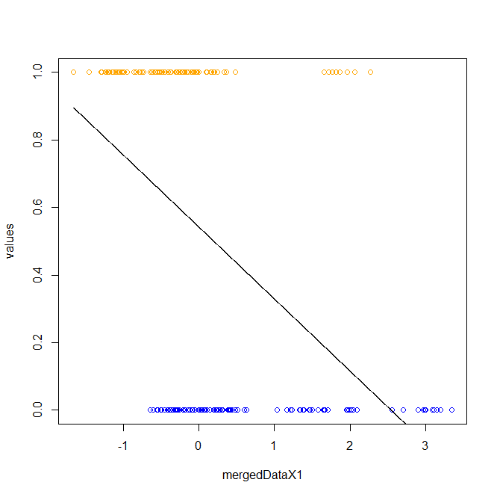
We can of course fit a linear model to these data
xSeq <- seq(min(mergedDataX1), max(mergedDataX1), 0.001)
myLm <- lm( values ~ mergedDataX1)
getProbLm <- function( x, B0, B1)
{
return ( B0 + B1 * x )
}
lines( xSeq, getProbLm(xSeq, coef(myLm)[1], coef(myLm)[2]),col="black")
We can think of the y-values as the p(blue|x value)
But our model can
Return values > 1 or <0, which doesn’t make sense for a probability

Slide 33
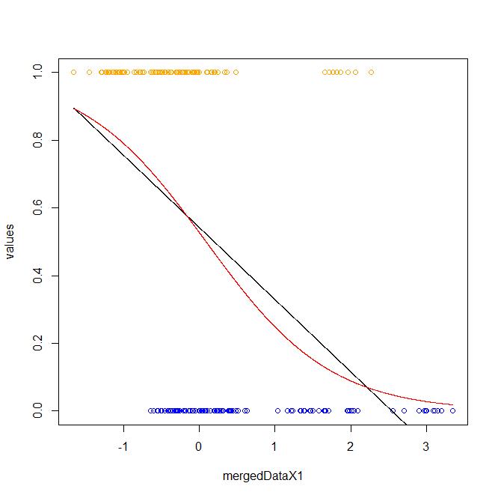
myLogReg <- glm( values ~ mergedDataX1 ,family = binomial)
summary(myLogReg)
xSeq <- seq(min(mergedDataX1), max(mergedDataX1), 0.001)
getProb <- function(x, B0, B1)
{
return (1 / (1 + exp(-(B0 + B1 * x ))))
}
lines( xSeq, getProb(xSeq, coef(myLogReg)[1], coef(myLogReg)[2]),col="red")
An alternative is a logistic regression
where the model can’t go >1 or <0

Slide 34
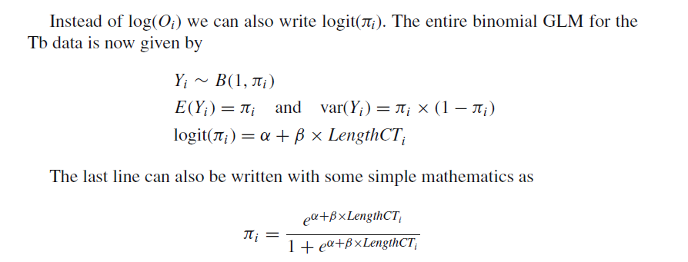
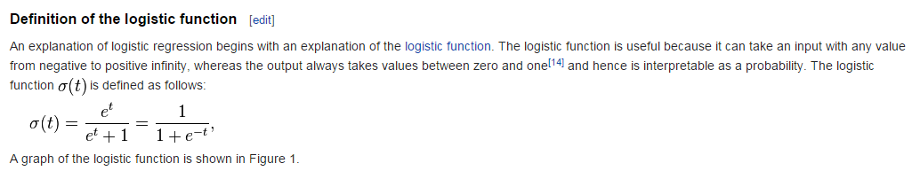
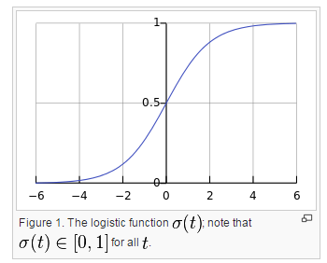
Here are the rules for a logistic regression…(Chapter 10 of the Zuur book..)
Binomial probability of 1 coin flip
Linker function
N * p * (1-p) with N = 1
This constrains us to between 0 and 1
http://en.wikipedia.org/wiki/Logistic_regression

Slide 35

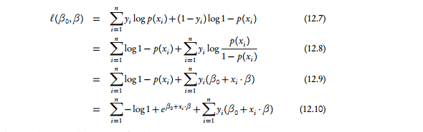
Put all this together into the likelihood…
Binomial distribution with n = 1
Yi is 1 or 0
This is π if a head (1- π) if a tail
Find the parameters to maximize this and we are good to go….
http://www.stat.cmu.edu/~cshalizi/uADA/12/lectures/ch12.pdf

Slide 36
The linear regression and logistic regression can vary in how closely they agree…
(Here we look at 3 different runs….)

Slide 37
Next:
Zero inflated Poisson and Negative Binomial

