Slide 1
Mean and value of continuous distributions
Derivation of the binomial equation
dbinom ,pbinom, qbinom and rbinom in R
The bionomial equation for inference
Implementing the binomial distribution

Slide 2
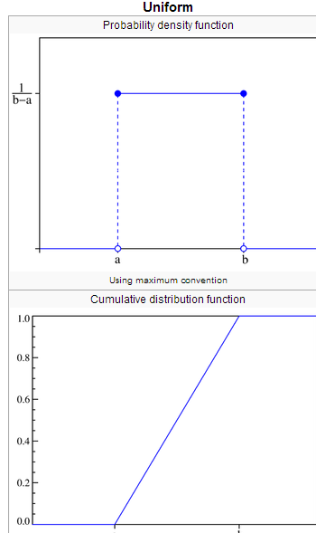
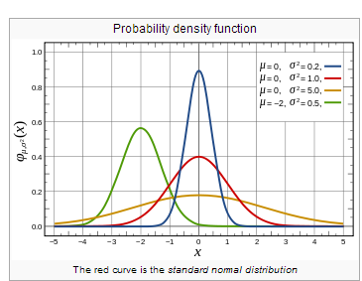
From last time:
Probability distribution can be continuous:
http://en.wikipedia.org/wiki/Normal_distribution
http://en.wikipedia.org/wiki/Uniform_distribution_(continuous)

Slide 3
or discrete:
A fair die
p(1) = 1/6
p(2) = 1/6
p(3) = 1/6
p(4) = 1/6
p(5) = 1/6
p(6) = 1/6
P(7 or greater) =0

Slide 4
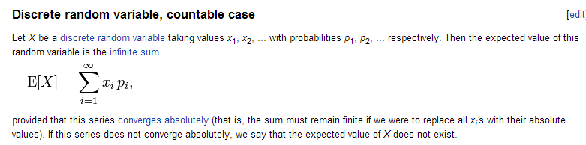
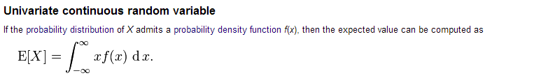
The expected value (or mean) of a discrete distribution
has an obvious analogy for continuous distributions:
http://en.wikipedia.org/wiki/Expected_valuez

Slide 5
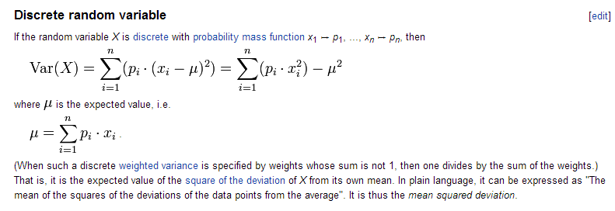
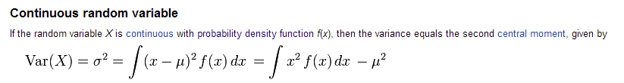
Likewise the variance of a discrete distribution
Has an obvious counterpart for continuous distributions
http://en.wikipedia.org/wiki/Variance

Slide 6
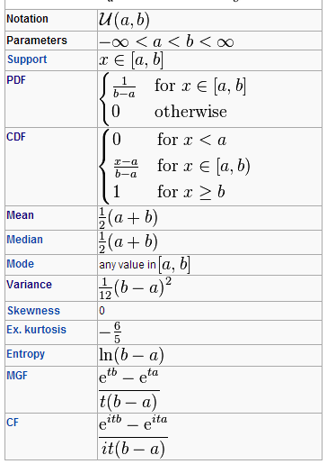
We will state (without proof) the following results for the Uniform distribution
that samples between a and b
The mean = ½ ( a + b )
Variance = 1/12 ( b-a)^2
If b = 1 and a =0;
mean =0.5
Variance = 1/12
http://en.wikipedia.org/wiki/Uniform_distribution_(continuous)

Slide 7
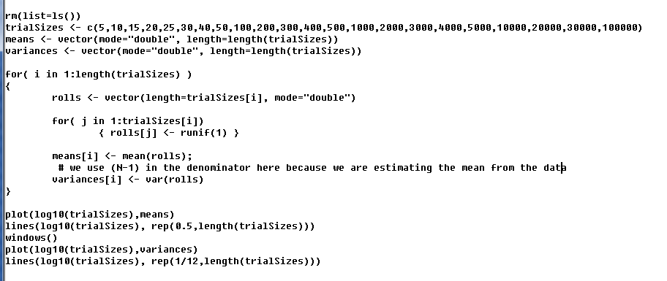
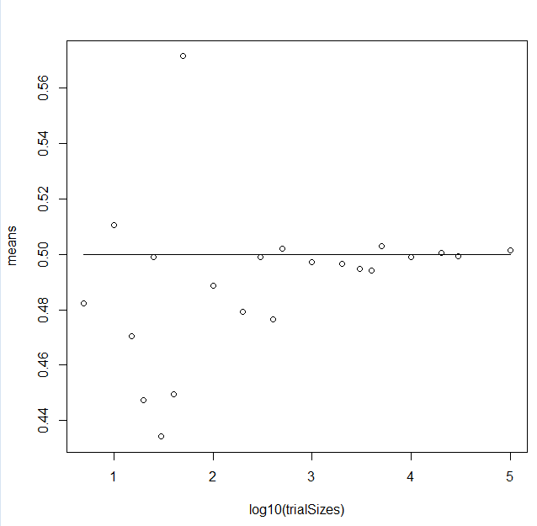
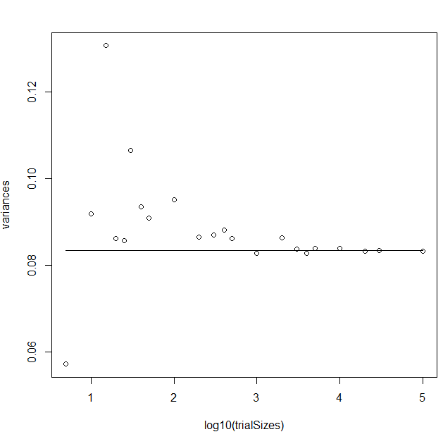
We can easily confirm these values…

Slide 8
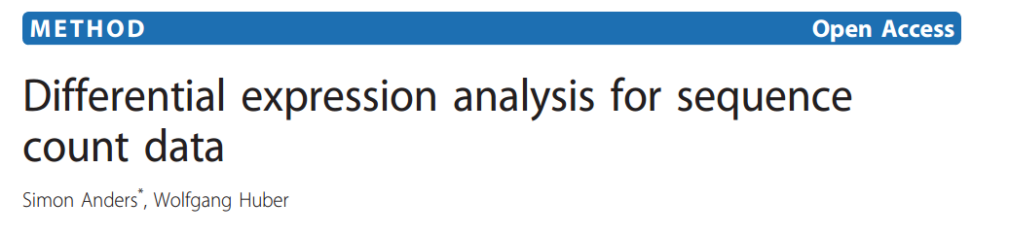
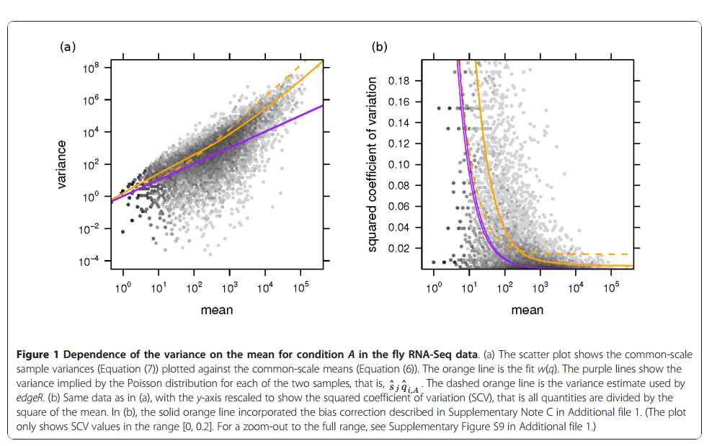
Understanding mean and variances well is important.
Dseq: A paper we are working towards…
This is plotting the relationship between mean and variance for
genes in an rna-seq dataset
For the Poisson distribution, the mean equals the variance ; not a good assumption here.
(We will keep working towards learning what all these words mean!!!!)

Slide 9
Mean and value of continuous distributions
Derivation of the binomial equation
dbinom ,pbinom, qbinom and rbinom in R
The bionomial equation for inference
Implementing the binomial distribution

Slide 10
Consider a fair coin with the following distribution:
p(Heads|Fair coin) = 0.5
P(Tails|Fair coin) = 0.5
We flip the coin 25 times. What proportion of the time will we see exactly 16 heads?
This is given by the binomial distribution.

Slide 11
Let’s derive the binomial equation!
(For our coin flip example…)
n = the number of coin flips (25)
k = the number of heads observed.
p = the probability of seeing a head (.5)
The probability of observing exactly k heads from a fair coin=
( )
n
k
p^{k} (1-p)^{n-k}
= n! * p^{k} (1-p)^{n-k}
k!(n-k)!

Slide 12
n!
Let’s start with the binomial coefficient
k!(n-k)!
Let’s say you have 8 letters
A,B,C,D,E,F,G,H ( n = 8; k=5 ) or (n=8; k=3)
How many ways can you break them into one set of 5 and one set of 3
A₁
A₂
A₃
A₄
A₅
B₁
B₂
B₃
There are 8! different ways you could arrange the 8 balls in the containers
But, it does not matter which “A” or “B” container a ball ends up in,
so you have to correct for the number of ways the balls could be ordered
within A or B. That is, once the balls are distributed, there are 5! ways
the A’s could be ordered and 3! ways the B’s could be ordered. So
( )
n!
n
=
k
k! (n-k!)

Slide 13
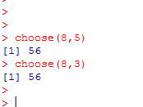
( )
n!
n
=
k
k!(n-k)!
We say “n choose k”.
( )
( )
8
=
8
5
3
8!
8 * 7 *6
( )
8
=
=
=
56
5
5!
3!
3 * 2
8!
8 * 7 *6
( )
8
=
=
=
56
3
3!
5!
3 * 2
In R:

Slide 14

You have four nucleotides.
How many ways can you choose a set of two nucleotides?
(set = distinct, order does not matter)
“4 choose 2” =
( )
(4*3) = 6
4
=
2
2
AC
AG
AT
CG
GT
CT
How many strings of two nucleotides (string = order matters):
4 * 4 = 16
A string of two distinct nucleotides = 4*3=12

Slide 15

You have 20 residues.
How many ways can you choose a set of 4 residues?
(set = distinct, order does not matter)
“20 choose 4” =
( )
(20 * 19 * 18 * 17) = 4,845
20
=
4
4 * 3 * 2
How many strings of four residues (string = order matters):
20 ^4 = 20 * 20 * 20 * 20 = 160,000
A string of four distinct residues = 20 * 19 * 18 * 17 =
116,280

Slide 16
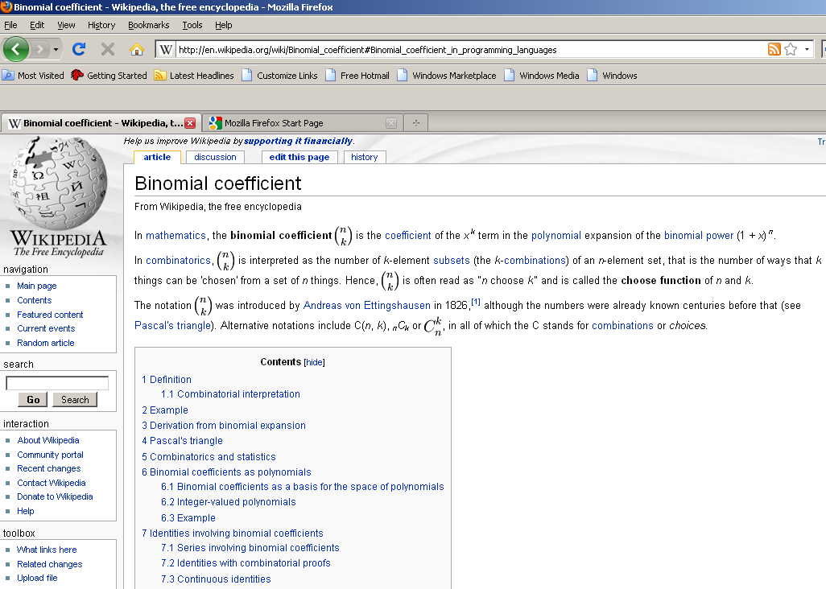
The wiki page on the binomial coefficient is very good..

Slide 17
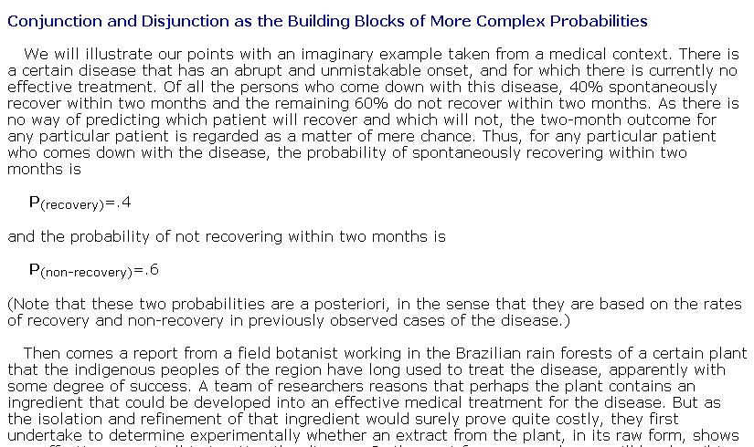
Ok. So on to the full binomial distribution…
The Vassar stats book does a nice job here…
(section 5.3 at http://faculty.vassar.edu/lowry/webtext.html )

Slide 18
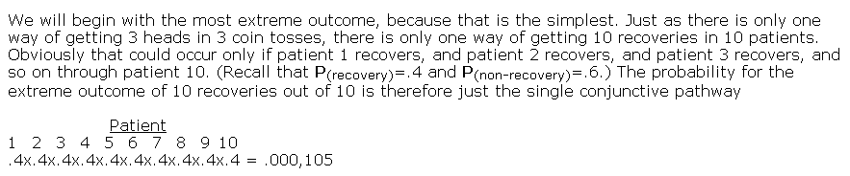
( )
= n! * p^{k} (1-p)^{n-k}
n
k
p^{k} (1-p)^{n-k}
k!(n-k)!
p(having all 10 patients recover)
n=10 ; k = 10; p(recovery) = 0.4
( )
10!
10
* 0.4¹⁰ *.6⁰ = * 0.4¹⁰* 1 = 1 * 0.4¹⁰= ~ 10⁻⁴
10
10! * 0!
p(having no patients die)
n=10 ; k = 0; p(death) = 0.6
( )
10
* 0.6⁰ *.4¹⁰
0
( )
( )
which = 0.4¹⁰ since
10
=
10
=
1
0
10
(we are either choosing 10 recovering patients or 0 sick ones)

Slide 19
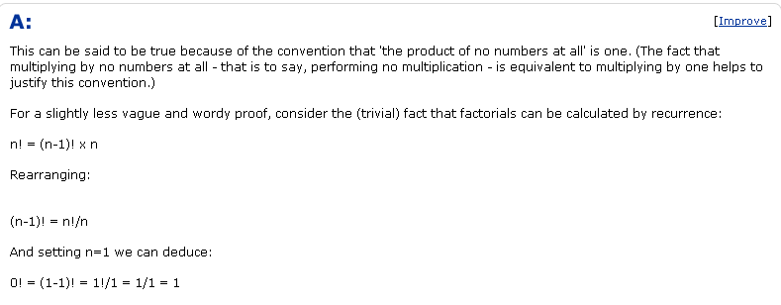
( )
10!
If
10
=1 bothers you….
0
10! * 0!
http://wiki.answers.com/Q/Why_is_zero_factorial_equal_to_one

Slide 20
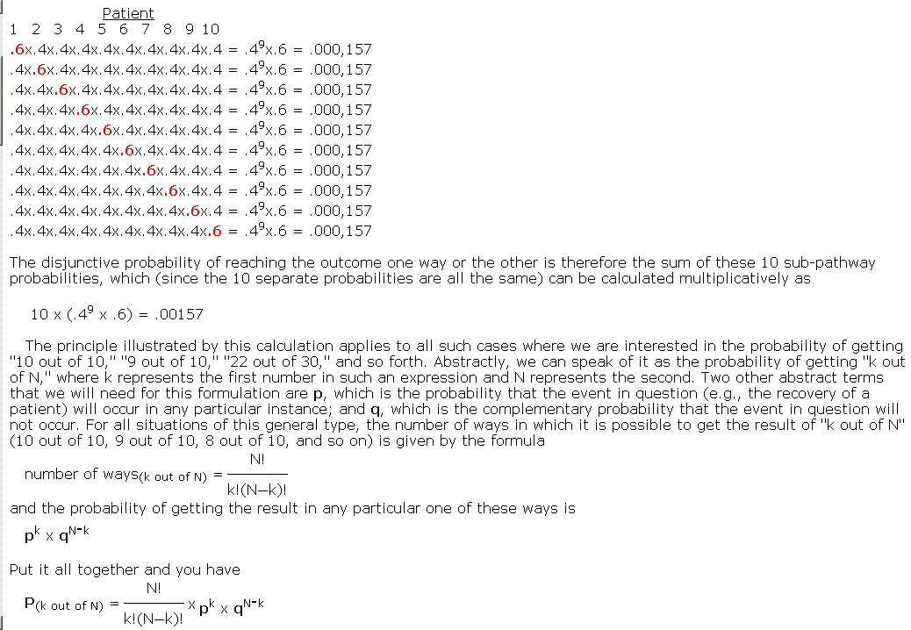
How about for 9 patients recovering...
There are 10 ways of choosing
1 sick (i.e. 9 recovering patients)
n=10 ; k = 9; p(recovery) = 0.4 or
n=10 ; k = 1; p(death) = 0.6
( )
( )
10
*.4⁹ * .6 =
10
*.6 * .4⁹
1
9
( )
= n! * p^{k} (1-p)^{n-k}
n
k
p^{k} (1-p)^{n-k}
k!(n-k)!

Slide 21
Mean and value of continuous distributions
Derivation of the binomial equation
dbinom ,pbinom, qbinom and rbinom in R
The bionomial equation for inference
Implementing the binomial distribution

Slide 22
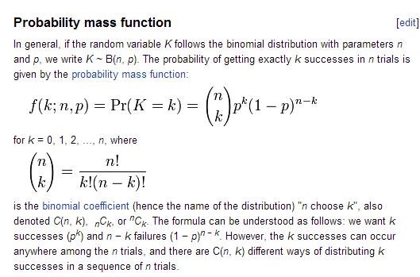
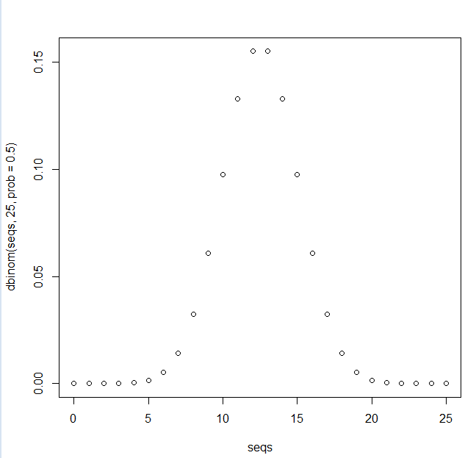
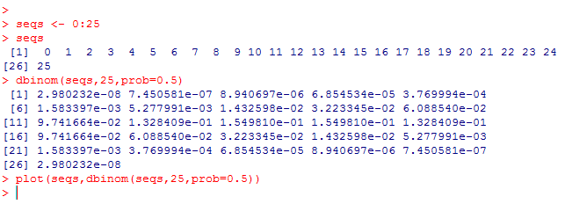
dbiom gives us the probability density function.

Slide 23
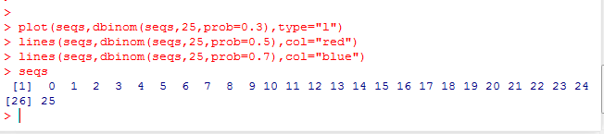
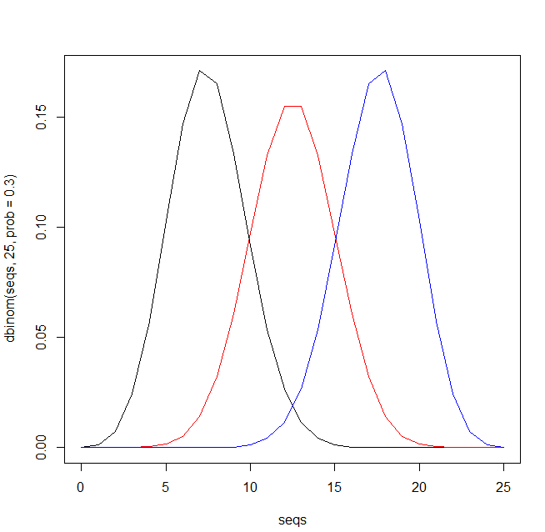
As p-changes we get different pdf’s..
What is the p(exactly k heads when)
P(head) = 0.3 (black)
p(head) = 0.5 (red)
p(head) = 0.7 (blue)

Slide 24
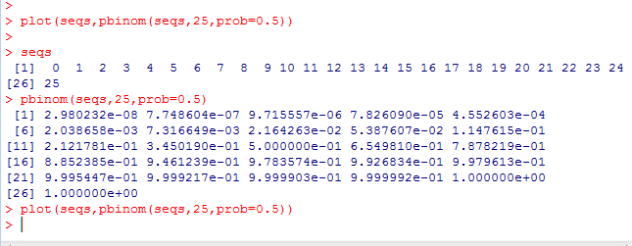
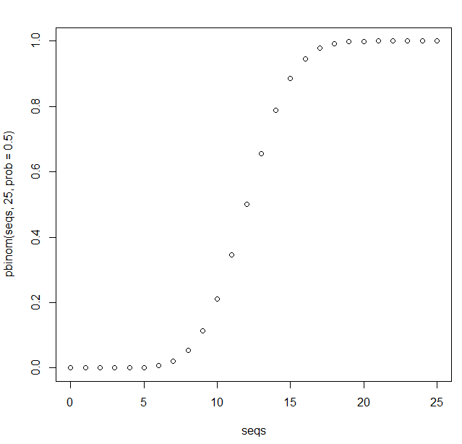
Pbinom gives us the cumulative distribution function.
What is the probability of k heads or
fewer in 25 flips..

Slide 25
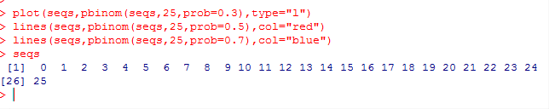
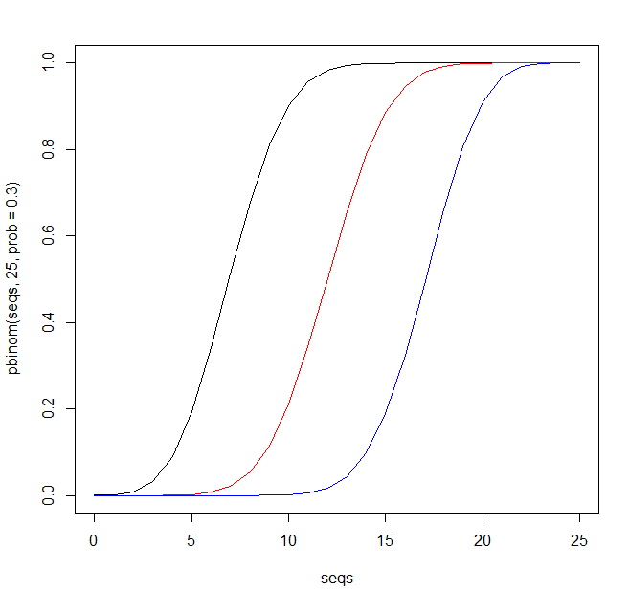
What is the probability of k heads or
fewer in 25 flips when
p(head) = 0.3 (black)
p(head) = 0.5 (red)
p(head) = 0.7 (blue)

Slide 26
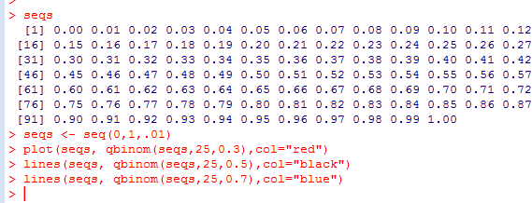
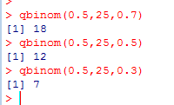
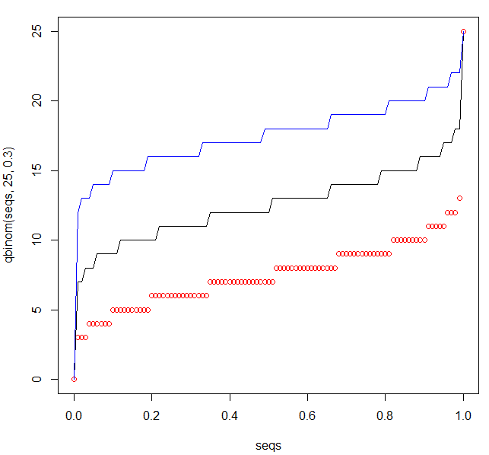
qbinom gives the inverse cumulative probability distribution function
From the cumulative probability,
get back the number of successes
If p(head) = 0.3, then 50% of the time
we will observe at least 7 heads in
25 flips…
Just take the cumulative distribution function and flip the axes
(I tend not to use this one very much…)

Slide 27
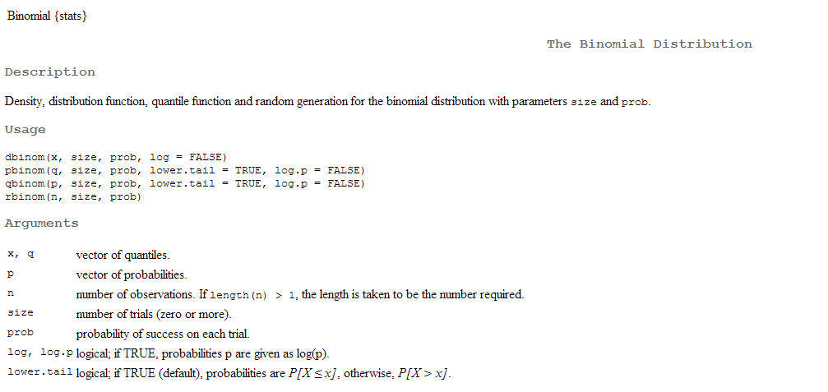
rbinom samples from the binomial distribution ( simulates data )

Slide 28
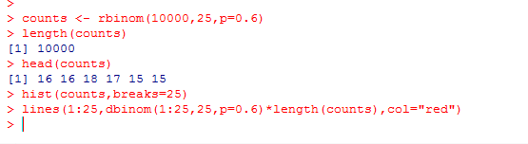
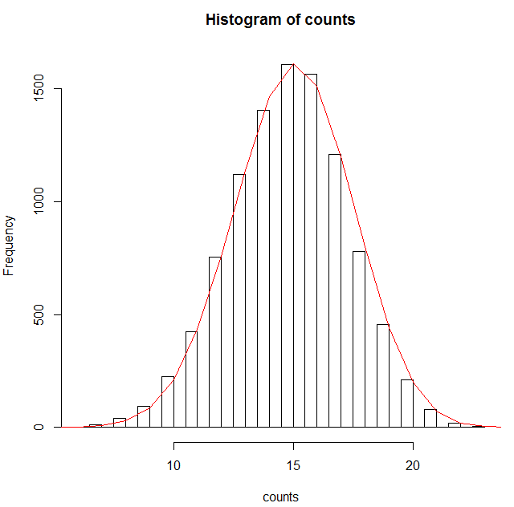
Here we compare the theoretical and sampled distribution of the binomial distribution
(which obviously by the law of large numbers have to be close)

Slide 29
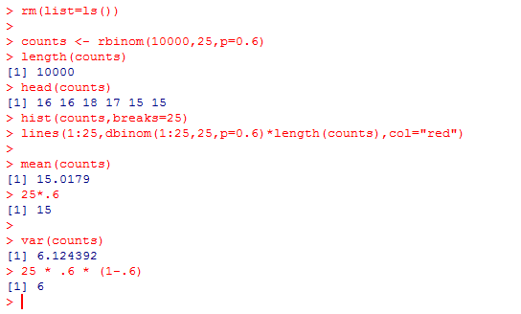
We state without proof:
mean (binomial) = np
Variance = np(1-p)

Slide 30
Mean and value of continuous distributions
Derivation of the binomial equation
dbinom ,pbinom, qbinom and rbinom in R
The bionomial equation for inference
Implementing the binomial distribution

Slide 31
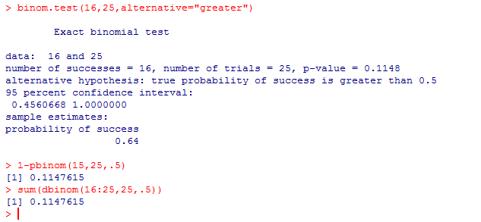
We can go back to our coin tossing example. The odds of flipping 16 or more heads
with a fair coin (p head = 0.5)
Because we want to know the odds of 16 or more heads, we have..
k=25
( )
Σ
n
k
p^{k} (1-p)^{n-k}
k=16
Where n=25 and p = 0.5
1-the area from
1 to 15
or
The area from x=16 to x=25

Slide 32
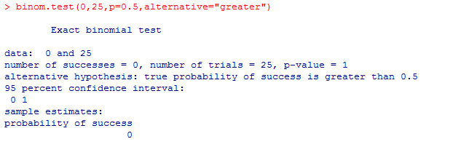
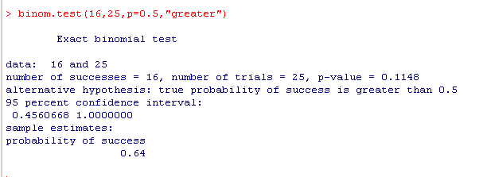
Using binom.test(…) gives us information about the test.
OR
Just 16/25
We are 95% sure that the “true” rate of generating
heads by the coin is between 0.45-1.0
Null hypothesis: true p(head) <= 0.5
Note that this is a one-sided test. If we get 0 heads, the p-value is 1…
Null hypothesis: true p(head) <= 0.5; if we see 0 heads, then we accept the null hypothesis
with complete certainty

Slide 33
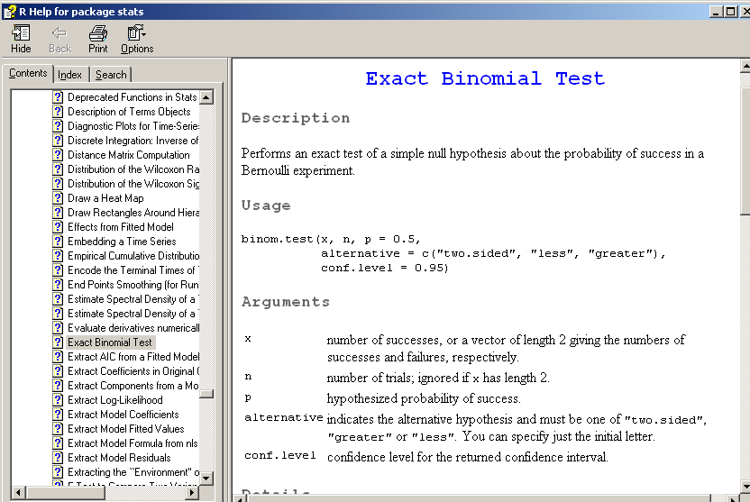
If you type ?binom.test you get the R doc to explain some of this

Slide 34
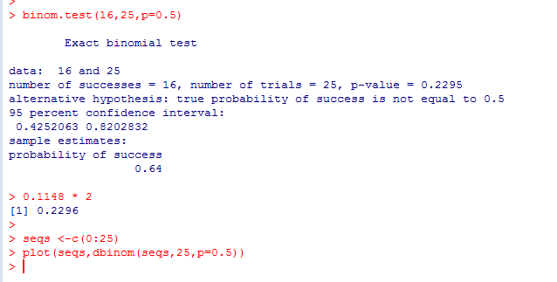
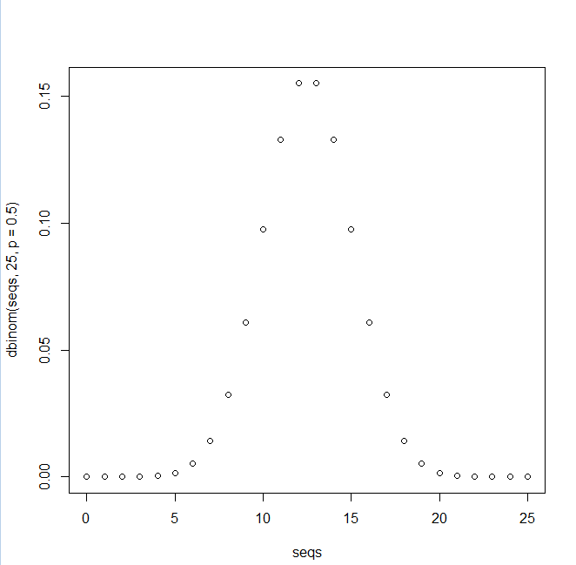

For a symmetrical binomial distribution (with p=0. 5), the two-sided test is clearly just twice the one-sided test
The area from 16 to 25 is the same on the other size of the curve, so we can just multiply by 2…
null hypothesis:
p(head) = 0.5
Alternatively sum up both sides:

Slide 35
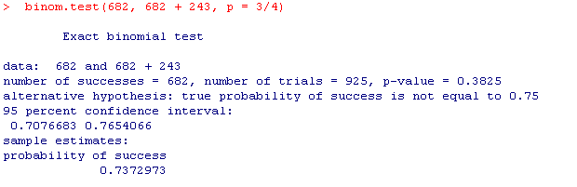
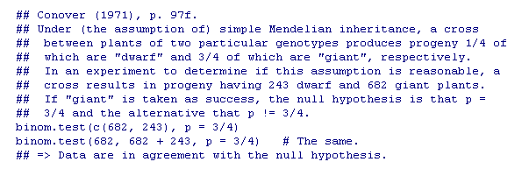
Two-sided tests are a little more complicated when p != 0.5
(An example from ?binom.test from r Docs)

Slide 36

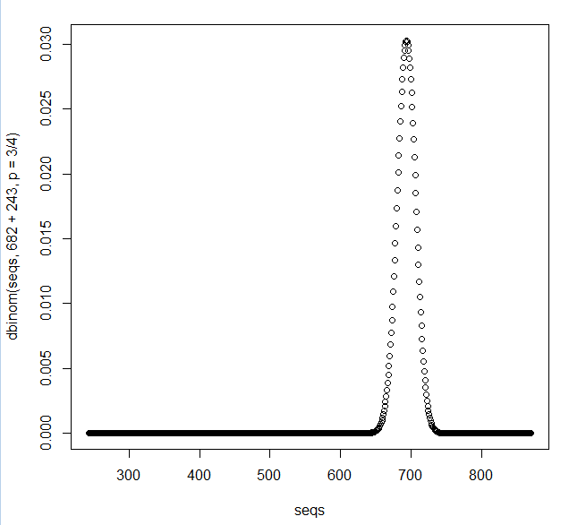
When p =0.5, the left and right areas are not equal and we can’t just double the p-value

Slide 37
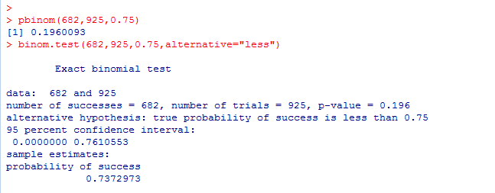
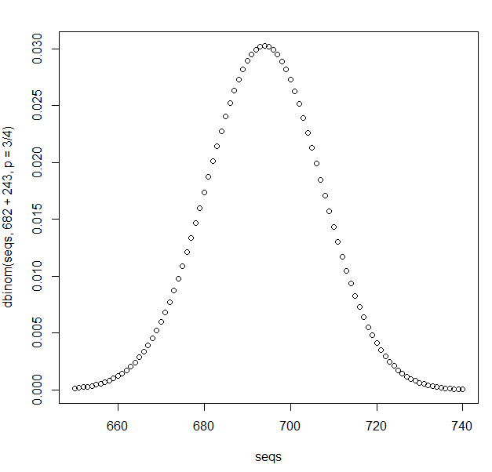

The one sided test (that the true value is < 0.75) is straightforward.
E(X) = 925 * 0.75
Observed value
682.
Null hypothesis:
P <= 0.75
We sum from 0 to the observed value in the PDF

Slide 38
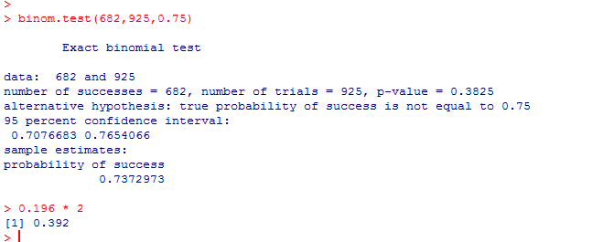
The one sided test (that the true value is < 0.75) is straightforward.
E(X) = 925 * 0.75
But the two-sided test is not exactly equal to
twice the one sided
Observed value
682.

Slide 39
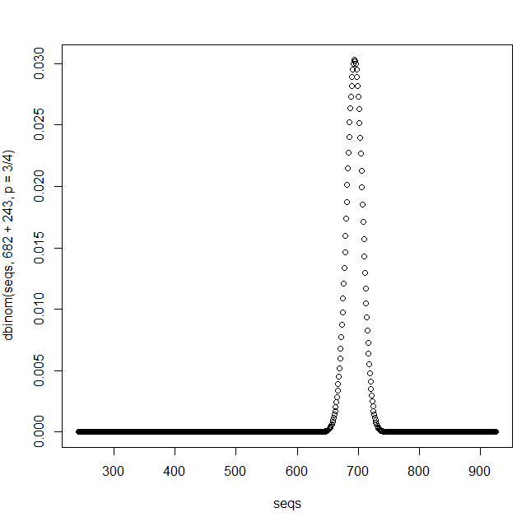
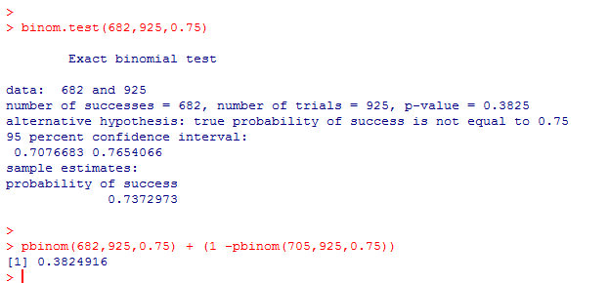
It turns out that binom.test is written in R, so we can get to code easily..(type binom.test in R )
Algorithm for 2 sided test:
Sum the probability from 0 to 682
Find the area on the right
hand side corresponding to
the height of dbinom(682,965,0.75)
(3) Add the area on the right.
Our p-values is
pbinom(0,682,0.75) +
everything from the equivalent
point on the right…
Equivalent
on right
682
This number turns out to be 705

Slide 40
Mean and value of continuous distributions
Derivation of the binomial equation
dbinom ,pbinom, qbinom and rbinom in R
The bionomial equation for inference
Implementing the binomial distribution

Slide 41
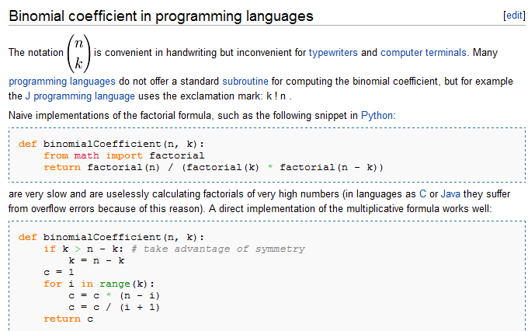
The wiki has a nice page about how to implement this yourself
http://en.wikipedia.org/wiki/Binomial_coefficient
( )
n * (n-1) *…* (n-k+1)
n
=
k
k * (k-1) * …. * 1
I confess to having used the naïve implementation!

Slide 42
The efficient implementation uses an
algebraically equivalent form….
( )
n * (n-1) *…* (n-k+1)
n
=
k
k * (k-1) * …. * 1
n * (n-1) *…* (n-k+1)
(n-k)!
=
*
k * (k-1) * …. * 1
(n-k)!
n!
=
k!(n-k)!

Slide 43
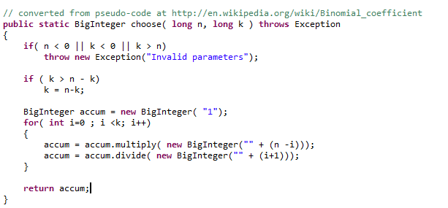

We put this into Java using BigInteger allowing this to scale arbitrarily big…
Then we can “brute force” a binomial implementation

Slide 44




This is in some ways a nice implementation because it can go to arbitrarily small numbers
Here we match R results…
162.3885E-84
Here we are able to report a probability where R underflows…
2.7379E-891
As we will see, the binomial distribution can acts as the frequency distribution for
applying bioinformatics to sequence alignments.
Sequence alignments can easily have 3,000 sequences.
Having the probabilities go all the way to zero can mess up our models
(if posterior is proportional to frequency * prior, if the frequency goes to zero, so
will the posterior and then the posterior is zero forever, insensitive to future updates).
But BigDecimal can be very slow and very memory intensive for big numbers…

Slide 45



A better option is to work in log space and use Stirling’s approximation

Slide 46


We can see that Stirling’s approximation is very good…

Slide 47
So if we report ln(binomial)
( )
ln(
n
k
p^{k} (1-p)^{n-k}
)
= ln(n!) – ( ln( k! ) + ln((n-k)!) + ln(p^{k}) + ln((1-p)^{(n-k)}
We can simplify this a bit since
log_{p} p^{k}= K
But also (by the rule of changing bases )
log_{p} p^{k} = ln(p^{k}) / ln(p) = K
So ln(p^{k}) = K * ln(p)
Performing a similar line of argument for ln((1-p)^{(n-k)} and substituting yields:
ln(n!) – ( ln( k! ) + ln((n-k)!) + k * ln(p) + (n-k) * ln(1-p)

Slide 48




ln(n!) – ( ln( k! ) + ln((n-k)!) + k * ln(p) + (n-k) * ln(1-p)
This allows us to efficiently work with smaller numbers than dbinom in R can use…

Slide 49
Next: The Bayesian universe!

