Slide 1
Reviewing multi-threaded designs from Assignment #7 (multi-threaded GUI…)

Slide 2
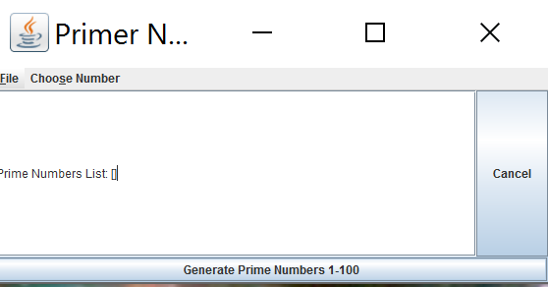
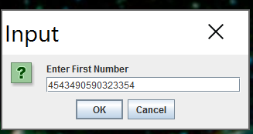
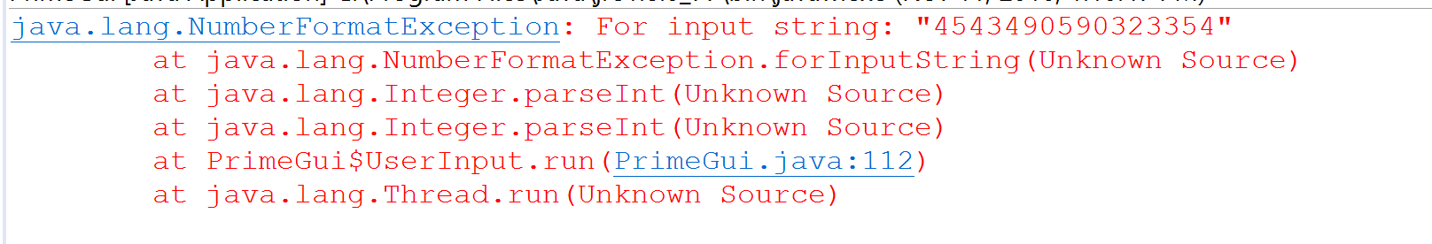
No error message with invalid integer…

Slide 3
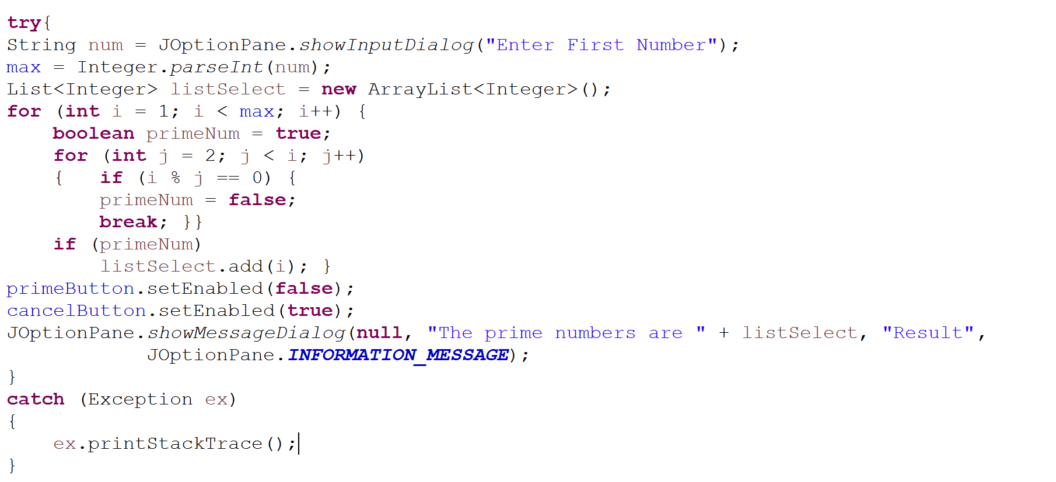
GUI applications need to give information back to the users
This line throws if not a valid integer
Error goes to the console, not the GUI

Slide 4
Results are shown in a JOptionPane message dialog….

Slide 5
Message dialogs are not always ideal for large amounts of information…
The “Ok” button is off my screen and I can’t get to it.
Application is effectively dead and has to be killed from task manager of kill -9
Consider a JScrollPane wrapped around a TextArea as an alternative (will give scroll bars…)
Also, the dialog can take a long time to render, effectively making the application look frozen

Slide 6
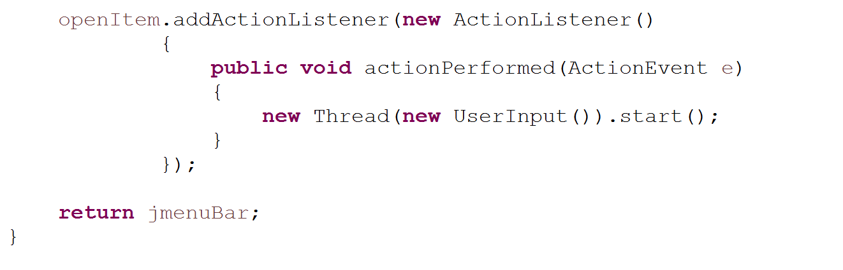
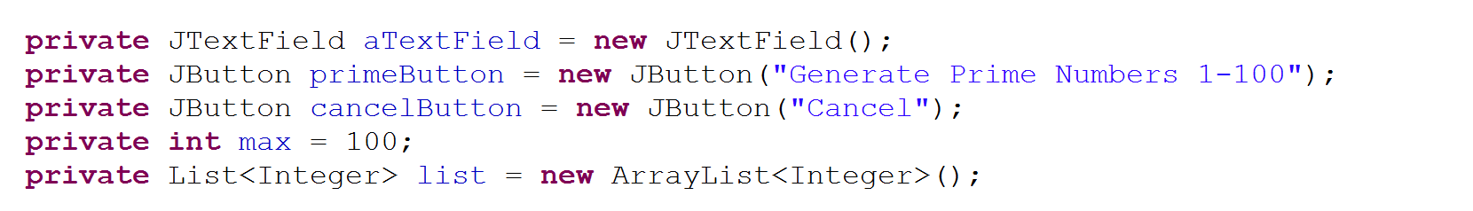
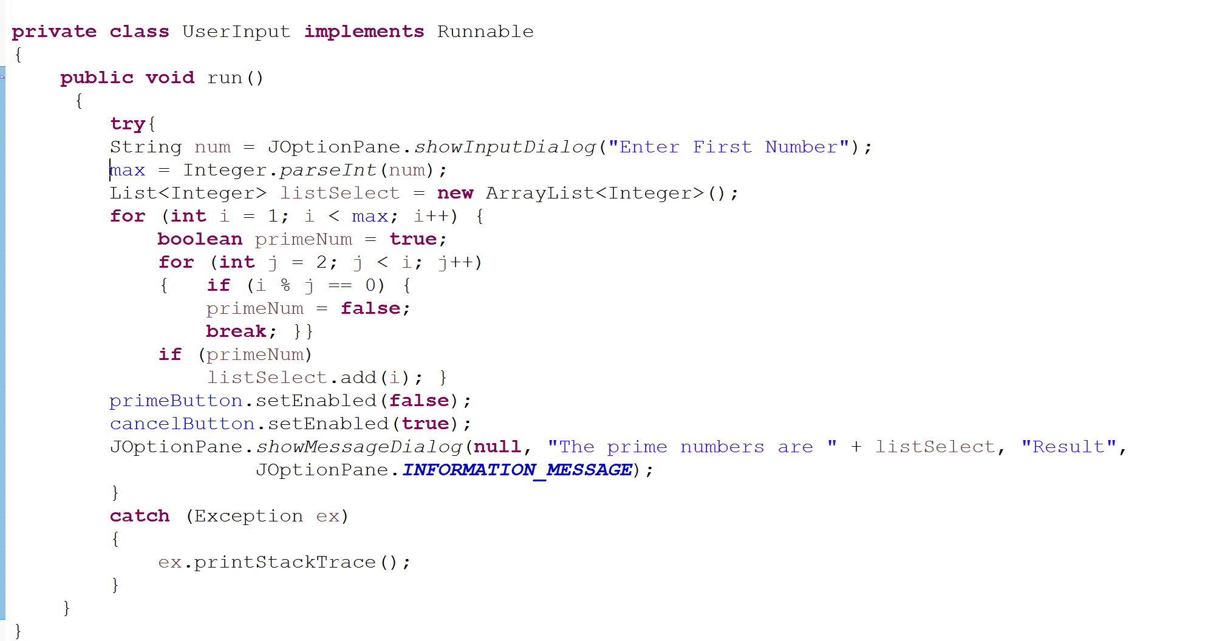
Not stack confined.
If user hits “Choose Number” again, max can change
with undefined results
These are not marked as thread safe – should be placed back on
AWT thread via SwingUtilities

Slide 7
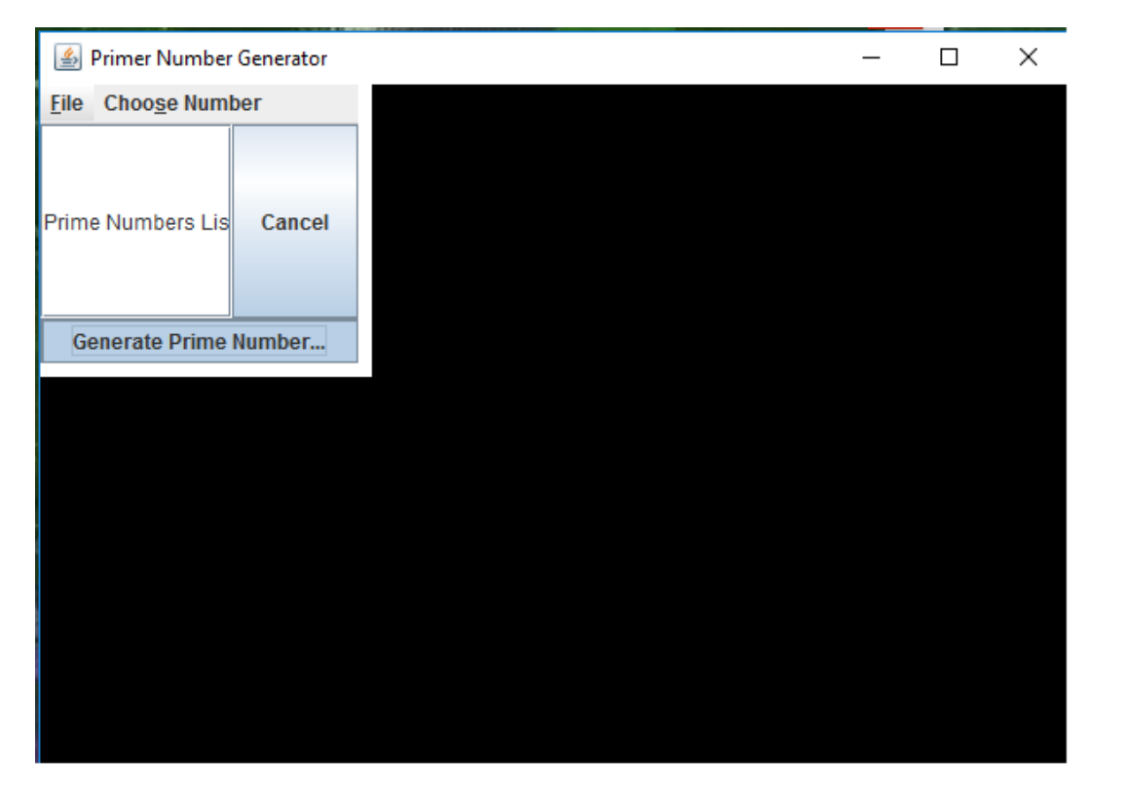
I was able to “freeze” the program (although it didn’t always freeze…)

Slide 8
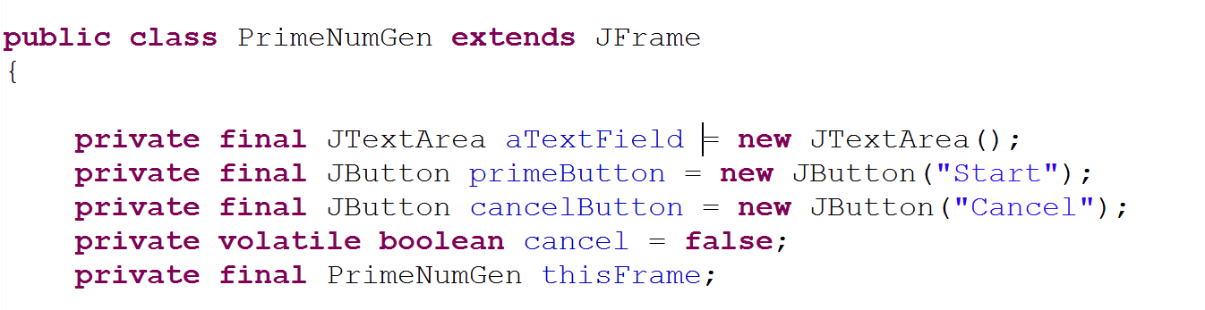
I made a version that (I think) may address some of these issues…
Volatile cancel flag
https://github.com/afodor/metagenomicsTools/blob/master/src/classExamples/gui/PrimeNumGen.java

Slide 9
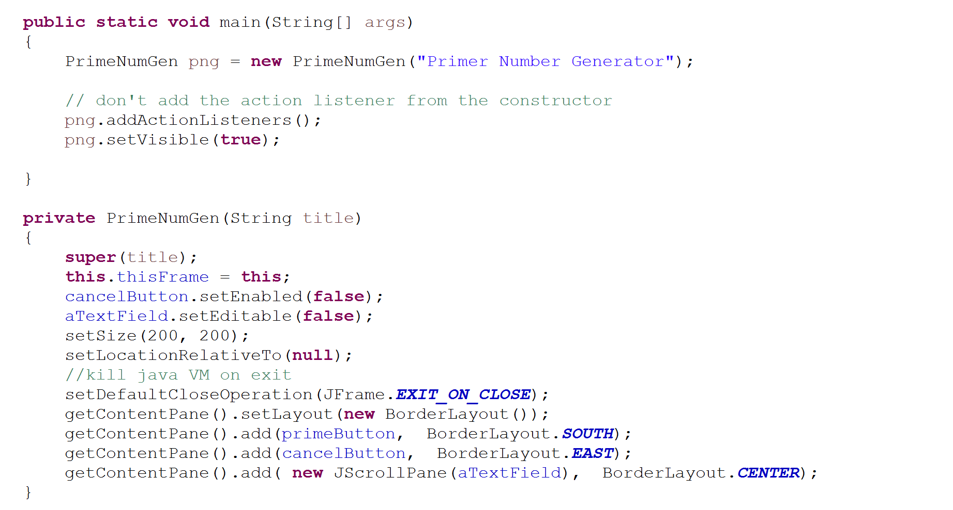
Private constructor
(because we will add the action listeners after construction)

Slide 10
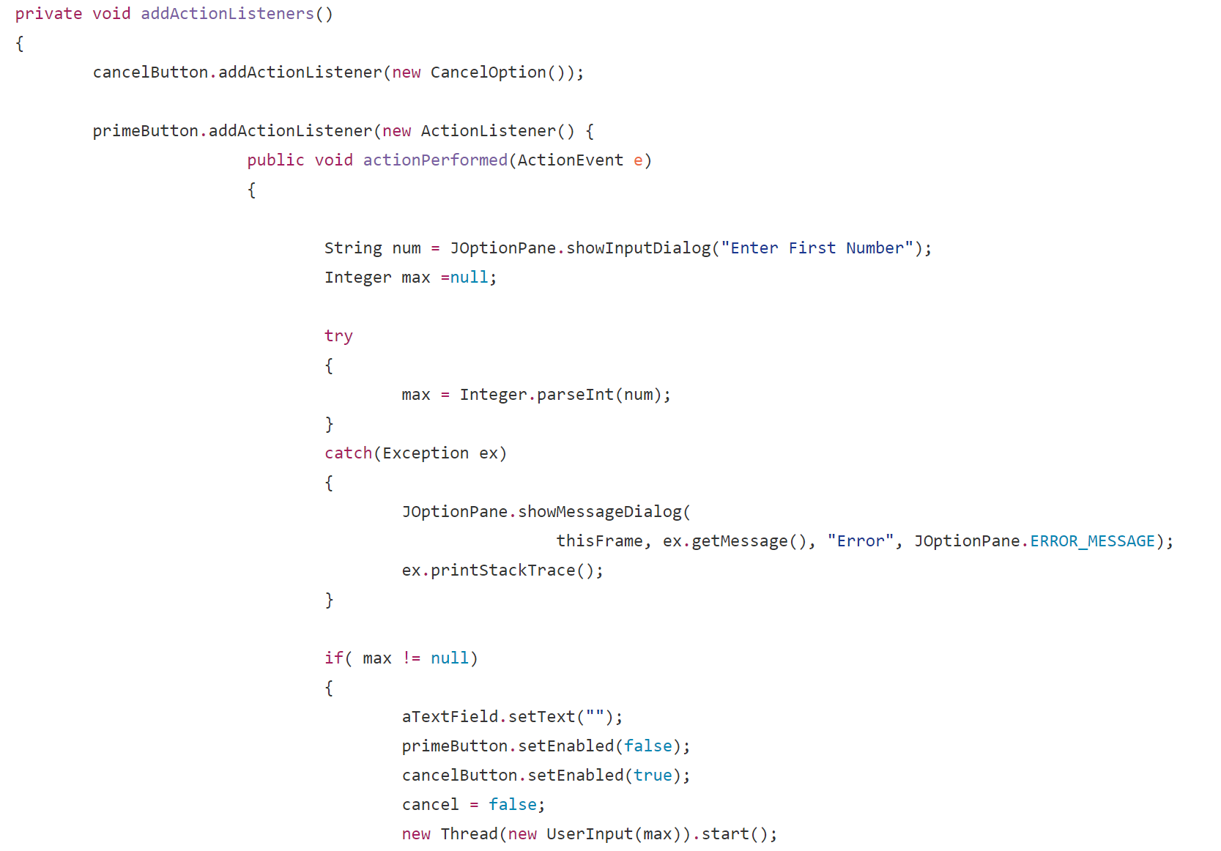
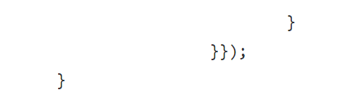
The action listeners are added
after construction…
Kick off the calculation on
the non-AWT thread…

Slide 11
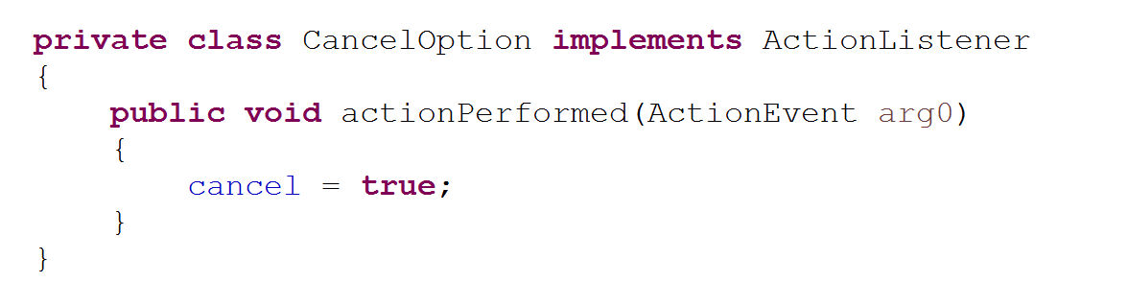
The cancel button just sets a flag (like cancel in a FutureTask).
We’ve made sure the boolean cancel is volatile so that it will be visible across threads

Slide 12
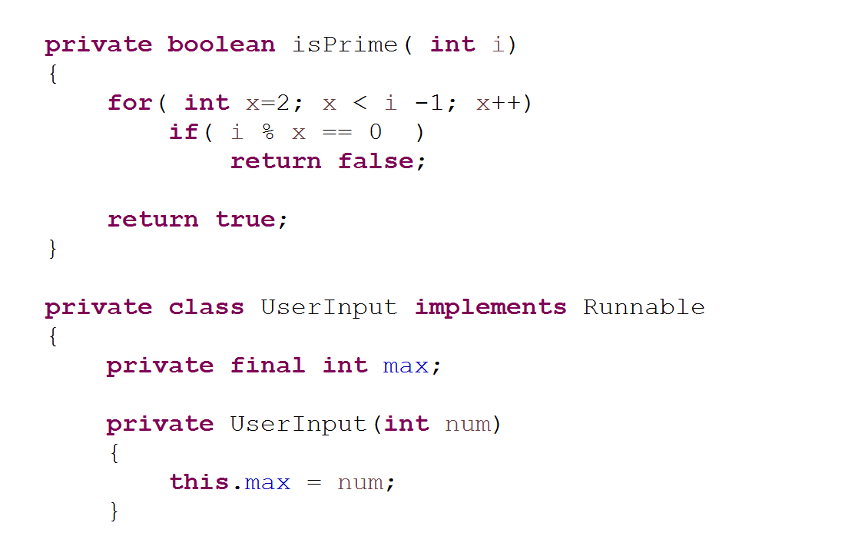
The Worker class makes an immutable copy of the work that it has to do…
Helper method
I might have called this PrimeWorker or something like that

Slide 13
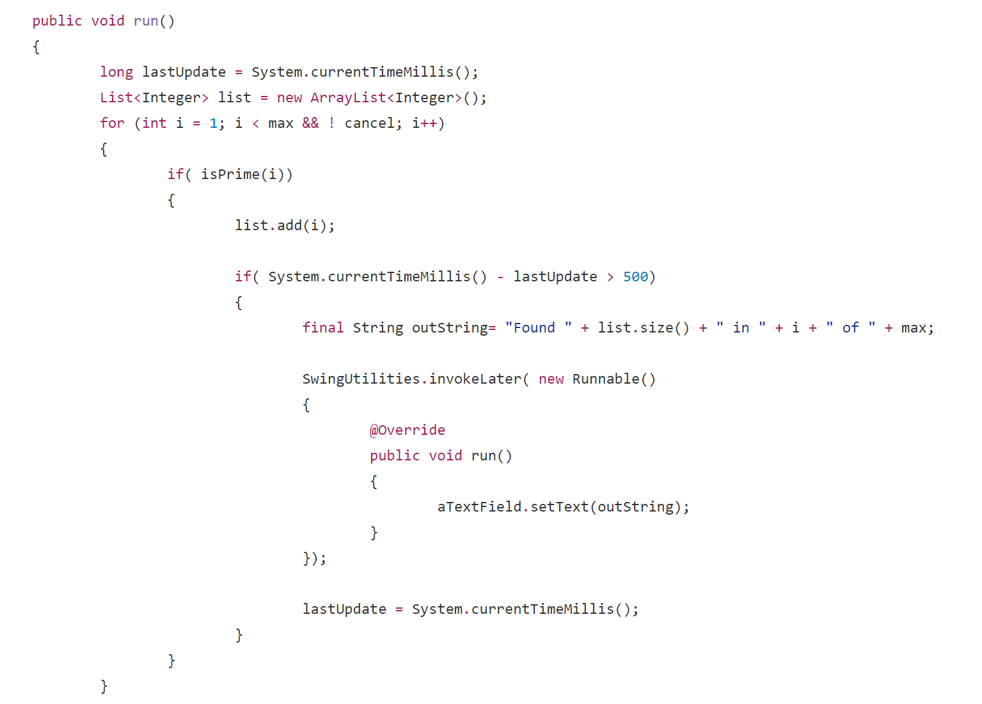
First part of the run method… does the calculation
List is stack confined; make sure it doesn’t escape!
Check for the cancel with every number
Only update twice a second!
Continuous updates will
freeze the AWT thread
Publish an immutable string
back to the AWT thread..

Slide 14
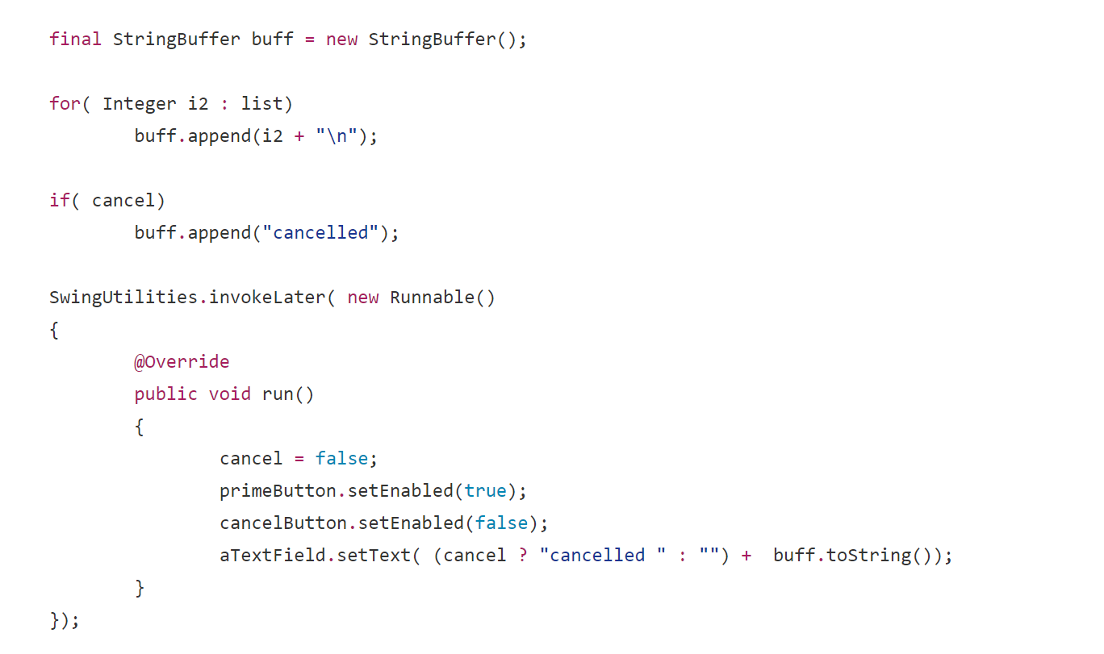
Second part of the run method…. Show final results…
Prepare the input string
Publish an immutable string
Back to the AWT thread….

Slide 15
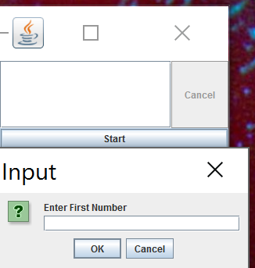
The start button
kicks off an input dialog

Slide 16
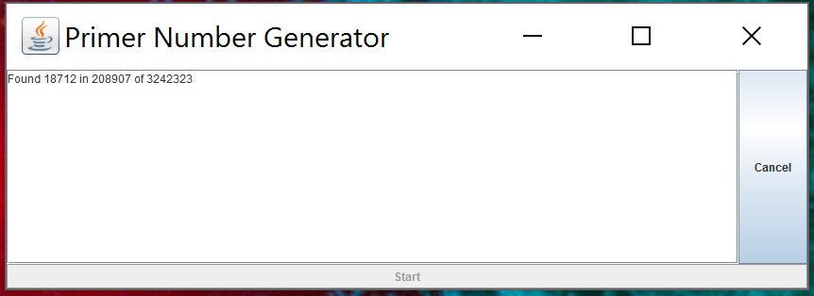
Cancel button works and is not blocked
Start button is disabled
Application can be resized and is not blocked

