Slide 1
Better visualization of the Metropolitan algorithm
The negative binomial distribution

Slide 2
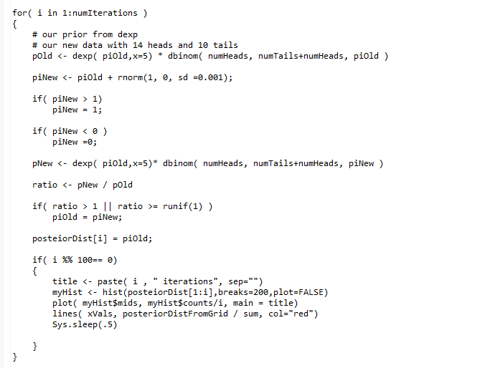
Plot every 100 iterations…
Everything is as before except the graph is now in the loop
https://github.com/afodor/metagenomicsTools/blob/master/src/metropolitan/realTimeGraphUpdates.txt

Slide 3
With this updated code, we can watch the posterior form in “real time”

Slide 4
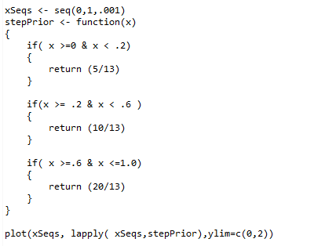
One last prior to consider (to again watch the prior belief melt away with new data….)
These constants are chosen so the integral sums to one….
lapply applies our function
to every element in the vector
https://github.com/afodor/metagenomicsTools/blob/master/src/metropolitan/realTimeGraphUpdates.txt

Slide 5
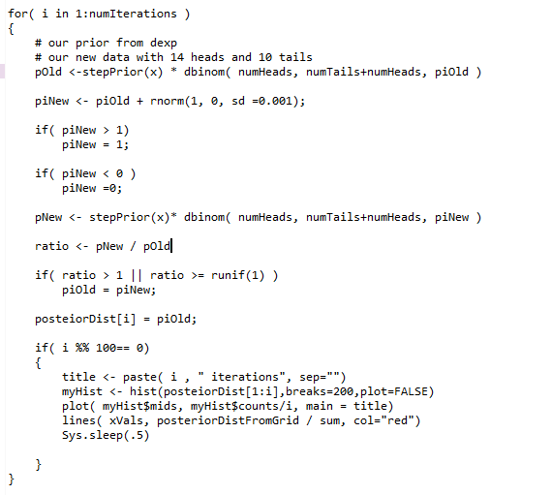
It is trivial to make this our new prior…

Slide 6
As is the case for the exponential prior, with enough steps, we find our posterior…
Notice the slight discontinuity left from our prior…

Slide 7
Better visualization of the Metropolitan algorithm
The negative binomial distribution

Slide 8
You enter a tournament
You can play until you have 3 losses.
Your rate of winning games is 60%.
What is the distribution of your expected number of wins?
This is the negative binomial distribution…
(This is also the tournament structure of the arena in Hearthstone, but I digress…)

Slide 9


The negative binomial distribution:
The # of wins (k) before we see r losses….
There are k wins
r losses
prob = p is the probability of a loss
K = # of wins …
r = # of losses before you are dropped from the tournament
P = 0.4 = prob(loss)
(so the probability of win = 0.6)
The probability of each individual sequence of wins and losses is
Since the last game must be a loss, there are
ways of organizing the “flips”

Slide 10
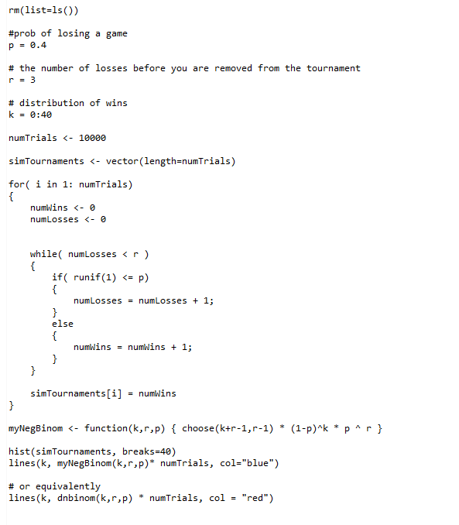
Here we simulate 10,000 tournaments
https://github.com/afodor/metagenomicsTools/blob/master/src/classExamples/simDist/negativeBinomial.txt

Slide 11
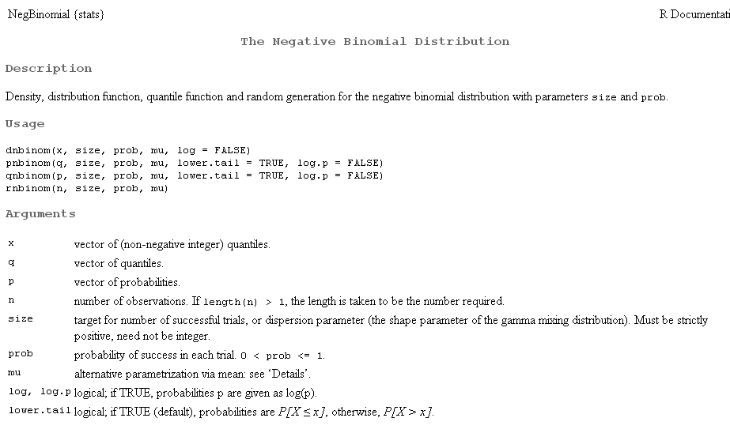
R, of course, has this distribution built in…

Slide 12

We state without proof for the negative binomial distribution:
Mean =
(1-p) * r
(1-p) * r
Variance =
p
p *p
Let’s say p =0.4 and r = 3.
The expected number of wins is:
.6 * 3 / 4 = 4.5
The variance associated with those wins is:
.6 * 3 / (.4*.4) =11.25
So for a player who wins 60% of the games,
mean +- SD = 4.5 +- 3.4
(To convert to the Wiki’s formulas, replace p with 1-p; we will stick with R’s notation in the class)

Slide 13
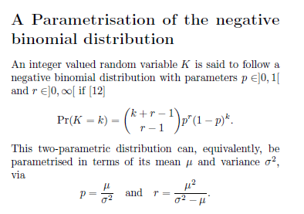
The reason the negative binomial distribution is the most popular algorithm for sequence count data in genomics….
If you know the mean and variance, you can calculate p and r…
(We also state this without proof…)
Mean # of wins
variance
p = 4.5 / 11.25 = 0.4
r = 4.5*4.5 / (11.25-4.5) = 3
So knowing the mean and the variance is the same as knowing r and p.
In the Dseq paper, for each gene, we can estimate the mean and the variance.
Then we can use a test based on the negative binomial distribution!

Slide 14
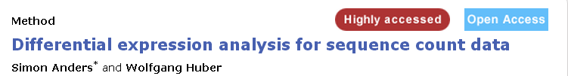
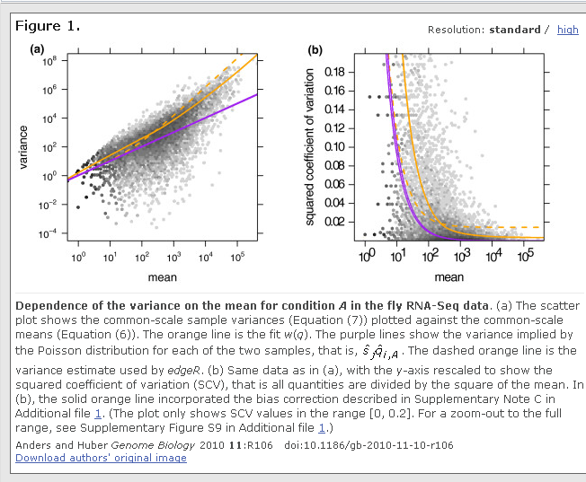
Using the negative
binomial distribution
gives us another
free parameter to
play with!
Relaxes the assumption
that mean == variance
Allows us a better
fit to the data than
the Poisson (or
binomial) distribution.
More on this next time…

Slide 15
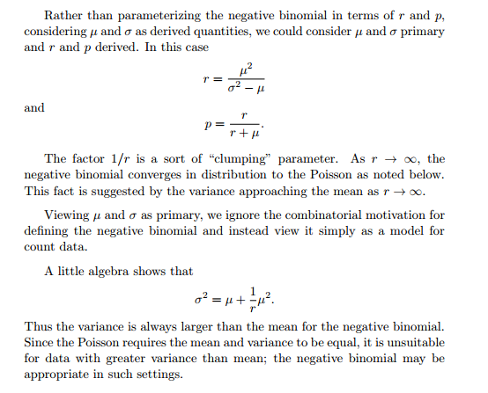
In the negative binomial distribution, the variance is always greater than the mean
So if we are going to use the negative binomial, we have to define
the variance as the mean plus something…
http://www.johndcook.com/negative_binomial.pdf

Slide 16
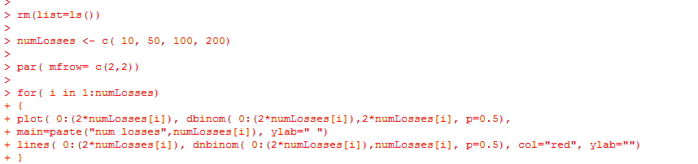
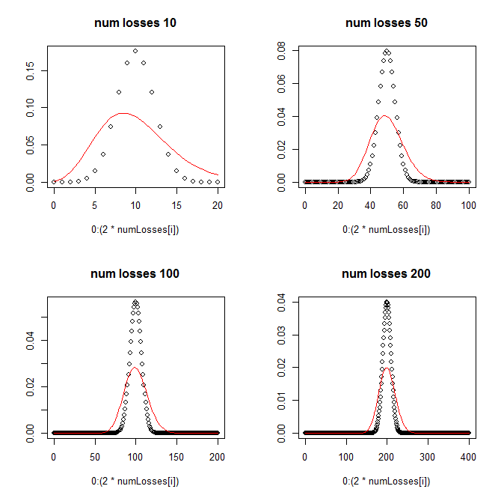
In comparing the binomial and the negative binomial, we see that the negative binomial
has a different variance….
Dbinom = flip the fair coin 20 times
and count the heads
Dnbinom = flip the coin until
you get 10 tails and count the
heads…
https://github.com/afodor/metagenomicsTools/blob/master/src/classExamples/negativeBinomialExamples.txt

